Slide 1
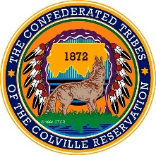


Developing Relationships and Collaborative Efforts with Tribal Audiences
Presented by:
Linda McLean, Office Director/FRTEP/ANR/4-H Educator
WSU Colville Reservation Extension

Slide 2
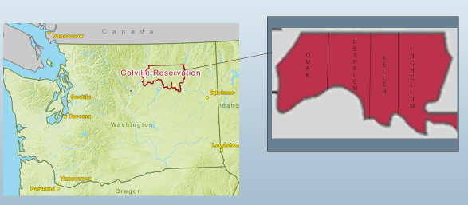
Intro
Enrolled member of Colville Confederated Tribes.
Director for WSU Colville Reservation Extension program.
Located on the Colville Indian Reservation in Nespelem WA.
We are the only MOA funded unit within WSU Land-grant system.
39 County Extension programs and 1 tribal Extension program.
Notes:
MOA is Memorandum of Agreement. This is a formal and legal agreement between entities. In this case the agreement is between WSU and Colville tribes to mutual house a WSU Extension program on the Colville Reservation.

Slide 3
Jam Board Question #1
What is the first thing that comes to mind when you think of Native American or Indigneous foods?

Slide 4
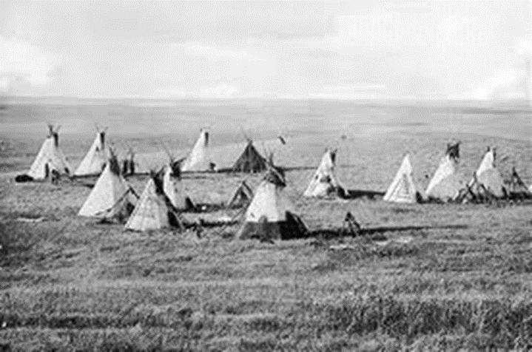
Native Americans and Food
Different regions have different food sources
Plateau tribes of WA were hunters, gathers, and fishers
Traditionally, Plateau tribes followed prescribed seasonal rounds as hunters & gathers
The first “recyclers” – they used everything from the plants, animals or fish
Notes:
Plateau Tribes = inland compared with coastal = along ocean coasts

Slide 5
Government Reservations Forced Change
Native Americans were forced to live on reservations
Forced to change their ways of living
Not allowed to perform basic routines
Basic way of life was disrupted

Slide 6
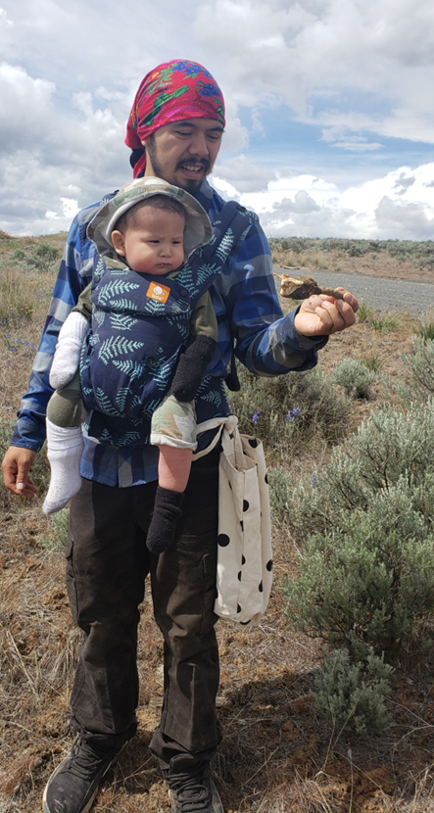
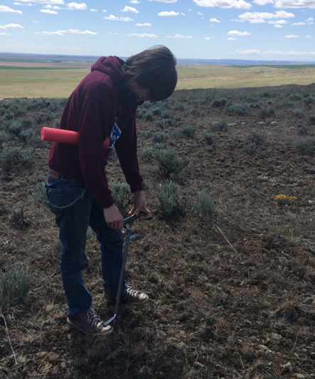
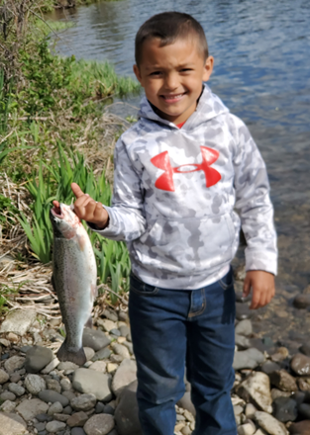
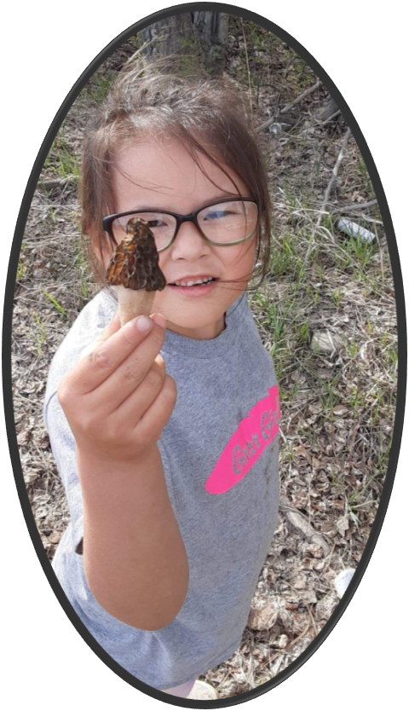
Traditional Foods
Large game – deer, elk, etc.
Fish – salmon, shellfish, mussels, crayfish
Waterfowl eggs
Roots, berries, and plants – used for food & medicine
Notes:
As you can see by the photographs, many of these practices are still followed today.

Slide 7
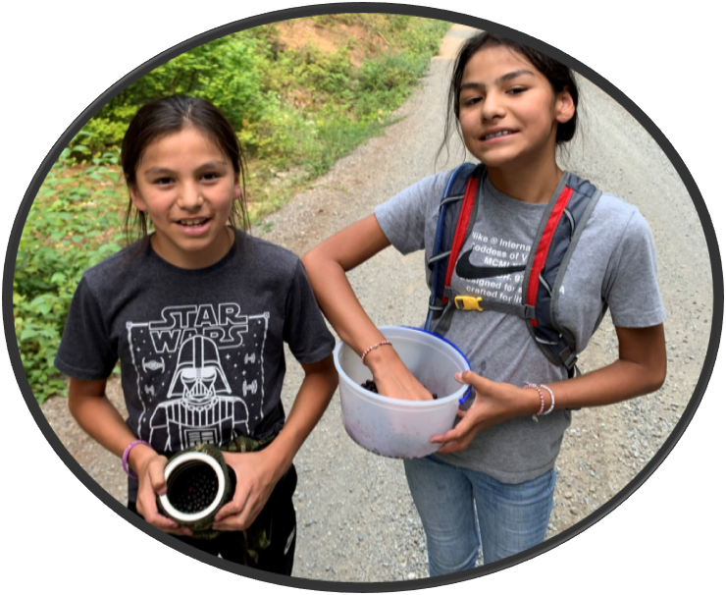
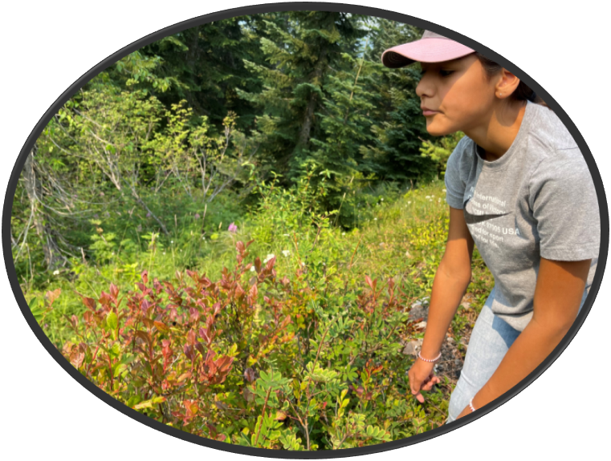
Health & Food
Food = gifts from the creator
Hunting & gathering = physical activity
Systems not used to European diets

Slide 8
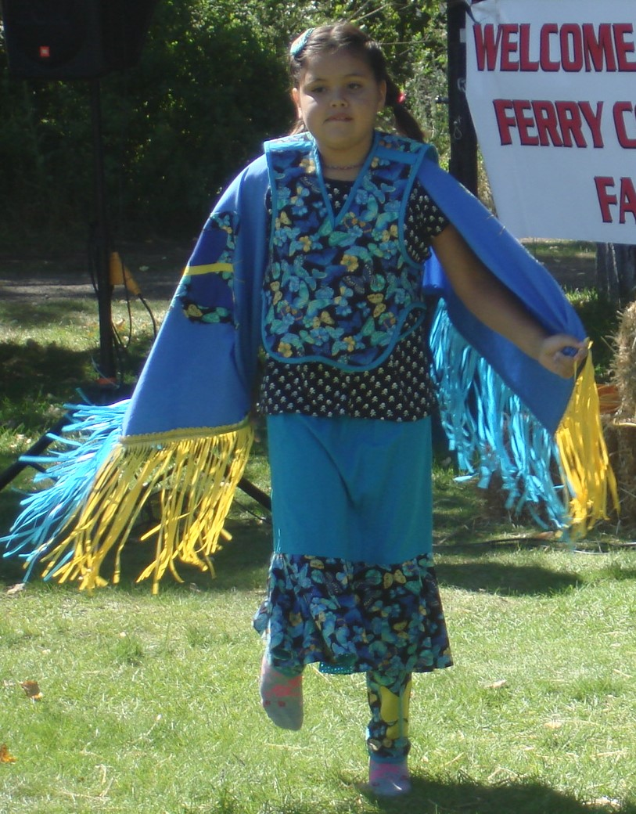


Health Decline
Government rations became standard
Food preparation methods changed
Diet and food options changed
Traditional gathering practices not allowed
Traditional activities – punishable offense
Notes:
Can you imagine being told you cannot go out an gather food to feed your family? How about practice your form of worship? Punished for dancing?

Slide 9
Let’s look at the jam board #1
Gardening was not a historic native activity, in European sense
Did manage resources – prescribed burns and gathering in same location to help roots develop more rapidly
Very few family history or memories of gardening
Large gardens were recorded before reservation times
Tribal gardens became common in 20th century, especially during the Depression
Early in Extension history here, we had a tribal member say, “You are just trying to make us into farmers.”
Do you have ulterior motives?
Notes:
Ulterior motives – just this last week I spoke with a lady who was concerned with wanting to teach Native Americans, and people in general, about growing their own food. During our conversation she began quoting religious scripture. I mentioned to that she should be mindful about the historic relationship Indigenous folks have with formal religions. And that if her messages about growing food contain religious undertones, then this might be one reason why people have not been hesitant to join the garden club. Be mindful of people and your own backgrounds, and your message.

Slide 10
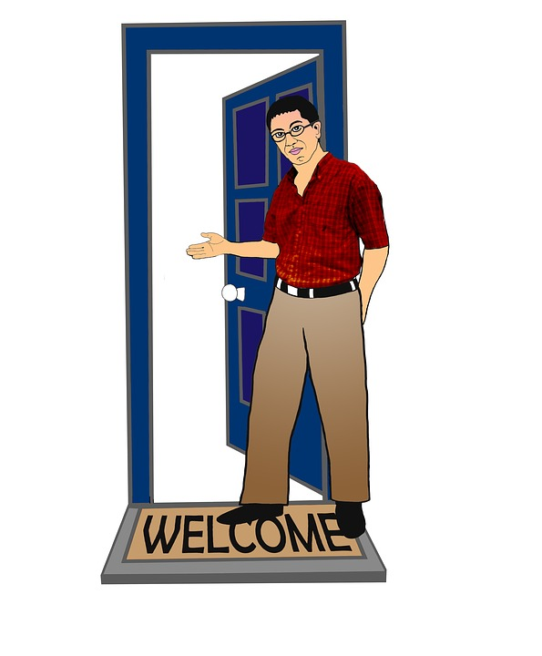
No Silver Bullet
This is a framework on how one may approach working with tribal audiences
When communicating with Tribes, there is no on-size-fits-all process
Not designed to provide all the answers
Best advise - approach with respect, appreciation, and the realization that we are guests in these Native communities
Notes:
Yes, even I as an enrolled member of the Colville Confederated Tribes, grew up on the reservation and still have family and strong ties to the reservation communities, am still considered a guest, when representing WSU Extension, as WSU is technically an outside agency.

Slide 11
Jam Board Question #2
Name the tribes located in your area of service.
Review Jam board before going to next slide.

Slide 12
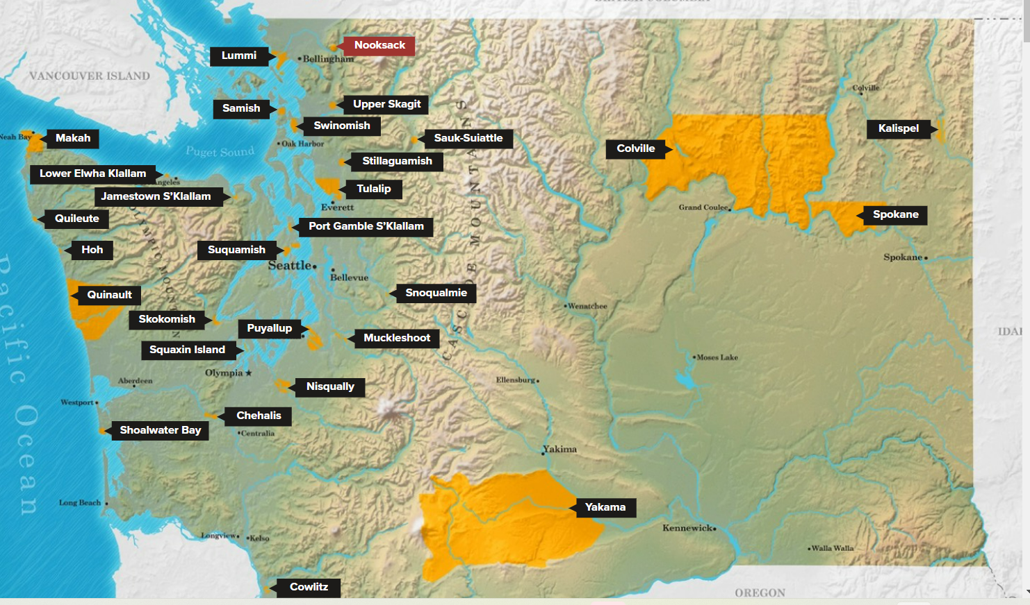
Know Your Audience
There are 29 Federally Recognized Tribes in Washington State and 565 Federally Recognized Tribes in the United States. Each has their own government, history, and traditions.
Familiarize yourself with the tribes in your local service area – view websites, learn the name of Chairman, follow local events, even participate in some events.
Learn how to properly pronounce
names or people and places.
Notes:
Keep in mind – Tribes are all different. They have their own cultural practices, different regalia and different traditions. Yes, many are similar but each in individual and their own sovereign nation. Be sure to learn the names and proper pronunciations of people and places. An example is when a letter gets addressed to a Chairman who may had died 3 years earlier.

Slide 13
Jam Board Question #3
Why do you want to work with tribes?
Review Jam Board before going to next slide.

Slide 14
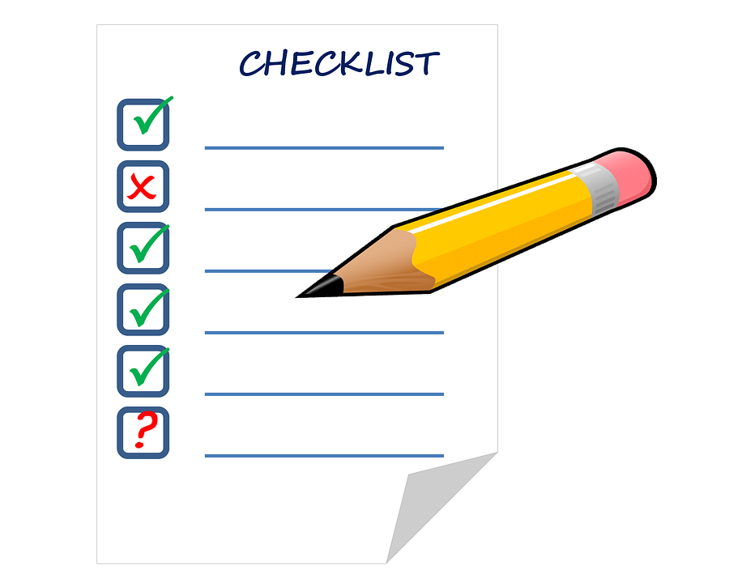

Why do you Want to Work with Tribes?
Want to help Tribes solve a problem?
Use the tribe and key Indigenous phrases for grant funding?
Check a box that says you worked with an Indigenous audience?
Has the tribe expressed a need or an issue?
Reach out to tribes BEFORE you write the grant!
Notes:
Do not assume that the Tribe will welcome you with open arms. We should not assume that the Tribes want or need our help.
We should not just write into the grant that you will work with a Tribe. and Many of the Tribal programs employ PhD. and Masters level employees. In many instances, they have state of the art equipment and software to assist in their work.

Slide 15
Consultation vs. Communication
Consultation is formal discussions with the tribal administration and government leadership.
Communications and discussions with an individual tribal program employee or an individual tribal member is NOT considered consultation.
Unless you have a formal agreement with the tribal government, you should not claim “working with the tribe” in statements or in grant applications.
Notes:
An example of this is I had a guy from WSU Communications reach out to the tribe to get their permission to publish a news article tat I had written and submitted. He was trying to be very mindful of tribal sovereignty. Fortunately he cc’d me to the email. I was ablet o act quickly and include the tribal Executive Director on the message and get clarification on what he was asking. If he actually wanted “tribal approval” he would be looking at several weeks of paperwork and processes that would get him on a official agenda with tribal government leadership. This would not help his deadline. The only people who can officially speak for the Colville Tribe is the Chairman, and with Council approval, the Executive Director. Consultations take time and formal agreements typically require legal review of documents and scope of work,

Slide 16

Letter of: Commitment or Support
LOC – something is being committed, i.e.. funds, facilities, services etc.
LOS – support for the project, grant, program, etc.
Both require consultation and negotiation with the Tribe.
This Photo by Unknown Author is licensed under CC BY-SA
Notes:
There seems to be some debate on the definition of these two types of letters. I have been informed that WSU considers these to be interchangeable. But when communicating and working with a Tribe, we need to know their terminology. A letter of commitment demonstrates a commitment of some kind, over and above simple support. Example: I have had requests from different WSU folks who were applying for grants that wanted to have a letter of support or commitment form the Tribe. Now keep in mind none these WSU folks had not spoken with me as the local Extension Agent, ahead of time, nor had they reached out to the WSU Extension Tribal Liaison, and they had not spoken with any tribal programs or officials about this project. They just thought they could request a letter of support, and the tribes would welcome the opportunity

Slide 17

Understand Sovereignty .
Tribes are sovereign nations. Have unique trust relationship with US Government.
As with any sovereign nations, Tribes have the right to consult, government to government with federal, state and local entities.
In modern times, there is on-going political tension between federal and state rights, which has complicated the federal-tribal relationship since tribal reservations and trust land are within the boundaries of the states.

Slide 18

Respect Time & Process It takes years to develop trust good relationships. It only takes moments to destroy trust and a good relationship.
When working with Tribes, understand that the process can be time consuming.
Depending on the tribe, issue, and agency, the consultation may be smooth, and it my be fast, but it all about relationship-building. This process is on-going
If we do not follow-through or deliver, then we
are just another self-serving agency willing to
make and break promises.
Consultation should not
be a one-time thing?
Notes:
Working with tribes requires relationship-building. This does not mean a few emails or phone calls. You need to meet with people in person. They need to be able to know that they can trust you and that you will follow through with what you say you will deliver. Would you want to partner or collaborate with someone or someentity taath yu did not trust? It takes years to develop trust good relationships. It only takes moments to destroy trust and a good ealtionship.

Slide 19
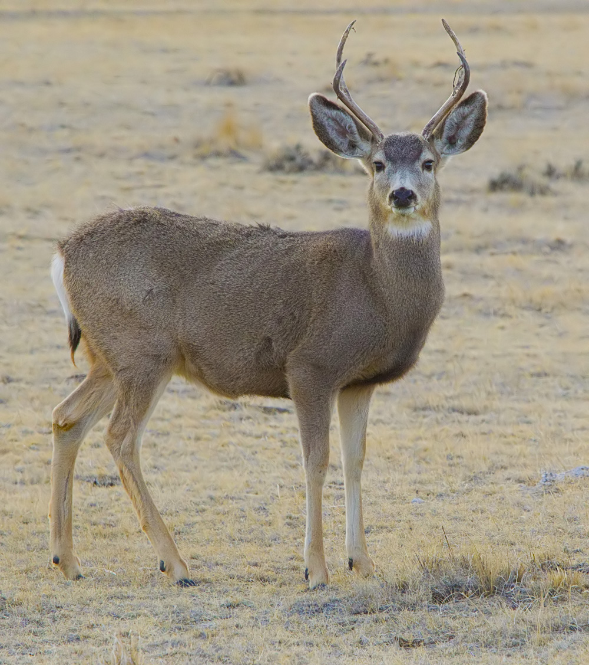
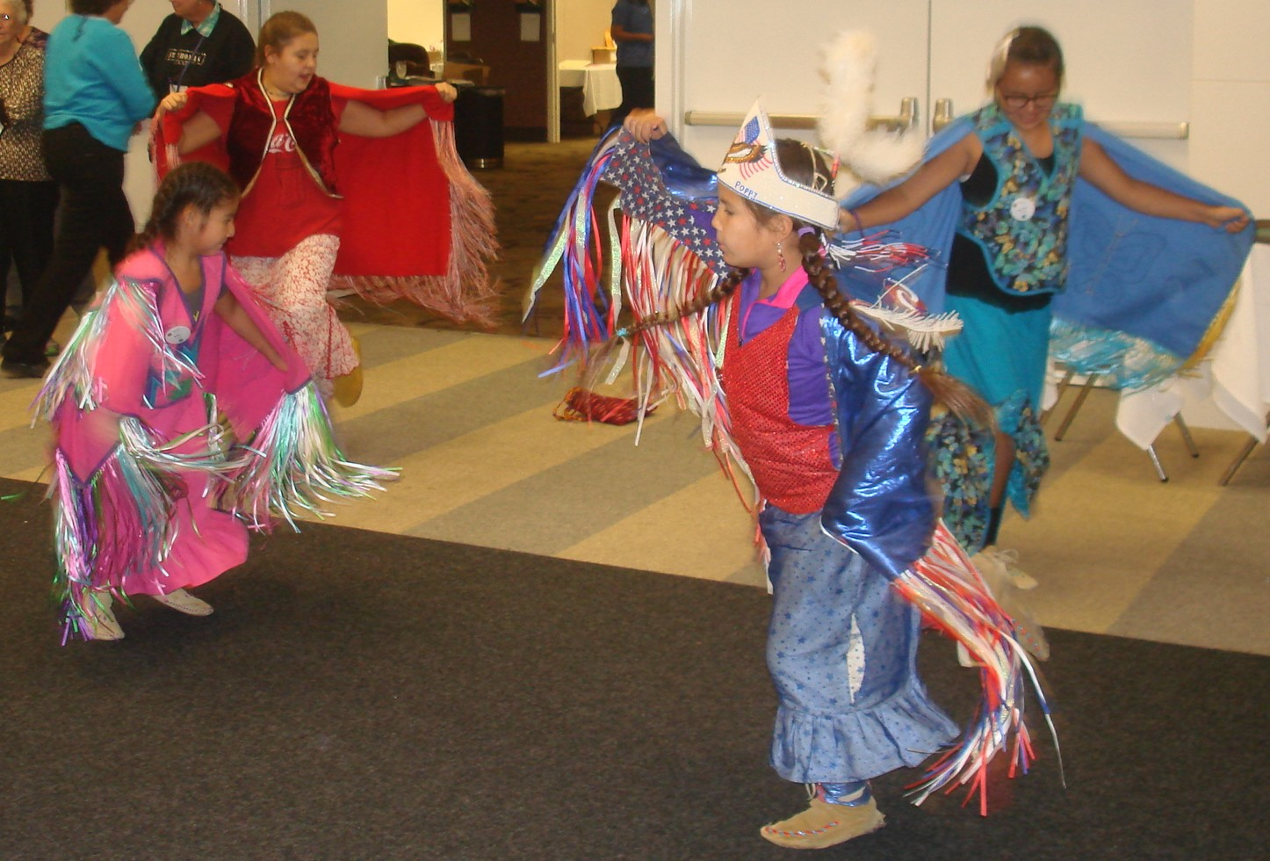
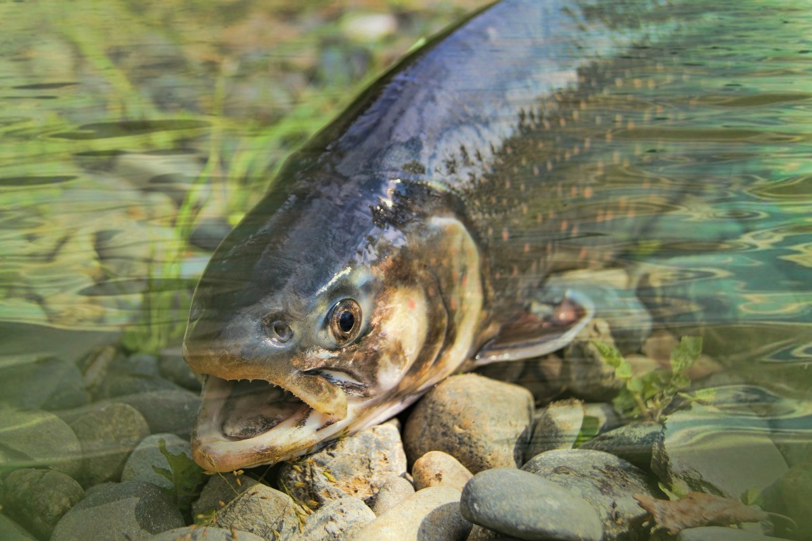
Fighting for Basic Rights Imagine if you will, strangers come in and pillage and plunder land and homes.
strangers remove you from your homeland and force you to live in a new place.
Then they half that place back (the part with good resources) from you. Then you are told you cannot perform your basic life tasks – hunting, fishing, gathering, dancing, celebrating, worshipping.
Then your children are taken from you and forced to live in boarding schools many miles away from you. These children are forced to wear different clothing, their hair is cut, they are forced to learn a different language and religion and they are punished for speaking the only language that they know or practicing the religion that they have been brought up with.
This is what Native Americans have had to endure and have had to work towards recovering from.
X
X
X
This Photo by Unknown Author is licensed under CC BY-SA

Slide 20
We are still Here Imagine having to prove that you exist. That is what Native Americans have been doing since colonial times.
Of all the ethnic groups in the United States, only American Indians must produce documentary proof of lineage and make conscious effort to be identified as members of federally recognized tribes.
Colville Tribes is comprised of 12 different bands that make up the confederacy. One of those bands is the Arrow Lakes, aka Sinixt. In 1956, the Canadian government declared the Sinixt to be extinct
The international boarder that divides Canada from the United states severed the Usual & Accustomed territories of the Sinixt, leaving some members in Canada and some members in the United States. When the last “known Sinixt member in Canada died, Canada declared them extinct.
Other bands – Okanogan, San Poil, Colville, Arrow Lakes all border Canada, as well as state borders
Can you imagine being told that you do not exist as a people?

Slide 21
Proof We Are Still Here
In April 2021, a landmark decision from the Supreme Court of Canada, R. v. Desautel which affirmed that the Sinixt are the aboriginal people of Canada with constitutionally protected right to hunt in their traditional territory of Canada, erasing the famous “extinction declaration” of 1956. This issue began in 1846 when the international boundary was established. Then in 1896 the C Government passed a law declaring that non-resident “Indians” lack hunting rights in the province. This cut off the access of the Arrow Lakes band of the Coville Confederated Tribes.
We are very proud that the Supreme Court of Canada has now admitted that we are not extinct and that we do exist.
This case is important as it ACKNOWLEDGES the existence of Native People.

Slide 22
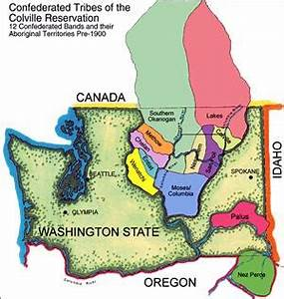
Land & Identity Respect and appreciate the connection to the land
Land Acknowledgements – Must go beyond pretty words. An agency must follow words with actions.
Learn why they are used. These are statements are about acknowledging the Native Americans that occupied the land where we stand.
Familiarize yourself with the tribes that inhabit or inhabited the land on which you are working
The land is the basic source for Indigenous identity. Historically, Native Americans have used the natural resources around them to survive.
Tribes should not be asked to write a land acknowledgement for an agency or institution.
Notes:
Think of it this way - A tribe writing a land acknowledgement is akin to writing their own apology.

Slide 23
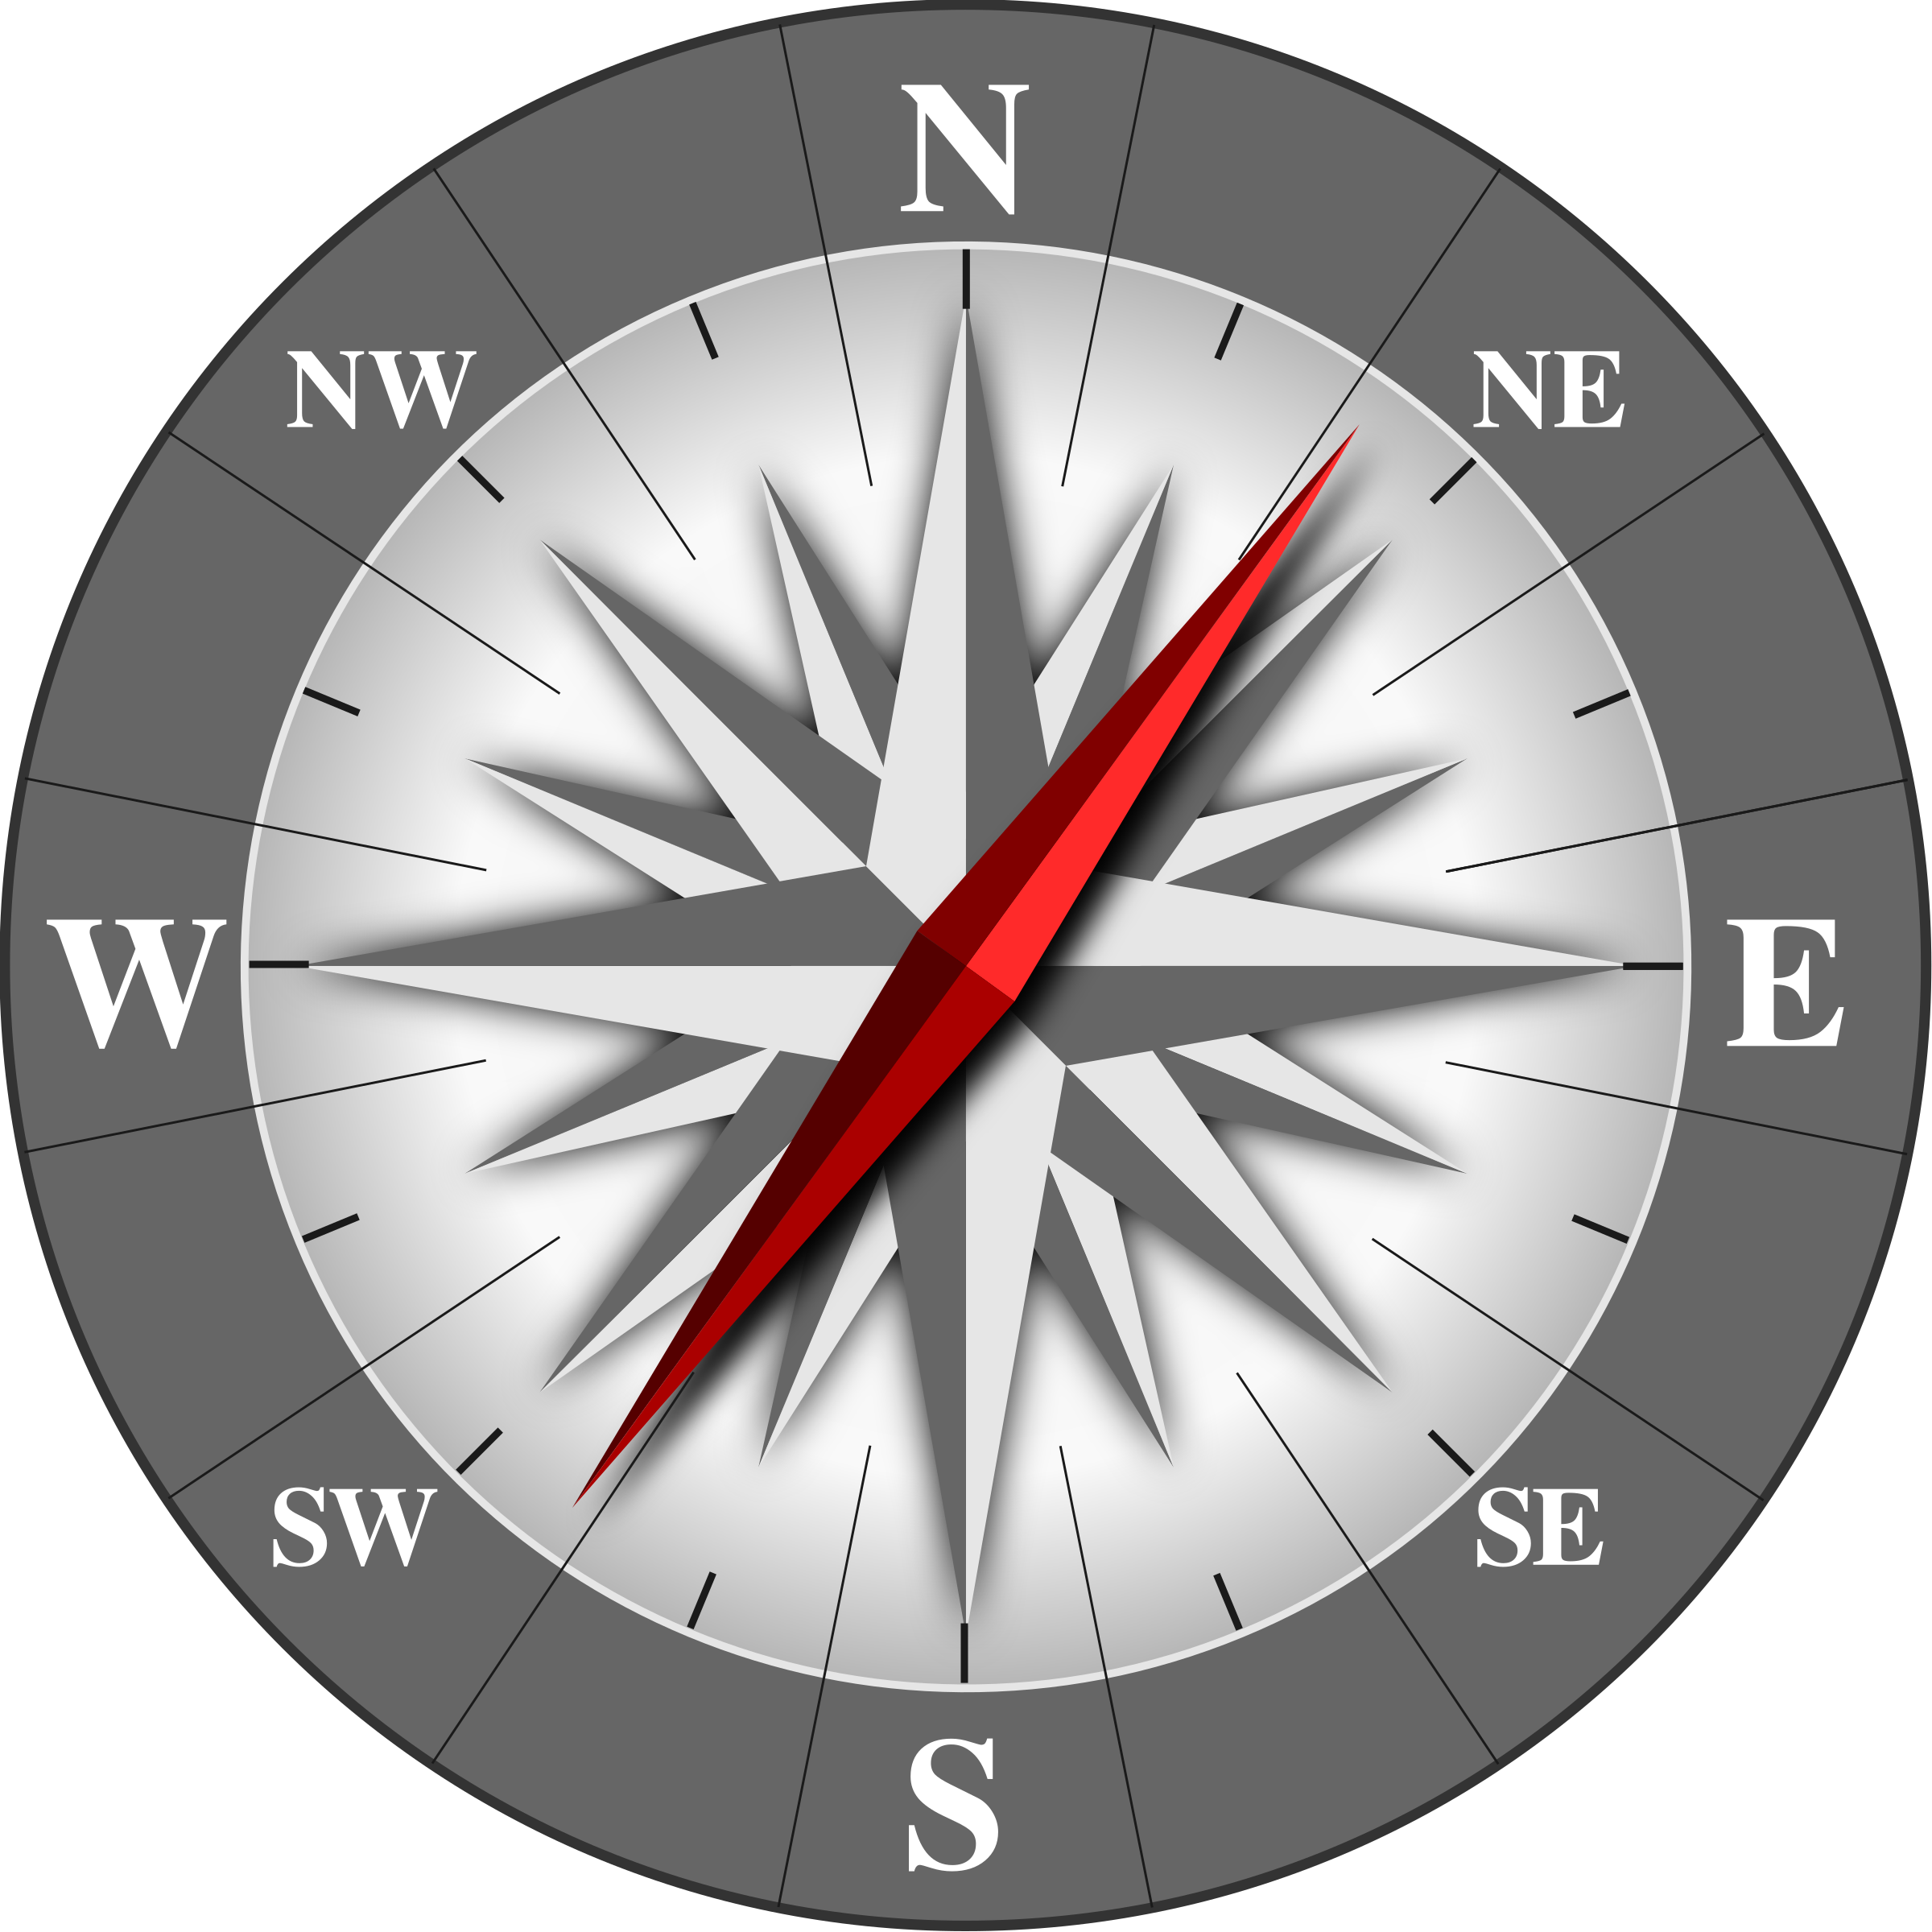
Use existing Resources to Connect with Tribes
Zoe Higheagle Strong, Tribal Relations office. Vice Provost & Tribal Relations Liaison to the President. She works directly with the Tribal Advisory Board for the Plateau Center at WSU. WSU has an MOU (Memorandum of Understanding) with several tribes from Washington, Idaho and Oregon. The Advisory Board is comprised of representatives from these tribes.
WSU Policy 41 – Directs WSU employees, researchers, staff etc., to reach out to the Provost’s office BEFORE approaching any tribe.
Daniel Fagerlie, WSU Extension Statewide Tribal Liaison. Can connect to all WA tribes.
Kalispel tribe - Tracey Morgan is the FRTEP (Federally Recognized Tribes Extension Program) Agent. She can provide insight into the inner workings of the Kalispel tribal government.
Colville Confederated Tribes - please reach out to me. I am the Director and the FRTEP Agent, located on the Colville Reservation. I can help guide you through the tribal processes and facilitate meetings with appropriate tribal programs, managers, or departments.
Life is easier with a guide to help navigate!
Notes:
For those affiliated with Washington State University (WSU). You do have a lot of good resources to help connect you with Native American tribes.

Slide 24
What is in a name?
When referring to Native populations, there are many appropriate options. It depends on your audience as to which term you would use. The more modern generic terms are Indigenous or First Nations. Some groups have gone to using these terms as they feel that Native American or Indian are more colonized terms.
Think in terms of pronouns – we refer to people how they wish to be referred.
The terms Native American and Indian have historically been used as generic, all-encompassing terms for Indigenous populations. Many Native people use these two terms interchangeably. Many Indian organizations and groups have the term Indian in their titles, for example: National Congress of American Indians and Society of American Indian Employees.
All federal Indian laws and federal agencies use the term Indian. For example: The Indian Reorganization Act and Bureau of Indian Affairs.
The term Tribes is generally accepted, but keep in mind that there are other countries that have tribes and tribal affiliations as well

Slide 25
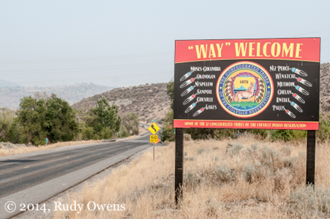
What is in a Name, cont. Take time to learn proper pronunciation and spelling of tribal names
Refer to the tribes by their name is always good. For example, Colville Confederated Tribes, Kalispel Tribes, Yakama Nation, etc.
understand that the terms “tribes” and “bands” can sometimes be interchangeable. But some tribes prefer he terms nations, pueblos, villages, communities or rancherias. For example, The Colville Confederated Tribes is comprised of 12 different bands or individual tribes. They were brought together and forced into a confederacy. The Yakama Nation is similar in that they have 13 or 14 different bands in their nation.
Keep in mind, an agreement or discussion with one of these individual bands does NOT constitute a formal agreement or discussion with the Tribe as a whole.
Note the spelling of Yakama Nation
This is their traditional spelling of the
name. They renamed themselves a
few years back.
Notes:
Those in the room with difficult names to pronounce understand the feeling of people never saying their name correctly. One should always do their homework ahead of time and learn how to properly pronounce the tribal names and places.

Slide 26

Exhibit Respect Above all Else
Treat tribes, and any diverse audience, with respect.
Rude behavior is not appreciated.
Elders ALWAYS command the utmost respect.
When asking questions, provide enough time for people to contemplate the question and formulate the answer.
Sometimes you need to allow for more time as Tribal people
do not want to offend you either.
Notes:
Basic manners and respect go a long way. When an elder speaks, you listen, no matter if he or she is speaking for 1 minute or for 1 hour, you listen. Think about the ZOOM meetings that we all participate in and people say they wait 7 - 8 seconds for questions before moving on.

Slide 27

Do Not Tie Yourself to One Tribal Employee or Council Member
Employee turnover is common, and elected officials run every two years.
When working in a new area, it is important to find a champion.
In the Tribal communities, there are different viewpoints and different levels to consider. As with all communities, you have different extremes – Ultra liberal – to ultra conservative and everything in between. With tribes, you also have traditional views and more modern views to consider.
Partnering with just the right mix can be an art and takes
a lot of effort. Much more than just an email.
Notes:
This could be said of any County as well as Reservation program.
Communicate with someone that really supports the work you are doing to help you make those important in-roads. Again it is all about knowing your audience, trust and relationships.

Slide 28
Jam Board Question #4
1. List the first thing that comes to mind when you think Indigenous people.
Strength
Intelligent
Resilient
Wisdom
Survivor
Notes:
Did anybody think of …… When working with diverse audience, we need to think abut our mindset and any pre-conceived notions about this audience. Pet Peve – When people say they are color blind. I sure hope not. We need to recognize peoples’ differences. Think hw boring the bag of M & M’s would be if they were all the same color? Same with people. We can not all be the same. Recognize and celebrate the diverse cultures that we have to work with.

Slide 29

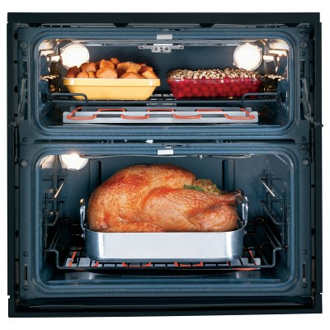
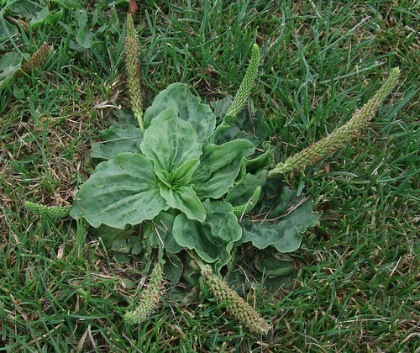
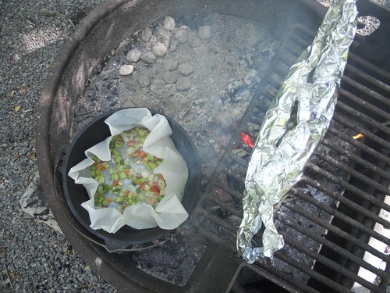
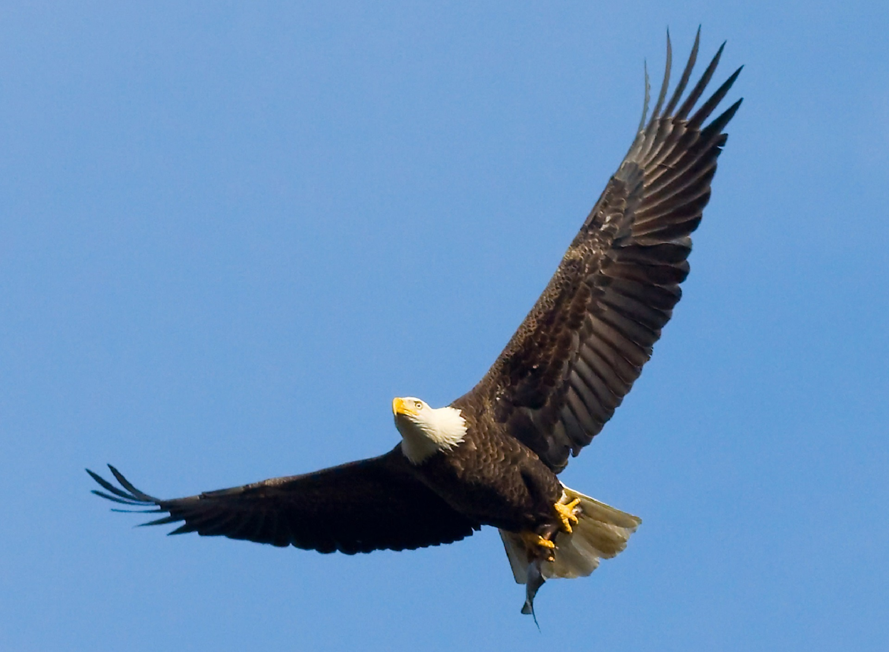
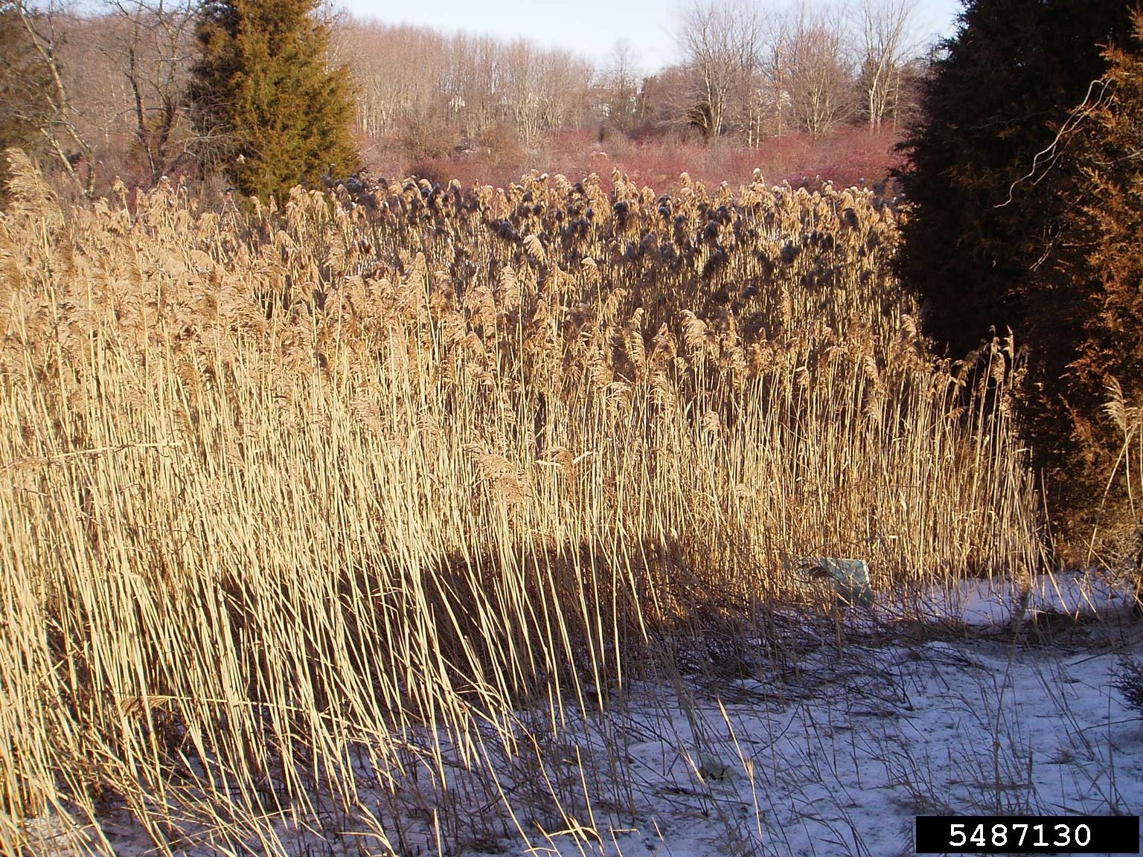
Understand Where People are Coming From
Indigenous people come from a place of nature.
In tune with nature – Earth, water, birds, animals, etc.
Expect discussions to reflect what people are familiar with.
STEM
This Photo by Unknown Author is licensed under CC BY
This Photo by Unknown Author is
licensed under CC BY
This Photo by Unknown Author is licensed under CC BY
This Photo by Unknown Author is licensed under CC BY
Notes:
Understand your audience’s background & experiences. People “know what they know” and relate everything to what they are familiar with. For example: We had a workshop with WSU Extension STEM Specialist. She asked the group to name things that fly. The answers were, eagle, hawk, butterfly, bees. What she was looking for was airplanes, rockets and drones. During our debrief session, she said she just could not understand why nobody listed these modern technology items. I informed her that many of the participants probably had never flown. Plus, they observe nature on a daily basis. She was astounded. She is a world traveler and could not imagine that someone had never flown in an airplane, let alone never been out of the state. Another example is when teaching foods and nutrition – never assume that everyone has access to electricity or indoor plumbing. or even access to appliances such as an oven or microwave. For those teaching about plants – what might be referred to as weed might be a medical lant used by indigenous people.

Slide 30

Institutional Review Board
The IRB process is an important process at University level.
Research Permit – Tribal process similar to IRB process.
ANY research conducted on a reservation is not allowed without the Tribes’ Research Permit.
Protects tribe and tribal information.
Respectful, legal, & ethical.
This Photo by Unknown Author is licensed under CC BY-SA
Notes:
A simple way to look at this is – if your project requires you to go through the IRB process, then you will need to plan to follow the tribal Research Permit process.

Slide 31

Humor – Choose Wisely
Humor is prevalent in many native communities.
Entertainment or to cover embarrassment or insecurities.
Good-natured bantering can be a sign of trust.
If not good at humor & try to force humor it may not be received well. But if done well, it can help build a connection and make a presentation much more enjoyable.
Notes:
We hosted a workshop on weather and climate. The participants were mostly tribal natural resources employees. I was the first presenter, and as I have worked with this group for several years, we were comfortable with each other and knew each other’s backgrounds. Some comments turned a bit humorous, and we bantered back and forth for a bit. I feel that laughter is always god during presentations. The next speaker was a female employee from the National Weather Service. She had extension experience working on many male-dominated fire mobilizations and was familiar with our audience, our area, and our terrain. When speaking about lightning, the topic of how to protect yourself in the outdoors came up, and she had a power point so pictures and examples were used. Of course. these brought out the humor in some and various comments ensued. As the precedent had already been set in the first presentation with humor and laughter, she was able to role with the punches and provide answers without breaking stride and losing her composure. She was able to maintain respect for her audience while interacting with them in a positive well-received manner. Thus she had received her audience’s respect.

Slide 32

Gifts
Traditional practice, Historically reciprocal
Keep it simple
Consider your audience
Make sure have enough for everyone
Some tribal governments have restrictions on accepting gifts
State & federal employees cannot accept gifts or gratuities over a certain value

Slide 33
Jam Board Question #5
After hearing this presentation, how will you approach, or change your approach, when working with Native American audiences?

Slide 34
Recap
Familiarize yourself with the tribe – their leadership, history, etc.
Understand things “take as long as they take”.
Follow your organization processes as well as tribal processes.
Decide if you need Consultation or communication.
Build a relationship before asking for something from a tribe.
Be aware of your preconceived notions as well as trauma –informed about you audience.
Best advise - approach with respect, appreciation, and the realization that we are guests in Native communities.

Slide 35
Questions?
Linda McLean
ljmclean@wsu.edu

