Slide 1

Madi Moore, Agricultural Economist MMoore@agr.wa.gov
Washington State Agricultural Producer COVID-19 Economic Impact Survey
WSDA Regional Markets Program

Slide 2

Agenda
Washington State Agricultural Producer COVID-19 Economic Impact Survey
Background
Overview of why, when, and how the WSDA conducted an economic impact survey.
Review of the survey questions and results.
Questions about the survey and discussion.
Survey data availability, ongoing and future work.
Current happenings in federal economic relief.
The Survey
Discussion
What Next?
Econ. Relief Programs

Slide 3
Background
89% of all farms in Washington are considered “small farms”
In 2017, small farms accounted for 6.3% of total agricultural value in WA State¹
Why: Understand the impacts of COVID-19 on farmers, ranchers, aquaculture and others within Washington State’s agricultural community
Focus: Small, mid-sized, regional, local and aquaculture producers
Use results alongside the Director’s stakeholder outreach to commissions
1. USDA, NASS. Summary of Market Value of Agricultural Products Sold: 2017. Table 72. 2017 Census of Agriculture – State Data.

Slide 4

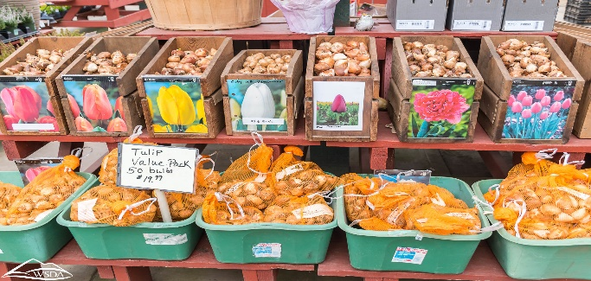
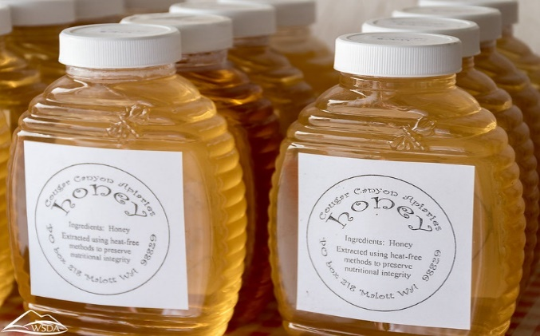
Background
Image(s)
When: Survey conducted between May 4th and May 14th
Survey Time frame:
Pre – pandemic (prior to January 1, 2020)
January 1st – April 15th, 2020
After April 15th (projections)
How: Survey link released via various public ListServs
THANK YOU FOR HELPING PROMOTE IT!
Response Rate: 789 respondents total

Slide 5
Survey Questions
Background:
Which activities does your agricultural business regularly/ primarily perform?
What does your farm produce?
What is your farm's gross annual revenue in a normal year?
How many acres do you actively farm?
What county is your business located in?
Where do you sell products geographically?
Are you...(demographic identifier)?

Slide 6
Survey Questions
Aquaculture Specific:
What types of aquaculture do you raise/harvest/produce?
Does your (aquaculture) business produce seed?
In a normal year, what percent of your (aquaculture businesses) annual gross revenue is used to purchase seed?
What license does your (aquaculture) business have?
What is your (aquaculture) farm's gross annual revenue in a normal year?

Slide 7
Survey Questions
Marketing Channels
How does your business normally sell its products? Please estimate the percent of your total annual gross sales by marketing channel.
Does your business sell any product via a food hub?
Employment
In a normal year, how many people do you employ, year round?
In a normal year, how many people do you employ as seasonal workers?
Does your farm utilize H-2A Temporary Agricultural Workers?

Slide 8
Survey Questions
Impacts between January 1 and April 15, 2020
Please estimate your business's gross revenue loss (in dollars) between January 1, 2020 and April 15, 2020 due to disruptions caused by the COVID-19 pandemic?
Of that estimated gross revenue loss, how does that loss break down by marketing channel?
Have you experienced increased demand in any marketing channels?
Is your business currently experiencing challenges due to the COVID-19 pandemic?
How many people has your business had to lay-off, furlough, reduce hours, or not hire due to the COVID-19 pandemic?

Slide 9
Survey Questions
Estimated Impacts (April 16th – December 31)
Looking to the season ahead, what do you anticipate your number of employees will look like?
How much do you anticipate your business will lose in gross revenue between April 16, 2020 and December 31, 2020?
Are you concerned about longer-term impacts to your business or your sector due to the COVID-19 pandemic?
Please tell us other agricultural, food and agribusiness related concerns you have about the current COVID-19 pandemic related to your agricultural business.

Slide 10
Survey Questions
Market disruptions prior to January 1, 2020
Were you experiencing market disruptions prior to COVID-19 (before January 1, 2020)? For example, was your business impacted by tariff-related disruptions?
Covid-19 Relief
Have you applied for any of these Coronavirus Relief Programs? If yes, what is the current status of that application?
Have you received any other COVID-19 relief?

Slide 11
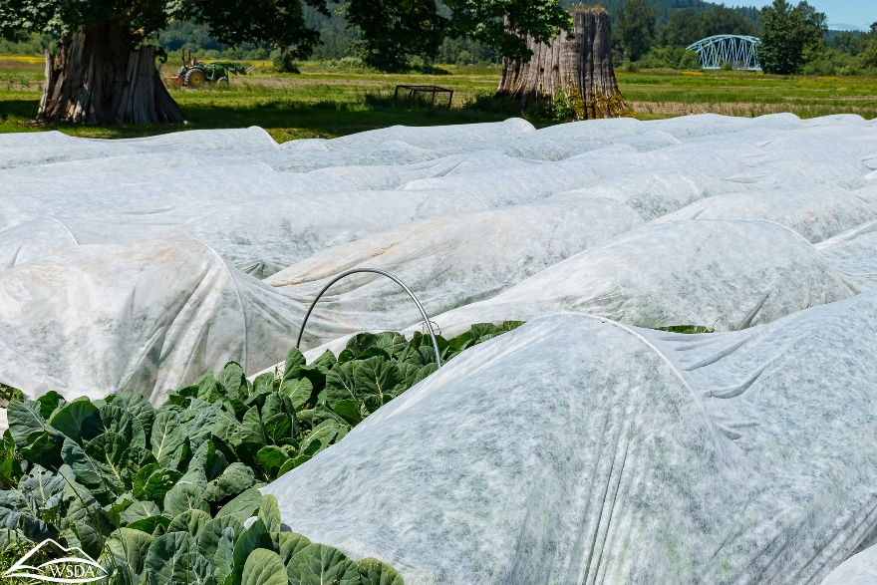
Small and Locally-Marketing Farms: Insights
We identify and analyze “small farms” according to the USDA definition of farms with a gross average revenue of less than $250k/ year.
331 respondents who both farm or ranch and have a gross annual revenue of less than $250,000/ year.
Small Farm Characterization:
65% of small farms produce on 50 acres or less
81% sell product regionally
Responses from almost every county in the state

Slide 12
Small and Locally-Marketing Farms: Insights
Relief and Marketing Channels
Top Marketing channels (% who sell in given market):
On-farm sales (58%)
Farmers markets (37%)
Wholesale, distributor, broker, packer (30%)
A majority of producer’s losses occurred in these top marketing channels:
Marketing Channels | Percent of who lost revenue in given marketing channel (Jan 1 - April 15)
On-Farm Sales | 44%
Farmers Markets | 38%
Direct to Restaurants | 35%

Slide 13
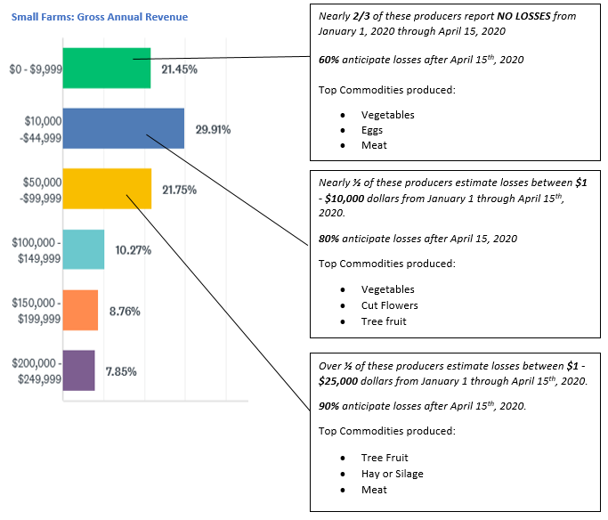
Small and Locally-Marketing Farms: Insights

Slide 14
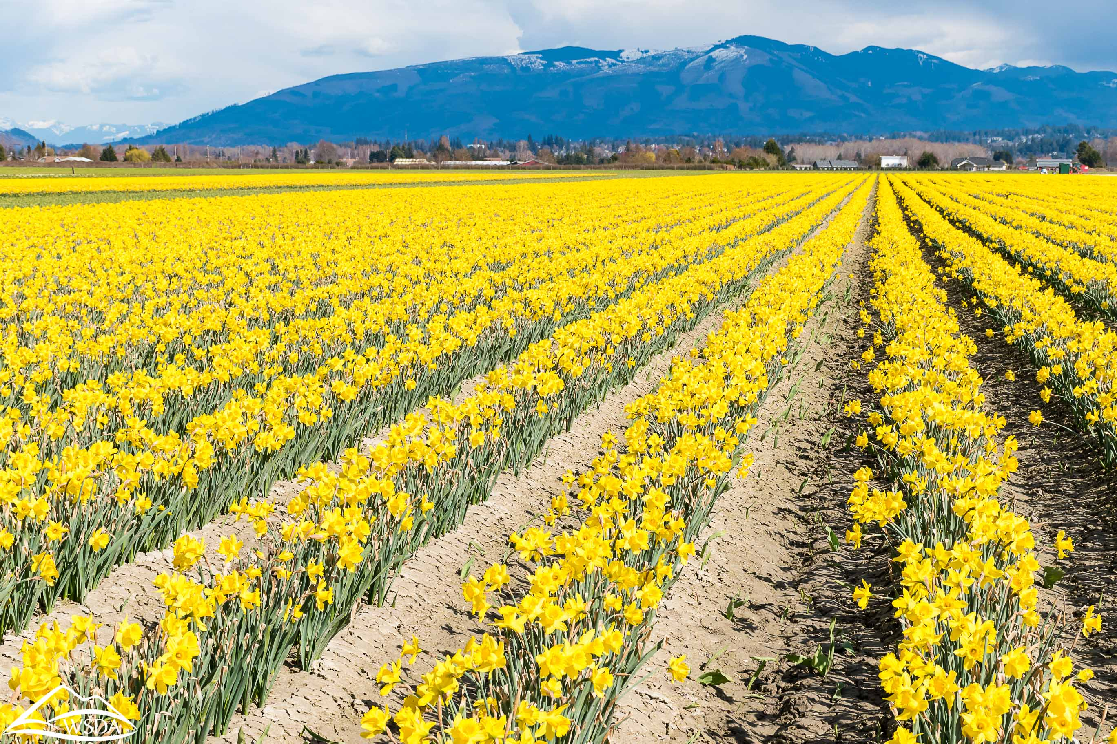
Small and Locally-Marketing Farms: Insights
Challenges
The TOP FIVE reported challenges due to COVID-19 are (at the time of the survey):
Closed market distribution and sales channels
Cash flow issues
Increases in operating costs and input costs
Inability to pay one’s self
Lost sales contracts

Slide 15
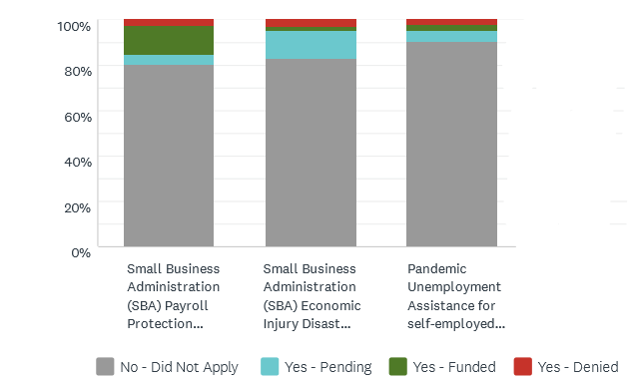
Small and Locally-Marketing Farms: Insights
COVID Relief
At the time of the survey:
80 - 90% of small farms had NOT APPLIED for Coronavirus Relief Programs
Most federal support had come through the SBA - Paycheck Protection Program

Slide 16
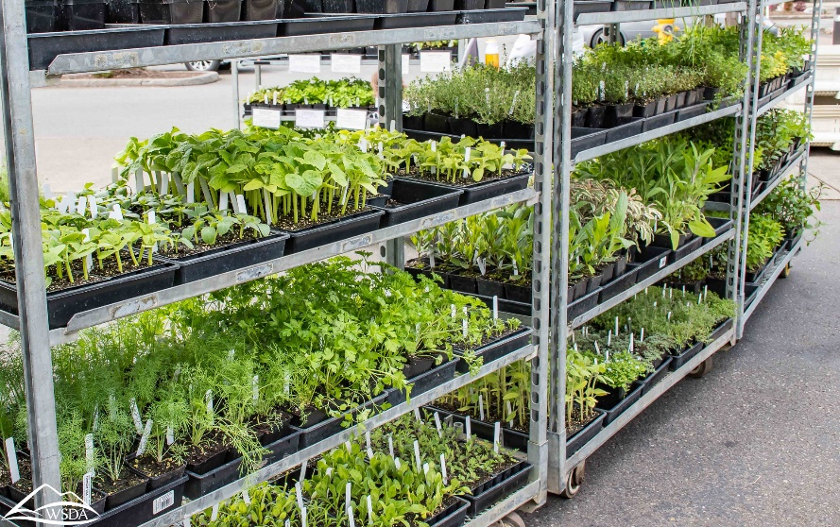
Small and Locally-Marketing Farms: Insights
Long-Run Concerns
2/3 of small farms are concerned about the long-run impacts of the COVID-19 pandemic.
Producers stated these TOP CONCERNS regarding the future:
Uncertainty
Market closures
Costs
Loss of customer base
Decreases in tourism and large events

Slide 17
Questions?
or
Discussion?

Slide 18
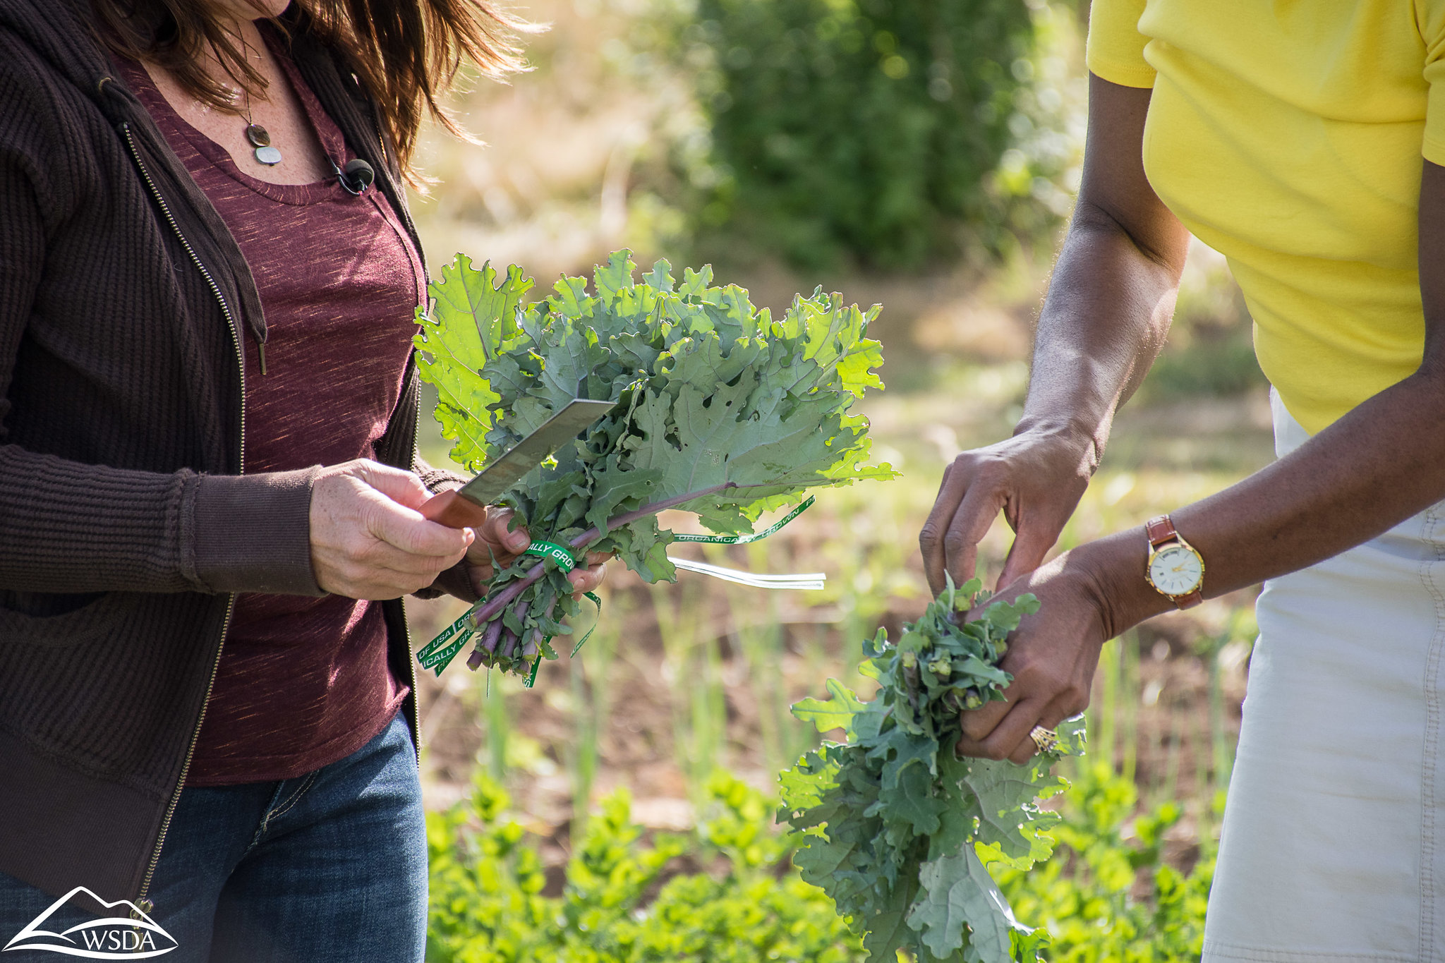

Next Steps
This survey is part of an ongoing effort by the WSDA to better understand our regional food system.
We are using this survey to collaborate with a graduate student at the University of Washington as to better understand resilience.
If this data is of interest to you, please reach out!

Slide 19

COVID Federal Economic Relief: SBA Progams
Small Business Administration –
Payroll Protection Program (PPP)
https://www.sba.gov/funding-programs/loans/coronavirus-relief-options/paycheck-protection-program
Self-employed; need to demonstrate income
Need to show net farm profit
Up to 100% forgiven
24 weeks to spend loan
Open through August 8, 2020
Apply via bank, other lender
See the FLAG guide for details and updates and ongoing changes.

Slide 20
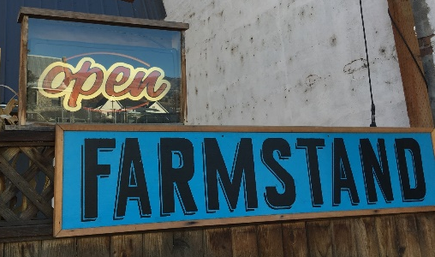
COVID Federal Economic Relief: SBA Programs
Small Business Administration -
Economic Injury and Disaster Loan/grant (EIDL)*
Deadline is Dec. 31, 2021; Funds are still available
Up to $10,000 grant (1K per FTE calculation, self employed OK)
Need to apply for the loan to get the grant BUT...don’t need to be found eligible nor accept loan at any level to get the grant portion
30 year loan, 3.75% interest rate (2.75% for non-profits),
IATC video: How to apply as an ag enterprise https://www.youtube.com/watch?v=BKf9grhwcuw&feature=youtu.be
See FLAG COVID 19 Guides for more details.
*https://www.sba.gov/funding-programs/loans/coronavirus-relief-options/economic-injury-disaster-loans

Slide 21

COVID Federal Economic Relief: USDA Programs
USDA Coronavirus Food Access Programs (CFAP)
CFAP Direct Payments, https://www.farmers.gov/cfap
Open through August, 2020
Payment is based on USDA assessed drop in commodity price
Apply via FSA – Producers should get receipt for service provision.
Phone translation available.
Details and crop eligibility continue changing; www.farmers.gov/cfap/specialty
Producers self-determine. USDA approves, adjusts,
or denies. May request follow up with questions or
request documentation.
FLAG and NSAC have guide resources. NSAC is tracking small farm access issues.

Slide 22
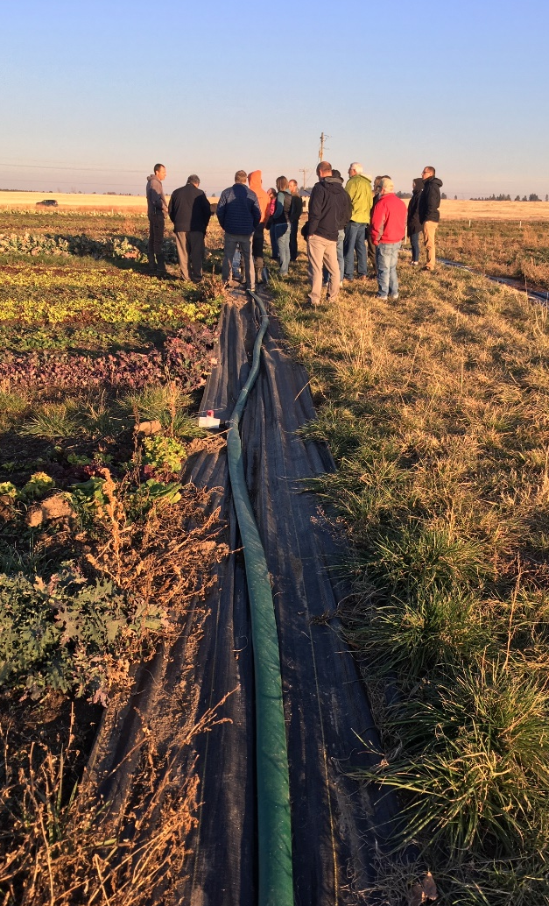
COVID Economic Relief: Other programs
FSA Disaster Set Aside Program allows FSA loan borrowers to move this year’s payment to end of loan period.
EQIP Emergency Animal Mortality Management offers funds for safe livestock disposal https://www.farmers.gov/sites/default/files/documents/EQIP%20-%20Emergency%20Animal%20Mortality%20Management%20Factsheet%20-%20All%20Livestock.pdf
County CARES Act funded programs
PPE
Grants
Business Support/Relief

Slide 23



COVID Federal Relief: Helpful Information
Farmers Legal Action Group (FLAG) www.flaginc.org/
“Navigating COVID-19 Relief for Farmers” produced with partners.
Plus many other resources
National Sustainable Agriculture Coalition (NSAC)
“CFAP 101 for Producers”, https://sustainableagriculture.net/our-work/nsac-response-to-covid-19/cfap-101-for-producers/
WSDA Regional Markets web page
COVID-19 Resources for Small and Direct Marketing Farms, agr.wa.gov/departments/business-and-marketing-support/small-farm/covid-19-resources

Slide 24

Contact Us
EMAIL
WEB
agr.wa.gov
MMoore@agr.wa.gov
LRaymond@agr.wa.gov
TWITTER
@WSDAgov
Images used in this presentation may not be reused without explicit written permission from the WSDA Communications Office

Slide 25
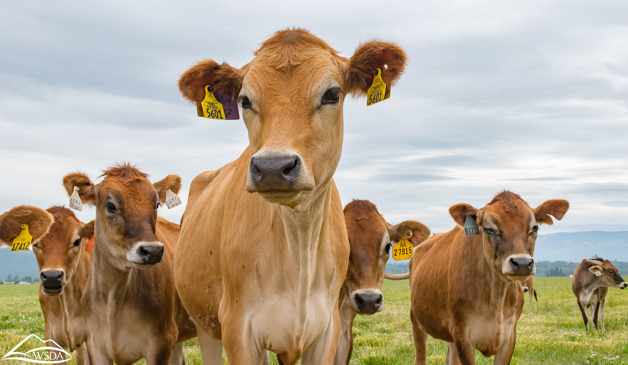
Image
Thank You

Slide 26
Survey Responses

Slide 27
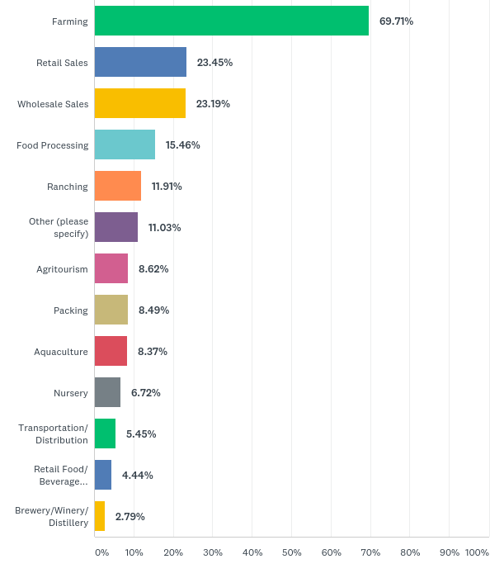
Q1: Which activities does your agricultural business regularly/ primarily perform? (Check all that apply)
Answered: 789 Skipped: 0
Back

Slide 28
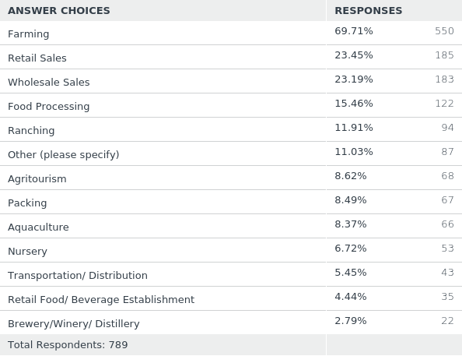
Back

Slide 29
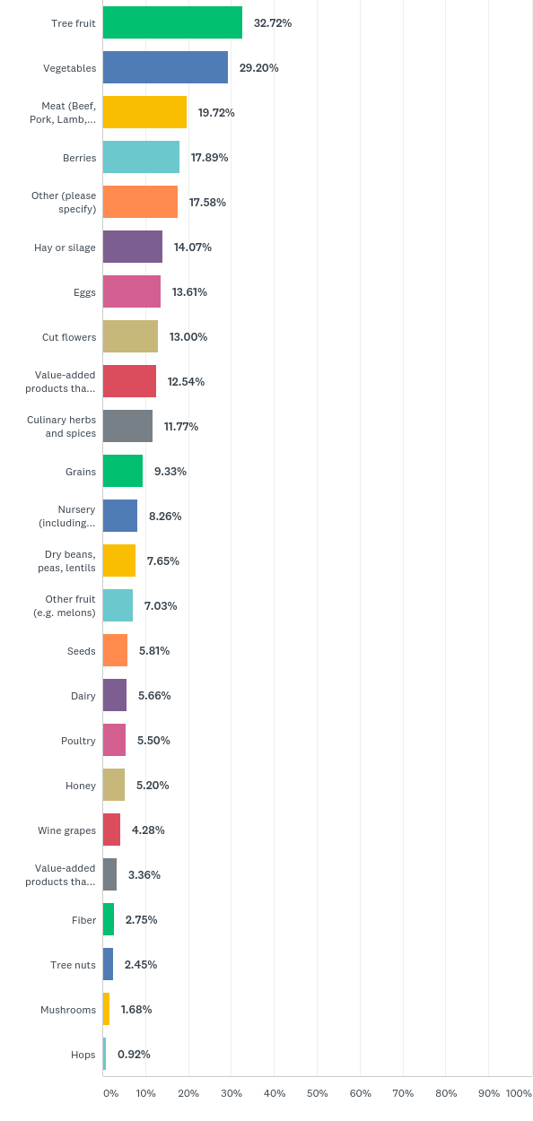
Q2: What does your farm produce? (Check all that apply)
Answered: 654 Skipped: 135
Back

Slide 30
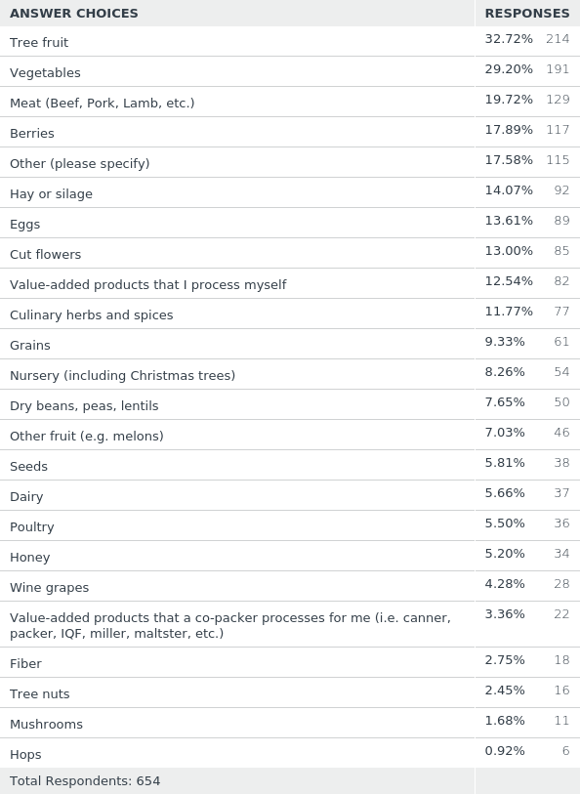
Back

Slide 31
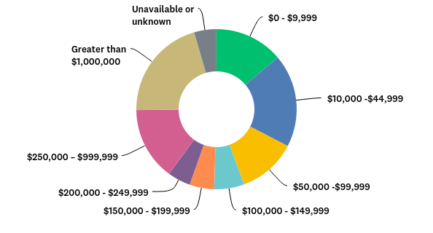
Q3: What is your farm's gross annual revenue in a normal year?
Answered: 644 Skipped: 145
Back

Slide 32
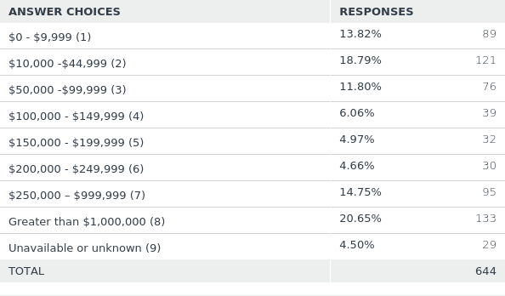
Back

Slide 33
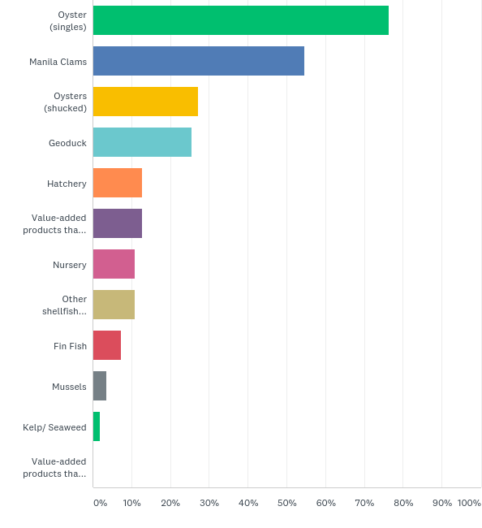
Q4: What types of aquaculture do you raise/harvest/produce? (Check all that apply)
Answered: 55 Skipped: 734
Back

Slide 34
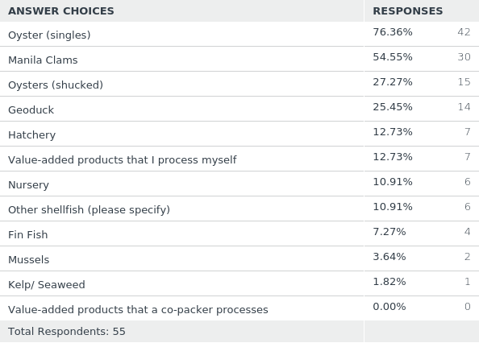
Back

Slide 35
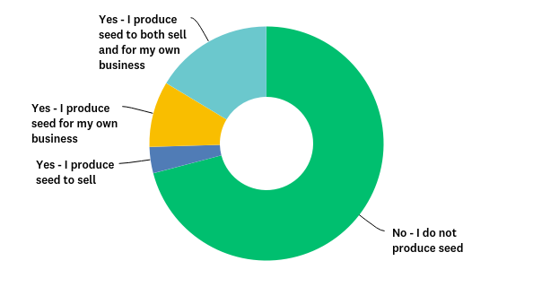
Q5: Does your business produce seed?
Answered: 55 Skipped: 734
Back

Slide 36
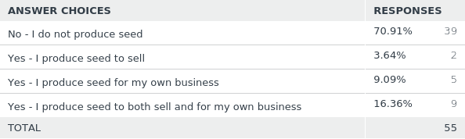
Back

Slide 37
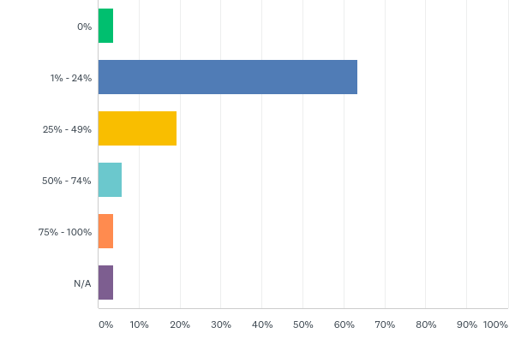
Q6: In a normal year, what percent of your annual gross revenue is used to purchase seed?
Answered: 52 Skipped: 737
Back

Slide 38
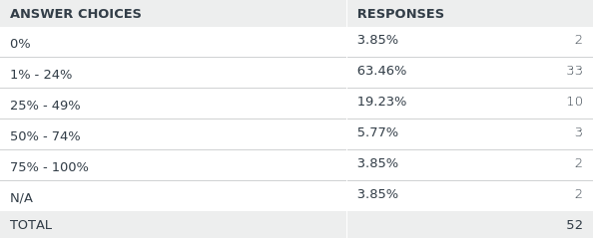
Back

Slide 39
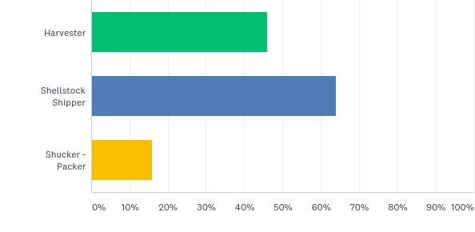
Q7: What license does your business have? (Check all that apply)
Answered: 50 Skipped: 739
Back

Slide 40
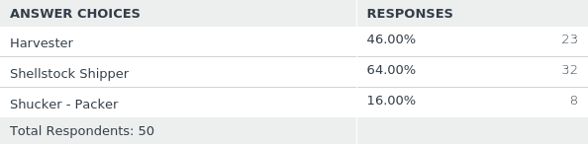
Back

Slide 41
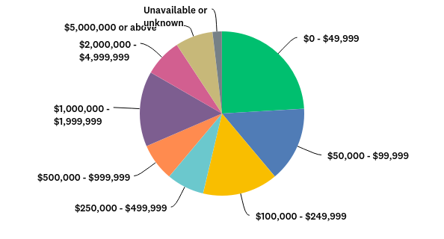
Q8: What is your farm's gross annual revenue in a normal year?
Answered: 54 Skipped: 735
Back

Slide 42
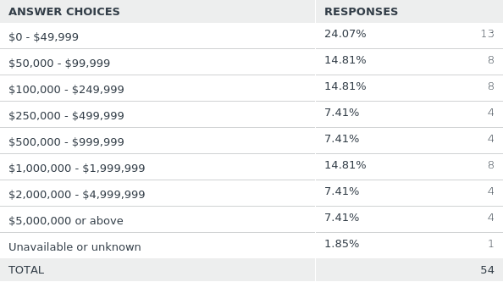
Back

Slide 43
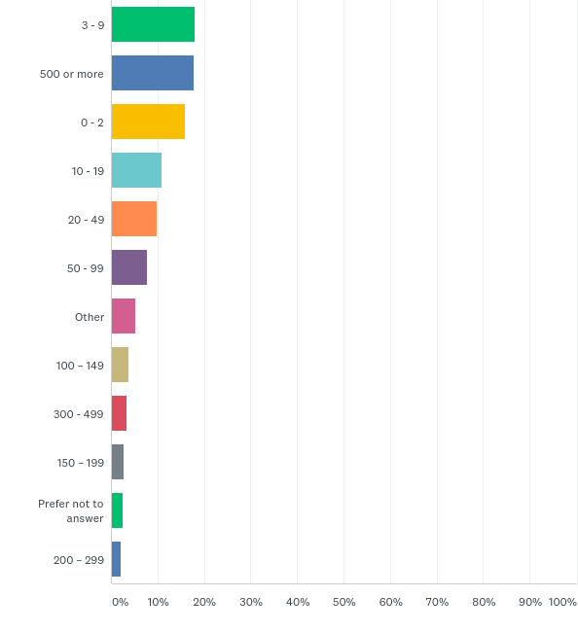
Q9: How many acres do you actively farm?
Answered: 647 Skipped: 142
Back

Slide 44
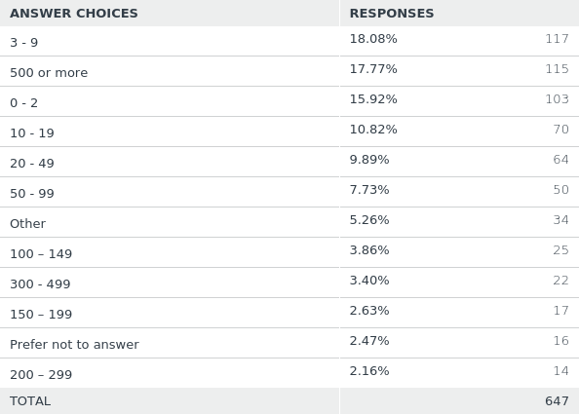
Back

Slide 45
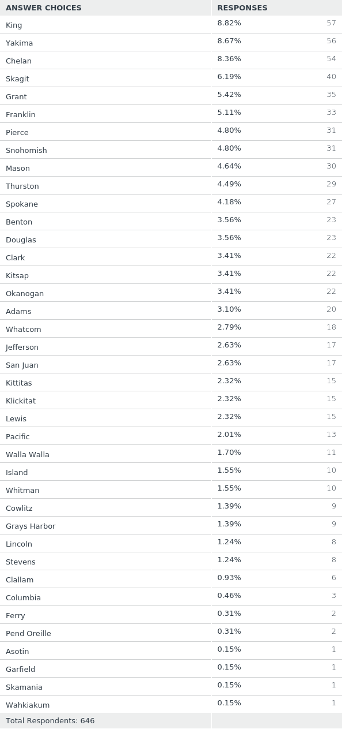
Q10: What county is your business located in? (Check all that apply)
Answered: 646 Skipped: 143
Back

Slide 46
Back

Slide 47
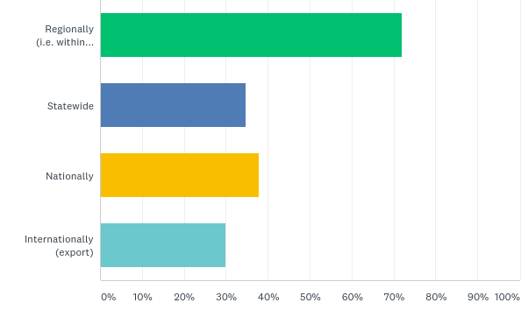
Q11: Where do you sell products geographically? (Check all that apply)
Answered: 640 Skipped: 149
Back

Slide 48
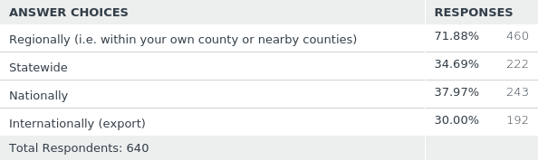
Back

Slide 49
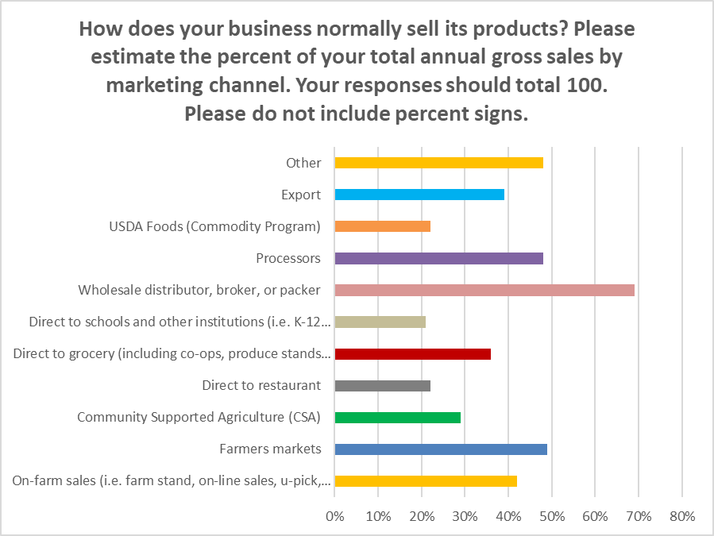
Q12: How does your business normally sell its products? Please estimate the percent of your total annual gross sales by marketing channel. Your responses should total 100. Please do not include percent signs.
Answered: 613 Skipped: 176
Back

Slide 50
Back

Slide 51
Back

Slide 52
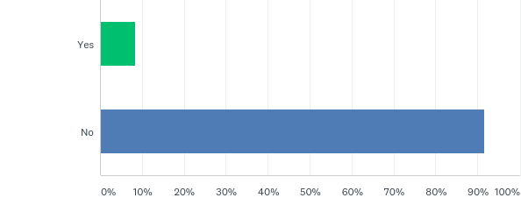
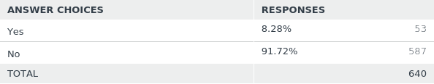
Q13: Does your business sell any product via a food hub?
Answered: 640 Skipped: 149
Back

Slide 53
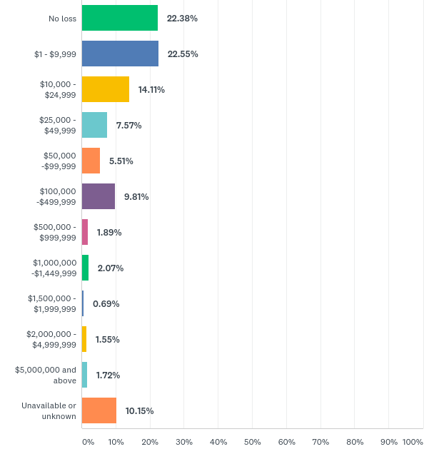
Q14: Please estimate your business's gross revenue loss (in dollars) between January 1, 2020 and April 15, 2020 due to disruptions caused by the COVID-19 pandemic?
Answered: 581 Skipped: 208
Back

Slide 54
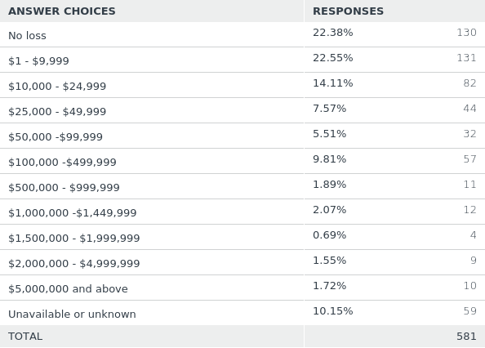
Back

Slide 55
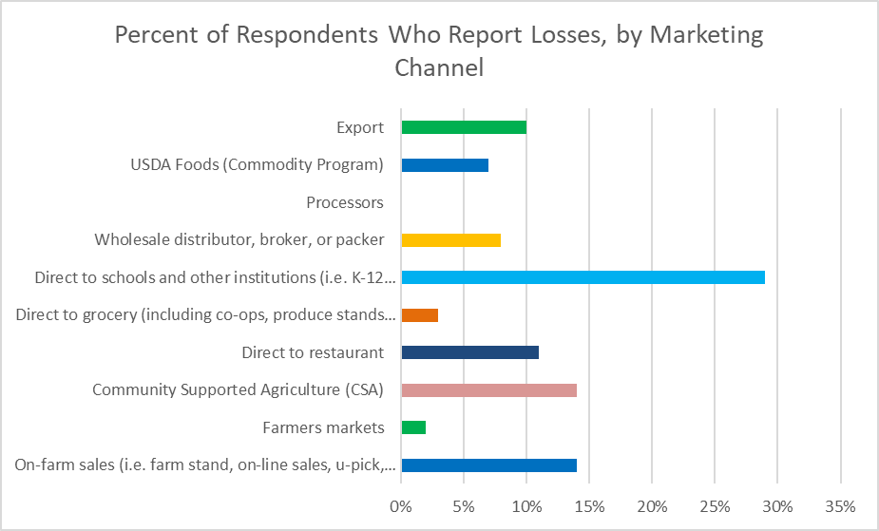
Q15: Of that estimated gross revenue loss, how does that loss break down by marketing channel? Please type the dollar amount. Do not use dollar signs.
Answered: 394 Skipped: 395
Back

Slide 56
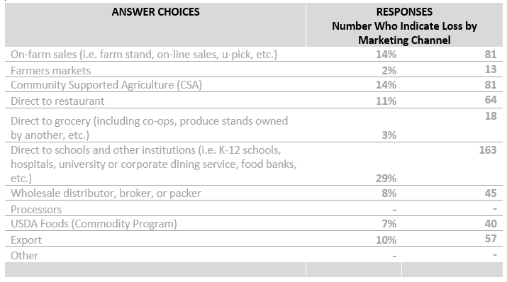
Back

Slide 57
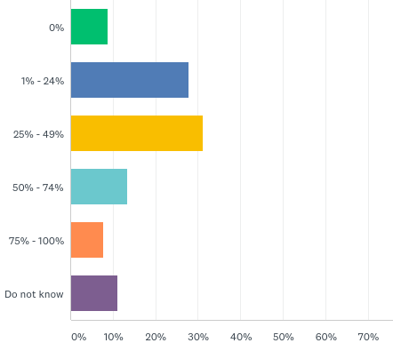
Q16: How much do you anticipate your business will lose in gross revenue between April 16, 2020 and December 31, 2020? Please estimate that loss as a percent of your gross revenue for the same period in a normal year.
Answered: 536 Skipped: 253
Back

Slide 58
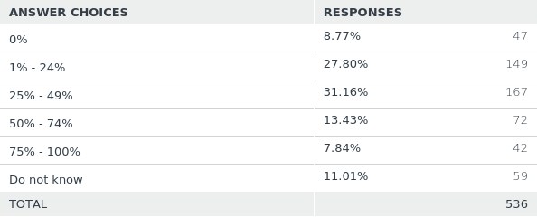
Back

Slide 59
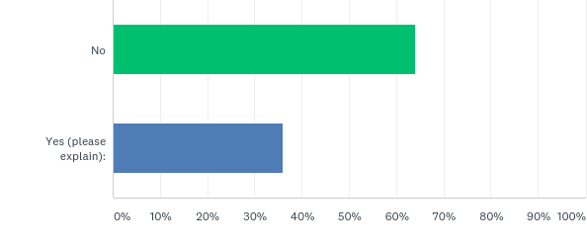
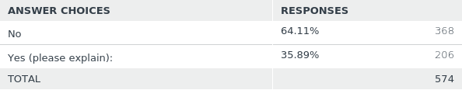
Q17: Have you experienced increased demand in any marketing channels?
Answered: 574 Skipped: 215
Back

Slide 60
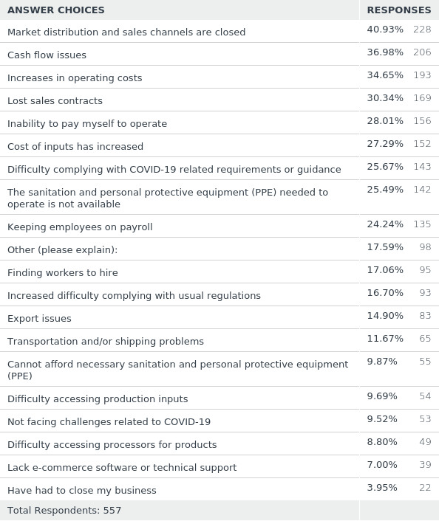
Q18: Is your business currently experiencing challenges due to the COVID-19 pandemic? (Check all that apply)
Answered: 557 Skipped: 232
Back

Slide 61
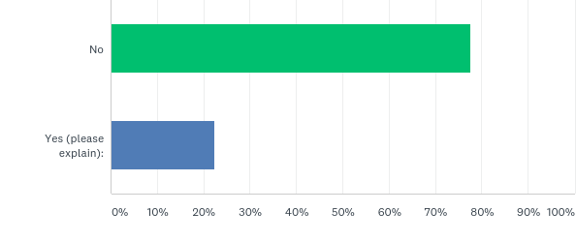
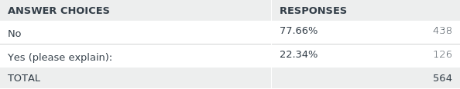
Q19: Were you experiencing market disruptions prior to COVID-19 (before January 1, 2020)? For example, was your business impacted by tariff-related disruptions?
Answered: 564 Skipped: 225
Back

Slide 62
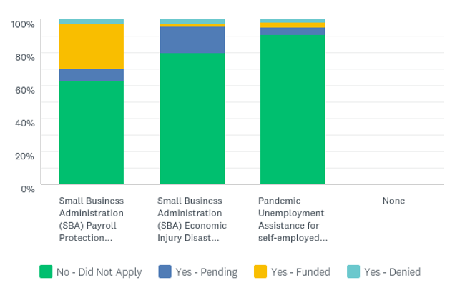
Q20: Have you applied for any of these Coronavirus Relief Programs? If yes, what is the current status of that application?
Answered: 558 Skipped: 231
Back

Slide 63
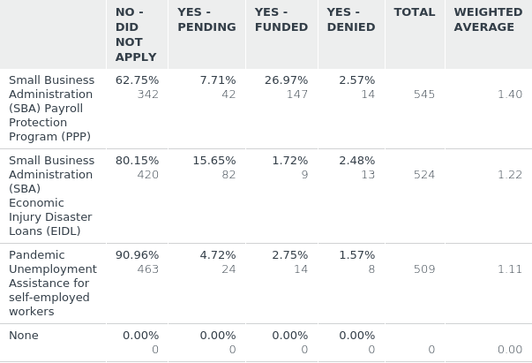
Back

Slide 64
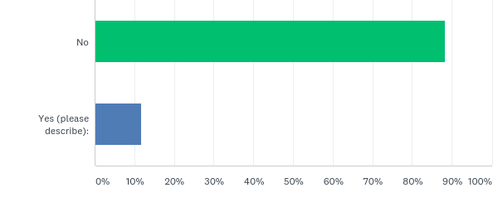
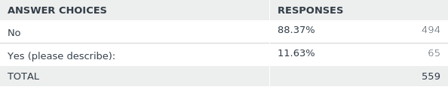
Q21: Have you received any other COVID-19 relief?
Answered: 559 Skipped: 230
Back

Slide 65

Q22: In a normal year, how many people do you employ, year round?
Answered: 551 Skipped: 238
Back

Slide 66

Back

Slide 67

Q23: In a normal year, how many people do you employ as seasonal workers?
Answered: 547 Skipped: 242
Back

Slide 68

Back

Slide 69

Q24: How many people has your business had to lay-off, furlough, reduce hours, or not hire due to the CCOVID19 pandemic?
Answered: 500 Skipped: 289
Back

Slide 70


Q25: Does your farm utilize H-2A Temporary Agricultural Workers?
Answered: 553 Skipped: 236
Back

Slide 71

Q26: Looking to the season ahead, what do you anticipate your number of employees will look like? Please approximate from 0% of normal number of employees to 100% of normal number of employees.
Answered: 533 Skipped: 256
Back

Slide 72

Back

Slide 73


Q27: Are you concerned about longer-term impacts to your business or your sector due to the COVID-19 pandemic?
Answered: 539 Skipped: 250
Back

Slide 74

Q28: Please tell us other agricultural, food and agribusiness related concerns you have about the current COVID-19 pandemic related to your agricultural business.
Answered: 306 Skipped: 483
Back

Slide 75

Q29: Are you (check all that apply):
Answered: 543 Skipped: 246
Back

Slide 76

Q29: Are you (check all that apply):
Answered: 543 Skipped: 246
Back

Slide 77
BLANK

