Slide 1

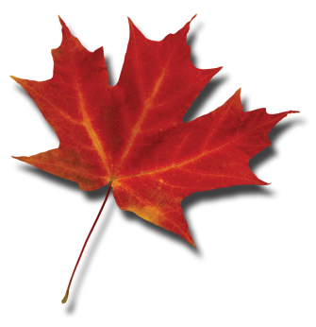
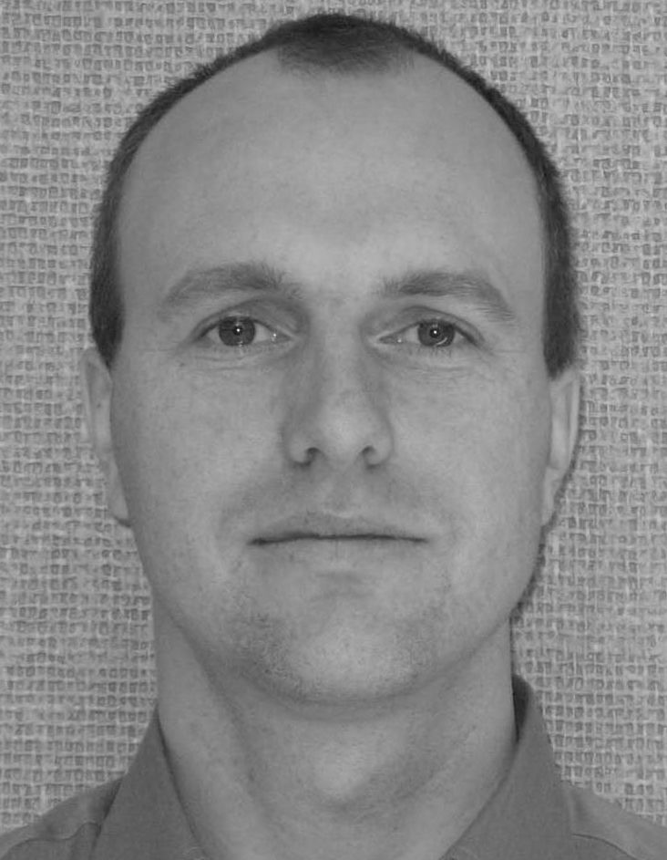
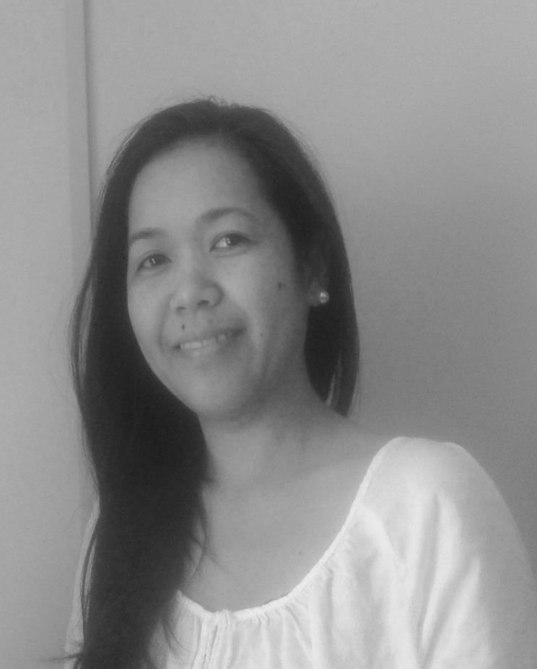
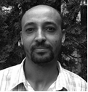
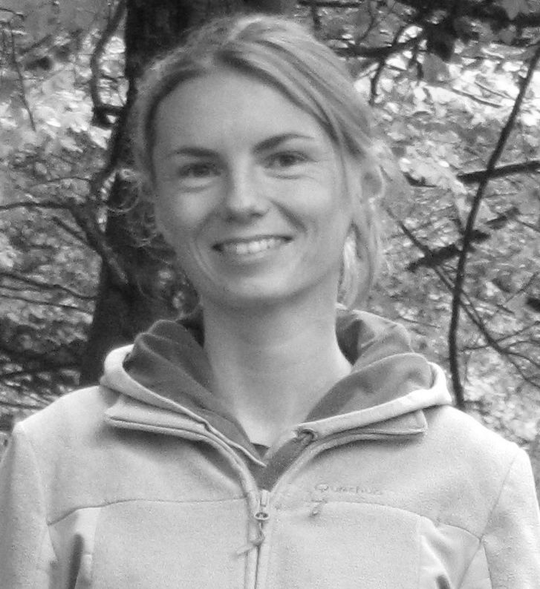

Visit from the Agriculture and Agri-Food Canada Holos model Research Team
Drs.: Roland Kröbel, Myra Martel, Aklilu Alemu & Sarah Pogue
Lethbridge Research and Development Center, Agriculture and Agrifood Canada, 5403 1st Ave S, Lethbridge, AB, T1J 2P2
Holos – an exploratory ecosystem model for Canadian farms – R. Kröbel
An ecosystem consists of not only the organisms and the environment they live in but also the interactions within and between. A whole systems approach seeks to describe and understand the entire system as an integrated whole, rather than as sum of individual components. Holos is a whole-farm model for estimating and testing GHG mitigation options for Canadian farms and their effect on whole-farm emissions. It is an exploratory tool rather than an accounting or inventory tool; intended to look beyond the question ‘what were my emissions?’ to ask ‘what could my emissions be?’ Algorithms used are generally based on the Intergovernmental Panel on Climate Change methods adapted to Canadian conditions. Holos Version 2 was developed through consultation with users and features two user input streams. Holos Research allows for detailed characterization of farm systems, while Holos Standard contains pre-built scenarios allowing for greater ease of use. Holos results are presented as annual or monthly time step.
Biography:
Roland is an AAFC researcher and ecosystem modeller, looking at a broader range of environmental interaction of farm systems. Roland has studied farm systems worldwide (Europe, China, Central America, and North America), and subscribes to a “there is no better use for money than to spend it on good food” philosophy.
A soil water budget model for Canadian agricultural conditions – M. Martel
A number of soil water balance simulation models have been developed over the years, but they frequently need to be calibrated for different conditions and may require input data that are not usually easily available locally. Thus, a simple soil water budget model for Canadian agricultural conditions is being developed to address these issues. The model uses the one-dimensional “tipping-bucket” soil water balance approach and adapts and applies algorithms and principles presented and employed by other existing models and reliable references (e.g. FAO Paper 56, AIberta Irrigation Management Model, Aquacrop, PRZM, EPIC, and SWAT). It is useful for predicting soil moisture, crop water uptake, irrigation requirement, runoff, and deep drainage. Validation of the model with data from various regions of Canada show good agreement between measured and simulated values. One of the intended purposes of the model is for water footprint assessment of crop production.
Biography:
Myra Martel is a postdoctoral fellow at the Lethbridge Research Centre. She earned her Ph.D. degree from the University of Saskatchewan. Her previous trainings and experiences include model development and simulations of processes pertaining to treatment of swine facility exhaust air in biotrickling filters and air pollution from mobile sources.
Reducing the Environmental Impact of Canadian Beef – A. Alemu
Canadian beef production systems are diverse in scale and size and generally categorized as cow-calf, backgrounding and finishing operations. The industry is important to the Canadian agriculture as well as the overall Canadian economy, generating $13 billion to the county`s GDP in 2014. However, the beef cattle sector is also a major contributor of agricultural greenhouse gas emissions (~43%). Therefore, with the aim of reducing its environmental impact, we are conducting different research projects including the use fed additives to reduce enteric methane emissions, implementation of different measurement techniques, improving animal efficiency and implementation of whole-farm models to evaluate management practices for farm perspective.
Biography:
Alemu is an NSERC post-doctoral fellow at Agriculture and Agri-Food Canada (AAFC) Lethbridge Research and Development Centre working on projects that aimed to minimize the environmental footprint of Canadian beef cattle industry through measurement and modelling. Alemu has received his PhD from University of Manitoba in Animal Science (Farm Systems Modelling), where he used different mathematical models to investigate Best Management Practices in beef production systems. Prior to this, he obtained his MSc. from university of Alberta in Ruminant Nutrition and BSc from Hawassa University, Ethiopia, in Animal production and Rangeland Management.
Beef and Ecosystem Services in Alberta – S. Pogue
Canada is the 11th largest producer and 5th largest exporter of beef globally, with the province of Alberta raising just over 4.9 million head of cattle (~ 40% of the national herd) on roughly 3.3 million hectares of rangelands. A deeper understanding of the beef industry's ecological performance with respect to a finite land base, both positive and negative, is crucial to determine environmentally and culturally acceptable land stocking densities and productivity levels. This research aims to provide a holistic assessment of the impacts of beef production in Alberta on the province’s natural capital and ecosystem service (ES) delivery across space and time. It will reveal how ES delivery has changed over time and in relation to specific management strategies, investigate trade-offs, synergies and interactions among services, and identify impacts of past human-driven system change on the provision of ES at later points in time.
Biography:
I am a post-doc fellow at the University of Lethbridge and Agriculture and Agri-Food Canada (AAFC) Lethbridge Research Centre, and my research is co-funded by the Alberta Biodiversity Monitoring Institute (ABMI) and Mitacs. Prior research used multiple long-term records to examine multi-centennial human-environment interactions and ES delivery in a protected area social-ecological system, and I worked in a voluntary and non-voluntary capacity on conservation and environmental projects in Australia, New Zealand, Thailand, Portugal and Italy.
© 2011

