Slide 1
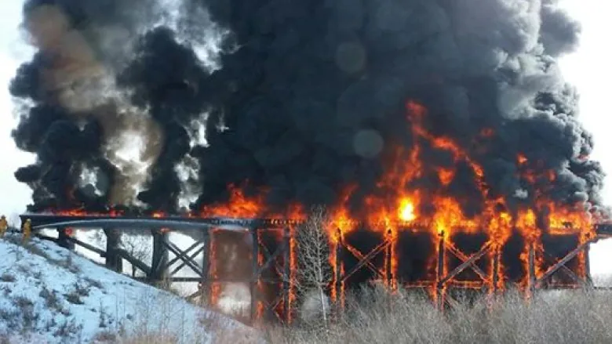
Life-cycle Fire Performance Assessment and Enhancement of Reinforced Concrete Bridges in Chloride-laden Environments
Ji Yun Lee & Xianming Shi
Washington State University
Bridge fires have increased with the growing use and transportation of highly flammable liquids and large-size batteries, the rise of extreme weather events due to climate change (e.g., droughts and heatwaves), and the use of new construction materials that have not been adequately tested for fire resistance.
Chloride-induced deterioration may reduce the fire resistance of a reinforced-concrete (RC) bridge and increase the risk of collapse.
Time-dependent performance of reinforced concrete bridges under the combined effects of fire and corrosion, especially under climate change, has not been extensively studied.
Image source: https://i.cbc.ca/1.3509125.1459188523!/fileImage/httpImage/image.jpg_gen/derivatives/16x9_780/porcupine-plain-train-bridge-fire.jpg

Slide 2
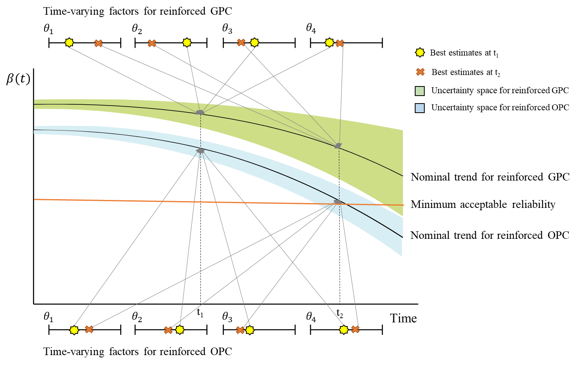
Project Goal and Tasks
Goal: Assess and enhance the life-cycle fire performance of RC bridges in chloride-laden environments
Tasks
1. Assess the time-dependent fire performance of reinforced ordinary Portland cement concrete (OPCC) and fly-ash-based geopolymer concrete (GPC) bridges in chloride-laden environments through experiments and numerical simulations
2. Quantify the life-cycle performance of two types of RC bridges under deep uncertainties
3. Develop a dynamic rolling-horizon approach that can dynamically optimize the maintenance schedule, aimed at enhancing the long-term fire performance of both types of RC bridges

