Slide 1
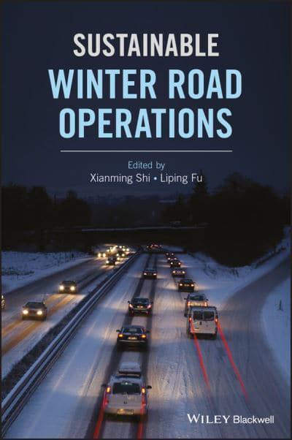

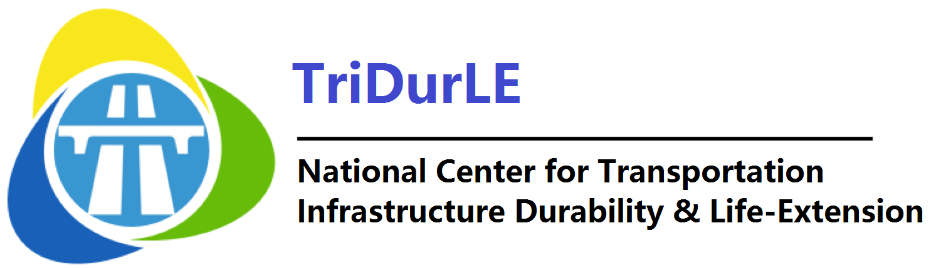
Upcycling agro wastes as additives for sustainable roadway anti-icing operations
Xianming Shi, Ph.D., P.E., F. ASCE
Professor, Civil & Environmental Engineering
Washington State University, Pullman

Slide 2
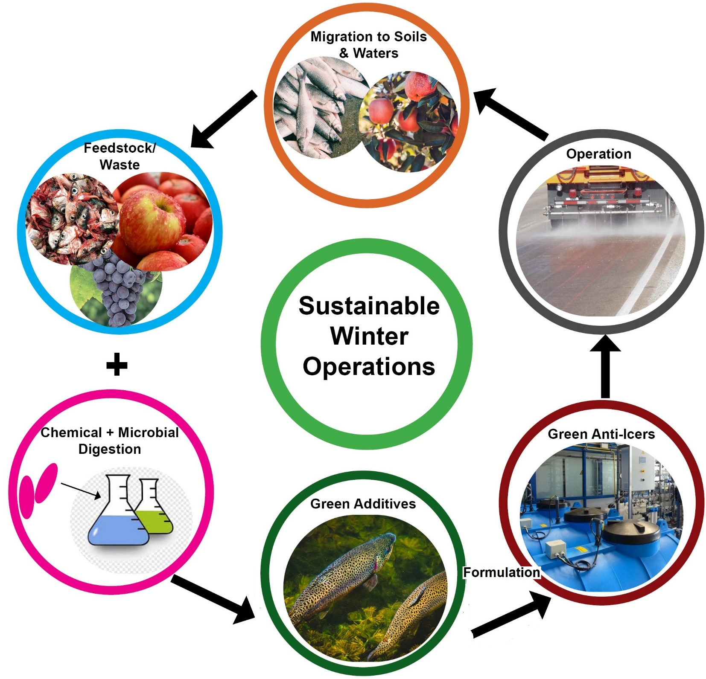
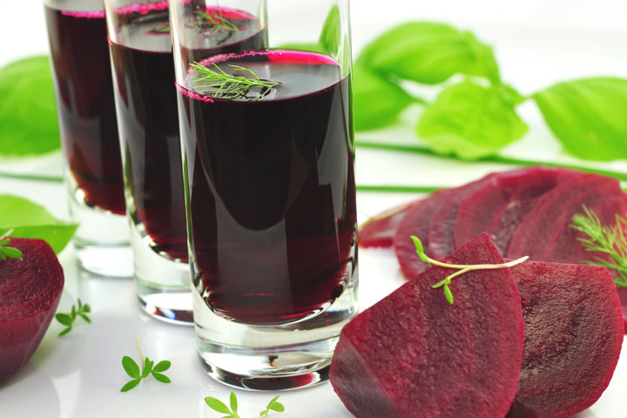
Cougar Cage: Furthering this WSU-patented technology
doctoroz.com

Slide 3
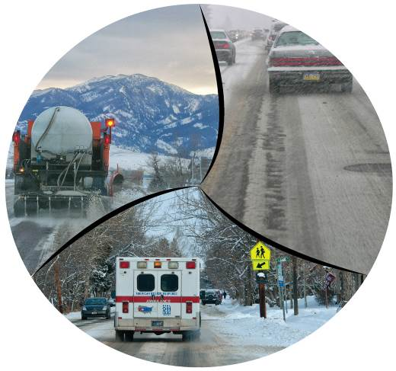
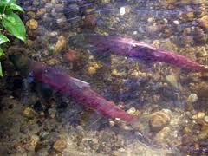
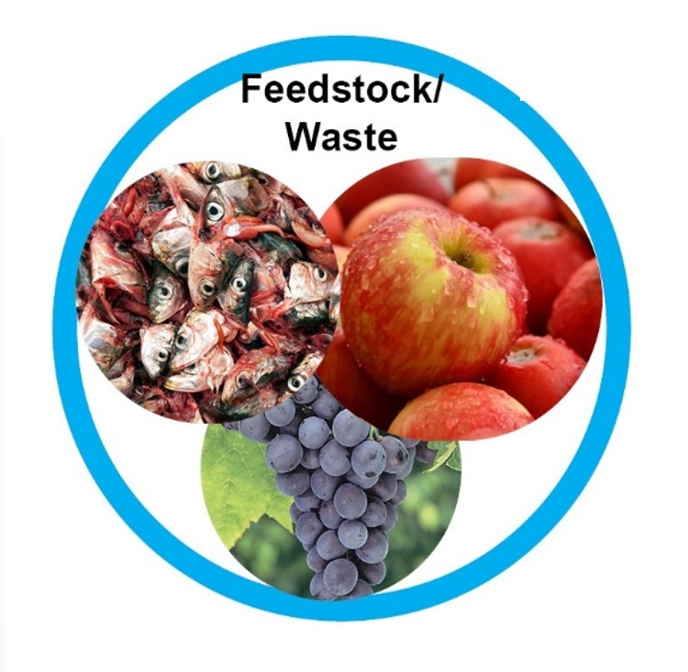
Vision
Our products will reduce chloride loading by at least 20% while achieving better overall performance vs. beet juice/salt brine blends (and salt brine).
They will feature greatly reduced oxygen demand and aquatic toxicity (key differentiator).
www.ci.bellevue.wa.us
  In Washington State, ~20,000 t of grape pomace + 30,000 t of apple pomace; ~1,800 t of fish waste per year.
Cougar Cage $48K + National UTC TriDurLE $48K:
11/1/2021 – 12/31/2022

