Slide 1

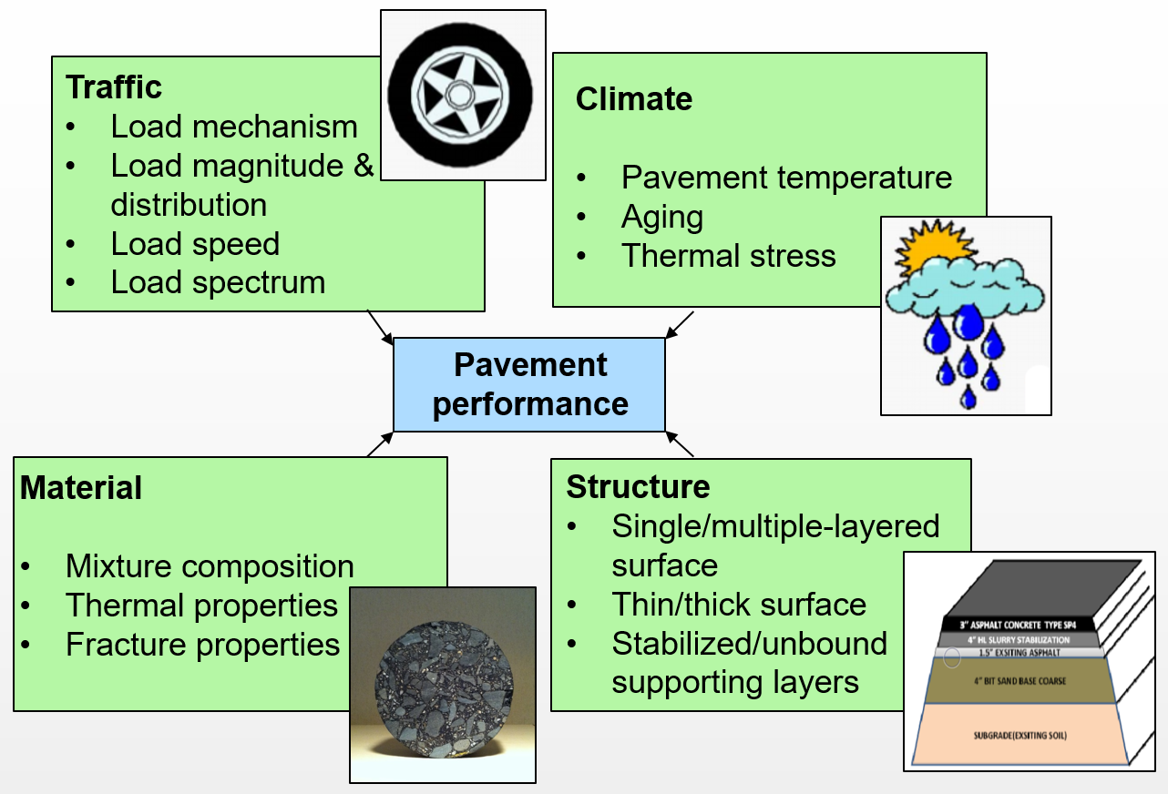
Developing Enhanced Performance Curves for ITD Asphalt Pavements
Xianming Shi, Ph.D., P.E., F. ASCE
Washington State University
ITD has identified an urgent need to refine the performance curves
The current approach of time-series forecasting often fails to account for the highly nonlinear, dynamic nature of pavement deterioration mechanisms, complexities in the design, materials selection, construction features, M&R history, etc.

Slide 2
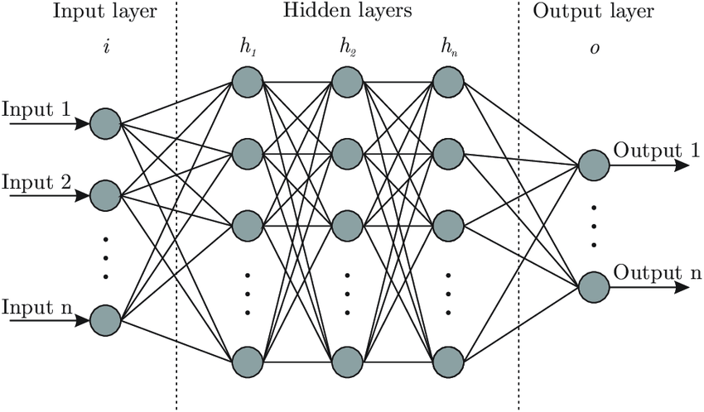
Project Goal and Objectives
Goal: develop reliable and realistic and enhanced performance curves for ITD asphalt pavements by mining the historical data
Objectives:
1) identify the appropriate parameters and additional criteria to use in the enhanced asphalt performance curves
2) develop & calibrate distress-specific models for forecasting future pavement conditions, for both new and rehabilitated asphalt pavements
3) validate existing and enhanced curves using historical performance data.

