Slide 1
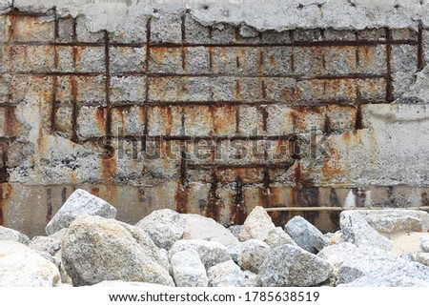
Developing High-Performance Nanocomposite Coating for Steel Reinforcement Protection in Chloride-Rich Concrete
Xianming Shi, Ph.D., P.E., F. ASCE
Washington State University
Epoxy coatings provide excellent corrosion protection for embedded rebar without a significant increase in material cost, and are not consumed during their operational life.
However, the durability of epoxy-coated reinforcement is of great concern due to its failure record in high chloride environments and localized corrosion conditions.

Slide 2
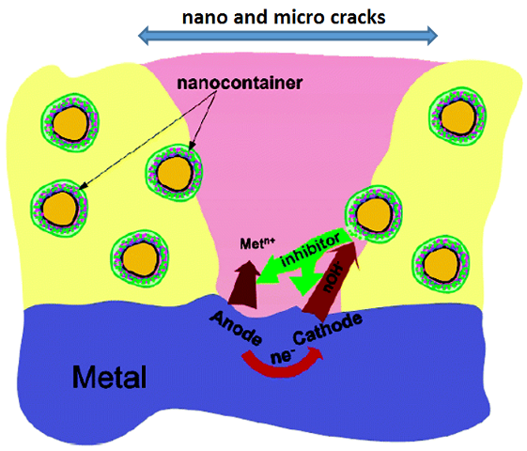
Research Plan and Goal
This project aims to design a long-lasting, high-performance rebar coating that effectively reduces corrosion at the interface between the rebar and the surrounding chloride-contaminated concrete.
A two-layer coating will be applied on steel rebar, with an inhibitor-loaded epoxy nanocomposite coating as the primer and a minerals-loaded epoxy-polyurethane nanocomposite coating as the top coat.
Electrochemical corrosion tests, surface analyses, and mechanical tests will be conducted to assess and elucidate the effect of different constituents on the protective performance of such novel epoxy-based nanocomposite coatings.

