Slide 1
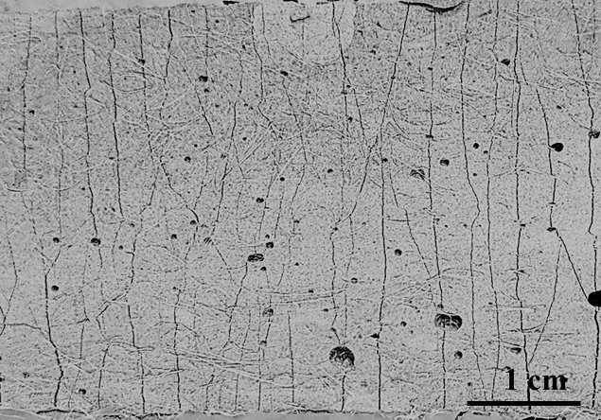
Development of microcapsule-based self-healing, high-strength engineered cementitious composites (SHHS-ECC)
Xianming Shi, Ph.D., P.E., F. ASCE
Washington State University
HS-ECC reinforced by PE fibers was developed to overcome the extreme brittleness of high-strength concrete, and is expected to ensure resilience of critical structures under extraordinary loads or displacements.
However, the crack width in HS-ECC can reach several hundred microns which makes it lose the autogenous self-healing capacity seen in PVA fiber reinforced ECC.

Slide 2
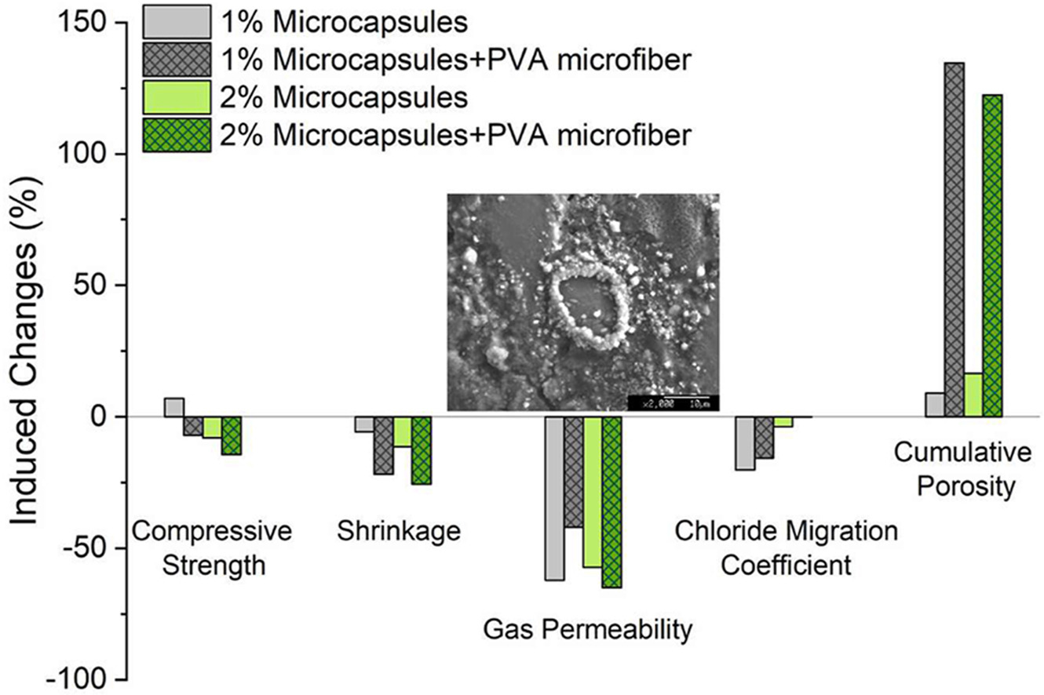
Research Plan and Goal
This project aims to design a self-healing HS-ECC by virtue of microcapsules encapsulating healing agent.
Identify the mix designs of HS-ECC incorporating microcapsules, based on the micromechanics theory
Evaluate the self-healing effectiveness of HS-ECC, in terms of restoration level of tensile and transport properties
Study the effect of crack width and pre-cracking age on the self-healing efficiency of HS-ECC.

