Slide 1
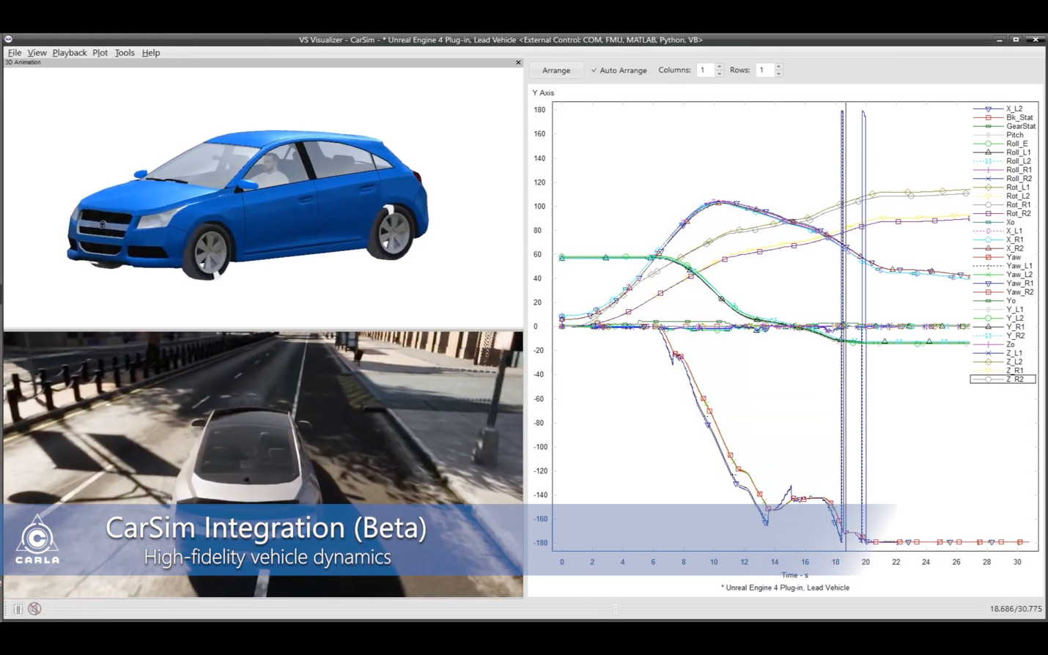
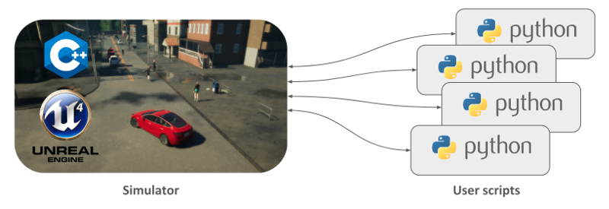
Preparation of Pavement Infrastructure for Connected and Autonomous Vehicle Deployment – Phase I
PIs: Dr. Xianbiao (XB) Hu, Dr. Jenny Liu, Missouri University of Science and Technology
This project will advance fundamental understanding of how system-wide CAV deployment may impact pavement performance, and further, how to assist the decision makers in finding optimum and cost-effective strategies for maintaining pavements in serviceable condition.
TriDurLE $60,000 & 1:1 match from Colorado DOT and Missouri S&T
June 2021 – May 2022, Rolla Missouri

Slide 2
Preparation of Pavement Infrastructure for Connected and Autonomous Vehicle Deployment – Phase I
Although CAV might be ten or fifteen years away from large-scale deployment in reality, considering the long lifespan of transportation infrastructure, it might be beneficial for DOT to start to prepare transportation infrastructure to support CAV testing and deployment
The CAV trajectory pattern will be quantified with the help of an autonomous driving simulation software
Existing datasets such as LTPP will be explored to develop and train an AI-based pavement performance predictive model
The developed model will be applied to study the impact of CAV movements to the pavement infrastructure

