Slide 1

Application of principal component regression at the US Transuranium and Uranium Registries
Martin Šefl
United States Transuranium and Uranium Registries
College of Pharmacy and Pharmaceutical Sciences
Mathematical Sciences Foundry Talks, Whitman College, September 19, 2022

Slide 2
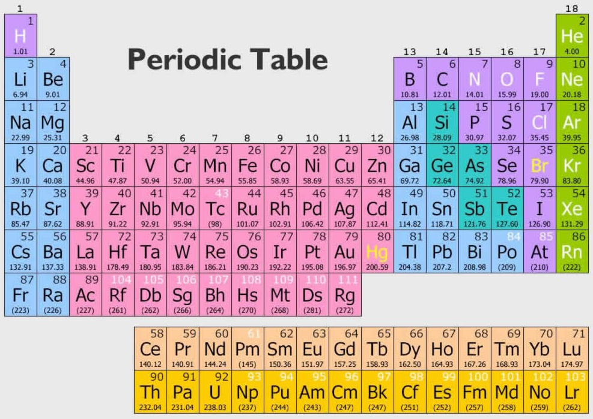
United States Transuranium and Uranium Registries: Mission statement
Follow up occupationally-exposed individuals (volunteer Registrants) by studying the biokinetics (deposition, translocation, retention, and excretion) and tissue dosimetry of uranium and transuranium elements, such as plutonium, americium, curium, and neptunium.
Apply USTUR data to refine dose assessment methods in support of reliable epidemiological studies, radiation risk assessment, and regulatory standards for radiological protection of workers and general public.
Actinides

Slide 3
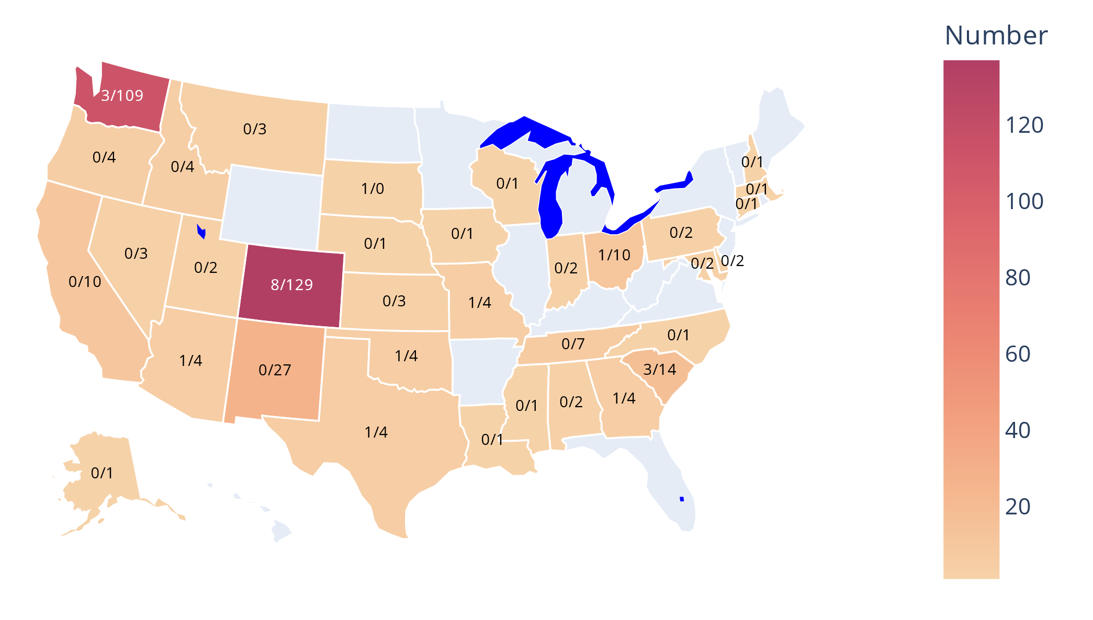
United States Transuranium and Uranium Registries: Registrants
Voluntary tissue donors (posthumous)
whole-(48) and partial-body (317) donations
Former nuclear workers form United States Department of Energy sites (Hanford, Rocky Flats, Los Alamos account for 85% of Registrants)

Slide 4
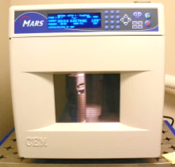
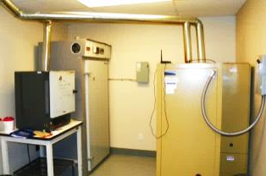
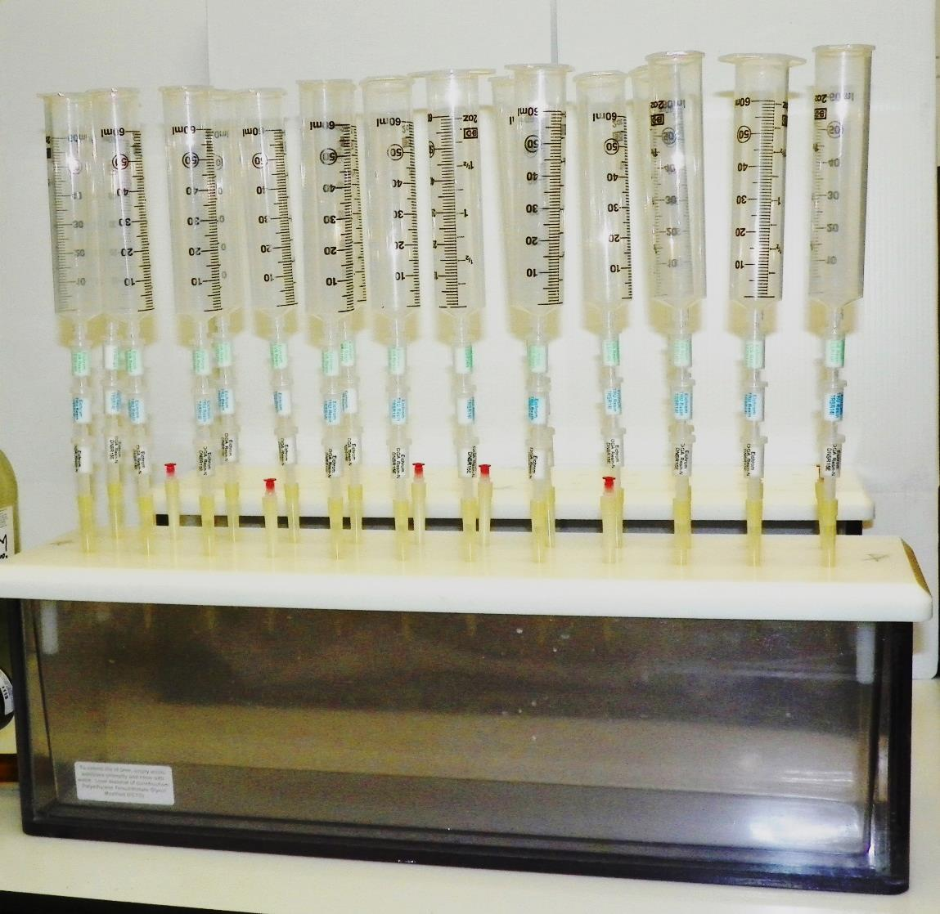
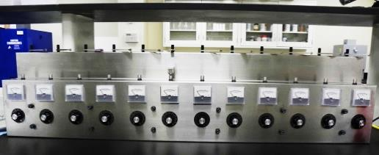
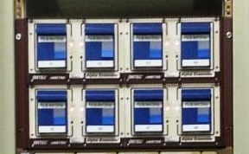
Analysis of tissue samples
Drying
Ashing
Digestion
Dissolution
Pu/Am/U/Th separation
α-source preparation
Pu/Am/U/Th measurement

Slide 5
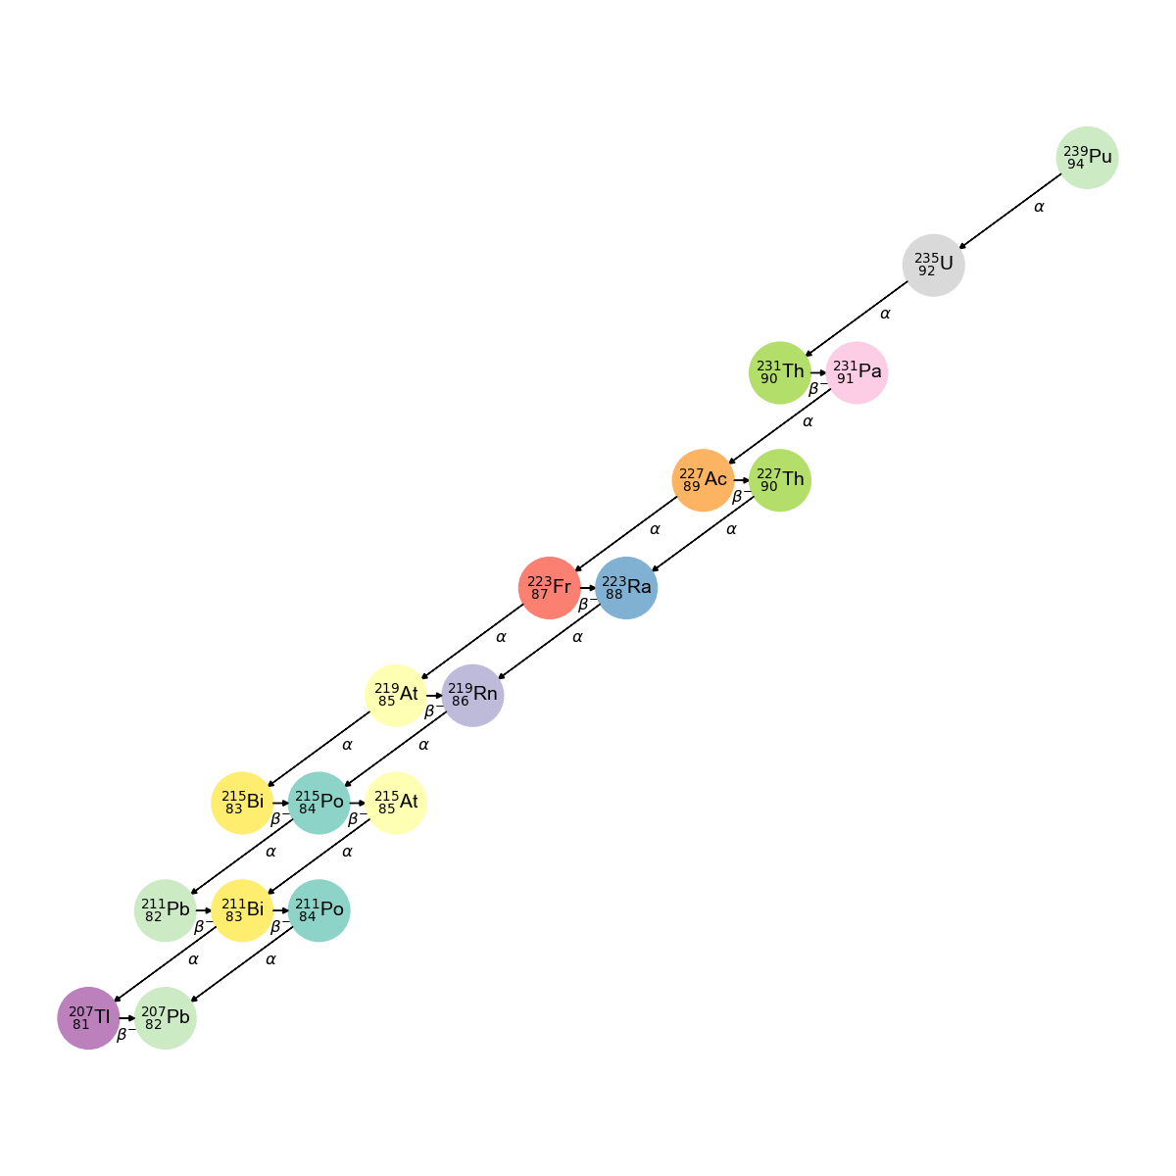
²³⁹Pu
Russia 191
United Kingdom 119
United States 87.7
France 80.7
Japan 45.5
India 8.8
China 2.94
Israel 0.9
Pakistan 0.41
North Korea 0.04
²³⁹Pu is a major anthropogenic radionuclide, T_{1/2} = 24,110 years (progeny ²³⁵U – T_{1/2} = 7×10⁸ years)
Nuclear weapons, power generation (stockpile 540 tons)
Enters human body as a result of global fallout and industrial/occupational incidents

Slide 6
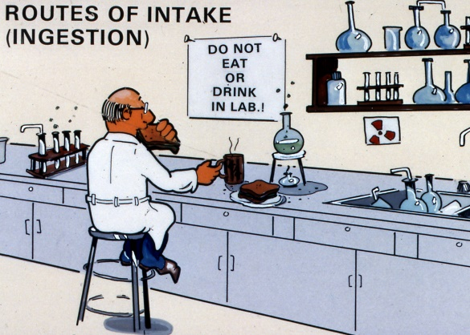
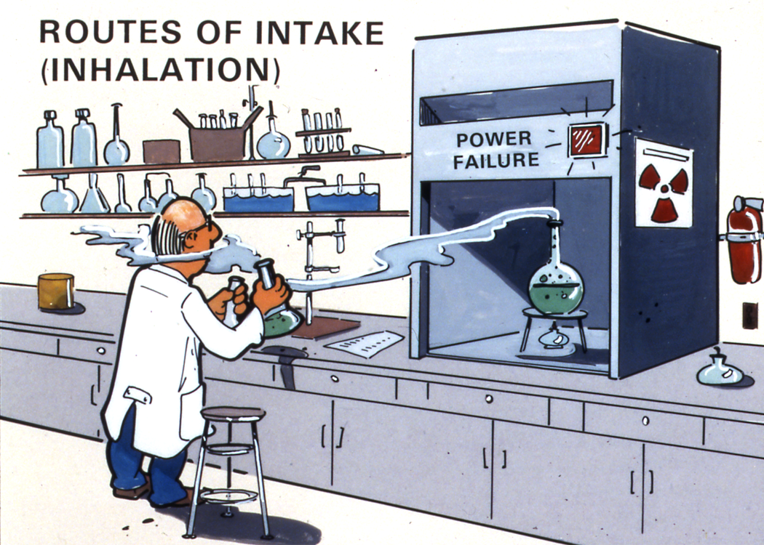
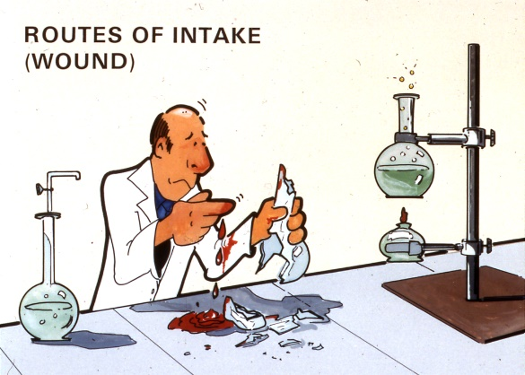
Routes of intake

Slide 7
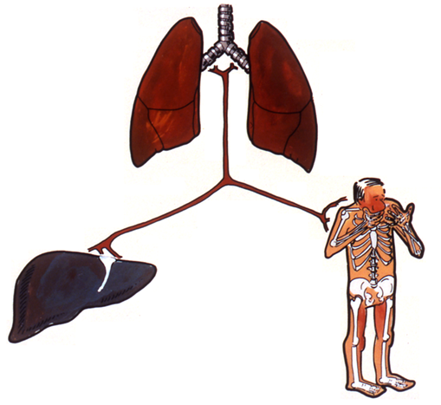
Plutonium in human body
Lungs
Skeleton and liver are major depository sites
Liver:Skeleton activity ratio
Blood stream (systemic)
Skeleton
Liver
Simplified pathways for plutonium
Šefl et al. PLOS ONE 16(10): e0259057; 2021.

Slide 8
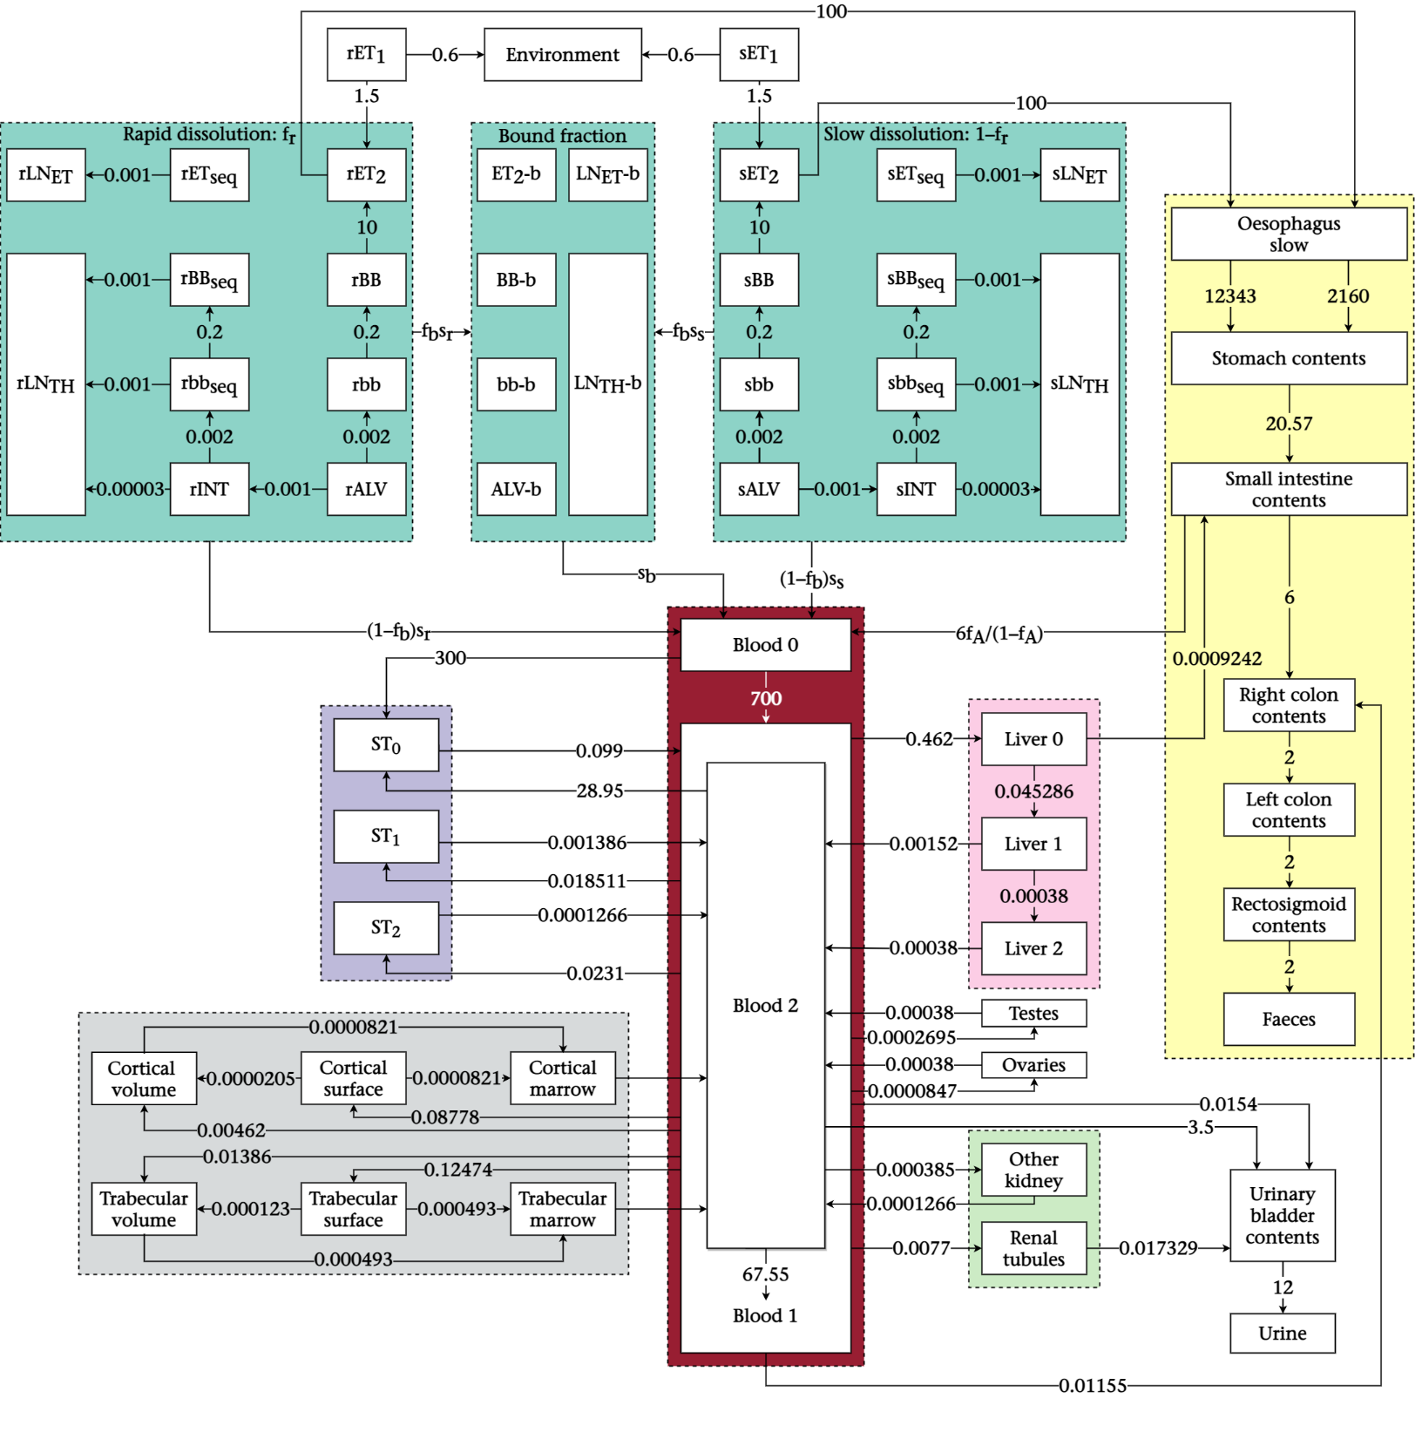
Model of Pu inhalation
ICRP Publication 130
“For radiological protection purposes, it is assumed that all biokinetic parameters of the Reference Worker are invariant on sex, anatomy, physiology, race, and other individual-related factors, but based on the Reference Male parameter values where sex-specific models are available.”

Slide 9
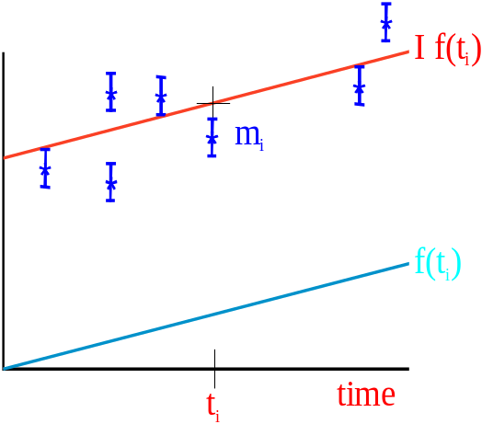
Modeling
Intake scenario(s)
Model prediction for 1 Bq intake of each intake scenario
Fit the data

Slide 10
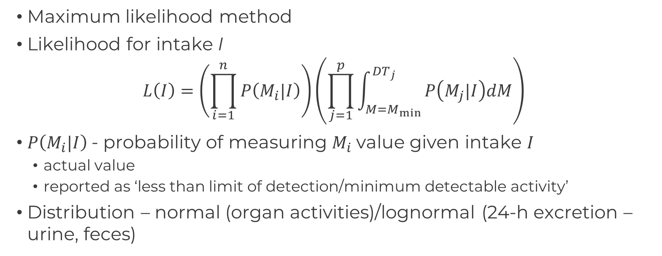
Data fitting
Maximum likelihood method
Likelihood for intake I
$L\left(I\right)=\left(\prod_{i=1}^{n}{P\left(M_{i}|I\right)}\right)\left(\prod_{j=1}^{p}{\int_{M=M_{min}}^{{DT}_{j}}{P\left(M_{j}|I\right)dM}}\right)$
$P\left(M_{i}|I\right)$- probability of measuring $M_{i}$value given intake $I$
  actual value
  reported as ‘less than limit of detection/minimum detectable activity’
Distribution – normal (organ activities)/lognormal (24-h excretion – urine, feces)

Slide 11
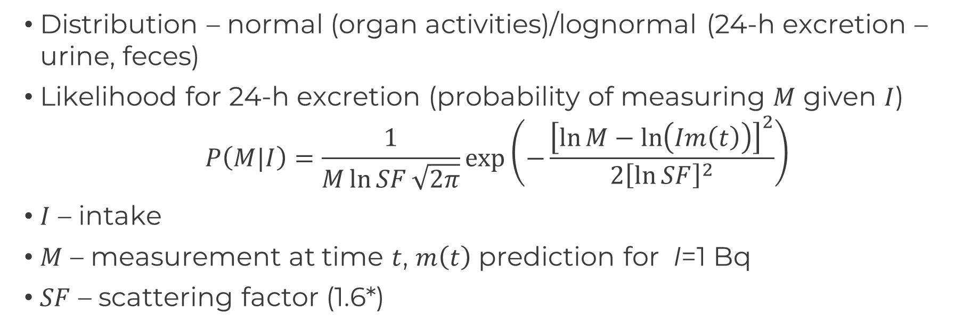
Data fitting – likelihood
Distribution – normal (organ activities)/lognormal (24-h excretion – urine, feces)
Likelihood for 24-h excretion (probability of measuring $M$ given $I$)
$$P\left(M|I\right)=\frac{1}{M\ln{SF}\sqrt{2π}}exp\left(−\frac{{\left[\ln{M}−\ln\left(Im\left(t\right)\right)\right]}^{2}}{2{\left[\ln{SF}\right]}^{2}}\right)$$
$I$ – intake
$M$ – measurement at time $t$, $m\left(t\right)$ prediction for I=1 Bq
$SF$ – scattering factor (1.6*)
*Castellani et al. IDEAS Guidelines (v2) for the estimation of committed doses from incorporation monitoring data

Slide 12
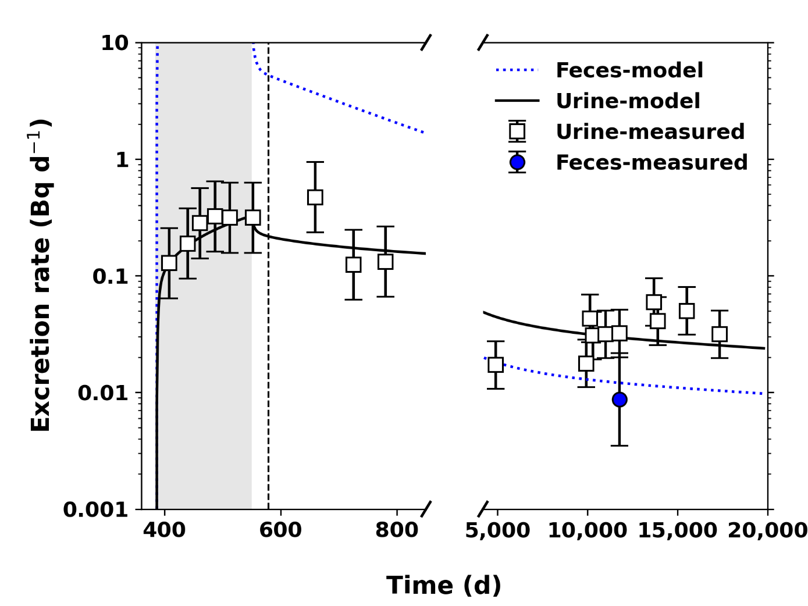
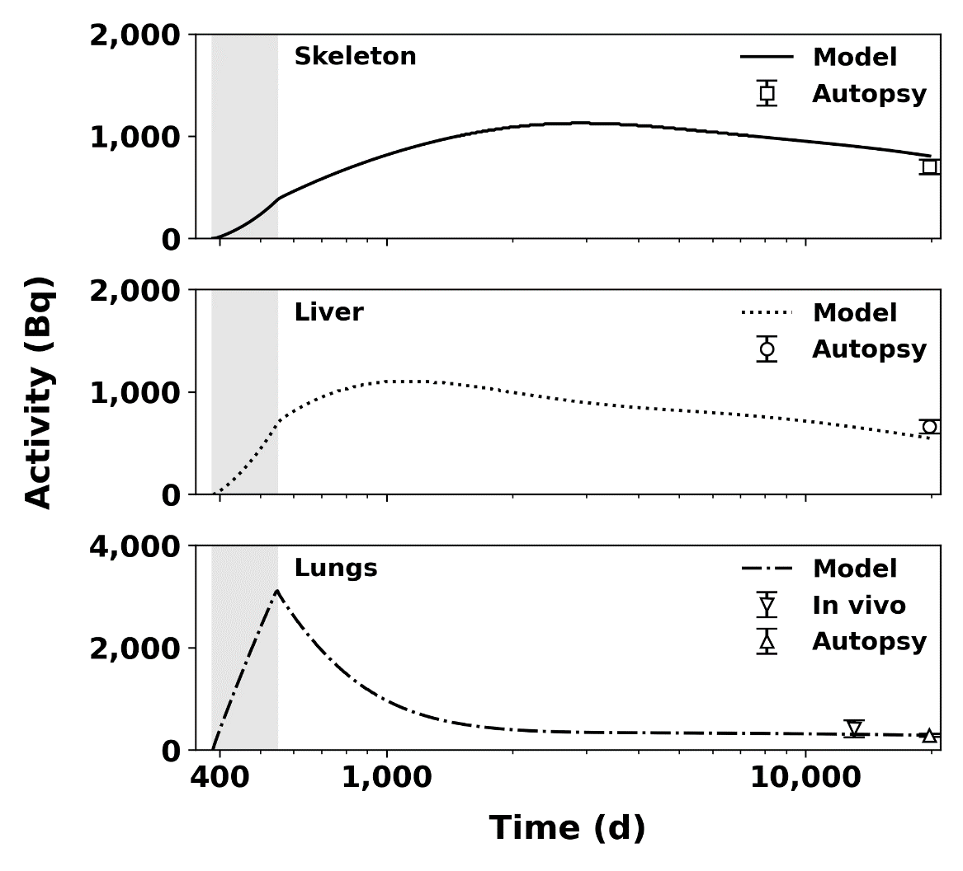
Data fitting
Bioassay measurements – urine, feces, blood, chest counts
Post-mortem tissue analyses – liver, skeleton, lungs
Šefl et al. Health Phys 120(6):661–670; 2021

Slide 13
Data
Urine data – many
Organ data – typically one measurement at the time of death (except lung counts)
Influence intake predictions
Šefl et al. PLOS ONE 16(10): e0259057; 2021.

Slide 14
Committed effective dose – influence of bioassay and tissue measurements
Liver+Skeleton
only
Urine only
Šefl et al. PLOS ONE 16(10): e0259057; 2021.

Slide 15
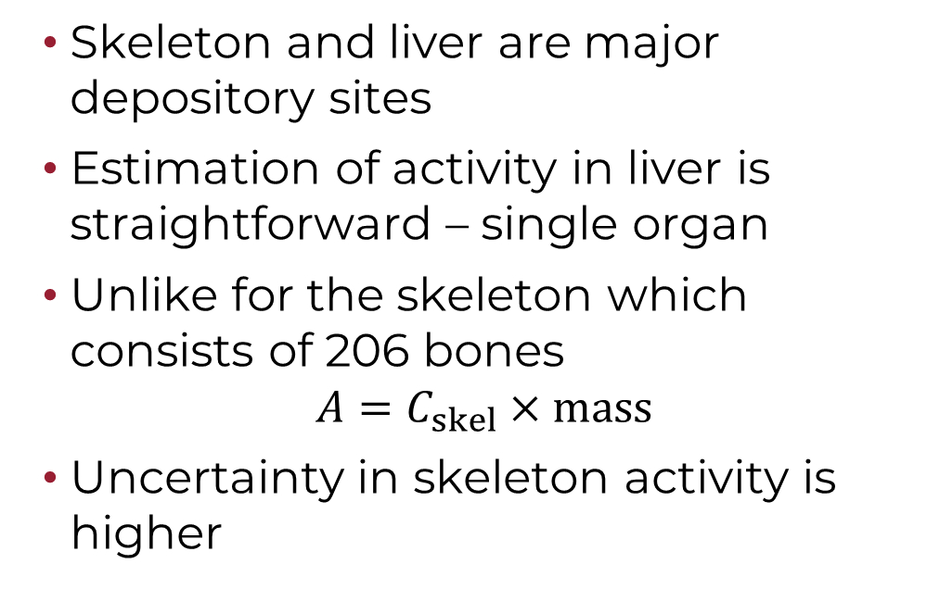
Plutonium in the skeleton
Lungs
Skeleton and liver are major depository sites
Estimation of activity in liver is straightforward – single organ
Unlike for the skeleton which consists of 206 bones
$$A=C_{skel}×mass$$
Uncertainty in skeleton activity is higher
Blood stream (systemic)
Skeleton
Liver
Simplified pathways for plutonium

Slide 16
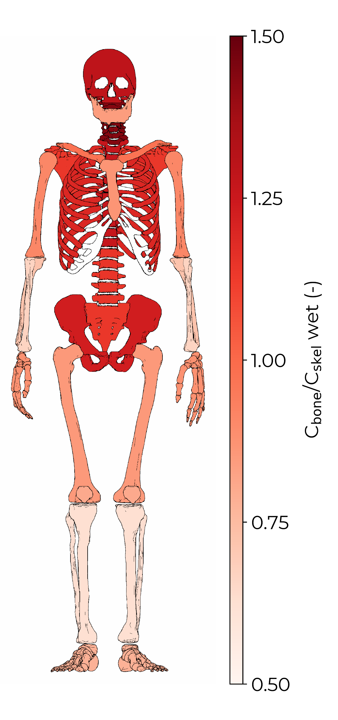
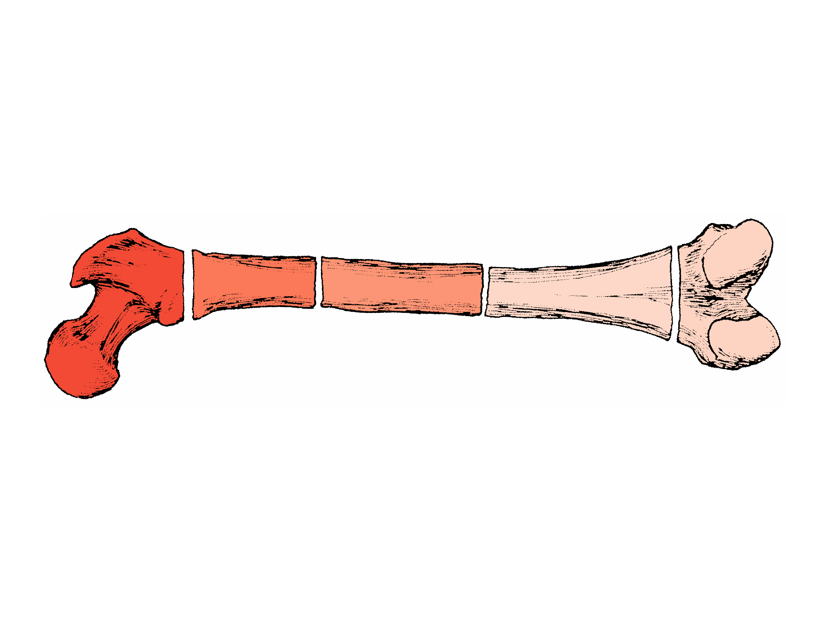
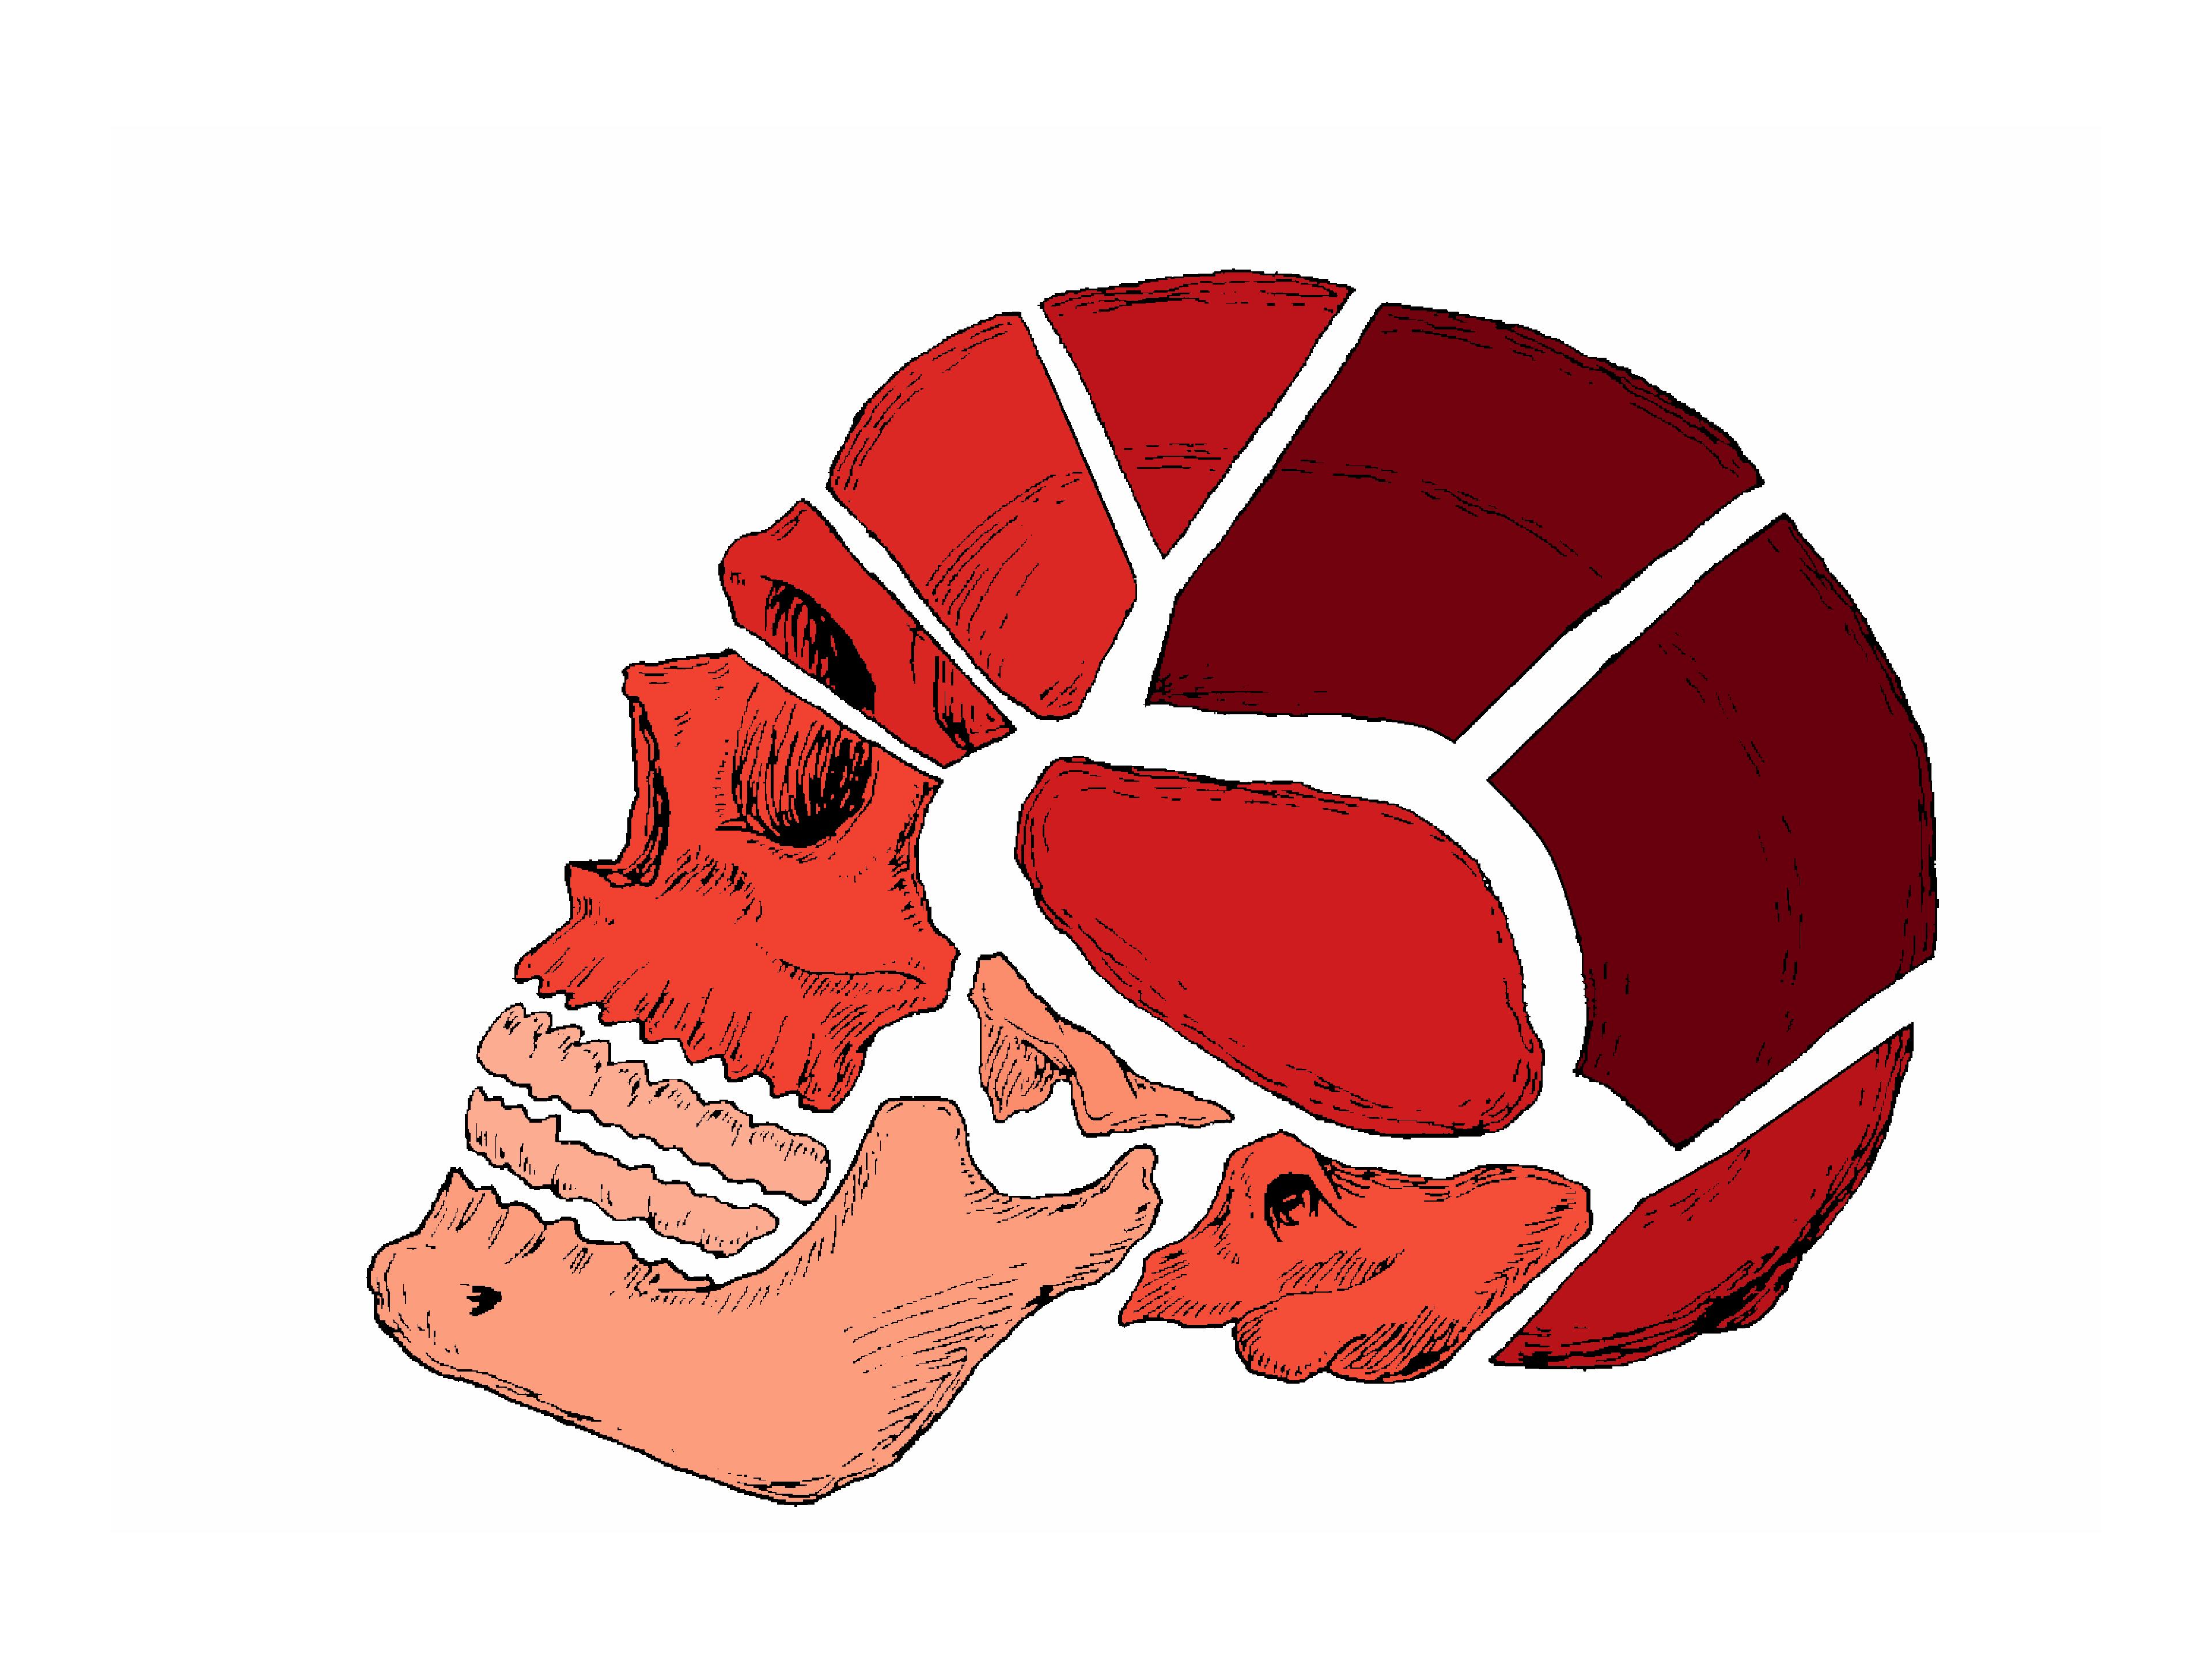
Non-uniform distribution of plutonium in skeleton
Bones differ in plutonium concentration
Bone parts differ in plutonium concentration
How to estimate activity concentration in the skeleton C_{skel} from limited number of samples?

Slide 17
Examples of bone sample collection
Case | Number of bone samples | ²³⁹Pu activity concentration in bone sample (Bq kg^{–1})
 |  | Parietal 1 | Vert T7 arch | Vert T7 body | Clavicle SE | Clavicle shaft | Clavicle AE | Rib 7 | Sternum | Hand and wrist | Femur MS | Femur DE | Patella
0719 | 4 |  |  |  | 14.1±0.9 | 18.9±0.6 | 16.0±0.8 |  |  |  |  |  | 22.4±0.4
0745 | 4 |  |  |  |  |  |  |  |  | 18.3±0.7 | 35.2±1.4 | 23.2±0.8 | 17.5±0.6
0778 | 4 |  |  | 87.5±3.1 |  |  |  | 85.0±2.0 | 34.7±1.1 |  |  |  | 125±4
0060 | 5 | 23.1±1.6 |  | 7.2±0.2 |  |  |  | 8.4±0.2 | 7.0±0.2 |  | 5.2±0.1
0255 | 7 |  |  | 4.4±0.2 | 2.5±0.2 | 1.0±0.2 | 4.6±0.4 | 1.8±0.1 | 2.4±0.1 |  |  |  | 4.3±0.7
0631 | 7 |  | 22.9±1.0 | 12.9±0.5 |  |  |  | 18.9±0.8 | 12.0±0.4 |  | 12.3±0.5 | 10.5±0.4 | 12.2±0.5
0634 | 8 | 30.7±1.1 | 26.9±0.9 | 21.8±0.7 |  |  |  | 13.2±0.5 | 14.4±0.5 |  | 18.0±0.7 | 17.8±0.6 | 23.7±0.8

Slide 18
How to estimate C_{skel}
Arithmetic mean (aka average) of the bone sample concentrations
Mass-weighted average of the bone sample concentrations
Multiple linear regression using whole body data – collinearity problems, sample size, imprecise and unstable estimates
Latent bone modelling (LBM) – principal component regression (Zhou et al. Health Phys. 122(4): S71-S72; 2022; Šefl et al. Radiation Protection Dosimetry. Submitted 2022)

Slide 19
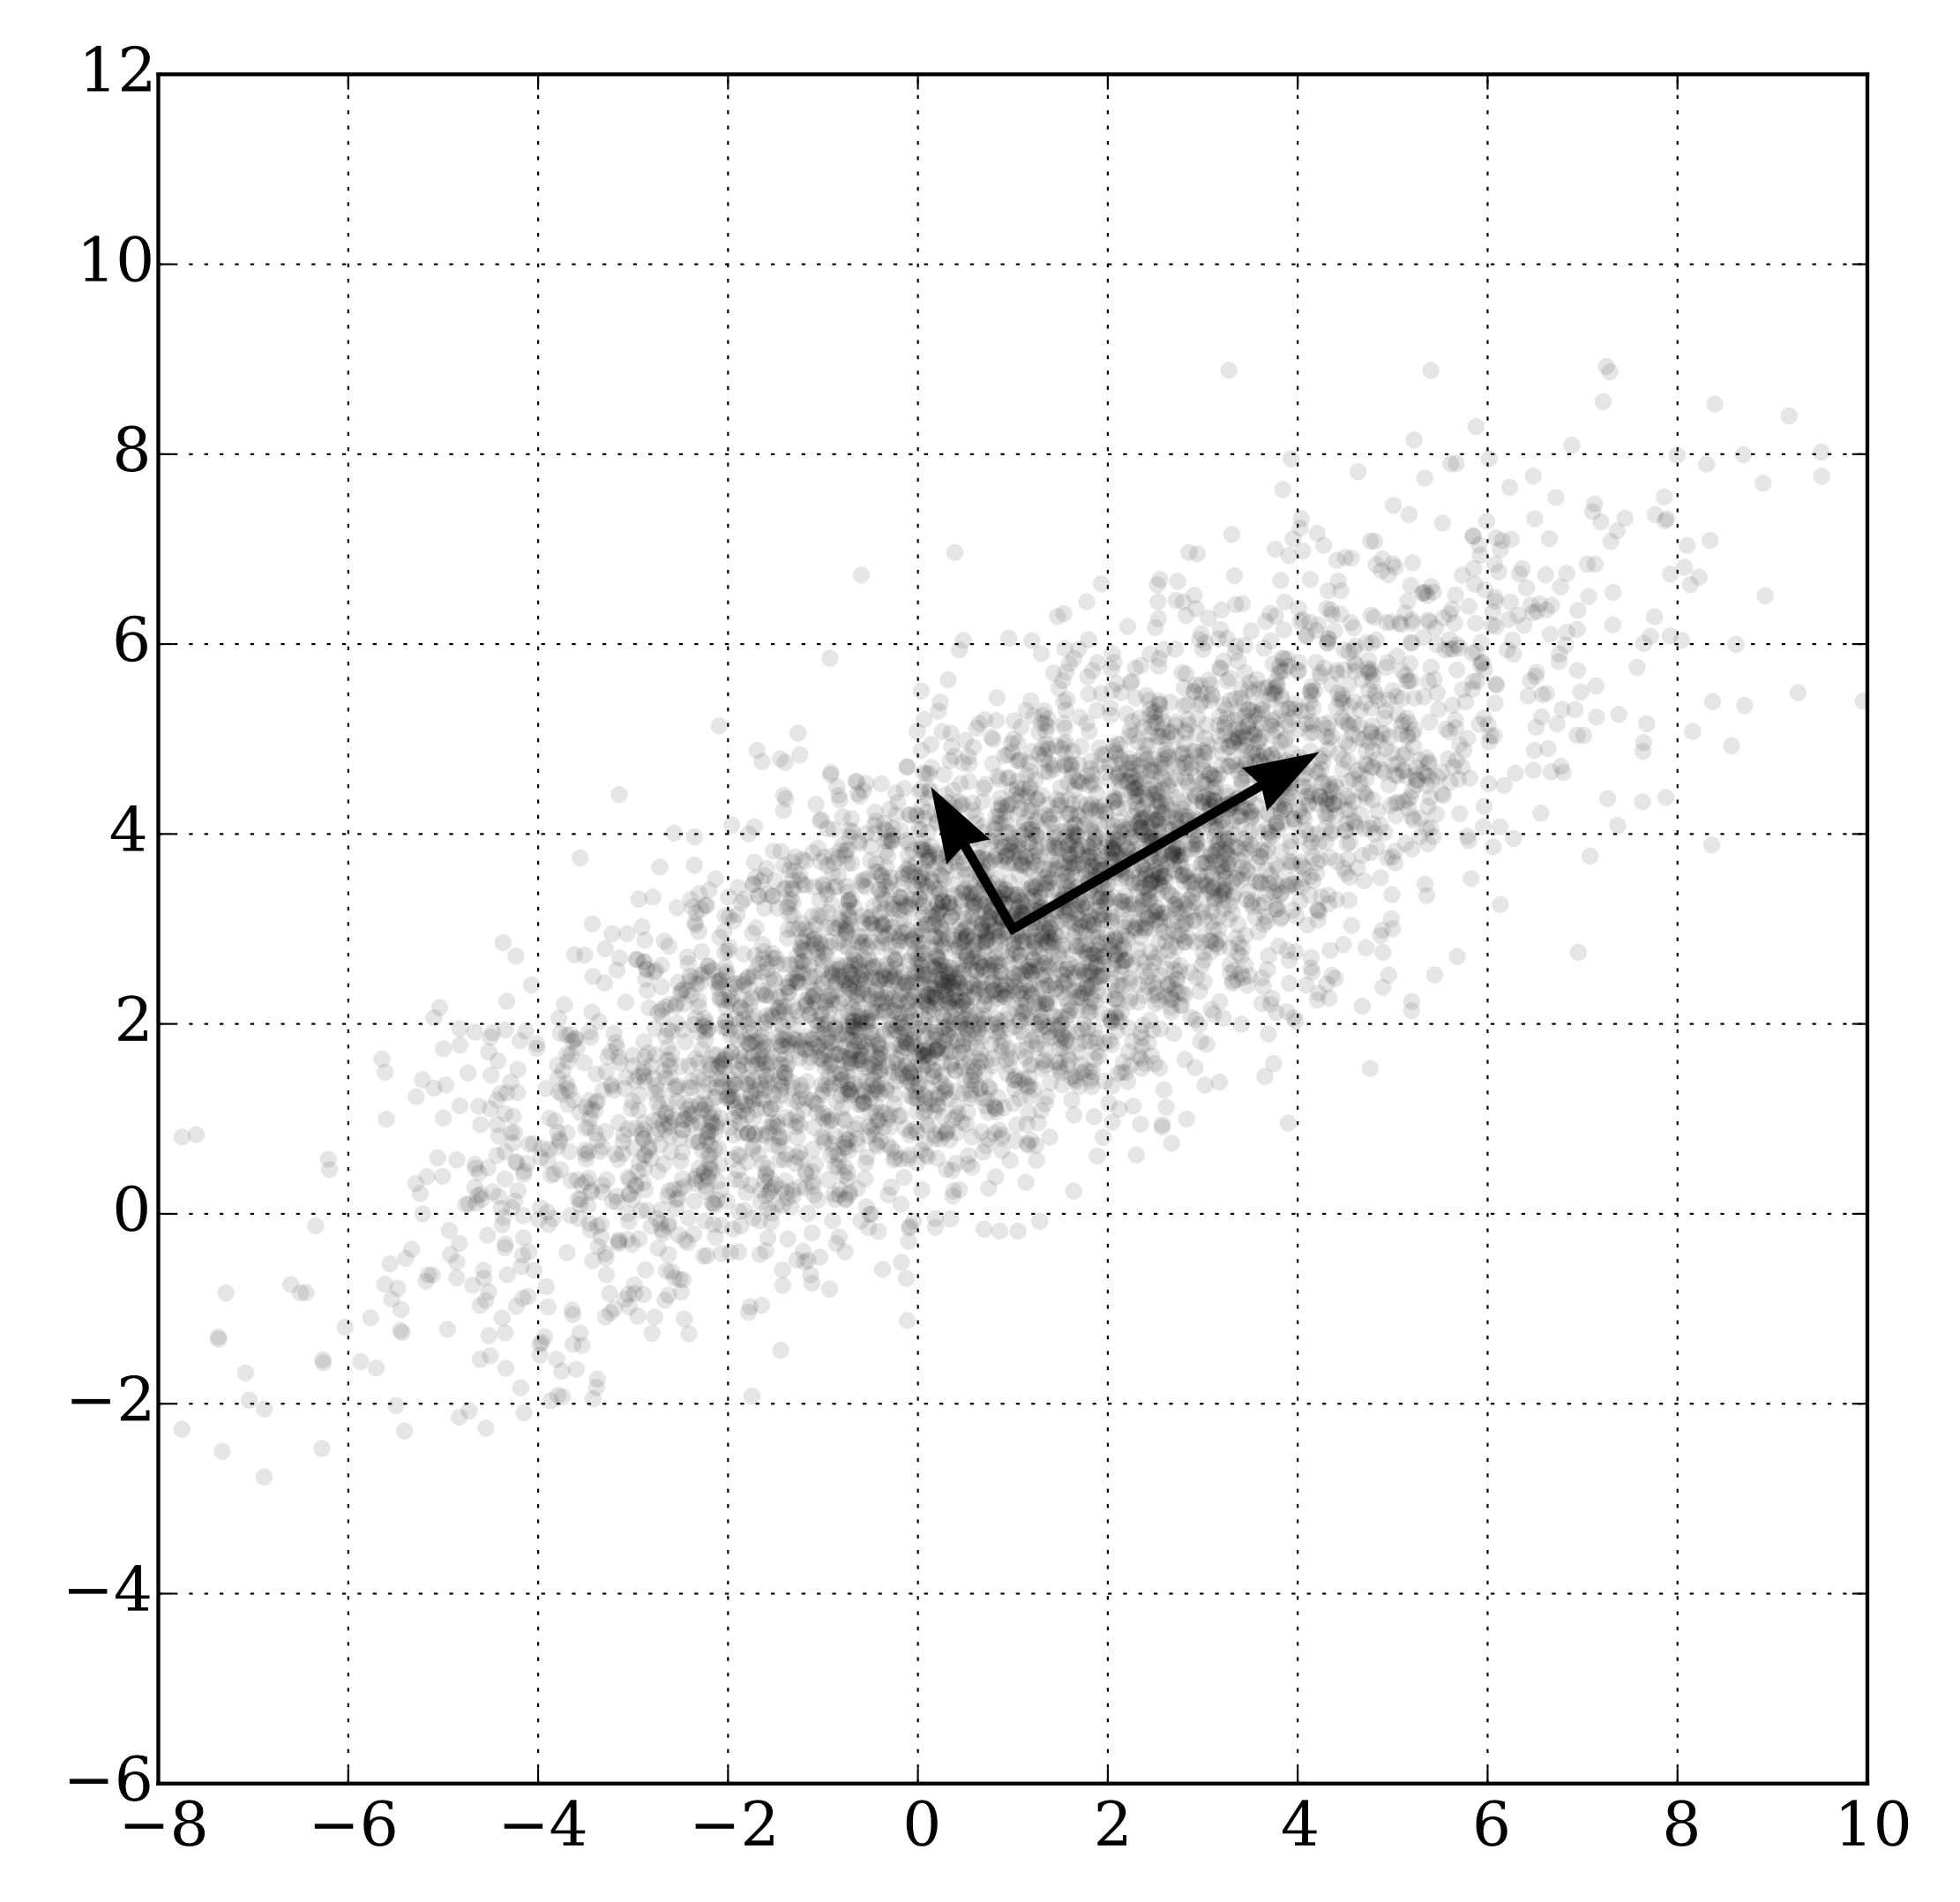
LBM: principal component analysis
Principal components – orthogonal unit vectors (directions)
1st principal component maximises the variance
2nd maximises the variance while being orthogonal to the first, …
Can be used to reduce dimensionality of the data and preserve maximum information
New variables = latent bones are a linear combination of old variables
https://en.wikipedia.org/wiki/Principal_component_analysis#/media/File:GaussianScatterPCA.svg
Notes:
Principal component analysis is used to identify most important features in the data. In this picture you can see two dimensional data. The question is, which direction has the largest variance?
When looking for principal components, we find the direction with the largest variance, that is the first component, then the second is orthogonal to it while maximizing the unexplained variance. And so on.
This can be used to find a new set of variables, and if we omit the remaining components we can reduce dimensionality.
The new variables are called latent variables, hence latent bone modelling.

Slide 20
LBM: principal component regression
Principal component analysis – transform the bone sample concentrations to new latent bone variables
Linear or multiple linear regression on transformed latent variables
For this study LBM=PCR
Implemented in Python 3.9, tested with GraphPad Prism 9
Notes:
The transformed variables, the latent bone variables may be used to perform regression. Therefore, in this latent bone modellling is principal component regression. Latent variable is a broader concept, and principal component analysis is a way to construct these new variables and transform the original data.

Slide 21
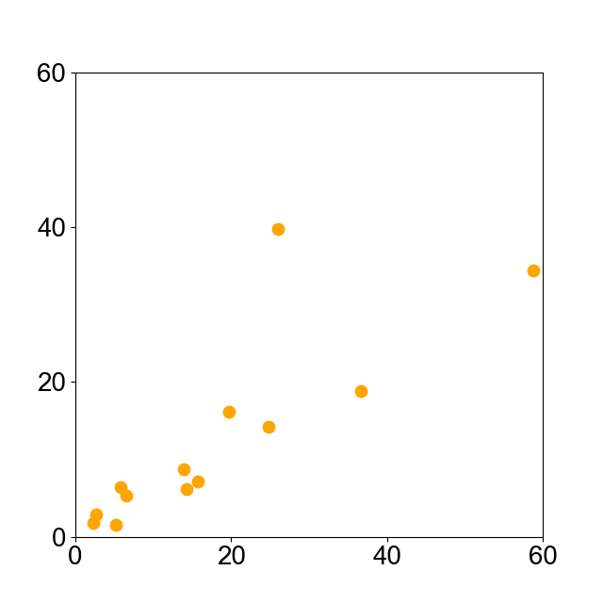
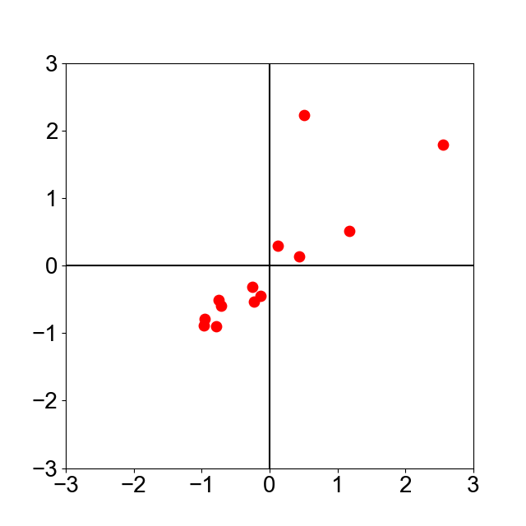

Training data: standardization
$$S_{bone,i}=\frac{C_{bone,i }−{Mean}_{bone}}{{SD}_{bone}}$$
 | C_{bone} (Bq/kg)
Case | Rib 7 | T7 Body | Sternum
1 | 6.5 | 5.3 | 1.1
2 | 13.9 | 8.8 | 2.9
3 | 14.3 | 6.1 | 3.2
4 | 24.8 | 14.3 | 4.7
5 | 58.8 | 34.4 | 7.1
6 | 15.8 | 7.1 | 16.1
7 | 2.6 | 2.9 | 10.5
8 | 2.3 | 1.7 | 5.6
9 | 5.2 | 1.6 | 7.9
10 | 26.0 | 39.8 | 17.1
11 | 36.6 | 18.8 | 31.6
12 | 5.8 | 6.4 | 22.9
13 | 19.7 | 16.1 | 44.8
Mean | 17.87 | 17.41 | 13.51
SD | 16.04 | 15.79 | 12.94
 | S_{bone} (Bq/kg)
Case | Rib 7 | T7 Body | Sternum
1 | -0.97 | -1.00 | -0.96
2 | -0.95 | -0.90 | -0.82
3 | -0.79 | -0.79 | -0.80
4 | -0.71 | -0.79 | -0.68
5 | -0.75 | -0.59 | -0.49
6 | -0.13 | -0.02 | 0.20
7 | -0.23 | -0.22 | -0.23
8 | -0.25 | 0.09 | -0.61
9 | 0.12 | -0.64 | -0.44
10 | 0.43 | 0.19 | 0.28
11 | 1.17 | 1.31 | 1.40
12 | 0.51 | 1.12 | 0.73
13 | 2.55 | 2.26 | 2.42
Mean | 0 | 0 | 0
SD | 1 | 1 | 1

Slide 22
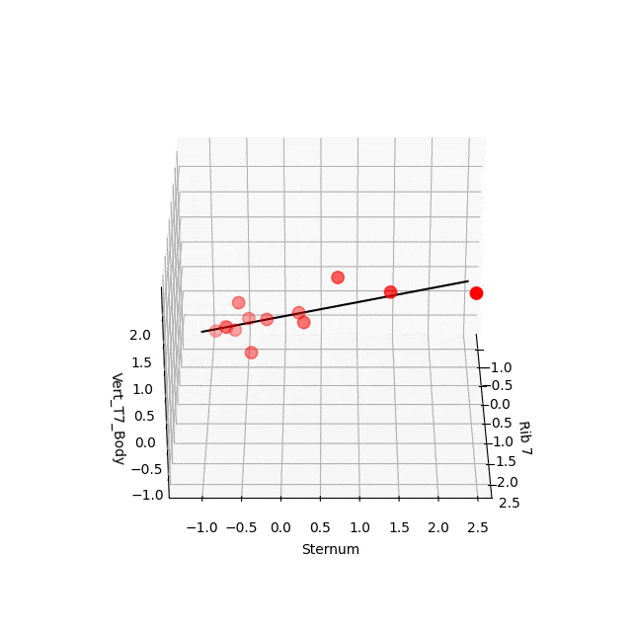
Correlation matrix
Correlation matrix
Find eigenvalues, and eigenvectors
  Eigenvalues: 2.9203, 0.0534, 0.0263
Latent bone variables
  L₁ = –0.576S_{Rib_7} –0.580S_{Sternum}–0.576S_{Vert_T7_Body}
  L₂ = –0.693S_{Rib_7} –0.0272S_{Sternum} –0.720S_{Vert_T7_Body}
  L₃ = –0.434S_{Rib_7} –0.814S_{Sternum} –0.386S_{Vert_T7_Body}
1.000 | 0.947 | 0.968
0.947 | 1.000 | 0.966
0.968 | 0.966 | 1.000

Slide 23
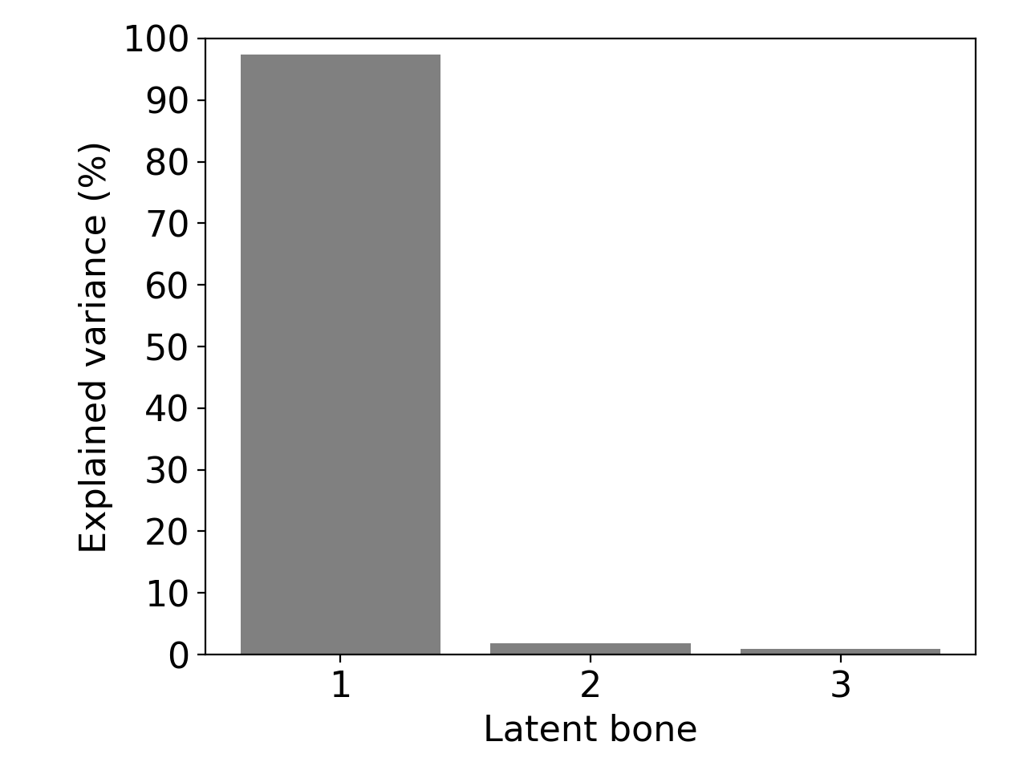
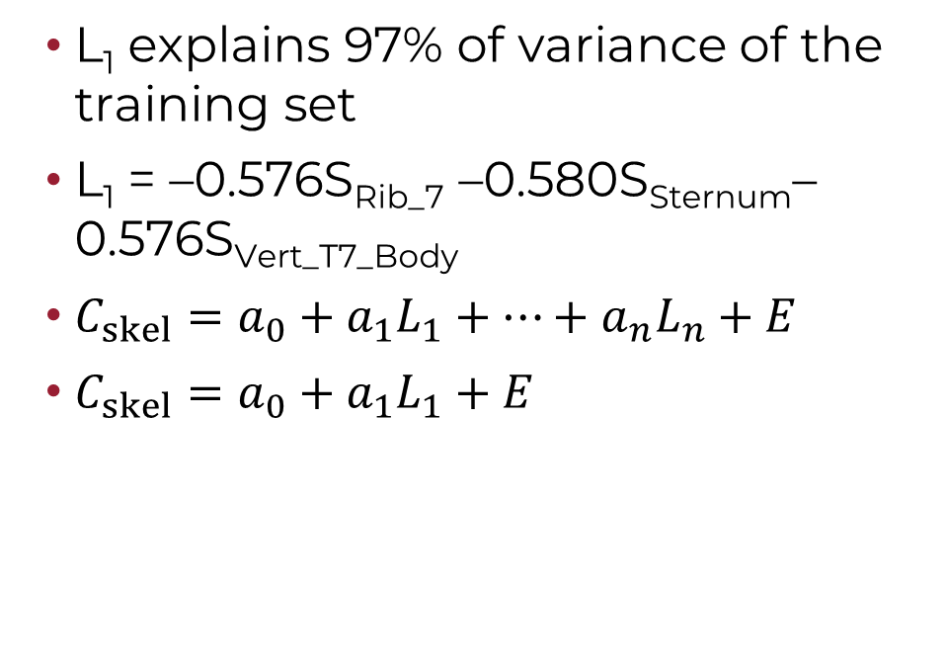
Principal component regression
T7 body, Rib 7, Sternum
L₁ explains 97% of variance of the training set
L₁ = –0.576S_{Rib_7} –0.580S_{Sternum}–0.576S_{Vert_T7_Body}
$C_{skel}=a_{0}+a_{1}L_{1}+⋯+a_{n}L_{n}+E$
$C_{skel}=a_{0}+a_{1}L_{1}+E$
Notes:
I will mainly focus on one dimensional regression, which means using only the L1.

Slide 24
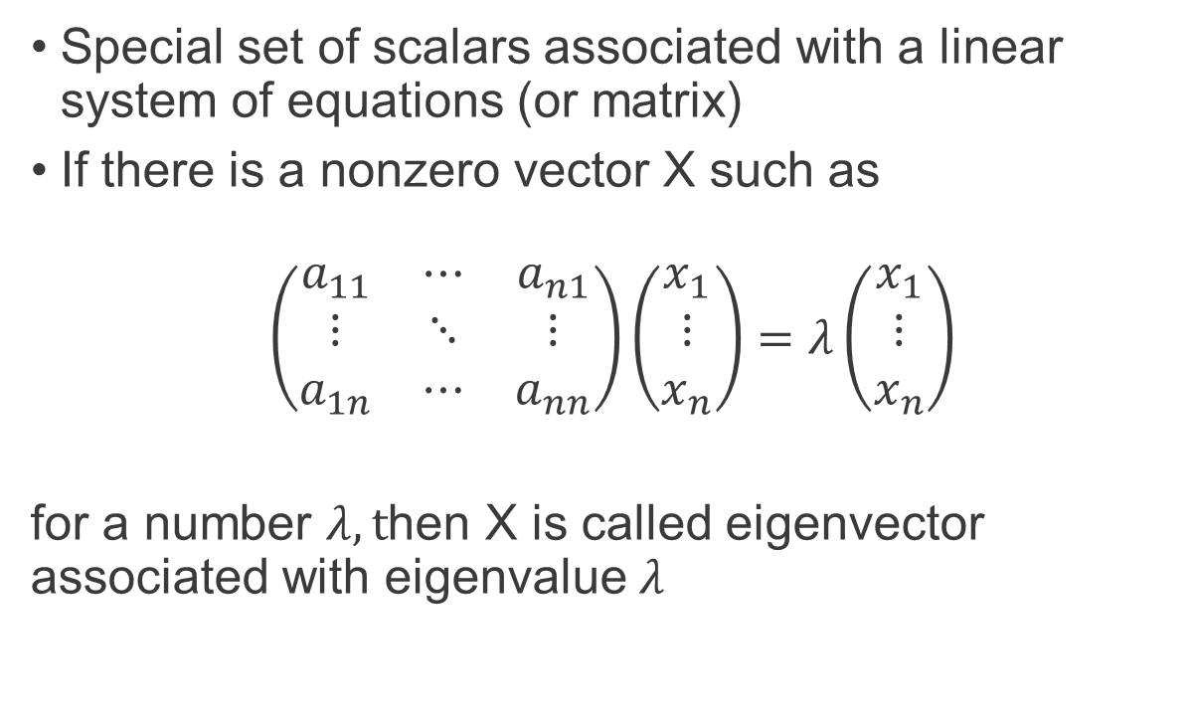
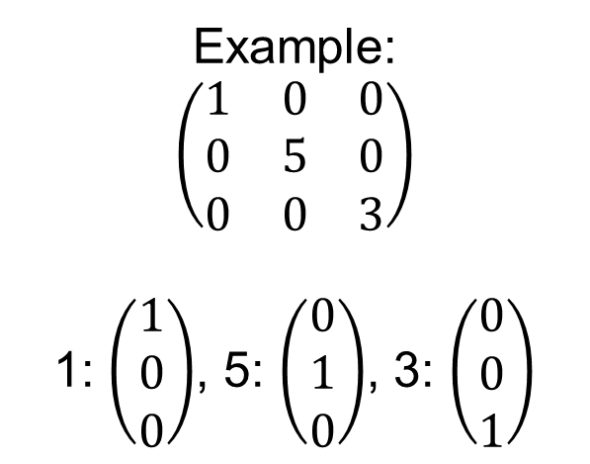
Eigenvalues and eigenvectors
Special set of scalars associated with a linear system of equations (or matrix)
If there is a nonzero vector X such as
$$\left(\begin{matrix}a_{11} & ⋯ & a_{n1} \\ ⋮ & ⋱ & ⋮ \\ a_{1n} & ⋯ & a_{nn}\end{matrix}\right)\left(\begin{matrix}x_{1} \\ ⋮ \\ x_{n}\end{matrix}\right)=λ\left(\begin{matrix}x_{1} \\ ⋮ \\ x_{n}\end{matrix}\right)$$
for a number $λ, t$hen X is called eigenvector associated with eigenvalue $λ$
Example:
$$\left(\begin{matrix}1 & 0 & 0 \\ 0 & 5 & 0 \\ 0 & 0 & 3\end{matrix}\right)$$
1: $\left(\begin{matrix}1 \\ 0 \\ 0\end{matrix}\right)$, 5: $\left(\begin{matrix}0 \\ 1 \\ 0\end{matrix}\right)$, 3: $\left(\begin{matrix}0 \\ 0 \\ 1\end{matrix}\right)$

Slide 25
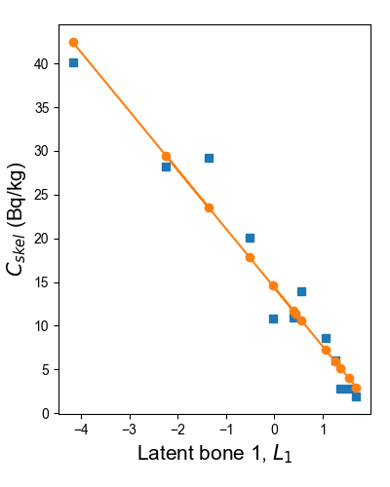

Regression
$$C_{skel}=14.36−6.74×L_{1}$$
L₁ | C_{skel}known | C_{skel}model | Residual
1.70 | 1.92 | 2.95 | -1.02
1.54 | 2.75 | 3.97 | -1.22
1.37 | 2.85 | 5.12 | -2.27
1.26 | 6.03 | 5.88 | 0.15
1.06 | 8.64 | 7.23 | 1.42
-0.03 | 10.79 | 14.56 | -3.77
0.39 | 10.93 | 11.72 | -0.78
0.44 | 11.16 | 11.38 | -0.23
0.56 | 13.98 | 10.62 | 3.36
-0.52 | 20.09 | 17.88 | 2.21
-2.24 | 28.18 | 29.44 | -1.26
-1.36 | 29.23 | 23.52 | 5.71
-4.17 | 40.17 | 42.46 | -2.29

Slide 26
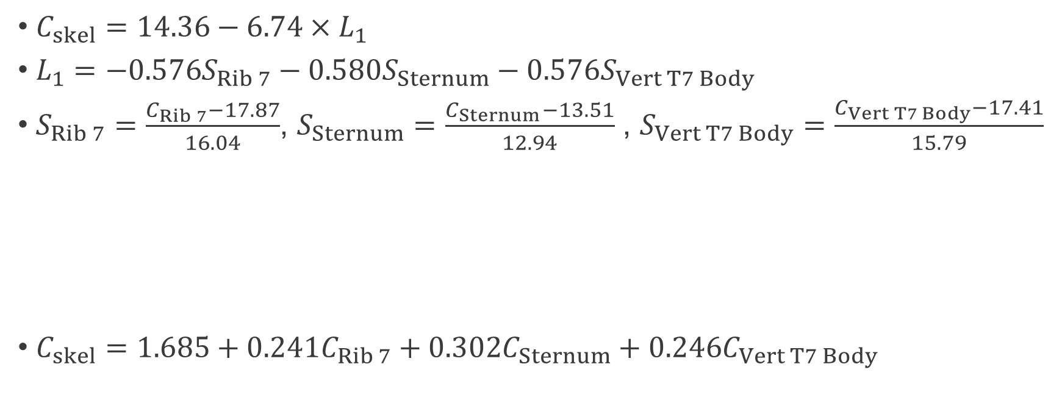
Back to original variables
$C_{skel}=14.36−6.74×L_{1}$
$L_{1}=−0.576S_{Rib 7}−0.580S_{Sternum}−0.576S_{Vert T7 Body}$
$S_{Rib 7}=\frac{C_{Rib 7}−17.87}{16.04}$, $S_{Sternum}=\frac{C_{Sternum}−13.51}{12.94}$ , $S_{Vert T7 Body}=\frac{C_{Vert T7 Body}−17.41}{15.79}$
$C_{skel}=1.685+0.241C_{Rib 7}+0.3{02C}_{Sternum}+0.246C_{Vert T7 Body}$

Slide 27
Leave-one-out cross validation
Predict case 1 using cases 2–13
Predict case 2 using cases 1, 3–13
 | C_{bone} (Bq/kg)
Case | Rib 7 | T7 Body | Sternum
1 | 6.5 | 5.3 | 1.1
2 | 13.9 | 8.8 | 2.9
3 | 14.3 | 6.1 | 3.2
4 | 24.8 | 14.3 | 4.7
5 | 58.8 | 34.4 | 7.1
6 | 15.8 | 7.1 | 16.1
7 | 2.6 | 2.9 | 10.5
8 | 2.3 | 1.7 | 5.6
9 | 5.2 | 1.6 | 7.9
10 | 26.0 | 39.8 | 17.1
11 | 36.6 | 18.8 | 31.6
12 | 5.8 | 6.4 | 22.9
13 | 19.7 | 16.1 | 44.8
 | C_{bone} (Bq/kg)
Case | Rib 7 | T7 Body | Sternum
1 | 6.5 | 5.3 | 1.1
2 | 13.9 | 8.8 | 2.9
3 | 14.3 | 6.1 | 3.2
4 | 24.8 | 14.3 | 4.7
5 | 58.8 | 34.4 | 7.1
6 | 15.8 | 7.1 | 16.1
7 | 2.6 | 2.9 | 10.5
8 | 2.3 | 1.7 | 5.6
9 | 5.2 | 1.6 | 7.9
10 | 26.0 | 39.8 | 17.1
11 | 36.6 | 18.8 | 31.6
12 | 5.8 | 6.4 | 22.9
13 | 19.7 | 16.1 | 44.8

Slide 28
Leave-one-out cross validation: Example
Box-plots arithmetic mean vs LBM
On average similar median estimates, except for two sets: b(21%) and d(10%)
Mean accuracy depends on bone samples – no guarantee
One latent variable is enough
Individual variability is high

Slide 29
Examples of bone sample collection
Case | Number of bone samples | ²³⁹Pu activity concentration in bone sample (Bq kg^{–1})
 |  | Parietal 1 | Vert T7 arch | Vert T7 body | Clavicle SE | Clavicle shaft | Clavicle AE | Rib 7 | Sternum | Hand and wrist | Femur MS | Femur DE | Patella
0719 | 4 |  |  |  | 14.1±0.9 | 18.9±0.6 | 16.0±0.8 |  |  |  |  |  | 22.4±0.4
0745 | 4 |  |  |  |  |  |  |  |  | 18.3±0.7 | 35.2±1.4 | 23.2±0.8 | 17.5±0.6
0778 | 4 |  |  | 87.5±3.1 |  |  |  | 85.0±2.0 | 34.7±1.1 |  |  |  | 125±4
0060 | 5 | 23.1±1.6 |  | 7.2±0.2 |  |  |  | 8.4±0.2 | 7.0±0.2 |  | 5.2±0.1
0255 | 7 |  |  | 4.4±0.2 | 2.5±0.2 | 1.0±0.2 | 4.6±0.4 | 1.8±0.1 | 2.4±0.1 |  |  |  | 4.3±0.7
0631 | 7 |  | 22.9±1.0 | 12.9±0.5 |  |  |  | 18.9±0.8 | 12.0±0.4 |  | 12.3±0.5 | 10.5±0.4 | 12.2±0.5
0634 | 8 | 30.7±1.1 | 26.9±0.9 | 21.8±0.7 |  |  |  | 13.2±0.5 | 14.4±0.5 |  | 18.0±0.7 | 17.8±0.6 | 23.7±0.8

Slide 30
Seven-case comparison: Estimated C_{skel}
Case | C_{skel} (Bq kg⁻¹) |  | LBM vs Mean (%)
Case | Mean | LBM | LBM1 vs Mean (%)
0719 | 17.9±1.8 | 18.4±0.4 | -3
0745 | 23.6±4.1 | 29.0±1.3 | -19
0778 | 83.2±18.6 | 72.9±2.3 | 14
0060 | 10.2±3.3 | 8.6±0.4 | 19
0255 | 3.0±0.5 | 3.4±0.5 | -12
0631 | 14.5±1.7 | 14.0±0.3 | 4
0634 | 20.8±2.2 | 19.9±0.3 | 5
Each case is a separate latent bone model (different bone samples available)
Mean and LBM within 20%
LBM has better precision

Slide 31
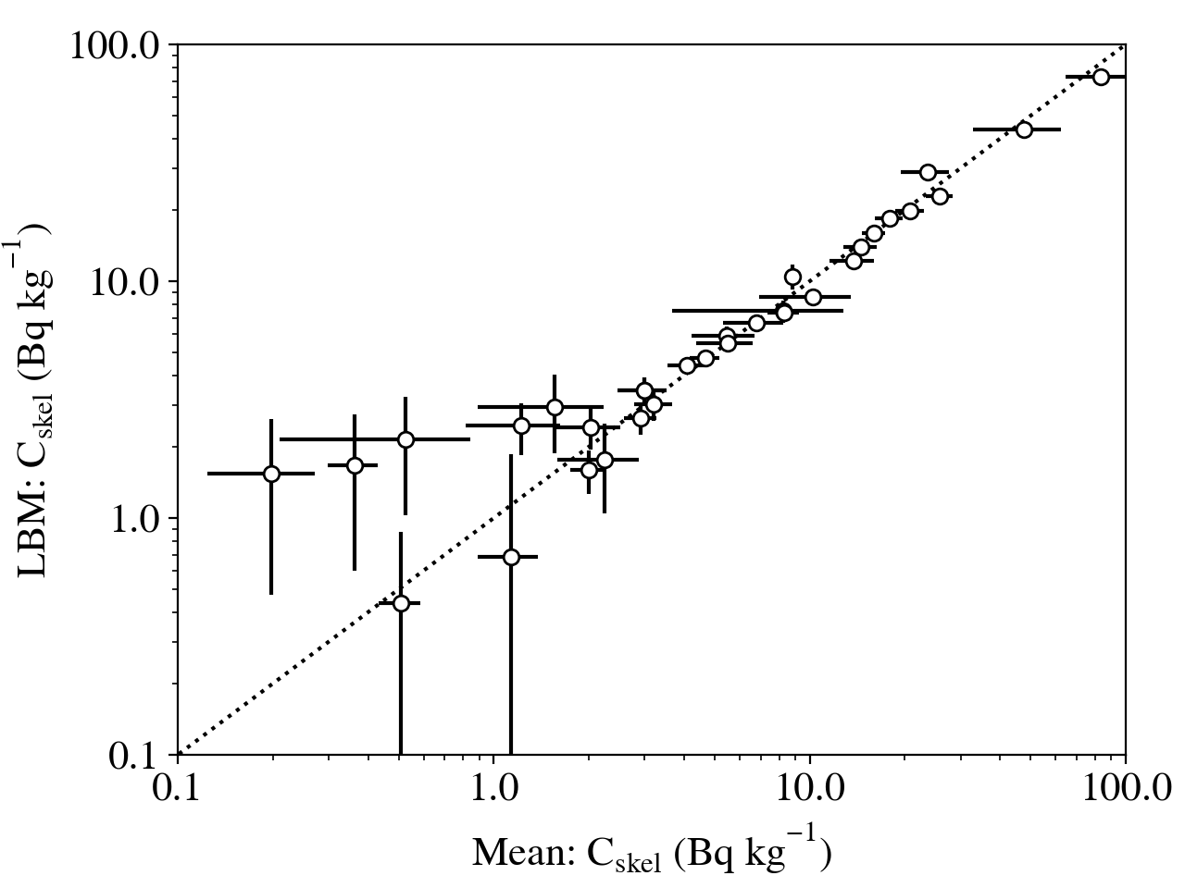
More cases
32 cases with different sets of bones: 2–8 samples
Standard error for LBM is lower

Slide 32
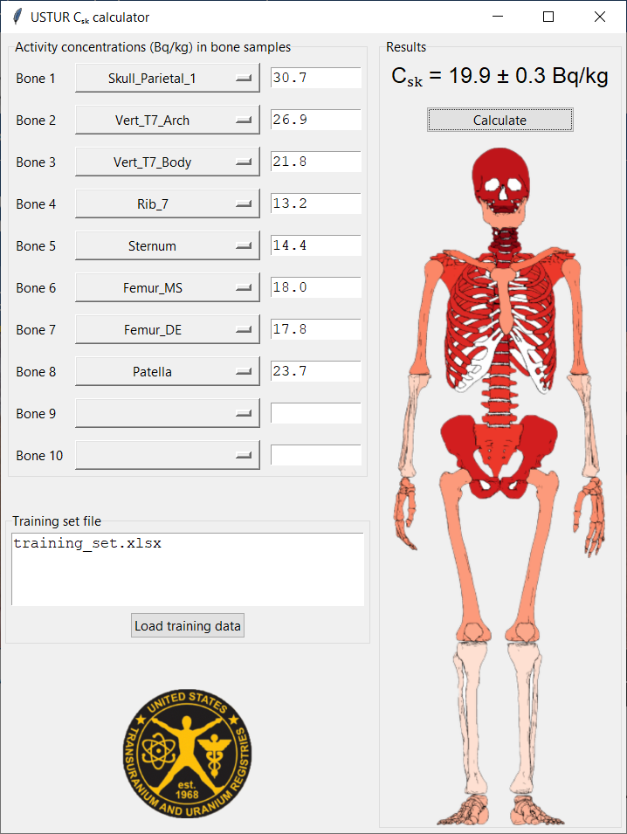
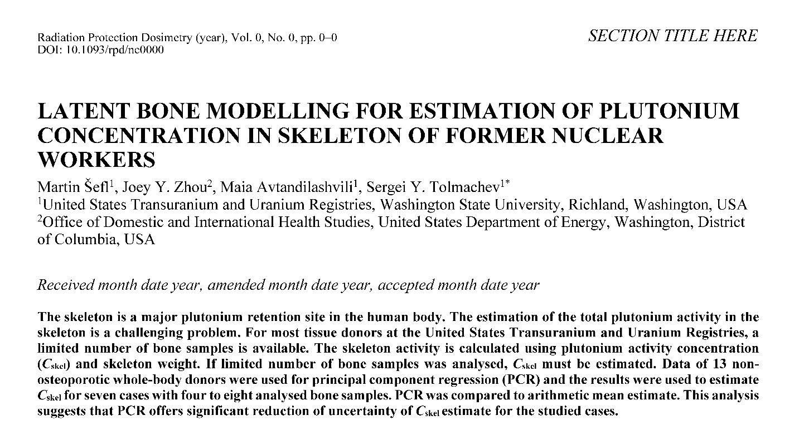
Implementation of LBM
Development of C_{skel} calculator

Slide 33
Conclusions
Latent bone modeling method for C_{skel} estimate was demonstrated and compared to arithmetic mean estimates
LBM/PCR offers similar central estimates of C_{skel}
LBM/PCR is a preferred method
  lower risk of bias for non-representative bone sampling
  utilizes all available information
  reduction of uncertainty by a factor of 4.7 (for 7 studied cases)

Slide 34
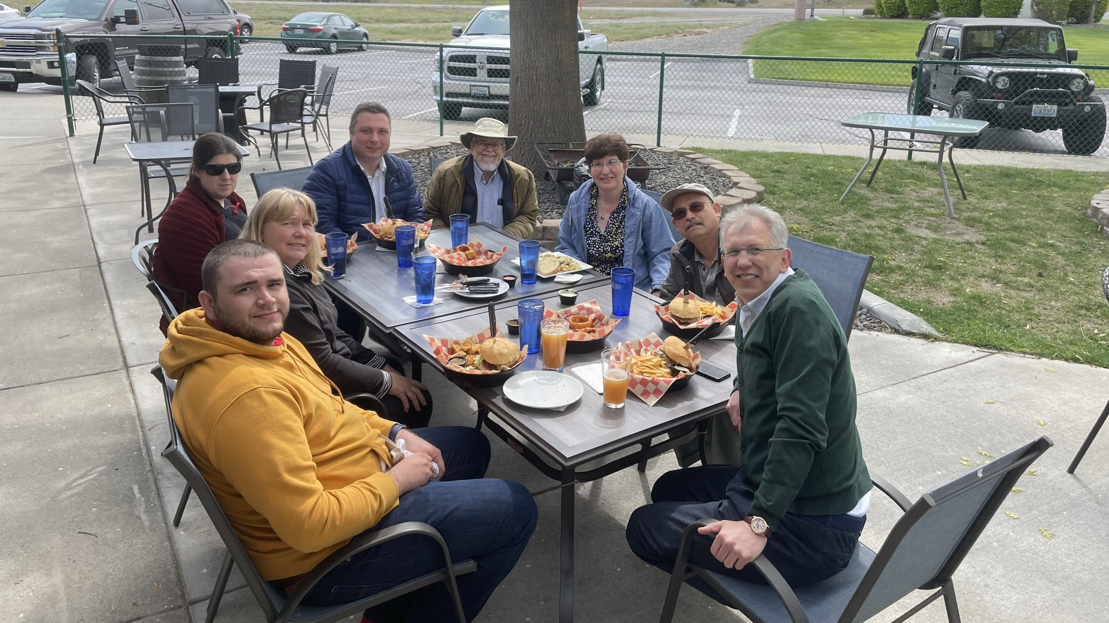

Thank you for your attention

