Slide 1


Spokane, August 13, 2021
53-year Follow-up of a Manhattan Project Worker
  Martin Šefl, Maia Avtandilashvili, Sergei Y. Tolmachev
  United States Transuranium and Uranium Registries,
  College of Pharmacy and Pharmaceutical Sciences,
  Washington State University, Richland, Washington
USTUR-0591-21A

Slide 2


United States Transuranium and Uranium Registries
The USTUR’s mission is to:
Follow up occupationally-exposed individuals (volunteer Registrants) by studying the biokinetics (deposition, translocation, retention, and excretion) and tissue dosimetry of uranium and transuranium elements, such as plutonium, americium, curium, and neptunium.
Obtain, analyze, preserve, and make available for future research, materials from individuals who had documented intakes of uranium and transuranium elements.
Apply USTUR data to refine dose assessment methods in support of reliable epidemiological studies, radiation risk assessment, and regulatory standards for radiological protection of workers and general public.

Slide 3
Unique Data Resource
Registrant acceptance: ≥ 74 Bq systemic content
Becquerel (Bq) is a unit of radioactivity
1 Bq = 1 decay per second
USTUR data
Work history
Medical records
Bioassay measurements
Tissue analysis results (Pu, Am, U)
Radiation exposure records
Chemical exposure records†
Smoking history†
† - self-reported data
Notes:
At USTUR we have a collection of unique resources starting from work history, medical records, smoking history, …

Slide 4
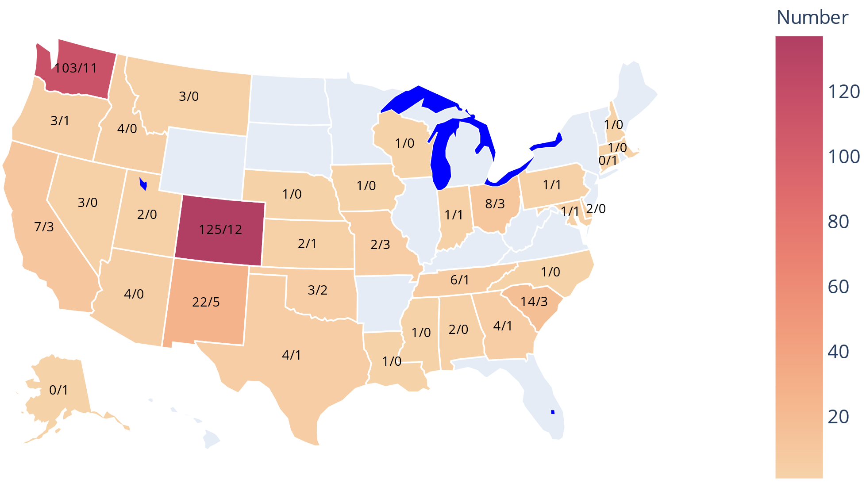
USTUR Registrants
Partial-body: 334 (19 living)
Whole-body: 52 (5 living)
PB/WB
Notes:
Bioassay data are part of the monitoring program

Slide 5
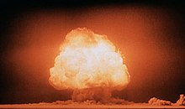
Plutonium
Plutonium is an artificial element discovered on December 14, 1940
Isotopes range from ²²⁸Pu to ²⁴⁷Pu
Registrants were exposed to ²³⁹Pu (half-life 24,100 y), and ²³⁸Pu (half-life 87.74 y)
²³⁹Pu:
  fissile, can sustain nuclear fission – nuclear weapons
  produced in a nuclear reactor
  Manhattan Project – first weapon
en.wikipedia.org/wiki/Nuclear_weapon#/media/File:Trinity_Detonation_T&B.jpg

Slide 6
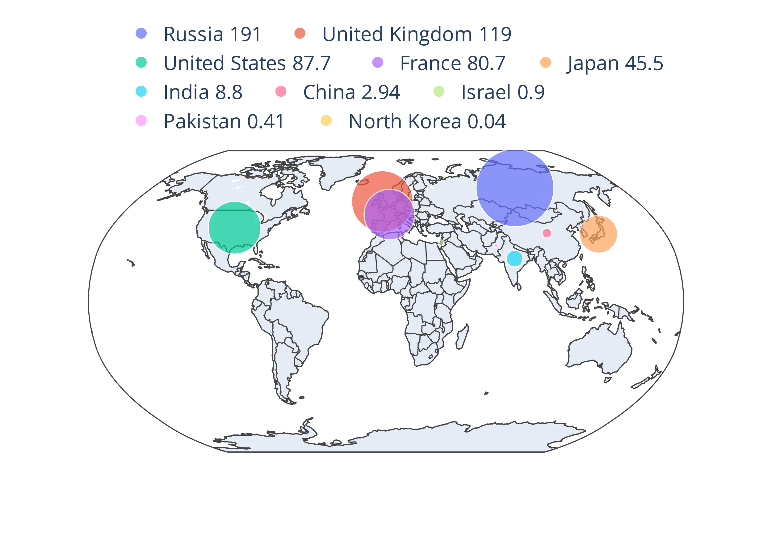
Plutonium in the World
As of beginning of 2020 global stockpile of separated plutonium was about 540 tons (metric)
316 tons considered civilian plutonium
France, Russia, UK, Japan, India, China operate reprocessing facilities separating plutonium from spent power reactor fuel
Data source http://fissilematerials.org/

Slide 7
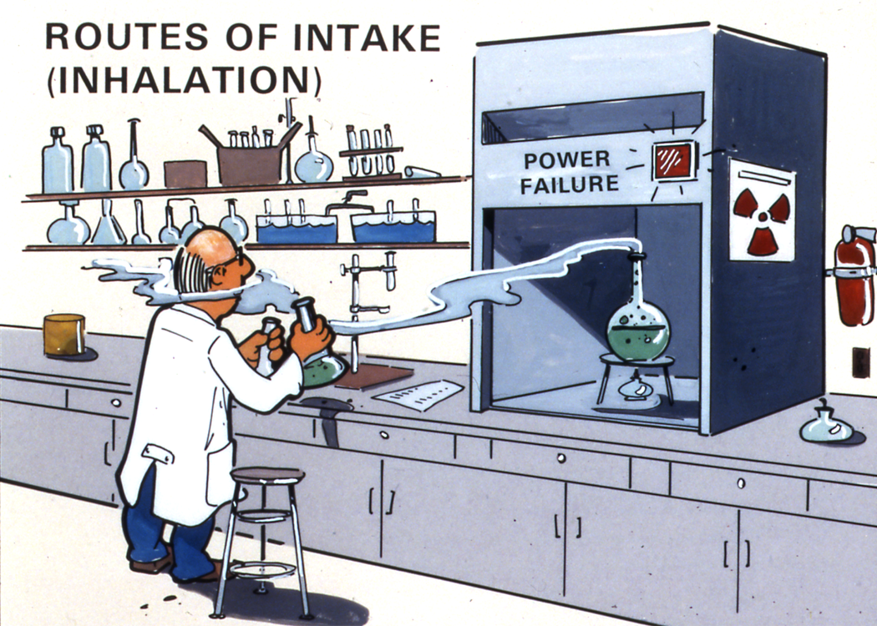
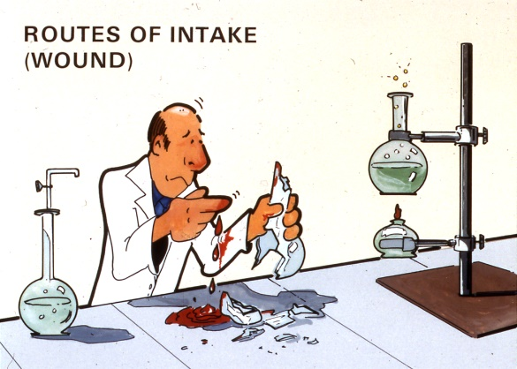
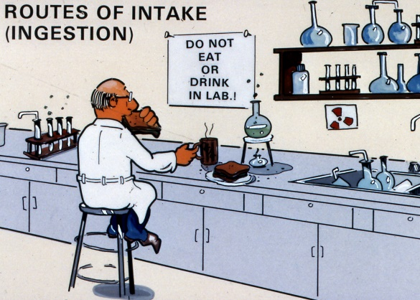
Routes of intake

Slide 8
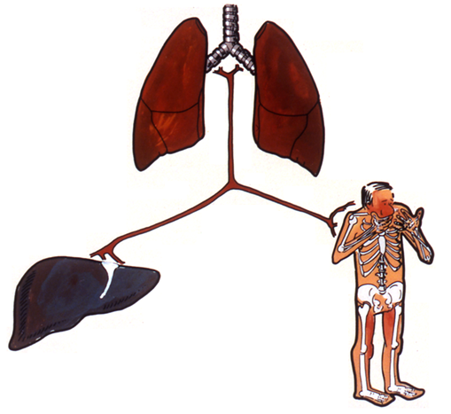
Plutonium in Human Body
Plutonium is a bone and liver seeker
Lungs
Blood stream (systemic)
Liver
Skeleton
Simplified pathways for plutonium

Slide 9
USTUR Case 0680
One of 26 Manhattan Project plutonium workers selected for medical follow-up “on the basis of the amount of plutonium excreted in the urine assayed by methods available before 1950.”
Worked as a chemist on plutonium recovery for 18 months in 1940s
Died 53 years after exposure at age 90+
Whole-body tissue donor to the USTUR
Voelz GL, Hempelmann LH, Lawrence JNP, Moss WD. A 32-year medical follow-up Manhattan Project plutonium workers. Health Phys 37(4): 445–485; 1979.
Notes:
Bioassay data are part of the monitoring program

Slide 10
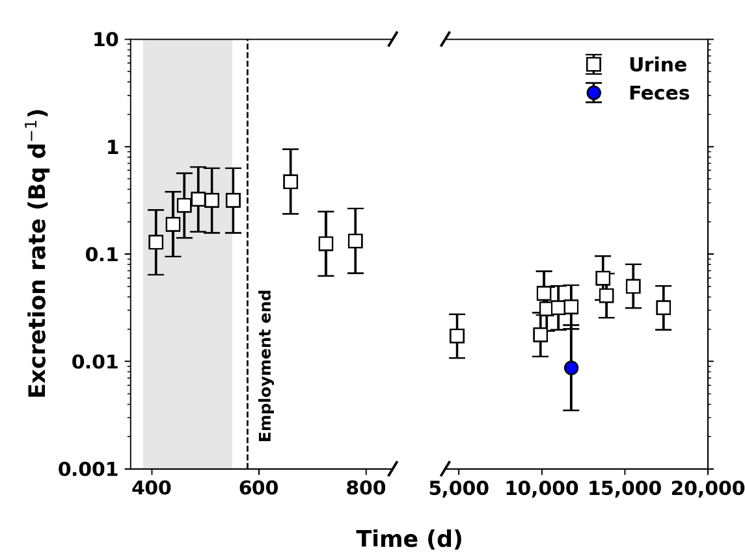
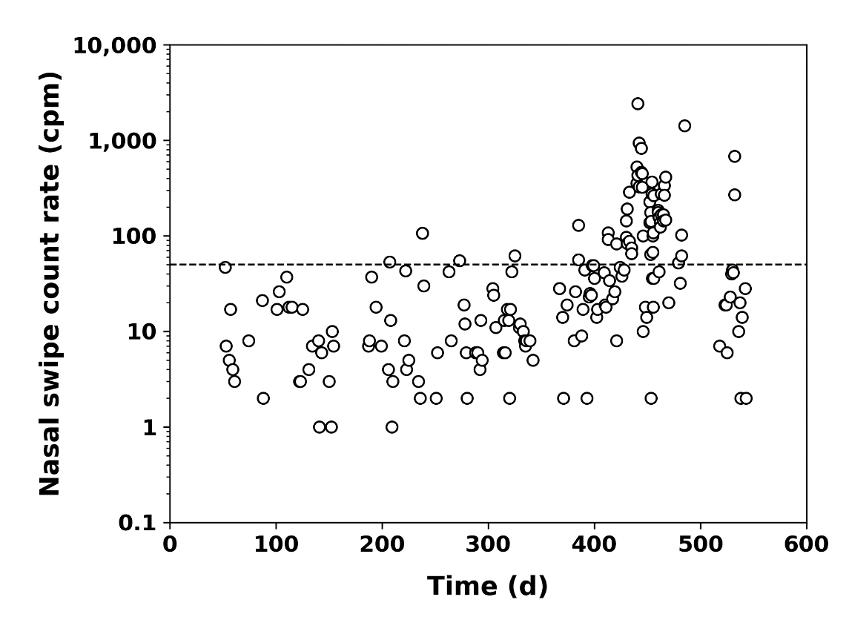
Data: Bioassay Measurements
19 urine samples
1 fecal sample
1 blood sample
212 nasal swipes
14 chest counts < MDA
Notes:
Bioassay data are part of the monitoring program

Slide 11
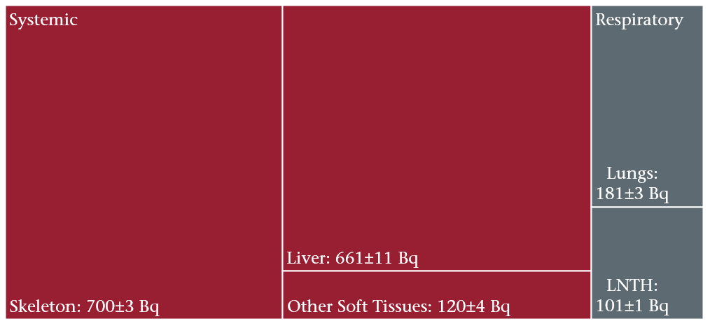
Data: Post-mortem Tissue Analyses
Tissues analyzed: 82 bone samples and 13 soft tissues
Total body: 1,765±12 Bq
Notes:
Bioassay data are part of the monitoring program

Slide 12
Biokinetic Modeling: Compartmental Model
k₇
Used for modeling distribution of Pu in human body
Set of ordinary differential equations with constant coefficients
Solvable analytically or numerically
k₁
I₀
Q₁
Q₂
k₂
k₃
k₆
Q₃
Q₄
k₅
k₄
dQ₁/dt = I₀ – (k₂+k₃+k₇)Q₁ + k₁Q₂
dQ₂/dt = k₂Q₁ – k₁Q₂ + k₆Q₄
dQ₃/dt = k₃Q₁ – k₄Q₃
dQ₄/dt = k₄Q₃ – (k₅+k₆)Q₄
Notes:
Bioassay data are part of the monitoring program

Slide 13
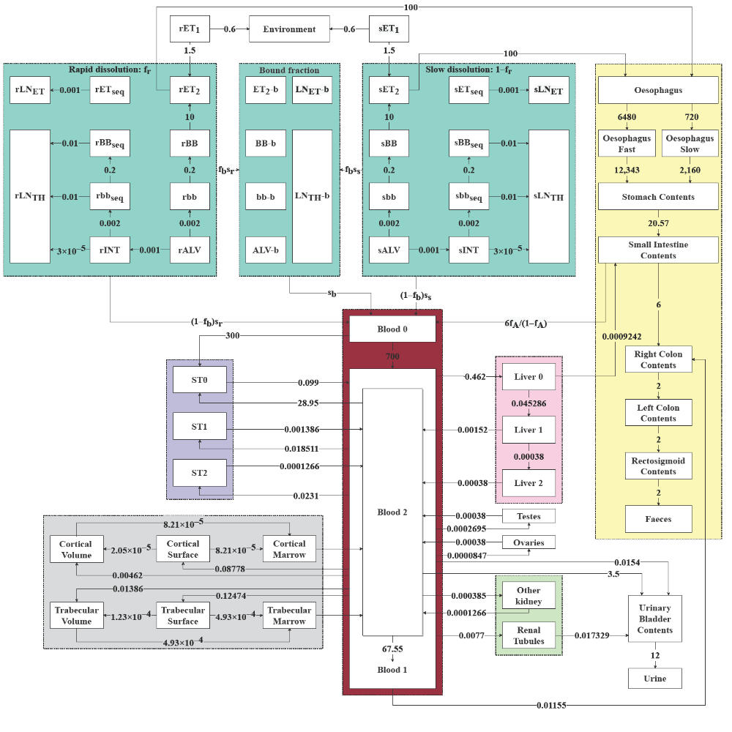
Intake Scenario
Chronic inhalation
  Pu-nitrate
  PuO₂
ICRP models
  130 Human Respiratory Tract
  100 Human Alimentary Tract
  141 Plutonium Systemic
Notes:
Bioassay data are part of the monitoring program

Slide 14
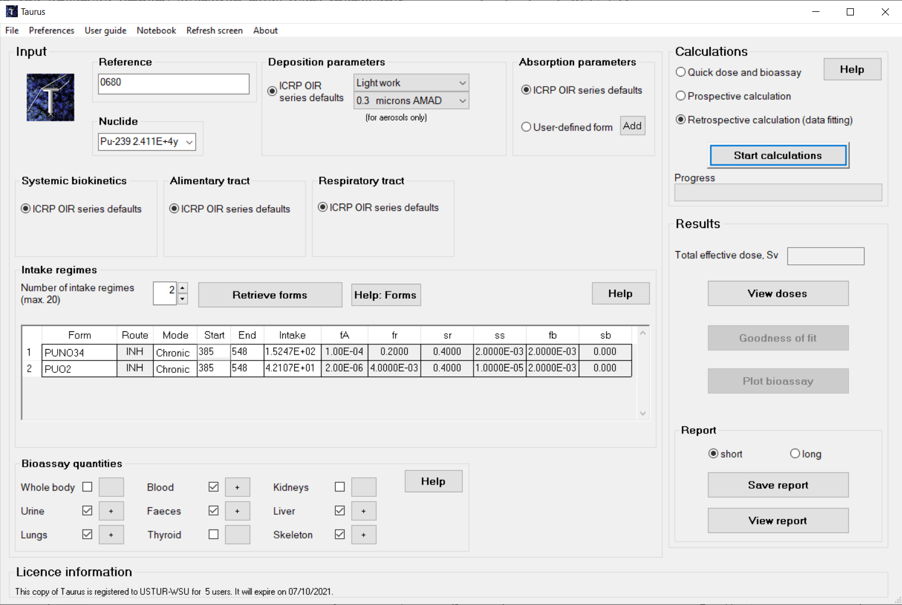
Taurus Internal Dosimetry Software
Public Health England, UK
Notes:
Bioassay data are part of the monitoring program

Slide 15
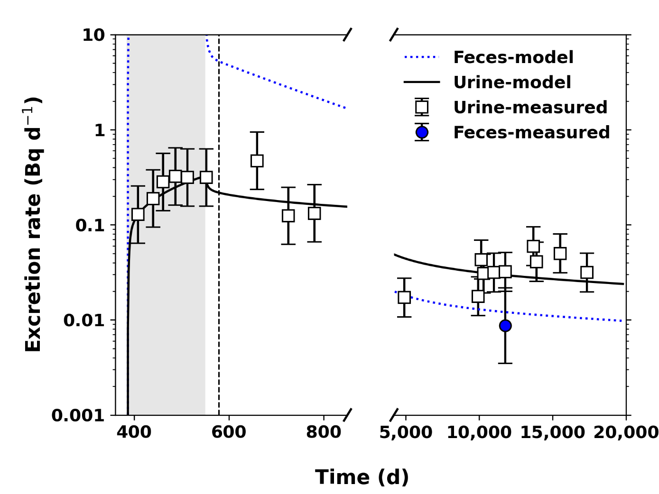
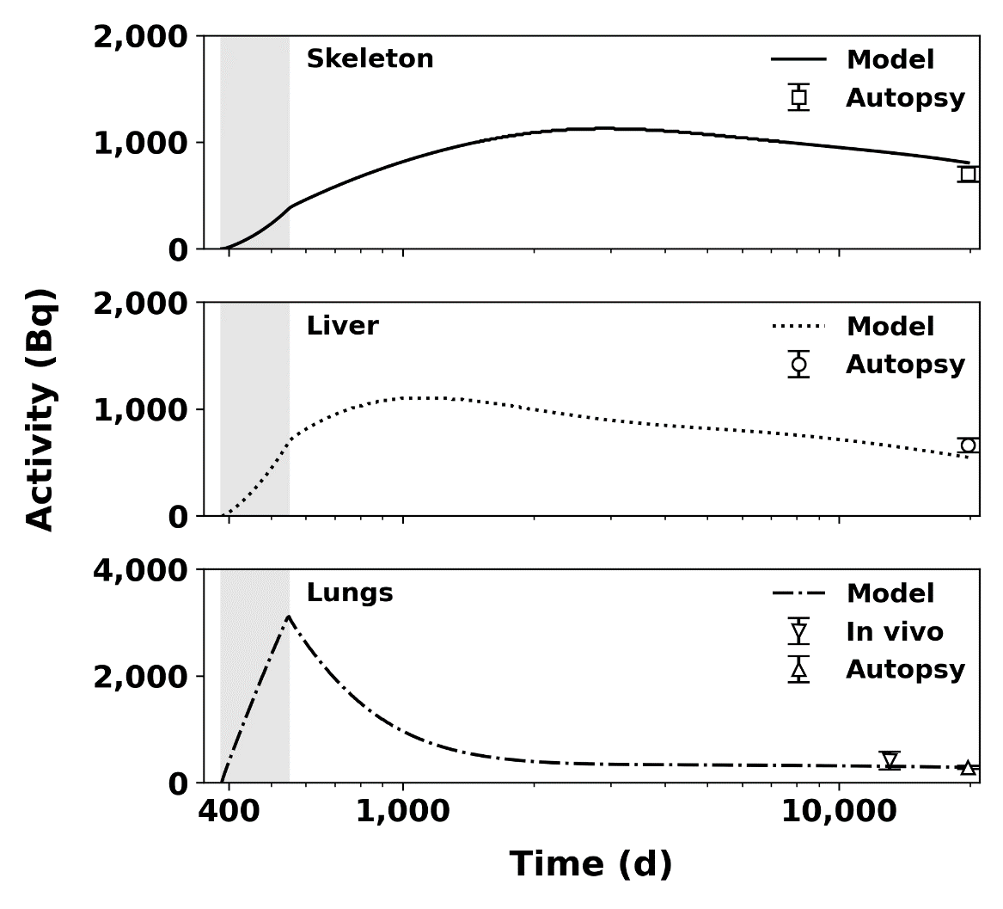
Results: Estimated Intake
Days | Material | Intake |  | Goodness of fit χ² p-value
 |  | Rate (Bq d ^{–1}) | Cumulative (Bq) | p (>0.05)
385 – 548 | Pu-nitrate | 152.5 | 25,570 | 0.808
 | PuO₂ | 42.1 | 9,485
Notes:
Bioassay data are part of the monitoring program

Slide 16
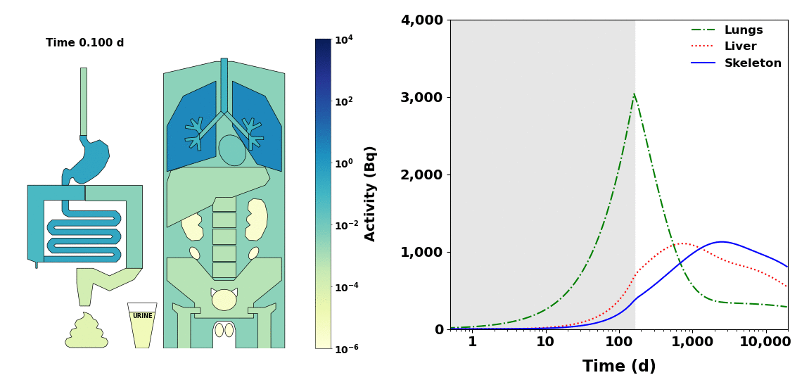
Results: Plutonium Organ Distribution over Time
Notes:
Bioassay data are part of the monitoring program

Slide 17
Effective dose
Radiation protection quantity
Used to compare the stochastic risk of exposure to radiation
Depends on:
  energy deposited
  type of radiation
  radiosensitivity of irradiated tissues
Unit: Sievert (Sv)
ICRP annual effective dose limit for general public: 1 mSv

Slide 18
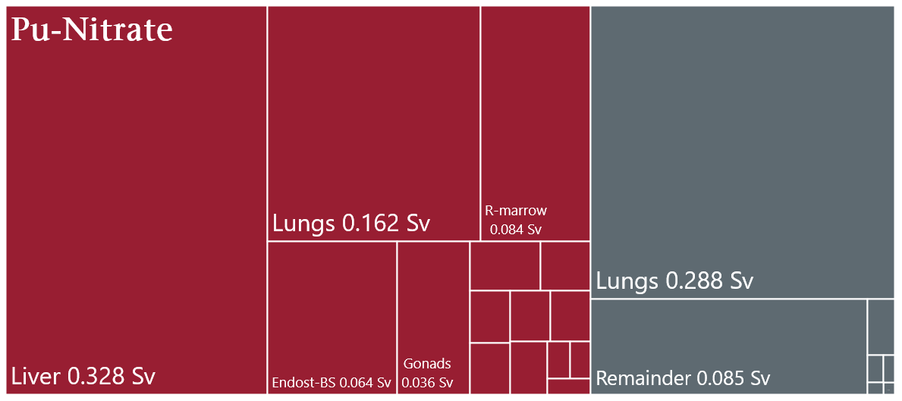
Results: Organ Contributions to Effective Dose
Committed effective dose: 1.22 Sv
PuO₂
Notes:
Bioassay data are part of the monitoring program

Slide 19
Summary
ICRP reference biokinetic models adequately described the long-term plutonium retention and excretion for this individual
Chronic inhalation of 78% Pu-Nitrate and 22% PuO₂
53 years post intake total body activity: 1,765 Bq
Total body distribution: systemic organs 84%, respiratory tract 16%
Systemic distribution: skeleton 47%, liver 45%, other 8%
Šefl, M, Avtandilashvili, M, Tolmachev, SY. Inhalation of Soluble Plutonium: 53-year Follow-up of Manhattan Project Worker, Health Physics 2021:120(6); 661-670.
Notes:
Bioassay data are part of the monitoring program

Slide 20
Acknowledgements
Internal Dosimetry Group, Public Health England, UK
Anthony Riddell, Demetrio Gregoratto, Public Health England, UK
The USTUR is funded by US DOE, Office of Domestic and International Health Studies (AU-13), under grant award DE-HS0000073 to
College of Pharmacy and Pharmaceutical Sciences at Washington State University
Thank you!
martin.sefl@wsu.edu

