Slide 1



66th Annual Meeting of the Health Physics Society
Phoenix, Arizona, July 25–29, 2021
USTUR Whole-body Case 0680: 53-year Follow-up
of a Manhattan Project Worker
  Martin Šefl, Maia Avtandilashvili, Sergei Y. Tolmachev
  United States Transuranium and Uranium Registries, College of Pharmacy and Pharmaceutical Sciences, Washington State University, Richland, Washington
USTUR-0576-21A

Slide 2


Unique Data Resource
Registrant acceptance: ≥ 74 Bq (2 nCi) systemic content
USTUR data
Work history
Medical records
Bioassay measurements
Tissue analysis results (Pu, Am, U)
Radiation exposure records
Chemical exposure records†
Smoking history†
† - self-reported data
Notes:
At USTUR we have a collection of unique resources starting from work history, medical records, smoking history, …

Slide 3
USTUR Case 0680
One of 26 Manhattan Project plutonium workers selected for medical follow-up “on the basis of the amount of plutonium excreted in the urine assayed by methods available before 1950.”
Worked as a chemist on plutonium recovery for 18 months in 1940s
Died 53 years after exposure at age 90+
Whole-body tissue donor to the USTUR
Voelz GL, Hempelmann LH, Lawrence JNP, Moss WD. A 32-year medical follow-up Manhattan Project plutonium workers. Health Phys 37(4): 445–485; 1979.

Slide 4
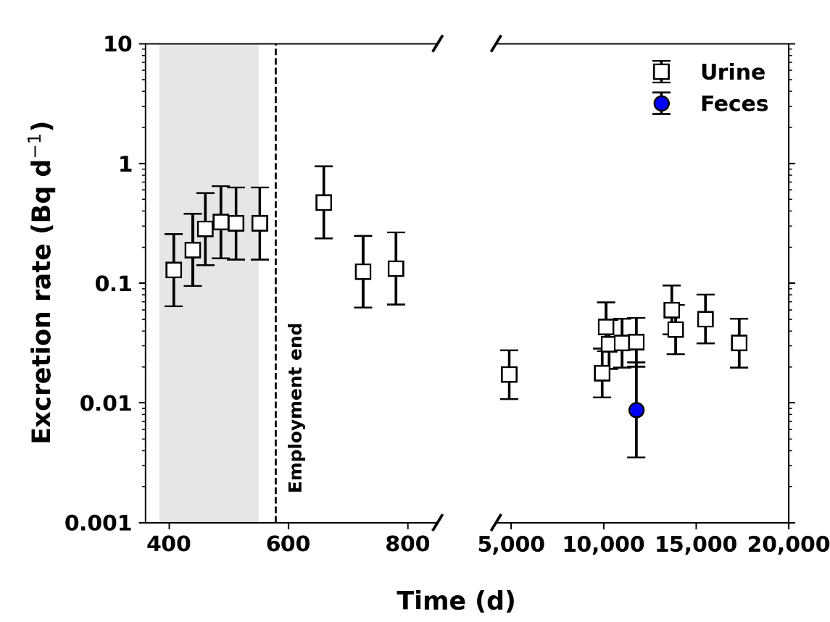
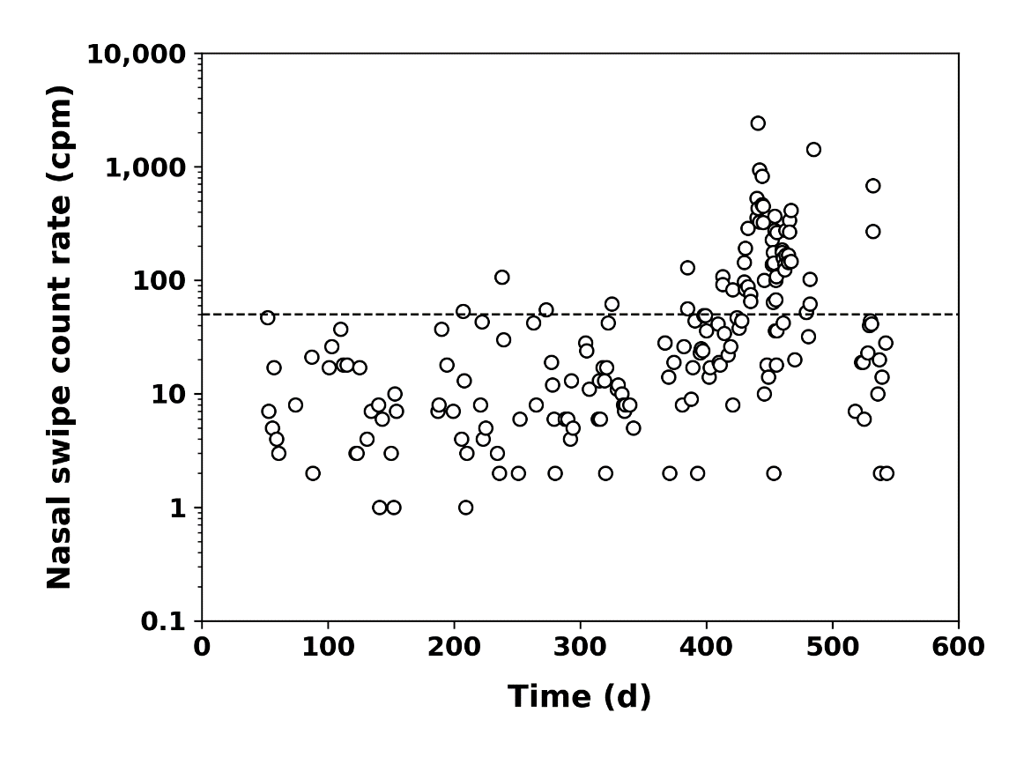
Data: Bioassay Measurements
19 urine samples
1 fecal sample
1 blood sample
212 nasal swipes
14 chest counts < MDA

Slide 5
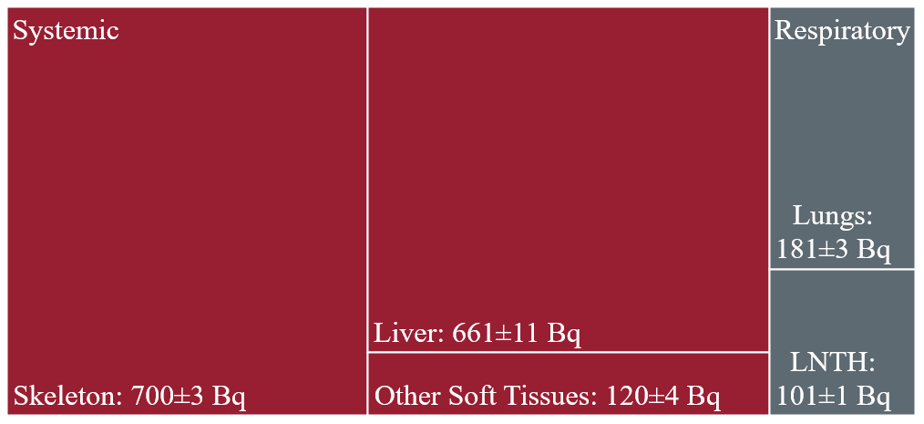
Data: Post-mortem Tissue Analyses
Tissues analyzed: 82 bone samples and 13 soft tissues
Total body: 1,765±12 Bq

Slide 6
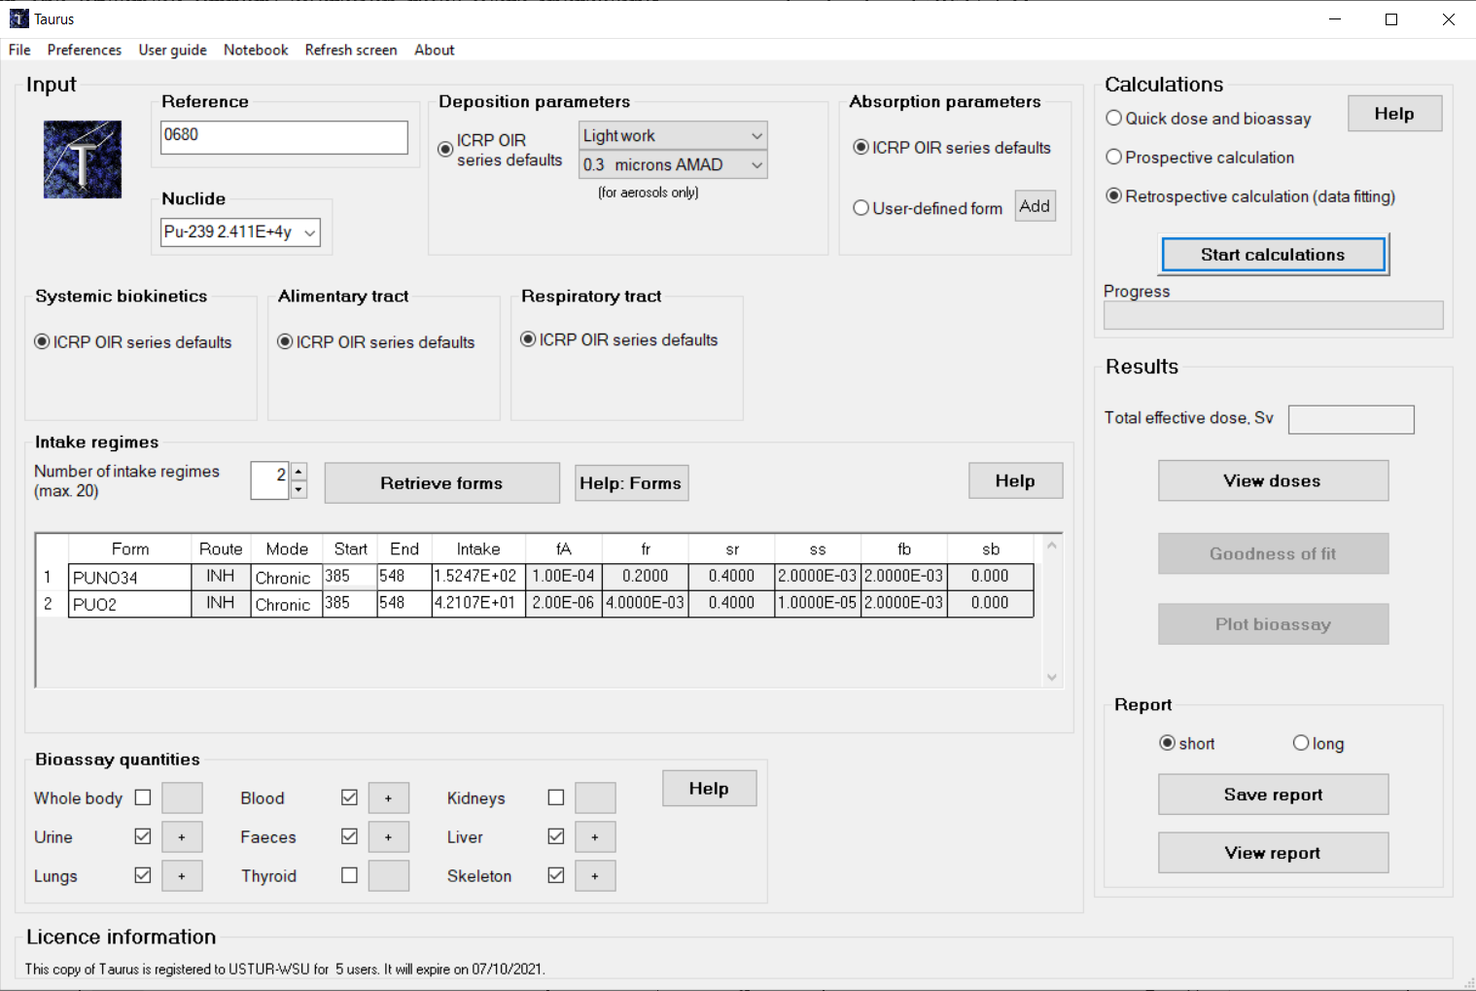
Methods: Taurus Internal Dosimetry Software
Public Health England, UK

Slide 7
Methods: Intake Scenario
Chronic inhalation
  Pu-nitrate
  PuO₂
ICRP models
  130 Human Respiratory Tract
  100 Human Alimentary Tract
  141 Plutonium Systemic

Slide 8
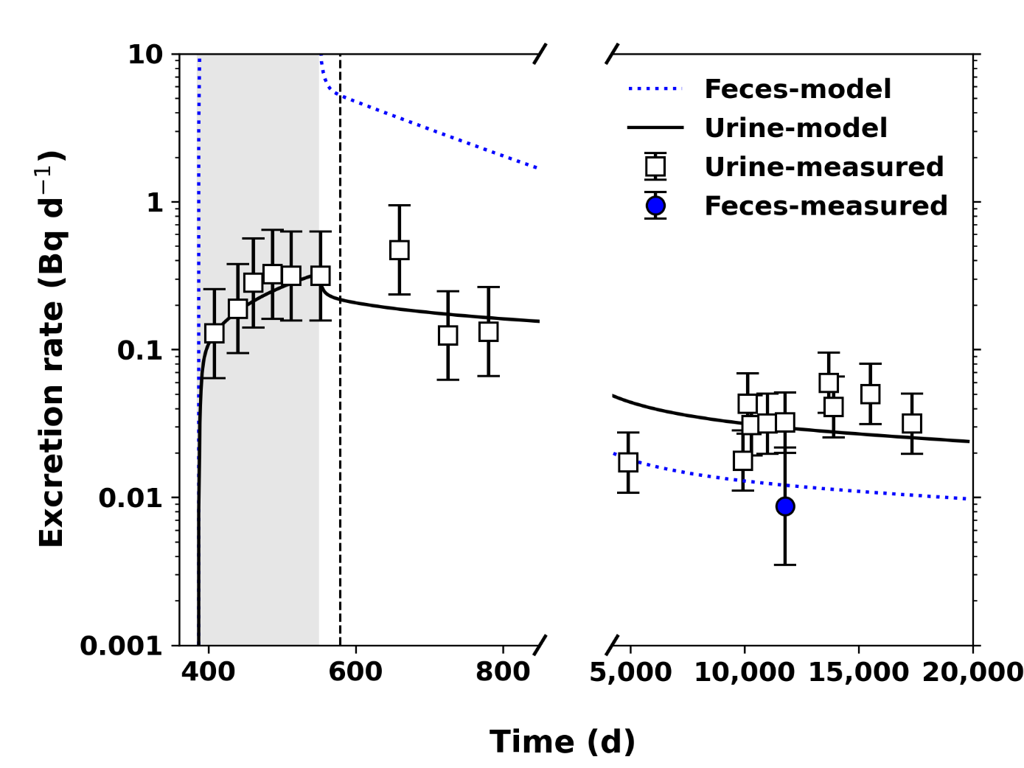
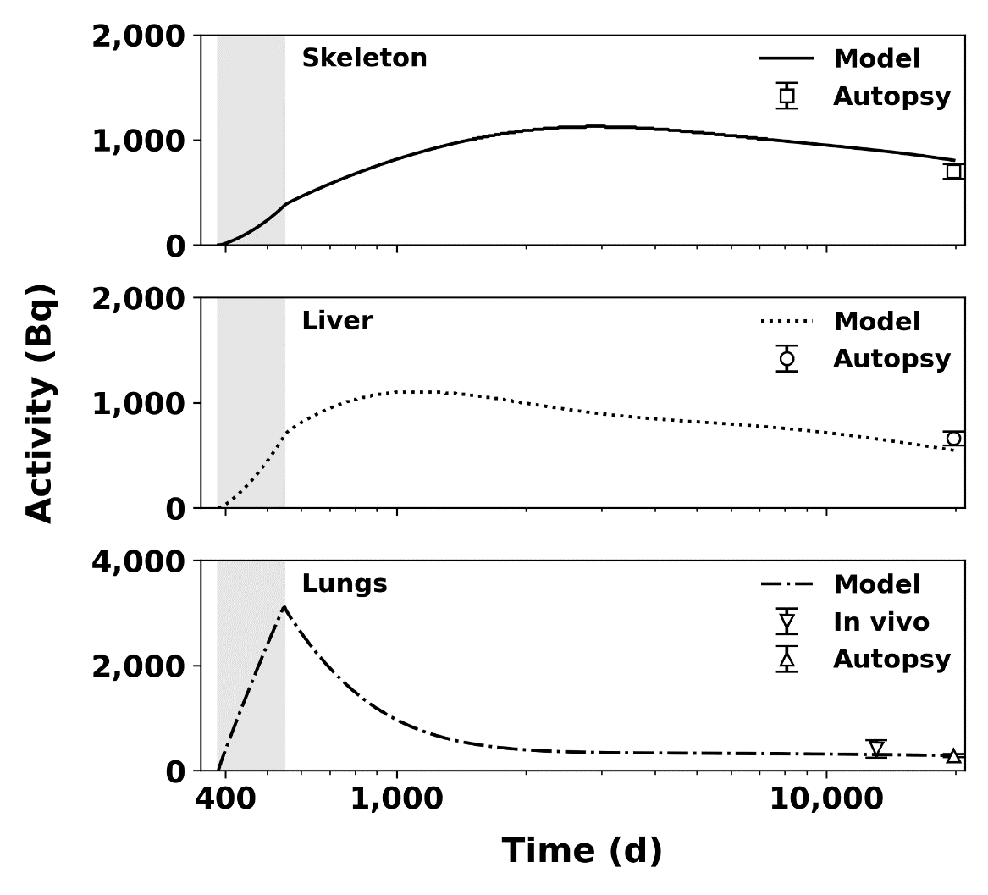
Results: Estimated Intake
Days | Material | Intake |  | Goodness of fit χ² p-value
 |  | Rate (Bq d ^{–1}) | Cumulative (Bq) | p (>0.05)
385 – 548 | Pu-nitrate | 152.5 | 25,570 | 0.808
 | PuO₂ | 42.1 | 9,485

Slide 9
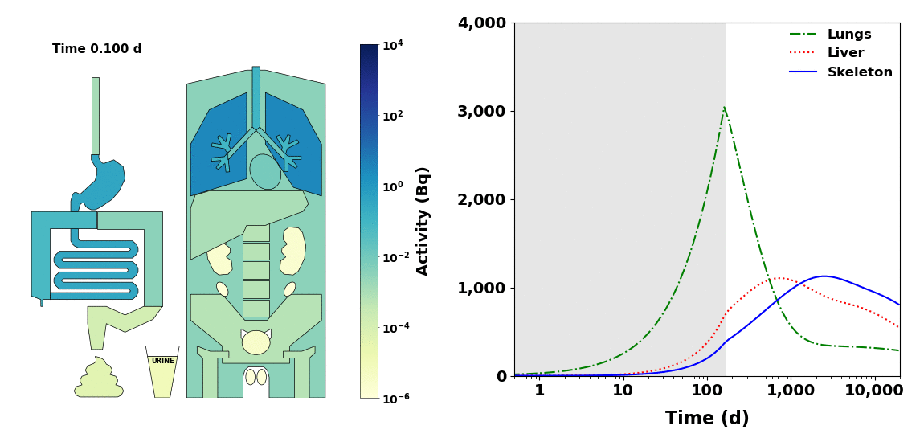
Results: Plutonium Organ Distribution over Time

Slide 10
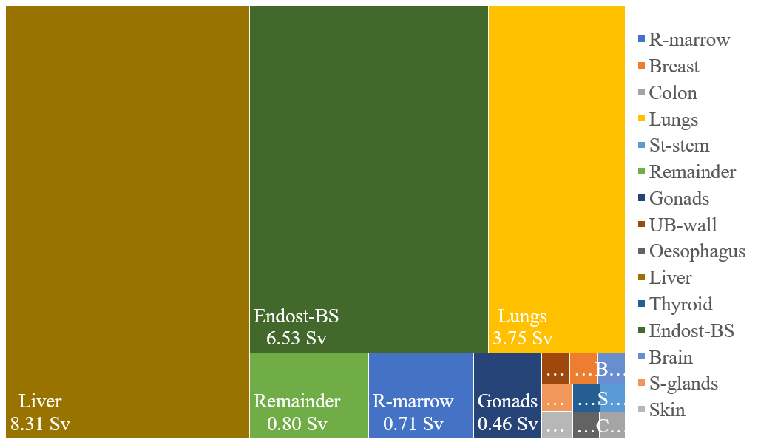
Results: Organ Equivalent Doses

Slide 11
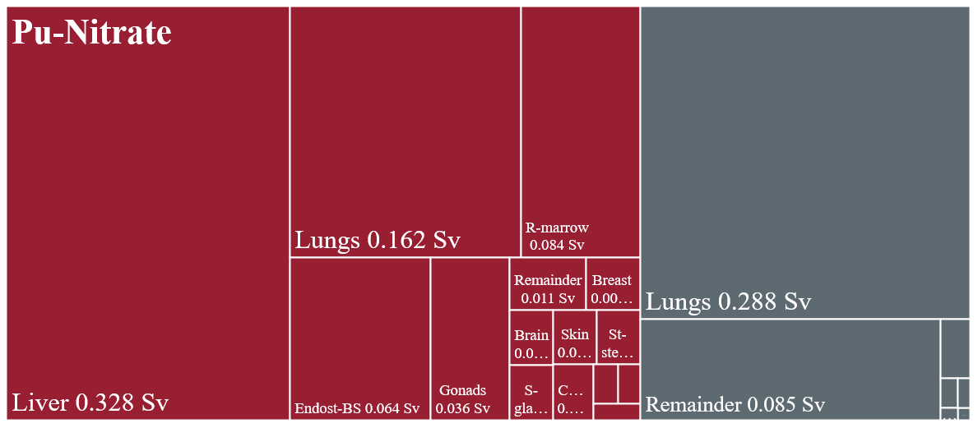
Results: Organ Contributions to Effective Dose
Committed effective dose: 1.22 Sv
PuO₂

Slide 12
Summary
ICRP reference biokinetic models adequately described the long-term plutonium retention and excretion for this individual
Chronic inhalation of 78% Pu-Nitrate and 22% PuO₂
53 years post intake total body activity: 1,765 Bq
Total body distribution: systemic organs 84%, respiratory tract 16%
Systemic distribution: skeleton 47%, liver 45%, other 8%
Šefl, M, Avtandilashvili, M, Tolmachev, SY. Inhalation of Soluble Plutonium: 53-year Follow-up of Manhattan Project Worker, Health Physics 2021:120(6); 661-670.

Slide 13
Acknowledgements
Internal Dosimetry Group, Public Health England, UK
Anthony Riddell, Demetrio Gregoratto, Public Health England, UK
The USTUR is funded by US DOE, Office of Domestic and International Health Studies (AU-13), under grant award DE-HS0000073 to
College of Pharmacy and Pharmaceutical Sciences at Washington State University
Thank you!

