Slide 1
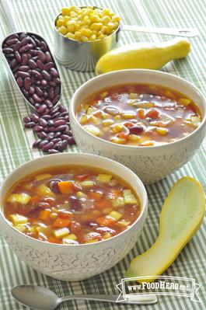


Three Sisters Soup
Three Sisters Soup
Ingredients
1 ½ Tablespoons vegetable oil
¾ cup diced carrot
1 cup chopped onion
1 teaspoon garlic powder or 4 cloves minced garlic
2 cups diced summer or winter squash (fresh or frozen)
1 ½ cups corn (fresh or frozen) or a 15-oz can (drained and rinsed)
1 ½ cups cooked beans (any type) or a 15-oz can (drained and rinsed)
1 can (15 ounces) diced tomatoes or 2 cups diced fresh
3 ½ cups low sodium broth (any type)
1 teaspoon cumin
¼ teaspoon pepper
Ingredients
1 ½ Tablespoons vegetable oil
¾ cup diced carrot
1 cup chopped onion
1 teaspoon garlic powder or 4 cloves minced garlic
2 cups diced summer or winter squash (fresh or frozen)
1 ½ cups corn (fresh or frozen) or a 15-oz can (drained and rinsed)
1 ½ cups cooked beans (any type) or a 15-oz can (drained and rinsed)
1 can (15 ounces) diced tomatoes or 2 cups diced fresh
3 ½ cups low sodium broth (any type)
1 teaspoon cumin
¼ teaspoon pepper
Directions
1. Heat oil in a large pan on medium heat. Add carrot and onion and sauté until onions have begun to turn slightly brown, approximately 8 to 10 minutes.
2. Add garlic, squash and corn and continue to stir for another 3 to 4 minutes.
3. Add beans, tomatoes, broth, cumin and pepper.
4. Allow soup to come to a boil and then turn heat down to a simmer until all vegetables are tender to taste (15 to 30 minutes, depending on the vegetables used).
5. Refrigerate leftovers within 2 hours.
Directions
1. Heat oil in a large pan on medium heat. Add carrot and onion and sauté until onions have begun to turn slightly brown, approximately 8 to 10 minutes.
2. Add garlic, squash and corn and continue to stir for another 3 to 4 minutes.
3. Add beans, tomatoes, broth, cumin and pepper.
4. Allow soup to come to a boil and then turn heat down to a simmer until all vegetables are tender to taste (15 to 30 minutes, depending on the vegetables used).
5. Refrigerate leftovers within 2 hours.
Your agency logo
Your agency logo
Find us on
Facebook URL
Find us on
Facebook URL
This institution is an equal opportunity employer. This material was funded by USDA’S Supplemental Nutrition Assistance Program—SNAP. SNAP provides nutrition assistance to people with low income. It can help you buy nutritious foods for a better diet. To find out more, contact the DSHS Community office at 877 501 2233; or go to http://foodhelp.wa.gov.
This institution is an equal opportunity employer. This material was funded by USDA’S Supplemental Nutrition Assistance Program—SNAP. SNAP provides nutrition assistance to people with low income. It can help you buy nutritious foods for a better diet. To find out more, contact the DSHS Community office at 877 501 2233; or go to http://foodhelp.wa.gov.

