Slide 1
Research Impact Challenge: Session 4
Presented by:
Cheryl Dykstra-Aiello, PhD, Research Development Specialist
Office of Research Advancement and Partnerships (ORAP)
2/20/2025

Slide 2
Research Impact Sessions and Challenges
Research Impact Challenge
Session 1
Challenges 1-3: Complete!
Session 2
Challenges 4-5: Complete!
Session 3
Challenges 6-7: Complete!
Session 4
Challenges 8-10: Citation-Based, Alternative, and Responsible Metrics

Slide 3
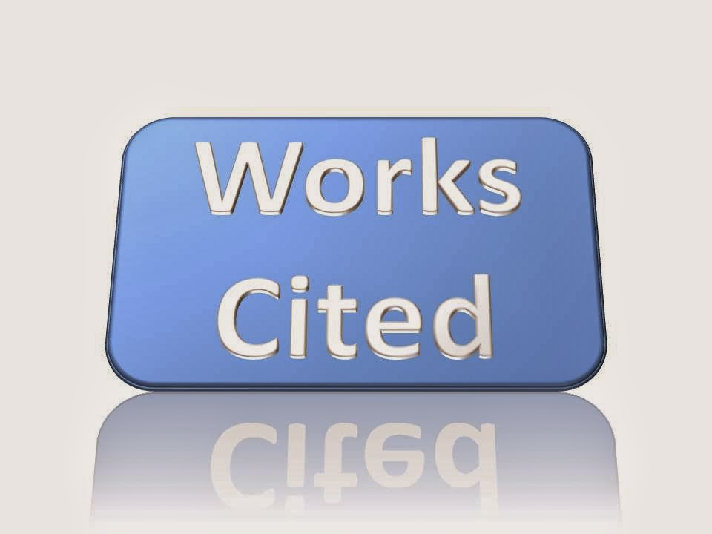
Citation Analysis: What is it?
Based on times cited, it is the study and assumed quality of an:
Article
Author
Institution
This Photo licensed under CC BY-NC-ND

Slide 4
Citation Analysis: Why use it?
Show impact of a publication through its use as an example by other authors as a basis for their own work or as a citation in their own publications.
Discover more about a field or topic by reading the papers that cite seminal work in that particular area.
Determine a particular author’s impact by seeing how often their work has been cited by others.

Slide 5
Challenge 8
Citation-based measures of impact: h-index

Slide 6

Two Citation Tools: Comparing Coverage
Coverage
Web of Science™
12,000+ peer-reviewed journals
1,300+ open access journals
30,000 books (10,000 added annually)
2.6+M chemical compounds & 1M chemical reactions
148,000 conference titles (12,000 added annually)
Google Books
Dissertations
Peer-reviewed articles
Patents, case law
Trade journals
Slide presentations, cited syllabi
Gray literature (e.g., reports, white papers, etc.)
Newsletters

Slide 7
Two Citation Tools: Comparing Subject Focus
Subject Focus
Web of Science™
Updated weekly
Science Citation Index
Social Science Citation Index
Arts & Humanities Citation Index
Unknown update time, but generally quick
All disciplines (theoretically)

Slide 8
Two Citation Tools: Comparing Strengths
Strengths
Web of Science™
Excellent search limits by discipline
The most well-known and most used resource for citation analysis
Excellent resource for finding cited references
Free to use
May find more obscure references

Slide 9
Two Citation Tools: Comparing Weaknesses
Weaknesses
Web of Science™
Poor coverage compared to Google Scholar
Too much irrelevant content in search results
Few options for sorting results
Further reading: “Google Scholar, Web of Science, and Scopus: A systematic comparison of citations in 252 subject categories”.(2018) doi: 10.1016/j.joi.2018.09.002

Slide 10
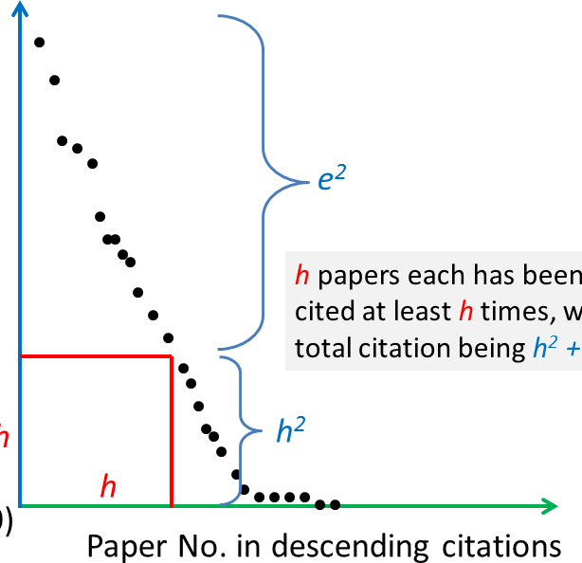
Citation Analysis: h-index
Measures productivity & impact:
A scholar index of h when h papers are published, and each paper has been cited at least h times.
Commonly used BUT contested and problematic
Further reading: “The h-Index: Understanding its predictors, significance, and criticism”.(2023) doi: 10.4103/jfmpc.jfmpc_1613_23

Slide 11
Find your h-index
Web of Science
https://www.webofscience.com/wos/

Slide 12
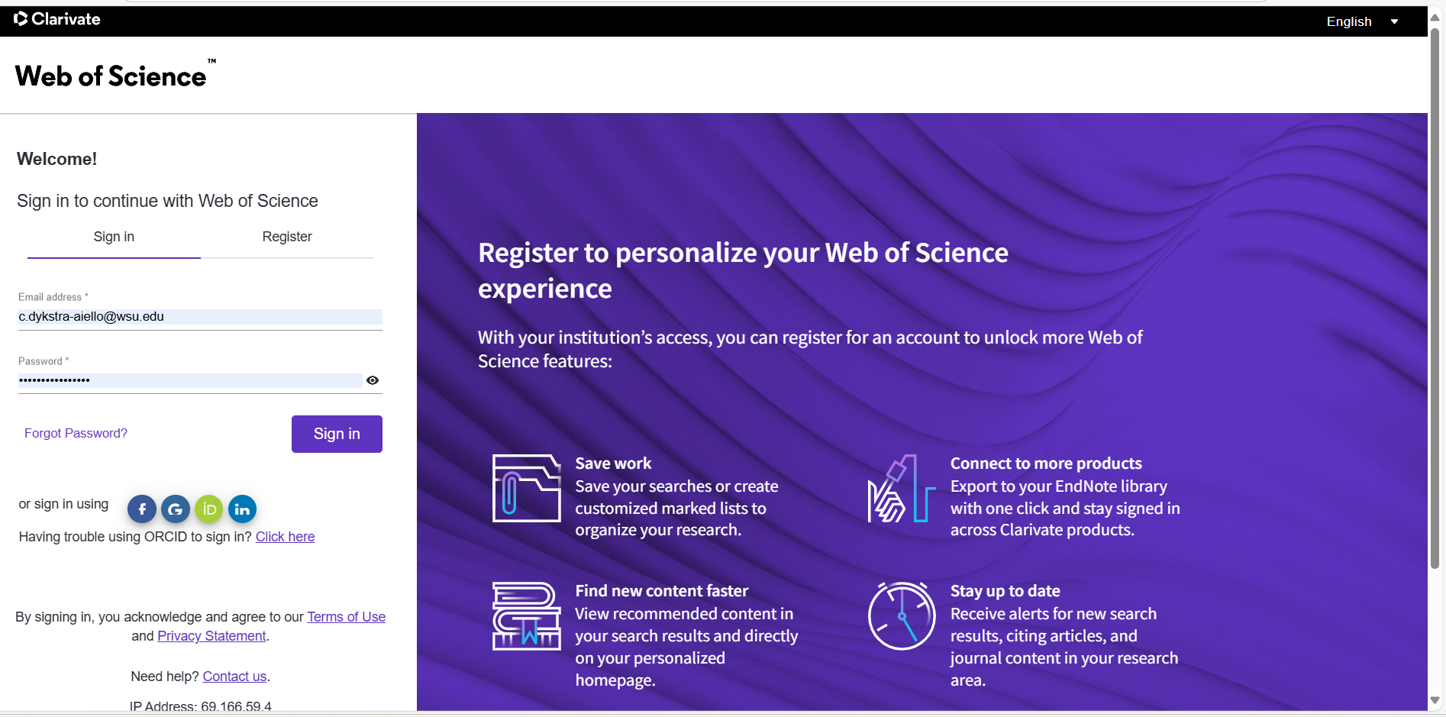
Sign in to Web of Science using your WSU email address

Slide 13
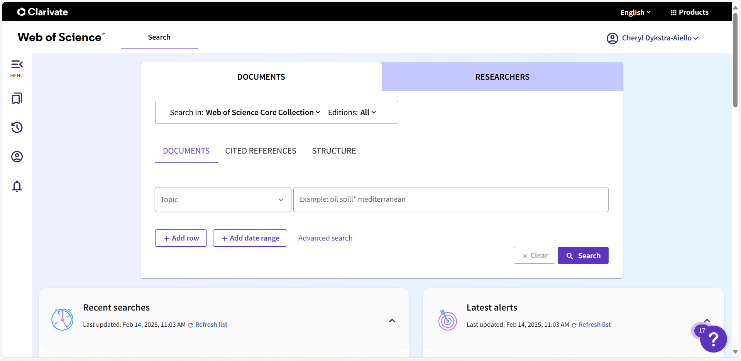
Click the “Researchers” tab

Slide 14
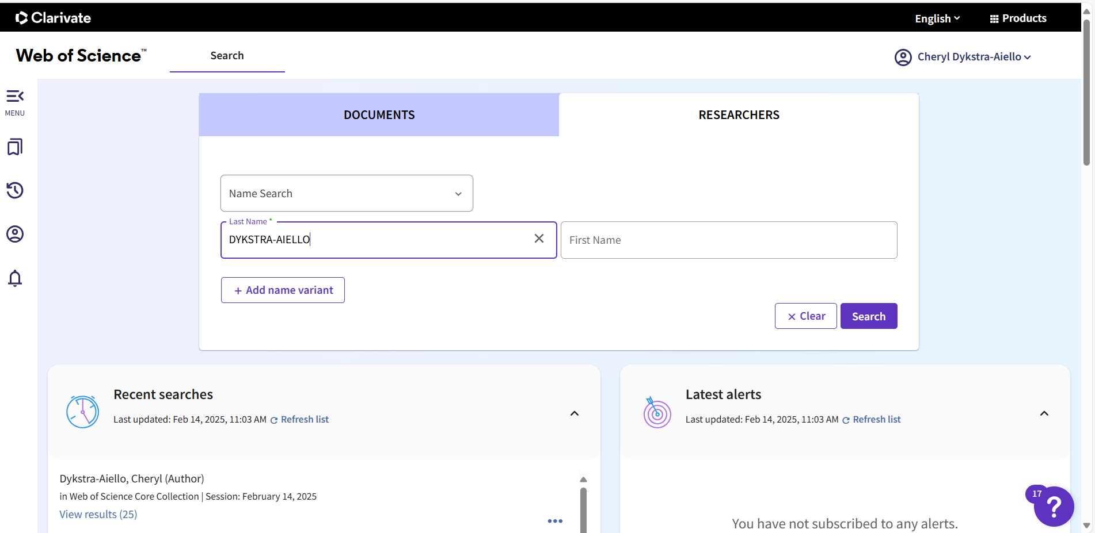
Type in an author’s name (your own or someone you’ve cited)

Slide 15
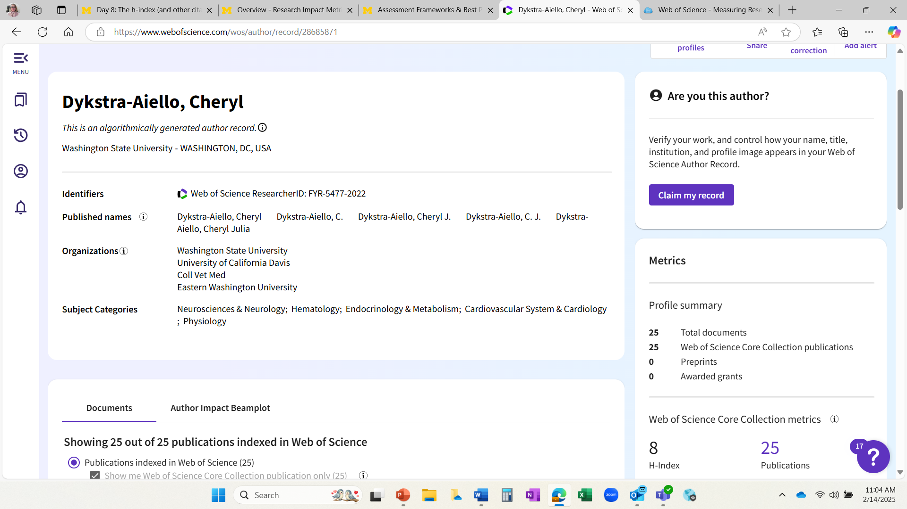
View the author’s metrics

Slide 16
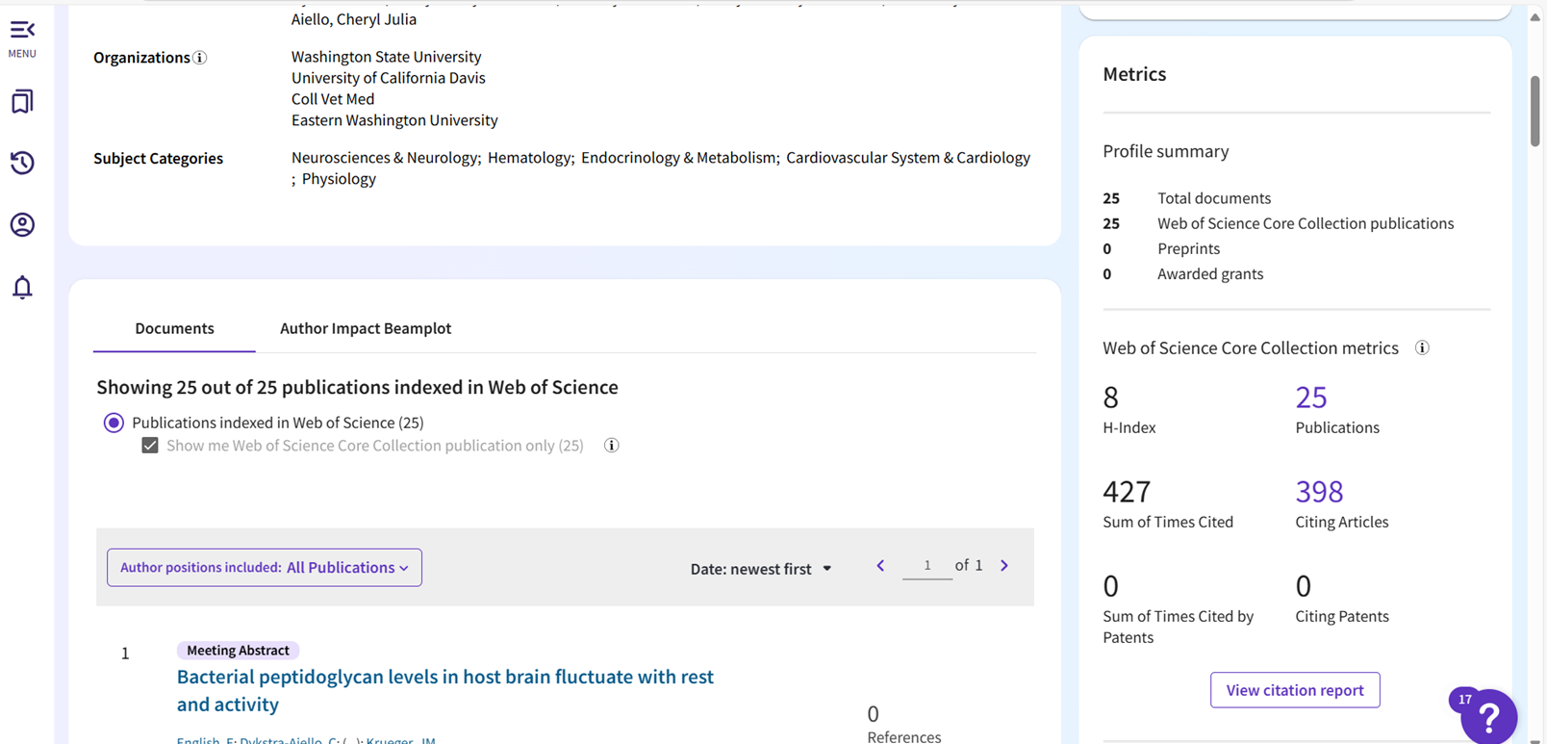
View the author’s citation report – 1

Slide 17
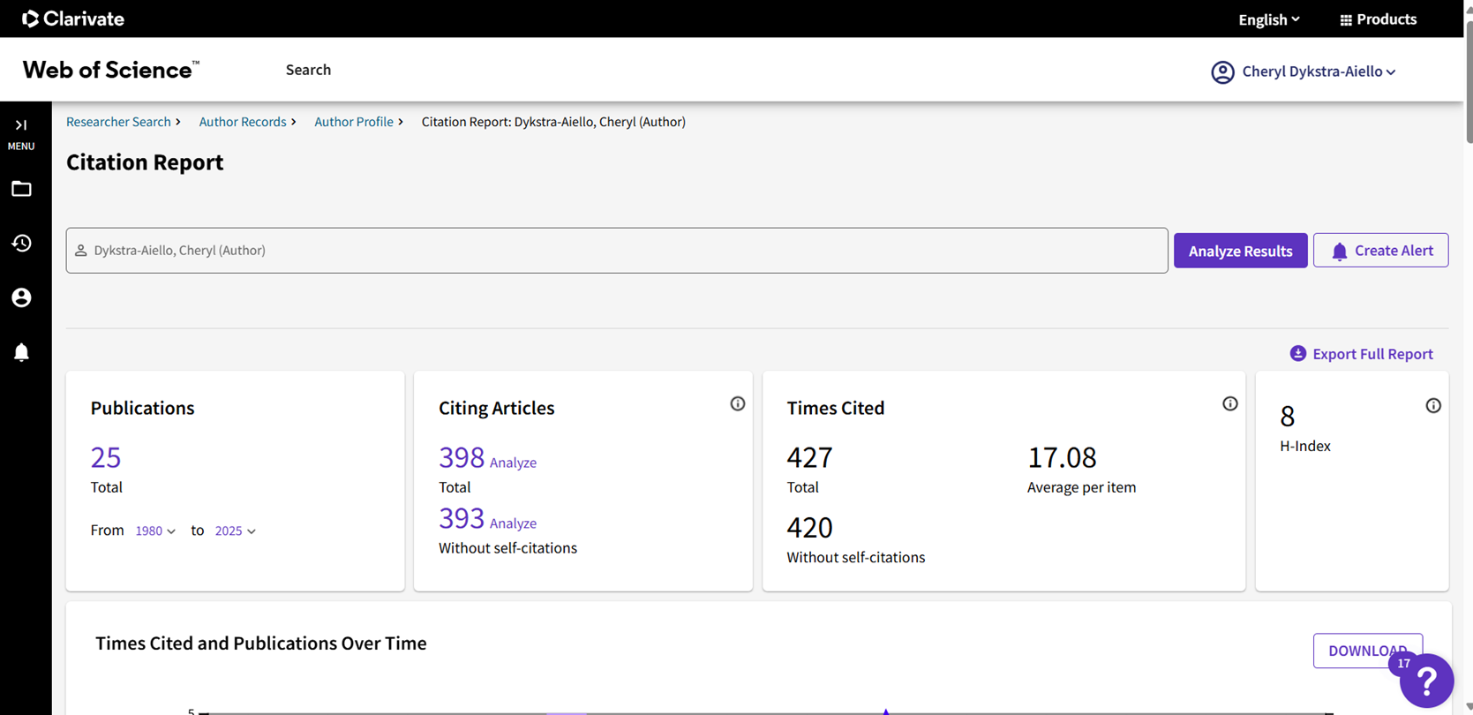
View the author’s citation report – 2

Slide 18
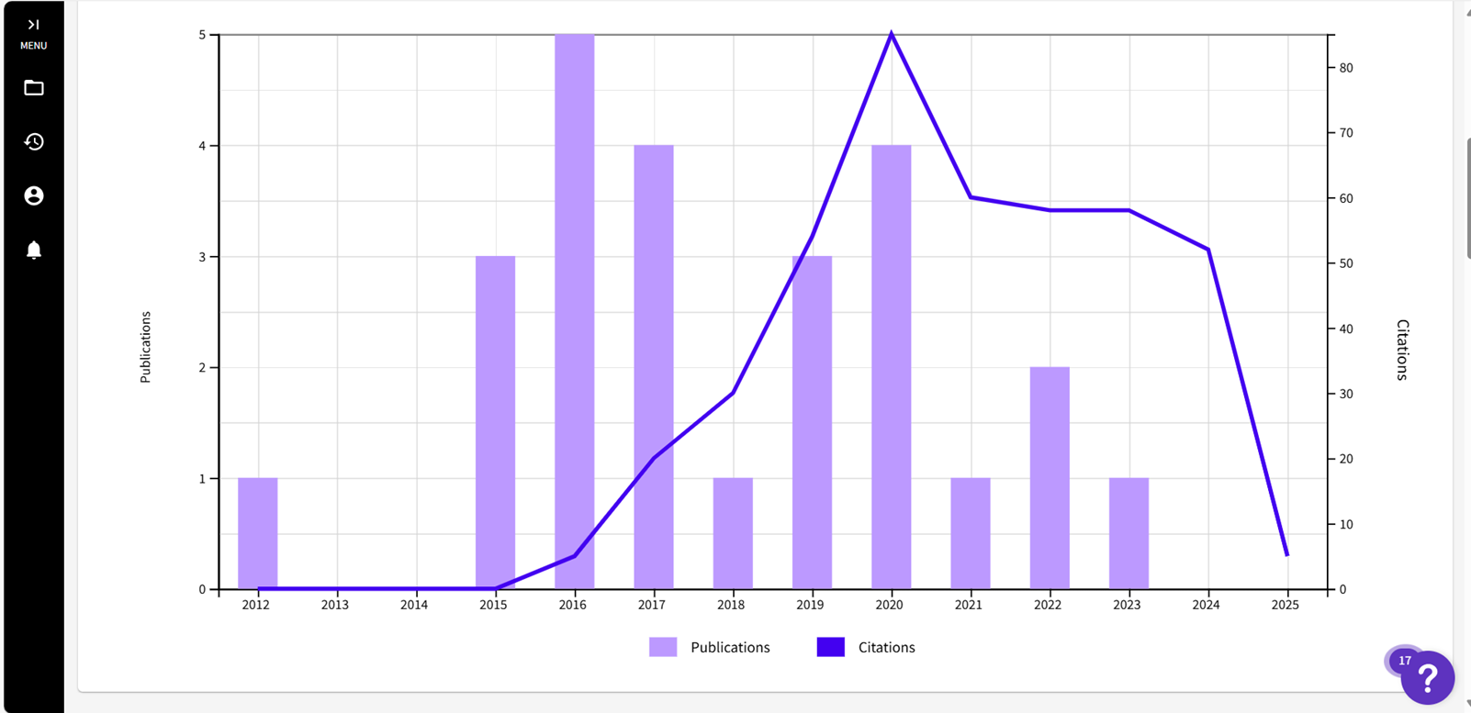
View the author’s citation report – 3

Slide 19
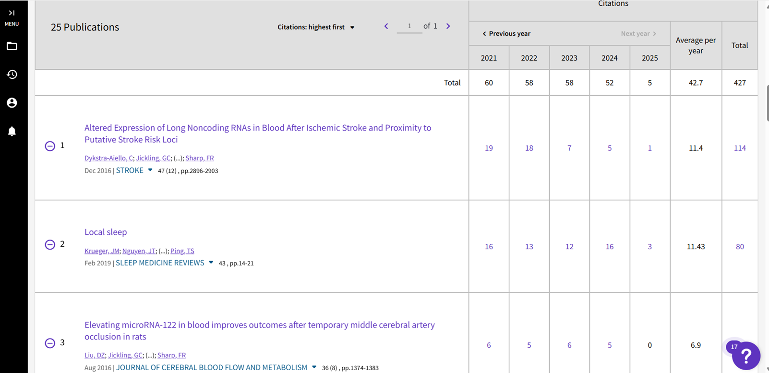
View the author’s citation report – 4

Slide 20
Find your h-index
Google Scholar
https://scholar.google.com/

Slide 21
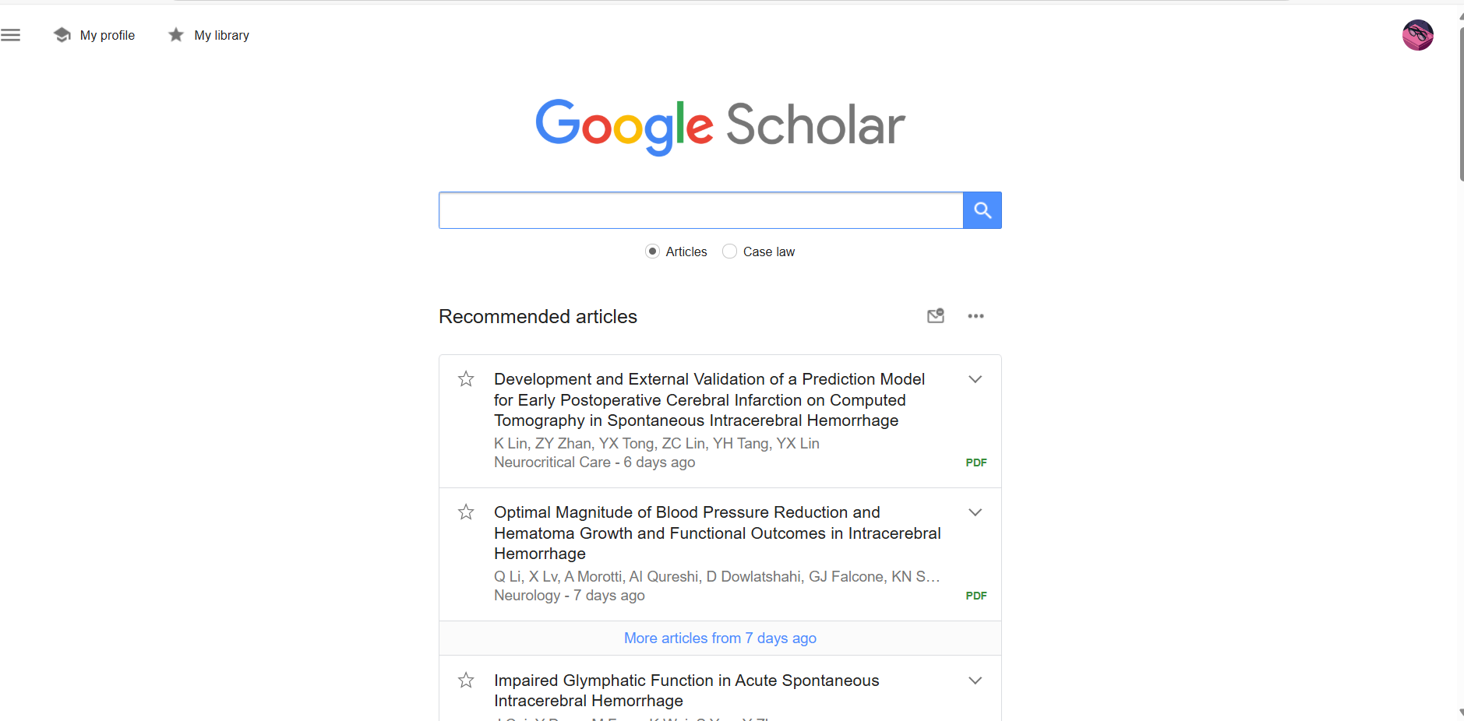
Sign in to Google Scholar using your WSU email address

Slide 22
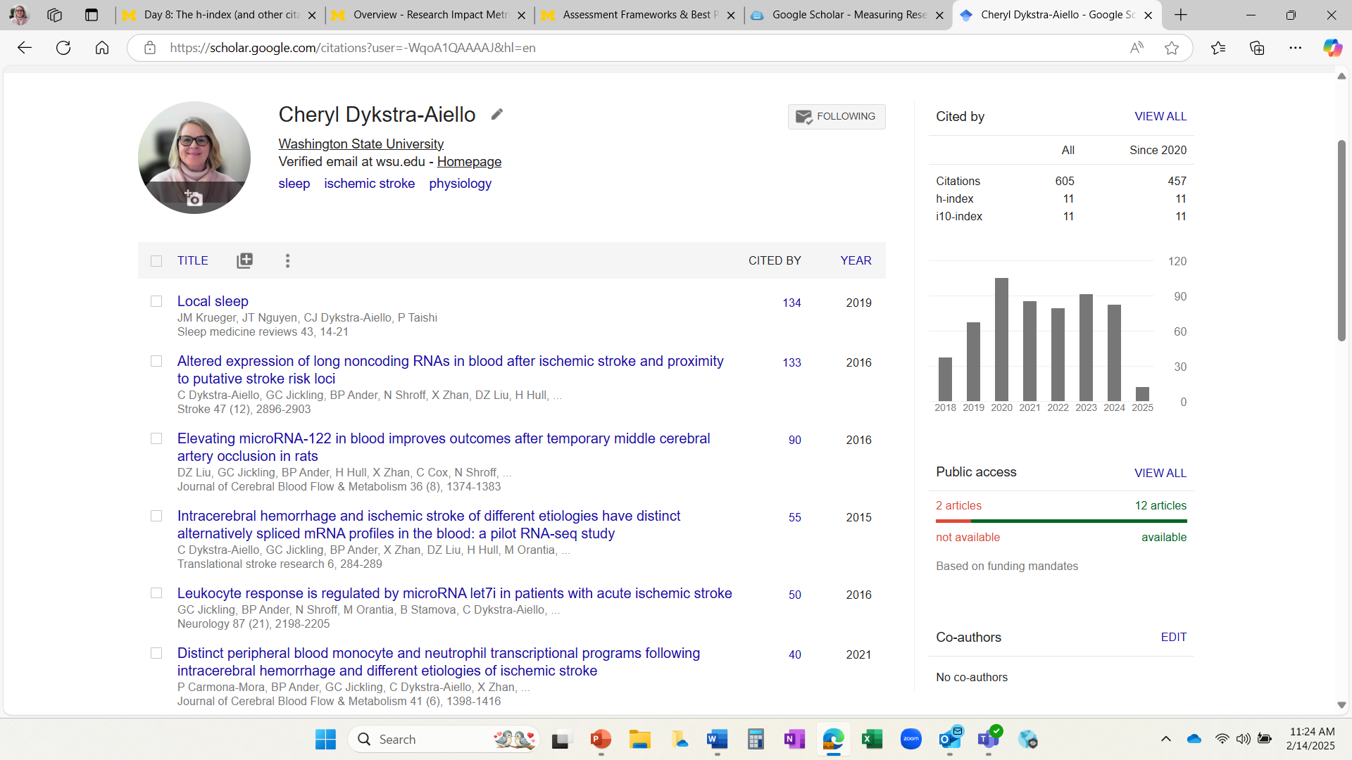
Click on your profile to view your h-index

Slide 23
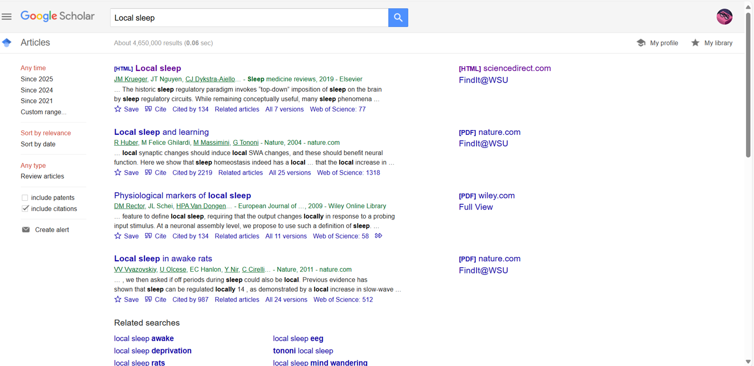
Alternatively – type in another author’s name or a title

Slide 24

h-index Takeaways
Depends on data source used for calculation
Favors scholars with longer careers – with more publications and more time to accrue citations
Inadequately represents impact of scholars whose publications aren’t indexed in data source used
Google Scholar
more inclusive* than Web of Science
*more material types than peer-reviewed articles)
often shows a higher h-index

Slide 25
Challenge 8 Complete!
Congratulations!
Now we will move on to alternative metrics

Slide 26
Challenge 9
Alternative metrics

Slide 27
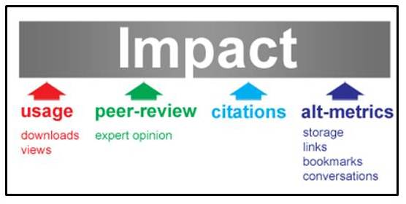
Altmetrics Defined
Considers other modes of scholarship communication beyond citations
Tweets
Blog posts
Online reviews
Shares
Downloads
Helps demonstrate impact of your work on-line
Before citations appear in traditional publications

Slide 28



Altmetrics Tools
PlumX Metrics
Measures individual researcher impact AND outputs from labs, departments and other groups
https://www.elsevier.com/insights/metrics/plumx
PLoS metrics
Combines altmetrics data from Altmetric with PLoS articles
Checks online “buzz” from social media, newspapers and online reference managers
https://plos.org/metrics/
Altmetric
Tracks what people are saying about papers online
On behalf of publishers, authors, libraries & institutions
https://www.altmetric.com/

Slide 29
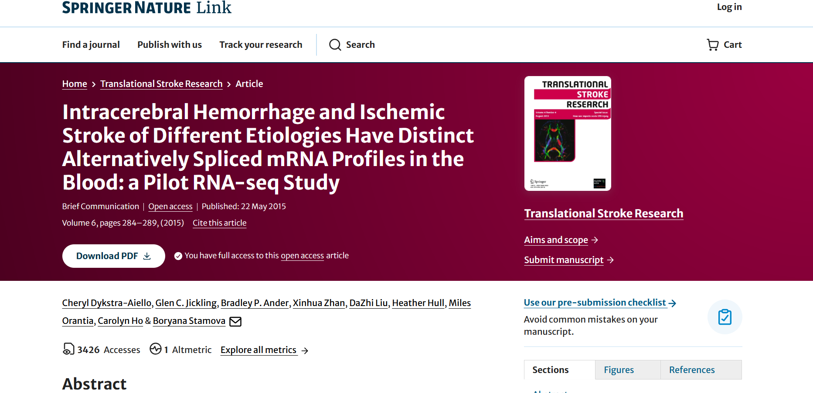
Altmetrics Tools: Journal Altmetric

Slide 30
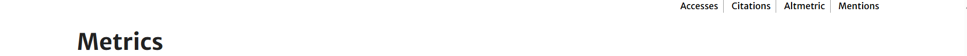
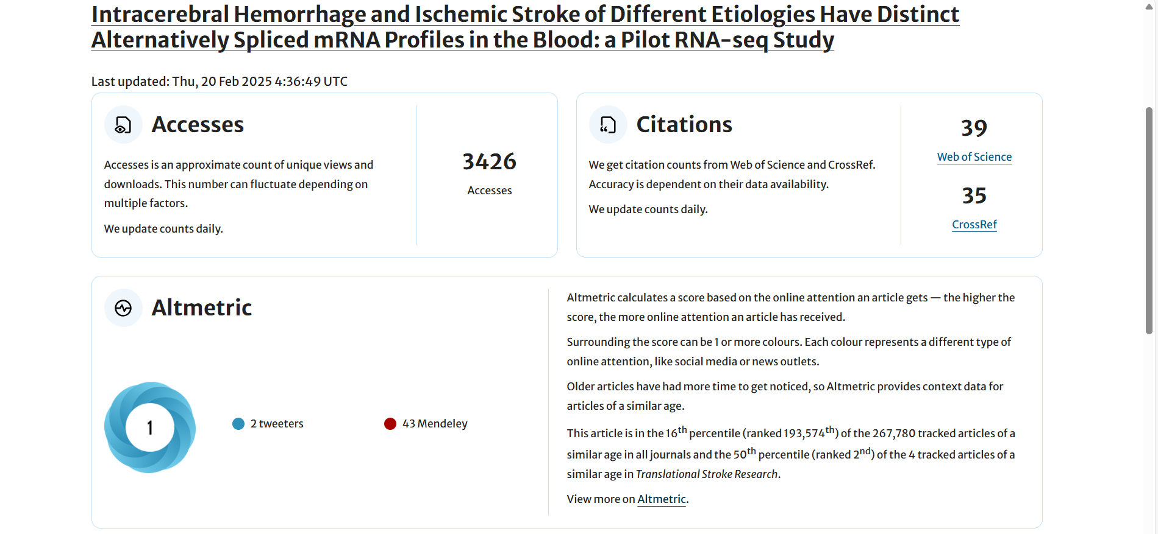
Altmetrics Tools: Journal Altmetric

Slide 31
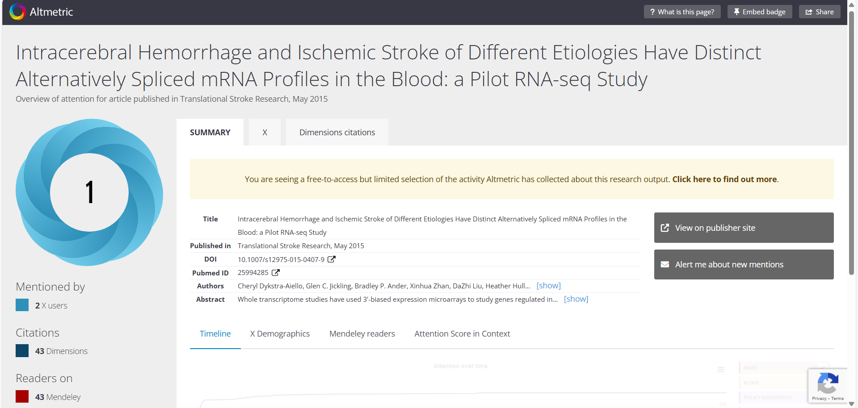
Altmetrics Tools: Altmetric details

Slide 32
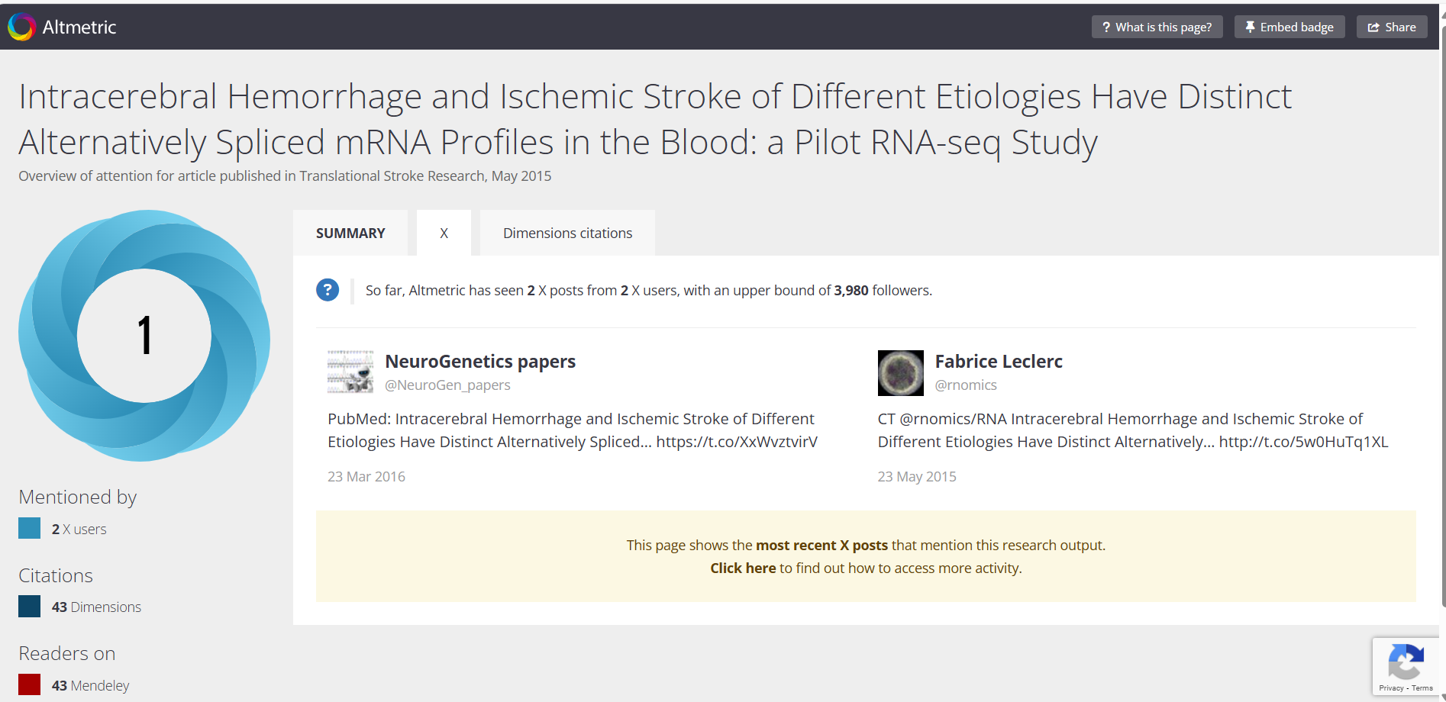
Altmetrics Tools: Altmetric details continued

Slide 33


Altmetrics Tools
)
Based on Crossref Event Data (https://www.crossref.org/services/event-data/ )
Online-linked data, social media
"New tools track article buzz online" in Nature Index
https://paperbuzz.org/
OpenAlex
A comprehensive catalog of scholarly papers, authors, institutions, and more.
https://openalex.org
"Massive open index of scholarly papers launches" in Nature
"Sorbonne’s embrace of free research platform shakes up academic publishing" in Financial Times

Slide 34
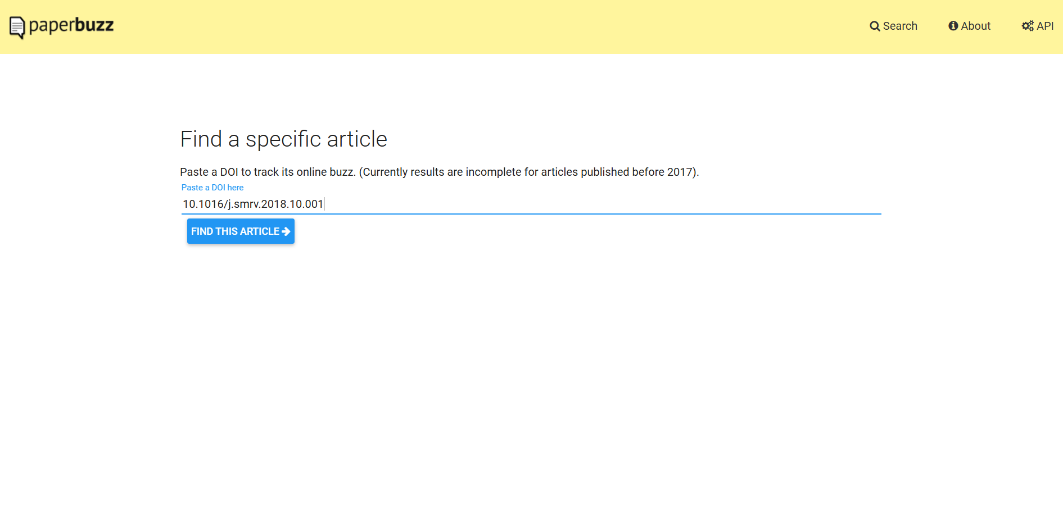
Altmetrics Tools: paperbuzz

Slide 35
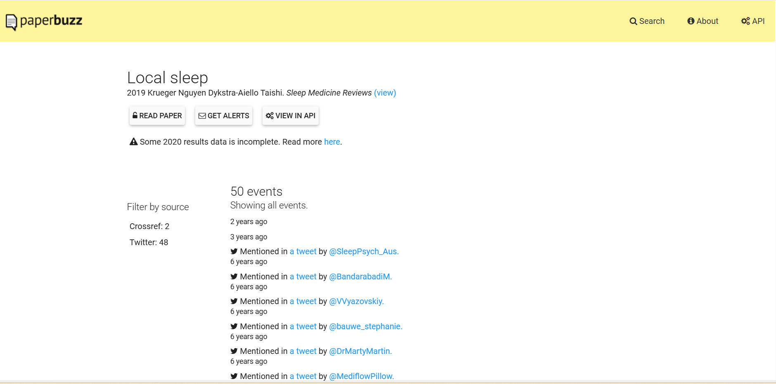
Altmetrics Tools: paperbuzz

Slide 36
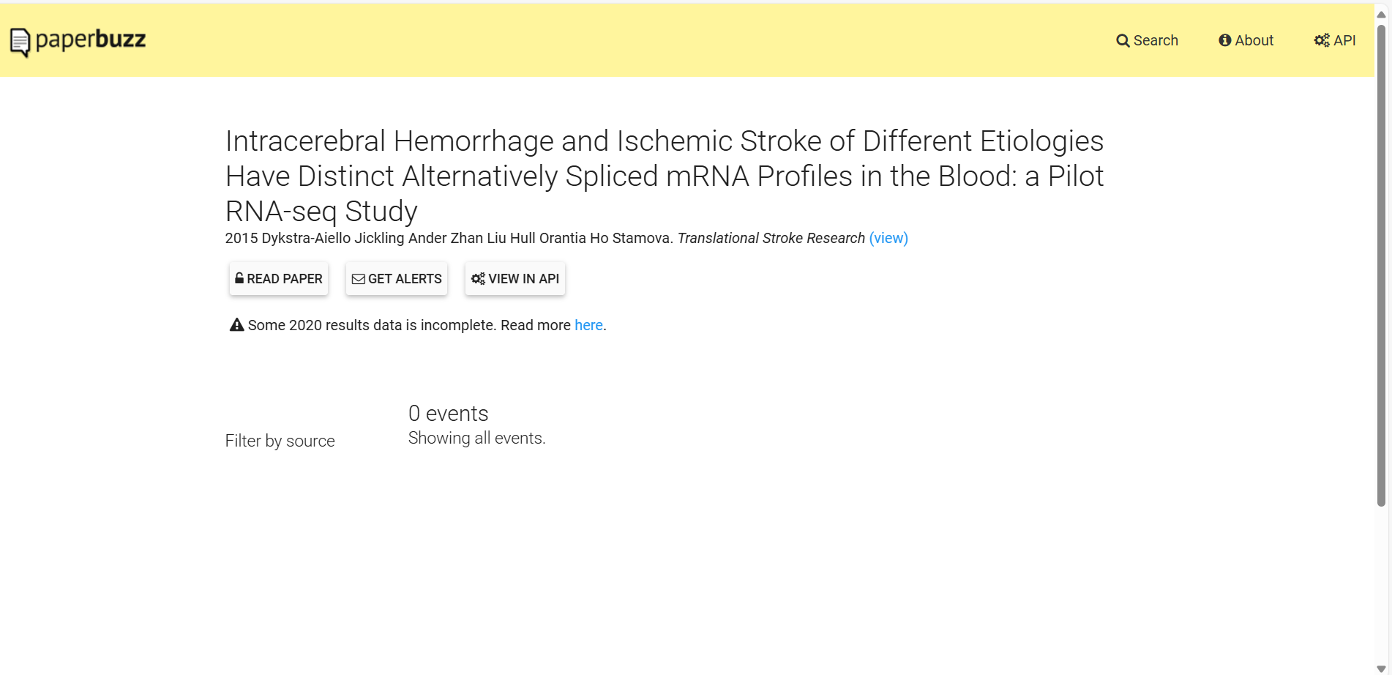
Altmetrics Tools: paperbuzz

Slide 37
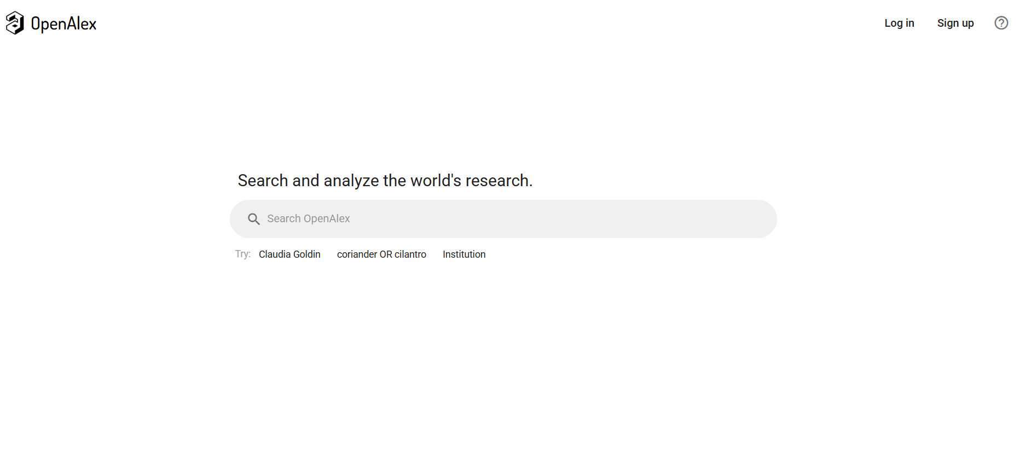
Altmetrics Tools: OpenAlex

Slide 38
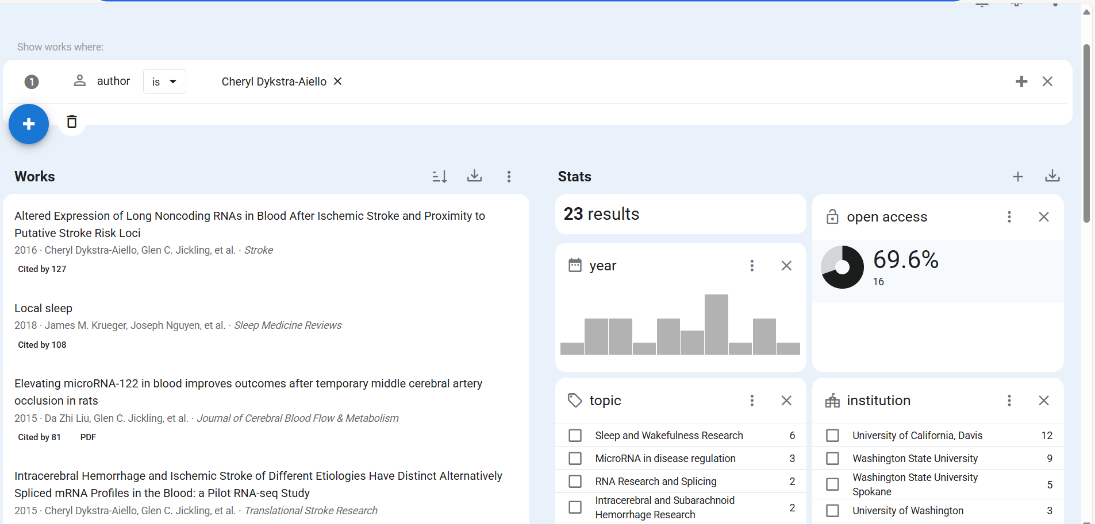
Altmetrics Tools: OpenAlex

Slide 39
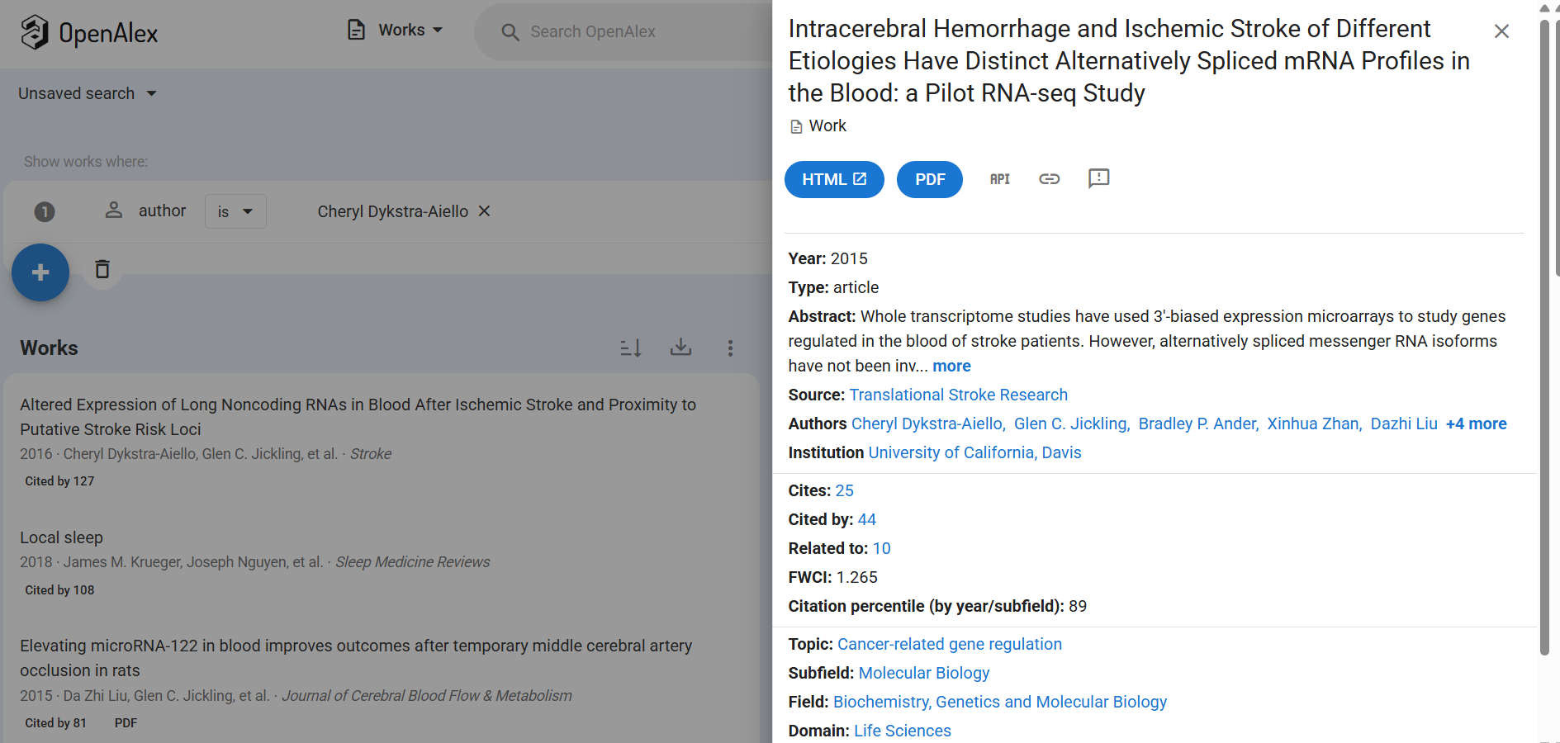
Altmetrics Tools: OpenAlex

Slide 40
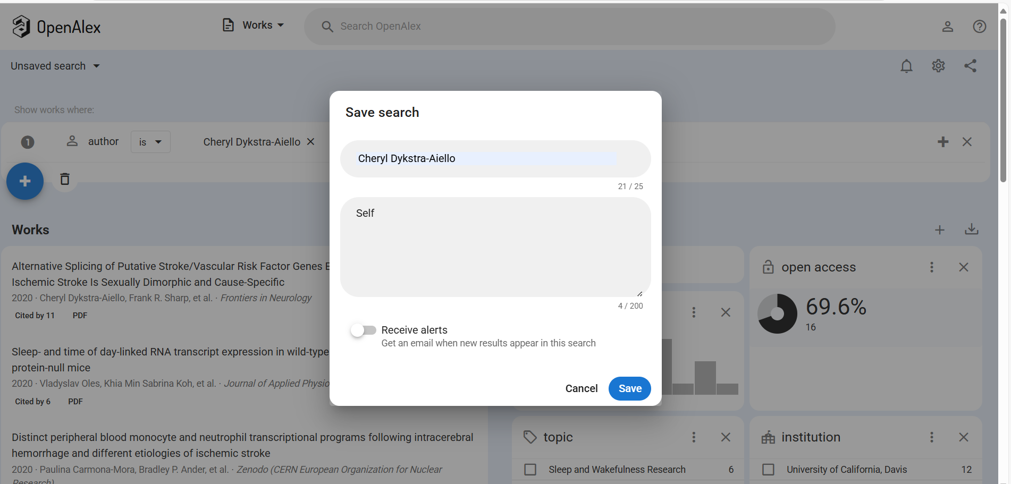
Altmetrics Tools: OpenAlex

Slide 41
Challenge 9 Complete!
Congratulations!
Now we will move on to responsible metrics

Slide 42
Challenge 10
Responsible Metrics

Slide 43
“not everything that can be counted counts, and not everything that counts can be counted”
William Bruce Cameron,1963
American author, most famous for A Dog's Purpose

Slide 44
Responsible Metrics Documents
3 key documents with own sets of principles
Outline more responsible use of metrics by researchers and/or institutions
DORA – the San Francisco Declaration on Research Assessment (2012)
The Leiden Manifesto (2015)
The Metric Tide Report (2015)

Slide 45
San Francisco Declaration on Research Assessment (DORA)
Developed at the 2012 meeting of The American Society for Cell Biology for all disciplines
18 total recommendations; 4 for researchers:
When involved in committees making decisions about funding, hiring, tenure, or promotion, make assessments based on scientific content rather than publication metrics.
Wherever appropriate, cite primary literature in which observations are first reported rather than reviews to give credit where credit is due.
Use a range of article metrics and indicators on personal/supporting statements, as evidence of the impact of individual published articles and other research outputs.
Challenge research assessment practices that rely inappropriately on Journal Impact Factors and promote and teach best practice that focuses on the value and influence of specific research outputs.
Read the Declaration | DORA

Slide 46
Leiden Manifesto for Research Metrics
Originally published in Nature in April 2015 as a comment, “Bibliometrics: The Leiden Manifesto for research metrics”.
10 principles proposed for the measurement of research performance, emphasizing:
Openness and transparency
Honoring local/regional excellence
Honoring institutional missions
#6: Account for variation by field in publication and citation practices.
Leiden manifesto for research Metrics - Home
The Leiden Manifesto for Research Metrics on vimeo

Slide 47
Metric Tide Report
Recommends ‘responsible metrics’ for using quantitative data for assessing research – with dimensions of:
Robustness: using best possible data in accuracy and scope
Humility: quantitative evaluation supports qualitative, expert assessment
Transparency: those being evaluated can test and verify the results
Diversity: accounting for variation by field and supporting a plurality of research and researcher career paths across the system
Reflexivity: recognition and anticipation of systemic and potential effects of indicators and updating them in response.
The Metric Tide: Report of the Independent Review of the Role of Metrics in Research Assessment and Management

Slide 48
Responsible Metrics
Does one of these documents resonate more with you than the others?
Do you see the recommendations in these documents being carried out in practice around you?
What do these recommendations have to say about commonly used metrics you've encountered in your career, such as the Journal Impact Factor or the h-index?

Slide 49
Further References
https://libguides.libraries.wsu.edu/citationsearching
The rise of responsible metrics as a professional reform movement: A collective action frames account | Quantitative Science Studies | MIT Press
Thing 5: Responsible Use of Metrics – IATUL Research Impact Things
An introduction to responsible metrics (Open Access Week) – Research Kaleidoscope

Slide 50
Challenge 10 Complete!
Congratulations!
You have now completed all the activities of WSU’s Research Impact Challenge!

