Slide 1
Research Impact Challenge: Session 3
Presented by:
Cheryl Dykstra-Aiello, PhD, Research Development Specialist
Office of Research Advancement and Partnerships (ORAP)
2/13/2025

Slide 2
Research Impact Sessions and Challenges
Research Impact Challenge
Session 1
Challenges 1-3: Complete!
Session 2
Challenges 4-5: Complete!
Session 3
Challenges 6-7: Determining What “Counts” and Finding Appropriate Metrics
Session 4
Challenges 8-10

Slide 3
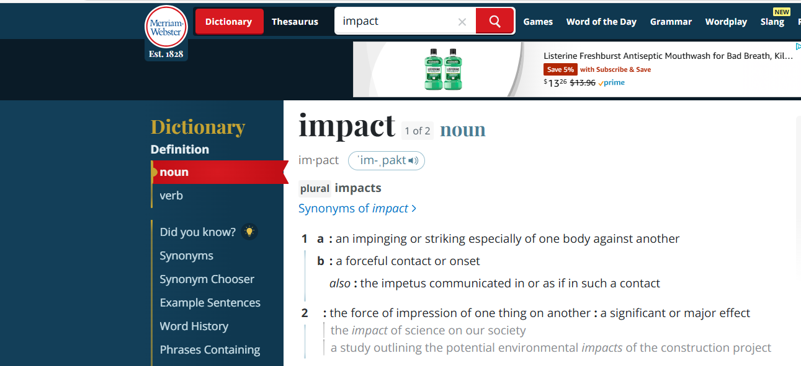
Defining Impact

Slide 4



Defining Impact
Academic
Advancing knowledge, understanding, methods, theory – within and across disciplines
Beneficial
Effects
Cultural/Societal
Benefiting people & places they live through effects on public policy, quality of life, the environment, health
Academia
…and beyond!
Adapted from: https://impact.enlight-eu.org/system/files/2022-07/Research_impact_ebook.pdf and https://stories.universityofgalway.ie/what-is-research-impact/index.html

Slide 5
Impact Areas Institution, funder, and discipline-specific
Policy
Influencing government decisions on policy changes
Environment
Impacting climate change, pollution, endangered species preservation
Technology
Improving products, processes, groups
Economic
Helping businesses & growth or development
Health
Advancing drug development, changing medical practice, reducing health inequality
Social
Benefitting community welfare, practices, behaviors, activities
Adapted from: https://impact.enlight-eu.org/system/files/2022-07/Research_impact_ebook.pdf and https://stories.universityofgalway.ie/what-is-research-impact/index.html

Slide 6
The Impact Journey
Adapted from: https://stories.universityofgalway.ie/what-is-research-impact/index.html
T I M E
Can be Controlled
Direct Influence
Indirect Influence
INPUTS
ACTIVITIES
OUTPUTS
OUTCOMES
IMPACTS
WHAT YOU NEED
WHAT YOU DO
PRODUCTS OF YOUR RESEARCH
AWARENESS & USE OF OUTPUTS
CONSEQUENCES OF USE OF OUTPUTS
Research funding
Researcher knowledge & expertise
Facilities & equipment
Staff
Research & development
New methods
Collaboration
Learning
Experiments
Theorizing
Publications
Prototypes, artifacts, datasets, software
Patents, products, services
Methods & processes
Exhibitions & performances
Postgraduates
Cited outputs
License income
Follow-on income
Uptake of device & therapies
Uptake of tools &instruments
Media coverage
New companies
Cultural
Economic
Educational
Environmental
Health
Political
Social
Technological
Planned Work
Intended Results

Slide 7
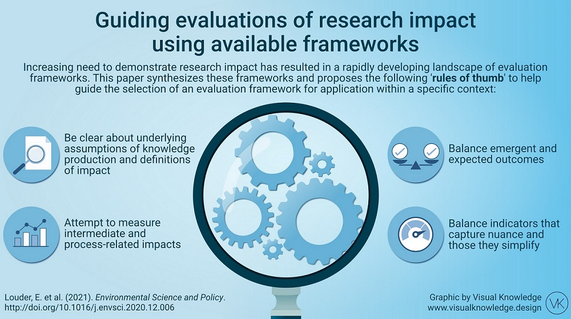
Evaluating Impact
https://i2insights.org/2021/03/16/evaluating-research-impact/
Louder et al., 2021, A Synthesis of the frameworks available to guide evaluations of research impact at the interface of environmental science, policy and practice.

Slide 8
Demonstrating Impact
SIGNIFICANCE
REACH
What is the importance or value of the impact to each beneficiary?
How widespread is the impact?
Significant:
The research has saved a life.
Significant with reach:
The research saved millions of lives.
ATTRIBUTION
How did the research contribute to the impact?

Slide 9
Other Resources for Understanding Impact
https://www.iua.ie/ourwork/university-societal-engagement/engaged-research-societal-impact/
https://www.iua.ie/wp-content/uploads/2023/12/Guide_ResearcherImpactFramework_Oct2022-8.pdf
https://www.fasttrackimpact.com/what-is-impact-subpage
Greenhalgh et al., Research impact: a narrative review. (2016) BMC Medicine.
https://impact.enlight-eu.org/understanding-research-impact

Slide 10
Challenge 6 Determining What Counts
“What I do, what’s important to me, and what “counts”

Slide 11

Challenge 6 Goal
To bring awareness to:
Your academic work
Your assumptions about what work is important

Slide 12

Think about the work you do
CONSIDER:
Why does your work matter?
How can you effectively communicate this?
How much is your work valued?
By you,?
By your peers?
By those in a position to evaluate you?

Slide 13
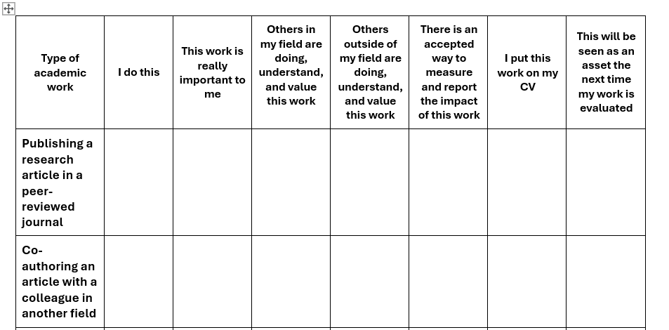
Consider the work you do
To help with this activity – complete the Challenge 6 worksheet

Slide 14
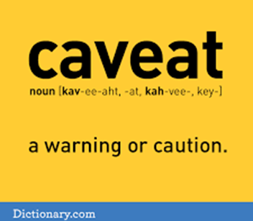
Caveat to this activity
All worksheet items may not apply to you.
Focus mainly on the previous 5 years.
While work types are grouped into categories of research, teaching, service, and engagement, for you, some activities might be more aligned with one area than another.
This list is long but not exhaustive so if you do a type of work not currently included on the list, add it in a blank row.

Slide 15
What about the work you exclude from your CV?
How would you describe the impact of this work?
What success indicators would you be looking for?
How would you capture them?
How would you report them systematically?
What work area is important to you but excluded from your CV or thought to be of no use to an evaluation?

Slide 16
Bonus Challenge
Read the guidelines or evaluation criteria for your next major milestone, reflecting on your assessment of your own work.
Is there alignment between what’s important to you, what you’re doing, and what’s expected?

Slide 17
Challenge 6!
Congratulations!
Now we will move on to finding appropriate metrics

Slide 18
Challenge 7 Finding Appropriate Measures
Finding appropriate metrics

Slide 19
Understanding Metrics
CONSIDER:
How do you get from the work you do to an appropriate metric for measuring and communicating its impact?

Slide 20
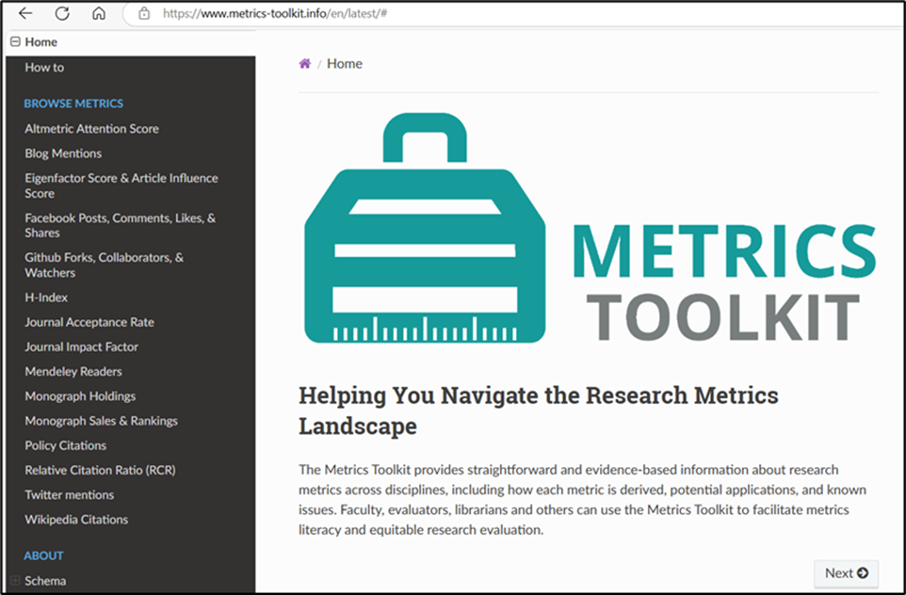
Understanding Metrics
Navigate to:
https://www.metrics-toolkit.info/en/latest/
Note:
Site is not completely up to date
Still valuable for understanding metrics

Slide 21
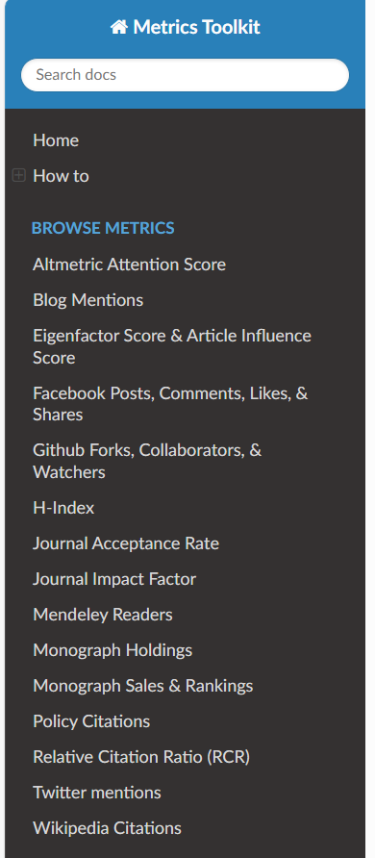
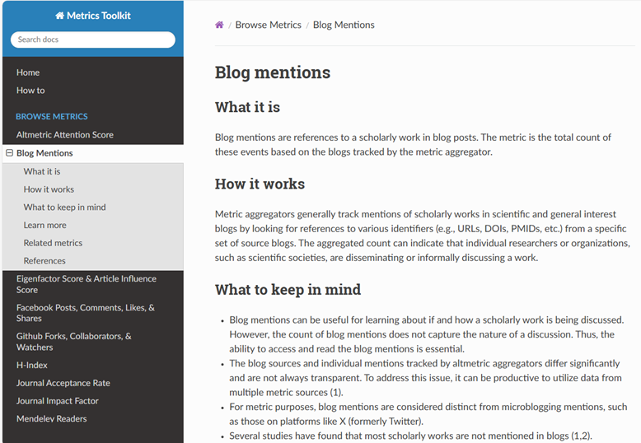
Understanding Metrics
Browse listed metrics
Discover:
What the metric is
How it works
Things to keep in mind
Where to learn more
Related metrics

Slide 22
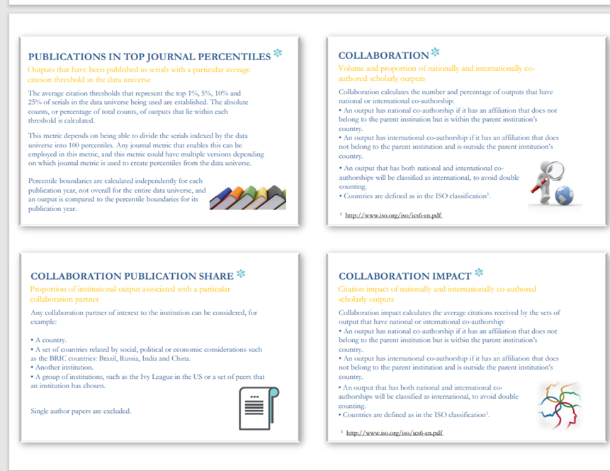
Understanding Metrics
See another way to define metrics:
Snowball Metrics
Metrics cards

Slide 23
Challenge 7 Complete!
Congratulations!
Next week, we will end the series by looking at citation-based metrics, alternative metrics, and responsible metrics

