Slide 1
Research Impact Challenge: Session 2
Presented by:
Cheryl Dykstra-Aiello, PhD, Research Development Specialist
Office of Research Advancement and Partnerships (ORAP)
2/6/2025

Slide 2
Research Impact Sessions and Challenges
Research Impact Challenge
Session 1
Challenges 1-3: Complete!
Session 2
Challenges 4-5: Auditing Your Online Presence in Social Media and a Personal Webpage
Session 3
Challenges 6-7
Session 4
Challenges 8-10

Slide 3
Challenge 4
Online Presence: Social Media
Take an inventory of the platforms you use and reflect on your future interaction

Slide 4

Inventory your Social Media Platforms
Today’s challenge:
  reflect on your social media use through an inventory of the platforms you use
  consider how these platforms pertain to you professionally
  decide where best to focus your future time and effort

Slide 5
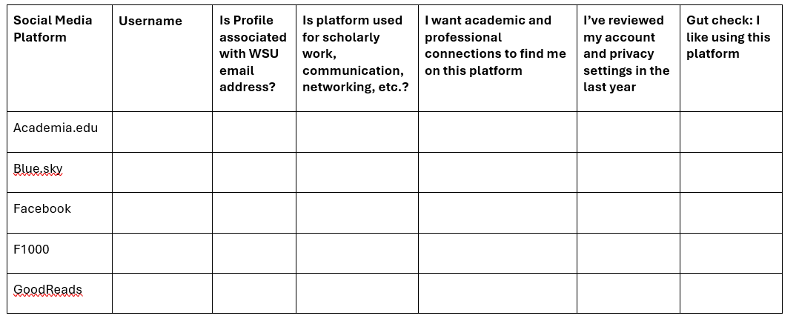
Complete your Inventory
Complete the table in the Challenge 4 pdf document

Slide 6
How to complete your inventory ofo Social Media Platforms
If you have a profile/account associated with a particular platform, record your username and note the following:
whether your profile is associated with your WSU email address
whether your scholarly identity is connected to the platform, networking, etc.
whether or not you have reviewed your privacy settings recently
whether or not you really like the platform.

Slide 7

Inventory - No right or wrong answers!
There are no right or wrong answers in this exercise!
  This is not a to-do list
  This activity is not meant as encouragement to create a presence on all these sites.

Slide 8

Inventory – Just take stock!
Simply take stock of where you already are
  Think carefully about where to focus your attention and efforts going forward

Slide 9

Engaging in Social Media - Considerations
Considerations as you contemplate your social media use:
  Is it practical and useful in your discipline?
  Does it enable connections with new colleagues?
  Is it a platform for communicating your work to a wider audience?

Slide 10

Engaging in Social Media – Inherent Risks
  Can you accept the inherent risks associated with social media?
      People of color, women, LGBTQ community members, contingent faculty, people doing controversial scholarship, and other vulnerable groups are disproportionately likely to be exposed to these risks that include harassment, abuse, even job security.

Slide 11

Things to Remember when Engaging in Social Media
Remember:
Engaging (or not) on social media is a personal and professional decision.
Only you can decide the most meaningful and productive ways in which to engage with these tools
Always keep self-care—and care for your colleagues—in mind in deciding where to best focus your time and energy and how to share your work.
This Photo by Unknown Author is licensed under CC BY-NC-ND

Slide 12
Find out more about Social Media Engagement
Find out more:
Understand WSU’s social media policy about employees’ use of social media on the job
For information about best practices when using social media, check out Social Media at WSU .
Check to see if your colleges and/or campus have its own guidelines.
  Some do:
    Social Media – CAHNRS
    Social Media - WSU Spokane
    Social Media General Guidelines – College of Nursing – geared to students but appropriate for all who engage with social media

Slide 13
Challenge 4 Complete!
Congratulations!
Now we will move on to pulling all previous activities together for your personal web page

Slide 14
Challenge 5
Online Presence: Your Personal Webpage
Pulling all previous activities together.

Slide 15

Update Your Public Profile Webpage
Use any public profile web page that can access that contains your information and work (e.g., Google Scholar)
  First choice: WSU departmental or staff profile page.
  Second choice: ORCiD profile
  Third choice: Any other social networking platform public profile
  Fourth choice: Independent website or blog

Slide 16

What about your ORCiD?
Review your public profile webpage and consider the following:
Is your ORCiD noted?
Is your ORCiD profile linked?
This Photo by Unknown Author is licensed under CC BY

Slide 17
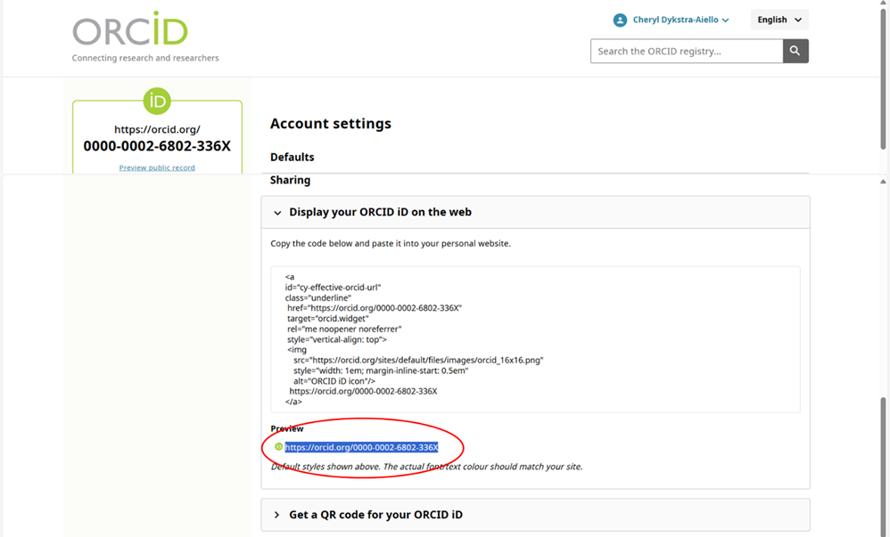
Share your ORCiD link!
Your ORCiD link for sharing can be found under your account settings

Slide 18
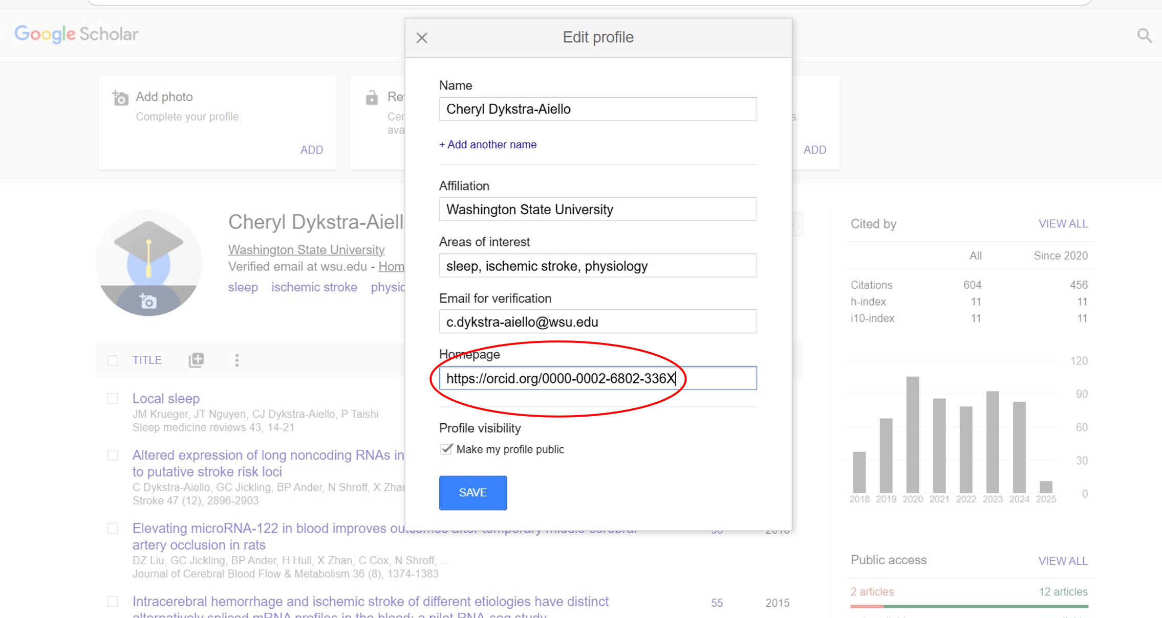
Linking your ORCiD on your Google Scholar Profile
If you don’t have a personal webpage already linked on your Google Scholar profile, you can link your LinkedIn or ORCiD profile as if it is your homepage.

Slide 19
Review Your Public Profile Webpage
Review your public profile webpage and consider the following:
Link to your Google Scholar profile.
Link(s) to any repositories where you have deposited your work

Slide 20
Update Links on Your Public Profile Webpage
Review your public profile webpage and consider the following:
Links to any social media profiles or feeds that you want your colleagues to know about, follow, or connect with

Slide 21
Now what?
Include your personal webpage URL in all the spaces listed above!
Consider using the URL on your email signature.
Ensure all other information on your personal web page (email address, campus address and phone number, research and teaching interests, etc.) is present and up to date!

Slide 22
Challenge 5 Complete!
Congratulations!
Next week, we will begin to look at metrics for determining research impact.

