Slide 1
Research Impact Challenge: Session 1
Presented by:
Cheryl Dykstra-Aiello, PhD, Research Development Specialist
Office of Research Advancement and Partnerships (ORAP)
1/30/2025

Slide 2
Introduction to the Research Impact Challenge
Adapted from University of Michigan's Research Impact Challenge
WSU Subject & Resource Guides (Talea Anderson) provides additional resources to manage your research portfolio
Ten activities, distributed over four sessions
Better understand and manage your online scholarly presence and research impact

Slide 3
Research Impact Sessions and Challenges
Research Impact Challenge
Session 1
Challenges 1-3: Register ORCID, Claim Google Scholar Profile, Preserve/Share Work with a Digital Repository
Session 2
Challenges 4-5: Auditing Your Online Presence in Social Media and a Personal Webpage
Session 3
Challenges 6-7: Determining What “Counts” and Finding Appropriate Metrics
Session 4
Challenges 8-10: Citation-Based, Alternative, and Responsible Metrics

Slide 4
Challenge 1: Claim your ORCiD
Open Researcher and Contributor iD
https://libguides.libraries.wsu.edu/orcid
How others will find you and your work online.

Slide 5
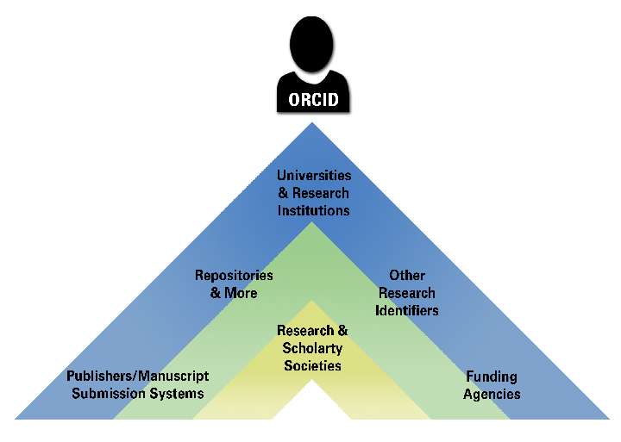
What is ORCiD?
Open, nonprofit, community-based effort to transparently link research activities and outputs
Produces a standard, unique identifier that distinguishes you from other researchers
Aims to prevent authorship confusion and can be used as a login
Used by Universities, Funders, Publishers, Repositories, Professional Associations,
and Research Organizations

Slide 6
Claim your ORCiD
https://orcid.org/register using your WSU email
Add your scholarly works; options to set up automatic updates and to delegate account management
Time designated to setting up or updating your ORCiD profile
Add your ORCiD to your email signature, personal webpage, and anywhere else you post your name, affiliation, and contact information
The more you use your ORCiD, the more useful it becomes at connecting your scholarship across the web

Slide 7
Important to note about your ORCiD
Researchers have autonomy with an ORCiD account.
ORCiD is “institution-neutral,” and will travel with you wherever you go; easy to update your contact email address.
You (the researcher) retain control of your ORCiD; only you can register on your own behalf (your institution cannot register for you), you control what information is visible, and only you can authorize third-party applications to read from or write to your ORCiD
Once you give permission, ORCiD is ready to import works from other sources.

Slide 8
Challenge 1 Complete!
Congratulations! Now we will move on to claiming your Google Scholar Profile

Slide 9
Challenge 2: Your Google Scholar Profile
scholar.google.com

Slide 10
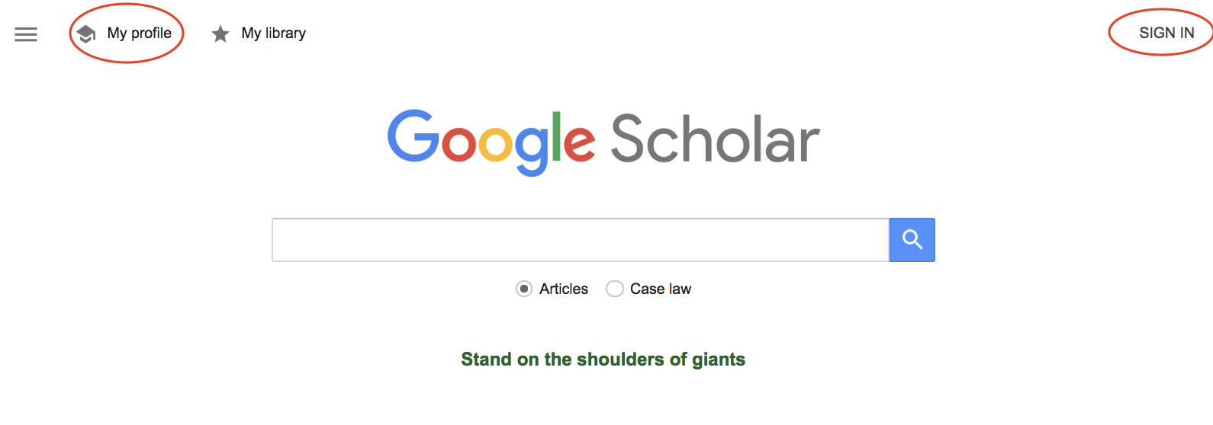
Claim your Google Scholar Profile
Sign in using WSU credentials
Click “My Profile” (upper left) to get started

Slide 11
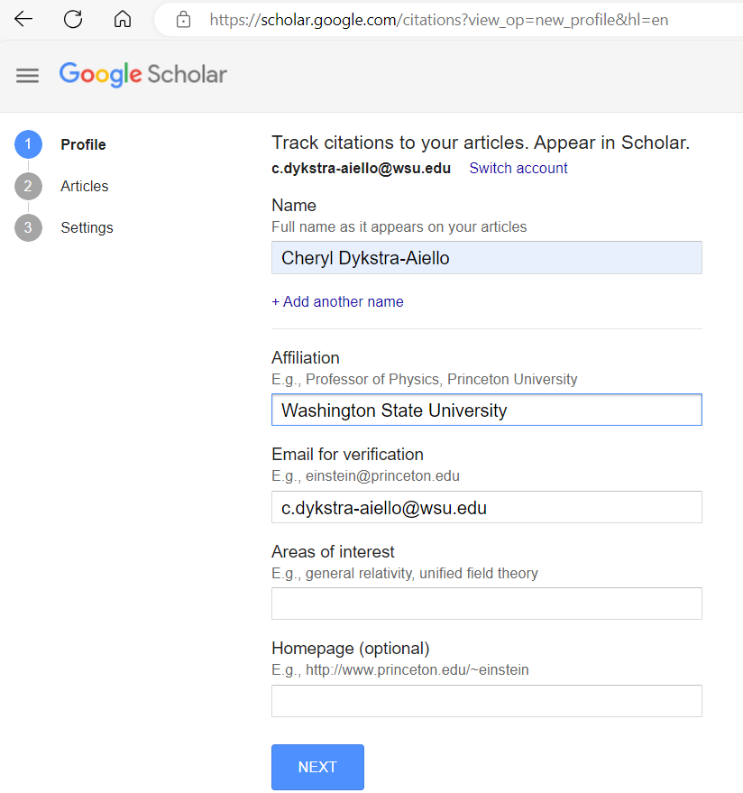
Edit your Google Scholar Profile
Complete name, affiliation, and email address
Recommended to use WSU email address
Verification process through WSU email results in authorization of Google Scholar to display your WSU affiliation as “Verified”

Slide 12
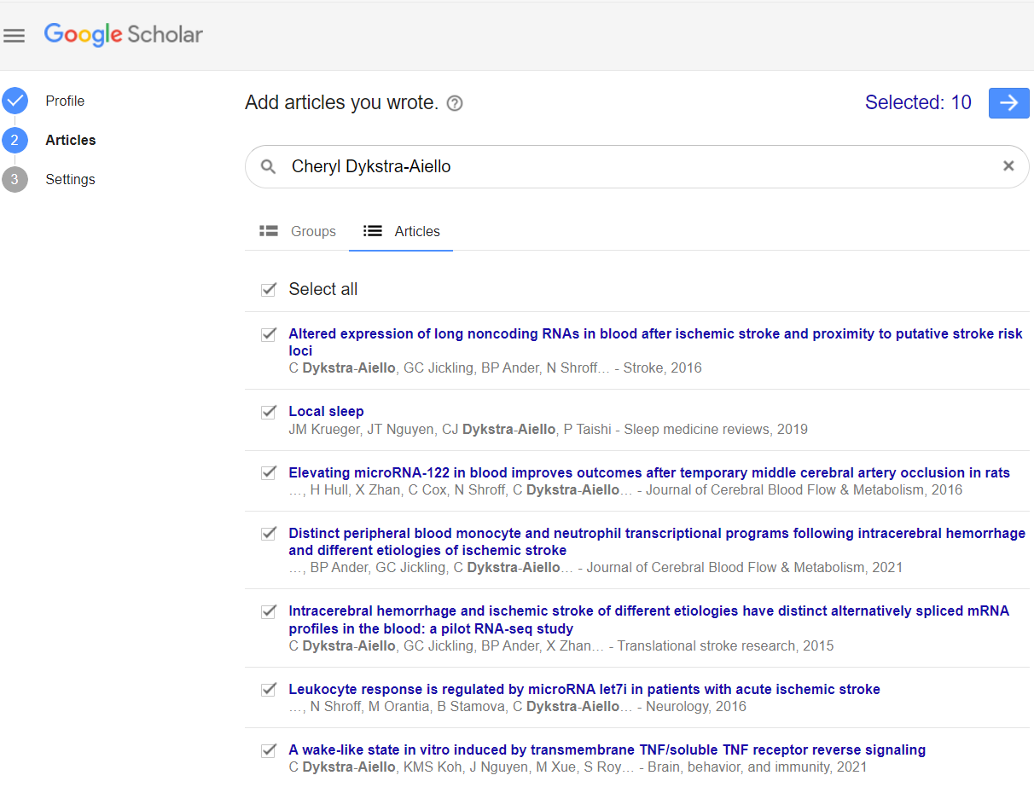
Review your Google Scholar Profile
Review Google’s suggested “articles you wrote”
Use checkbox to select publications that do not belong to you and click “Delete”
If multiple records of the same work are present, use the checkbox to select articles that refer to the same work and click “Merge”
Once the list of publications only contains your work, click “Next”

Slide 13
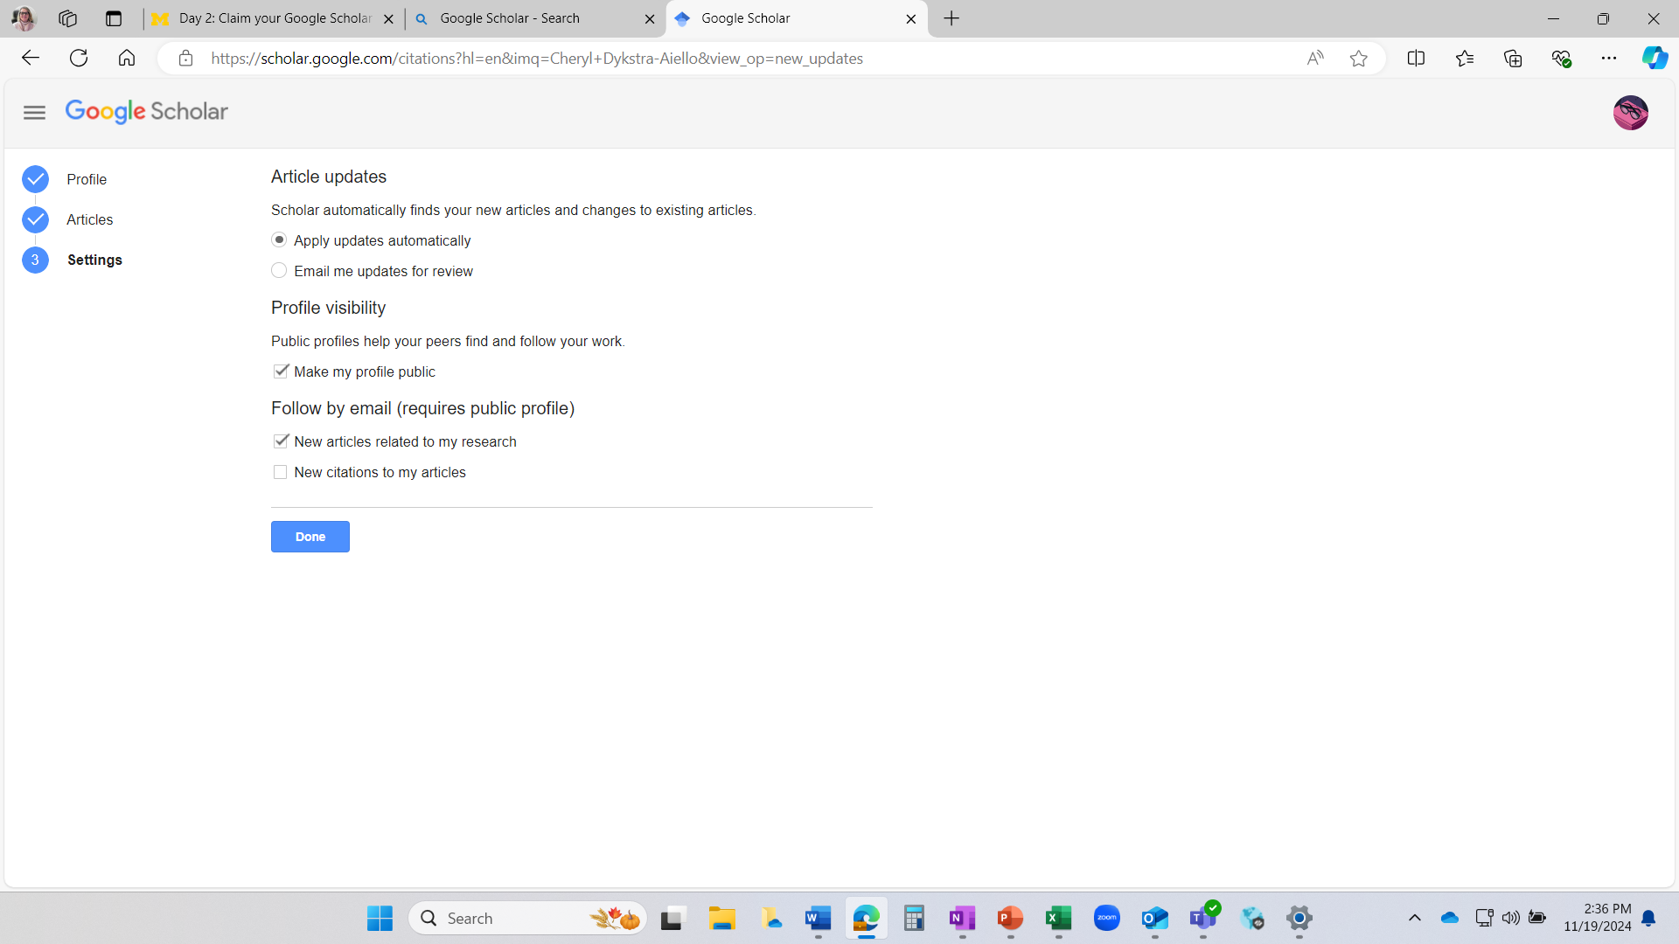
Now you have some decisions to make
Do you want Google Scholar to automatically add your publications to your profile as it finds them (without you having to do anything), OR
Do you want it to send you an email with publications to review before they appear on your profile?
This is up to you, and you can change it later if you wish.

Slide 14
Decide your profile visibility
Do you want your profile to be public?
If you check the box to make it public, you’ll be more “Googleable” by others.
If you have a long list of publications to review (from step 3) and haven’t gone through them all yet, you may wish to set your profile to private until you’re confident that the work represented on it is all truly yours and then switch it to public.
You can always change your profile from private to public and vice versa.

Slide 15
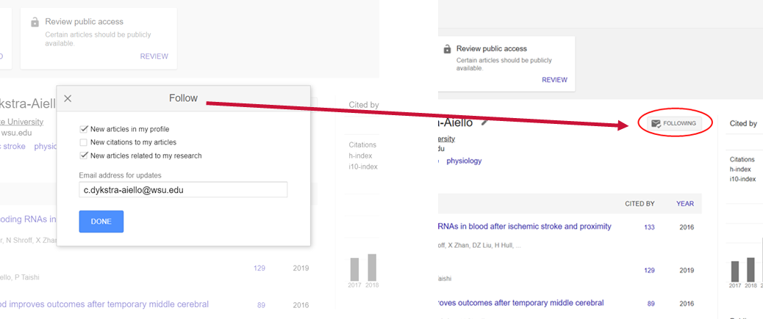
A Google Scholar Tip
(Tip: you can click “follow” (upper right corner of your profile page) to get alerts about new publications and new citations for any researcher with a public Google Scholar profile, not just yourself)

Slide 16
You’ve claimed your Google Scholar Profile: What next?
Consider whether you want to add a picture to your profile
Use “Alerts” to create email alerts for new publications that match any search terms you choose
Enhance your profile by adding co-authors: click “Edit” next to “Co-authors” on the right-hand side of your profile page
Read about Google Scholar’s citation metrics--a sneak preview of the themes we’ll dig into in Week 2 of this challenge.

Slide 17
Challenge 2 Complete!
Congratulations! Now we will move on to preserving and sharing your work with a digital repository.

Slide 18
Challenge: Digital Repository
Preserve and Share Your Work

Slide 19
Digital Repository
Ever shared your pre-prints or other work to colleages via email or social media or posted on your personal webpage?
Repositories make your scholarly work* more stable and easier to preserve, share, discover and cite.
* including article pre-prints to slide decks to syllabi

Slide 20
Digital Repository Benefits
Stable URL
Share with others or post to social media, your personal website, etc.
Easier for others to cite your work.
No broken links or about migrating
No re-posting your work to a new web page if you move to a new institution or if your website moves to a new platform.
Indexing by Google and Google Scholar
Your work is more discoverable by others
Feedback about how the work has been used
See how many views it has received, download counts, shares, etc.

Slide 21
Scholarly Digital Repositories
Often focused on specific disciplines
e.g., math or biology; or particular communities.
Today's challenge:
Choose and explore a repository from the list provided in the accompanying challenge document (or a different one that you know)
Find one item of interest in the repository to read, use in your research or teaching, or share with colleagues
Check submission guidelines

Slide 22
WSU’s Digital Repository: Research Exchange
A place for preservation and sharing of WSU’s scholarship
https://libguides.libraries.wsu.edu/rex
Who can deposit? WSU faculty, staff, and students
What you can deposit? articles, book chapters, working papers, technical reports, conference presentations, posters, images, media, datasets, and educational resources.
Who can access deposited materials:? WSU faculty, staff, students and the general public, unless that material has been temporarily embargoed.

Slide 23
Research Exchange – Ways to Use
Create a faculty profile to showcase research and educational materials.
To get started, contact libraries.research@wsu.edu
The Libraries can help pre-populate the profile with citations and information collected from Pivot and other sources.
Archive datasets and articles using Research Exchange. By doing so, you as a researcher can comply with funder open-access mandates while ensuring that others can access and build upon your findings.
Build a collection of materials that document the work of a lab or research group.
Use Research Exchange as a curricular tool by inviting students to showcase their research.

Slide 24
Challenge 3 Complete!
Congratulations! Next week, we will move on to strategic academic use of social media

