Slide 1

Energy Systems Innovation Center (ESIC) Update
Mani V. Venkatasubramanian
Director, ESIC

Slide 2
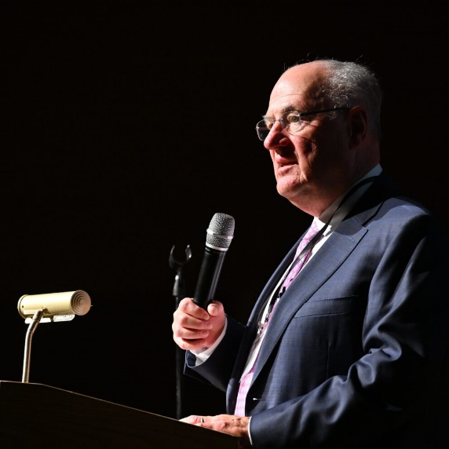
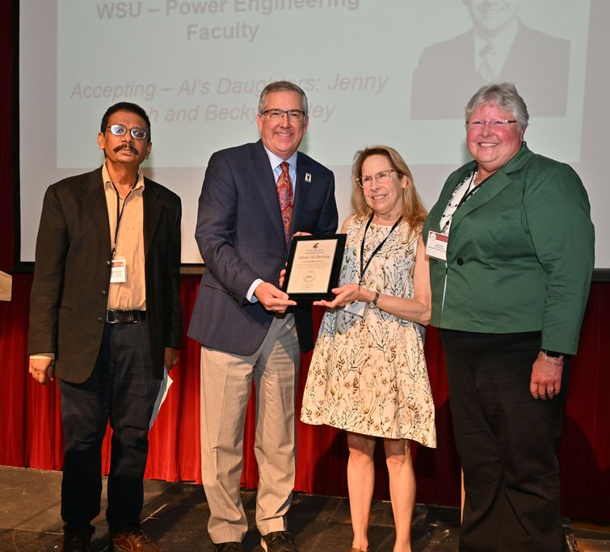
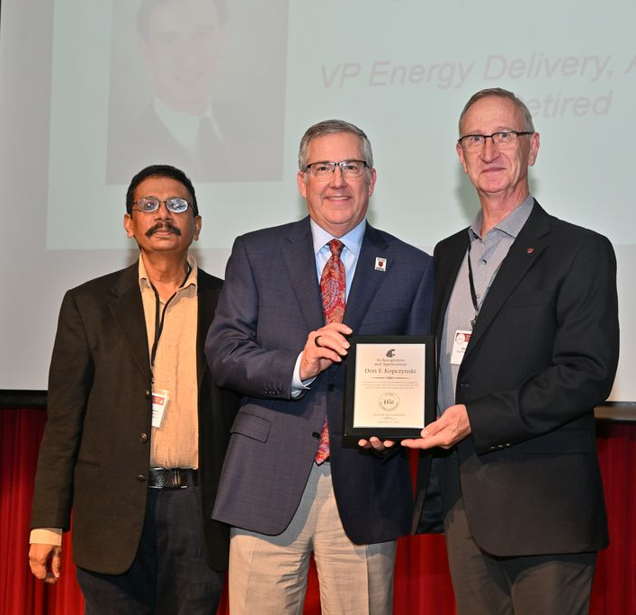
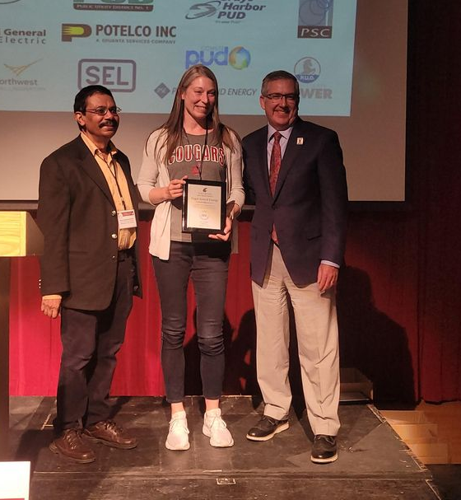
WSU Power Program
Power Professorship program since 1973
Energy Systems Innovation Center since 2012
50th-anniversary celebration on Sep 15, 2023
To recognize, honor, and thank contributions from students, faculty, alumni, and industry

Slide 3

Energy Systems Innovation Center
Vision
Leading the transition to affordable, sustainable and resilient electric power systems
Mission
Collaborative research, education, and outreach to solve challenges for modern power systems
Notes:
Power Program at WSU
A top program in US****
Leadership in research; well funded by government and industry
Significant and sustained impact on education
Educating leaders in industry****
Power professorship program since 1973
Professional services and conference activities

Slide 4
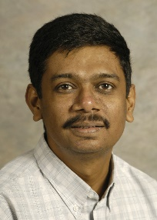
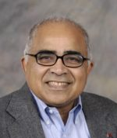
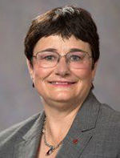
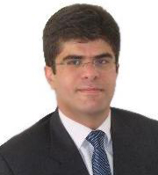
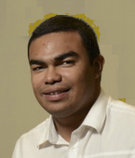
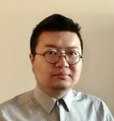
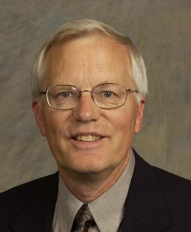
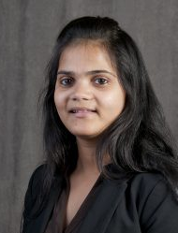
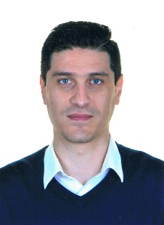
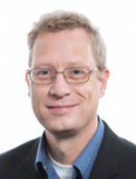
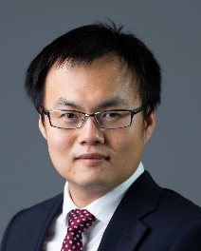
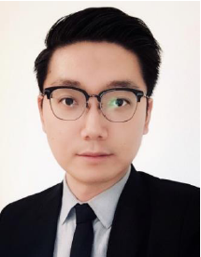
ESIC Power Faculty
Mani Venkatasubramanian, ESIC Director, Boeing Distinguished Professor
Anjan Bose, Regents Professor, Distinguished Professor in Power Engineering
Noel Schulz, INEF Director, Professor
Robert Olsen, Professor Emeritus
Saeed Lotfifard, Associate Professor
Anamika Dubey, AGI Co-Director (WSU), Huie-Rogers Endowed Chair Electrical Engineering
Milad Ebrahimi, Assistant Professor
Javier Guerrero, Clinical Assistant Professor
Shuzeng Xie, Clinical Assistant Professor
Josue Campos Do Prado, Assistant Professor
Hang Gao, Assistant Professor
Wei Du, AGI Co-Director (PNNL), Research Professor
Kevin Schneider, Research Professor

Slide 5


ESIC Faculty in Allied Disciplines
Computer Science
Partha Pande – Network-on-Chip
Behrooz Shirazi – Pervasive Computing
Diane Cook – Smart Home/Environments
Jana Doppa – Machine Learning
Assefaw Gebremedhin – Data science
Ananth Kalyanaraman – Computing
Electrical Engineering
Sandip Roy – Dynamic Networks
Pat Pedrow – High Voltage
Hang Gao– WSU Vancouver
Xinghui Zhao – WSU Vancouver
Civil & Environmental
Michael Wolcott– Sustainable Infrastructures
Jennifer Adam – Water and Storage
John Petrie – Impact of Hydro Operations
Ji Yun Lee – Infrastructure resilience
Architecture
Todd Beyreuther – Integrated Design
Economics
Alan Love – Electricity Markets
Chemical Engineering
Su Ha – Fuel Cells
Communication
Amanda Boyd – Risk Communication
Mechanical & Materials Engineering
Jacob Leachman – Hydrogen/Nuclear
Dustin McLarty – Energy Storage
Grant Norton – Nanotechnology
Soumik Banerjee – Solar Cells, Batteries
Yuehe Lin – Batteries
Liberal Arts
Paul Whitney – Cognitive Behavior
Christine Horne – Social Norms

Slide 6
Research Expenditures
$M

Slide 7
ESIC Thrust Areas
1) Microgrids and IBRs
2) Reliability and Resilience
3) Grid Edge/Privacy/Cybersecurity
4) AI and ML Applications
5) Workforce 2.0

Slide 8
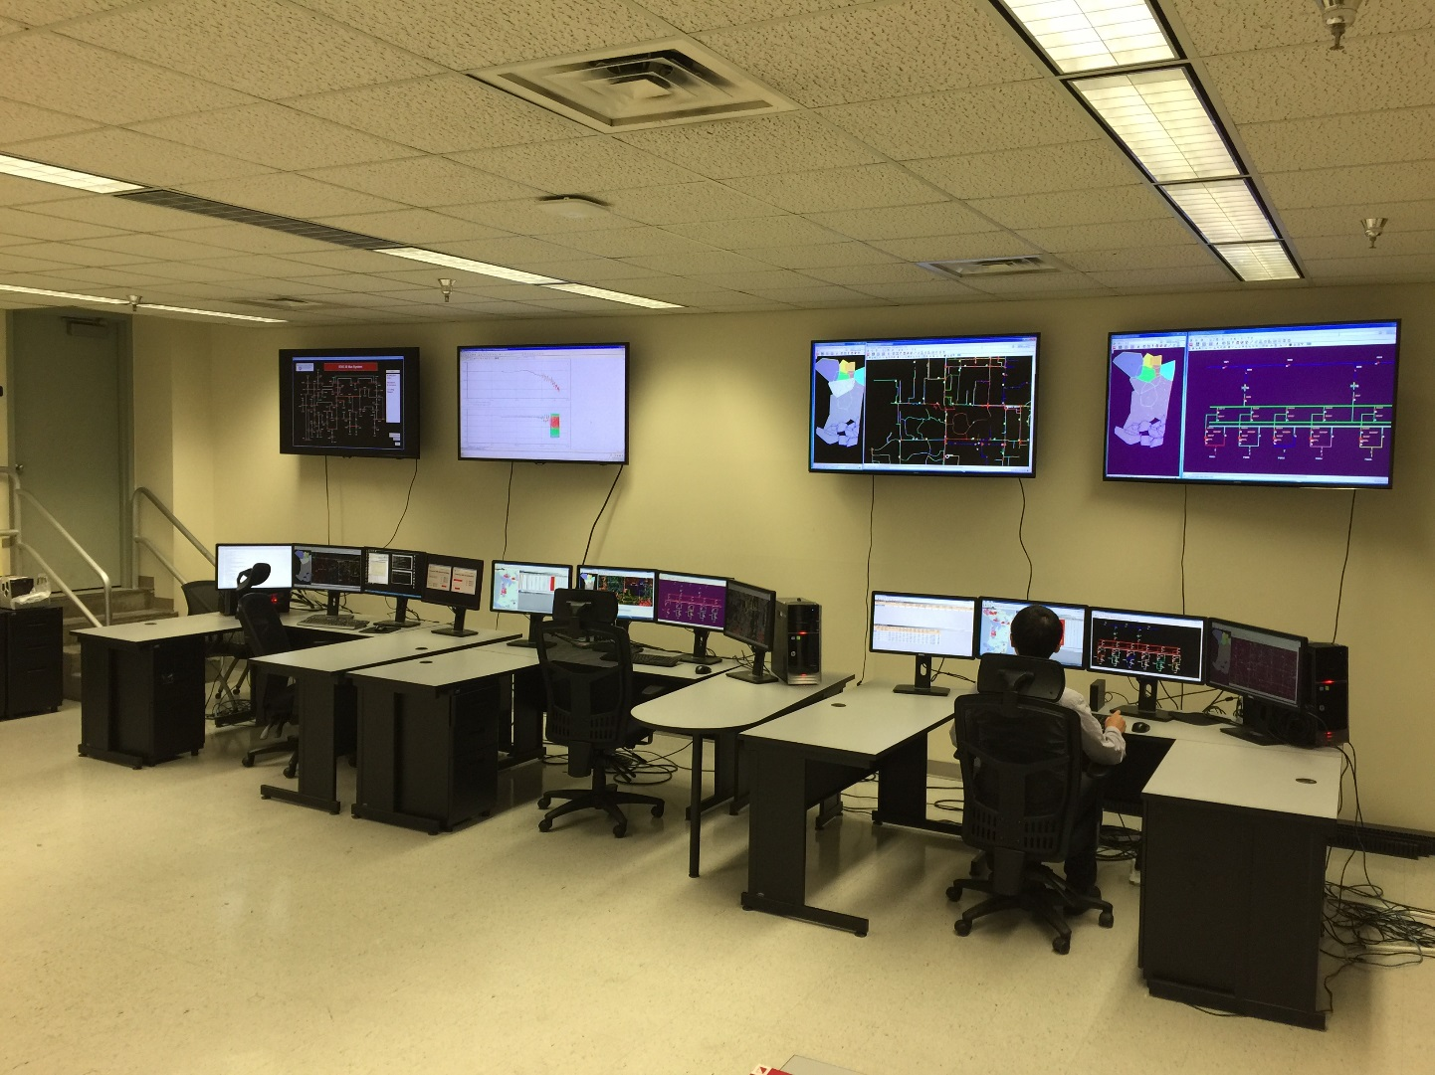
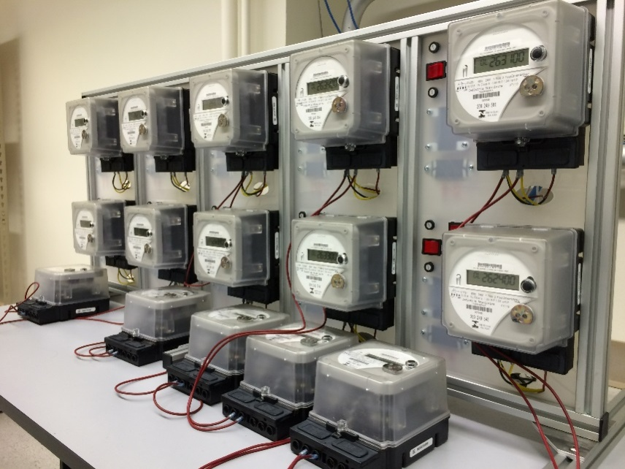
WSU GE Smart City Testbed

Slide 9
ESIC Outreach
Technical conferences: WPRC
ESIC Seminars (weekly)
ESIC Scholarships
Leadership in professional societies
Technology transfer – start-up companies and technology licensing
Collaboration with centers, e.g. AGI, PSERC, CHARGE, EARNEST.

Slide 10
ESIC PEP Membership
ESIC Power Education Partnership (PEP)
Annual Membership: Varies
Benefits – Support Power Engineering Education
Practicum
Support for Internships/Jobs
Power Curriculum Feedback
Free booths at Fall Career Expo and IEEE Career Fair
Professional Development Hours for ESIC weekly seminars
Optional Tutorials by Faculty Experts
Dedicated Industry Liaison

Slide 11












ESIC PEP Membership
ESIC PEP Members
2024

Slide 12
ESIC REP Membership
ESIC Research Excellence Partnership (REP)
Annual Membership: $15K
Benefits - Access to ESIC research:
Research collaborations
ESIC weekly seminars
Project catalog/announcements
Research reports and papers on secure website
Invitation to be project advisors
Tutorials by faculty experts
Dedicated industry liaison
Seed projects at no overhead (no deliverables)

Slide 13






ESIC REP Membership
ESIC REP
Members 2024

Slide 14
PSM in Electrical Power Engineering
Professional Science Masters (PSM) in Electrical Power Engineering (EPE)
Online degree program offered by ESIC
Combination of Electrical Engineering and Engineering Management courses
Students from all over the world

Slide 15
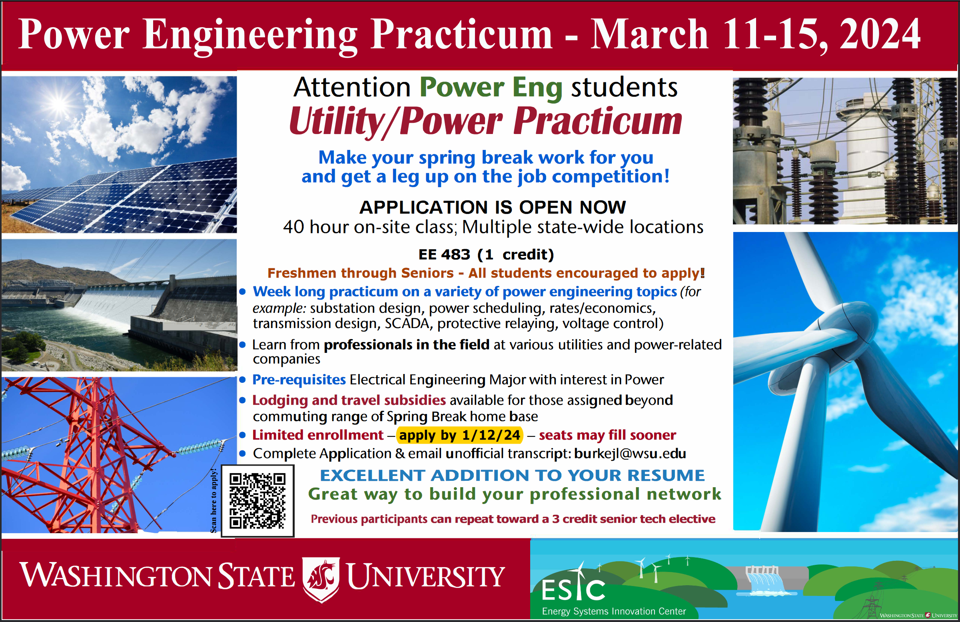
Spring Break Practicum

Slide 16
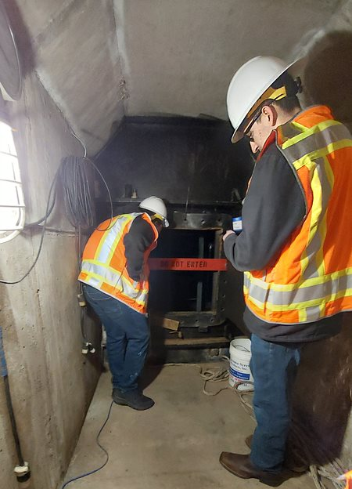
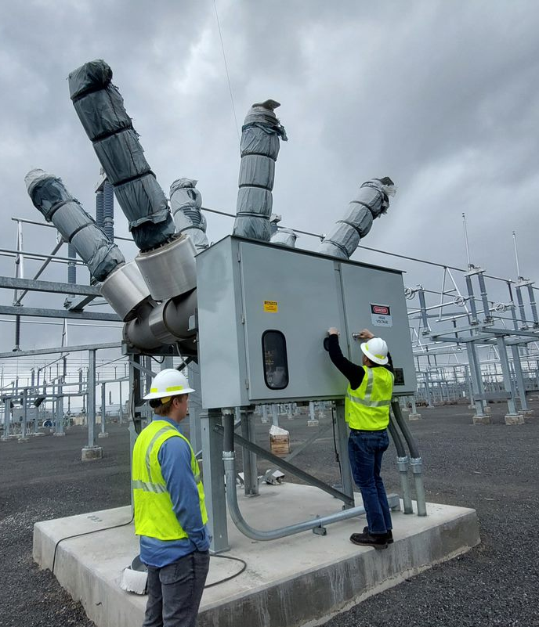
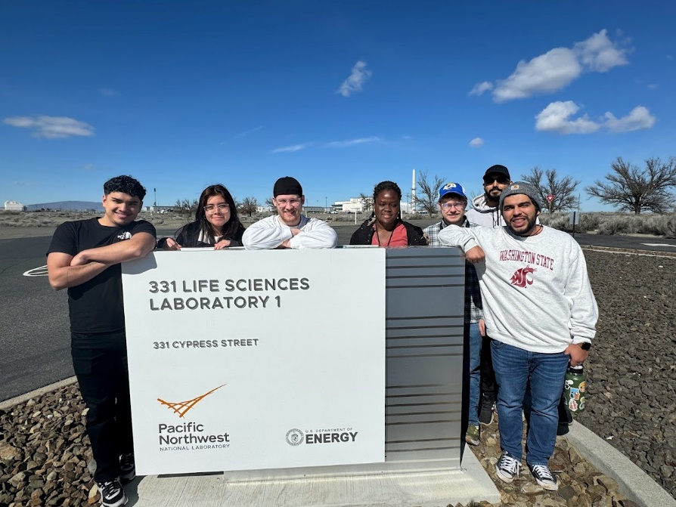
Power Practicum
2024 Practicum
46 Student Participants
5 WSU Campuses
12 Industry Hosts
Power Practicum Grant County PUD March 2024 [photo credit Nathan Bucholz]
Power Practicum Grant County PUD March 2024 [photo credit Nathan Bucholz]
Power Practicum PNNL March 2024 [photo credit [Jessica Pantoja-Garcia]

Slide 17

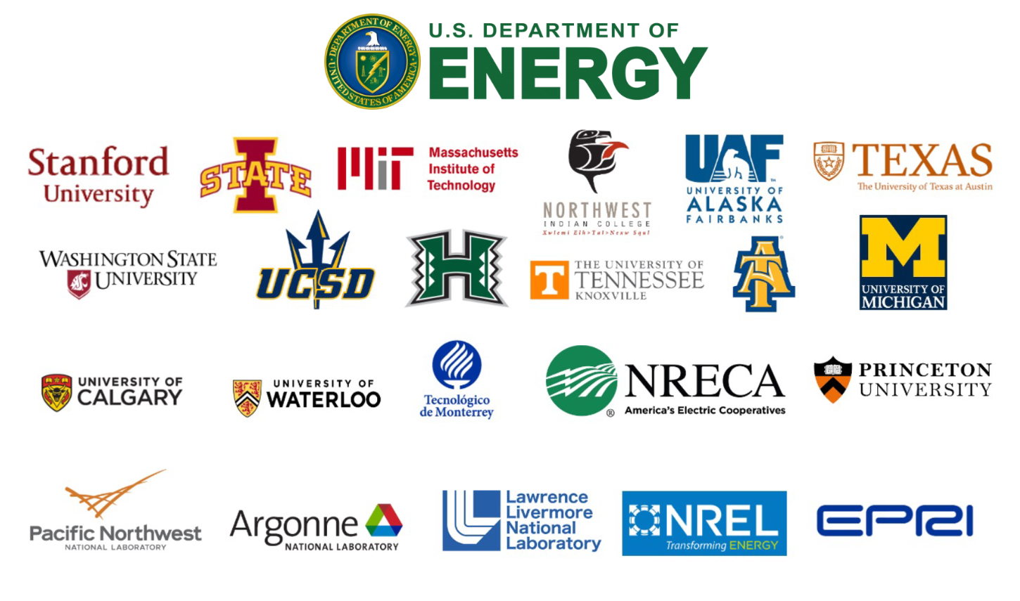
DOE Resilience Center EARNEST
Led by Stanford
Equitable solutions for energy resilience.
$20M total funding. WSU funding at $2M.
Mani, Anjan, Anamika and Noel.
Close collaboration with PNNL, Avista, and regional Tribes.
17

Slide 18
DOE SETO OPTIMA Planning Tools
Led by WSU
Planning tools for managing uncertainties in future scenarios.
$2.4M funding.
Mani and Anjan.
Close collaboration with Iowa State University and Southwest Power Pool.
18

