Slide 1

WSU’s Institute for Northwest Energy Futures - Developing A Systems Approach to Clean Energy
Noel Schulz
Inaugural Director, INEF
Bob Ferguson Endowed Professor
Washington State University Tri-Cities

Slide 2

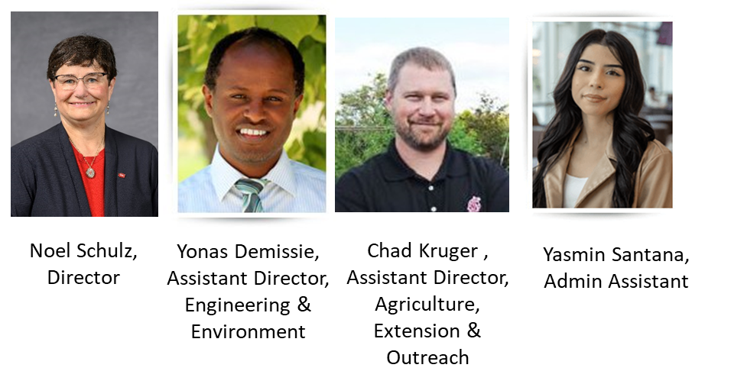
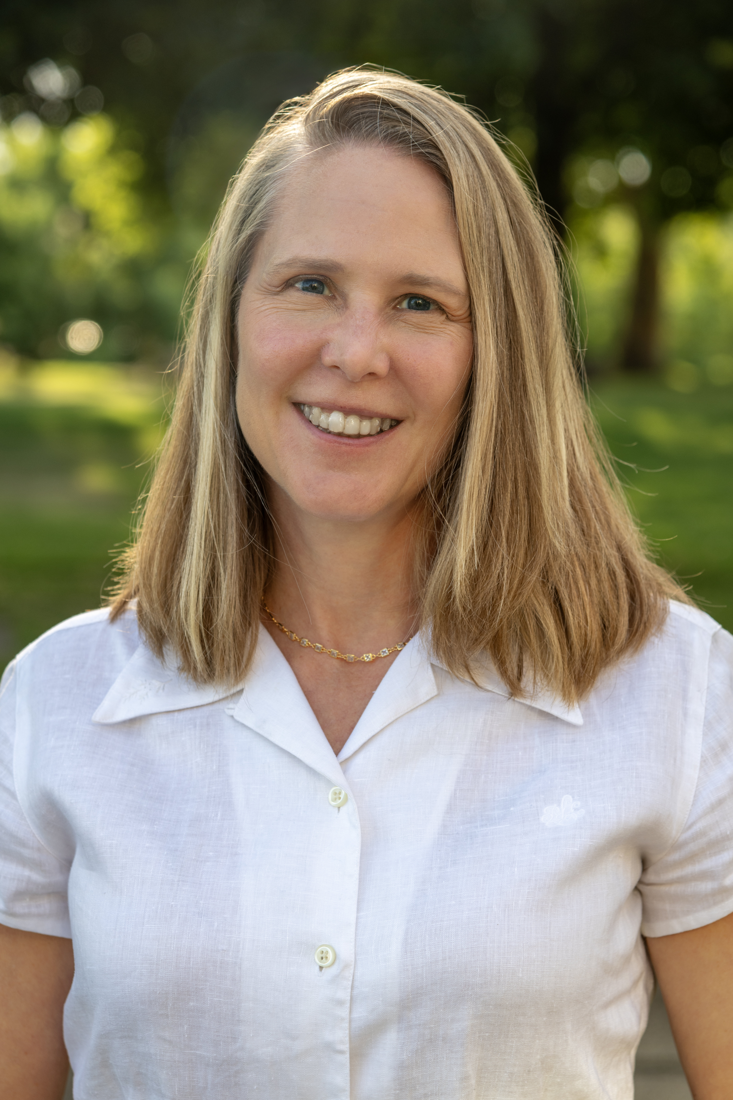
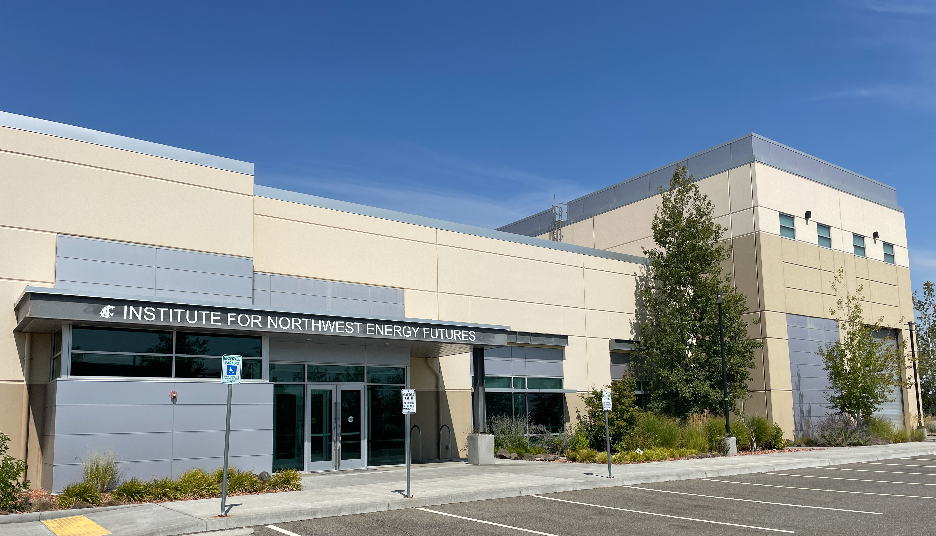
INSTITUTE FOR NORTHWEST ENERGY FUTURES
Institute for Northwest Energy Future (INEF)
This new WSU state-funded energy research center aims to bring together researchers, industry leaders, policymakers and communities to innovate and develop cutting-edge clean energy technologies using a systems approach. Funding includes seven new faculty, six staff and three administrative positions.
WSU TRI-CITIES
INEF Leadership Team
Headquartered at WSU Tri-Cities
Carmine Hanks Communications Director

Slide 3
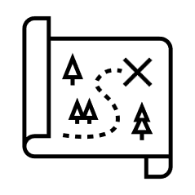
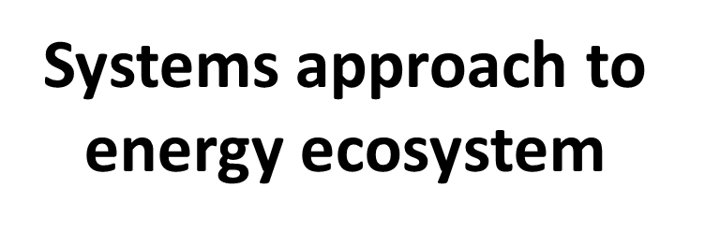

INSTITUTE FOR NORTHWEST ENERGY FUTURES
INEF Vision and Strategy
INEF will help develop and implement roadmaps for clean energy system approach in the Tri-Cities area, Washington and beyond.
WSU TRI-CITIES
Goals
Provide research support
Develop needed workforce
Leverage the region’s energy hub with
WSU’s unique research, education and extension resources
Growing partnerships with industry and PNNL

Slide 4
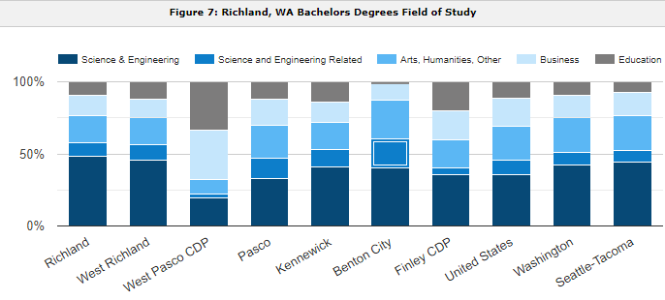
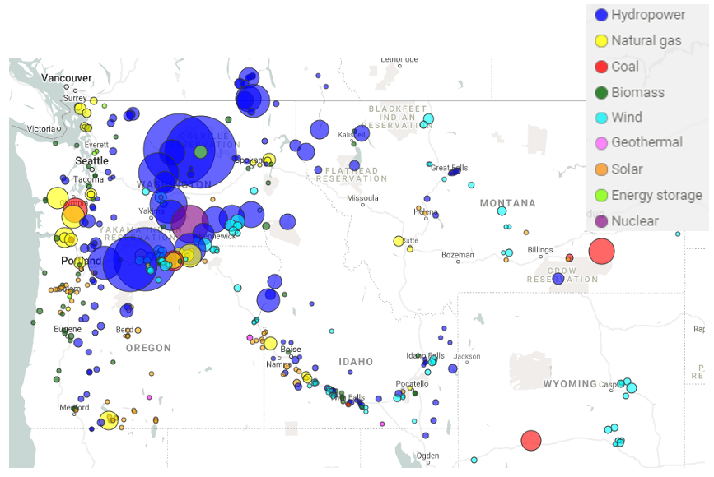
INSTITUTE FOR NORTHWEST ENERGY FUTURES
Opportunity to Leverage Tri-Cities Region
What makes Tri-Cities unique related to clean energy
Skilled energy workforce in Tri-Cities area
Strong public-private partnerships across the energy ecosystem
WSU TRI-CITIES
Richland:
58% S&E
Seattle:
52% S&E
United States:
46% S&E
Source: Northwest Power and Conservation Council
https://www.census.gov/programs-surveys/acs/data.html

Slide 5

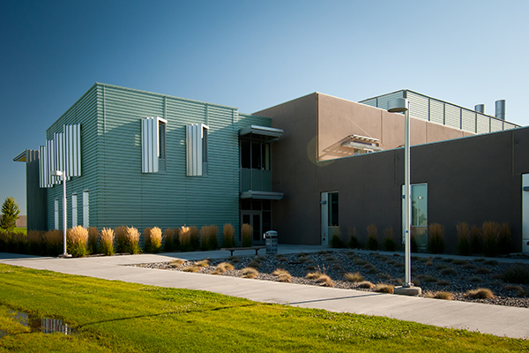
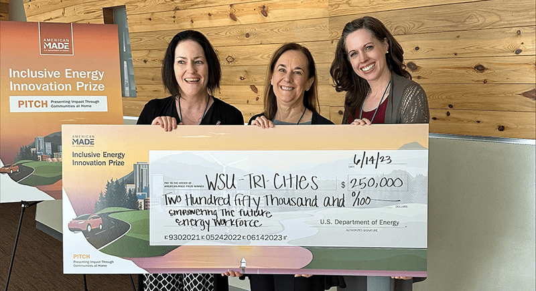
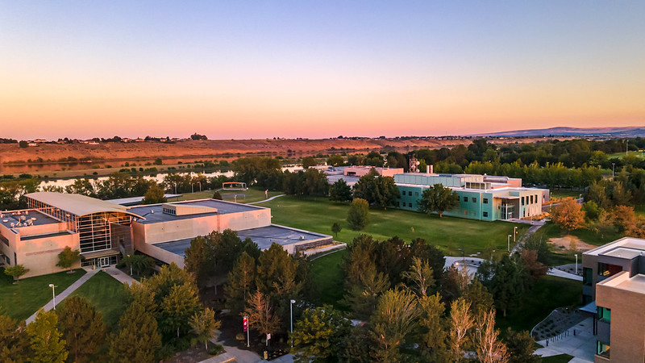
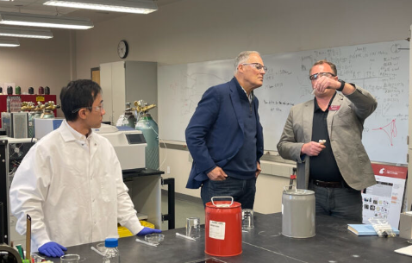


INSTITUTE FOR NORTHWEST ENERGY FUTURES
Leveraging WSU Tri-Cities Existing Activities & Growing Partnerships
WSU TRI-CITIES
Bioproducts, Sciences and Engineering Laboratory (BSEL)
US DOE Inclusive Energy Innovation Prize
Joint Institutes
Advanced Grid
Bioproducts
Nuclear Science and Technology
Pacific Northwest Hydrogen Association (PNWH2)
Sustainable Aviation Fuel (SAF)

Slide 6
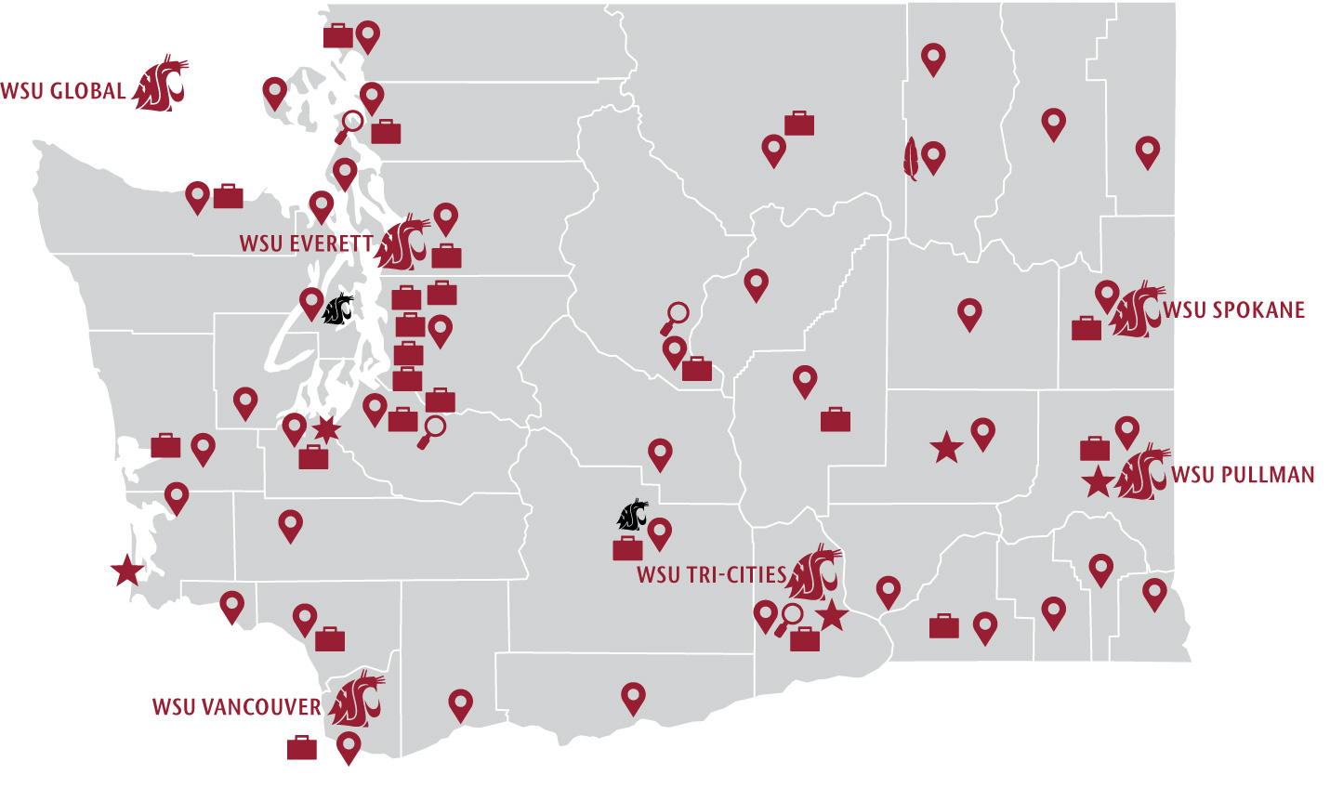
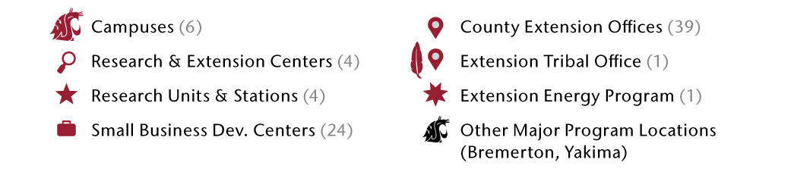
INSTITUTE FOR NORTHWEST ENERGY FUTURES
Leverage the WSU System Energy Ecosystem
While INEF is headquartered on the WSU Tri-Cities campus,
it is a WSU System initiative with activities across the state.
WSU TRI-CITIES

Slide 7
INSTITUTE FOR NORTHWEST ENERGY FUTURES
WSU System Energy Related Activities For Research, Education and Outreach
WSU Extension
Institute for Northwest Energy Futures (INEF)
WSU Energy Program
Laboratory for Atmospheric Research (LAR)
Northwest Virtual Institute for Cybersecurity Education and Research (CySER)
WSU Fusion Initiative
Water Research Center (WRC)
The Aviation Sustainability Center (ASCENT)
HYdrogen Properties for Energy Research Center (HYPER)
Joint Center for Deployment & Research in Earth Abundant Materials (JCDREAM)
Freight Policy Transportation Institute (FPTI)
Institute of Materials Research (IMR)
Nuclear Science Center (NSC)
Energy Systems Innovation Center (ESIC)
Pacific Northwest Hydrogen Hub (PNWH2)
Bioenergy & Bioproducts Engineering
WSU TRI-CITIES
Center for Sustaining Agriculture and Natural Resources (CSANR)
Bioproducts Science and Engineering Laboratory (BSEL)
PNNL/WSU Advanced Grid Institute (AGI)
PNNL/WSU Nuclear Science and Technology Institute (NSTI)
PNNL/WSU Bioproducts Institute (BioIn)
Integrated Design + Construction Laboratory (ID+CL)
Composite Materials and Engineering Center (CMEC)
The Consortium for Hydrogen and Renewably Generated E-Fuels (CHARGE)
Clean Energy Ambassadors Network (CEAN)
WA Oilseed Cropping Systems Project
Center for Environmental Research, Education and Outreach (CEREO)

Slide 8







INSTITUTE FOR NORTHWEST ENERGY FUTURES
Key areas of WSU System Energy Related Activities
Food-Energy-Water Nexus
Energy and Artificial Intelligence
Materials Science and Engineering for energy related applications
Hydropower
Advanced Nuclear Reactors and Fuel Cells
Electrical Grid - Interconnections, Transmission, Distribution and Storage
Buildings/Energy Efficiency/Sustainability
Federal Facilities Transition to Zero Emissions
Sustainable building materials
Low Carbon Transportation Fuels
Biofuels – feedstocks genetics and production, conversion, co-products, fuel testing
Hydrogen and E-Fuels production, storage, conveyance
Logistics and Supply Chain Development and Management
Energy and Carbon Policy and Economics
Energy Equity and Energy Justice
Training/Policy/Services/Community engagement
WSU TRI-CITIES

Slide 9
INSTITUTE FOR NORTHWEST ENERGY FUTURES
INEF Activities
Coordinate, leverage and promote WSU system energy related activities
Advance Regional Energy Educational/Research Program Collaborations
Leverage existing partnerships with PNNL and regional industry partners
Create INEF Industry Advisory Board and topic specific Working Groups
Coordinate Collaborative Assessment Reports across energy ecosystem topics
Agriculture Symbiosis (funded through Commerce)
Future topics
WSU TRI-CITIES

Slide 10
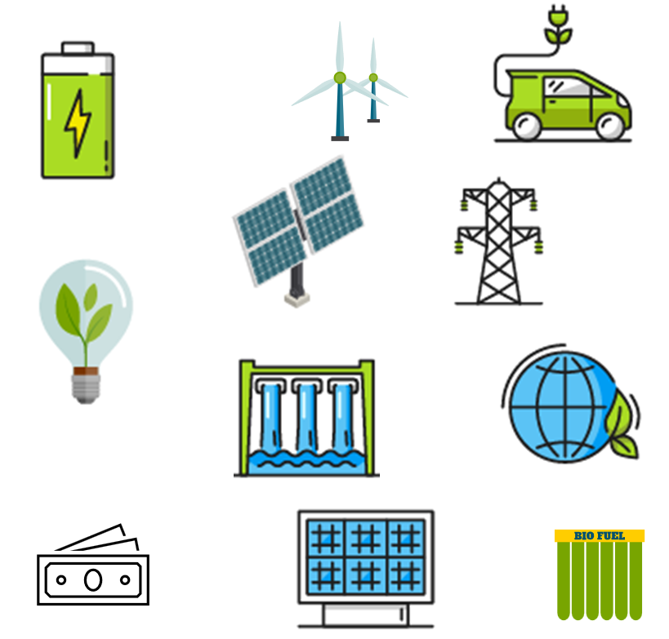
INSTITUTE FOR NORTHWEST ENERGY FUTURES
INEF Industry and Energy Community Interactions
INEF Industry Advisory Board
INEF Working Groups
Energy sources & grid – AGI, NSTI
End users (i.e. Ag, Transportation (BioIn), Buildings)
Crosscutting areas
Energy Equity
Energy Economics
Energy Data Analytics
Energy Life Cycle Analysis
Environment
WSU TRI-CITIES

Slide 11
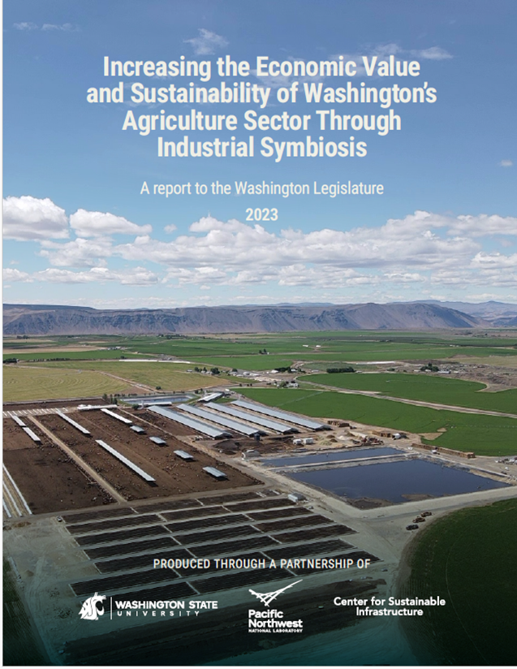
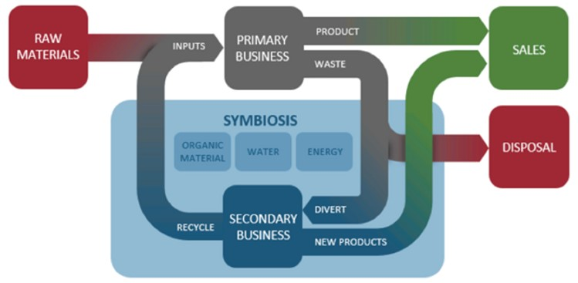
INSTITUTE FOR NORTHWEST ENERGY FUTURES
Agriculture Symbiosis
Agriculture Symbiosis happens when food, beverage, or farm businesses partner with each other, or with businesses from other industry sectors, to share their surplus resources – energy, water, and organic ‘wastes’ – for mutual economic benefit.
WSU TRI-CITIES
Roth, R., M.P. Wolcott, G.G. Yorgey, J.L. Male, T. Sturdevant, D. Camenzind, F. Pierobon, J. Padowski, C.E. Kruger, A. Whittemore, T. Carroll, K. Jensen, S. Moddemeyer, and A. Ybarra. 2023. Increasing the Economic Value and Sustainability of Washington’s Agricultural Sector through Industrial Symbiosis: A report to the Washington Legislature. WSU Center for Sustaining Agriculture and Natural Resources, and WSU Institute for Northwest Energy Futures, Richland, WA.

Slide 12
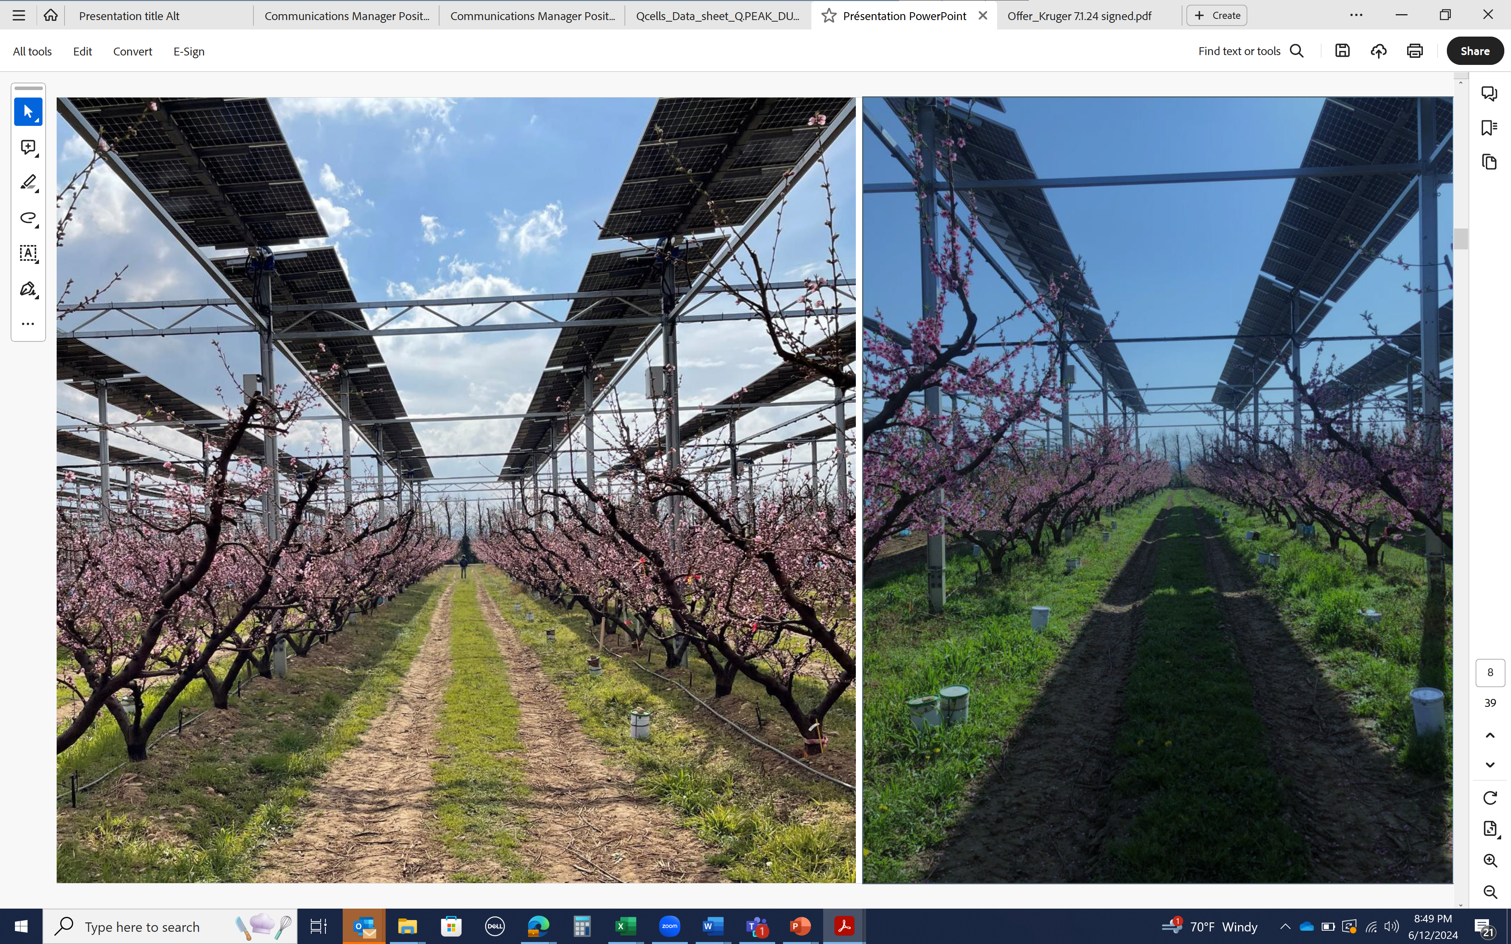
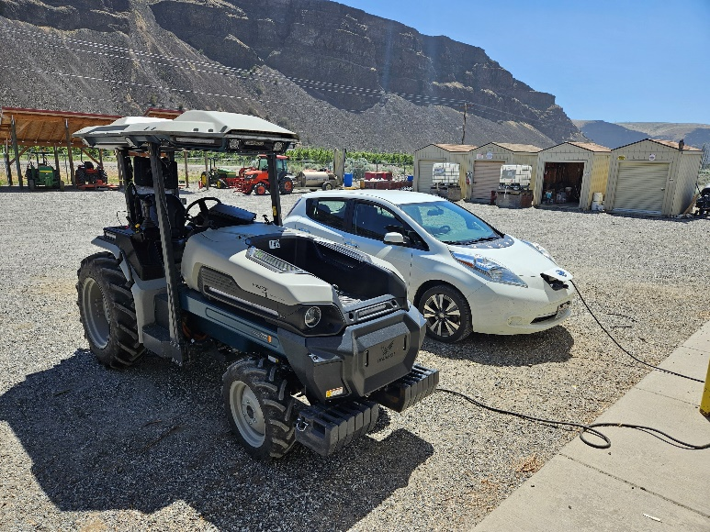
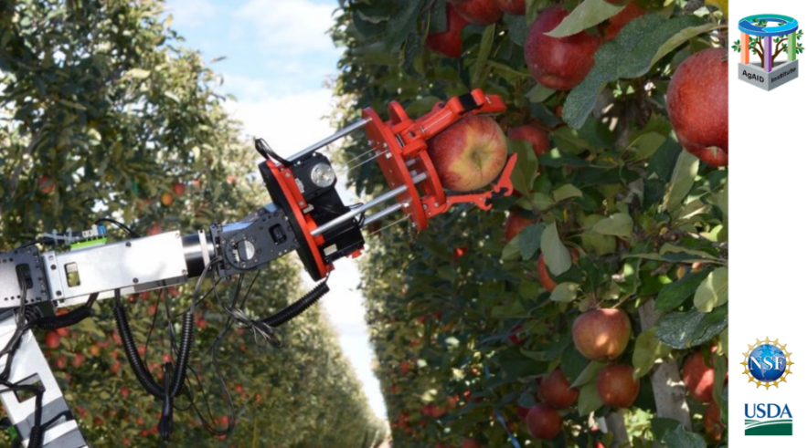

INSTITUTE FOR NORTHWEST ENERGY FUTURES
Topics for future collaborative assessment reports
Food-Water-Energy Nexus in Washington
Energy-water trade off – irrigation versus hydrogeneration
Energy demand and energy use for food growth and processing
Electrifying agriculture including renewable energy
Other suggestions
Grid resilience to increased demand – Opportunity for Collaboration with AGI
Water and land use in renewable energy production
WSU TRI-CITIES
Credit: Sun’Agri

Slide 13


INSTITUTE FOR NORTHWEST ENERGY FUTURES
Opportunities for Engagement
Join us on October 2 from 4:30-6:00 pm as
WSU Tri-Cities hosts ribbon-cutting and open house at our new building for INEF
Reach out to INEF about energy-related expertise across the WSU system.
Provide suggestions for our Industry Advisory Board.
Participate in our INEF Working Groups.
Help connect us with those interested in “Food-Energy-Water Nexus“.
Partner with INEF on proposals and activities.
Ask us about opportunities to sponsor educational activities.
WSU TRI-CITIES
Many thanks to AGI Co-Directors for
opportunity to share about INEF
https://tricities.wsu.edu/inef/ tricities.inef@wsu.edu

