Slide 1
PNNL Grid Program Overview
Jim Ogle
Director Electricity Infrastructure Sector
PNNL-SA-202980

Slide 2
History Of Grid Innovation And Impact
Reliability against system dynamics with time synchronous sensors (PMUs and NASPI)
Reliability leveraging PMUs, real-time control with high performance computing and grid energy storage
DOE Grid Modernization Initiative–integration across DOE and industry
1990’s
Late 1990’s Early 2000’s
2000’s
2010’s
2015
2020’s
Demand response and transactive energy theory and demonstrations
Resilience due to super storm impacts and cyber risk. NAERM emerges
Clean energy objectives challenge generation transition w/o compromising reliability and resilience. Emergence of climate risk, equity and justice dimensions of system planning
Climate science and GCAM climate policy analytics
PNW hydropower and fisheries
Data intensive computing and AI/ML

Slide 3

PNNL Grid R&D Program Areas
Cybersecurity
and Emergency
Response
Power
Electronics/Grid
Integration
PNNL Grid
R&D Program
Elements
Energy
Storage for
Social Equity
Grid
Architecture
Grid Energy
Storage
Reliable
Transmission
Resilient
Distribution
Notes:
Resilient Distribution
Energy Storage
Grid Architecture
Reliable Transmission
Cyber Security & Emergency Response

Slide 4

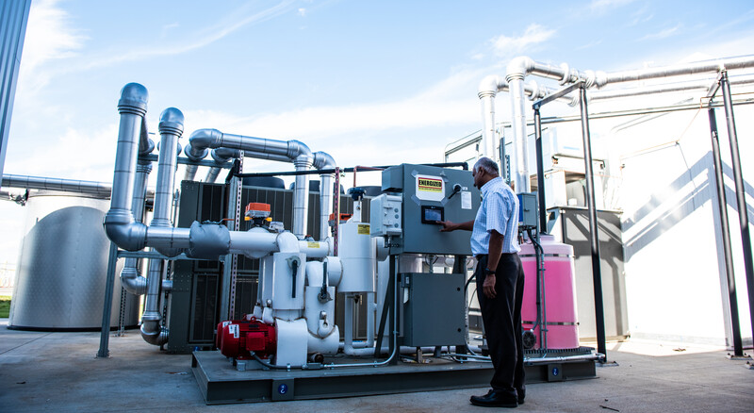

Energy Decarbonization Lab Objective Integrates across sectors and technologies
Energy Decarbonization through Grid Control and Energy Storage
GRID DECARBONIZATION
Power electronics
Grid edge control
Transmission planning
National analytics platform
BUILDING DECARBONIZATION
Demand flexibility
Electrification
Energy efficiency
ENERGY STORAGE
Grid long duration storage
Transportation storage
Leadership storage capabilities

