Slide 1
WSAS Analysis & Stakeholder Engagement to Examine the Impacts & Options for Valuing Distributed Solar in WA State
August 28, 2024
Donna Gerardi Riordan Executive Director, Washington State Academy of Sciences

Slide 2


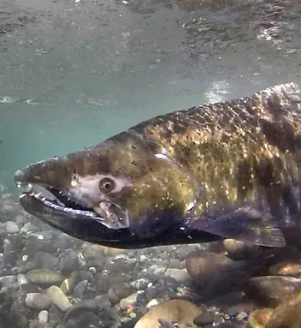
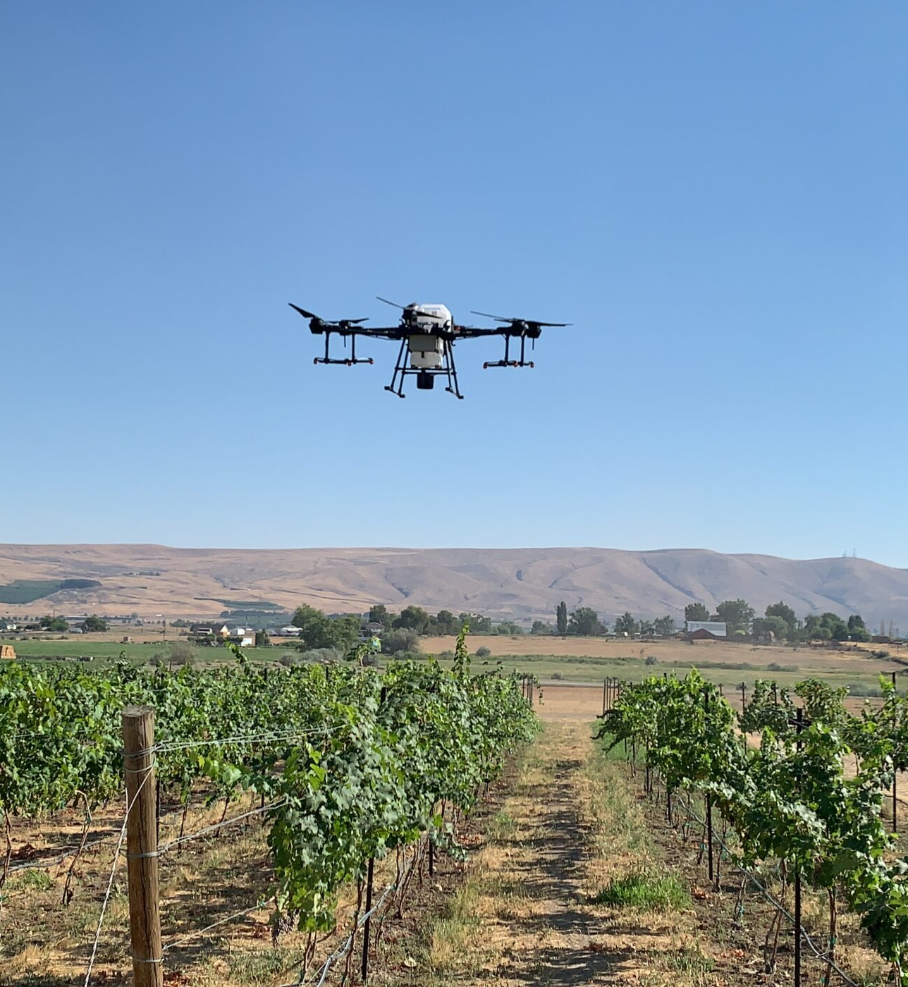
OUR MISSION
We provide expert scientific and engineering assessments to inform public policymaking and work to increase the impact of research in Washington State.
Clean energy
Sustainable aviation
Salmon recovery
Precision agriculture
SCIENCE IN THE SERVICE OF WASHINGTON STATE
Notes:
The Washington State Academy of Sciences (WSAS) exists to provide expert scientific and engineering assessments to inform public policymaking and to work to increase the impact of research in Washington State.

Slide 3
A BRIEF HISTORY
2005
Establishment
Requested by Governor Gregoire and created by the Legislature
Modeled in form and function after the National Academies
2008
Organization
WSU serves as the Academy’s fiscal sponsor through an MOU
2017–2024
Period of growth
Elected membership increased to 430+ senior scientists and engineers
Initial group of 107 members – all NASEM
Core funding from the state increased in FY 2023
WSAS forms 501(c)(3) nonprofit
Notes:
In 2005, Washington State Governor Christine Gregoire recognized the need for – and called for the creation of – an independent resource that state policymakers could turn to for scientific and technical advice. The Washington State Legislature took up her call, unanimously passing Engrossed Senate Bill 5381. This legislation officially established the Washington State Academy of Sciences with the principal mission of providing “scientific analysis and recommendations on questions referred to the Academy by the Governor, the Governor’s designee, or the legislature.”
An Organizing Committee, co-chaired by University of Washington President Mark Emmert and Washington State University President Lane Rawlins, developed the initial budget, articles of incorporation, and bylaws of WSAS. National Academy of Sciences members Gordon Orians and R. James Cook among others helped set WSAS up as a ‘working academy’ modeled in form and function after the National Academies.
In 2008, WSAS was established as a 501(c)(3) nonprofit. Washington State University (WSU) serves as the Academy’s fiscal sponsor through a Memorandum of Understanding, though WSAS operates completely independently of WSU. Initially membership was just extended to scientists elected to NASEM. 2010 was the first year that WSAS began holding our own elections.
Over the years, WSAS has grown, and continues to grow, in our capacity to respond to the ever evolving scientific and technological information needs of Washington State. Our membership includes over 400 of the leading scientists and engineers in Washington State’s universities, national lab and industries. Thanks to an increase in our core funding from the state, we have recently expanded our staff, allowing us to have greater bandwidth to engage policymakers and other stakeholders across the state.

Slide 4
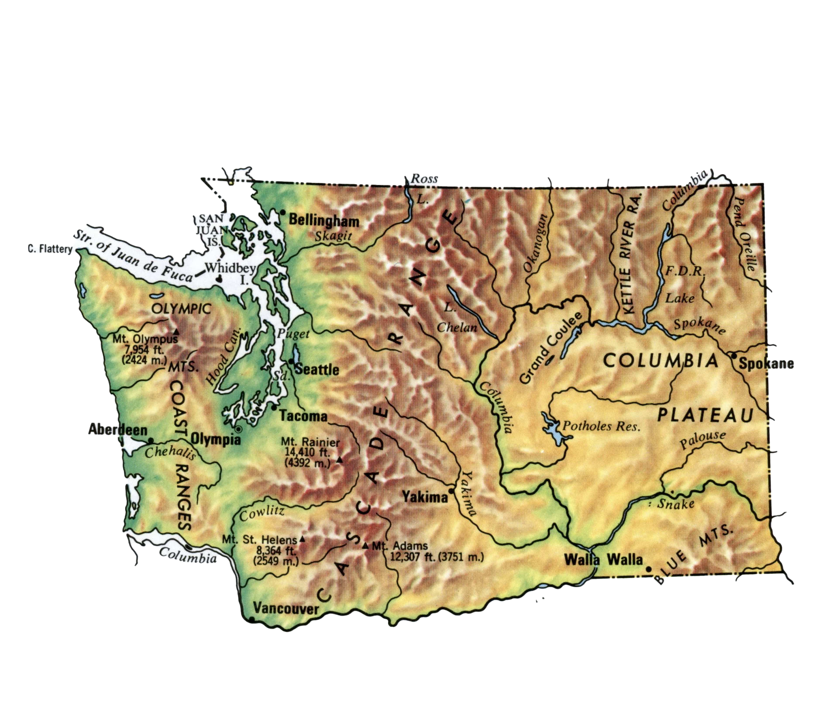
RESEARCH POWERHOUSES IN WA
Everett
Pullman
Tri-cities

Slide 5
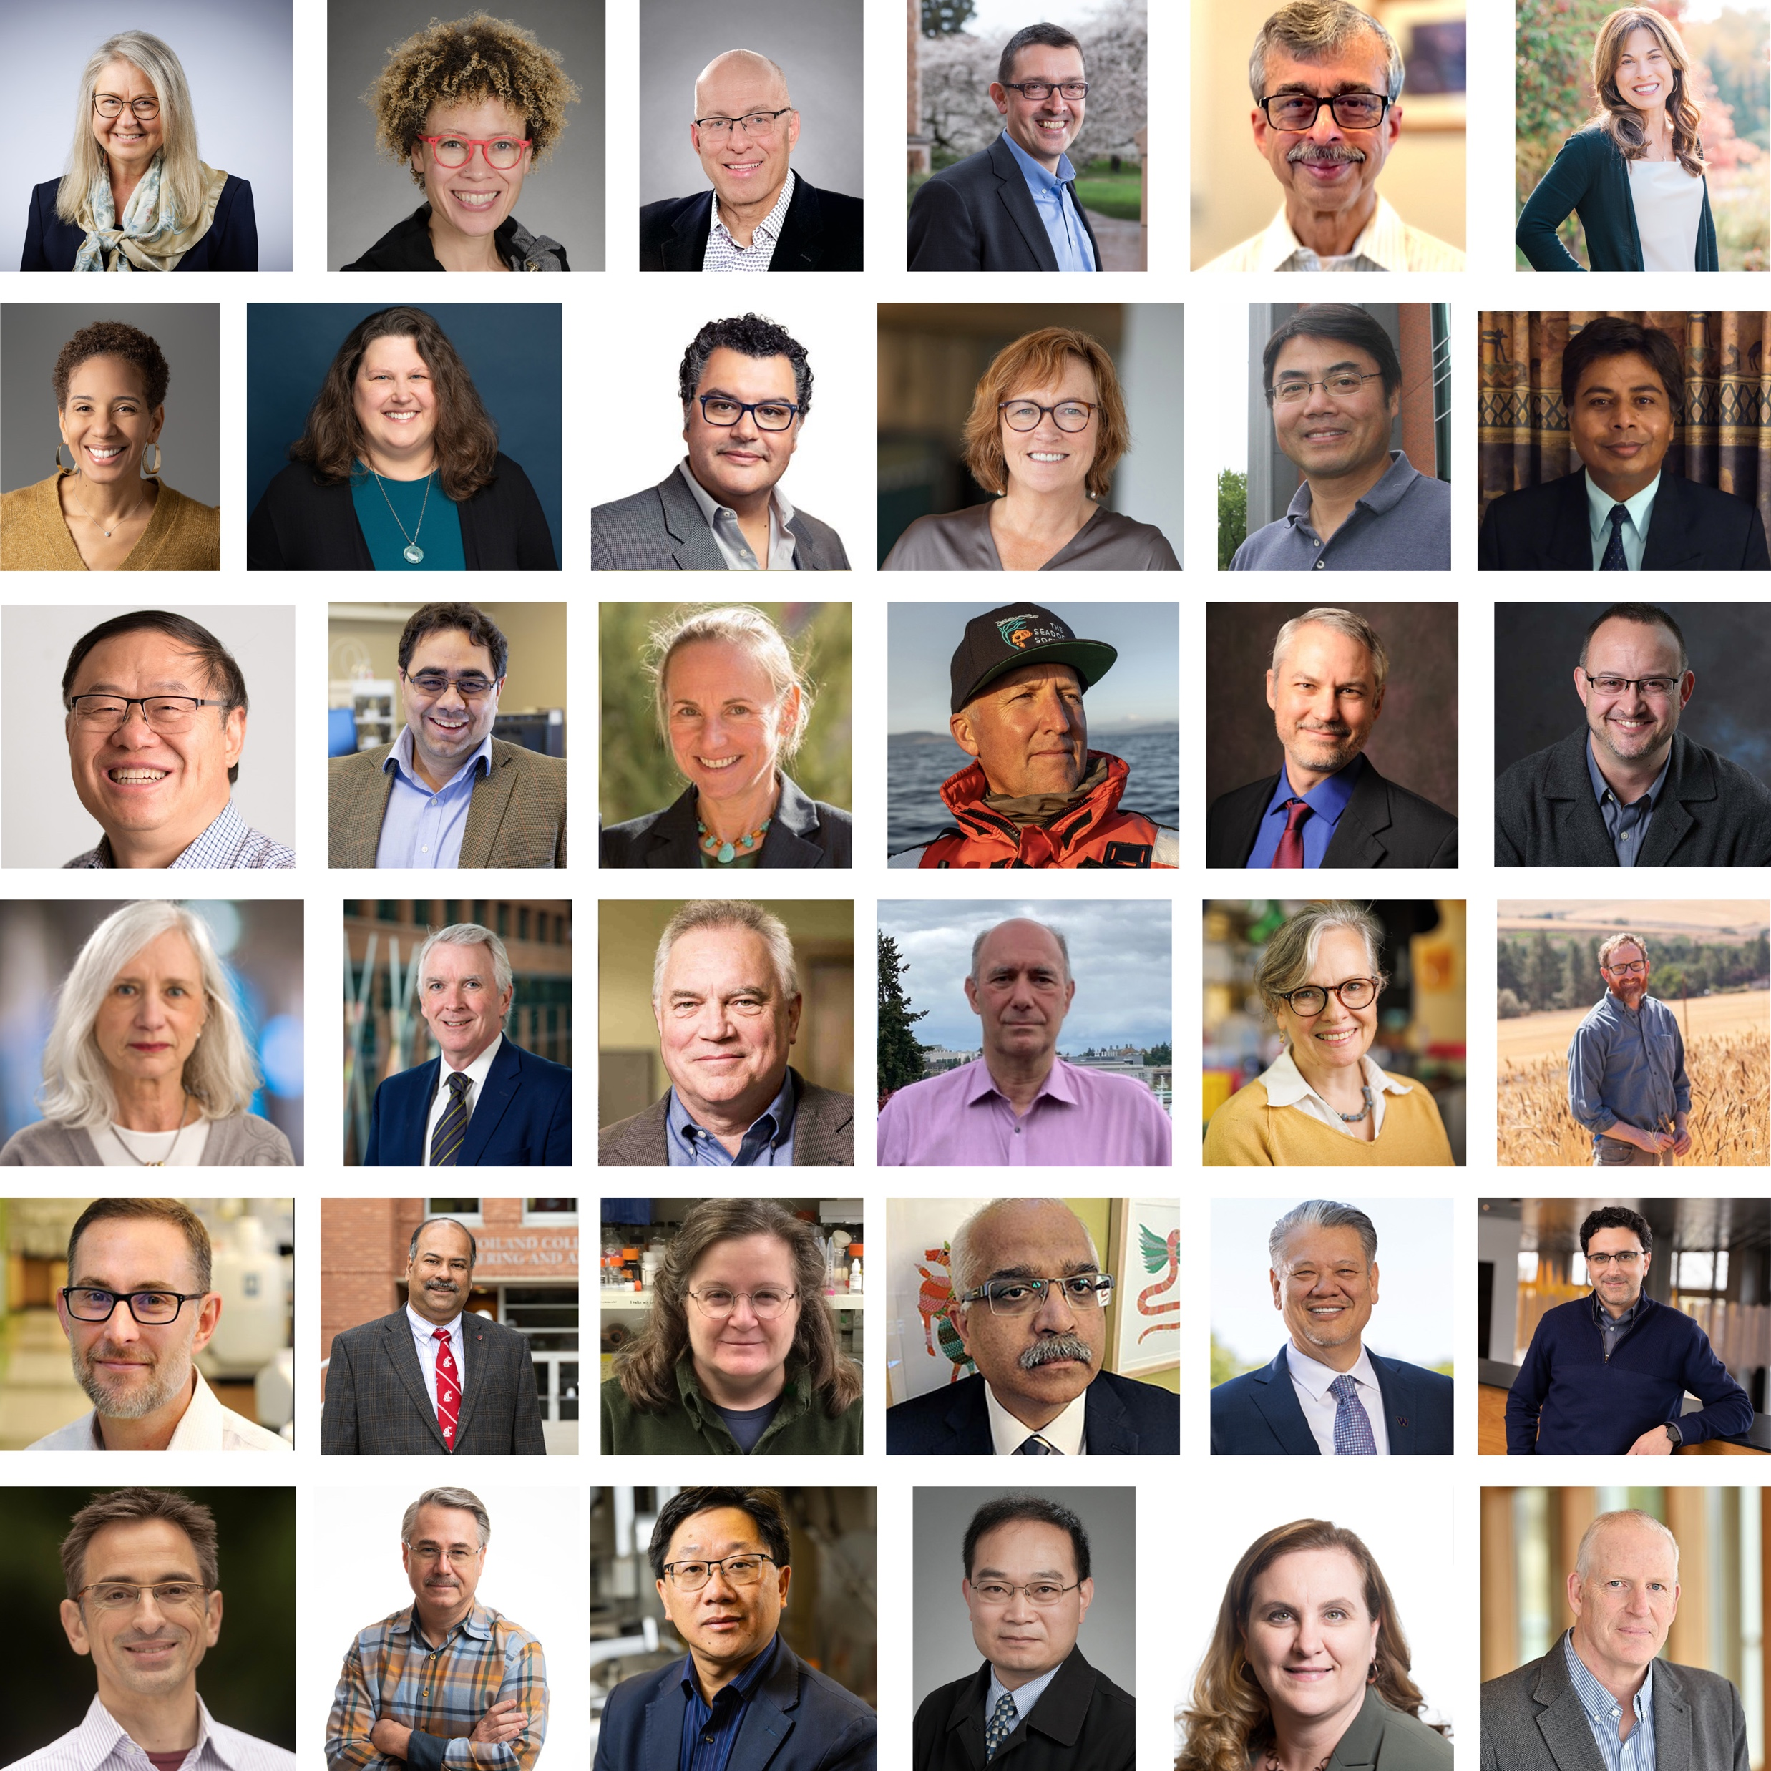
WHO WE ARE
Non-partisan, non-advocate, non-profit organization
Independent Academy through which leading scientists volunteer in service to the state
Established in 2005 by the Legislature to advise state agencies, the Legislature and the Governor on public policy issues involving science & technology
Funding from state flows through WSU
Pictured: 30 new members inducted in 2024
Notes:
The Washington State Academy of Sciences (WSAS) is a nonpartisan, nonprofit organization established by the Washington State Legislature in 2005 to advise state agencies, the Legislature and the Governor on public policy issues involving science and technology. We advocate for science informing policy but not for specific policy outcomes.
Washington is among the few states in the nation served by an independent academy through which leading scientists volunteer in service to the state. Our 400+ members are nationally recognized for their scientific and technical expertise across physical sciences and mathematics, engineering and technology, biology, agriculture, health, and human behavior.
(Pictured: 2023 inducted members – 29 in total)

Slide 6
OUR MEMBERS
430+ members with expertise across all scientific and engineering disciplines
Volunteer their expertise in service to the state
Members are elected directly to the Academy or are members of the National Academies of Sciences, Engineering and Medicine (NASEM) who work or reside in WA State
40% of active WSAS members are NASEM members
Notes:
Members are distinguished researchers from:
WA’s research universities – UW, WSU
Pacific Northwest National Laboratory – US DOE/Battelle
Industrial research, including the world’s leading aerospace, biotechnology, energy, information technology, and manufacturing companies (Boeing, Microsoft etc)
Other nonprofit research institutions (such as Fred Hutch) and Foundations (Gates Foundation)

Slide 7
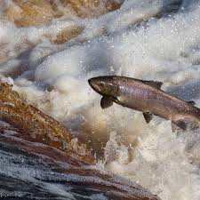
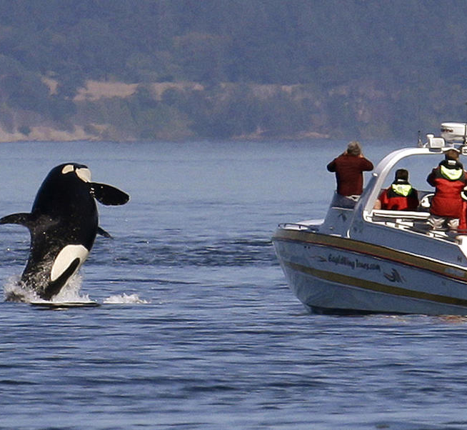


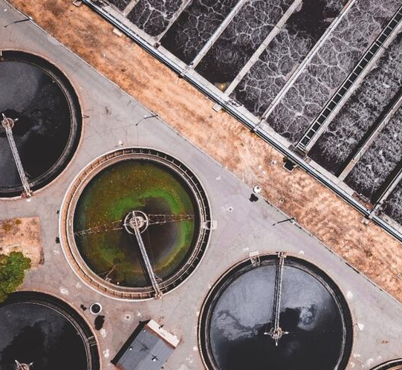
WHAT WE DO
We mobilize leading experts within and beyond the Academy to provide objective scientific and engineering assessments on issues that impact the citizens, governments and businesses of Washington State.
Convene committees and review panels (from WA and beyond)
Conduct independent third-party reviews
Produce consensus reports from expert committees
Organize convenings of scientific communities & stakeholder groups
Host symposia to address issues that are important to Washington State
Create other convenings to fit the needs of the state
Notes:
We provide unbiased advice on science and technology issues through a variety of different mechanisms depending on the needs and timeline of the request.
We are mindful of role of tribal co-managers
Our work aligns to the state’s legislative calendar (projects start in July)
Our team is Seattle-based but we currently work almost exclusively virtually.

Slide 8
March 2024 - Value of Solar Proviso Language from ESSB 5950
(45)(a) $500,000 of the general fund—state appropriation for fiscal year 2025 is provided solely for the department [of Commerce] to contract with the Washington state academy of sciences to conduct a study to determine the value of distributed solar and storage in Washington state, including any factors the academy finds relevant, in order to create recommendations and options for a methodology or methodologies that utility regulators and governing bodies may use after the statutory four percent net metering threshold is met. In the course of their research and analysis, the academy shall engage relevant stakeholders focused on the value of distributed energy resources in Washington state, including solar, storage, vehicle to grid, and other resources. This shall include, but is not limited to, representatives from consumer-owned utilities, municipal-owned utilities, investor-owned utilities, utility regulators, the rooftop solar and storage industry, as well as advocacy organizations involved with consumer advocacy, environmental justice, clean energy, climate change, labor unions, and federally recognized Indian tribes.
(b) The Washington state academy of sciences shall submit an interim report to the department and the utilities and transportation commission by June 30, 2025. This interim report must include a plan and cost estimates for further work in the 2025-2027 fiscal biennium to develop policy recommendations and submit a final report to the department and the utilities and transportation commission.

Slide 9
Two key components of our project
conduct a study to determine the value of distributed solar and storage in Washington state, including any factors the academy finds relevant, in order to create recommendations and options for a methodology or methodologies that utility regulators and governing bodies may use after the statutory four percent net metering threshold is met.
engage relevant stakeholders focused on the value of distributed energy resources in Washington state, including solar, storage, vehicle to grid, and other resources.

Slide 10
Year 1: Establish, Engage, Analyze and Plan
Establish Oversight Committee of experts in Energy Systems, Policy, Regulations, Economics, Equity and other fields,
Form subcommittees to focus on specific topics (final list TBD)
Stakeholder engagement
Data
Equity
Values
Regulatory, legal, market issues

Slide 11
Engage targeted consultant expertise to assist with
Facilitating of stakeholder groups
Contextualizing national-level analyses and state-level experiences
Examining the range of equity and economic considerations
Developing a plan to access and analyze data
Analyze the range of inputs
Develop a detailed workplan for Year 2+

Slide 12
TIMELINE: FY 25
2024 |  |  |  |  |  | 2025
Q1 |  |  | Q2 |  |  | Q3 |  |  | Q4
July | Aug | Sept | Oct | Nov | Dec | Jan | Feb | Mar | Apr | May | June
Develop project workplan, communications, website
Form oversight committee and subcommittees
Plan stakeholder outreach engagement
Begin stakeholder outreach and engagement
Committee meeting(s)
Continue stakeholder engagement
Committee meeting(s)
Prepare Interim report
Finalize detailed work plan for FY 25-26 (if funded)
Prepare summary of findings of stakeholder engagement
Submit Year 1 report
Year 2+: FY 26-27 TBD

Slide 13

Stay informed about the progress of this project
https://washacad.org/projects-publications/value-of-solar/
Email: donna.riordan@washacad.org

