Slide 1
INTENT John Z. Gibson INTENT Board of Directors Vice Chair Avista Innovation Lab Director

Slide 2
Regional Energy Platform – INTENT Origin Story
N
Notes:
Talking Points:
Avista's Innovation Lab is located on the third floor of the Morris Center shown as the gray building. On the first floor of the Morris Center is an energy plant which provides condition environment for the Morris Center and the Catalyst Building. The energy plant is scaled to support two additional buildings in the development. The Catalyst building the brown building in the backdrop is a cross-lamented building which is designed to be a net-zero and carbon free building. The Catalyst building recently received the innovative technologies award from the American Institute of Architects.

Slide 3
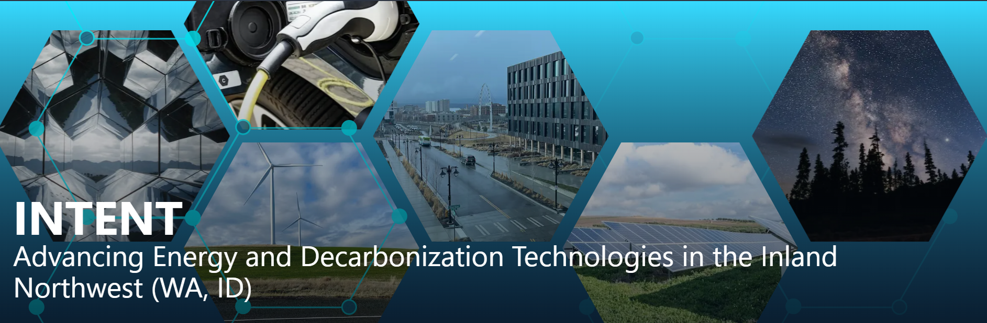
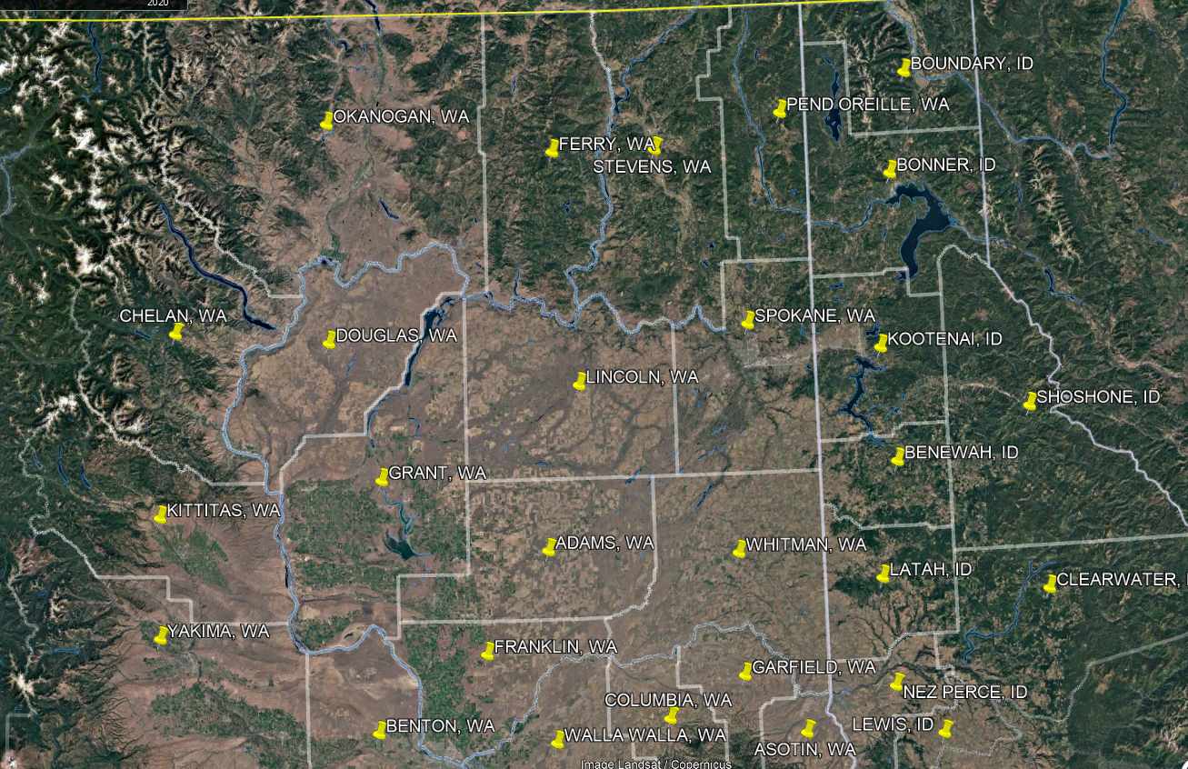
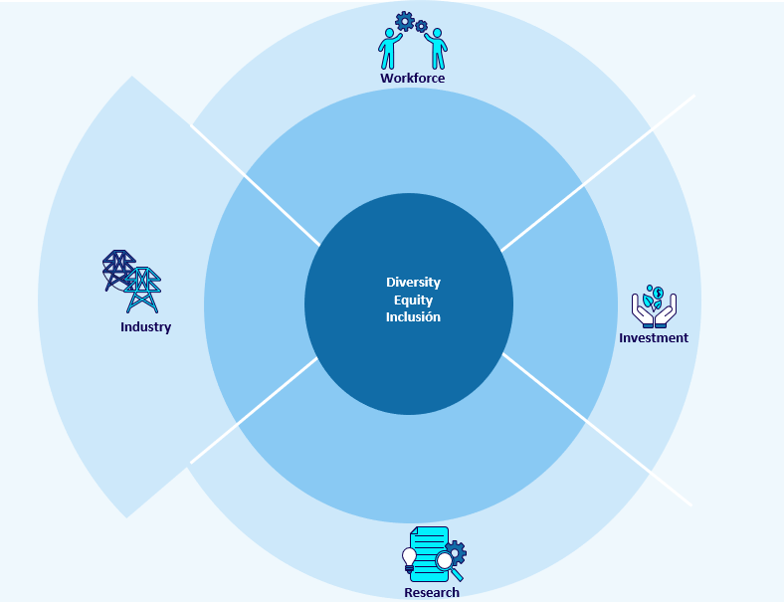
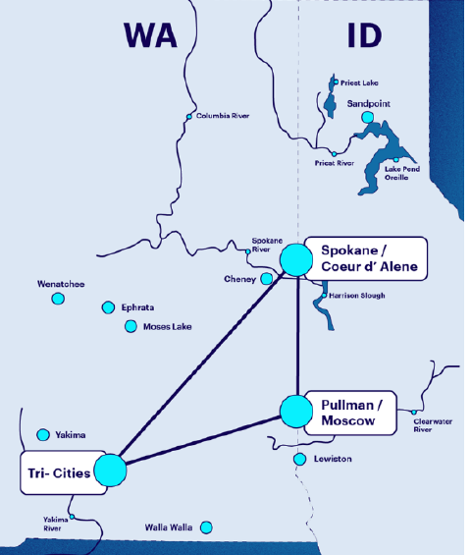
INTENT LLC
Innovation Engine
EXECUTIVE SUMMARY
Geographical Reach
Working Groups
Culture & Research Triangles
Spokane Tribe
Rural Communities
Nez Perce Tribe

Slide 4
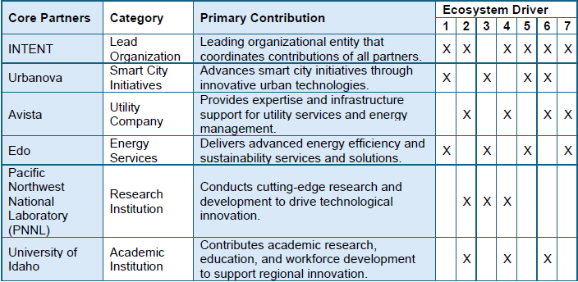
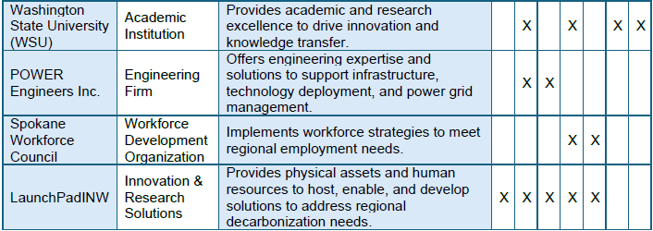
Core Partners
N
Ecosystem Drivers
Cross Sector Partnerships & Relevant Party Alignment
Use-Inspired R&D
Translation of Innovation to Practice
Workforce Development
Inclusive Engagement
Strategic Investment
Governance and Management
Notes:
Talking Points:
Avista's Innovation Lab is located on the third floor of the Morris Center shown as the gray building. On the first floor of the Morris Center is an energy plant which provides condition environment for the Morris Center and the Catalyst Building. The energy plant is scaled to support two additional buildings in the development. The Catalyst building the brown building in the backdrop is a cross-lamented building which is designed to be a net-zero and carbon free building. The Catalyst building recently received the innovative technologies award from the American Institute of Architects.

Slide 5
Formation
INTENT Accomplishments
John Z. Gibson
Notes:
Common understanding around how energy works – how can we iterate to a model that isn’t so strict. In the least cost planning model, how can we plan for equity.
The strength of our proposal is that we aren’t planning to blow it up, we are intending to do it logically through the model.
Understand the box that we’re currently in
As were thinking about the roadmap, the roadmap has to lead us out of it
Cant just leap to a completely different business model.
Thoughts around how it could change / people don’t understand it
How does the region function
Energy pathways project study (2020 study)
Where we are in terms of the energy system
Energy boutique model > the intersection there. The role they will play in the future and how that is a solution for some equity issues that we see. (eg. Economic, sovereignty, health …)
BOD presentation could be good to leverage for this presentation
Non technical people don’t understand how the energy domain works

Slide 6
INTENT Formation
INTENT Innovation Timeline
EXECUTIVE SUMMARY
Industry, Research, Workforce, Investment Working group
Regional Workshop on Energy
NSF Planning Grant Awarded
Forming Workshop
Roadmap Workshop
2022
2023
2024
2024
2024
2022
2023
2023
2024
2024
NSF Planning Grant Submittal
INTENT Incorporation
Accenture Contract
Key Interventions Workshop
NSF Innovation Proposal Submitted
*Not prioritized by order

Slide 7
Top Intervention Ideas
Our top 6 Intervention Ideas identified during INTENT’s Innovation Engine Workshop*
EXECUTIVE SUMMARY
Community Energy Incubator
Demonstration Test Bed
Partnerships
Establish a community energy incubator / work with current incubators and community initiatives to support start ups in clean energy, providing funding, workspace, and expertise
Enable several demonstration test beds in the region that are fully functional for microgrids and tested to extremes with the appropriate back-ups to share data with future investors
Facilitate co-production by creating partnership links between universities, energy firms, and regional governments to develop resilient energy technologies
Market Matching
Strategic + Market Roadmap
Empower Communities
Create a bio / ecosystem district platform, matching market players and distributed generation actors together; include incubated solutions
Regulation, strategy and inventory of the region for energy systems, working with regulatory agencies, local and regional government; Develop a long-range roadmap that aligns with the goals of the Regional Innovation Engine (RIE) and creates a POV for the direction of the energy market and provides research priorities
Identify community partner(s) to co-create and plan pilot for project(s) in the community, by the community, for the community (e.g., a version of Key Tech’s Solar Punk)
*Not prioritized by order

Slide 8
Regional Energy Dilemma

Slide 9
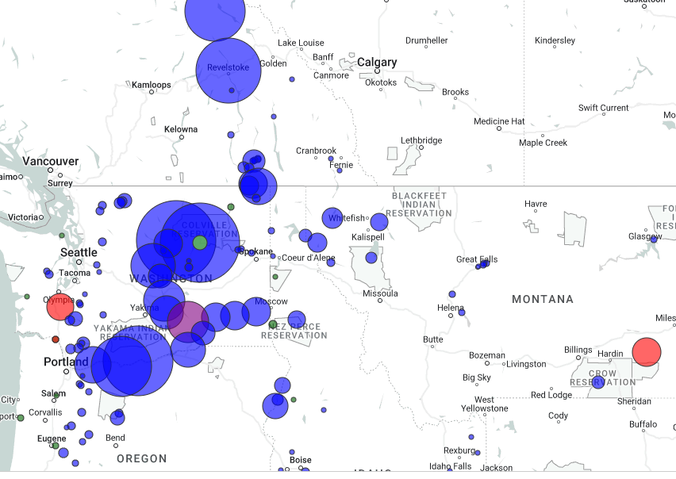
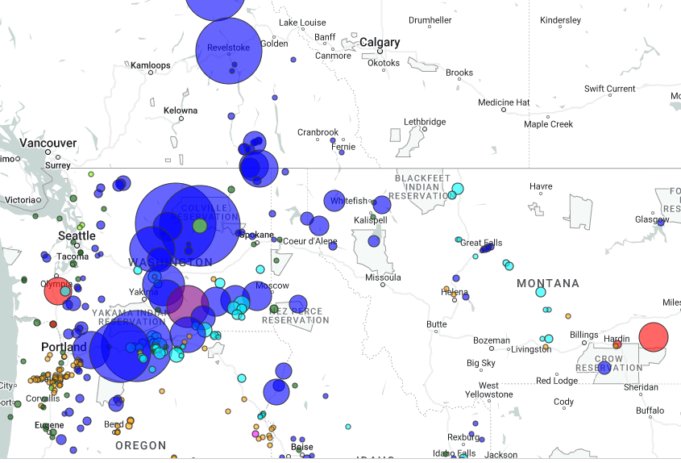
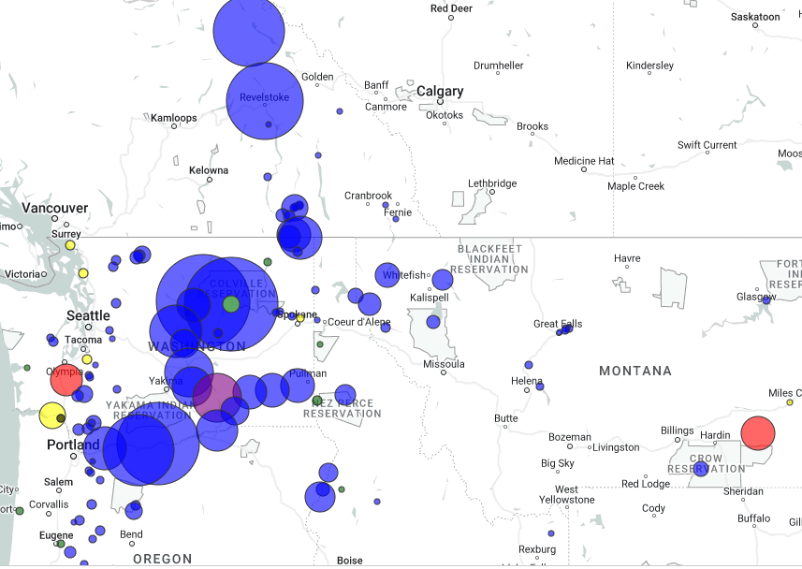
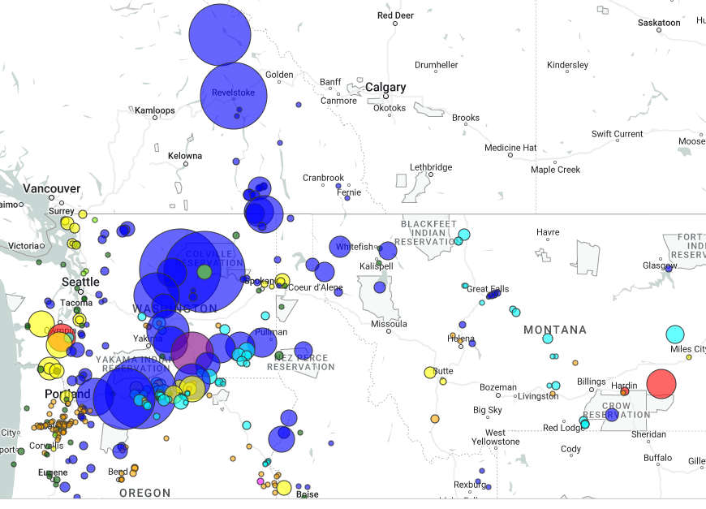
Pacific Northwest Resource Mix
Regions Resource Mix 1984
Regions Resource Mix 2024
Hydropower
Coal
Wind
Solar
Natural Gas
Biomass
Nuclear
Energy Storage

Slide 10
Washington Regulator Climate
Washington’s Legislative Agenda
Clean Energy Transformation Act (CETA)
Utility CETA Plan Submittal & NG Building Code
Energy Independence Act (EIA) I-937
CETA – Eliminate all Coal Resources
GHG Neutral Electric Retail Sales
100% Renewable or non-emitting
2016
2021
2023
2027
2031
2006
2019
2022
2026
2030
2045
EIA 9% Renewable
CCA – Emission Allowance Auction
Built Environment - Energy Performance Standards – 200,000 sqft
Built Environment - Energy Performance Standards – 20,000 sqft
Climate Commitment Act (CCA) & Clean Fuel Standards

Slide 11
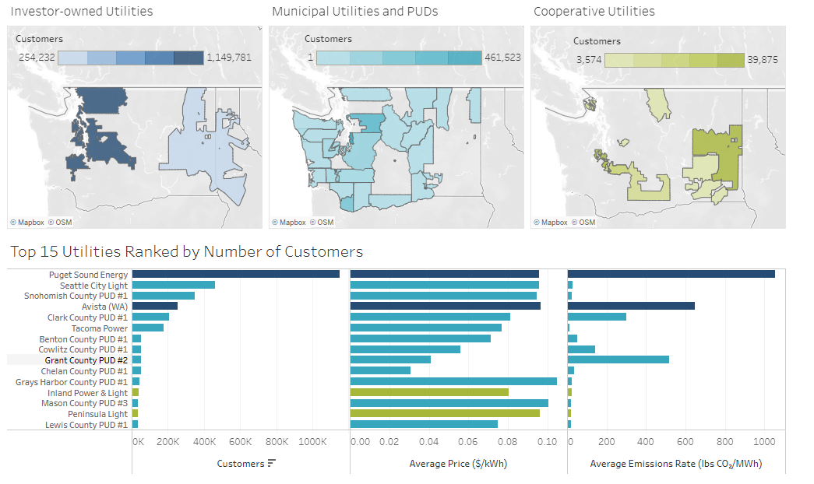
Washington Utilities

Slide 12
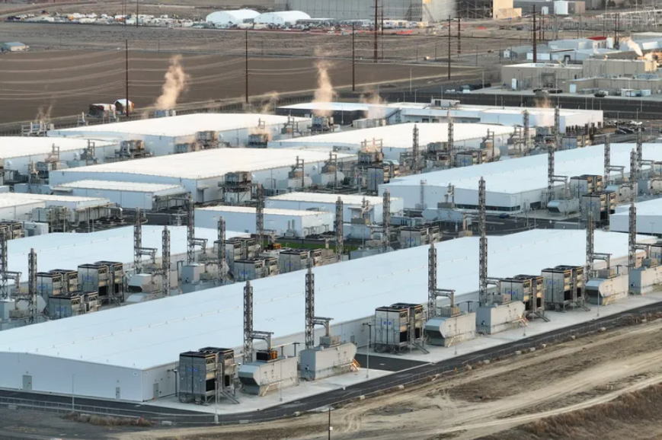
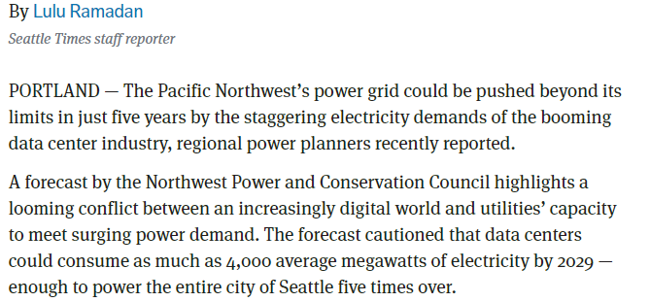
Load Growth

Slide 13
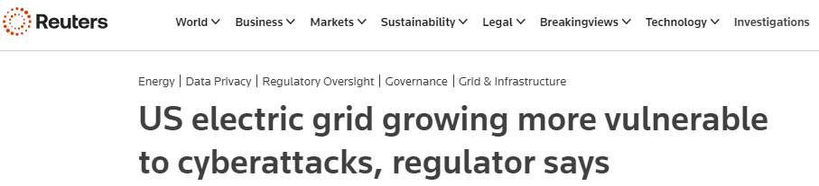
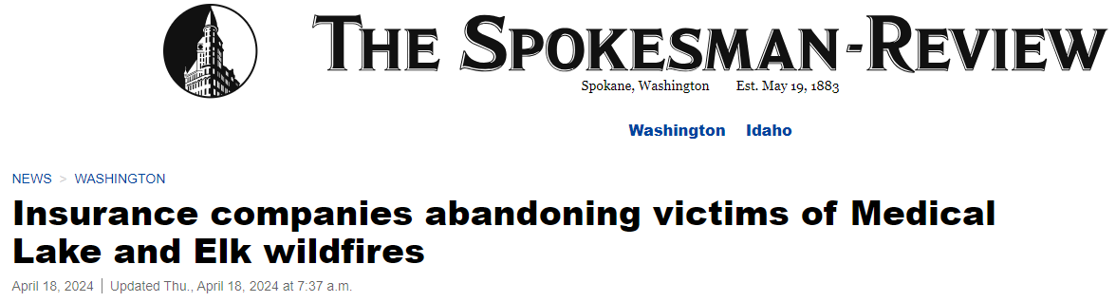
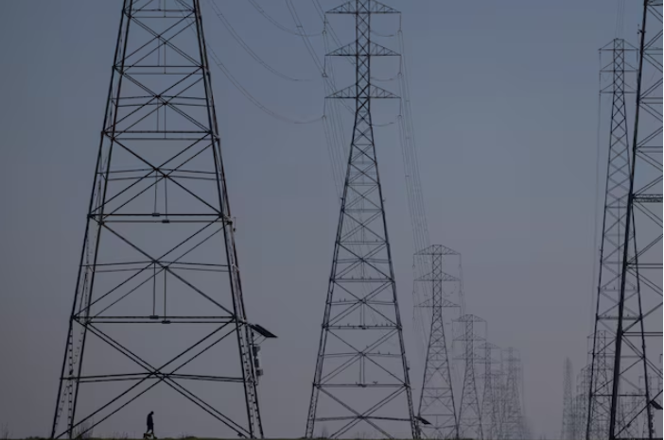
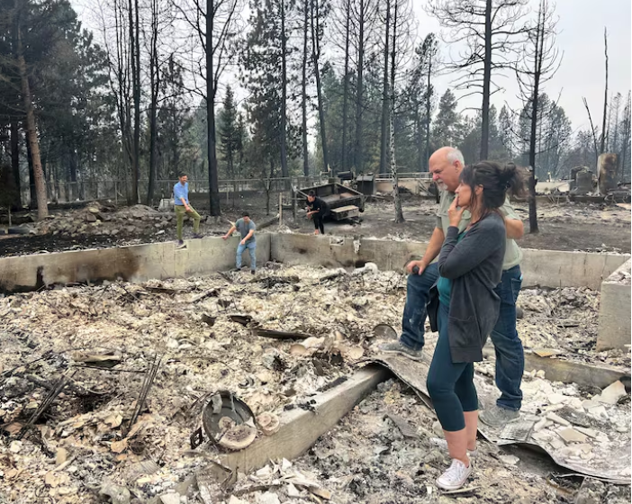
Threats

Slide 14
Inland Northwest Who Are We?

Slide 15
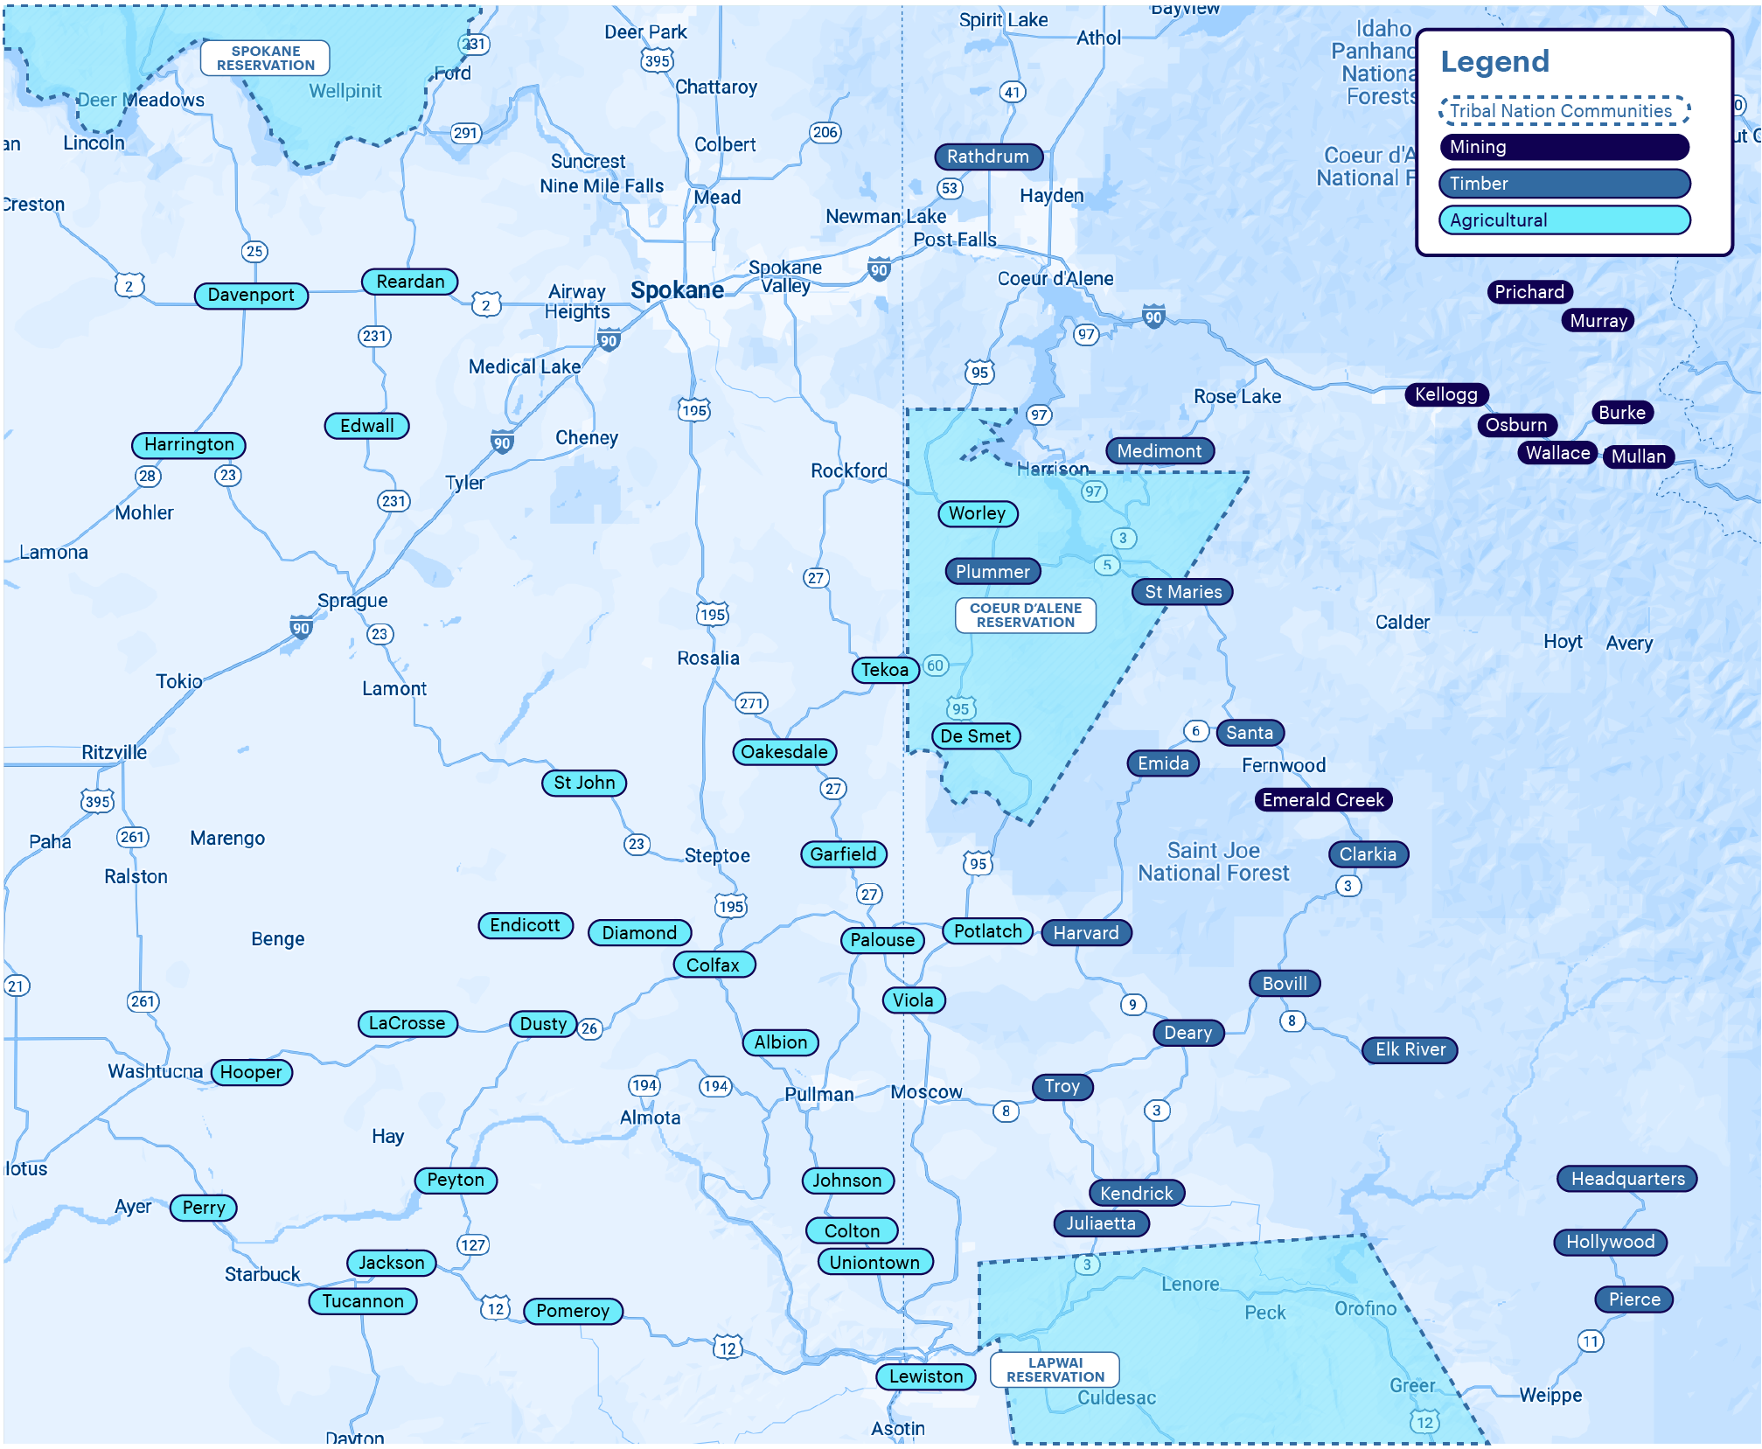
Who are we as a region?
Inland Empire - Shared Cultural Values
Self-Reliant
Rugged Individualism
Natural Resource Dependency
Rural - Remote

Slide 16
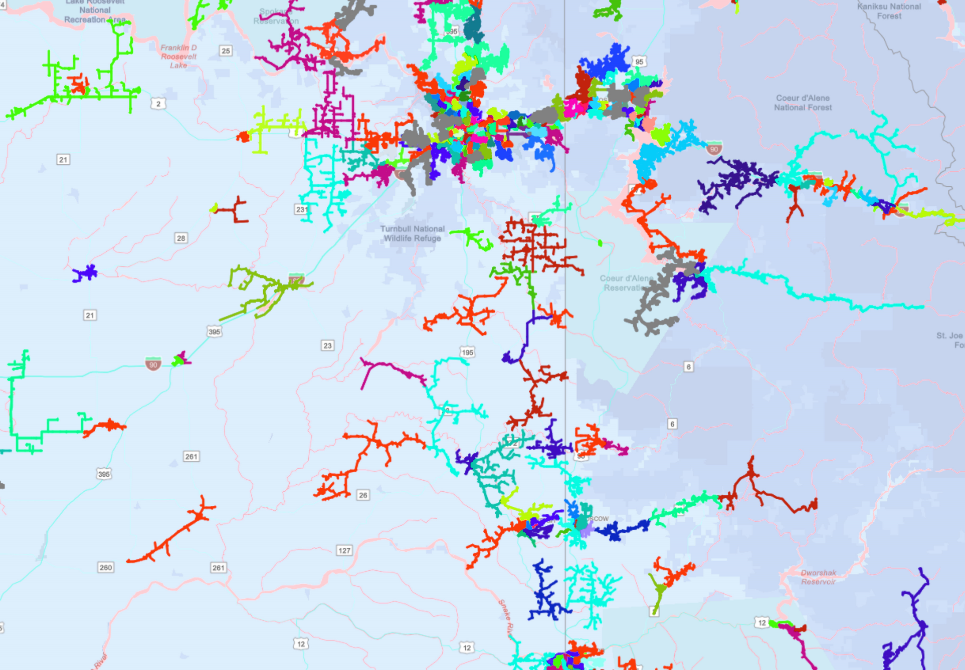
How are we served?
Inland Empire – What are your observations?
Delivery Infrastructure
Operational Flexibility
Reliability
Resiliency
Security

Slide 17
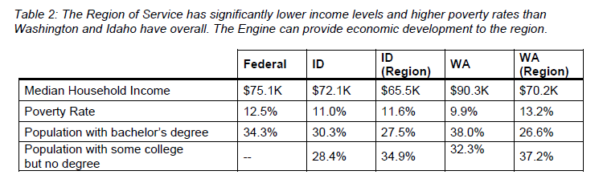
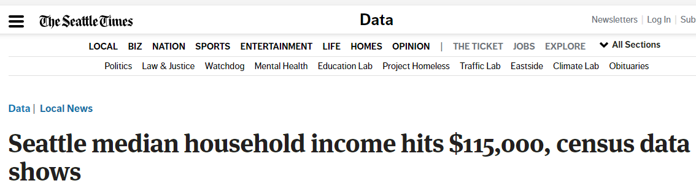
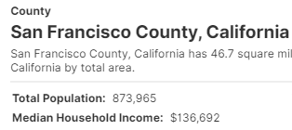
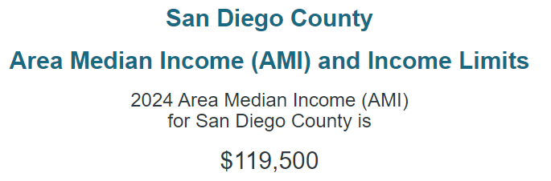
Rural Poverty – Jump Starting America “America is often called the land of opportunity but in recent decades the opportunities have been shrinking – in a geographical sense – as we increasingly rely on a small set of superstar cities located on the coasts … Meanwhile, much of the rest of the country has missed out”
I-5 Corridor
I-90 Corridor
Ritzville
Reardan
Spokane
Coeur d’ Alene
Pinehurst
Wallace
Seattle
Olympia
Portland
San Francisco
San Jose
San Deigo

Slide 18
Value Proposition How do we lift the region?

Slide 19
INTENT Innovation Engine
Rember Our Origin Story

Slide 20
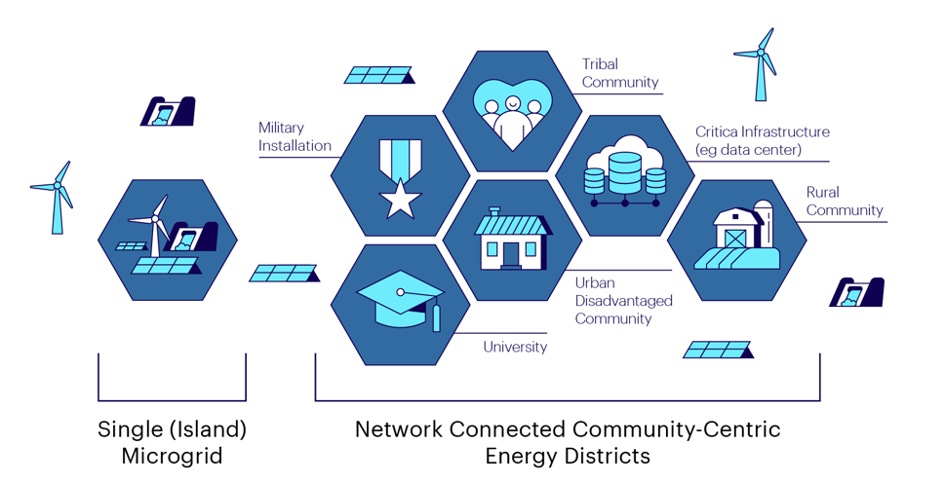
INTENT Innovation Engine
The Origin Story has Evolved

Slide 21
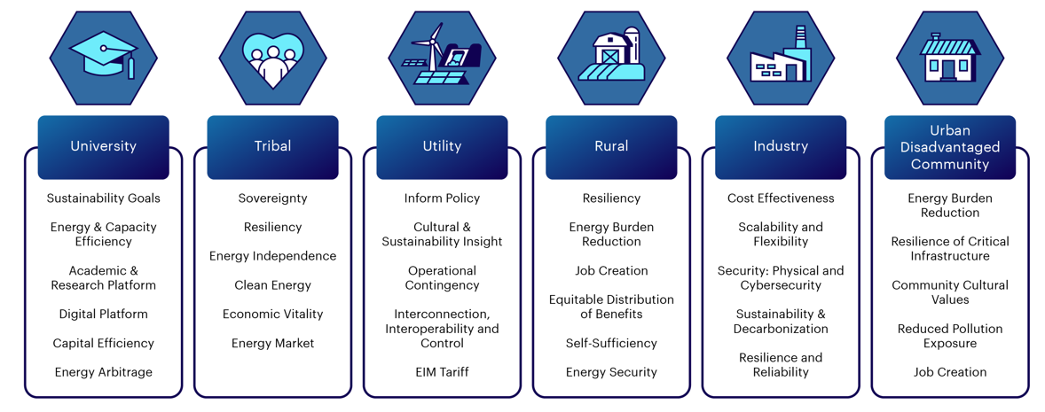
INTENT Innovation Engine
Energy Market

Slide 22
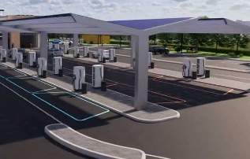
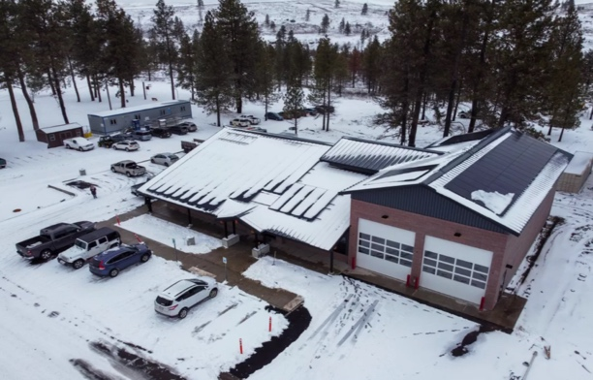
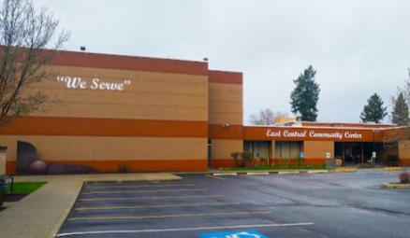

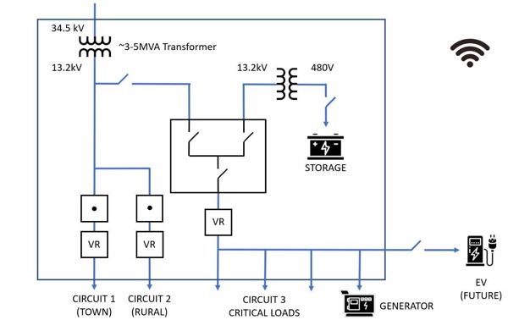
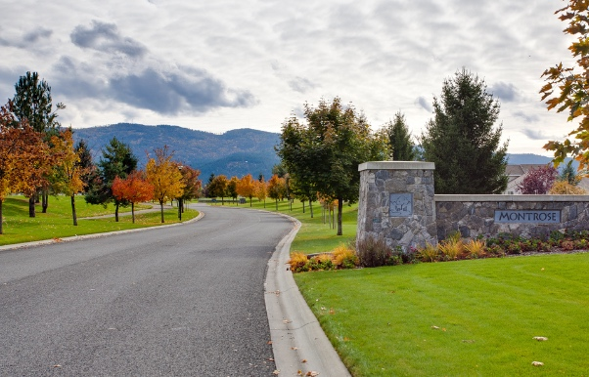
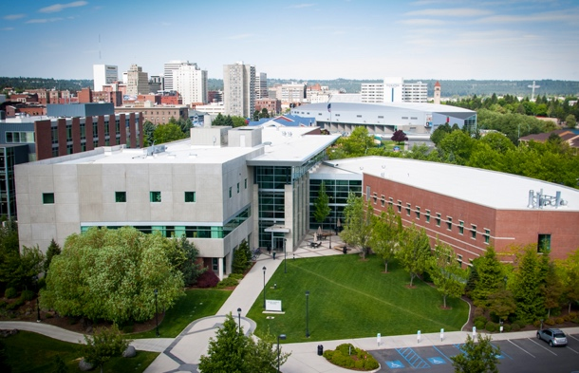
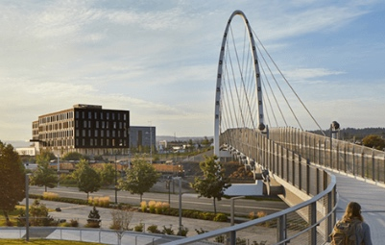
INTENT Product & Services
Shared Energy Economy – Not least marginal cost assets
Energy Boutiques
Combine Private/Public Investment
Hub Charging Stations
Rural Emergency Energy Center
Neighborhood Resiliency Center
Cultural Infrastructure
Clean Branded Neighborhoods
Campus Energy Districts
Urban Eco-Districts

Slide 23
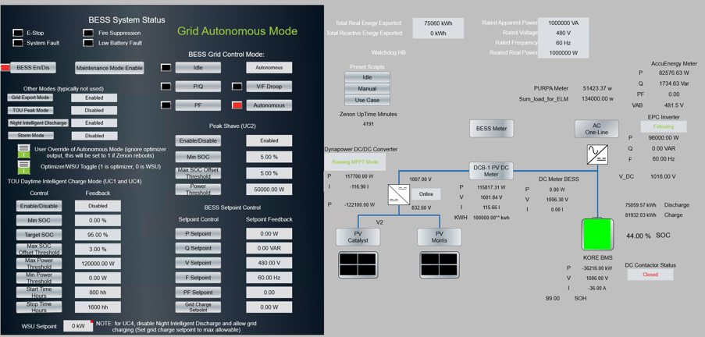
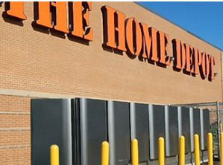
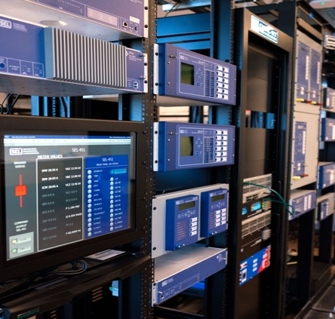
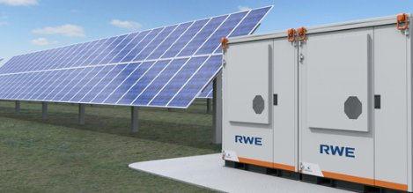
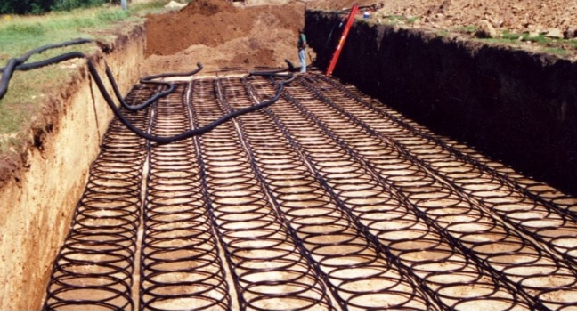
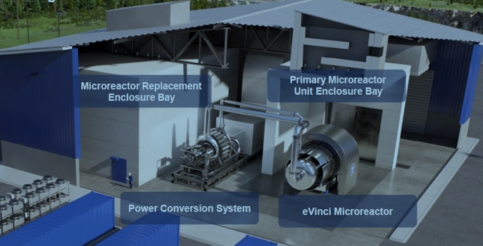
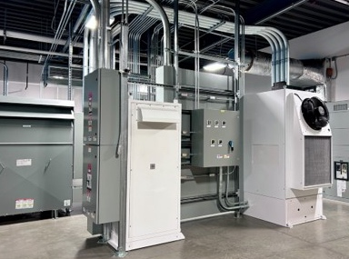
INTENT Technology Platforms
Shared Energy Economy Platform
Alternative Energy Platform
Market Driven Research
Software Simulation/Optimization & Controller
Fuel Cells
Communication/Network
Solar/Storage Microgrids
Geothermal Networks
Small Modular Reactors
Thermal/Electrical Storage

Slide 24
Innovation Engine Roadmap

Slide 25
INTENT Roadmap
INTENT Innovation Engine
Product/Service Businesses
Market – Community Product/ Services for Energy Boutiques
Industry Alignment/Engagement
Technology Platform/Market Pulled Research
Operationalize Technology/ Workforce Development
Pilot Project & Investment/Startup
Equity considerations
Product development

Slide 26
INTENT Roadmap
Build Value Proposition
Business Model
Market Research
Job Skills Work Force
Strategic Market Roadmap
Investment Working Group
Industry Working Group
Research Working Group
Workforce Working Group
Entrepreneurial Ecosystem
Product/Capabilities
Community Challenge Definition
Community Skill Set Inventory
Empowering Communities
Investment Working Group
Industry Working Group
Research Working Group
Workforce Working Group
Business to Market Need
Platform to Market Need
Market Pulled Technology
Skills for the Market
Market Mapping
Investment Working Group
Industry Working Group
Research Working Group
Workforce Working Group
Investment to Research
Community Applications
Technology Maturity
Academic to Industry
Partnerships
Investment Working Group
Industry Working Group
Research Working Group
Workforce Working Group
Proof of Concept
Architecture Platform
Use Case Development
Work Practice Standards
Community Energy Incubator
Investment Working Group
Industry Working Group
Research Working Group
Workforce Working Group
Pilot Project for Funding
Corporate Participation
Platform Test Case
Academic to Industry
Demonstration Test Bed
Investment Working Group
Industry Working Group
Research Working Group
Workforce Working Group

Slide 27

Bringing it all together
Energy
Boutique
Energy
Boutique
Energy
Boutique
Energy
Boutique
Energy
Boutique
Energy
Boutique
Energy
Boutique
Energy
Boutique
Energy
Boutique
Energy
Boutique
Energy
Boutique

Slide 28
Questions
INTENT
Formation
Regional Energy Dilemma
Inland Northwest – Who are we?
Value Proposition – How do we lift the region?
Innovation Engine - Roadmap

