Slide 1
Leading the Next Electrical Revolution
Mike Miller
Vice President, Transmission Engineering and Technical Services, BPA

Slide 2

An Inspirational Day
“Vision is the art of seeing things invisible”
Jonathan Swift

Slide 3









An amazing group of experts, leaders and genius level contributors!

Slide 4
Two Goals for today
Importance of our collective mission
Leadership skills needed to accomplish it

Slide 5

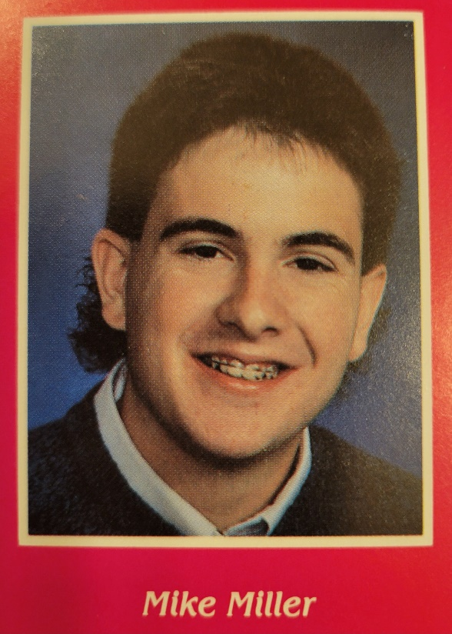
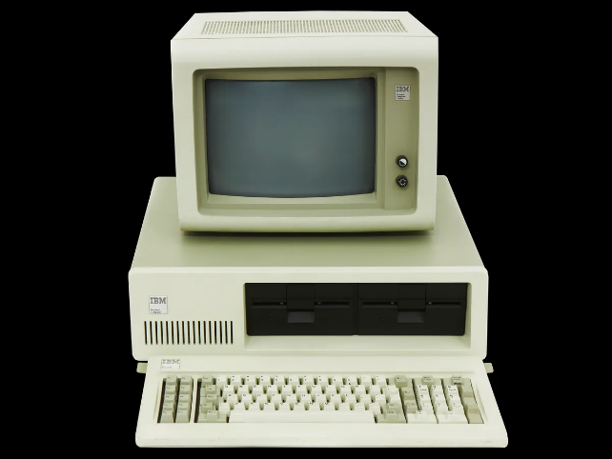

1985

Slide 6


Household electronics loads
1985…
8.2% of U.S. households had computers.
0.1% of people had cell phones in the U.S.
There was no internet.
Today…
91% of U.S. households have computers.
97% of people in the U.S. have a cell phones.
92% of households in the U.S. have internet access.

Slide 7


Why does this matter
Nearly everything we do today consumes electricity.
What other fuel sources do you have in your homes? In your businesses?
The other sources we used to use (Oil, Gasolene, Natural Gas, wood,...) are all moving to electricity.
Our electrical loads are growing while all other sources shrink.

Slide 8


Major industrial electric loads
1985
Aluminum smelters
Manufacturing
Today…
Microchip manufacturing
Data centers
8

Slide 9


Electrical power generation
1985
57% from coal
12% from natural gas
12% from renewable sources
Today…
16% from coal
43% from natural gas
21% from renewables
9

Slide 10


Why does this matter
Location, location, location!
Coal, oil, natural gas were all shipped to where the demand was and converted to electricity or used directly.
Wind, solar and wave energy are converted at the source and require major transmission investments to get the power to the load.

Slide 11
What's driving this growth?
Climate change
Changing our fuels
Changing our locations
Artificial Intelligence
Massive need for computing power
Massive need for storage

Slide 12


BORING!

Slide 13
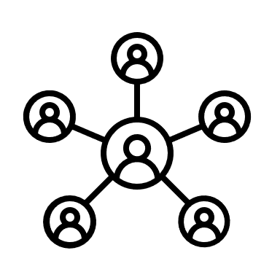


Why area these facts interesting?
Massive transformation, short timeline!
Connect to anyone, anywhere, in an instant!
What does the future look like?
Who knows!

Slide 14

Why does this matter to us?
The people in this room are the at the center of this universe!
Electrical power innovation is the key to meeting the needs of an unknown future!

Slide 15

How does this relate to today?
The clock is ticking!
It will take all of us!
More importantly, it will take the teams we lead and the young people we inspire!

Slide 16


Two Goals for today
Importance of our collective mission
Leadership skills needed to accomplish it

Slide 17

What skills do we need to lead and inspire?
Be a HIPPO!
Honest
Intentional
Present
Productive
Optimistic

Slide 18
Honest
Integrity is the core of leadership
Trust can only come through experiencing integrity

Slide 19
Intentional
Plan before you act
Act in alignment with your values

Slide 20
Present
Associate location with purpose
Be where you are

Slide 21
Productive
Purpose without action is meaningless
Track your progress

Slide 22
Optimistic
Attitude is a choice
Elevate those around you

Slide 23
Join the Bloat!
HIPPO
(Honest, Intentional, Present, Productive & Optimistic)

Slide 24
Questions/Comments?
Let’s lean in today and take advantage of this great opportunity!

