Slide 1

School of Economic Sciences Research Team Olvar Bergland School of Economics and Business Norwegian University Life Sciences and School of Economic Sciences Anamika Dubey School of Electrical Engineering and Computer Science and Pacific Northwest National Laboratory Alan Love School of Economic Sciences Graduate Student Grishma Manandhar School of Economic Sciences Support Sloan Foundation grant # G-2018-11303 “Bilateral Contract Design and Retail Market Development for Flexible Electric Power Systems with Residential Demand-side Participation”
Emerging R&D Directions in Grid Research: Economics

Slide 2
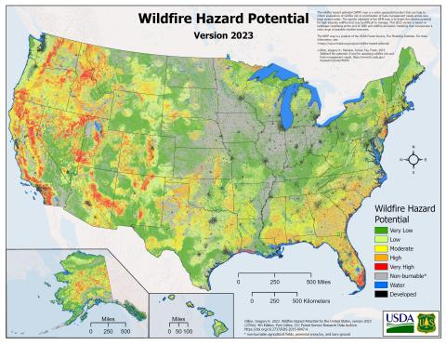
Background
Environmental change and emerging grid technologies are driving the need for change in power generation, distribution, and household behaviors
Environmental drivers for change:
Power system needs to be more flexible and resilient (islanding)
Power system needs to easily incorporate carbon reducing generation (solar & wind, other)
Environmental Driver | Consequences for Grid
Increasing average temperature | Increased cooling demand, need for de-carbonization
More extreme weather | Grid failure, more extreme system demands (heating/cooling)
Worsening droughts | Wildfire, grid failure, hydro power interruption
Source: US Forest Service
Missoula Fire Sciences Lab
https://www.firelab.org/project/wildfire-hazard-potential

Slide 3
Background
Technological facilitators for change:
Increasing penetration of distributed energy resources (DERs) like solar and wind
Nascent but improving small scale storage technologies (batteries)
Digitalization of power distribution grids through information and communication technology (ICT devices) and smart meters that enable smart grid networks
Technological innovations can enable increased flexibility in:
Power generation (PVs at the household level - prosumers)
Consumption (demand response)
Distribution (real-time trading in interconnected microgrids)

Slide 4
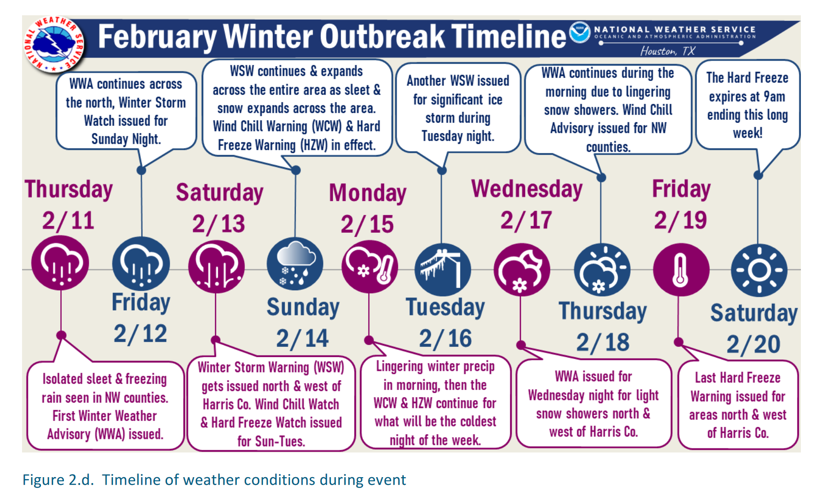
Background
Household behaviors, income/wealth inequalities, state-of technology, and governance remain potential obstacles to change
Past failures in transition to market-based power systems (California & Texas)
Risk aversion and low participation in incentive-based demand response programs
High entry costs for many DERs limit adoption of prosumer enabling technologies, especially for low-income households.
Better control technologies, regulatory policies and contract designs could enable greater active prosumer/demand response participation
Source: The Timeline and Events of the February 2021 Texas Electric
Grid Blackouts, The University of Texas at Austin, Energy Institute, July 2021 https://energy.utexas.edu/sites/default/files/UTAustin%20%282021%29%20EventsFebruary2021TexasBlackout%2020210714.pdf

Slide 5
Background
Energy System is in Transition
Changing governance and policies to increase grid resilience and decarbonization
Household and Prosumer Demand Response among End-users
Engage -- Program (contract) designs that are attractive and inclusive
Activate -- Program designs that efficiently attract responsive consumers (Participation Constraint)
Harness – Program designs that are effective and that reliably maintain continuous desired response (Incentive Compatible Constraint)

Slide 6
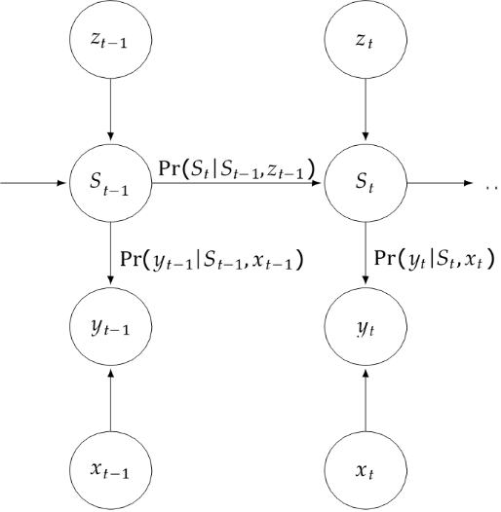
Research Areas
Household and Prosumer Demand Response Among End-users
Our work has focused on three main areas:
Non-intrusive Household Power Use Disaggregation
Shortage of household level use-labeled data
We use machine learning (Input-Output Hidden-State Markov Models (IOHMM) and Fast and Frugal Decision Trees) to expand data availability for households without use-labeled data
Demand Response Contract Designs
Many examples in literature and practice have low participation and high fall-out rates
Include Participation and Incentive Compatibility Constraints
Time-of-Use Contracts
Critical Peak Rebate (CPR) Contracts
Community Microgrids
Demand Response
Incentives for household solar panel adoption
Forward-looking AI driven automatous-agent trading
Electricity Consumption Patterns
Smart Meter Data, Time of Day, Meteorological Data
Machine Learning
Household Willingness to Pay
Time of Day
External Weather Conditions
Optimal Contracts
Principal Agent Models
Empirical Distribution of Household Willingness to Pay

Slide 7
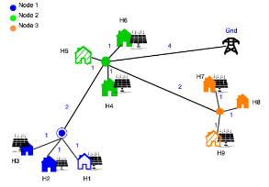
Community-Based, Autonomous-Agent Enabled, Electricity Trade in a Grid Connected End-Node Setting
Community based micro-grids address many of the environmental issues, technological opportunities, and behavioral obstacles just discussed
All households in an area must trade on an interconnected, community grid
Focus on HVAC cooling during summer months
Model 9 houses using Northwest Energy Efficiency Alliance data
Trade completed each period (15 minutes) is determined by an automated central auction entity with autonomous agent bidding so that trading is fully automated
Auction is designed so truthful bidding among prosumers is a dominate strategy and so potential opportunistic bidding can be detected
External Grid Connection (Import/Export)
Community Grid

Slide 8
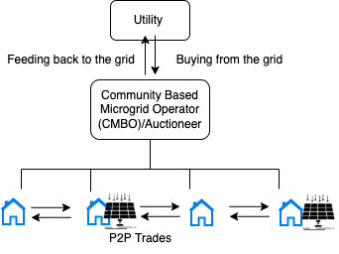
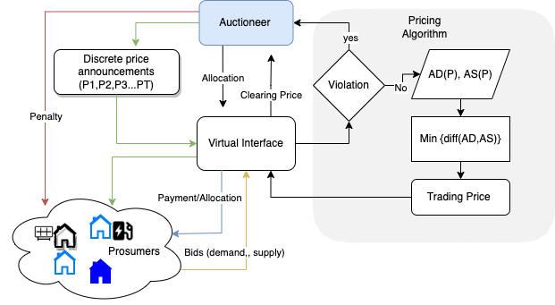
Community-Based, Autonomous-Agent Enabled, Electricity Trade
Community Based Microgrid Operator (CMBO)/Auctioneer
Announcement of discrete trading prices such that: P_{Grid export} < P_{p2p}< P_{Grid import}
Prosumers submit bids as supply or demand quantities for corresponding prices
A uniform market clearing price is determined (possibly importing or exporting grid power)
Least-cost customer matching (including the grid) is solved using LP
Autonomous agents
Forward looking (4 periods – 1 hour)
Adjust thermostats to optimize each prosumer household’s net-return for comfort-cost tradeoff
Constraints for:
House-specific thermo-response to cooling
Household-specific willingness-to-pay for cooling (HVAC) power use
Community Based Market
Auction Flowchart

Slide 9
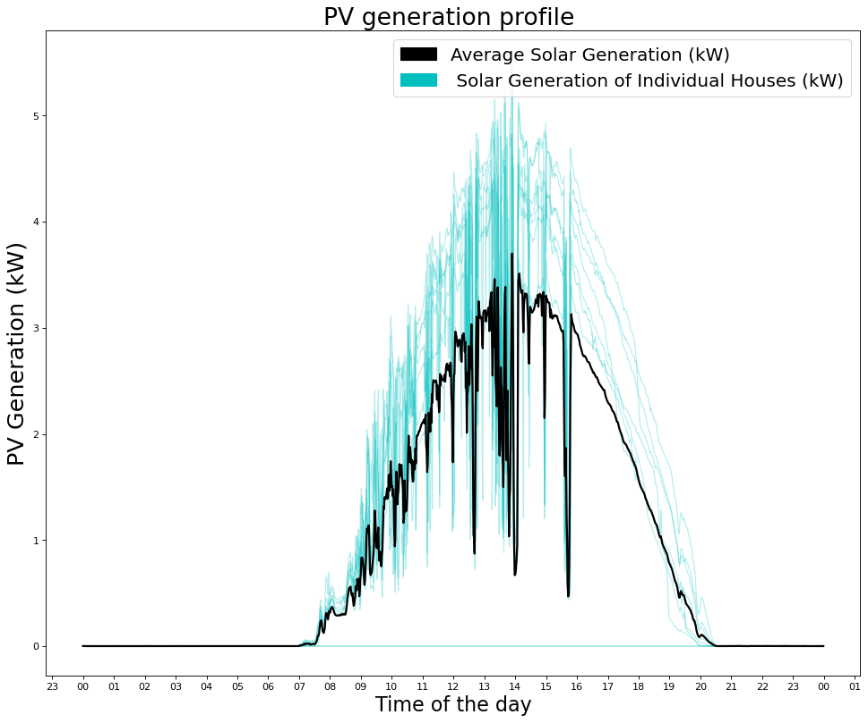
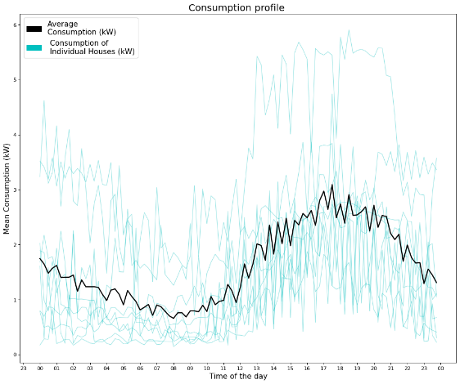
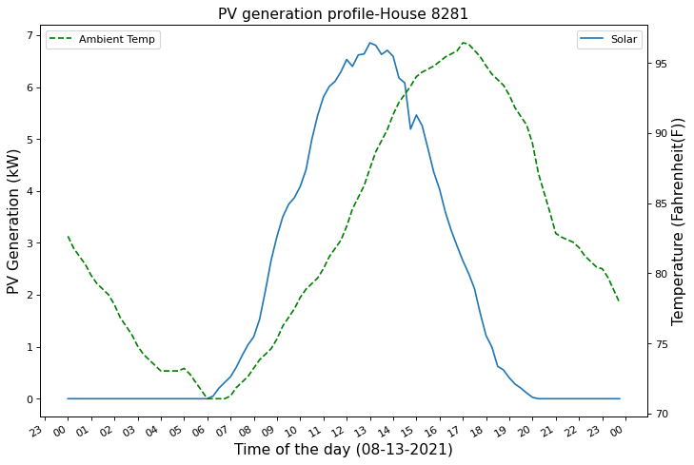
Community-Based, Autonomous-Agent Enabled, Electricity Trade in a Grid Connected End-Node Some Preliminary Results for Nine Houses
PV Generation (all houses)
Power Consumption Profile (all houses)
PV Generation vs Ambient Temperature (sample house)

Slide 10
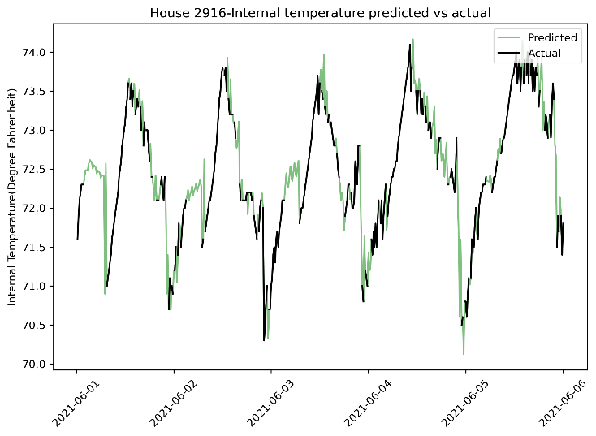
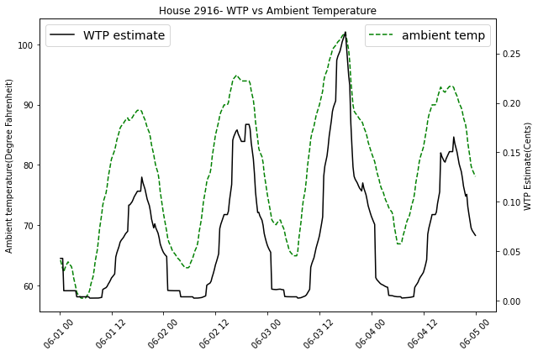
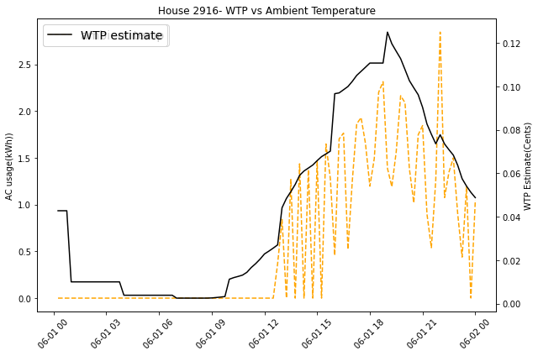
Community-Based, Autonomous-Agent Enabled, Electricity Trade in a Grid Connected End-Node Some Preliminary Results for Nine Houses
Internal Temperature Predicted vs Actual (sample house)
Willingness to Pay vs Ambient Temperature (sample house)
Willingness to Pay vs AC Usage (sample house)

Slide 11
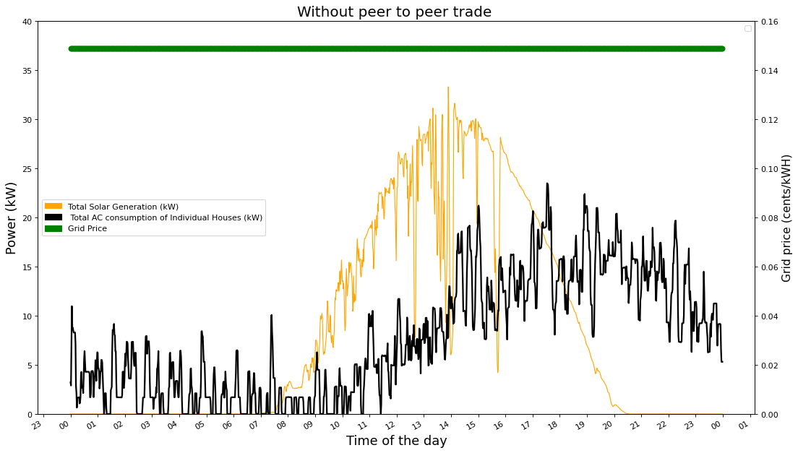
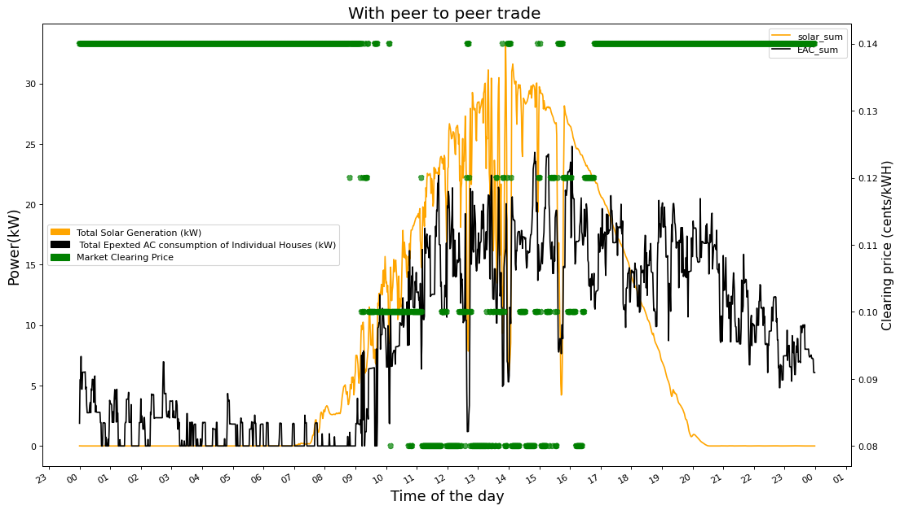
Community-Based, Autonomous-Agent Enabled, Electricity Trade in a Grid Connected End-Node Some Preliminary Results for Nine Houses
Power Generation, AC Consumption, and Price (all houses) – Without Trade
Power Generation, AC Consumption, and Price (all houses) – With Trade

Slide 12
Contributions
Optimal contracts and community auctions with financial risk reduction may lead to increased consumer retention in demand-response programs
Errors in anticipated consumer response when designing contracts and auctions can lead to unanticipated results including customer discontent and profit losses
Optimal contracts can meet objectives of both utility company and residential consumers
Generate new value streams for flexible loads at the residential-scale
Peak management and reduced need for worst-case infrastructure investment via non-wires alternatives
More flexible power grid to better manage demand-supply imbalances
Leading to a more efficient and economical grid
Reduce price volatility and improve market efficiency using demand response
Reduce impacts of real-time wholesale market uncertainty (due to renewables or other variables)
Encourage adoption of renewables like solar and wind

Slide 13
Additional Contributions from Economics
Improve understanding of information and incentives that successfully promote household adoption of DERs
Improve understanding of how various technologies might differentially affect different households and their ability to participate in the modern grid
Improve understanding of how various resources, prosumer heterogeneity, and incentives might be used to increase islanding coverage
Improve understanding of how storage might affect power consumption patterns and potential for islanding

Slide 14
Related Work
M. Ostadijafari, G. Manandhar, A. Dubey, H. A. Love and O. Bergland, "Principal-Agent Model for Bilateral Contract Design to Incentivize Residential Demand-side Flexibility," IEEE Transactions on Energy Markets, Policy and Regulation, Vol. 1 No. 5, December 2023 pp. 310-321.
Chen, Sijie, H. Alan Love, and Chen-Ching Liu. “Optimal Opt-In Residential Time-of-Use Contract Based on Principal-Agent Theory.” IEEE Transactions on Power Systems, Vol. 31, No. 6 November 2016, pp. 4415-4426.
Bergland, Olvar, Anamika Dubey, Grishma Manandhar, H. Alan Love. “Demand Response Supply Estimation with Smart Meter Data,” International Association for Energy Economics, European Conference Milan, July 24–27, 2023.
Manandhar, Grishma, H. Alan Love, Olvar Bergland. "Dynamic Auction and Matching Mechanism for Peer-to-Peer Electricity Trading in Microgrids." 43rd International Association of Energy Economics, International Conference, 31 July - 4 August 2022, Tokyo, Japan.
Manandhar, Grishma, H. Alan Love, Olvar Bergland. “Autonomous Agent Enabled Auction Designed for Peer-to-Peer trading in Microgrids.” 39th USAEE/IAEE North American Conference, October 23-26, 2022, Houston, Texas, USA.
Bergland, Olvar and H. Alan Love. “A Machine Learning Approach to Demand Response Supply Estimation,” 1st International Association of Energy Economics Online Conference, June 07-09, 2021. 1st IAEE Online Conference 2021 (iaee2021online.org)
Bergland, Olvar, H. Alan Love, Anamika Dubey, Grishma Manandhar. “Non-Intrusive Detection of Household’s Electricity Patterns,” Climate, Resources, Energy and Environment (KREM), Norwegian University of Life Sciences, As, Norway, April 7, 2021. Climate, resources, energy and environment (KREM) | NMBU

Slide 15
Related Work
Bergland, Olvar and H. Alan Love. “A Machine Learning Approach to Demand Response Supply Estimation.” US Association of Energy Economics /International Association of Energy Economics, 37th North American Conference, 3-6 November 2019, Denver Colorado, USA.
Bergland, Olvar, H. Alan Love, and Faisal Mirza. “Congested Transmission Lines and Market Power: An Input-Output Hidden Markov Model of Supply.” Western Economics Association International, 15th International Conference, 21-24 March 2019, Keio University, Japan.
Bergland, Olvar, and H. Alan Love. “Two-Period Household Electricity Demand Estimation with Limited Data.” 39th International Association for Energy Economics (IAEE) International Conference, June 19-22, 2016, Norwegian School of Economics, Bergen, Norway

