Slide 1

Grid Analytics and Cybersecurity
Assefaw Gebremedhin
School of EECS, WSU
AGI Day 2024
August 28, 2024

Slide 2
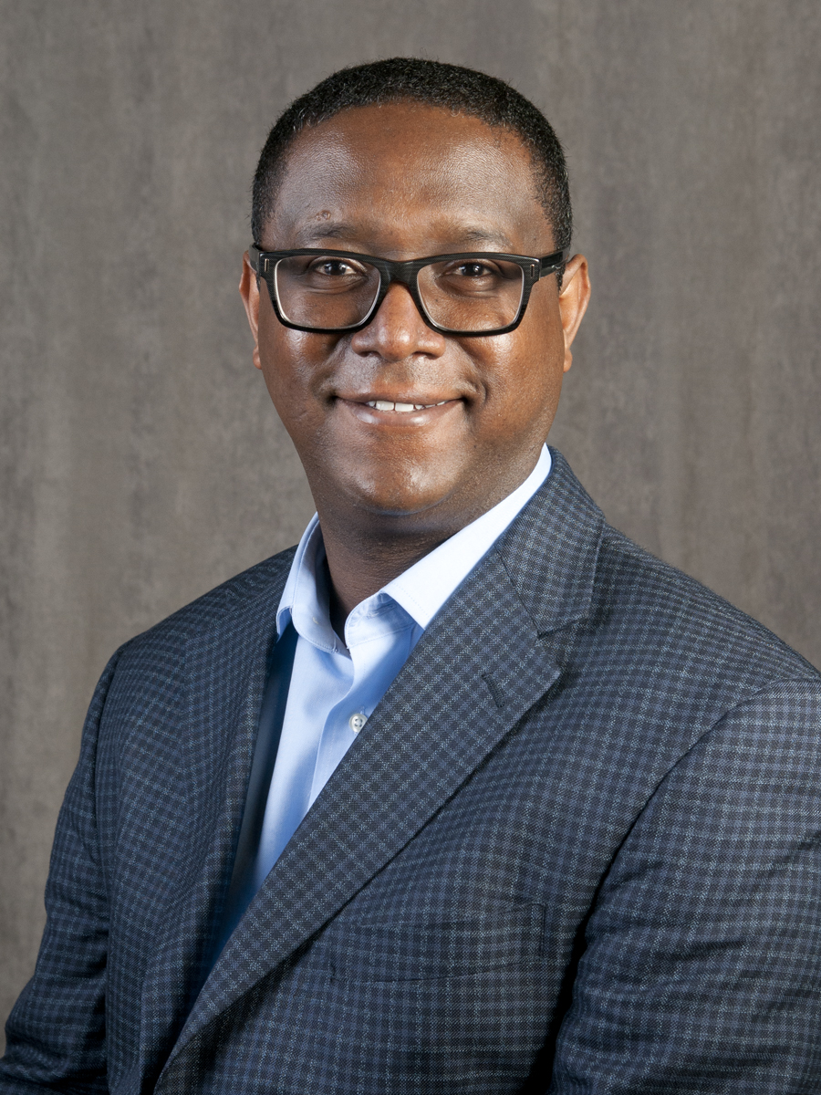
Intro
Assefaw Gebremedhin
Associate Professor, Computer Science
assefaw.gebremedhin@wsu.edu
http://www.eecs.wsu.edu/~assefaw
http://scads.eecs.wsu.edu
https://cyser.wsu.edu
Director, Scalable Algorithms for Data Science Lab (SCADS)
Lead PI, VICEROY NW Institute for Cybersecurity Education and Research (CySER)
Director, GAANN program on AI for engineering applications
Research interests:
Data science and AI
Cybersecurity
Network science
Applications: bioinformatics, health informatics, grid analytics
NSF CAREER Project (2016—2022)
Fast and Scalable Combinatorial Algorithms for Data Analytics
More on background:
Joined WSU in 2014
2016 NSF CAREER Award
2021 George Polya Prize in Applied Combinatorics
2022 Reid Miller Teaching Excellence Award
PhD from University of Bergen, Norway

Slide 3




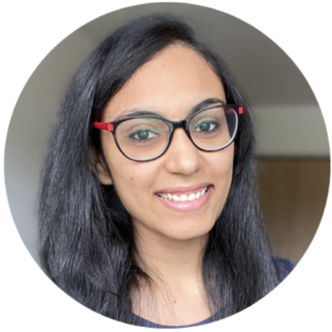

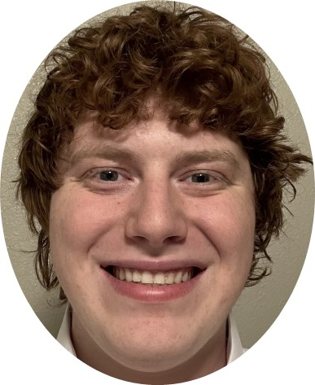

Current SCADS Lab Members and Activities
Tashi Stirewalt
Software security
PhD student
James Halvorsen
AI for security of CPS
PhD student
Jarren Briscoe
Fair AI, Forecasting
PhD student
Stephanie Kane
Responsible Data Science
PhD student (IID Program)
Shruti Patil
Bioinformatics
PhD student
Funso Oje
AI for Public Health
PhD student
Harrison Greenlee
Computational Epidemiology
PhD student
James Crabb
Cybersecurity Education
Post-doc

Slide 4
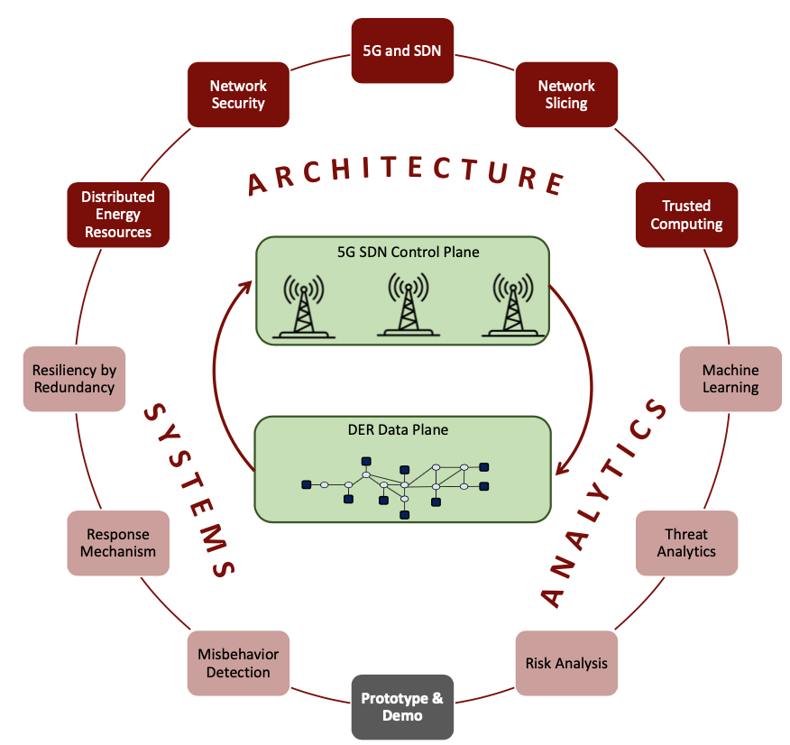
Examples of Specific Topics
Data science and ML
Robust methods for integration and analysis of IoT data
Management and analysis of DNA sequence data
Network model for sequence data (DiWANN)
Computational epidemiology
Geo-spatial data analytics
Grid analytics and digital twins
Behind-the-meter load/PV disaggregation
Customized cyber-power synthetic network for distribution systems (CP-SyNet)
Decentralized voltage control in power distribution systems
Energy efficiency and building models
AI/ML Foundations
Active Learning, Transfer Learning, Reinforcement Learning
Bias and bias mitigation
ML methods for complex time-series data (forecasting and nowcasting)
Cybersecurity
Graph algorithms for software security
Generative machine learning for intrusion detection systems
Holistic Zero-Trust Architecture for 5G-enabled Power Systems (ZTAPS)
Cybersecurity education
High performance computing
Graph and hypergraph algorithms for structure discovery (e.g. clustering)
Algorithms for graph isomorphism
ZTAPS overview

Slide 5

VICEROY CySER Institute
WSU
Established in June 2021 in the first cycle of the DoD VICEROY program
VICEROY = Virtual Institutes for Cyber and Electromagnetic Spectrum Research and Employ
Program born out of the National Defense Authorization Act
Trains DoD-aligned civilian workforce and ROTC in cybersecurity
Integrates cybersecurity research and education with professional skills in teamwork, communication, leadership and lifelong learning
Training organically merges theoretical knowledge with experiential learning
Builds a strong consortium in the Pacific Northwest for cybersecurity education and research
4 institutions with complementary strengths and diversity
WSU (lead), Montana State University, Univ of Idaho, and Central Washington Univ

Slide 6
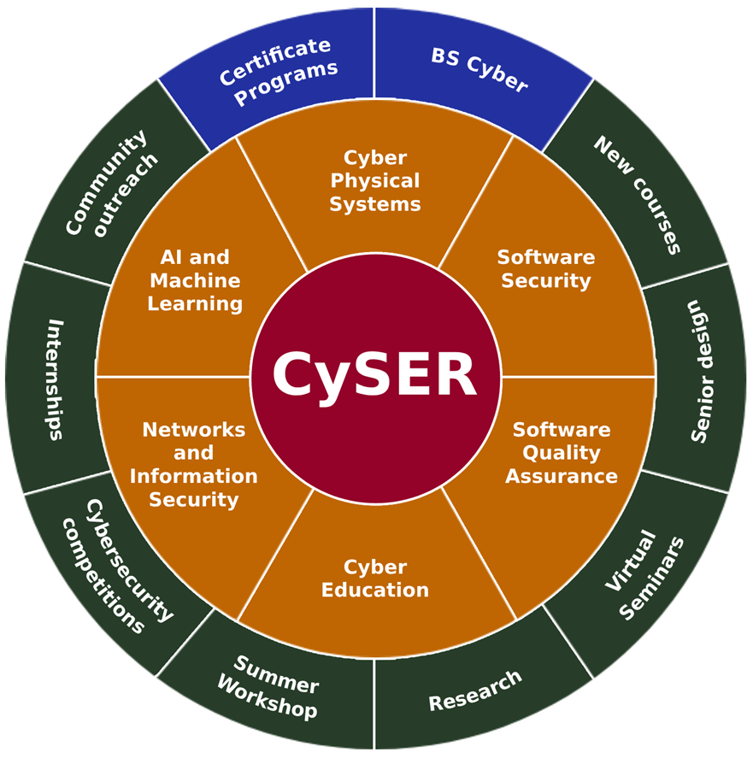
CySER Overview & Program Elements
WSU

Slide 7
