Slide 1
Power Electronics for a Better Grid
Wei Du
PNNL-WSU AGI Interim Co-Director
Solar subsector manager
Pacific Northwest National Laboratory
Research Associate Professor (Joint Appointment)
Washington State University
AGI Day 2024
Washington State University Tri-Cities, Richland, WA

Slide 2
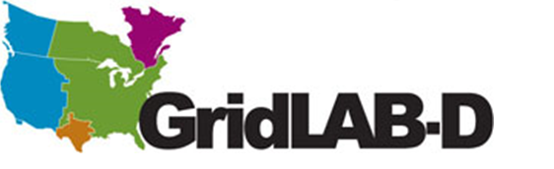
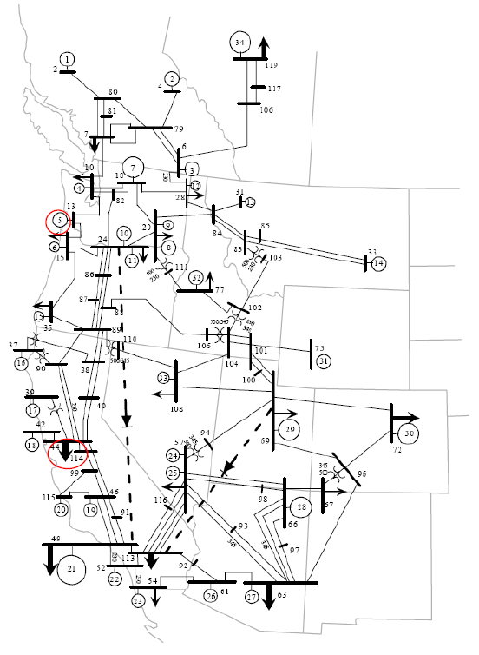
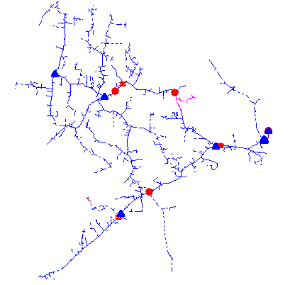
PNNL Developed Integrated T&D Co-Simulation Platform to Study the Impact of 10,000+ inverters on the System Stability
System size: 10,000+ inverters and 160,000+ nodes
All 19 load buses of the MiniWECC system are replaced by detailed feeder models
550 DERs in each feeder
10,000+ Inverters
Image source: OpenDSS
Modified IEEE 8500-Node Test Feeder
MiniWECC system

Slide 3
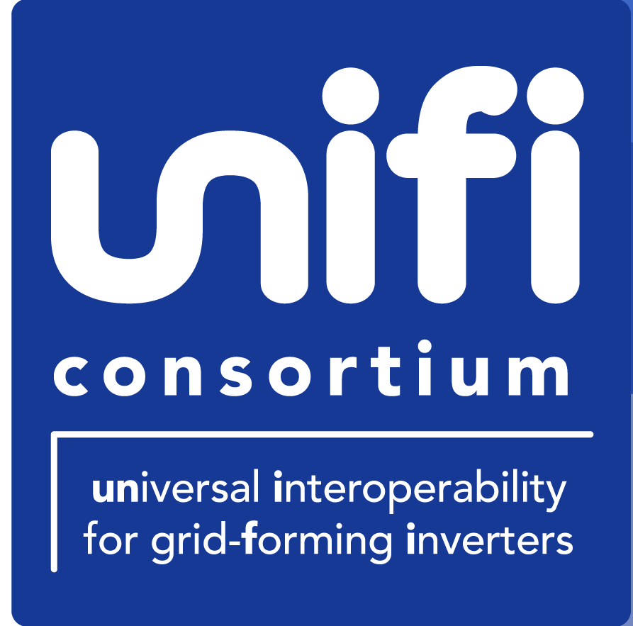
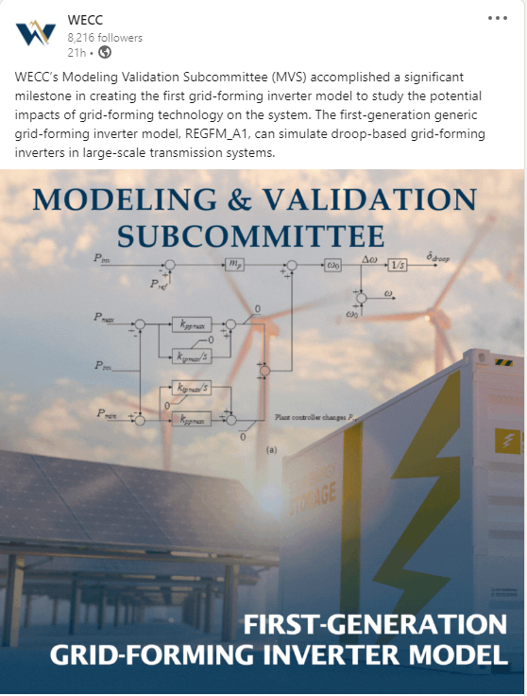
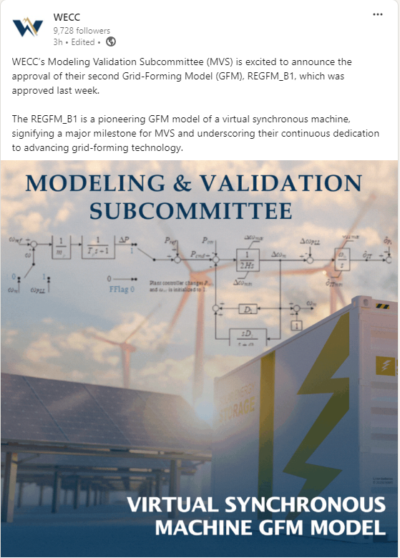
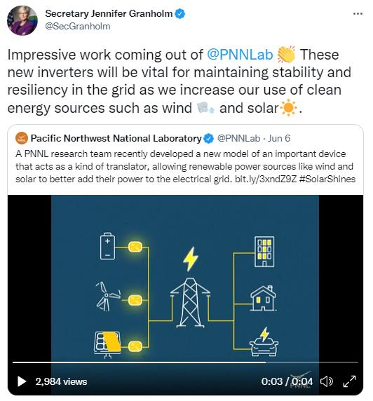
PNNL Led the Development of WECC-Approved Standard Library Grid-Forming Inverter Models
These two models become the first generation of WECC-approved grid-forming inverter (GFM) models, and have been integrated into the simulation tools used by transmission planners worldwide, including PSS/E, PSLF, PowerWorld, and TSAT
Tweeted by Secretary of Energy Jennifer M. Granholm
WECC Announcements of REGFM_A1 and REGFM_B1 Model Approvals

Slide 4
PNNL Continues Leading Standard Library Grid-Forming Inverter Models Development in Collaboration with Industry Partners
Grid-Forming Inverter Model Specifications
(REGFM_A1 and REGFM_B1)
PNNL bridges the gap between utilities and inverter manufacturers for addressing challenges of low-inertia systems
PNNL
SMA
PTI-PSS®E
WECC Utility Members and others
EPRI
GE
GE-PSLF
Tesla
PowerWorld
TSAT
Research Institution
Inverter
Manufacturer
Software
Vendor
System Planner

Slide 5
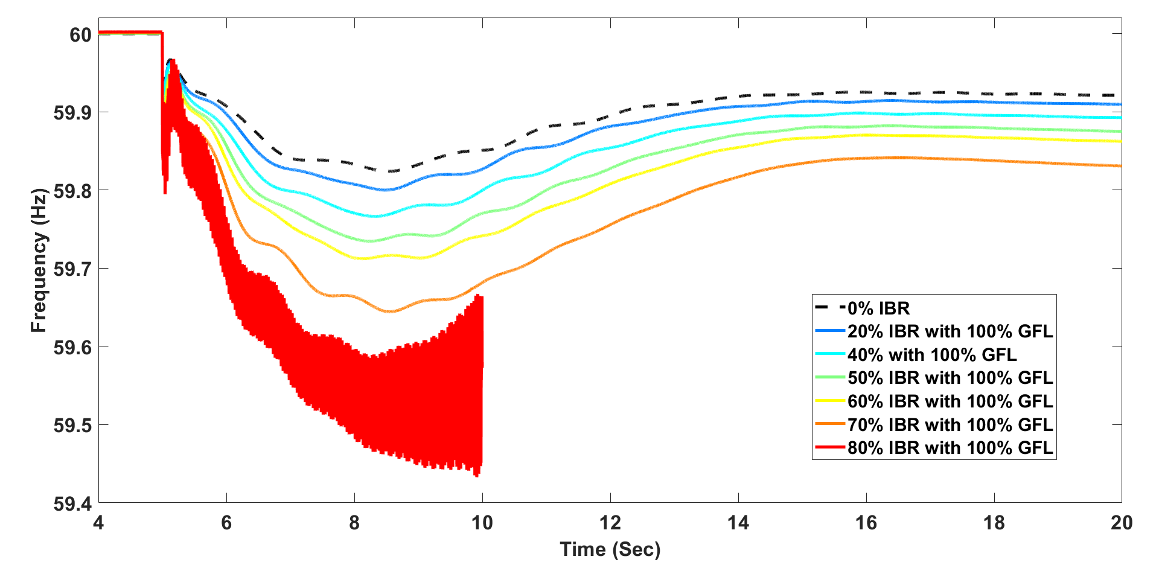
Grid-Forming Inverters Improve the System Frequency Response
With more grid-following inverters (GFLs) in the system, the system frequency response becomes worse
With more grid-forming inverters (GFMs) in the system, the system frequency response is significantly improved
100% synchronous machine
100% IBR (12.1% GFM and 87.9% GFL)
GFL penetration increases, frequency nadir decreases
GFM penetration increases, frequency nadir increases
35 Hz oscillation
[1] Yuan Liu, Renke Huang, Wei Du*, et al., “Highly-Scalable Transmission and Distribution Dynamic Co-Simulation with 10,000+ Grid-Following and Grid-Forming Inverters”, in IEEE Transactions on Power Delivery, 2023.

Slide 6
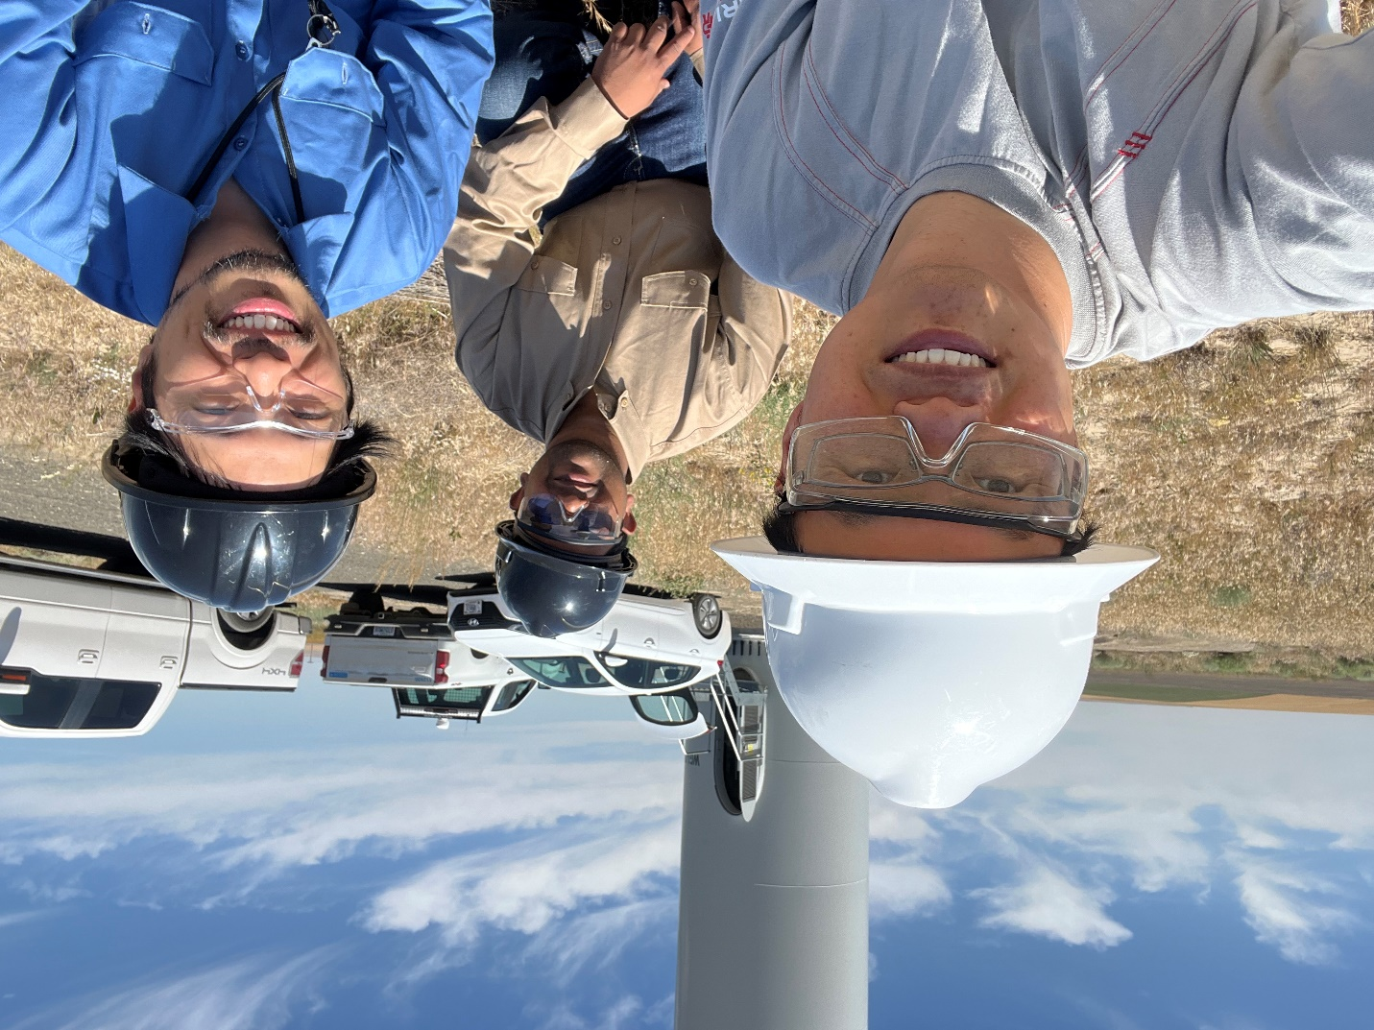
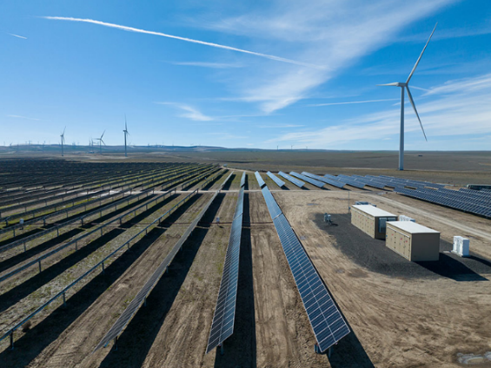




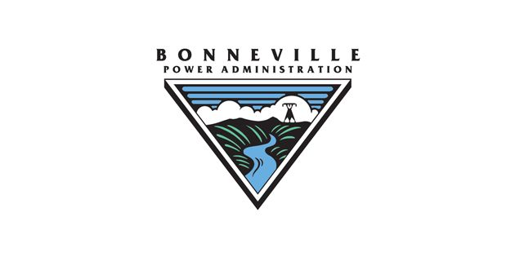



Demonstration of Grid-Forming Grid Services by a 380 MW Wind, Solar, and Battery Storage Combined Power Plant
Wheatridge Renewable Energy Facility is North America’s first energy center to combine wind, solar, and battery storage in one location, with 300 MW of wind, 50 MW of solar, and 30 MW of energy storage systems.
This will be the nation’s first bulk power system-connected grid-forming hybrid power plant in the United States
Wheatridge Renewable Energy Facility
Project Lead

Slide 7
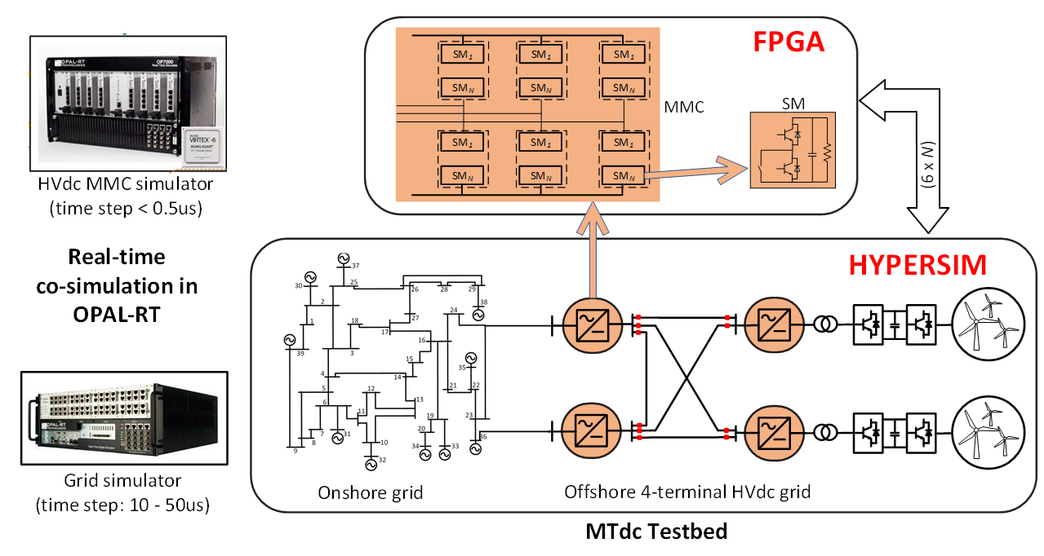
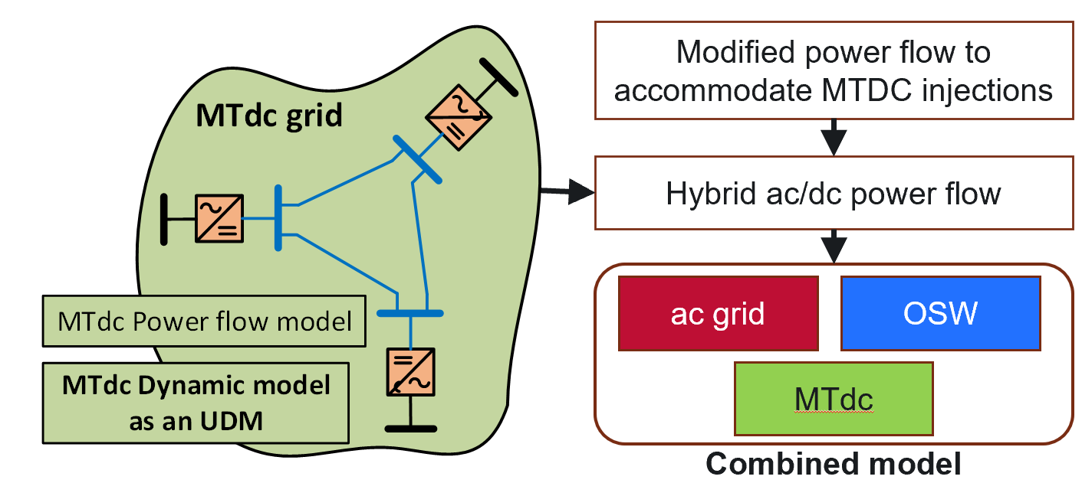
Multi-Fidelity HVDC and MTDC Modeling and Simulation Platform for Offshore Wind and Continental Power Grid Planning Studies
PNNL has developed multi-fidelity HVDC/MTDC models, including electromagnetic transient (EMT) models, positive-sequence phasor models, and real-time simulation testbeds to support different power system study purposes
Real-time EMT simulation platform for HVDC/MTDC control strategy testing
Phasor domain HVDC/MTDC models for bulk power system transient stability simulation

Slide 8
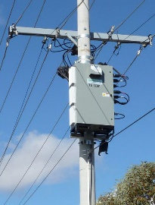
PNNL Innovation on Grid-Enhancing Technologies (GETs)
PNNL developed an innovative control strategy for a GETs device called dynamic voltage restorers (DVRs), which enable them to not only regulate voltage, but also regulate frequency
PNNL collaborated with a local manufacturer called Pacific Volt to implement the control on their commercial product
A DVR product by Pacific Volt
Hardware testing results on a commercial product
DVR and the proposed new control
[1] Du, Wei, Kevin P. Schneider, Francis K. Tuffner, Jing Xie, and Thanh T. Vu. "Using distributed power electronics-based devices to improve the voltage and frequency stability of distribution systems." U.S. Patent 11,515,704, issued November 29, 2022.

Slide 9

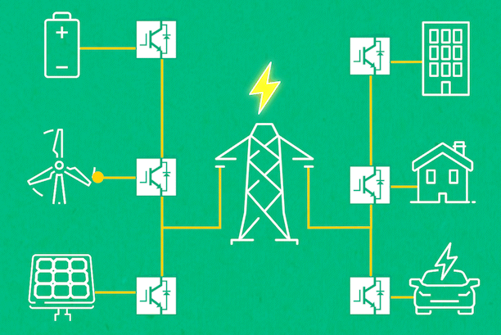
PNNL Energy System Co-Design with Multiple Objectives and Power Electronics (E-COMP) Initiative
The PNNL E-COMP Initiative aims to create new capabilities that enable the optimized design and operation of energy systems subject to multiple objectives and with high levels of power electronics
Energy System of the Future
Aspirations | Why PNNL
New characterization and modeling to understand the stability of interacting devices and systems. | World class multi-disciplinary capabilities in optimization, controls, power systems engineering, modeling and simulation, energy economics, and computational science.
Co-optimization of design and operation (aka co-design) to meet multiple objectives across multiple time scales. | State-of-the-art test facilities, high performance computing, libraries of data sets, and network of stakeholders
 | State-of-the-art test facilities, high performance computing, libraries of data sets, and network of stakeholders
Multi-entity simulation platform to enable value modeling, energy policy evaluation, and techno-economic approaches for future energy system operation. | Proven system-level expertise to tackle large-scale problems driving toward affordable, clean, and reliable energy systems
 | Proven system-level expertise to tackle large-scale problems driving toward affordable, clean, and reliable energy systems
Prototypical use cases.
E-COMP = smart decision making to support the energy system transition
https://www.pnnl.gov/projects/e-comp

Slide 10
Wei Du
Wei.du@pnnl.gov

