Slide 1
​​RD2C Initiative Overview
Thomas Edgar, RD2C Research Thrust Lead
Chief Cyber Security Scientist
Cyber Resilience Foundations

Slide 2
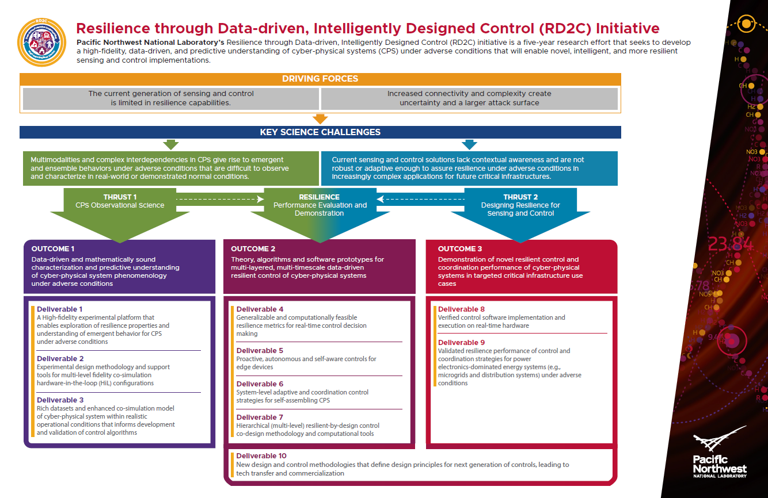

Slide 3
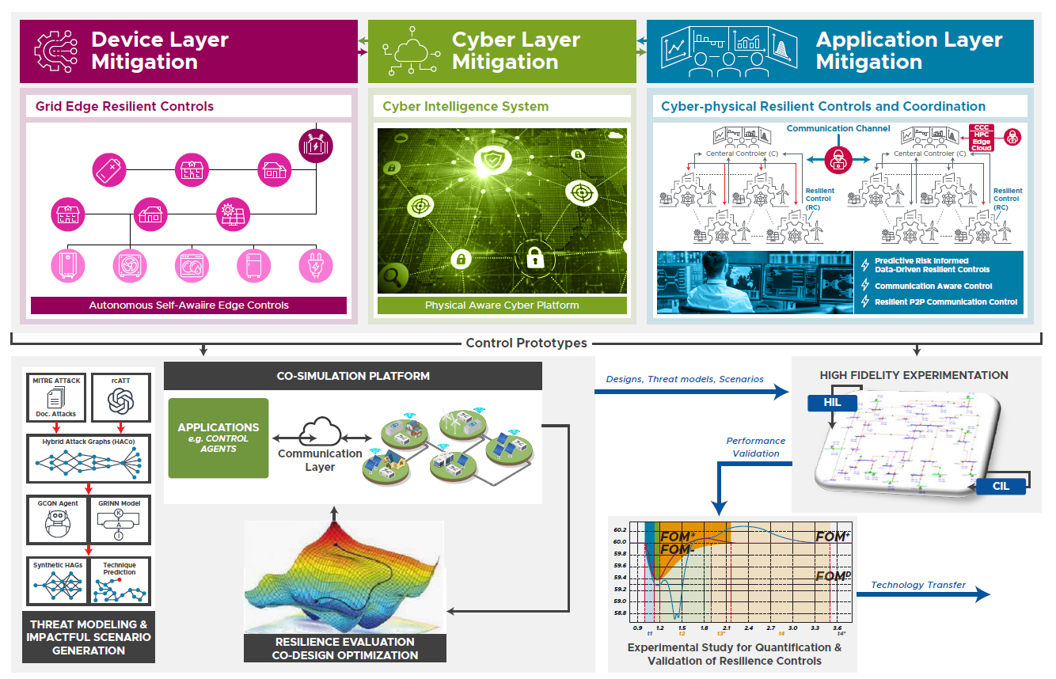

Slide 4
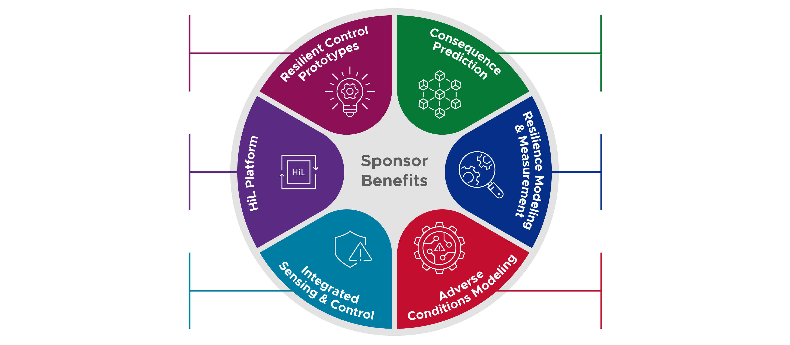
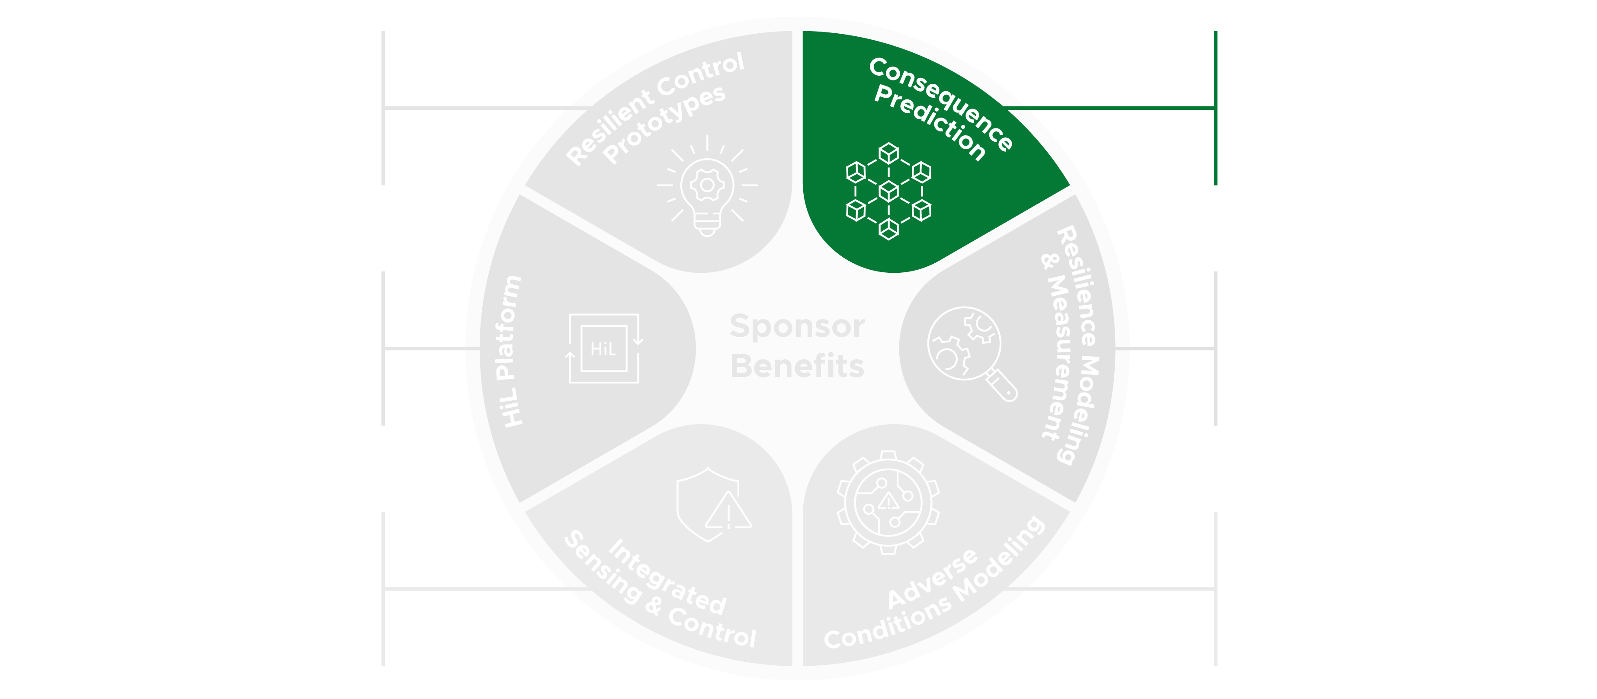
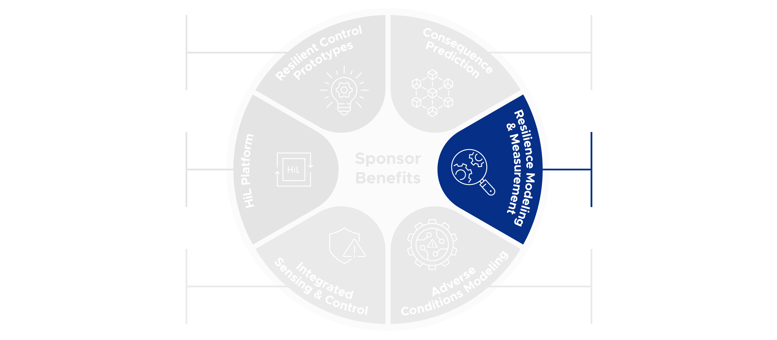
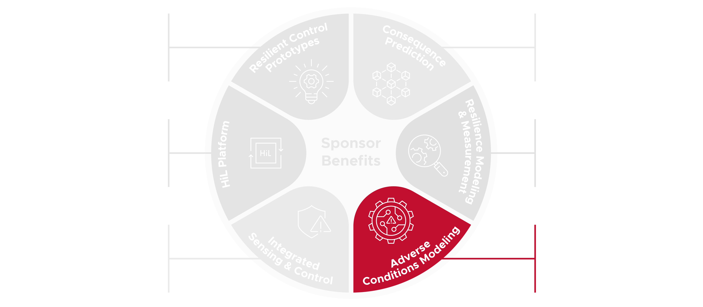
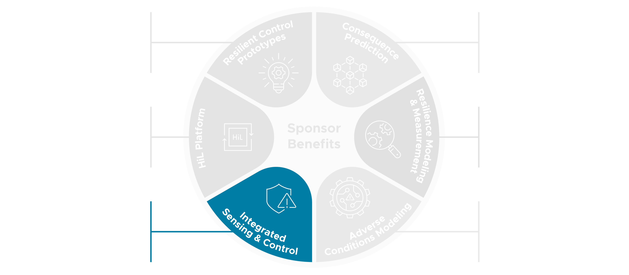
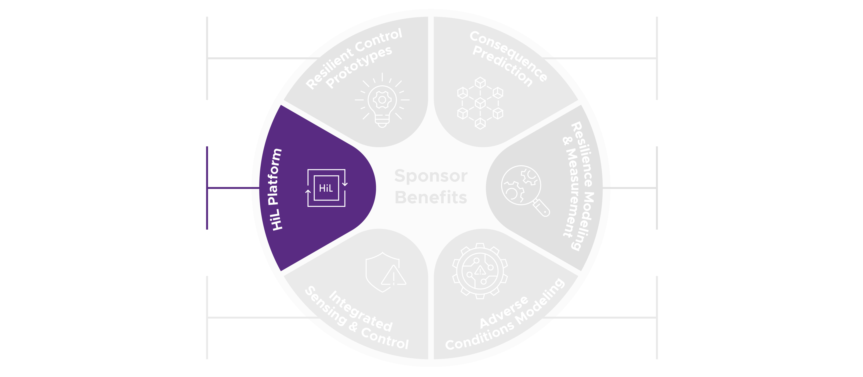
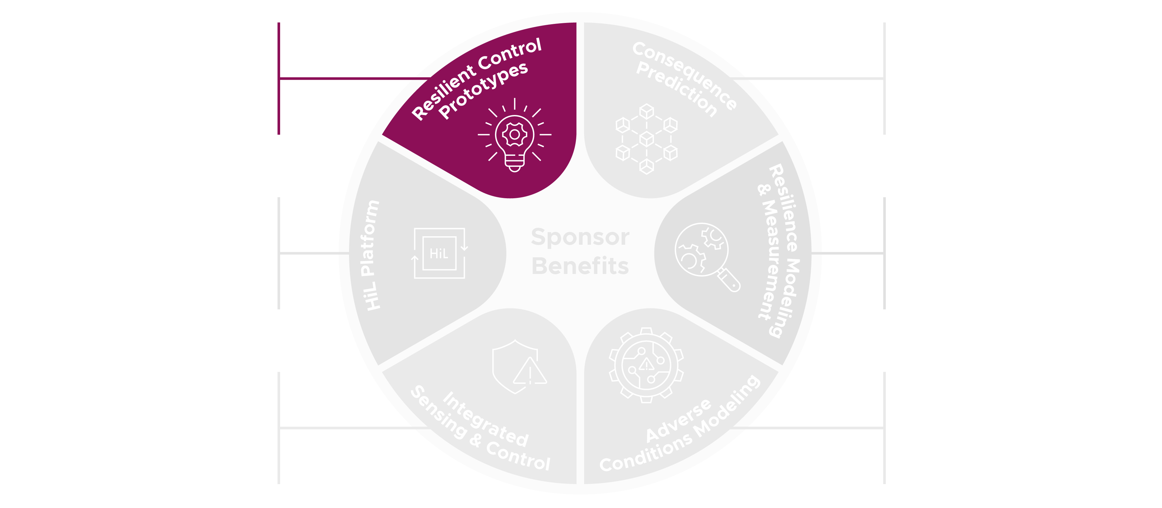
Desired Research Outcomes
Foundational building blocks for consequence prediction of cyber and physical effects of CPSs under adverse conditions
A resultant set of resilient control prototypes
Observational science platform for hardware-in-the-loop (HiL) integrated CPSs
Advance high-fidelity resilience modeling and measurement
Integrated design of sensing and control for CPSs
Adverse conditions modeling and optimization for CPSs

