Slide 1
WSU’s Leadership Activities in the Energy Area
Sandra Haynes (WSU Tri-Cities Chancellor) and Jonathan Male (WSU Assistant Vice Chancellor for Research and Director of National Laboratory Partnerships)
August 28, 2024
AGI DAY 2024 - Nexus of Power Systems Engineering and Advanced Analytics Toward a Resilient and Decarbonized Grid

Slide 2
WSU TRI-CITIES A LEADER IN CLEAN ENERGY
Premiere Research | Hands-On Learning | Community Oriented
Notes:
Remember to hit the reset button to make sure all the page elements react properly.
There are 20 different layouts that you can choose from.

Slide 3
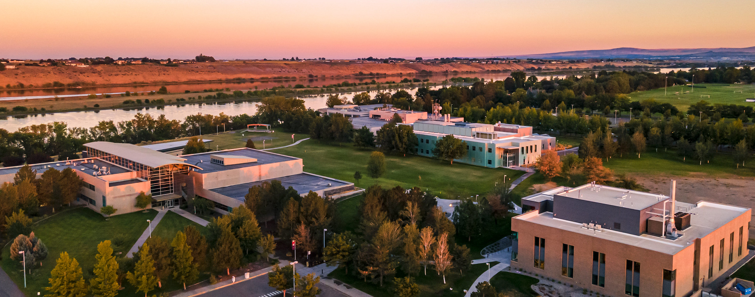
1 of 6 WSU campuses statewide
Positioned to work on the Energy Ecosystem
Notes:
WSU is a land-grant university, meaning we serve the entire state of Washington through:
Education
Research
Community service and partnerships
Map of Washington state with campus locations:
WSU Everett
WSU Pullman
WSU Spokane
WSU Tri-Cities
WSU Vancouver
WSU Global (online campus)
WSU Tri-Cities established in 1989

Slide 4
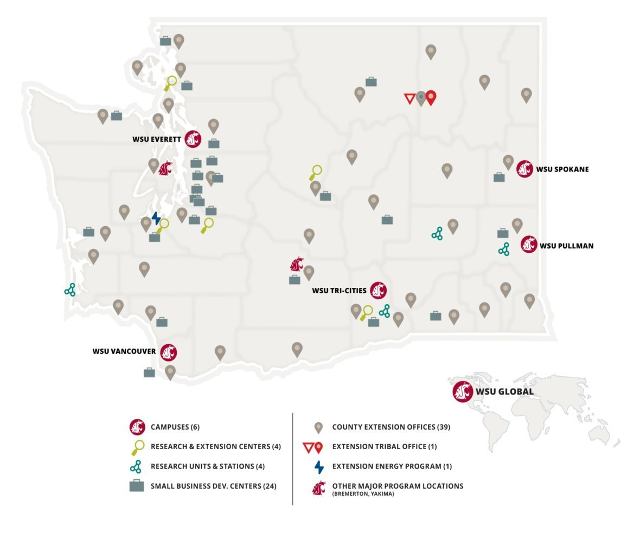
WSU System
The state's land grant university with 26,000+ students across campuses
Serving the entire state through:
Education
Research
Community service and partnerships
Notes:
Why AGI Day and Energy Research in Tri-Cities

Slide 5
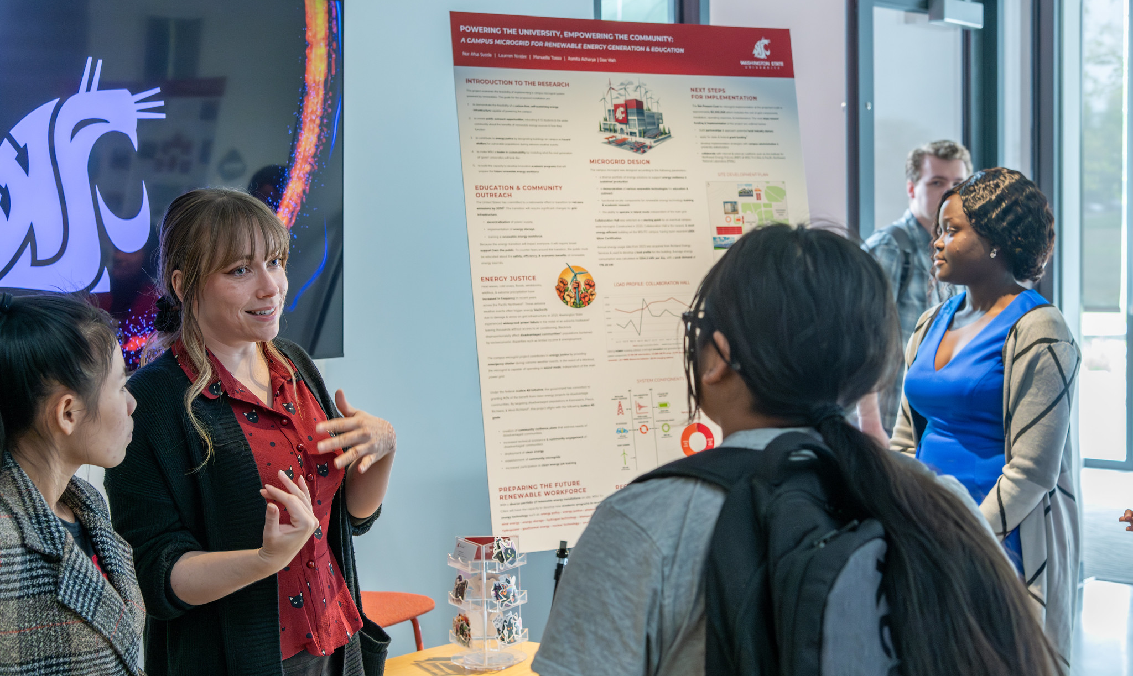
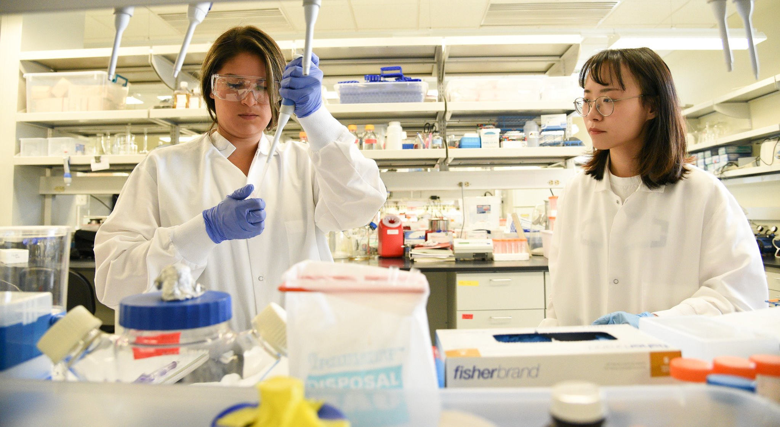
WSU Tri-Cities
Reflecting the community we serve
Student population:
Nearly 50% students of color
51% first generation students
60% female students
STEM Majors:
40% total enrollment in STEM
53% of STEM students from historically marginalized populations
Research strengths in Energy, Environment, & Agriculture
Notes:
Why AGI Day and Energy Research in Tri-Cities

Slide 6
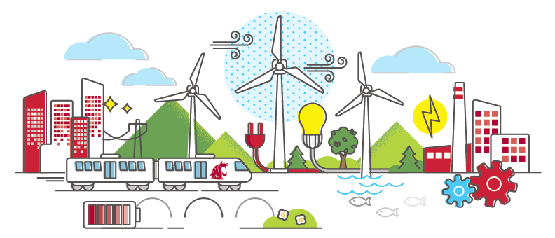
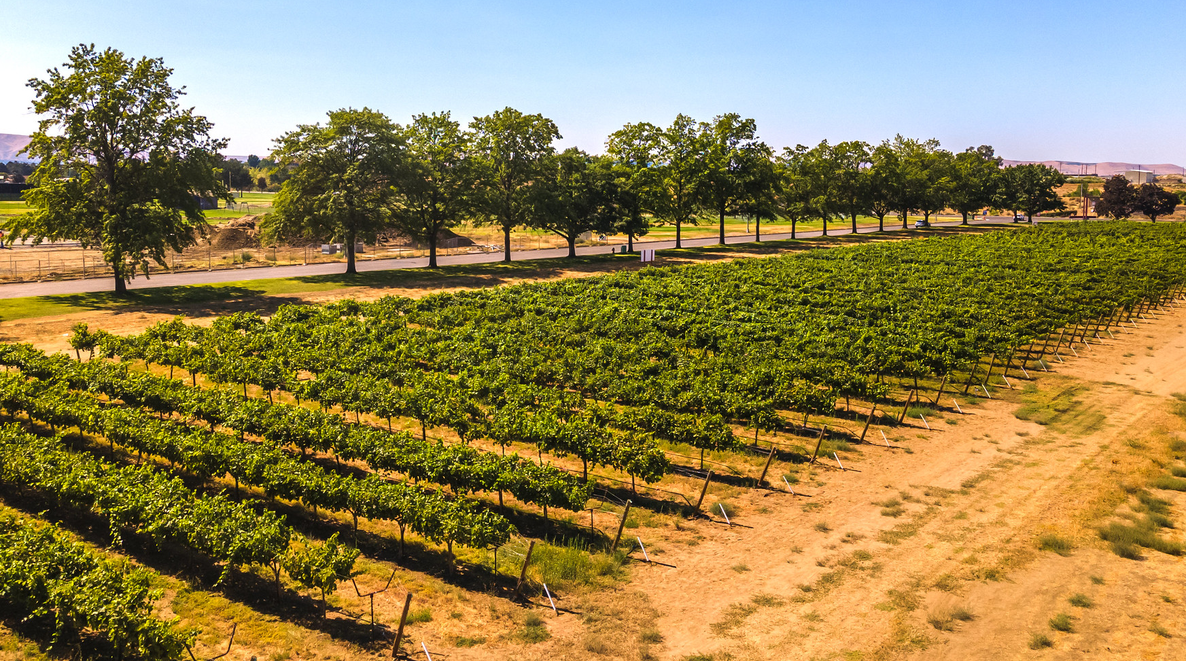
"Of" the Community
Rich and unique in energy production and capability​
Region hosts bountiful low carbon energy generation from hydropower, nuclear, solar and wind resources serving​ demand in the state and adjacent regions.
It is also a rich agricultural area with multiple sources of biomass from which to create fuels, innovate at the nexus of agriculture and energy, and has abundant water for H2 production.

Slide 7
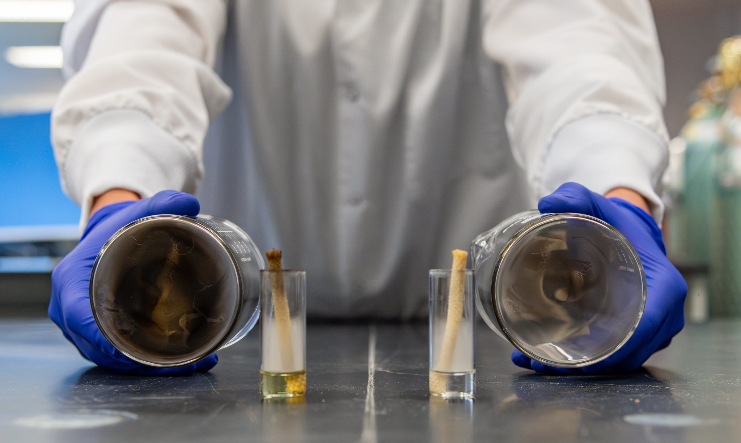
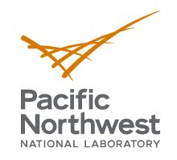
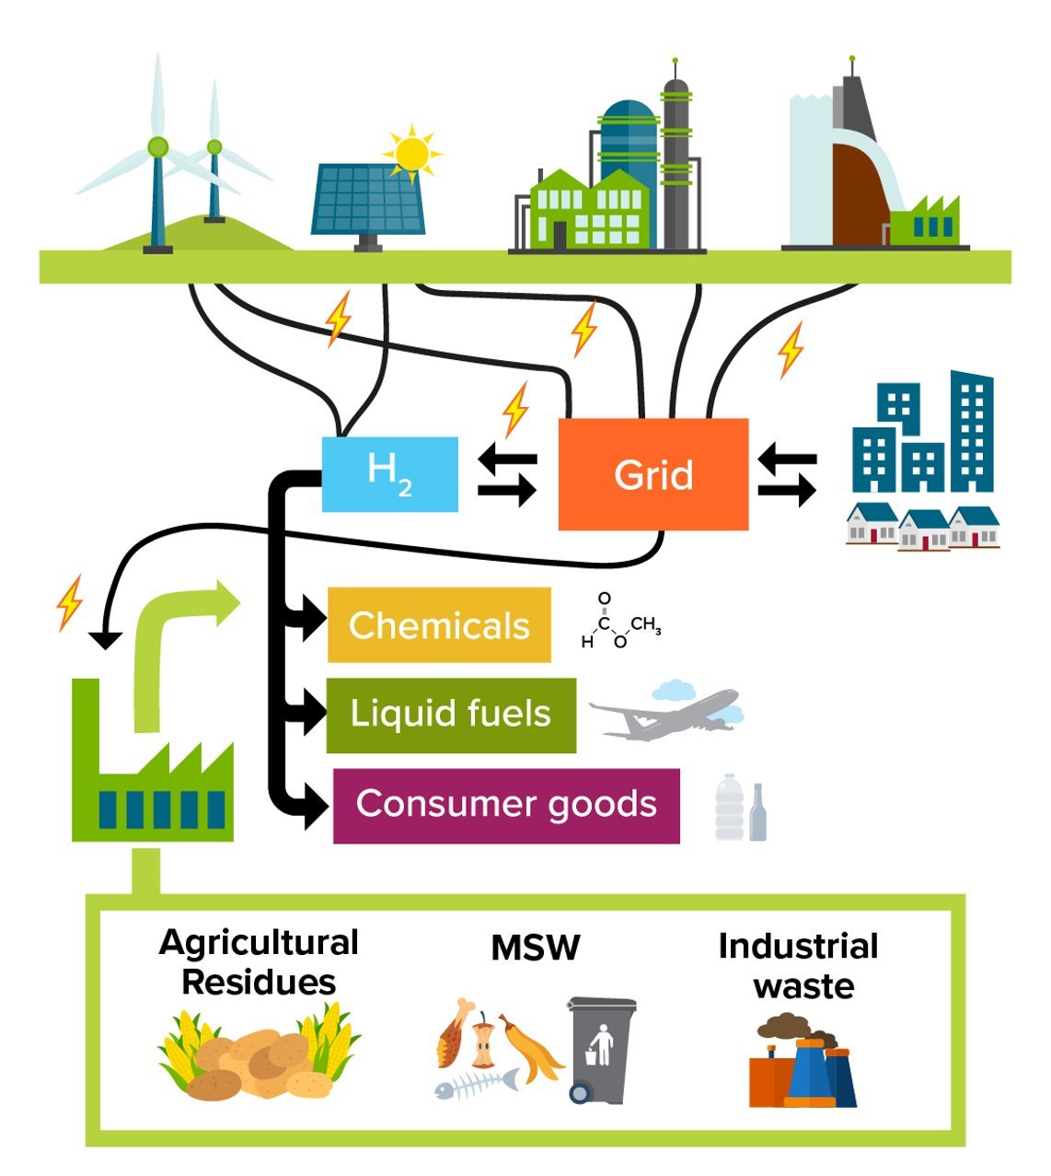
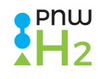
Leading the Transition
Partnerships with PNNL:
Bioproducts, Sciences, and Engineering Lab (BSEL)
Pacific Northwest Hydrogen (PNWH2) Hub
Institute for Northwest Energy Futures (INEF)​
Leveraging diversity of energy ecosystem players to examine energy systems

Slide 8
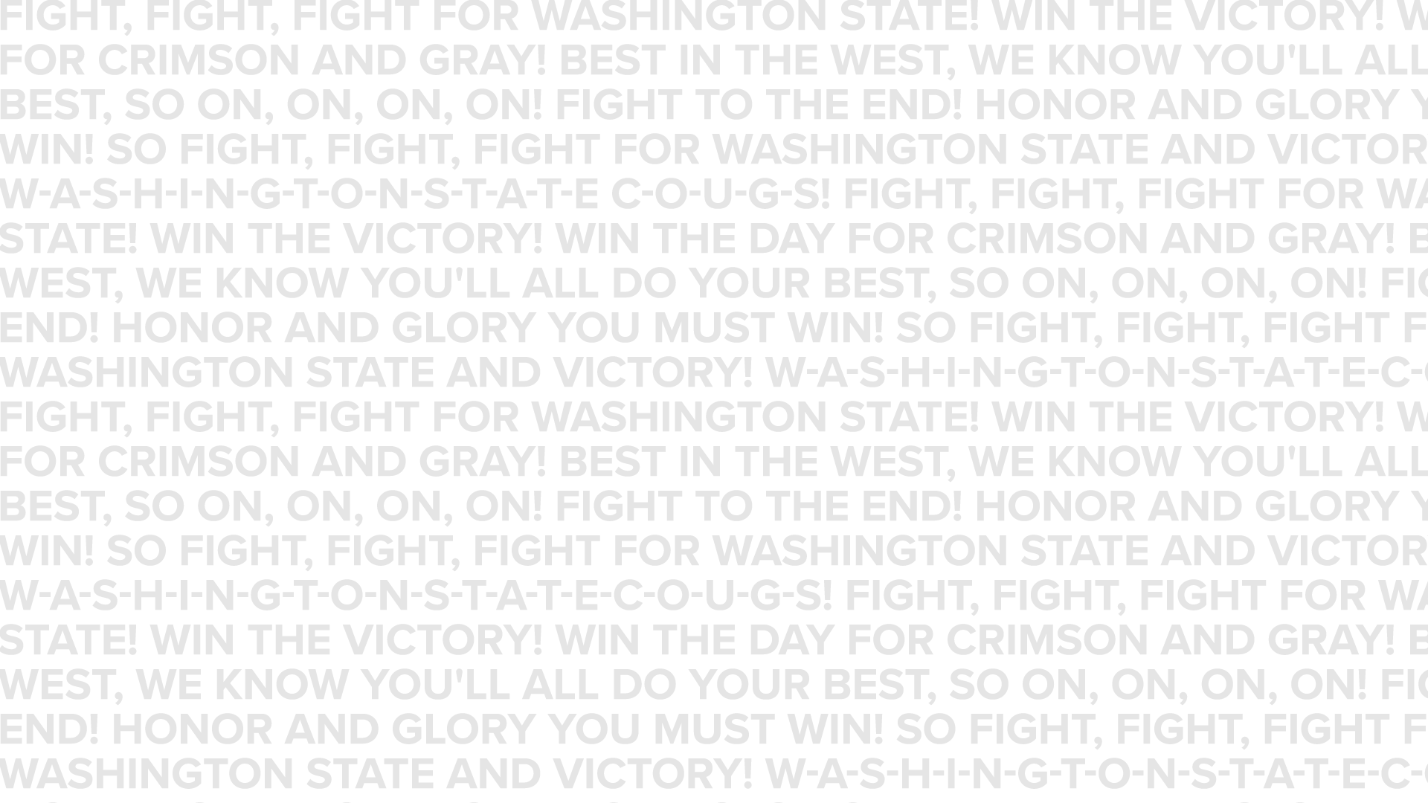

Slide 9
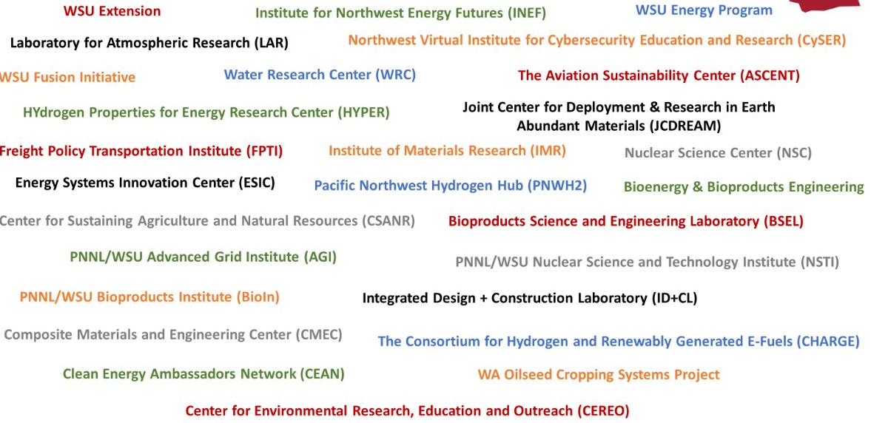
WSU System Energy Related Activities for Research, Education, and Outreach
(Bio-In)
Notes:
General Slide -- WSU Research in energy space – Diversity of Topics covered across university
Wide spectrum – Grid, Nuclear, Bioproducts, Agriculture (feed stock and energy use), Transportation Fuels, Advanced Materials, Smart Buildings, Water, Advanced Materials, Hydrogen, Energy and Environment, Economics, Energy Equity, Artificial Intelligence and Machine Learning, Cybersecurity
Large Number of Energy Entities across system working on these topics – Noel Slide
Washington State and the surrounding Northwest region is in the process of transitioning its overall energy approach to adapt to an increased demand for low-carbon electricity and transportation fuels.
Washington State already has the 3rd lowest cost electricity and the highest zero-carbon electricity mix in the United States, building off its unique and ample electricity production from hydropower, nuclear power, and wind and underlying energy infrastructure. However, more progress towards decarbonization is sought, while at the same time ensuring resilient, available, and affordable energy.
Energy across colleges and campuses
ESIC: The Energy Systems Innovation Center leads the transition to affordable, sustainable and resilient electric power systems through collaborative research, education and outreach to solve challenges for modern power systems. ESIC is distinguished by the intellectual capabilities in multidisciplinary collaborations with industries, universities, national labs, and other institutions. These partnerships position ESIC at the forefront of solving the power engineering challenges in transitioning to the resilient, reliable, sustainable, and affordable power grids of the future.
Nuclear Science Center - provides unique opportunities to researchers, commercial clients, and government agencies—especially as the reactor housed here is the only research reactor in the State of Washington, and one of less than thirty in the nation.
CHARGE is an initiative of the Joint Center for Deployment and Research in Earth Abundant Materials (JCDREAM.) JCDREAM was founded by the Washington State Legislature and is administered by Washington State University. Since 2015, JCDREAM has been facilitating innovation in the use of earth-abundant materials in clean energy and transportation. A state-wide focus on developing earth-abundant materials technologies within the existing innovation and manufacturing competencies will help propel Washington state into a position of national leadership in sustainable manufacturing practices within these important industries.
JCDREAM has assessed key supply chains in Washington's clean energy and transportation industries and found that there is an extraordinary opportunity to decarbonize these sectors and build a sustainable value chain in the hydrogen economy. Based on this assessment, JCDREAM and WSU have worked to establish CHARGE - a consortium focused on building Washington's hydrogen economy in a sustainable, circular, and collaborative manner.
Washington State and the surrounding Northwest region is in the process of transitioning its overall energy approach to adapt to an increased demand for low-carbon electricity and transportation fuels.
Washington State already has the 3rd lowest cost electricity and the highest zero-carbon electricity mix in the United States, building off its unique and ample electricity production from hydropower, nuclear power, and wind and underlying energy infrastructure. However, more progress towards decarbonization is sought, while at the same time ensuring resilient, available, and affordable energy.
Washington State University (WSU) has for many years engaged in addressing this transition through energy-related research, academic programs, and outreach. It is noted that certain WSU energy capabilities and programs are already recognized throughout the state, the nation, and internationally.
WSU is now at a juncture in time and place to revisit its assets and progress in support of this energy transition, and further, evaluate the potential for collectively achieving greater impact.
Energy across colleges and campuses
ESIC: The Energy Systems Innovation Center leads the transition to affordable, sustainable and resilient electric power systems through collaborative research, education and outreach to solve challenges for modern power systems. ESIC is distinguished by the intellectual capabilities in multidisciplinary collaborations with industries, universities, national labs, and other institutions. These partnerships position ESIC at the forefront of solving the power engineering challenges in transitioning to the resilient, reliable, sustainable, and affordable power grids of the future.
Nuclear Science Center - provides unique opportunities to researchers, commercial clients, and government agencies—especially as the reactor housed here is the only research reactor in the State of Washington, and one of less than thirty in the nation.
CHARGE is an initiative of the Joint Center for Deployment and Research in Earth Abundant Materials (JCDREAM.) JCDREAM was founded by the Washington State Legislature and is administered by Washington State University. Since 2015, JCDREAM has been facilitating innovation in the use of earth-abundant materials in clean energy and transportation. A state-wide focus on developing earth-abundant materials technologies within the existing innovation and manufacturing competencies will help propel Washington state into a position of national leadership in sustainable manufacturing practices within these important industries.
JCDREAM has assessed key supply chains in Washington's clean energy and transportation industries and found that there is an extraordinary opportunity to decarbonize these sectors and build a sustainable value chain in the hydrogen economy. Based on this assessment, JCDREAM and WSU have worked to establish CHARGE - a consortium focused on building Washington's hydrogen economy in a sustainable, circular, and collaborative manner.
CHARGE: The Consortium for Hydrogen and Renewably Generated E-fuels (CHARGE) is a new effort to align industry, researchers, and government around decarbonizing our power grid, transportation, and technology sectors the production of hydrogen and e-fuels.
CHARGE: WSU is convening private sector in collaboration with PNNL, utilities, Public Utility Districts, and others across the state, we aim to develop and deploy new technologies in the emerging hydrogen and e–fuels economy.
HYDROGEN PROPERTIES FOR ENERGY RESEARCH (HYPER) CENTER The only cryogenic hydrogen research center in US academia.
Hydrogen Properties for Energy Research (HYPER) Laboratory is the only US-based cryogenic hydrogen research laboratory in academia. The HYPER community’s vision is for cryogenic hydrogen, a zero-carbon electro-fuel, to become a cost-effective, safe and high-performing fuel-of-choice for both earth-bound and space-bound energy. Their research studies and technologies are advancing that vision.
FPTI: The Freight Policy Transportation Institute is funded by the United States Department of Transportation (USDOT) and has the following key goals and objectives: (1) improve our understanding of the importance of efficient and effective freight transportation to the regional and national economy; (2) address the need for improved intermodal freight transportation, policies, and actions to lower operating costs, increase safety, and lower environmental impacts of freight transportation and; (3) improve freight transportation performance to specific industries and sectors of the economy
The Center for Environmental Research, Education, and Outreach (CEREO) is a progressive network of more than 350 faculty, staff, students, and industry leaders working to resolve environmental issues through collaborative partnerships. Guided by a roster of distinguished scientists, CEREO seeks to apply innovative technologies and management tools to the ever-growing challenges of global climate change and environmental sustainability
Washington Water Research Center - The State of Washington Water Research Center (WRC) was established by the American Water Resources Research Act of 1964 as one of the National Institutes for Water Resources. Over it’s more than half century of work on water resources for the benefit of the State of Washington, The WRC has become an integral connection between academics; local, state, and federal government; and the private sector:
-Oversee sand conducts applied water-related research
-Fosters the education and training of our Nation’s future water professionals
-Serves as a nexus within the academic community by transferring research result to those who manage or use the Nation’s water resources.
CSANR: The Center for Sustaining Agriculture & Natural has been supporting research and development on several farm-based energy resources as well as improving energy use efficiency. Most forms of agriculture is highly reliant on fossil energy for machinery, nutrients, irrigation, processing, storage, and transport. Farms have the potential to run more on “current solar income” by producing renewable fuels from sources such as oilseeds, plant biomass, and manure. CSANR currently organizes programs in anaerobic digestion, biochar, and biofuels.
ASCENT – the Aviation Sustainability Center – is a cooperative aviation research organization co-led by Washington State University and the Massachusetts Institute of Technology. Also known as the Center of Excellence for Alternative Jet Fuels and Environment, ASCENT is funded by the FAA, NASA, the Department of Defense, Transport Canada, and the Environmental Protection Agency. ASCENT works to create science-based solutions for the aviation industry’s biggest challenges. A coalition of 16 leading US research universities and over 60 private sector stakeholders committed to reducing the environmental impact of aviation, ASCENT also works in partnership with international research programs, federal agencies and national laboratories to create an all-inclusive research capability for whatever environmental impact obstacle the aviation industry faces.
ASCENT – the Aviation Sustainability Center – is a cooperative aviation research organization co-led by Washington State University and the Massachusetts Institute of Technology and serves as the FAA Center of Excellence for Alternative Jet Fuels and Environment. ASCENT creates science-based solutions for the aviation industry’s biggest challenges including decarbonization.
WSU Energy Program: a self-supporting program in WSU Extension that operates like a consulting firm. Staff of energy engineers, energy specialists, technical experts, and software developers work from satellite locations across the state of Washington to provide energy services, products, education and information
Bioproducts, Sciences & Engineering Laboratory: The BSEL lab provides space to advance research in identifying useful non-energy products that can be used to promote energy sustainability. Since May 2008, the BSEL teaching laboratory has been a partnership between WSU and the Pacific Northwest National Laboratory (PNNL) operated by Battelle. BSEL features the Biorefinery and the Combinatorial Catalysis Research Lab, plus a variety of laboratories and classrooms.
· JCDream - Since 2015, the Joint Center for Deployment and Research in Earth Abundant Materials (JCDREAM) has provided the organizational framework to stimulate innovation in the use of earth-abundant materials within an established and emerging industrial sector. A state-wide focus on developing earth-abundant materials technologies within the existing innovation and manufacturing competencies will help propel Washington state into a position of national leadership in sustainable manufacturing practices within large-scale (transportation) and growth (clean energy) industries.
INEF
“The Institute for Northwest Energy Futures will bridge the gap between science and policy for innovations in clean energy by leveraging WSU research expertise in power, transportation, fuels, and other areas in a systems analysis approach.

Slide 10
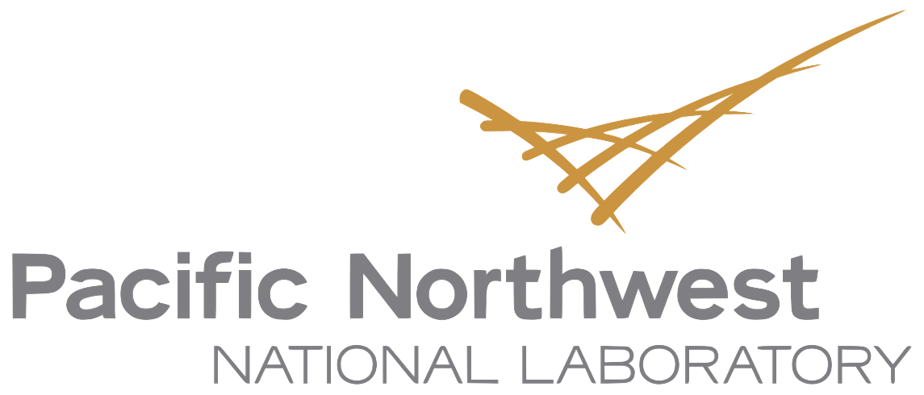

WSU-PNNL Strategic Partnership
PNNL advances the frontiers of knowledge, taking on some of the world’s greatest science and technology challenges.
Distinctive strengths in:
Biology,
Chemistry,
Earth Sciences
Data Science
Materials Science
Washington State University will be recognized for embracing risk and bold thinking to serve the needs of its communities through innovative research, scholarship, and creative activities.
Research Strengths: Food Security and Sustainable Agriculture
Community and Public Health
Environmental Sciences and Energy Futures
Biomedical, Life Sciences, and Biotechnology
Next Generation Materials and Advanced Manufacturing
AI/ML and Robotics
Notes:
WSU-PNNL partnership is a key element of the WSU research strategy- institutions share numerous research strengths
Both institutions will benefit from an
intentional strategic partnership
Expertise in electric power engineering with advanced grid modeling to support planning and operations of complex power systems of the future and its workforce, including addressing cyber security, smart grid, and other.
Expertise in next generation feedstocks, fuel conversion methods, bioproducts, biorefineries, distribution infrastructure and environmental safety.
Expertise in catalysis (especially when coupled with PNNL). One of the strongest and most comprehensive catalysis programs in a US academic institution. WSU has unique instrumentation for the analysis of reactive surfaces under operating conditions and host many national and international collaborations
Expertise in hydrogen liquefaction (cryogenic hydrogen) expertise, supporting zero-carbon electrofuels, i.e., to become a cost-effective, safe and high-performing fuel-of-choice for both earth-bound and space-bound energy.
Expertise in the understanding and control of how materials evolve in radiation environments to prevent the use of illicit nuclear materials, resolve issues in nuclear waste management.
Expertise in materials science and engineering, including associated with building materials, solar energy, fuel conversion, bioproducts, etc. associated with synthesis, fabrication, materials characterization.
Outstanding Scientific Colleagues
World Class Analytical and Computational Facilities
Unique Educational Experiences
Focus on Relevant Problems with Societal Impact
Synergistic access to funding and funding agencies
Leverage shared research strengths and deliver world-class research, technology transfer, increased publications
Work on critical national issues and grow the talent pipeline in science & technology through innovative approaches to STEM education
Increase multidisciplinary research projects and funding – extending the breadth and depth of research efforts for both institutions
Link additional research partners including other federal agencies and industry
Enhance faculty experience in collaborative research environment with specialized equipment and facilities
Create additional opportunities for undergraduate & graduate students, including post-doctoral experiences
Both institutions will benefit from an
intentional strategic partnership

Slide 11

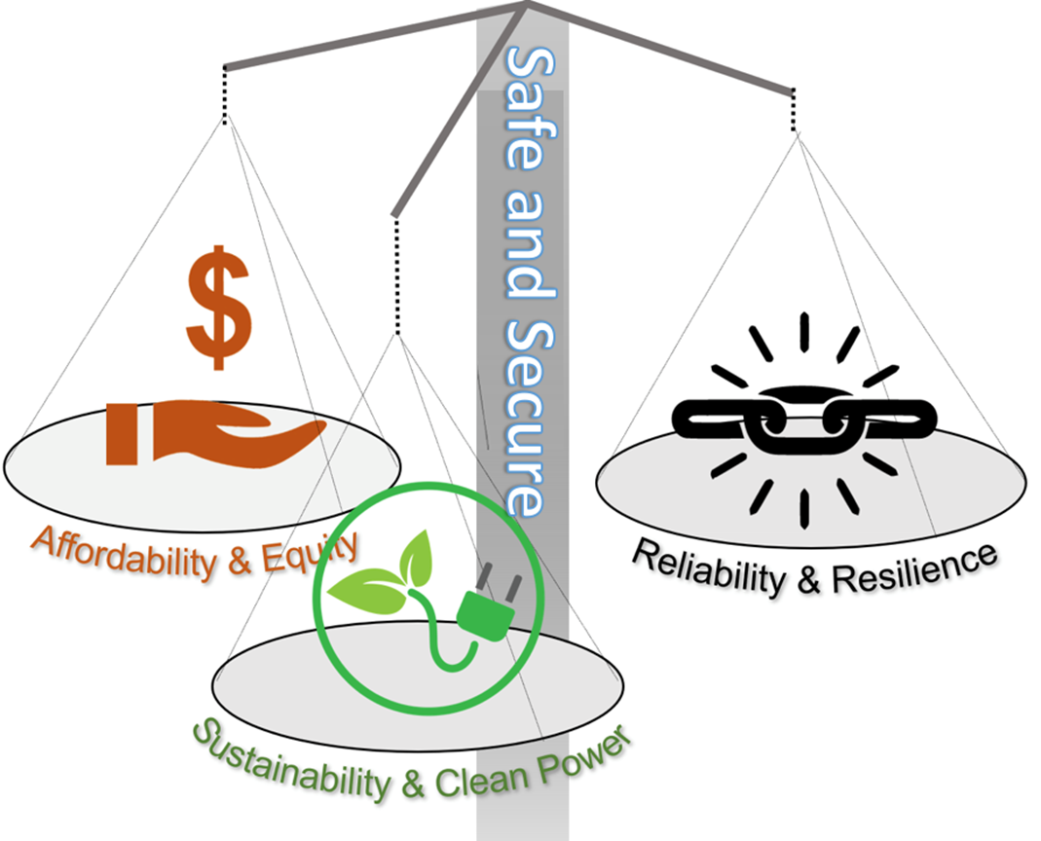
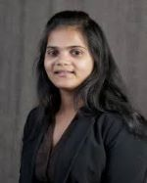

WSU-PNNL Advanced Grid Institute (AGI)
Grid modernization requires engineering tradeoffs
Anamika Dubey-WSU
Co-Director
Wei Du- PNNL
Interim Co-Director
Involves:
ESIC- Energy Systems Information Center (WSU)
INEF- WSU Tri-Cities Institute for Northwest Energy Futures
EARNEST- Equitable, Affordable & Resilient Nationwide Energy System Transition (DOE University Consortium)
Goal: The WSU-PNNL AGI will specialize in system-centric approach to assist with the rapid decarbonization and electrification of the power grid
Key technical areas:
Energy Analytics and Decision Support
Power Electronics-dominated Power Grid
Resilience to Cyber and Natural Threats
11
Notes:
We will achieve this by advancing energy analytics upon integrating cross-infrastructural, cross-sectoral, and multi-domain information/influences; and developing targeted products/services for grid planners/operators for future grid readiness.

Slide 12
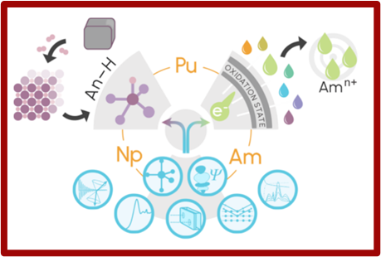
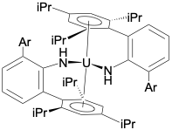
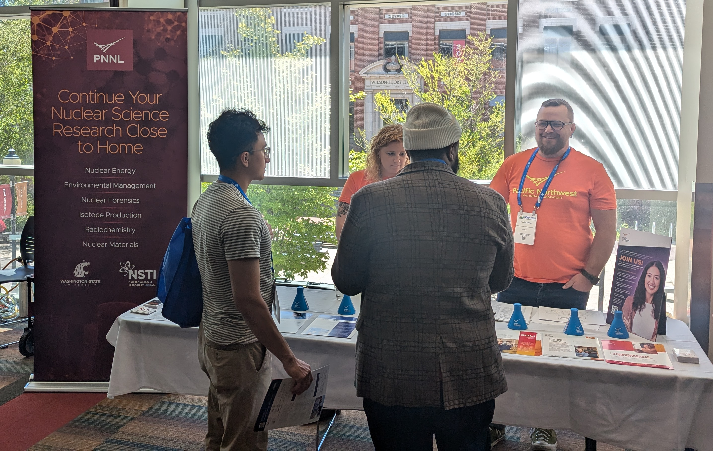

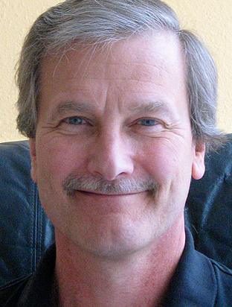

WSU-PNNL Nuclear Science and Technology Institute
We seek to understand and control how materials evolve in radiation environments to advance knowledge in nuclear materials management, next-generation nuclear energy, and non-proliferation of nuclear weapons
New Transuranic Chemistry Center of Excellence
Heavy element chemistry
Neil Henson, PNNL
Working with NIST on new WSU hot cell facility
Enhanced outreach and recruiting
Jim Boncella, WSU
12
Notes:
We seek to understand and control how materials evolve in radiation environments to advance knowledge in nuclear materials management, next-generation nuclear energy, and non-proliferation of nuclear weapons.
Mission: To advance knowledge and the applications of that knowledge in nuclear science and technology, and to create the next-generation nuclear workforce, through effective research partnerships between Pacific Northwest National Laboratory (PNNL) and Washington State University (WSU)
Transuranic Chemistry Center of Excellence: Support for 20-40 undergrads and 25-35 grad students over 5 years (over 6 institutions)
Three Thrust Areas
Chemistry of transuranic hydrides
Redox control of americium speciation
Theory and computation to support thrusts 1 and 2 and development of the computational methodology to do so
Heavy element chemistry: New classes of uranium and thorium complexes in low (U(II)) oxidation states
Unique pincer ligand transition metal complexes for metal catalysis and low valent uranium chemistry
Funding: IDREAM EFRC ($10M BES), NEUP ($745K NE), ACE ($1.5M DP), ETI ($2M NA-22), Rad Chem Grant ($2M EM)
Dodgen: Single crystal XRD, easyXAFS, SAXS/WAXS
Fullmer: facility capability funded by $500K investment from PNNL LDRD
Joint Appointments: 7 with 2 more pending approvals, and 2 more in progress
Students: Two graduate students graduated this year (Beck,Meadows ), currently have 10 graduate students working on NSTI programs including DGRPs (Louis, Krzysko, Kumar), several examples of WSU graduate students now working as post-docs and staff at PNNL (Graham, Nienhuis) and elsewhere (Krzysko, ANL)
Publications: 30 in 2020, 13 so far in 2021.
Hot cell
Phase I Construction –hot cell building only
$7.642 M total budget for Phase I (FY24 Appropriations Bill)
Approximately 2-year design/construction
Operational costs
M&O (Facilities) costs –
Produce and/or distribute radioisotopes that are in short supply in large quantities
Conduct R&D to develop innovative technology, advanced radiochemical separations, experiments performed in building
NORM
57 presentations made by WSU staff, students and PNNL staff
27 PNNL speakers
17 WSU speakers
8 joint PNNL/WSU presentations
9 posters (including six by undergraduates)
NSTI recruiting table with PNNL nuclear materials and nuclear forensics team engaged 35 students
Great outreach activity for regional student engagement in the Pacific Northwest for PNNL and WSU
12

Slide 13
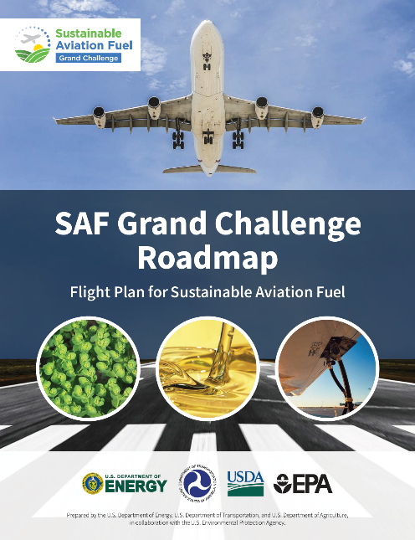
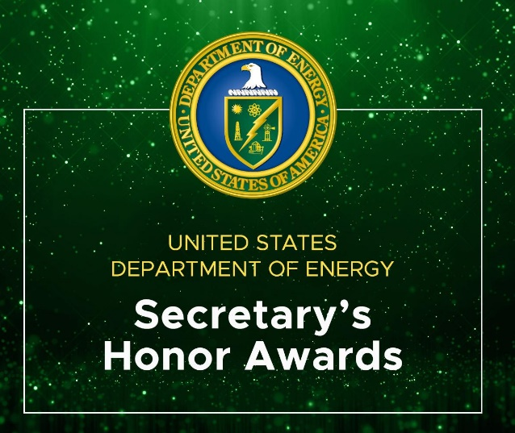
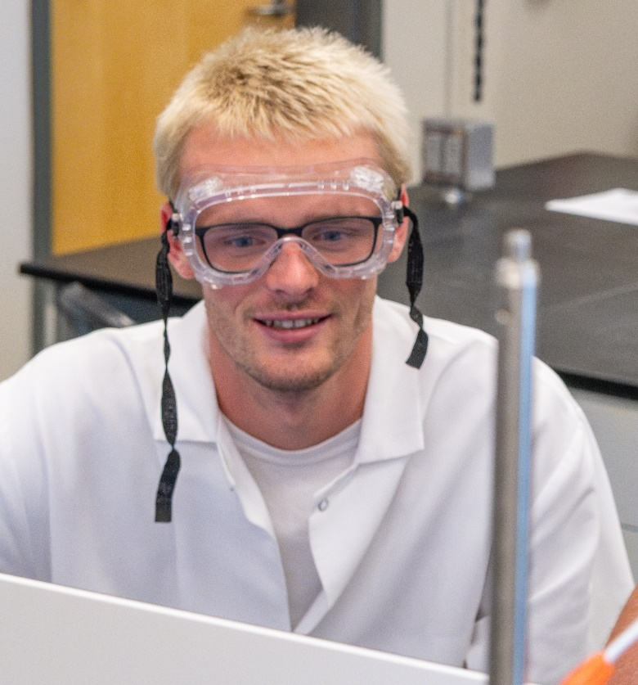
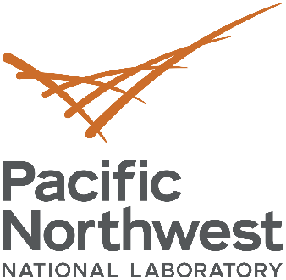

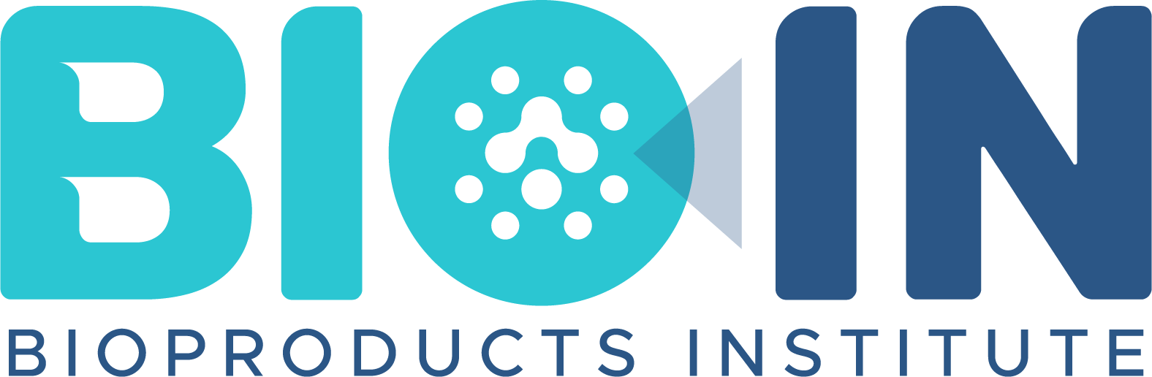

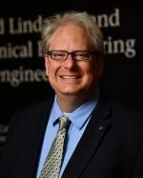

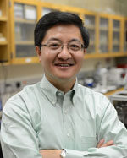




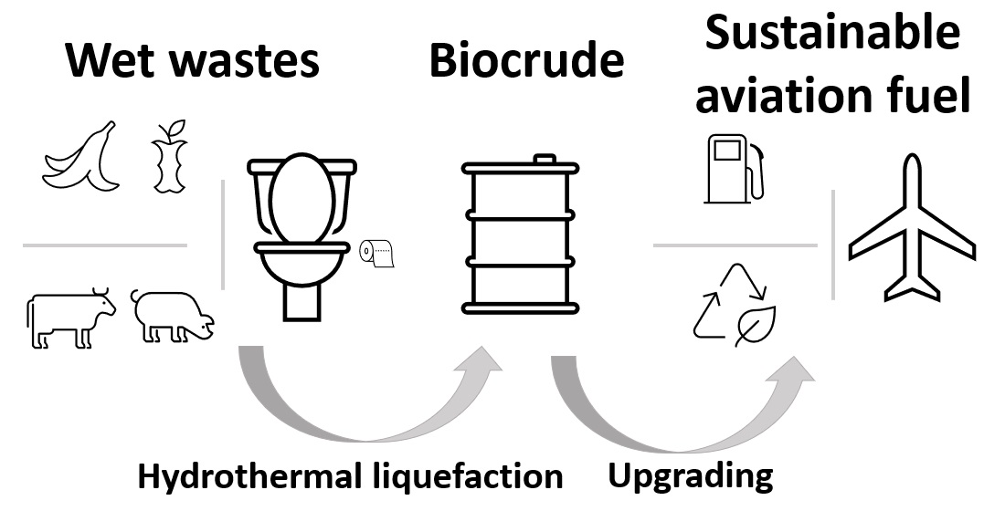
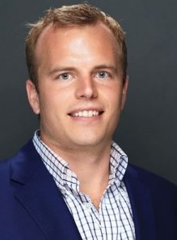

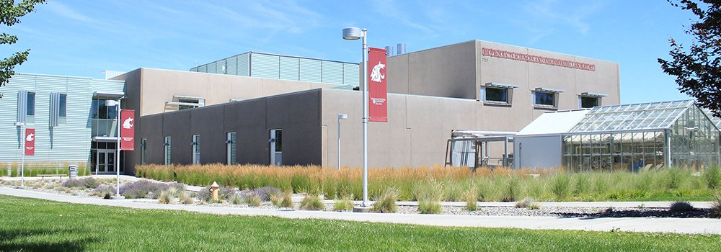
Joshua Heyne (WSU) Corinne Fuller (PNNL)
Turning today’s waste into tomorrow’s carbon resource
National Distinctions:
Joint Graduate Study Opportunities:
DGRP and first Alaska Airlines Fellow, Conor Faulhaber
Fuller awarded Secretary's Honor Award
Wolcott only academic author of SAF GC Road Map
Joint Appointments (13):
17 Distinguished Research Graduate Program Fellows since 2018, Tutored 11 Post-Docs and Students
Joint Projects:
to WSU
to PNNL
to WSU
to PNNL
Shared Space:
>$33 million in new projects
Centroid of Bio-In, space split 53/47 PNNL/WSU Bioproducts, Sciences, and Engineering Laboratory (BSEL), WSU Tri-Cities
>83 research publications
Notes:
Mission
Serving as a hub for education, multidisciplinary research, and innovation in carbon fluxes management
Vision
Be the portal to multi-disciplinary research and education for carbon fluxes management
Aspirations : A carbon-enabled performance economy (carbon neutral or negative economy)
Accomplishments
major new programs Alaska Airlines ($200k donation) during COVID -19
total funding, scientific - In first 3 years awarded $19.3 million in competitive funding (FOAs) across agencies (ARPA-e, EERE, FAA, TCF)
Areas funded:
Sustainable aviation fuels
Polymer recycling
Building materials
Advanced anaerobic digestion
Waste-heat/electricity and CO₂
Technological impact, - International Workshop Hydrothermal Liquefaction: Path to Sustainable Aviation Fuel virtual Workshop November 17-19, 2020 leading to Special Issue in Frontiers in Energy Research
scientific leadership, - Current initiatives
Deep decarbonization
Environmental services
Beyond the transportation sector
notable publications, - Successful thermochemical conversion workshop 2020 Thermal & Catalytic Sciences Symposium Oct 5th-7th 2020 leading to Special Issue in Energy & Fuels on Progress in Biomass and Plastics Thermochemical Processing
Strategic science opinion article Ground-truth the magnitude of the energy challenge for CO₂ to fuels
education and training of students - 10 Distinguished Research Graduate Program Fellows since 2018, Tutored 9 post-Docs and Students
workforce development. - 11 strategic joint appointments and working on a further 6
One or two major items that you are planning with the Institute. – Developing understanding of in the carbon fluxes in the economy
We need to learn how to manage carbon fluxes to replace fossil carbon that is embedded in materials
Hire a new Co-Director of Bio-In/ and Director of BSEL
Start an Industrial Advisory Board
Hold a new series of Bio-In seminar in special focus areas (renewable polymers and resins, carbon intense solids, carbon flux management, gasification of biomass and wastes, CO₂ utilization)
Angewandte Chemie Cover paper is: Direct Catalytic Conversion of Ethanol to C5+ Ketones: Role of PdZn Alloy on Catalytic Activity and Stability
Plastic bottle picture is: Waste PET Chemical Processing to Terephthalic Amides and Their Effect on Asphalt Performance
Total of 19 Joint Appointments with Bio-In

Slide 14
WSU – PNNL Joint Appointments
WSU faculty or PNNL scientist/engineer
JAs between PNNL and WSU are intended to elevate the scientific impact and productivity of researchers at both institutions
Graduate student mentorship and joint grants
Strategic collaboration
Wei Du- PNNL
Notes:
FY23 (through May 11, 2023): 31 active, 16 in renewal process, 2 new/pending.
The updated PPT slide is the FFY count. The chart version in the August 2022 PPT is old and was before we moved to FFY count to be consistent with how PNNL was counting.
In October 2022 we put together a detailed spreadsheet by FFY with names of appointees by year that we can refer back to ( here with full detail if you are interested).
The two that are new/pending are Hongfei Lin and Olga Marina. Since Wei Du (the possible new JA in EECS) is in very early stages, I did not yet add him on the “new/pending” list, but this is a judgement call and he could be added if you prefer.
Markus Flury and Sandip Roy are included since their appointments are active as of today’s count, but since they expire in a few months, both of these will drop off before the end of FFY23.
Newest JA is Wei Du, active 5/27/24.
Most recent renewal JA was Jim Amonette, active 7/14/24.

Slide 15
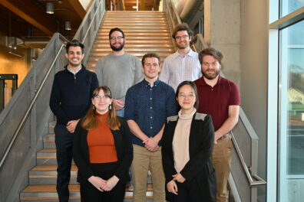
Distinguished Graduate Research Program (DGRP)
The DGRP enables a research experience for outstanding PhD students using the unique capabilities and synergistic research programs at both WSU and PNNL
Years 1 & 2 [pre-All But Dissertation (ABD)]
Funded by WSU through normal channels and according to departmental policies
Aimed at completing coursework & preliminary exam requirements
Years 3 & 4 (ABD)
Funded by PNNL scientist
Students paid through WSU
Resident at PNNL
WSU Graduate School provides tuition waiver
Current total: 41 students (14 active students / 27 graduated)
DGRP Students from Cohort 7 in 2023
https://natlab.wsu.edu/dgrp/
Notes:
Work on critical national issues and grow the talent pipeline in science & technology through innovative approaches to STEM education
Research collaborations- individual, evolving to more strategic efforts
Discuss the above bullet by sharing the areas of research collaborations in areas such as power grid, nuclear science, bioproducts/safe BSEL operations, nuclear science, catalysis, biosecurity and other health sciences, and plant science and environmental sciences.
In the future
Distinguished Graduate Research Program
Differentiate recruiting of new graduate students for WSU - PNNL
Use DGRP to bring in more high-quality students
Work to improve educational experience of student
Enhance WSU and PNNL collaborative research
Increase the quality and quantity of STEM Ph.D. graduate students at WSU and PNNL
Provide unique training, education, and research experiences for highly talented STEM students
Broaden talent pipeline and valuable future collaborators for WSU, PNNL, the DOE National Lab complex, and industry

Slide 16
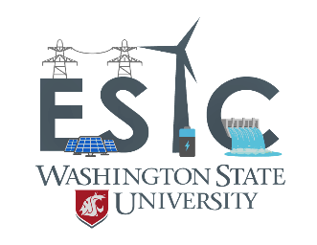


Energy Systems Innovation Center (ESIC) Mani V. Venkatasubramanian, Director
Energy Systems Innovation Center
Vision
Leading the transition to affordable, sustainable and resilient electric power systems
Mission
Collaborative research, education, and outreach to solve challenges for modern power systems
Notes:
Power Program at WSU
A top program in US****
Leadership in research; well funded by government and industry
Significant and sustained impact on education
Educating leaders in industry****
Power professorship program since 1973
Professional services and conference activities
ESIC funded by DOE and industrial partners, is a leading Center of Excellence, both nationally and internationally, for research, education, technological innovation, and technology transfer in energy systems, including smart grids. With a team of 12 faculty in power, energy, and computer science, and more than 20 faculty in allied fields (including economics, public policy, and sociology), the ESI Center provides a strong synergistic environment for conducting major multi-disciplinary studies on electric energy and its social and economic impacts, facilitating the development of public policy at the state and national levels.
Internal & External Collaborators
Multidisciplinary Faculty
DOE National Labs: PNNL, NREL, LLNL, INL
Power Industry Partners
Research Centers: AGI, PSERC, CHARGE
Funding Sources
DOE, NSF, Industry
PSERC
Industry Membership Programs: Power Education Partnership (PEP), Research Excellence Partnership (REP)
WA State Clean Energy Funds
Examples of current ESIC members include:
Avista, GE, Portland General Electric, PNNL, Cowlitz PUD, Tacoma Power, Benton PUD, Grays Harbor PUD, SEL, etc.

Slide 17
















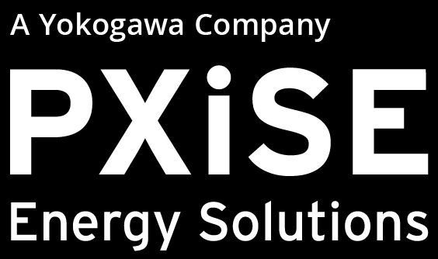

ESIC ESIC Power Education Partnership (PEP)
EP Membership
PEP Members
2024
Benefits – Support Power Engineering Education
ESIC Research Excellence Partnership (REP)
REP Membership
REP Members 2024
Benefits - Access to ESIC research
Notes:
ESIC Power Education Partnership
Annual Membership: Varies
Benefits – Support Power Engineering Education
Practicum
Support for Internships/Jobs
Power Curriculum Feedback
Free booths at Fall Career Expo and IEEE Career Fair
Professional Development Hours for ESIC weekly seminars
Optional Tutorials by Faculty Experts
Dedicated Industry Liaison
12 ESIC Power Education Partnerships in 2024
ESIC Research Excellence Partnership
Annual Membership: $15K
Benefits - Access to ESIC research:
Research collaborations
ESIC weekly seminars
Project catalog/announcements
Research reports and papers on secure website
Invitation to be project advisors
Tutorials by faculty experts
Dedicated industry liaison
Seed projects at no overhead (no deliverables)
8 ESIC Research Excellence Partnership in 2024

Slide 18

WSU Energy Program: Northwest Onsite Energy Program
The WSU Energy Program partners with federal, regional, state and community organizations to identify, plan, and support effective energy projects
The U.S. Department of Energy’s Onsite Energy Technical Assistance Partnerships (TAPs) help industrial and other large energy users transition to clean energy, lower costs, reduce emissions, and contribute to a clean energy economy
Photo from Getty Images
The Technical Assistance Partnership (TAP) program are also supported by NREL, ORNL, and PNNL
Notes:
Industrial Efficiency and Decarbonization Office
Onsite energy refers to electric and thermal energy generation and storage technologies that are physically located at an industrial facility or other large energy users, and provide clean energy services directly to their site.
This program supports the U.S. industrial sector and other large energy users to add onsite clean energy technologies to their facilities. Large energy users can include campuses, hospitals, and other sites with
significant energy loads year-round.
Bob Kirchmeier – WSU
NW = WA, OR, ID, AK

Slide 19
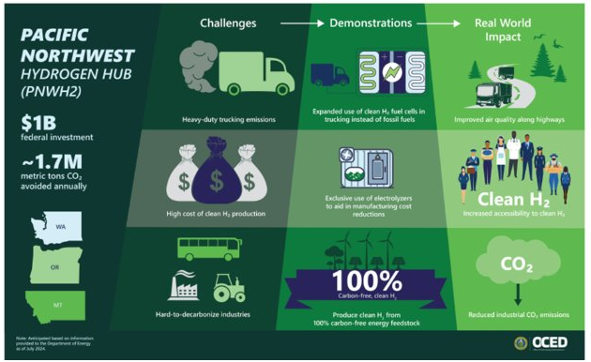
Pacific Northwest Hydrogen Hub (PNWH2)
www.energy.gov/oced
Notes:
As a part of the OCED Regional Clean Hydrogen Hubs
Led by
The Pacific Northwest Hydrogen Association
There are many partners in the PNWH2 Hub. It does include PNNL and WSU who are involved in the community engagement component of the project
Project At a Glance – Phase 1 Total OCED Cost Share Amount: Up to $1 billion
Phase 1 OCED Award Amount:
$27.5 million*
Phase 1 Total Project Amount:
$125 million**
Phase 1 Scope of Work:
Planning and development activities
Phase 1 Timeline:
12-18 months
Recipient:
Pacific Northwest Hydrogen Association (PNWH2)
Project Locations:
Richland, WA; Chehalis, WA; Seattle, WA;
Ferndale, WA; St. Regis, MT; Durkee, OR;
Boardman, OR; and Port of Morrow, OR
Project Start Date:
July 2024
The Pacific Northwest Hydrogen Hub is comprised of the following eight nodes, or groups of projects,
that are planned to span across Washington, Oregon, and Montana. The proposed locations for most nodes are identified.

Slide 20
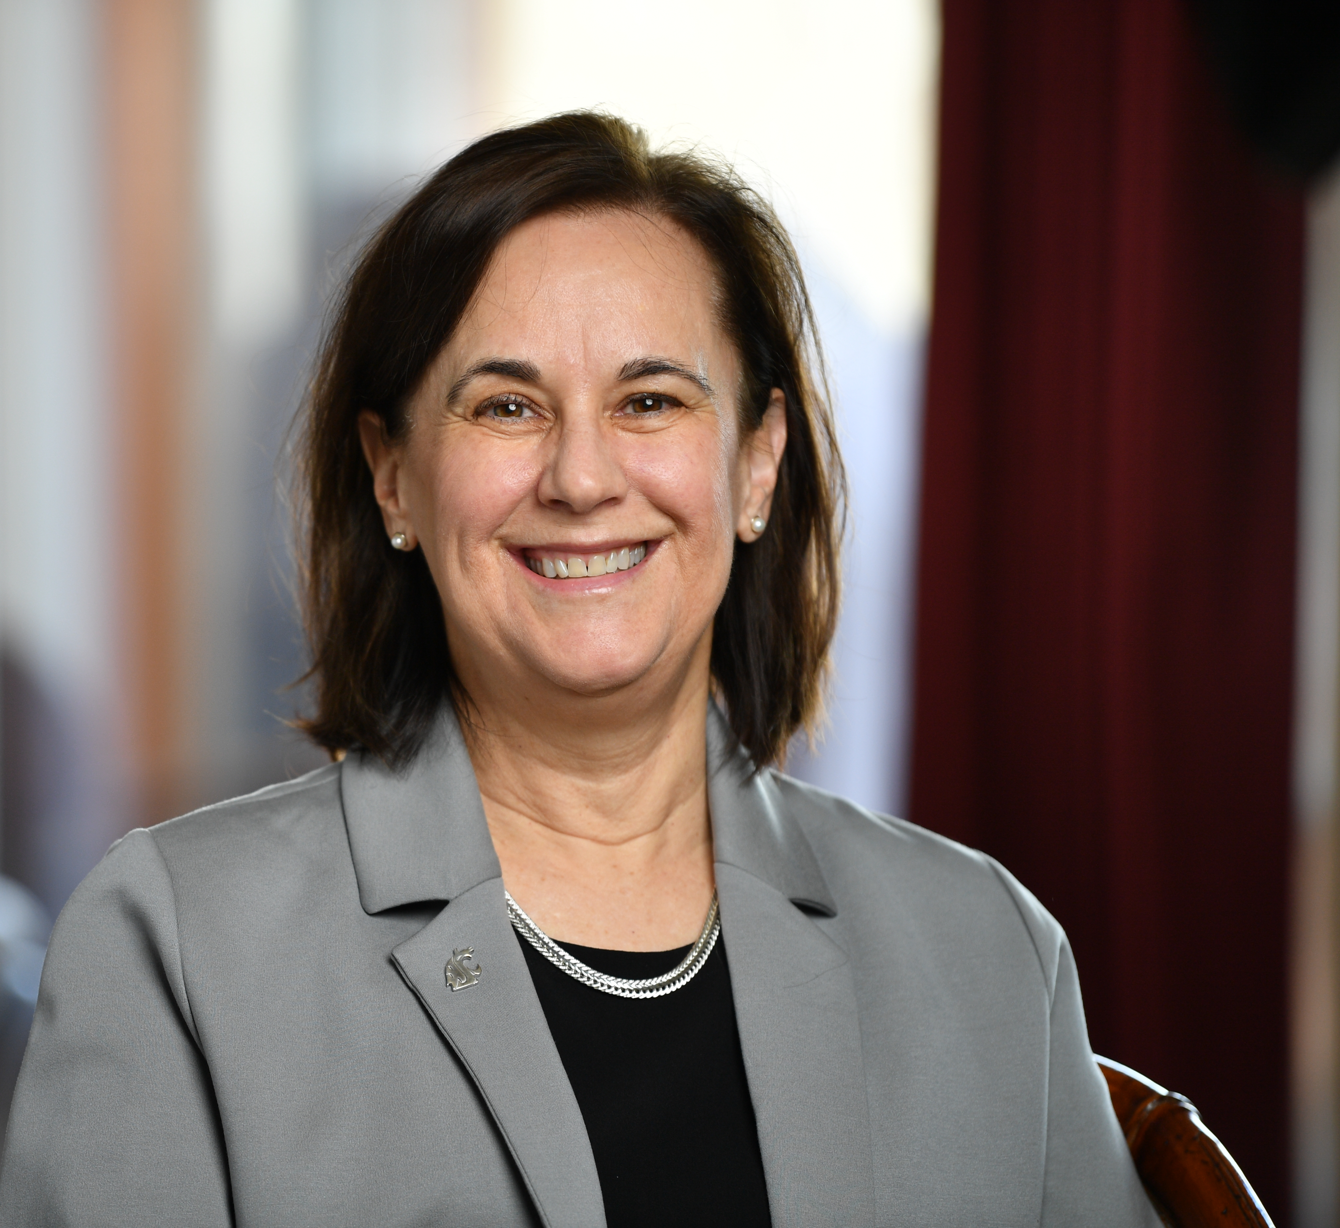
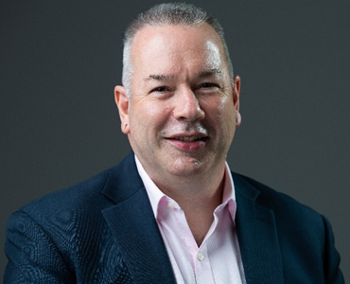
Turning Possibilities into Reality
WSU Tri-Cities Office of the Chancellor
Email: tricities.chancellor@wsu.edu Website: tricities.wsu.edu/chancellor
WSU Office of Research
Email: jonathan.male@wsu.edu
Notes:
Admissions Contact info

