Slide 1
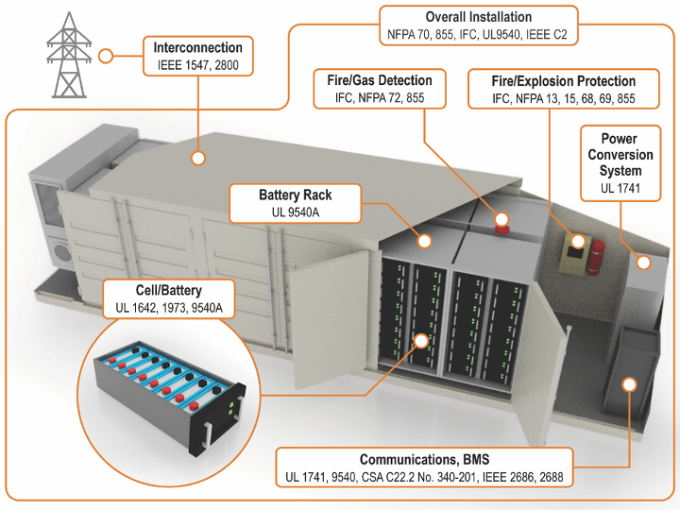
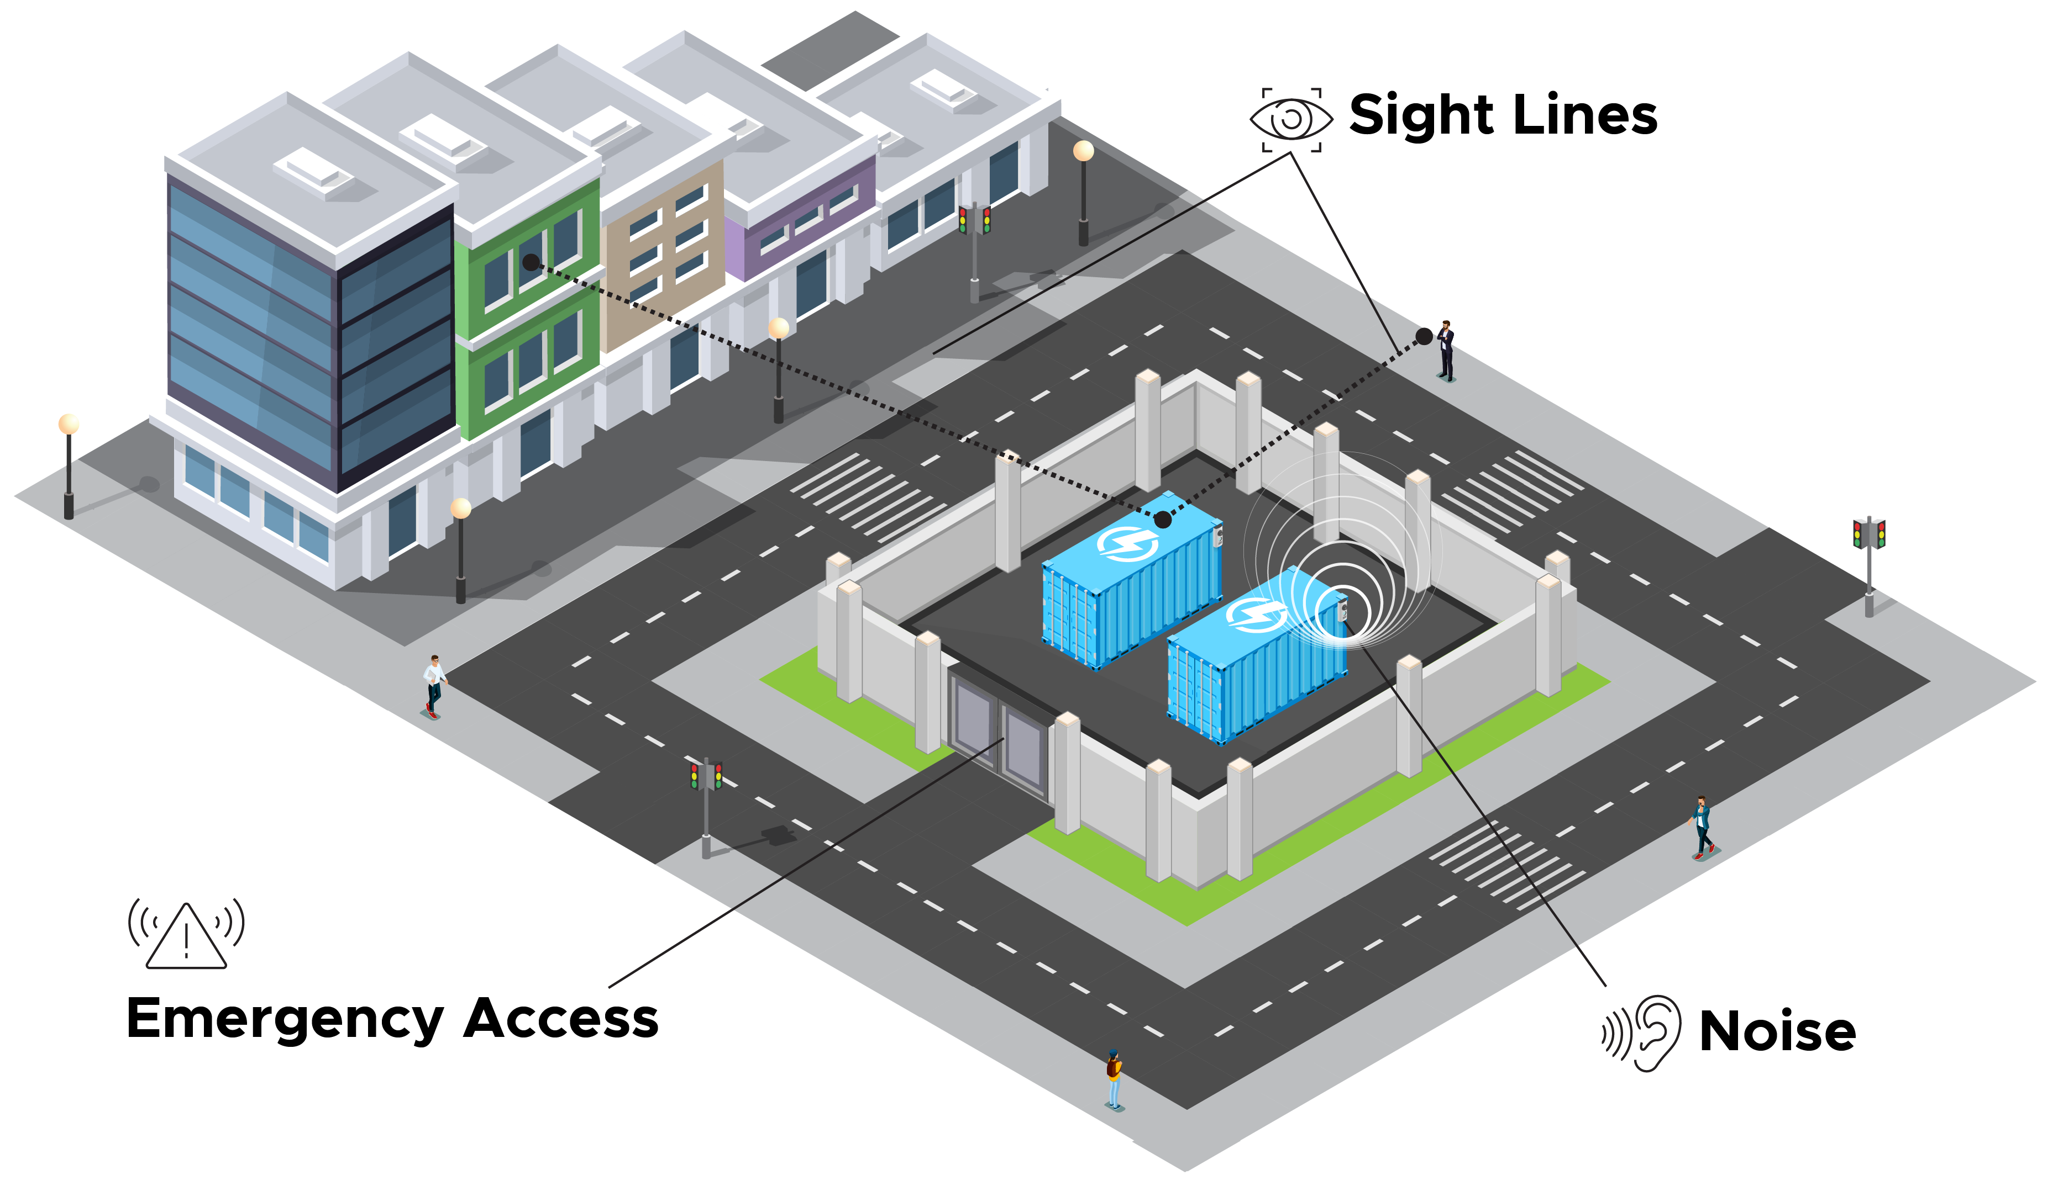
Siting Energy Storage: Local Zoning Considerations
Survey of Energy Storage in Local Ordinances
Jeremy Twitchell, Devyn Powell, Matt Paiss
Project Overview
Lithium-ion energy storage technologies offer two key benefits: scalability and flexibility. These characteristics allow lithium-ion battery energy storage systems (BESS) to be designed for a wide range of locations and to serve a wide range of grid needs. But they also present the potential for BESS to be installed in close proximity to other uses, which creates the potential for conflict. Local zoning officials are tasked with resolving those conflicts, but they and their constituents may lack the necessary information to respond to proposed projects. The purpose of this project is to provide objective and reliable information to these parties about the potential impacts of BESS on host communities, the safety standards that apply to BESS installations, and how planners can mitigate the impacts of BESS.
Description | Number of ordinances found | Examples
Ordinances written to regulate solar installations that also include storage: Generally, only regulate storage systems when co-located with solar generation and apply all solar PV regulations to storage components. | 37 | • Plumsted, New Jersey requires all equipment for a solar energy system, "including ... structures for batteries or storage cells" to "be completely enclosed by a minimum 12 foot high fence," and prohibits all systems from being located in a "front, side, or rear yard setback." (Township of Plumsted, NJ Code § 15-5.21) • Boulder, Colorado's zoning ordinances define a "solar energy system" as "a system ... which may include an energy storage facility," and defines permitting requirements and eligible zoning districts for these systems. (Boulder County Land Use Code Article 18, 18-199)
Local adoption of fire or building codes that include standards for energy storage systems: County and municipalities have adopted fire and/or building codes that include explicit safety, labeling, and siting guidance for energy storage, such as the 2018 IFC, 2020 NEC, or NFPA 855. | 12 | • Yarmouth, Maine has locally adopted NFPA 855, "Standard for the Installation of Stationary Energy Storage," into its municipal fire and safety code. (Town of Yarmouth, Maine Code Chapter 319: Fire Prevention and Life Safety Ordinance, 2021) • Daly City, California amended the California Fire Code, which already includes some regulations for energy storage, to specify that means for disconnection must be included with ungrounded conductors connected to energy storage systems. (City of Daly City, Municipal Code 15.24.130 - Article 706.7)
Ordinances specifically targeted at energy storage technologies: Include labeling standards, permitting requirements, setbacks, height standards, and visibility requirements. May contain language from fire or building codes and may exceed these codes to add additional guidance. Alternatively, they may be adopted by local governments unable to exceed state code requirements. | 12 | • King George County, Virginia requires battery energy storage facilities to have access to water, provide access to the county fire department, have decommissioning plans, be labeled with NFPA 704 placards, and to not be visible from “any adjacent street, use or building.” (King George County, Virginia Code of Ordinances § 4.19) • Madison, Maine requires battery storage systems to be enclosed by a minimum eight-foot fence with a locking gate and feature a visible sign to warn of potential voltage hazards. (Town of Madison, Maine Code of Ordinances § 484-41)
Ordinances that incent or encourage energy storage development: Some municipal ordinances protect the right to install energy storage systems or use local building codes to add incentives for storage. | 5 | • Lancaster, California ensures that all residents and businesses are “permitted to construct and operate stand-alone electric energy systems,” including “fuel cell systems [and] battery systems.” (City of Lancaster, California, Ordinance No. 1067) • Wilton Manors, Florida’s “Green Building Design Option” system, written into its code of ordinances, requires new buildings to earn a minimum number of green building “points,” and allows on-site solar and storage systems to contribute to their total. (Wilton Manors, Florida Code of Ordinances § 170-050).
Battery Safety Codes and Standards Summary
Figure 1: Overview of codes and standards governing BESS
As Figure 1 illustrates, a BESS is subject to numerous codes and standards that govern its construction, installation, and operation. Detailed knowledge of these complex codes is not required for local zoning officials to respond to a proposed project, but a working knowledge of key requirements can help officials know what questions to ask. Even if the local jurisdiction is within a state that has not adopted the most current code requirements, informed questions may facilitate the negotiation of conditions that ensure compliance with industry best practices and protection for the community in the event of a system failure.
A BESS Can Have Material Impacts on a Community, But They Can Be Mitigated
In addition to safety, a BESS has three other types of community impact that, depending on the site, planners may want to mitigate:
Visual: Most battery system enclosures range between 8 and 12 feet.
Mitigation options: Solid walls around the facility provide security while also screening the system; some jurisdictions have required an additional layer of vegetation to screen the walls
Auditory: A battery system uses inverters, air conditioning systems, and transformers, all of which create noise.
Mitigation options: A buffer of 400 feet has been found to reduce the noise of a large BESS to the level of a conversation at the property line; physical screening such as walls and trees reduces that distance
Odor: Under normal operations, a BESS will not release gas or odor, but both will be present in a failure state.
Mitigation options: An evacuation plan or shelter-in-place order may be appropriate to protect neighboring property owners in the event of a system failure
Figure 2: Potential Community Impacts of BESS
Jeremy Twitchell
971-940-7104
jeremy.twitchell@pnnl.gov
Notes:
NOTE: This file must print at 100% SCALE to achieve a final print size of 36” wide x 48” tall.
• Contact Digital Duplicating (375-2969, http://digitalduplicating.pnl.gov) to order poster printing and finishing services for your completed poster design.
• Remember to have your poster cleared for public display/distribution through the Information Release system (https://informationrelease.pnl.gov). A text placeholder for your poster’s Clearance Number is included in the footer.

