Slide 1
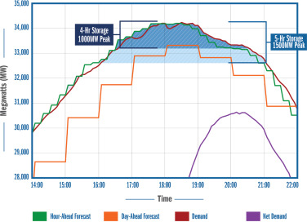
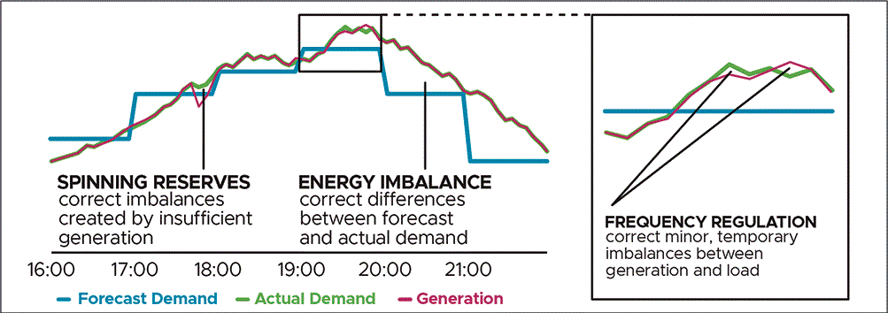
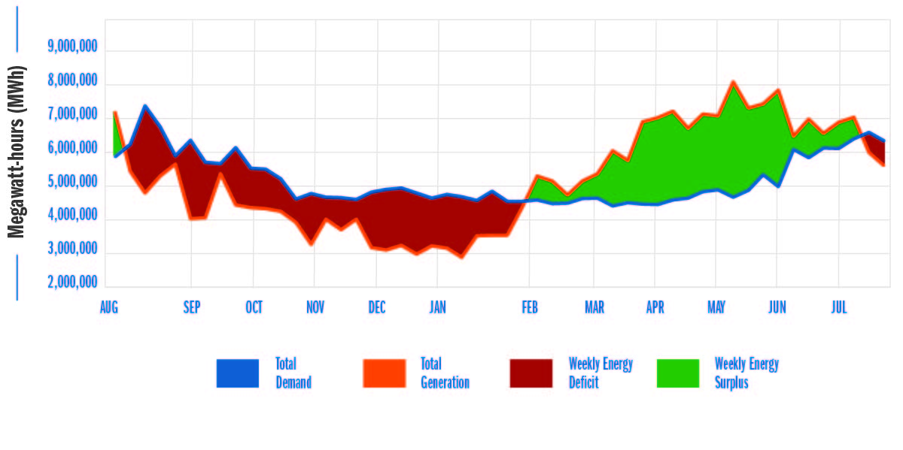
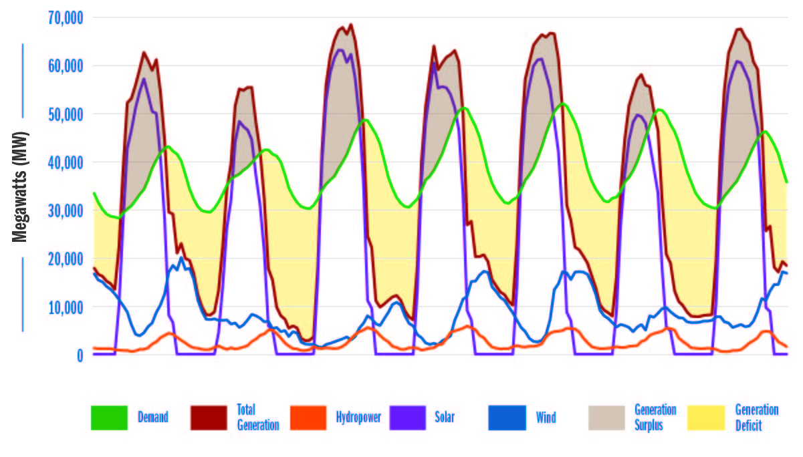


Long-Duration Energy Storage: A Necessity in a Decarbonized Grid
Jeremy Twitchell, Kyle Desomber, Vincent Sprenkle, Di Wu
Project Overview
Long-duration energy storage (LDES) technologies could provide the necessary flexibility to meet grid decarbonization goals, but current grid planning and operational practices do not send the necessary investment signals for the development of LDES technologies. PNNL researchers are working on a series of studies to identify the need for LDES technologies, the barriers to their development and deployment, and mechanisms for overcoming those barriers. This poster summarizes two publications from this project.
Changing Grid Needs Create Need for LDES
Figure 1 (below) shows several electric grid ancillary services, which are designed to give the grid flexibility to respond to changing levels of generation and demand. Because their output is variable, renewable resources like wind and solar require ancillary services to match their output with grid needs. Because ancillary services only cover imbalances lasting from a few seconds to few hours, lithium-ion batteries are well-suited to providing ancillary services.
However, ancillary service markets tend to be relatively small, and other use cases for energy storage (such as peak shaving or resource adequacy) require longer duration. As Figure 2 (right) shows, when storage is deployed for meeting daily peaks, duration requirements increase as remaining peaks become flatter and wider.
Figure 1: Electric Grid Ancillary Services
Figure 2: Incremental Storage Duration Requirements for Peak Shaving
Decarbonization and LDES: A California Case Study
To illustrate the need for LDES technologies, we took one year of load and generation data from the California Independent System Operator (CAISO). We then removed all natural gas generation because it would be ineligible under the state’s decarbonization requirement, nuclear generation because the state’s last nuclear plant is scheduled for closure, and imports from neighboring regions because those regions have decarbonization policies of their own and face looming capacity shortfalls.
We then added in onshore wind and solar generation resources until there was enough generation over the course of the year to meet all load over the course of the year. However, there are significant differences between when energy is generated and used.
Figure 3: Decarbonized Load and Resource Balance, Annual Resolution
As Figure 3 (above) shows, California would generate enough energy to meet all demand over the course of a year, but on a weekly basis, would experience large surpluses during spring and summer and large deficits during fall and winter. Figure 4 (left) drills down into the last week of July to illustrate the daily cycle, which sees large surpluses driven by solar generation during the day and large deficits—which can be up to 30 gigawatts in size and persist for up to 10 hours—overnight. A similar daily cycle exists year-round, but deficits in the winter tend to be larger and last up to 20 hours.
This analysis identified two classes of LDES that would be needed. The first is a product of up to 20 hours in duration for managing daily cycles and the other is a product with a duration of days or weeks to manage seasonal cycles.
Figure 4: Decarbonized Load and Resource Balance, Weekly Resolution
Paper: Energy Storage: A Key Enabler for Renewable Energy
Paper: Defining Long-Duration Energy Storage
Jeremy Twitchell
971-940-7104
jeremy.twitchell@pnnl.gov
Notes:
NOTE: This file must print at 100% SCALE to achieve a final print size of 36” wide x 48” tall.
• Contact Digital Duplicating (375-2969, http://digitalduplicating.pnl.gov) to order poster printing and finishing services for your completed poster design.
• Remember to have your poster cleared for public display/distribution through the Information Release system (https://informationrelease.pnl.gov). A text placeholder for your poster’s Clearance Number is included in the footer.

