Slide 1
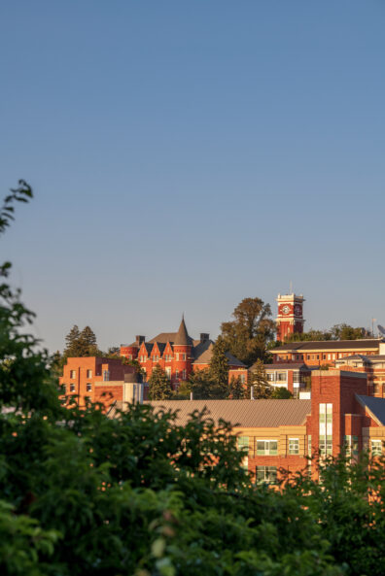
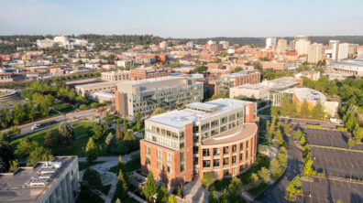
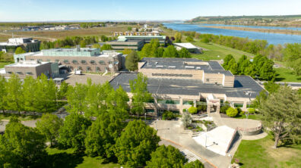
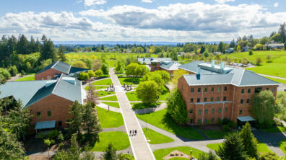
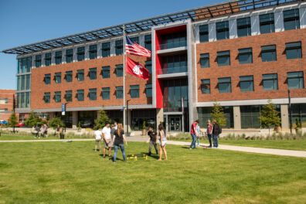
COACHE Faculty Satisfaction Survey 2022
Report and other information at https://provost.wsu.edu/coache/

Slide 2
COACHE Faculty Satisfaction Surveys
Harvard Collaborative on Academic Careers in Higher Education
Annual survey on faculty satisfaction
WSU participated in 2008, 2014, 2022
Delivered to 82 universities 2022
WSU faculty participation rate = 48%
Notes:
Just to review…

Slide 3
COACHE Survey Domains
Nature of Work (in service, research, teaching)
Resources and Support
Cross-Silo Work and Mentoring
Tenure and Promotion
Appreciation and recognition
Institutional Leadership
Shared Governance
Departmental Engagement/Quality/Collegiality

Slide 4
Strengths | Weaknesses
Departmental leadership and collegiality Tenure Mentoring | Compensation Equity, inclusion, belonging Faculty recognition and appreciation Mentoring (CT) Nature of workload Promotion and tenure clarity Shared governance

Slide 5
Gathering feedback
After aggregate data received:
  Feedback/scoping from domain subcommittees
  Published preliminary findings (Sep. 2023)
  Socialized findings and collected feedback using town halls, meetings with other groups
  Feedback was evaluated to identify actionable steps
  Report approved by Provost Chilton (Jan. 2024)

Slide 6
Criteria for selecting actions
Preference for activities that:
  Address more than one domain weakness
  Can be executed in a timely manner
  Benefits expected to accrue to all faculty
  Feasible given resources available
  Who are the actors?

Slide 7
Action plan https://provost.wsu.edu/coache/
Faculty Recognition Initiative
Phase I (Spring-Fall, 2024)
  Develop an inventory of faculty activities across the WSU system
  Re-examine annual review process for inclusivity of faculty effort; re-examine the role of Activity Insight
  Phase II (Spring-Fall, 2025)
  Revise annual review guidelines and implement spring 2026
  Develop process for regular review of P&T guidelines across system
Notes:
Speaks to dissatisfaction with recognition of work effort, dissatisfaction with promotion criteria, and dissatisfaction with honorific recognition; inspired by an inventory effort at Seattle University that was presented at a VAuLTS conference in fall 2023

Slide 8
Other planned activities
Requiring a review of faculty activities in the fourth year post-associate to ensure that faculty are well-positioned to seek promotion to professor within the upcoming 1-3 years.
Develop resources for faculty to describe impact of their work, particularly in the context of community-engaged scholarship.
Develop a workshop or other resource on how to write impactful nomination letters for faculty honorifics.
Commit to specific proposals to advance the research enterprise at WSU by the end of July 2024.

Slide 9
Other potential activities
Offer a career-track professional leave.
Offer ongoing financial incentives and support for faculty to engage with high performance learning methods such as student service learning.
Work with Faculty Senate and HRS to conduct a system-wide review of practices and policies on staff hiring to identify concerns and propose solutions.
Develop a philanthropically funded scholarship program to allow WSU employees to enroll in WSU Global courses.
Appoint a system-level position for DEI leadership.

Slide 10
COACHE 2024
Launches in early February – expect to see a formal invitation for participation from Provost Chilton
You will receive a survey link directly from COACHE
All faculty with >=0.5 FTE are invited.
We will have campus- and college-level results.
Unlike 2022, we will have access to individual record data, which allows us to analyze cross-sectionality of variables.
With 2022 data,
Q: Clarity of whether I will be promoted? 37.4% overall
Women = 39.4%, Faculty of color = 36.8%
Women who are faculty of color = ??

Slide 11
Important qualifiers
Faculty with associate dean or higher appointments are excluded.
Questions about faculty leadership = Faculty Senate
Provost Office will NOT have access to record-level data, which is crucial to protect anonymity.
Data will be fire-walled and analyzed at Institutional Research.
This work is governed by an IRB/human subjects protocol.
 |  |  | All Faculty
 |  | response label | count | %
Q137G | Clarity of expectations: Patient care/client services | Very clear | N<5 | N<5
 |  | Somewhat clear | N<5 | N<5
 |  | Neither clear nor unclear | N<5 | N<5
 |  | Somewhat unclear | N<5 | N<5
 |  | Very unclear | N<5 | N<5
 |  | Decline to answer | N<5 | N<5
 |  | Not applicable | N<5 | N<5

Slide 12
Once COACHE 2024 is announced,
Please encourage your colleagues to participate
Data => Discussion & scoping of activities => action
This only works well if the data is representative of the faculty population.

Slide 13
Questions
The COACHE Survey website states that the survey was "partially funded with state funds provided to support a state-mandated faculty climate survey". What was the source or sources of funding other than state funds?
What state entity mandated this survey, and did this state entity receive a full report including the quantitative and qualitative data?
When will the qualitative comments from the COACHE survey be released on the website constructed for dissemination of data and results?

Slide 14
Washington State SB 5227, 07/21
Concerning diversity, equity, inclusion, and antiracism training and assessments at institutions of higher education
Provides for establishment of a professional development program on DEI, and antiracism for faculty and staff
Must conduct a campus climate assessment to understand the current state of DEI in the learning, working, and living environments on campus for students, faculty, and staff.
The campus climate assessment must be conducted, at minimum, every five years.
By December 31, 2024, and biennially thereafter…submit a report on the professional development programs and campus climate assessments and annual listening and feedback sessions.

Slide 15
2022 COACHE Committee
Laura Hill, Doug Call, Katie Cooper co-leads
• Ekaterina Burduli • Kira Carbonneau • Pat Carter • Kim Christen • Chris Dickey • Glen Duncan • Obie Ford III • Fran Hermanson • Christine Horne • Masha Gartstein • Phil Gruen | • Lisa Guerrero • Stephanie Kane • Coleen McCracken • Clemma Muller • Oladunni Oluwoye • Kristina Peterson-Wilson • Bruce Pinkleton • Anna Plemons • Paul Skilton • Clif Stratton • Jenny Thigpen

