Slide 1

W A S H I N G T O N S T A T E U N I V E R S I T Y
External Affairs & Government Relations
Presentation to Faculty Senate
Colleen Kerr, J.D.
Vice President for External Affairs and Government Relations
Affiliate Faculty, Paul G. Allen School for Global Health
NOVEMBER 18, 2021

Slide 2
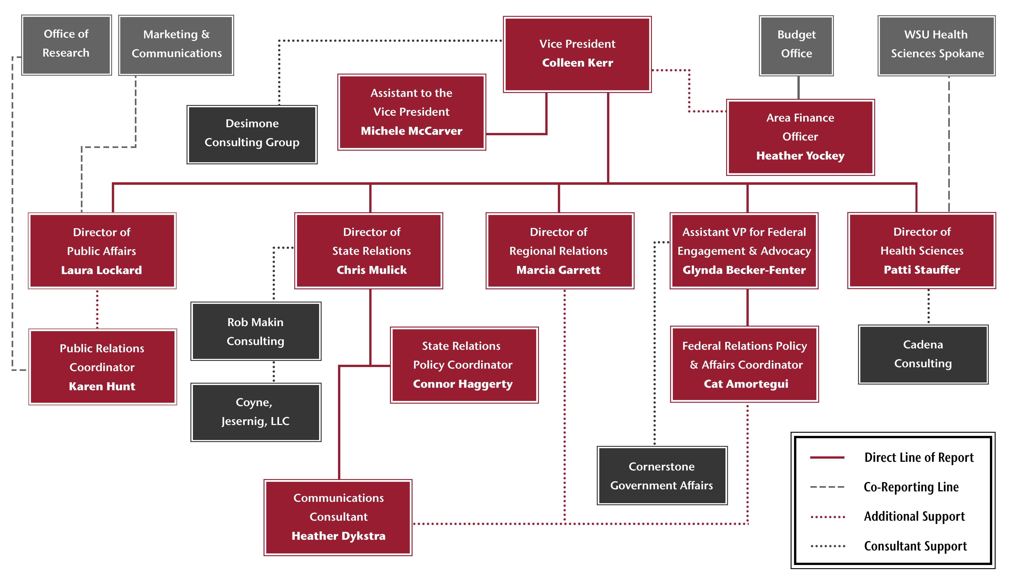
OFFICE OF EXTERNAL AFFAIRS AND GOVERNMENT RELATIONS | ORGANIZATION CHART
Insert Org Chart
Notes:
EAGR is a WSU System Office, supporting all WSU campuses, R&E centers, and other offices across the state
The office embraces matrix reporting with MarComm, Health Sciences (multiple colleges), OR, and plan/anticipate more into the future – for example, to support “ag”
Consultants provide capacity and support a stakeholder based model

Slide 3


THE ENGAGEMENT MODEL FOR PUBLIC ADVOCACY | NOVEMBER 2021
DEFINE ‘THE WIN’
Advancing WSU’s research and education mission and goals align with public values
DEVELOP AND MAINTAIN A ‘FIELD’ EFFORT
Partnerships, events, alumni advocacy efforts, coalitions, collaborations, aligned with marketing and communications efforts and priorities
TARGET STRATEGIC INFLUENCERS
(thought leaders, voters & those who influence voters) identify and cultivate policy-maker and stakeholder champions
COMMUNICATE WITH OUR CONSTITUENTS DIRECTLY
Owned media, placed media, paid media and engage
COLLECT DATA, FORMALLY AND INFORMALLY
To gauge opinions and identify messages that resonate and align with policy concerns of the public

Slide 4
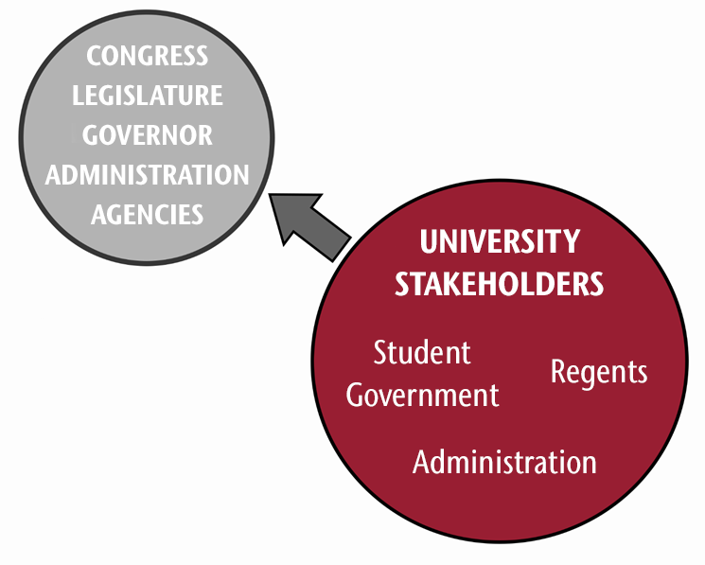
ADVOCACY: THE TRADITIONAL LOBBYING MODEL | NOVEMBER 2021
The traditional institutional lobbying model:
State Relations operated as a Special Assistant to the President
Federal Relations was part of the Office of Research
Primary focus was on lobbying
SOME
SCHOOLS
STILL USE THIS
MODEL
As the population has grown and the state budget has grown, the number of petitioners to policy-makers has also grown.
This dilutes the impact of “lobbying” as the primary tool for advocacy.

Slide 5
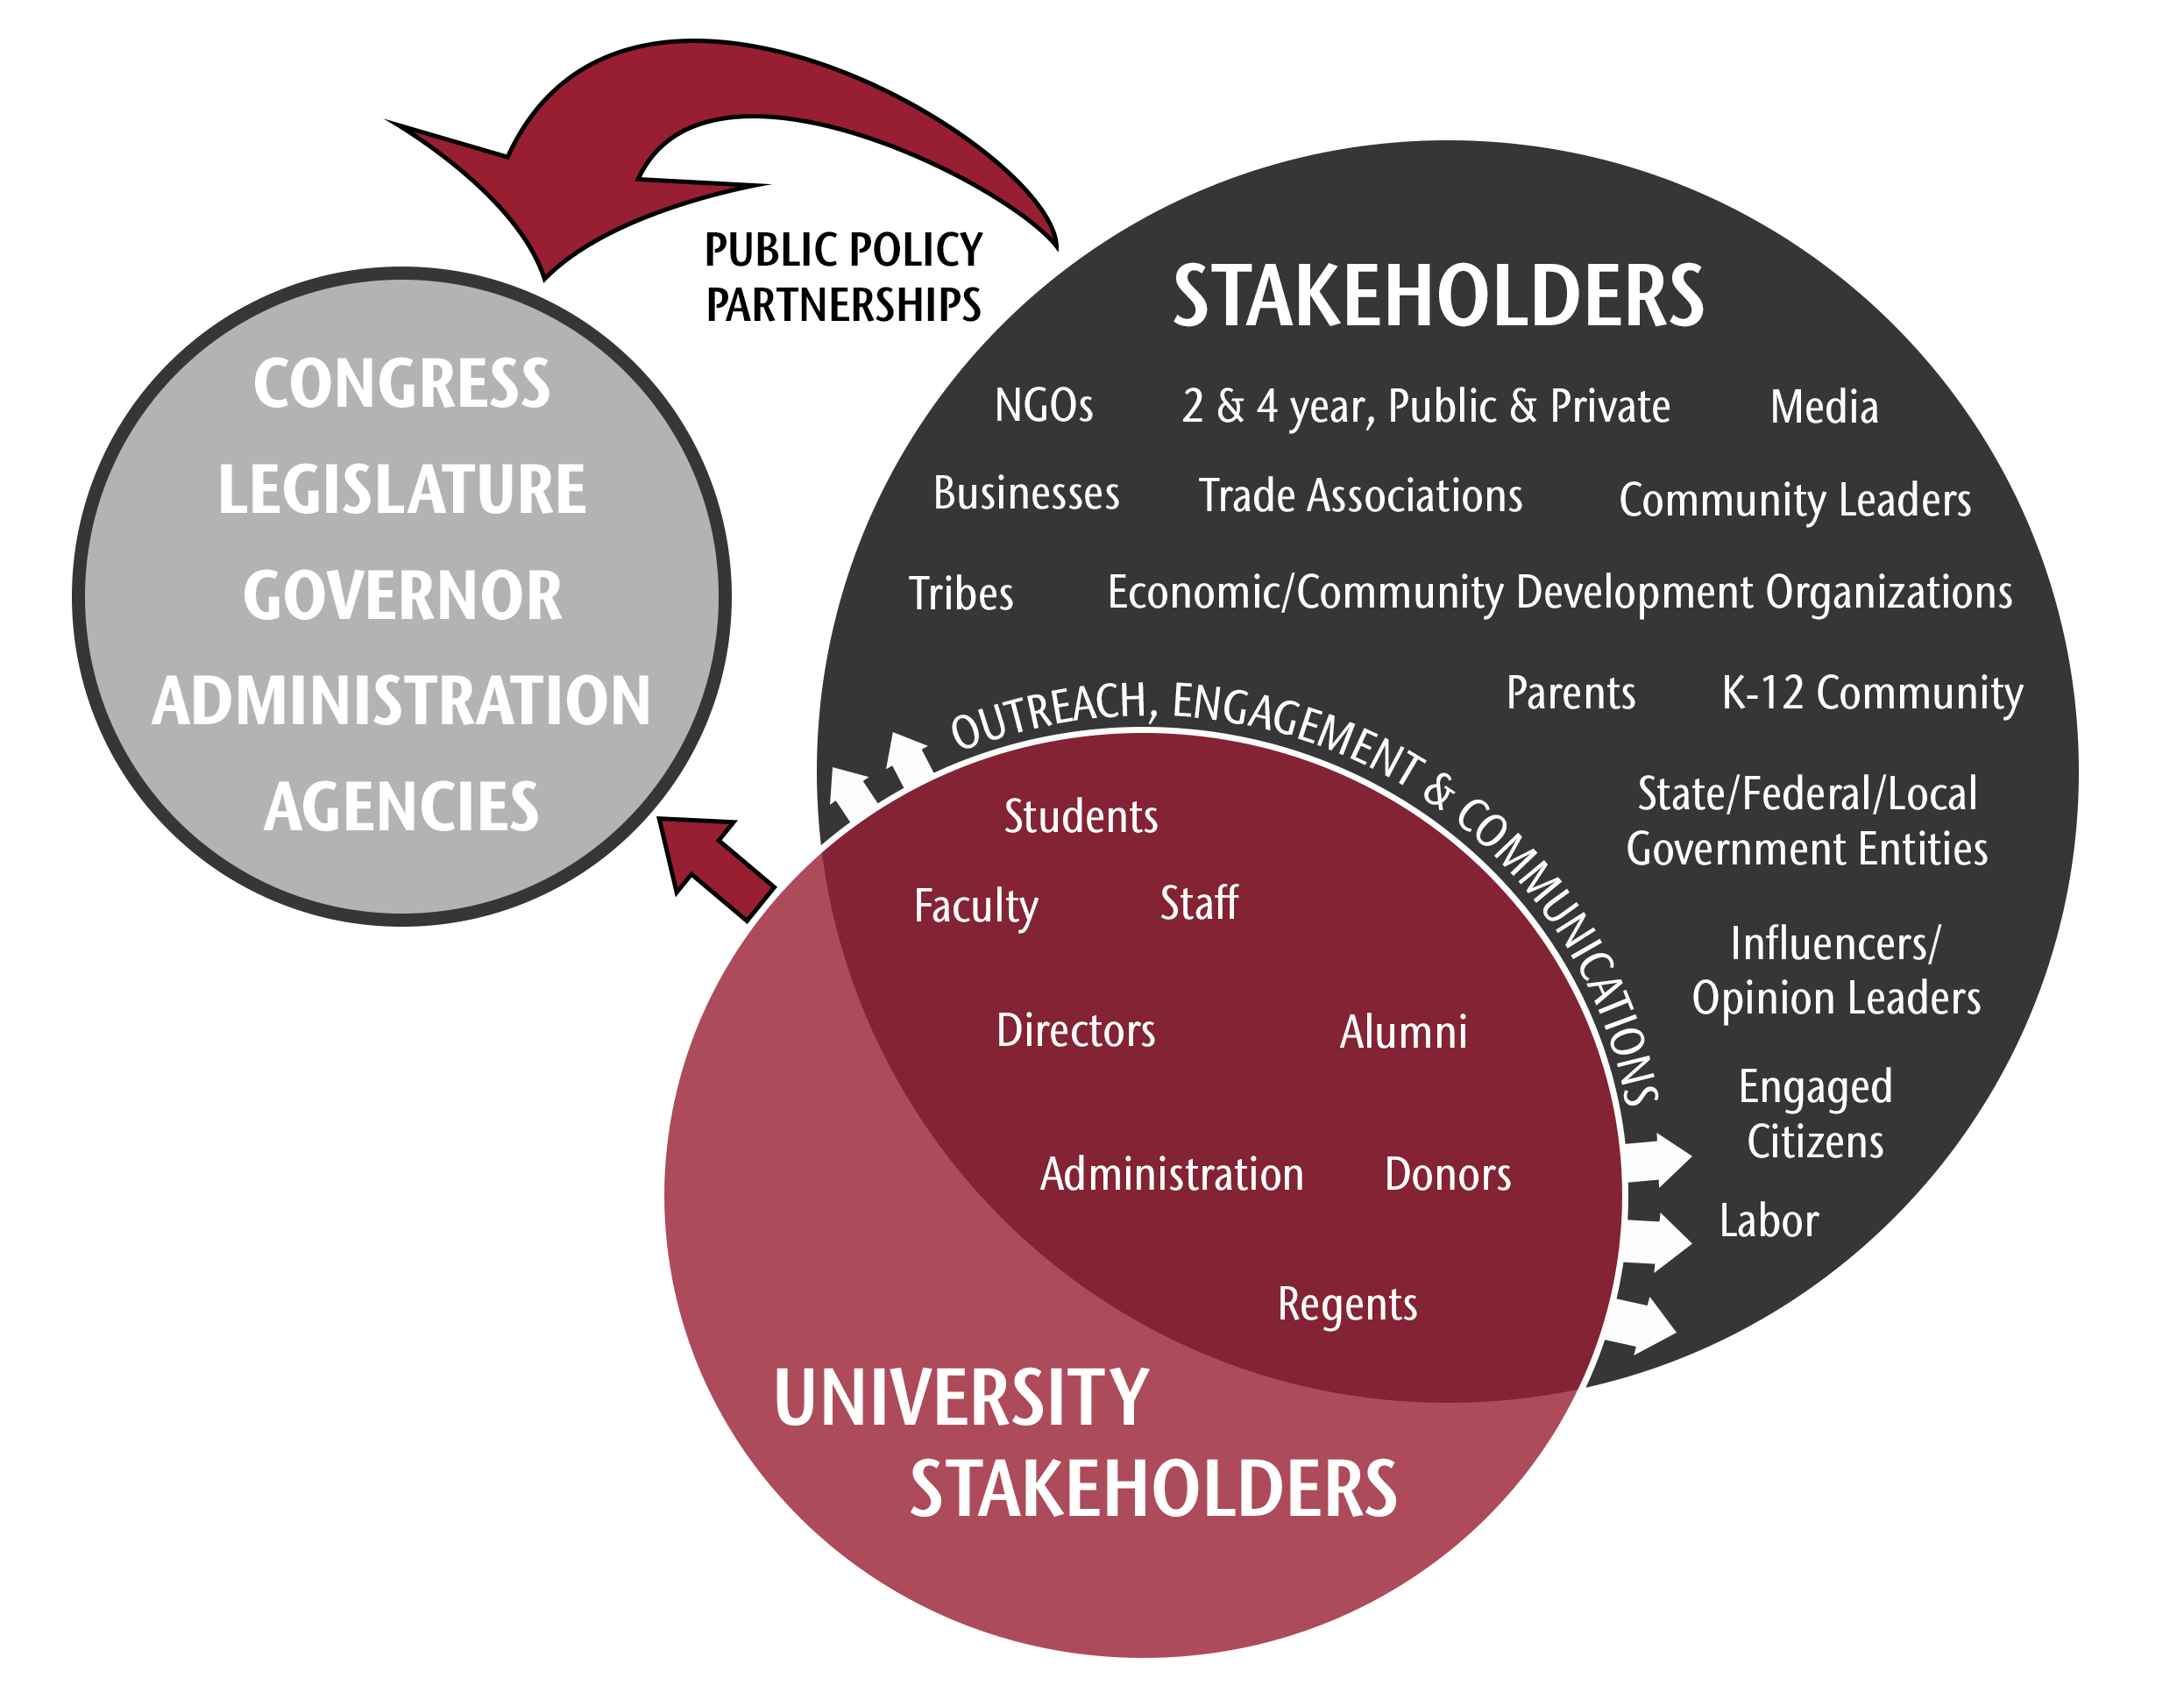
ADVOCACY: THE ENGAGEMENT MODEL | NOVEMBER 2021
ex. State Votes Goals
1
_
25
_
50
Stakeholder engagement includes coalition building by geography, sector, industry, and other interests
(like higher ed!)
Insert Org Chart
Legislative Session is tactically focused, representing only one place of engagement
When? Opportunities to engage with stakeholders exist 365 days a year

Slide 6
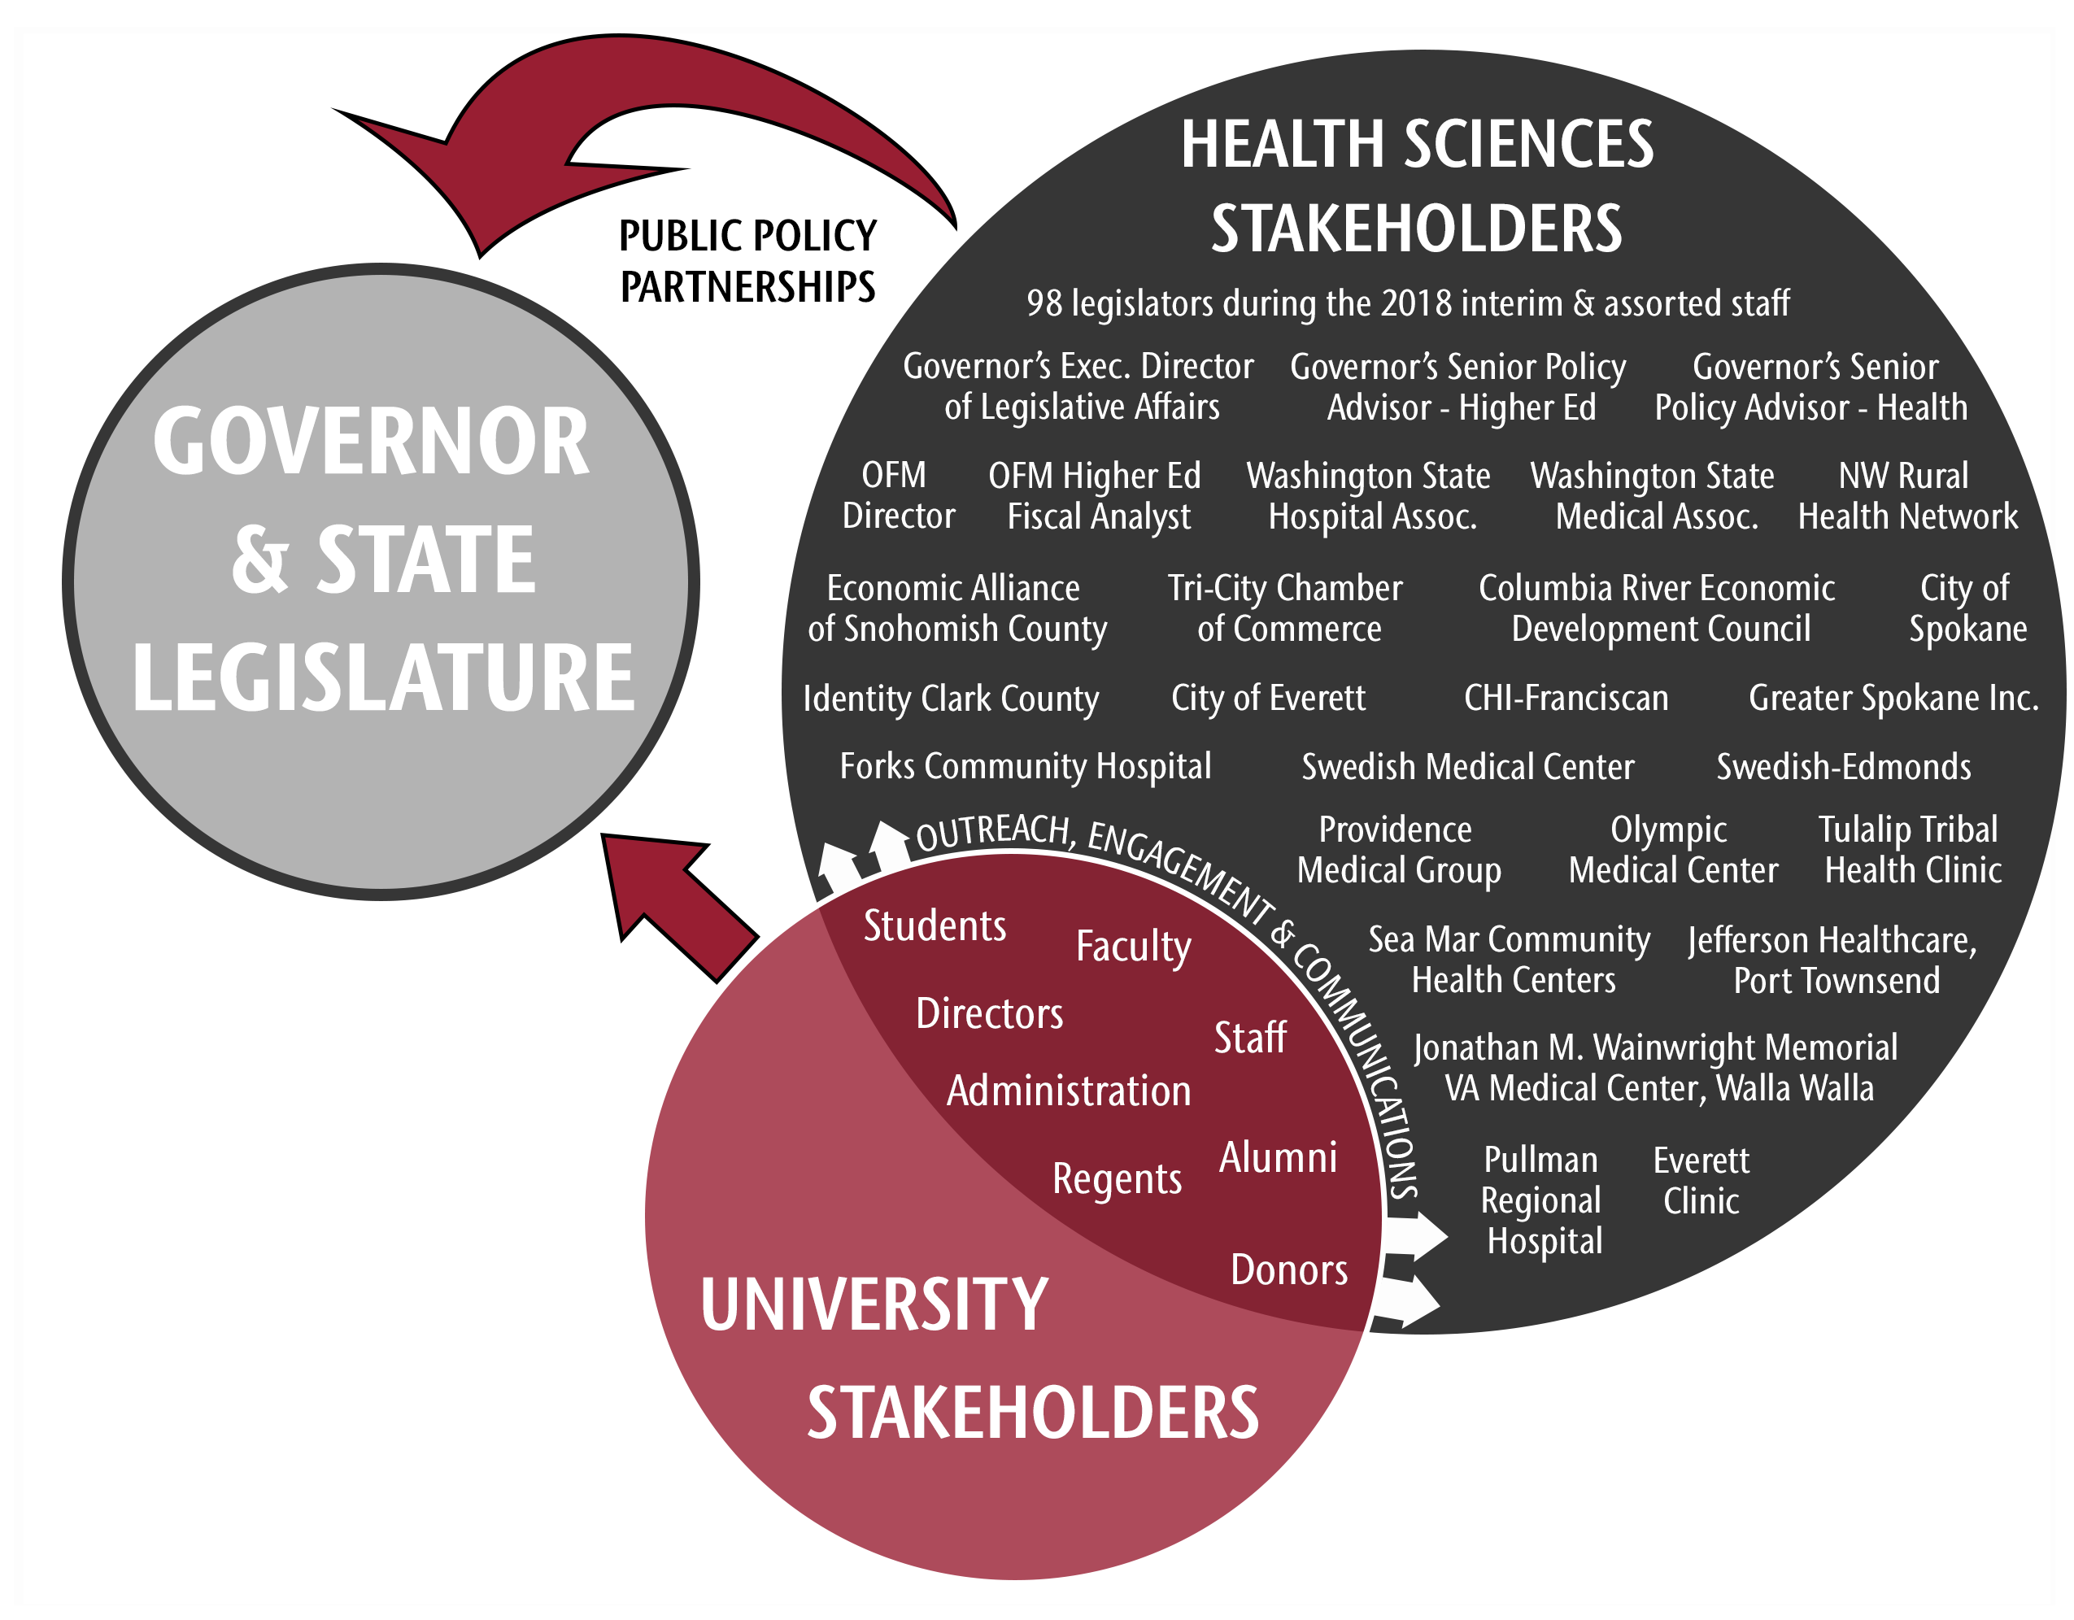
ADVOCACY: PURSUING LEGISLATIVE AUTHORIZATION FOR ESFOCOM| NOVEMBER 2021

Slide 7
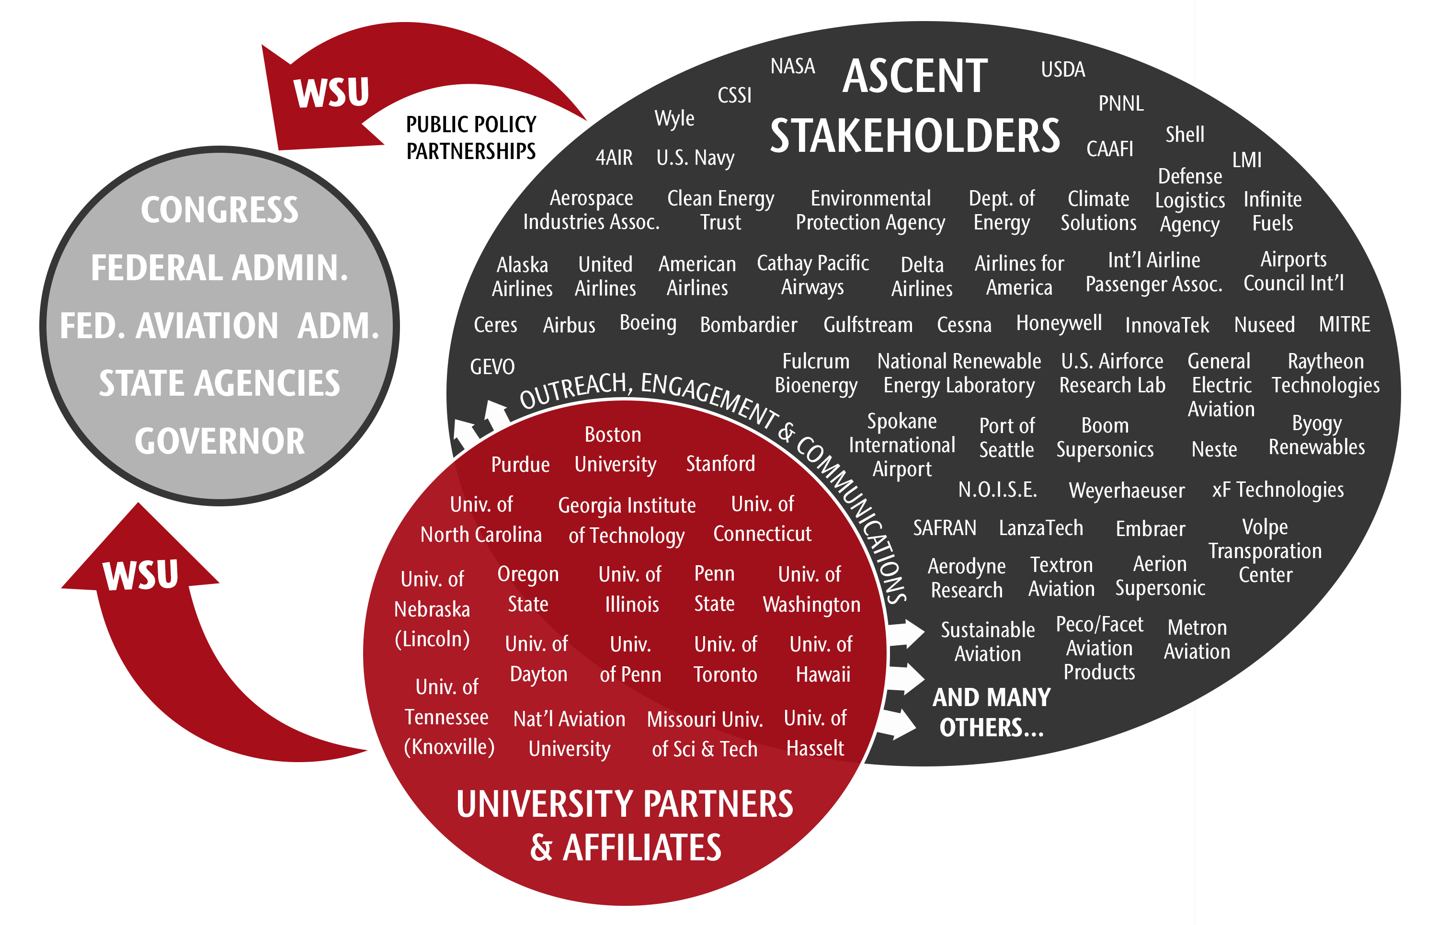
ADVOCACY: REQUESTING THE FAA TO RELEASE A COE RECOMPETE| NOVEMBER 2021

Slide 8
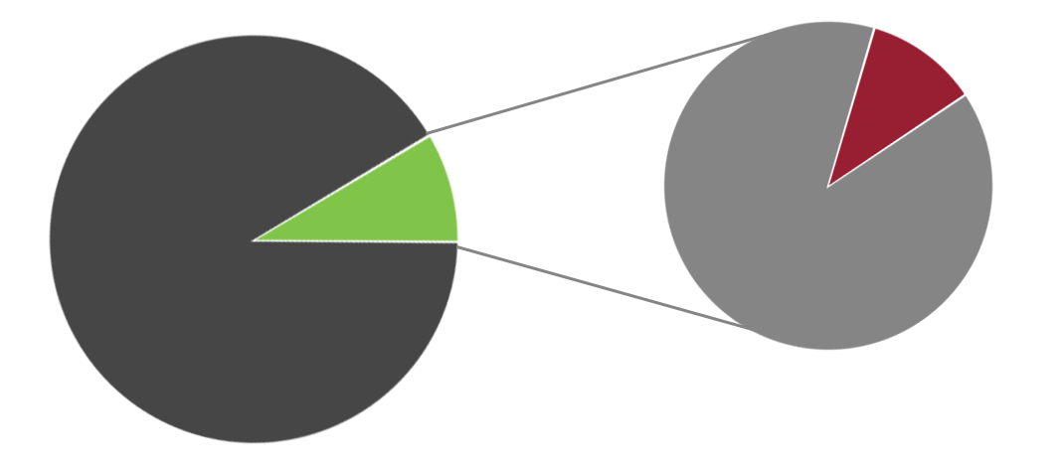
ADVOCACY: GROWTH IN WSU STATE APPROPRIATION| NOVEMBER 2021
The 2021-23 state budget totals $59.2B, an increase of 83.9 percent in 10 years
The 2021-23 WSU appropriation totals $565m, an increase of 83.1 percent in 10 years
From the 13/15 biennium through
21/23 biennium the state budget
has grown by 83.9% and WSU’s
state appropriation has grown
proportionally at 83.1%
In the 10 years prior, from the
03/05 biennium through the 11/13
biennium, the state budget grew by 25.9%
and the WSU appropriation declined by 17.8%
$565M
TOTAL: $59.2B
TOTAL: $5.12B
$5.12B
Other Legislative
Funding
Higher Education
Budget
Other Higher
Ed/financial aid
WSU
appropriation
Notes:
In the past 10 years (13/15 biennium through 21/23 biennium – the period of time in which WSU established this office) the state budget has grown by 83.9 percent while WSU’s state appropriation has grown at a proportional rate of 83.1 percent. This window captures a period that begins with the state’s emergence from the Great Recession.
Why is this noteworthy? In the 10 years prior (03/05 biennium through the 2011/13 biennium), the state budget grew by 25.9 percent and the WSU appropriation declined by 17.8 percent. This window captures the worst of the Great Recession and illustrates the disproportionate reductions handed to higher education, which was partially offset by tuition increases.

Slide 9
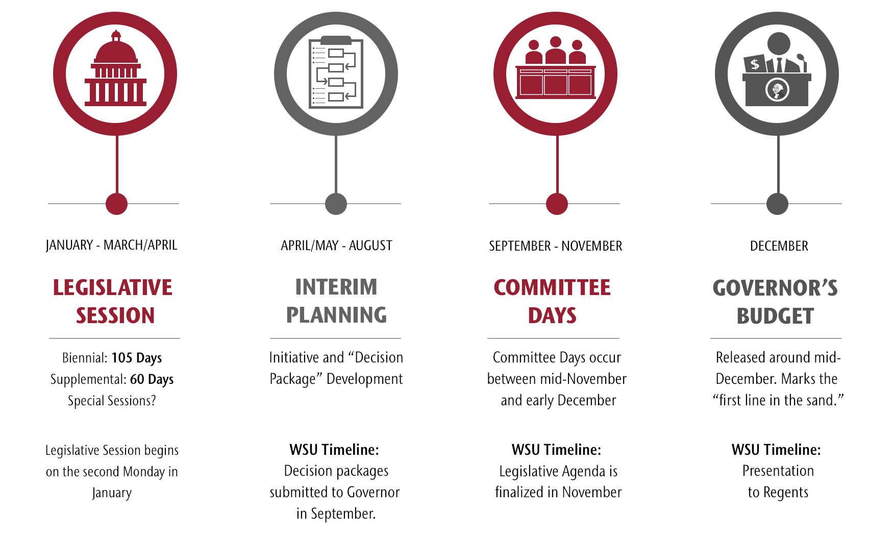
EXTERNAL AFFAIRS AND GOVERNMENT RELATIONS:OFFICE OF STATE RELATIONS TIMELINE| NOVEMBER 2021

Slide 10
STATE RELATIONS | MATCHING WSU ACADEMIC PRIORITIES TO STATE POLICY PRIORITIES | NOVEMBER 2021
CRITERIA FOR INCLUSION IN TASK FORCE RECOMMENDATION:
  Proposals that support WSU system and campus strategic plans
  Multi-unit/multi-campus collaborations of multiple geographies and/or sectors are encouraged
  Proposals for which strong stakeholder support can be reasonably anticipated, building political capital
  Proposals for which strong state support can be reasonably anticipated because it matches state priorities
 | Example: ALLEN SCHOOL |  | STATE PRIORITIES
 |  | EXAMPLE REQUESTI: | EQUITY | CLIMATE | PUBLIC HEALTH
 | WSU PRIORITIES | AG, FOOD, & RURAL ECON.
 |  | HEALTH |  |  | X
 |  | DATA & TECHNOLOGY
 | Example: SOIL HEALTH |  | STATE PRIORITIES
 |  | EXAMPLE REQUESTI: | EQUITY | CLIMATE | PUBLIC HEALTH
 | WSU PRIORITIES | AG, FOOD, & RURAL ECON. |  | X | X
 |  | HEALTH |  | X | X
 |  | DATA & TECHNOLOGY
 | Example: ESFCOM |  | STATE PRIORITIES
 |  | EXAMPLE REQUESTI: | EQUITY | CLIMATE | PUBLIC HEALTH
 | WSU PRIORITIES | AG, FOOD, & RURAL ECON. | X | X | X
 |  | HEALTH | X | X | X
 |  | DATA & TECHNOLOGY | X | X | X

Slide 11







STATE RELATIONS | FINDING THE SWEETSPOT| NOVEMBER 2021
WSU: the state’s research land-grant
FOOD
HEALTH
DATA & TECHNOLOGY
STATE POLICY PRIORITIES
EQUITY
CLIMATE
PUBLIC HEALTH

Slide 12
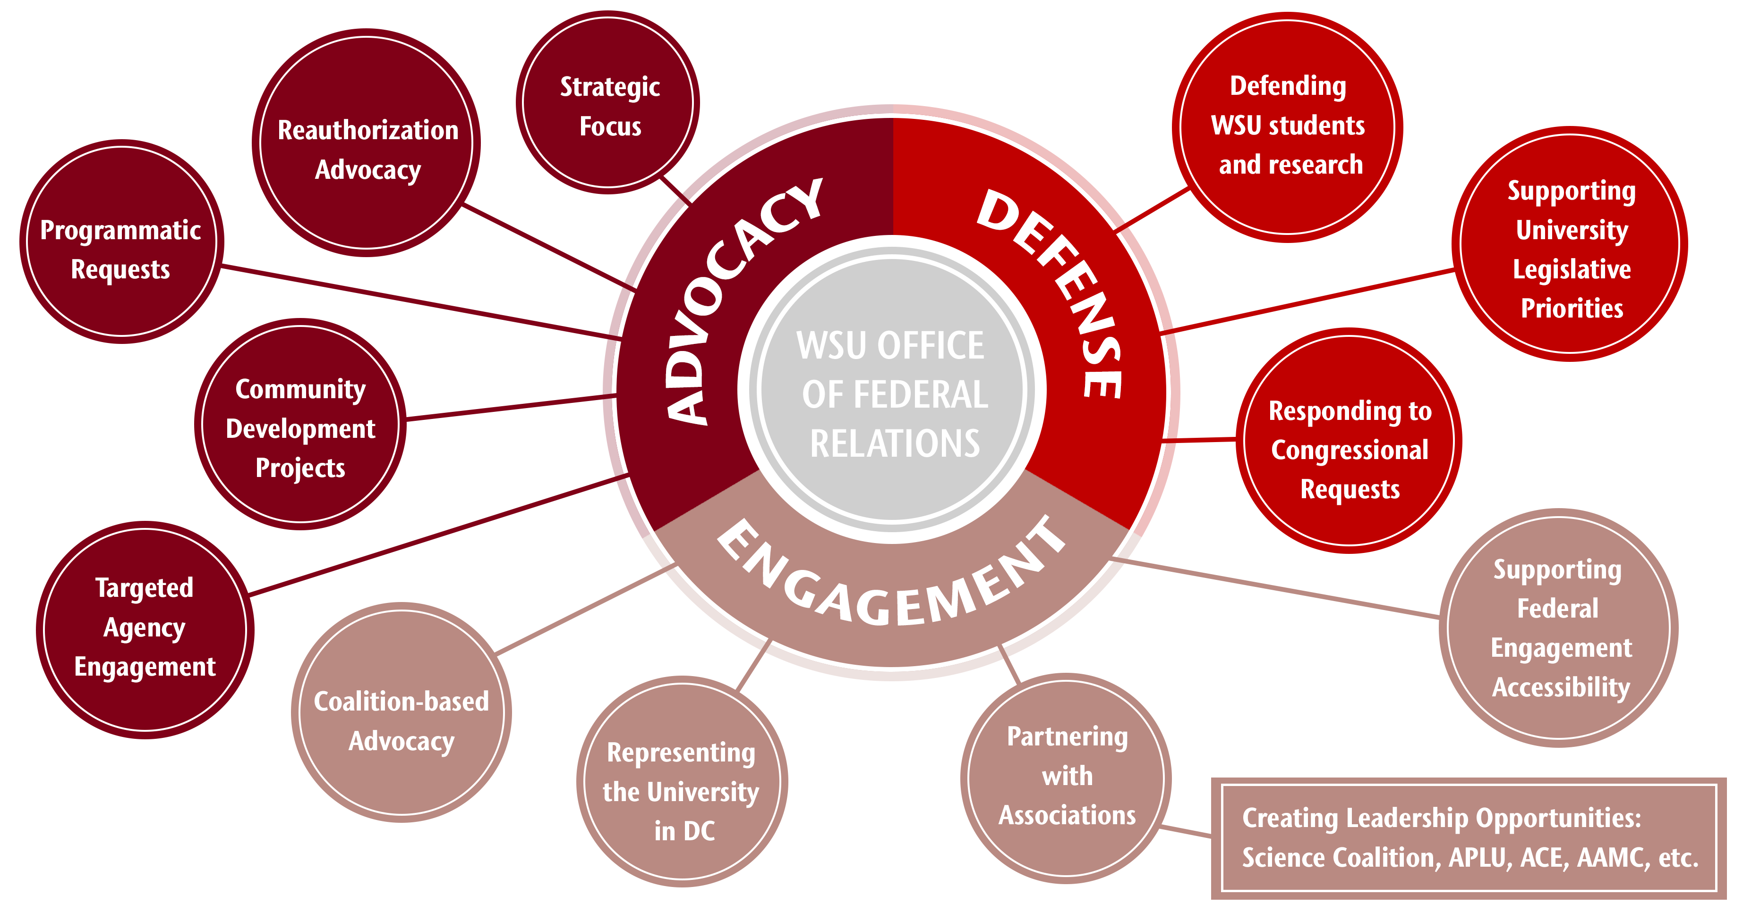
EXTERNAL AFFAIRS AND GOVERNMENT RELATIONS| THE OFFICE OF FEDERAL RELATIONS | NOVEMBER 2021
Notes:
REMOVE LAURA LOCKARD? KEEP KAREN HUNT?

Slide 13
THE OFFICE OF FEDERAL RELATIONS | CONCEPT PAPERS (FORMERLY “WHITE PAPERS”) | NOVEMBER 2021
OCTOBER 1 | NOVEMBER 1 | DECEMBER | JANUARY | FEBRUARY/MARCH
EAGR & OR ask Deans and ADR’s for white papers | First draft of white papers due to EAGR & OR | EAGR & OR discuss white papers with CGA | Socialization of white papers in DC | EAGR submits FY Programmatic Requests and targeted federal proposals to WA delegation and staff
In partnership with the Office of Research, Federal Relations has initiated a process through which faculty submit concept papers detailing new ideas around their research to review potential funding opportunities from within the federal government.
These documents are reviewed by both OFR and OR offices and by external reviewers, consultants retained by the Office of External Affairs and Government Relations (EAGR).
The documents outlining faculty concepts are used to engage with programmatic staff within strategically targeted federal agencies.
These papers may also be used to build a case to support federal funding with committee staff and members of the Washington congressional delegation.
Number of concept papers received for FY 2022: | 17
Documents submitted for plus up requests: | TBD
Documents requiring additional follow-up with faculty: (Papers are happening in preparation for FY 2023) | TBD
Documents to be discussed over the next few months for future activity in FY 2023, partnerships or other opportunities: | TBD
Notes:
REMOVE LAURA LOCKARD? KEEP KAREN HUNT?

Slide 14

THE OFFICE OF FEDERAL RELATIONS FEDERAL RESEARCH AND DEVELOPMENT FUNDING | NOVEMBER 2021
The CGA contract supports the interface between
WSU and federal agencies and the administration.
Please see the appendix for growth in federal funding for research and education.
During this same period, WSU has reduced personnel in DC and reduced office space.
CONNECTIONS:
Celestina Barbosa-Leiker was asked to serve on 2 expert panels
John Roll being appointed to the Evidence-Based Resource Center Stimulants Guidebook technical expert panel for SAMHSA.
Provided faculty development opportunities: DOD 101 Briefing with more than 80 attendees in person and 20 online from around the system
Support WSU Health Sciences Leadership with DC coalitions around substance abuse
Provided guidance to WSU faculty presenting before the White House Covid Task Force
DOLLARS:
Cornerstone team successfully increased funding for the National Institute on Disability, Independent Living, and Rehabilitation Research (NIDILLR) by $1 Million supporting WSU researchers.
Cornerstone placed language in the FY 2021 DOD bill that will fund cyber research with universities which resulted in 2-year funding of $1.5 Million announced in July 2021
Since 2018, secured $5.542 Million for VCEA HYPER Lab
Cornerstone team successfully increased funding for Indian Health Services supporting WSU research by $14.3 Million.
Currently collaborating with VCEA on $10 Million/year DOD Army Research Lab Ceramics Project
$5.12B
Notes:
The Cornerstone Government Affairs contract has expanded beyond the successful ROI to include counsel and guidance in positioning WSU as faculty and staff as thought leaders in their field in Washington, D.C.
In addition, we have utilized their expertise to help faculty and staff from around the system learn how the Department of Defense operates. We are planning on additional faculty development opportunities in other areas including energy, health sciences and agriculture/natural resources.

Slide 15
THE OFFICE OF FEDERAL RELATIONS | “EARMARKS” | NOVEMBER 2021
EARMARK: “…any congressionally directed spending, limited tax benefit, or limited tariff benefit if it benefits a specific entity or state, locality, or congressional district other than through a statutory or administrative formula or competitive award process.”
WASHINGTON STATE
EARMARK EXAMPLES FY 2010
( the last time Congress did earmarks! )
THE REQUIREMENTS
  Congressional Members can only submit 10 requests across all subcommittees and must post info on all community project funding requests to the Appropriations Committee.
  Valid for one year funding only - cannot include multi‐year funding.
  Must include a budget breakout specifically describing how the requested Federal funding will be used by the grantee
  The Committee will not fund any for‐profit entities.
  Only projects with demonstrated community support will be considered by congress.
  Matching fund requirements are not waived.
  Members are required to send the Chair and Ranking Member a letter stating that the Member does not have a financial interest in the proposed project.
Dept. of Defense: Positron Capture
and Storage - $2.4M
Health & Human Services: WSU College of Nursing facilities and equipment - $900K
Health & Human Services (Facilities & Admin): $250K for equipment Gonzaga University
Health & Human Services (Facilities & Admin): $400K for PNWU facilities and equipment
Higher Education, Evergreen College $325K for curriculum for the Bioregion Initiative
USDA/ARS Laboratory in Pullman: $3.740M
USDA/NIFA/Extension $1.033M in PA, WA to support diabetes education
OTHER NOTES:
  Eligible accounts within federal agencies for earmarks differ in the House and Senate
  Earmarks are only implemented when the funding bill is signed into law
Notes:
REMOVE LAURA LOCKARD? KEEP KAREN HUNT?

Slide 16
QUESTIONS?
Thank you and GO COUGS!!
Colleen Kerr, J.D.
Vice President
External Affairs & Govt. Relations
colleen.kerr@wsu.edu
Glynda Becker Fenter
Asst. Vice President for Federal Engagement
External Affairs & Govt. Relations
glynda.becker@wsu.edu
Chris Mulick
Director of State Relations
External Affairs & Govt. Relations
chris.mulick@wsu.edu

