Slide 1

The External Mentor Program: Enhancing Professional Development of STEM Women Faculty
Rebecca Craft, Ph.D.
Chair, Psychology Department
Assoc Dean for Faculty Development, College of Arts & Sciences
Washington State University

Slide 2

WSU
Land-grant
“Research 1”
4+ campuses
Main campus:
20,000 undergrads
5,000 grad/professional students
WSU-Pullman

Slide 3
Background
Mentoring relationships in the workplace:
  Increase job satisfaction
  Increase institutional commitment
  Increase rates of promotion and retention
  Decrease work conflict
  de Janasz & Sullivan, 2004; Moody, 2004; Neilson et al., 2001; Tenenbaum et al., 2001
Notes:
Bilimoria et al (2006): For both male and female faculty, academic job satisfaction is significantly influenced by institutional leadership and mentoring, and the mediating factors are “internal academic resources” and “internal relational supports” –these mediators contribute equally for men, whereas for women, “internal relational supports” have a greater influence on job satisfaction than resources.

Slide 4
WSU Faculty Mentoring Survey
(Spring 2011)
Gathered information from faculty (>1,000; 39% response rate) about:
  existing forms of mentoring,
  faculty perceptions of barriers and benefits to mentoring,
  important mentoring topics, etc.

Slide 5
TYPES OF INTERNAL FACULTY MENTORING
At WSU

Slide 6
Respondent sub-group: tt faculty + chair/unit dir/admin

Slide 7
Respondent sub-group: tt faculty + chair/unit dir/admin
Notes:
most “unsure” respondents are ASSISTANT Profs

Slide 8
Respondent sub-group: non-tenure track faculty
Notes:
Only clinical-track and research-track faculty respondents

Slide 9
SATISFACTION WITH INTERNAL FACULTY MENTORNIG at WSU

Slide 10
Respondent sub-group: tenured/tenure-track faculty

Slide 11
Respondent sub-group: tenured/tenure-track faculty
Notes:
Assoc profs are LEAST satisfied with mentoring for post-tenure faculty

Slide 12
Respondent sub-group: non-tenure track faculty

Slide 13
PERCEPTION OF Benefit FROM FACULTY MENTORING
AT WSU

Slide 14
Notes:
All respondents

Slide 15
Pre-tenure Faculty
The most common type of mentoring for pre-tenure faculty is a “formal tenure guidance committee”…
  ~65% of assistant and associate professors are somewhat to very satisfied with mentoring for pre-tenure faculty
  22% are somewhat to very dissatisfied, with no significant gender differences

Slide 16
Post-tenure & non-TT Faculty
No mentoring is provided for most post-tenure and non-TT faculty members.
  48-49% are somewhat to very dissatisfied

Slide 17
ADVANCE External Mentor Grant Program
2009-2014
Preliminary Summary

Slide 18
Aim
To increase retention, productivity and success of STEM women faculty at WSU
  Provide additional source of career mentoring for WSU assistant and associate professors
  Promote collaboration between WSU faculty and researchers outside WSU
Average grant = $3388 (range ~$2-6K, primarily for travel) + $750 mentor honorarium

Slide 19
Guidelines
Proposal Format: in 1 page, identify
external mentor (need supporting letter from her/him);
potential for award to initiate long-term collaboration;
seminar topic that will be shared by mentor with mentee’s department or college;
tentative timeline of grant-related activities (aim for 1 yr);
…+ budget.
Evaluation:
Do proposed activities/mentor have potential to further professional development of WSU faculty member?
What is probability that proposed activities will establish a long-term collaborative research relationship?

Slide 20
Who was funded?

Slide 21
19 DEPARTMENTS
College of Engineering & Architecture:
(CEA) Chemical Engineering & Bioengineering (2/3)
Civil & Environmental Engineering (4/4)
Electr. Engineering & Computer Science (2/3)
Mechanical & Materials Engineering (0/1)
College of Arts & Sciences: Anthropology (3/6)
(CAS) Biological Sciences (3.5/5.5)
Chemistry (2/2)
Earth & Envir Sciences (2/2)
Math & Statistics (1.5/2.5)
Physics & Astronomy (0/1)
Psychology (6/7)
Sociology (0/7)
College of Veterinary Medicine: Molecular Biosciences (1/6)
(CVM) Integrative Physiol Neurosci (2/4)
Vet Microbiol & Pathol (1/3)
Global Animal Health (3/5)
College of Agriculture, Human & Natural Resource Sciences (CAHNRS):
Animal Sciences (0/2)
Inst. Biological Chemistry (1/1)
BioSystems Engineering (1/1)
Crop & Soil Sciences (1/3)
Economic Sciences (1/5)
Entomology (1/1)
Food Science (2/4)
Hort. & Landscape Architecture (0/5)
Plant Pathology (0/2)

Slide 22
Who was funded?
Rank
  27 tenure-track assistant professors
  11 tenured associate professors
  1 research assistant professor
  1 clinical assistant professor
Location
  33 Pullman (main campus)
  6 Vancouver (branch campus)
  1 Tri-Cities (branch campus)

Slide 23
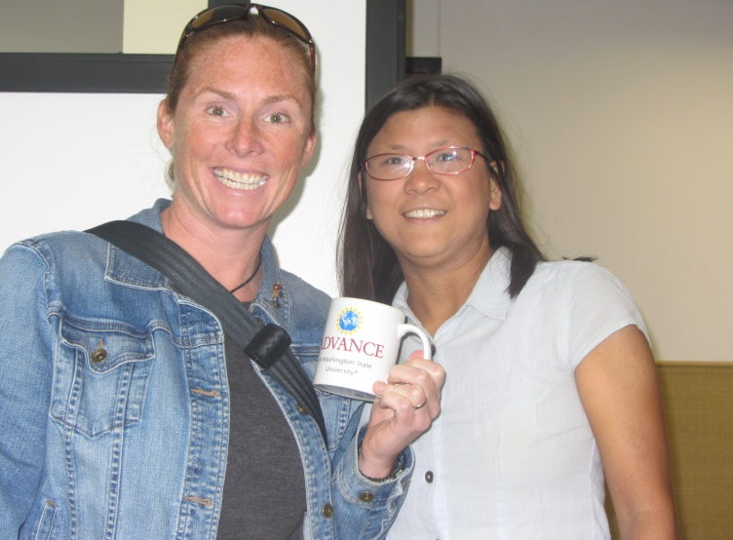
Who Were the Mentors?
From 33 different academic institutions + 2 research institutes
All U.S. except 1 Thailand, 1 Singapore, 1 Scotland
Mostly full professors
22 female, 18 male
Mentor Dr. Wiedinmyer (NCAR) & Dr. Chung (WSU)

Slide 24
Primary Grant Activities
Visit mentor’s institution (typically included giving a seminar): 80%
Host mentor visit to WSU (typically included mentor seminar to dept.): 63%
Co-attend national or international conference, or other activity: 45%
Regular to periodic communication by email/Skype/phone: ~90%
Notes:
Based on 30 faculty who completed their grant activities as of 3/31/14

Slide 25
At Completion
Initial report submitted within 1 month of completion of proposed activities (n=39)
Average time to completion: 14.5 months (range 4-32)
1 year after submission of initial report, follow-up solicited (n=24 so far)

Slide 26
Notes:
Based on 39 faculty who completed their grant activities as of 8/31/14; what activities would not have been possible or would have been unlikely without the advice of or collaboration with the EM?

Slide 27
What types of advice did you receive from your mentor?
Research-related: 97%
Mentoring trainees: 78%
Balancing research/teaching/service: 70%
Work-life balance: 57%
Classroom teaching-related: 22%
“Other”: 62%; e.g.,
  Navigating department politics
  Developing collaborations

Slide 28
Best piece of advice received?
Most common category of response, after research-related advice: assertiveness, self-confidence (25%)

Slide 29
Notes:
Based on 39 faculty who completed their grant activities as of 8/31/14

Slide 30
Issues Encountered After Grant Award
Mentor “drops out” (n=5)
  Illness/accident
  Change in career status
> Grant duration extended (2); alternative mentor found (1)

Slide 31
Qualitative Feedback
“Within just 5 months of my collaboration with __________, I have been able to jump start an entirely new research direction… …I now have enough data to support a strong NSF grant proposal… and a publication…” (assistant professor)

Slide 32
Qualitative Feedback
“The exposure to other well established researchers at ____________’s institution and the connections I established with them are direct results [of interactions with mentor]… My mentor was instrumental in introducing what my lab can contribute to these researchers, who did not know of my lab’s ability until now. These newly established collaborative efforts are promising for many years to come.” (assistant professor)

Slide 33
Qualitative Feedback
“Although I have known __________ for many years… she has never scrutinized me or offered advice to me until I explicitly asked for it. Her advice has been amazing, eye-opening, and thought provoking… It was both difficult (to be criticized) and exciting (to find out what I have been doing well, and what I can do better)… Being an associate professor is sort of like being stuck in the doldrums and any motivation is welcome and appreciated toward making that push to full professor.”

Slide 34
Qualitative Feedback
“ My research writing has become broader, I have met others in my field, I have a collaboration that has developed as a result, and I have someone I can always turn to for advice now and in the future. This award has led to a wonderful and invaluable experience!” (associate professor)

Slide 36
Other Outcomes at Follow-up (29%)
Mentor made additional visit to WSU to discuss collaboration
WSU graduate student sent to mentor’s lab for training
WSU faculty member won research award
WSU faculty member submitted first symposium proposal, and gave invited lecture
WSU faculty member developed new software
Equipment (confocal microscope) successfully purchased and set up at WSU-Vancouver

Slide 37
Cost-benefit?
Total program costs:
  Grants + Honoraria ~ $171K for 40 grants
  + Program Administration
Benefits: some apparent early quantitative benefits; significant qualitative ones
Drawbacks: long-term outcomes have yet to be measured; control group lacking (but see Blau et al. (2010)
Notes:
Blau et al (2010): a randomized trial of female assistant profs (economists), provided with mentoring or not; after 5 years the first mentored cohort averaged 0.4 more NSF or NIH grants & 3 more publications, and were 25% more likely to have a top-tier publication than faculty in the no-mentor group.

Slide 38
Future Plans/Recommendations
WSU will implement external mentor grant program university-wide starting in 2015
Encourage faculty applicants to:
  Choose a mentor with whom they could potentially collaborate
  Avoid mentors in the midst of career transitions
  Consider back-up plan if first mentor does not work out
Require unit chair/director to assist with planning mentor visit to WSU, and with cost

Slide 39

Questions?
craft@wsu.edu

