Slide 1

WSU Pullman Undergraduate Student Technology Fee Committee
October 16, 2026

Slide 2

Agenda
Introductions
Committee Overview
What does the Undergraduate Student Tech Fee Fund
Allocation History
Process Improvement Discussion (?)
Request Process & Materials
Next Steps
  Elect Chair
  Finalize Timeline

Slide 3

Committee Overview
Committee is subject to both Open Public Records and Open Public Meeting Laws.
Evaluates proposals and makes allocation recommendations for the expenditure of WSU Pullman technology fee revenue. This recommendation goes forward to the WSU Board of Regents for final approval.
Provides allocation recommendations to ASWSU and University Administration.
All decisions are made by a majority vote of students. Quorum consists of 5 members, majority of which are students.
Committee Chair must be a student

Slide 4
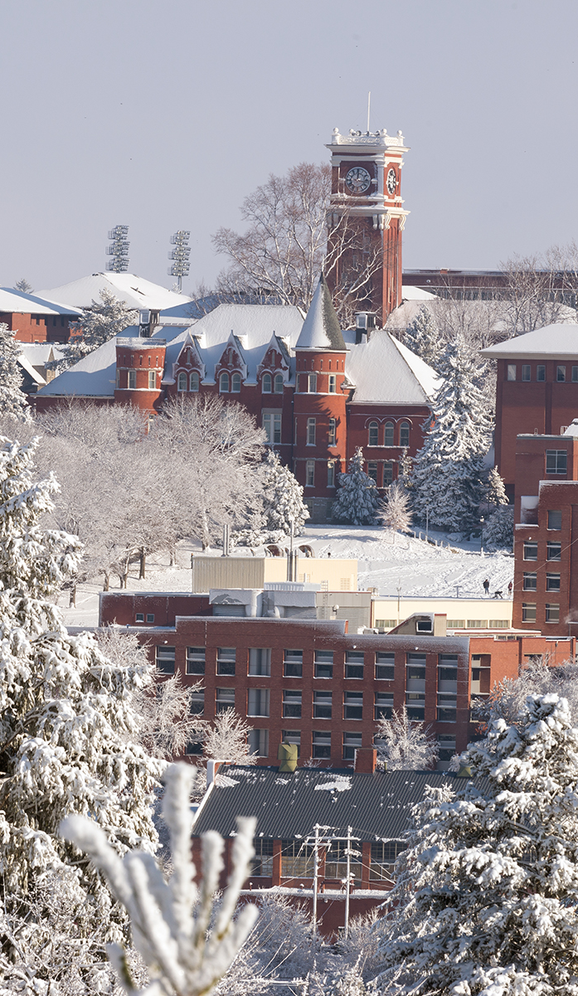


What Does the Fee Fund ?
Fee funds specific tech related projects which can be completed in one fiscal year.
Revenue from this fee shall be used exclusively for technology resources for general student use.
“Technology Fee” is a fee charged to students to recover, in whole or in part, the costs of providing and maintaining services to the students that include but are not limited to: Access to the internet, email, & software.
Only Undergraduates pay the fee.
RCW 28B.15.051
Past & Current Project Include:
  Student Printing
  ESports Gaming Lounge in Chinook
  Improvements to Wifi Infrastructure
  Creative Corridor Projects
  The Fiz
Notes:
Fee is $40/annually

Slide 5
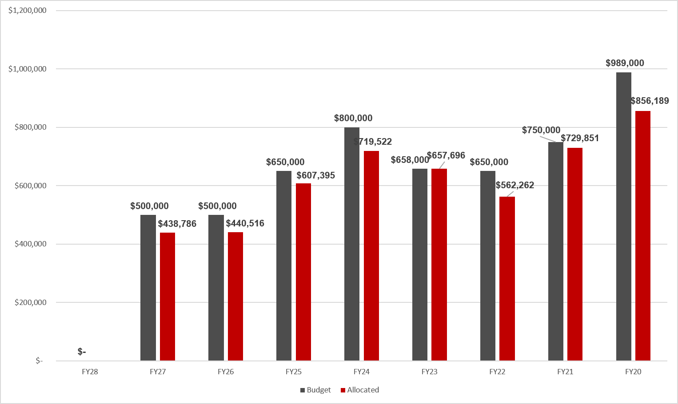
Allocation History

Slide 6
Process Improvement Discussion
Communication to greater WSU Community
ASWSU involvement?
Communication to Area Finance Officer/Technology Officers
Longer time to review requests?
Add additional meeting to review requests
Requests
  Add instruction sheet for groups
  Require groups to bundle priorities
Hearings – create standardized slide deck
  How project meets the WSU Strategic Pillars
  General accessibility for student use
  Review and update guidelines

Slide 7

Request Materials
Workbook
Presentation Slides
Can include schematics, student petitions, or other supporting documents in the workbook.
Proposals that require any structure modifications must include estimate from facilities services in request.
Each group will present their request during the hearings.
  12 minute blocks: presentation + q&a’s with committee

Slide 8

Request Submission
Materials located on the budget office website
Overview of FY28 Process
Workbook
Slide template
Submitted wsubudget.office@wsu.edu
Materials posted on Teams

Slide 9
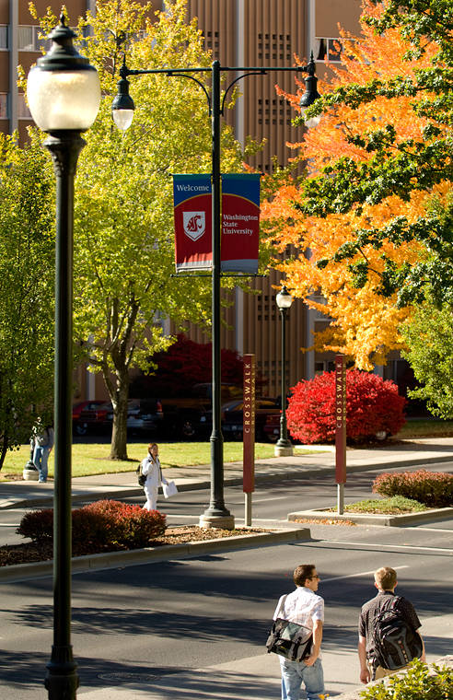
Notes to Groups
Keep presentations to no more than 5-6 minutes; maximize Q&A time.
Students must present. Staff/Faculty Reps attend hearings in support of student presenters.
Must include estimate from myfacilties for any structural modifications.
Requests must include signature for staff/faculty rep and area finance officer.
Requests must be limited to a single fiscal year.
Allocation request is two (2) step process:
  1. Written proposal (cover sheet + itemized spreadsheet)
  2. Presentation to committee
  **Groups must complete both steps to be considered for funds.**

Slide 10

Next Steps

Slide 11
Timeline
Deadline: February 3, 2027
October 16, 2026 – Meeting finalize request materials
November 2026 Open request process
January 2027
January 8 – Request deadline
January 11-15 – Initial review of requests / Budget Review
January 18,19,21 – Hearings – Monday and Tuesday, Thursday, if necessary
January 26,28 - Deliberations – Tuesday, Thursday (Feb 2 if necessary)

Slide 12
Discussion

