Slide 1

Lauren’s Promise- I will listen and believe you if someone is threatening you.
Lauren McCluskey, a 21-year-old honors student athlete, was murdered on Oct. 22, 2018, on the University of Utah campus by a man she briefly dated. We must all take actions to ensure that this never happens again.
If you are in immediate danger, call 911.
If you have or are experiencing sexual assault, domestic violence, and/or stalking, please report it to me and I will connect you to resources or call Alternatives to Violence of the Palouse at 877-334-2887 (24-hour crisis hotline).
Any form of sexual harassment or violence will not be excused or tolerated at Washington State University.
More info/ resources:
  See syllabus
  Daily Evergreen story, with links: https://dailyevergreen.com/67488/news/aswsu-approves-laurens-promise/

Slide 2
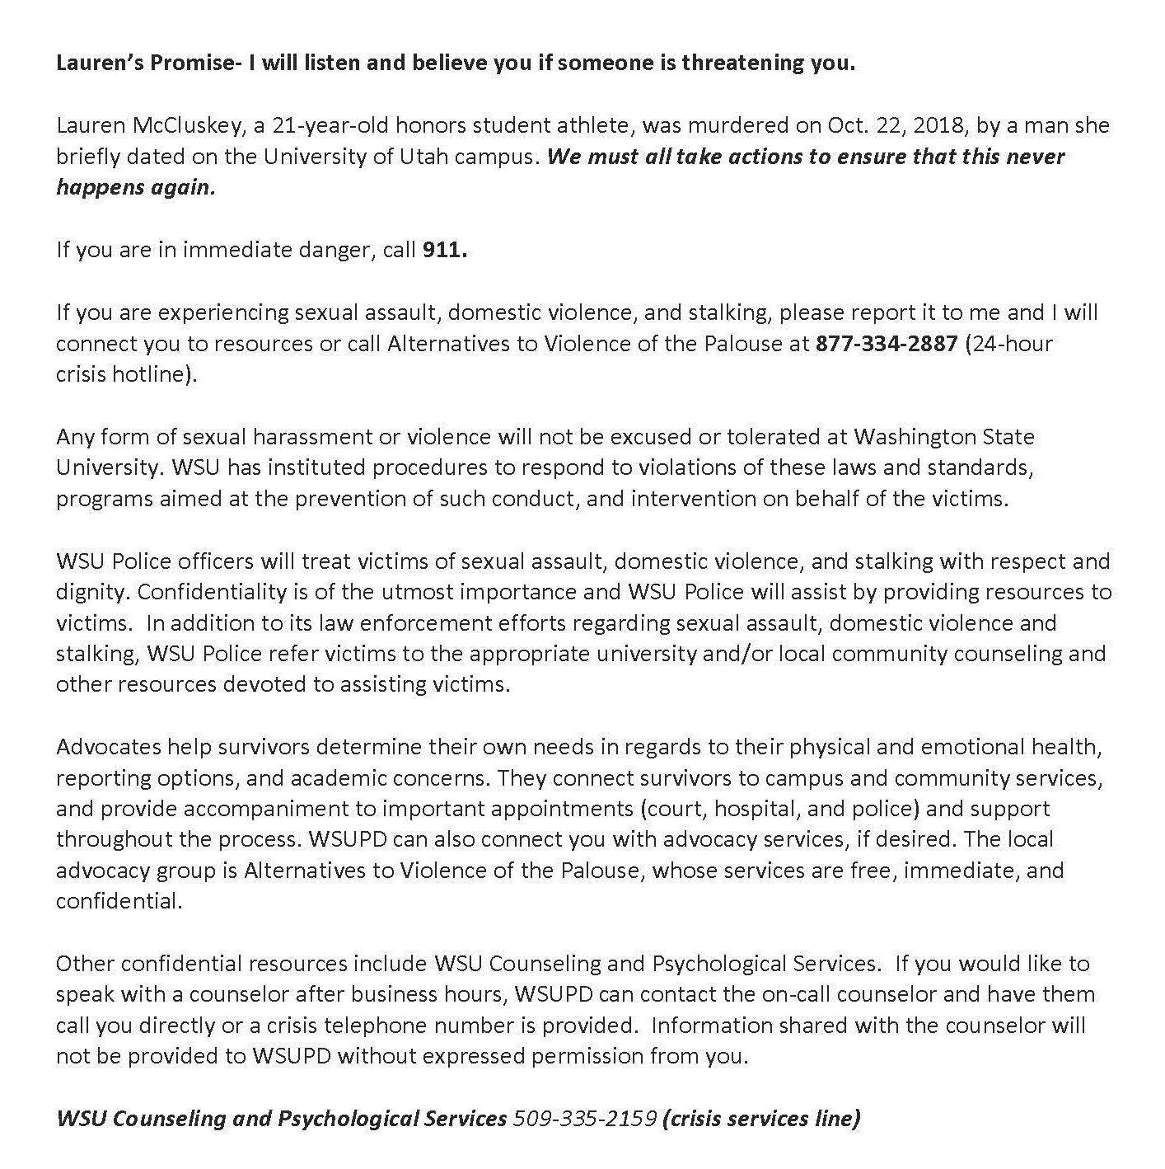
Syllabus statement from Professor Jill McClusky
Source: https://twitter.com/jjmccluskey/status/1157120442257199105?lang=en

Slide 3
Lauren’s Promise statement (cut & paste in syllabus—can edit w/ local resources if outside of WSU and/or add national resources listed on next slide)
Lauren’s Promise – I will listen and believe you if someone is threatening you.
Lauren McCluskey, a 21-year-old honors student athlete, was murdered on Oct. 22, 2018, on the University of Utah campus by a man she briefly dated. We must all take actions to ensure that this never happens again.
If you are in immediate danger, call 911.
If you have or are experiencing sexual assault, domestic violence, and/or stalking, please report it to me and I will connect you to resources or call Alternatives to Violence of the Palouse at 877-334-2887 (24-hour crisis hotline).
Any form of sexual harassment or violence will not be excused or tolerated at Washington State University. WSU has instituted procedures to respond to violations of these laws and standards, programs aimed at the prevention of such conduct, and intervention on behalf of the victims.
WSU Police officers will treat victims of sexual assault, domestic violence, and stalking with respect and dignity. Confidentiality is of the utmost importance and WSU Police will assist by providing resources to victims. In addition to its law enforcement efforts regarding sexual assault, domestic violence and stalking, WSU Police refer victims to the appropriate university and/or local community counseling and other resources devoted to assisting victims. Advocates help survivors determine their own needs in regards to their physical and emotional health, reporting options, and academic concerns. They connect survivors to campus and community services, and provide accompaniment to important appointments (court, hospital, and police) and support throughout the process. WSUPD can also connect you with advocacy services, if desired. The local advocacy group is Alternatives to Violence of the Palouse, whose services are free, immediate, and confidential.
Other confidential resources include WSU Counseling and Psychological Services. If you would like to speak with a counselor after business hours, WSUPD can contact the on-call counselor and have them call you directly or a crisis telephone number is provided. Information shared with the counselor will not be provided to WSUPD without expressed permission from you.
WSU/ Local Resources:
Alternatives to Violence of the Palouse: 877-334-2887 (24-hour crisis hotline)
WSU Counseling and Psychological Services: 509-335-2159 (crisis services line)

Slide 4
National Resources
National Resources for Domestic Violence, Sexual Assault, and Stalking:
National Domestic Violence Hotline: 1-800-799-7233 or https://www.thehotline.org/
RAINN (Rape, Abuse & Incest National Network): 1-800-656-4673 or https://www.rainn.org/
Victim Connect Resource Center: 1-855-484-2846 or https://victimconnect.org/
Love is Respect – National Dating Abuse Hotline: 1-866-331-9474 or https://www.loveisrespect.org/
Anti-Violence Project Hotline: 1-212-714-1141 or https://avp.org/

