Slide 1




Warm-up
Split into teams of 2
One teammate walks the route given, other teammate follows with a timer (use your phone) and records footsteps taken

Slide 2
Team Updates (1 person from each team)

Slide 3
Flow

Slide 4
Goal for Today
Understand how eliminating waste will improve flow and efficiency
Design a layout of the lab at Central Receiving that flows

Slide 5
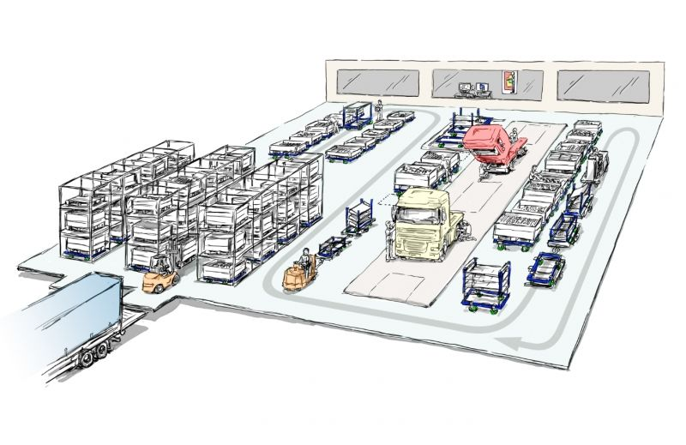
Flow
Flow: How work progresses through a system
When a system works well, or has “good flow,” it moves steadily and predictably
Seamless linking of value-added steps in a process
In a “bad flow,” the work starts and stops—these interruptions increase the accumulation of waste
Notes:
Agile workflows vs inv

Slide 6
Barriers to Flow
These all correspond to different types of waste—
Physical distance between steps
Long setup times
Unreliable deliveries (keeping extras on hand just in case parts don’t arrive on time)
Approval processes (work piles up until the go-ahead is given)

Slide 7
Discussion on the warm-up
•How does tracking steps and time help measure waste and flow?

Slide 8

Time to design the new lab layout…

Slide 9
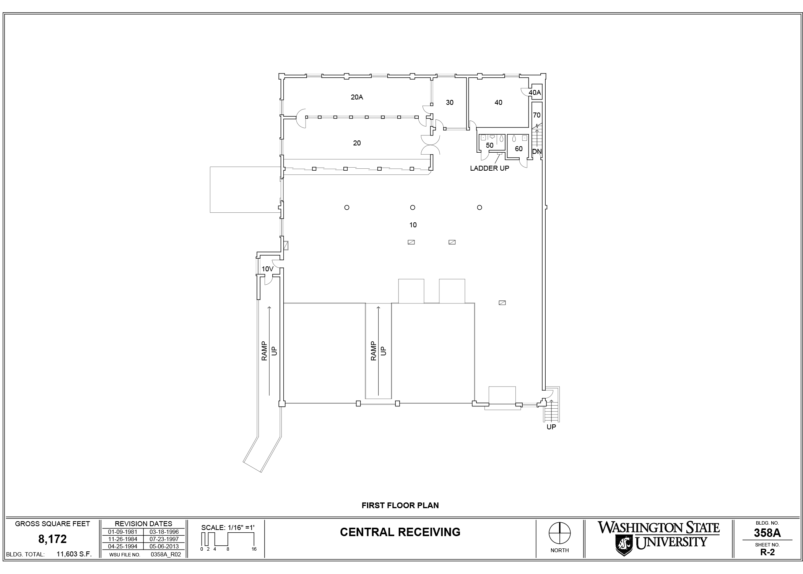
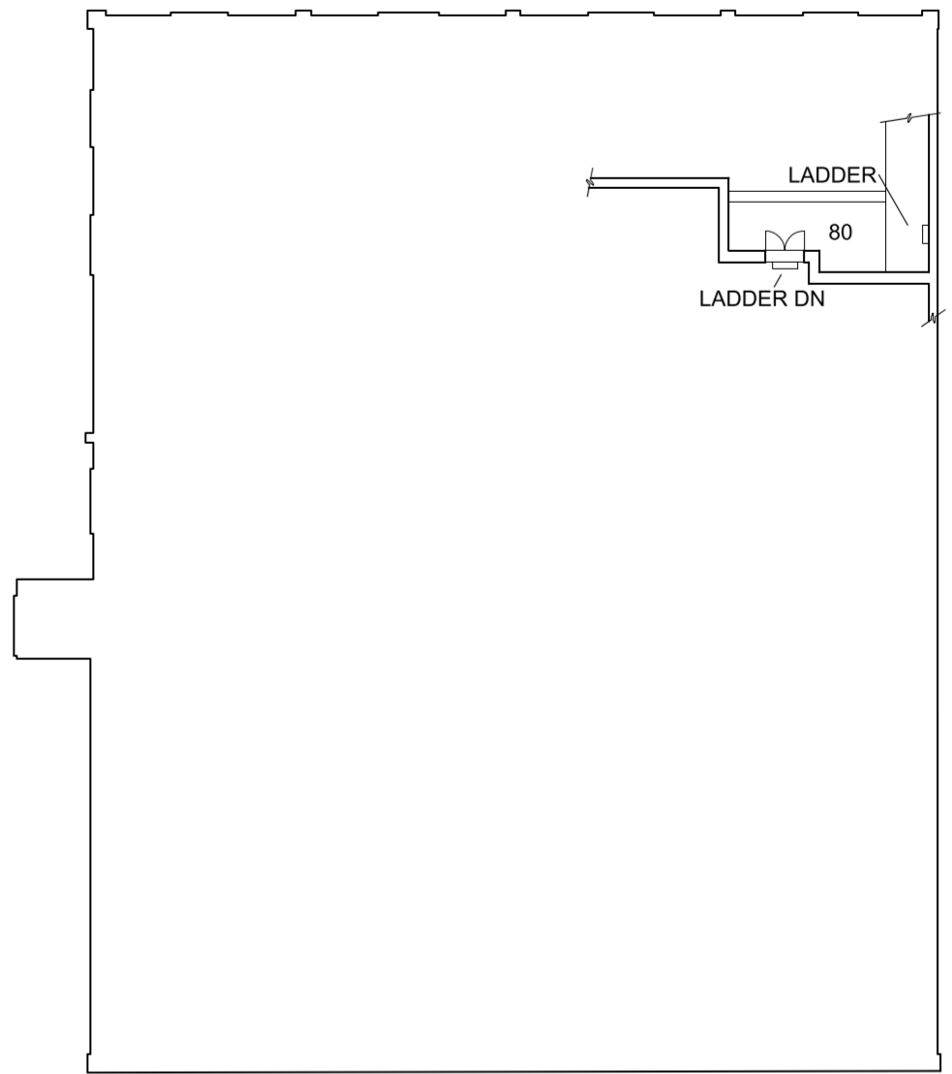
Restrooms
Entrance
Posts

Slide 10
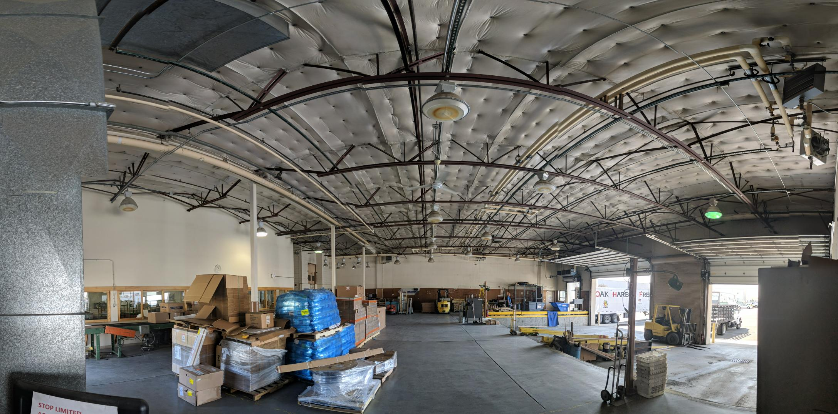
Main space

Slide 11
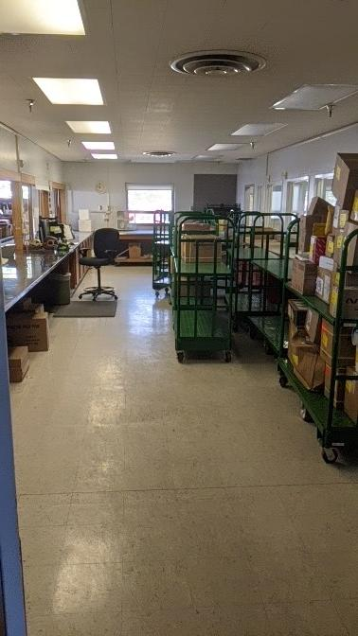

Slide 12
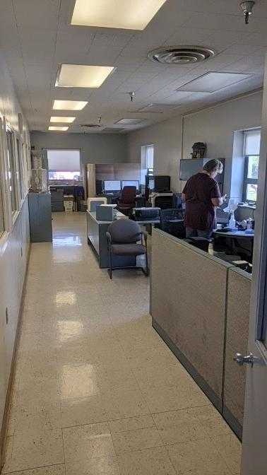
Don’t let the walls limit you!
Could be removed or utilized

Slide 13
Musts & Shoulds

Slide 14
Designing the new lab space!
Split up into 4 teams with 4 posters
Multiple 45-second rounds
45 seconds to…
Place ONE lab component on the floor plan
Hand off your poster to the next team. Receive another team’s poster
Then, 45 seconds to evaluate the newly received layout for its potential flow and strategically add the next component. DO NOT REARRANGE, just add.

Slide 15
2min to overview
45s to place tools area

Slide 16
2min to overview
45s to place tools area
Swap
45s evaluate flow of new layout and strategically place supplies area.

Slide 17
Awards
Remember: Nominate someone who has done something above and beyond their job description

