Slide 1
Itinerary
Warm-up (10min)
Updates (10min)
Presentation (10min)
Discussion (5-10min)
Activity (10min)
2nd Discussion (5min)
Awards (5min)

Slide 2
Warm-up
Complete your assigned challenge!
  Split into 6 teams
  Read your given directions and execute
  10 minutes on the clock to complete your task!
  *Don’t talk to other teams unless directed otherwise*
10
7.5
5
2.5
0
Timer (mins)
Notes:
Give them specific time or ask them to time themselves?

Slide 3
Team Updates
(1 person from each team)

Slide 4
Waste

Slide 5
Goal for Today
Understand, identify, and eliminate waste

Slide 6
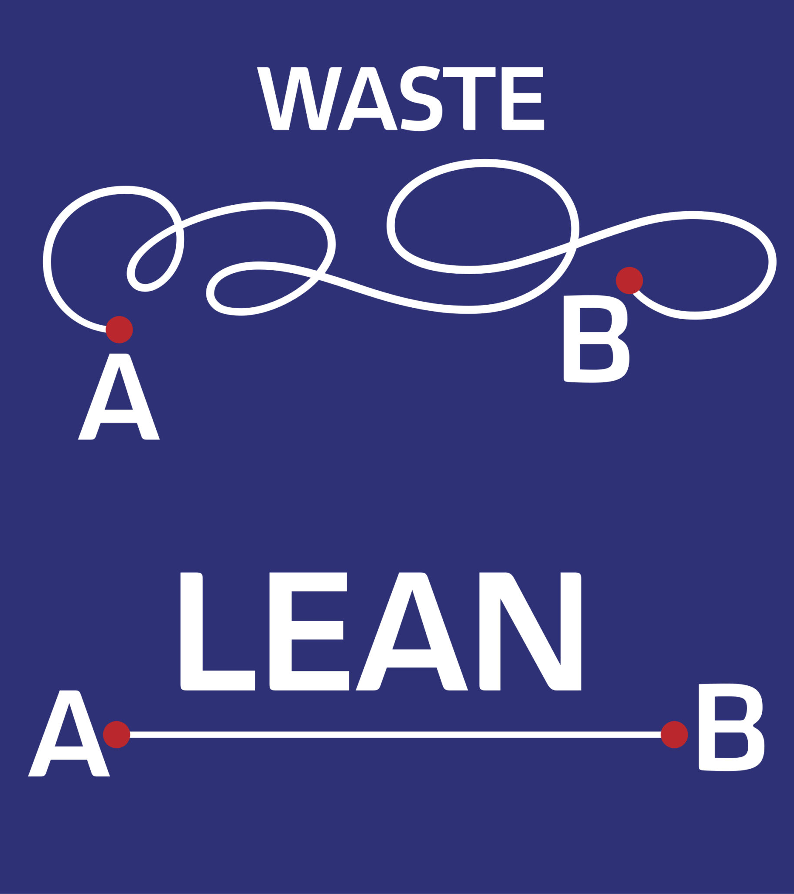
Waste (Muda)
Definition: Any action, outcome, or feature that does not add value to the final product
Our defined wastes:
Complexity
Scraps
Motion
Idle Inventory
Time
Disorganization
Defects
Notes:
Takes us off course of where we want to be

Slide 7
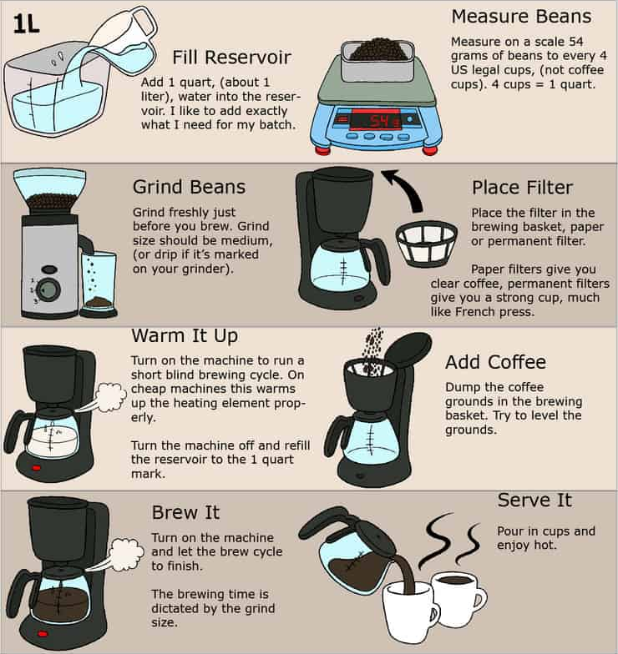
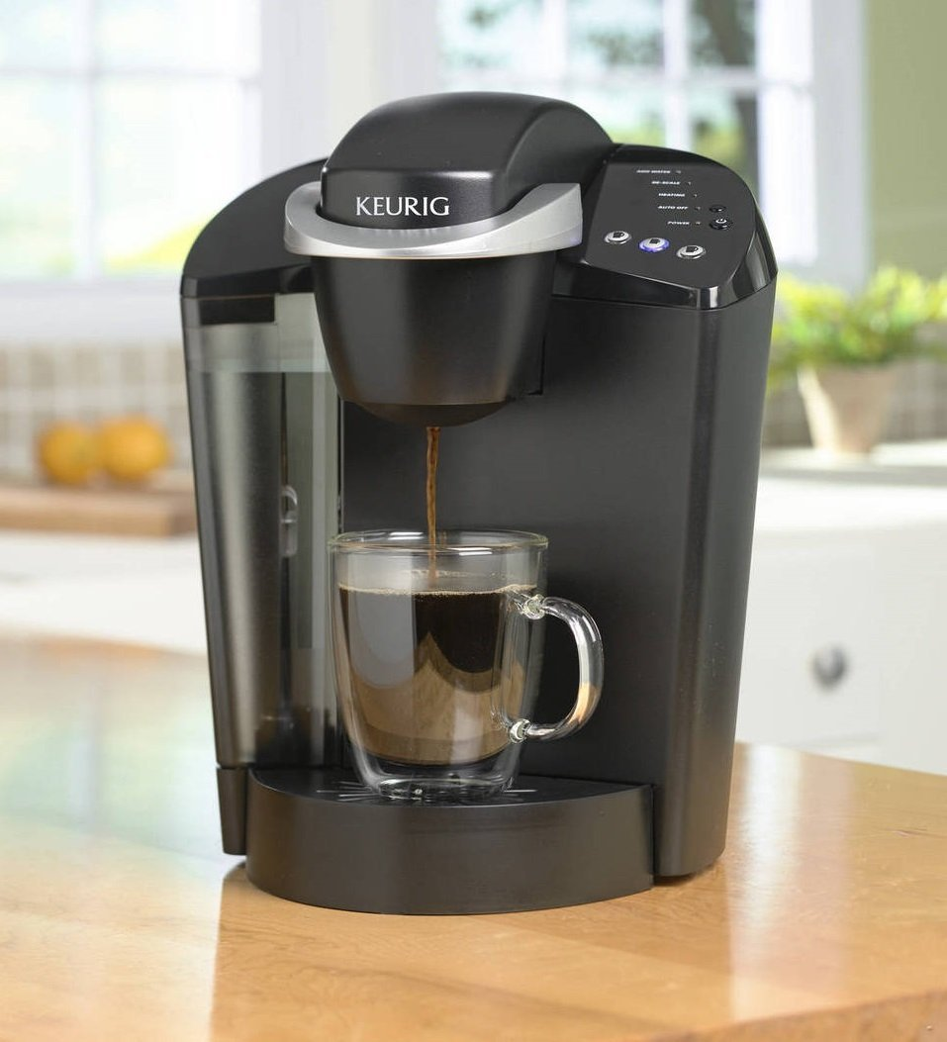
Complexity
Needlessly complex systems necessitate more energy to use, manage, and create
Coffee example: More steps doesn’t add any value to the coffee

Slide 8
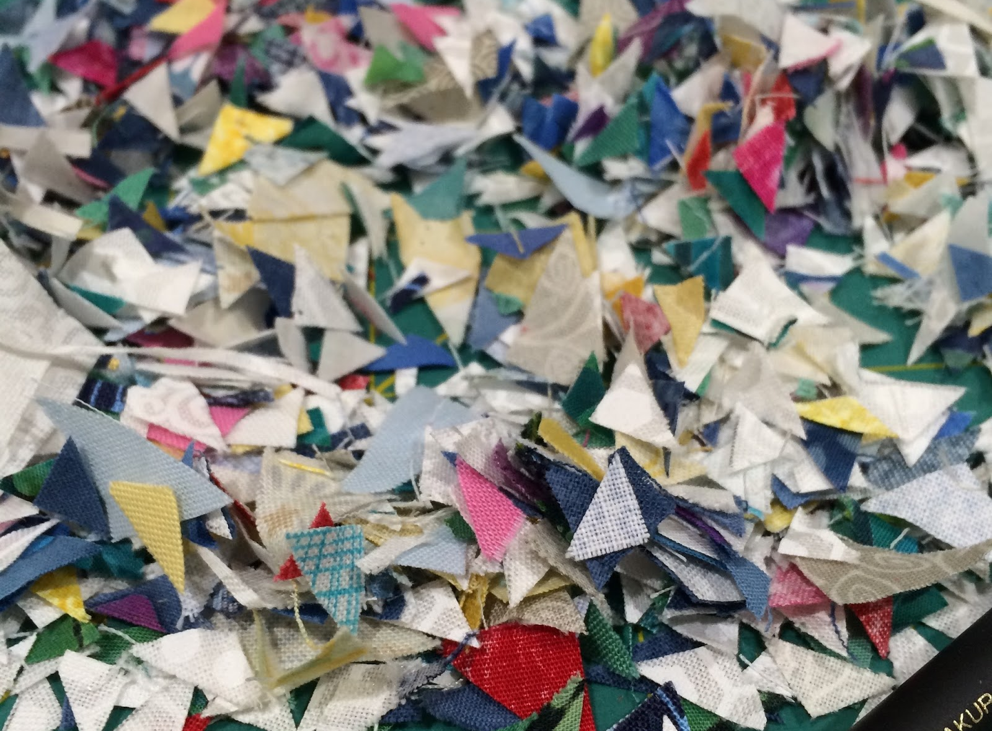
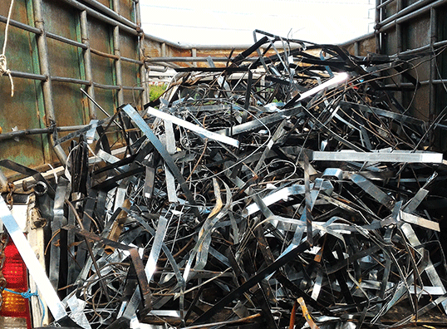
Scraps
Scrap, trim, and excess raw materials that are created from the conversion of materials into products

Slide 9

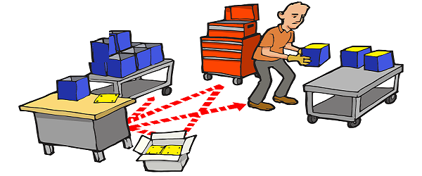
Motion
The use of time and energy in unnecessary motion of people and materials
Notes:
What do you guys suppose the solution to unnecessary motion is?

Slide 10
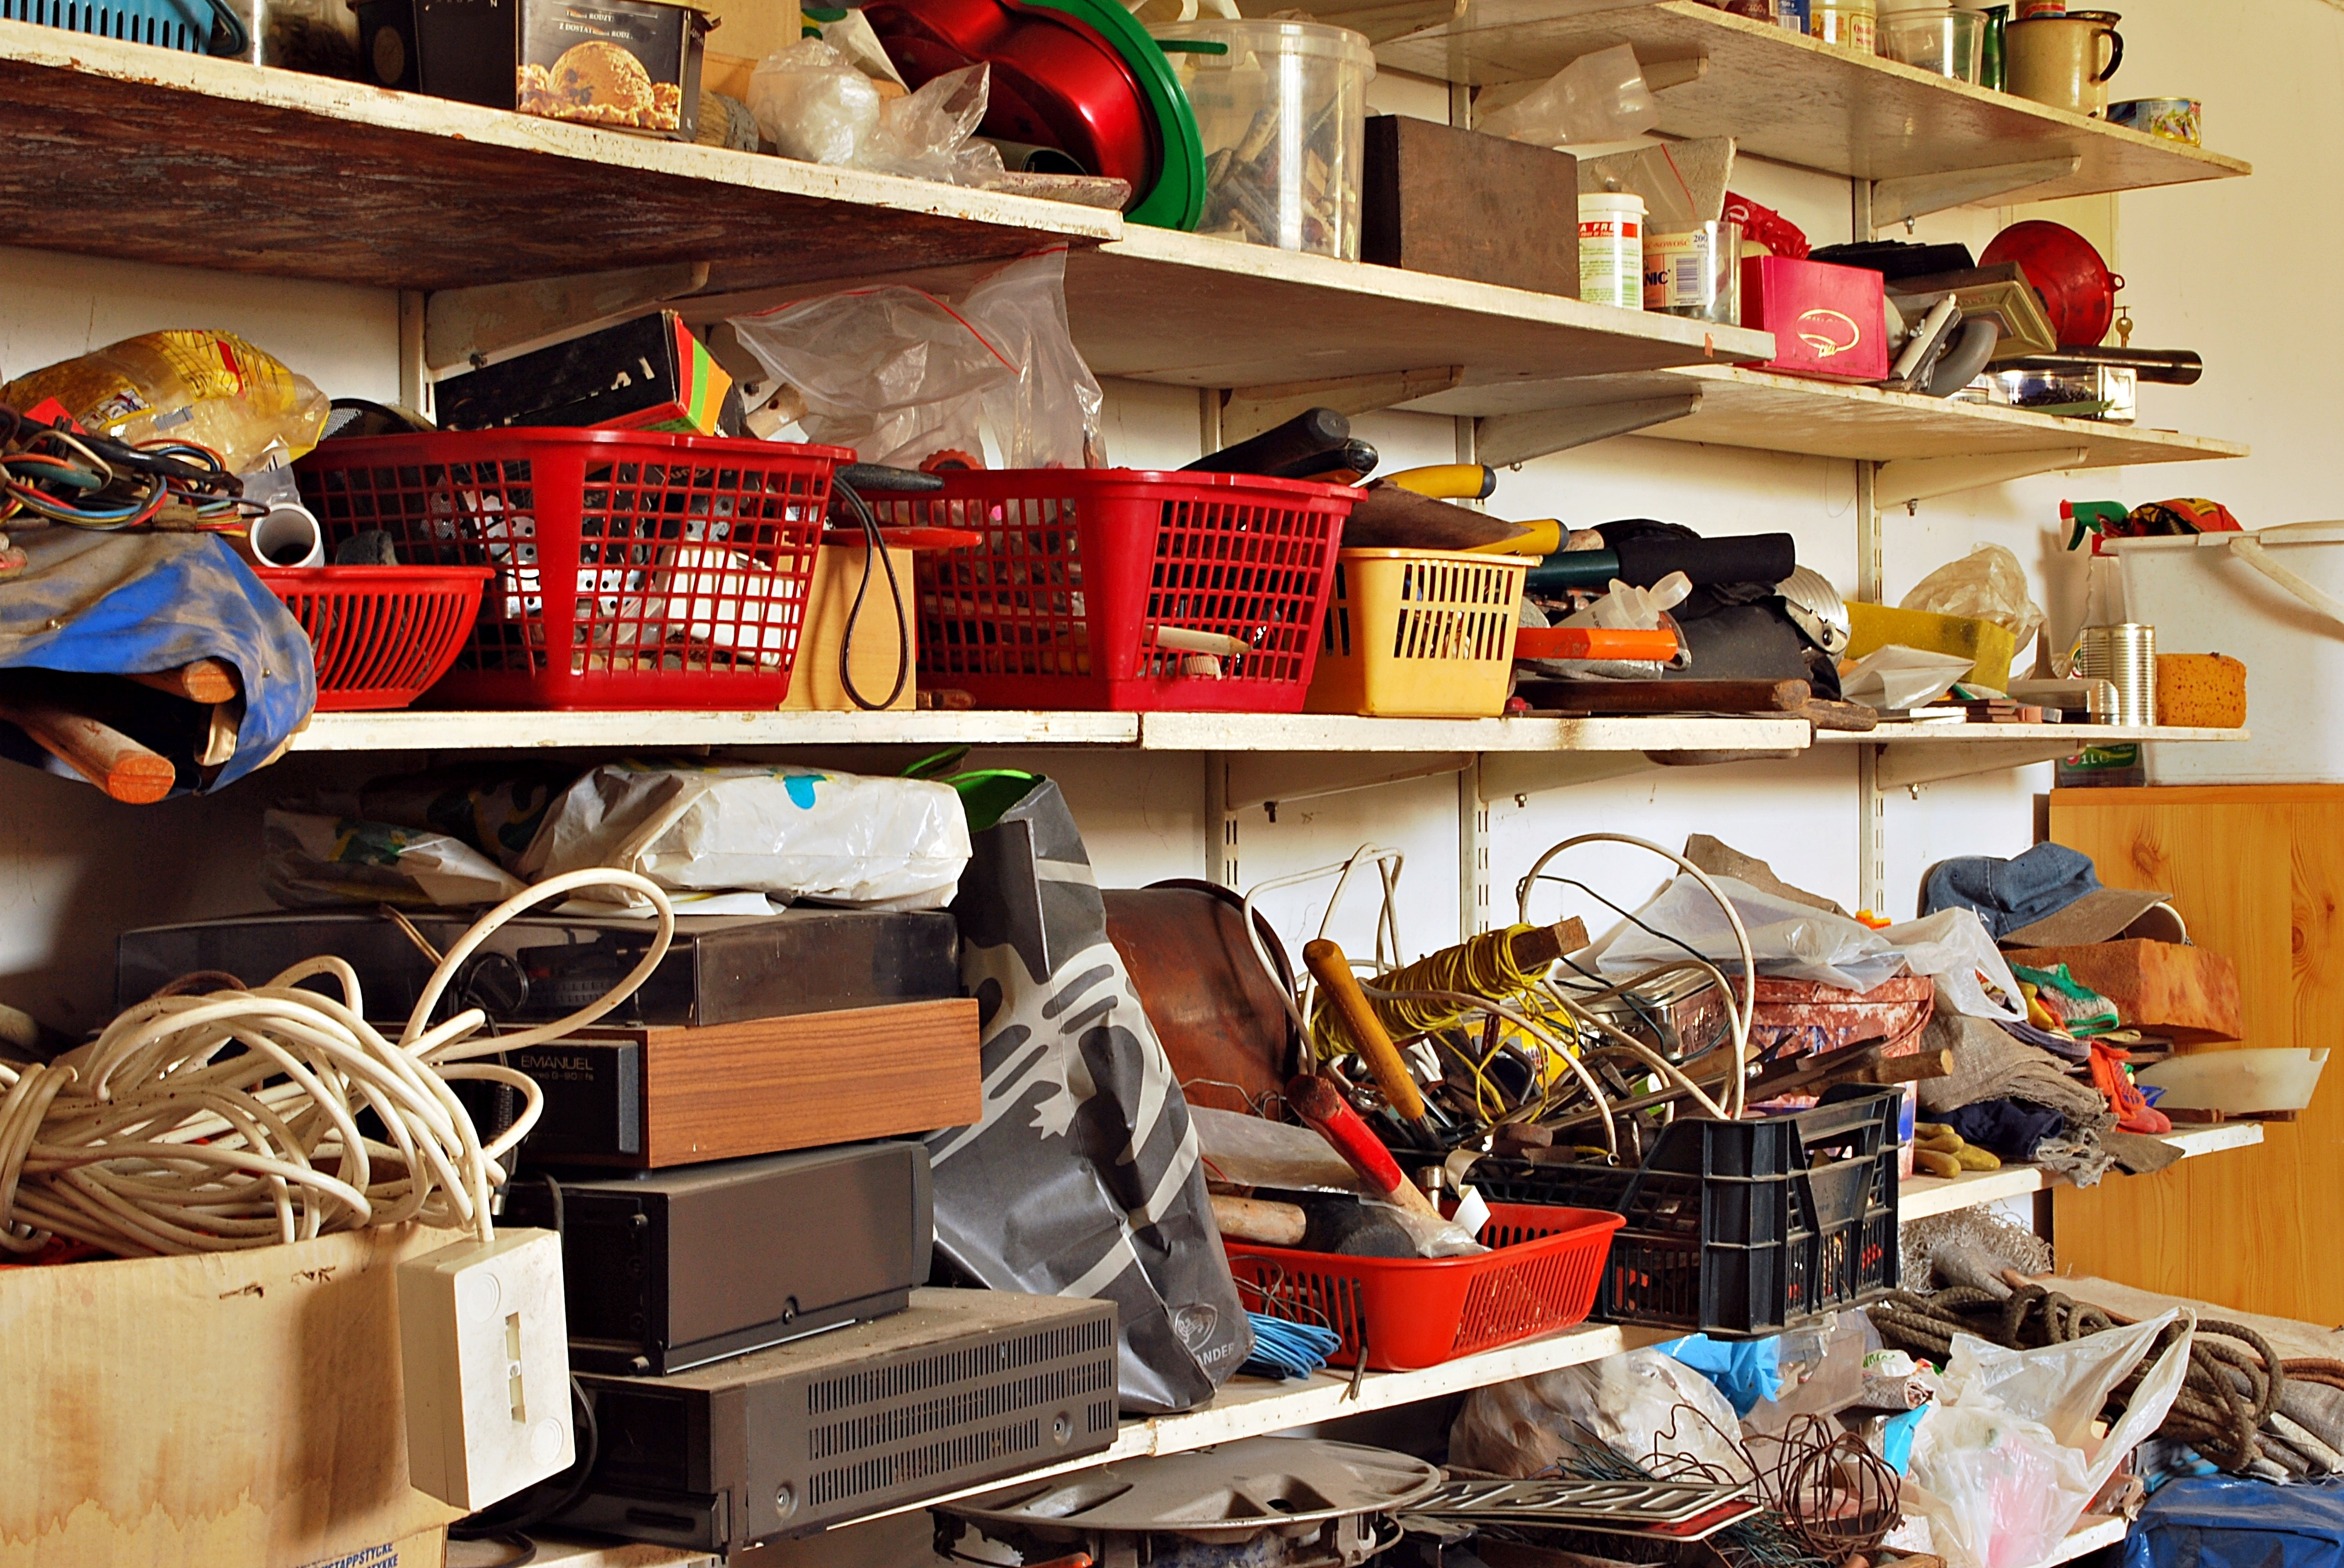
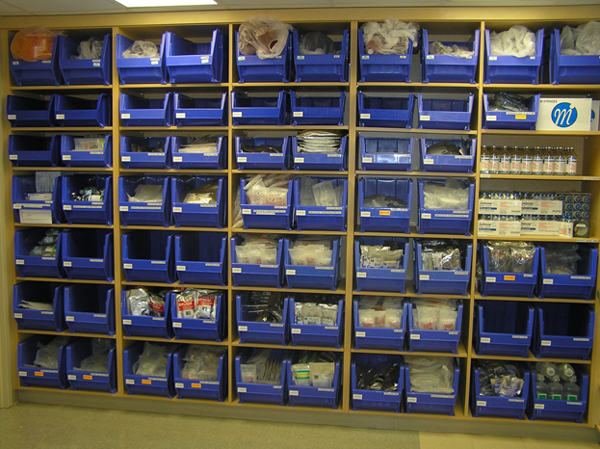
Idle Inventory
Any excess supply that is not frequently used

Slide 11



Time
Delays, unplanned downtime of machines or processes or people, setup time, searching
Notes:
Creates unevenness in workflow.

Slide 12
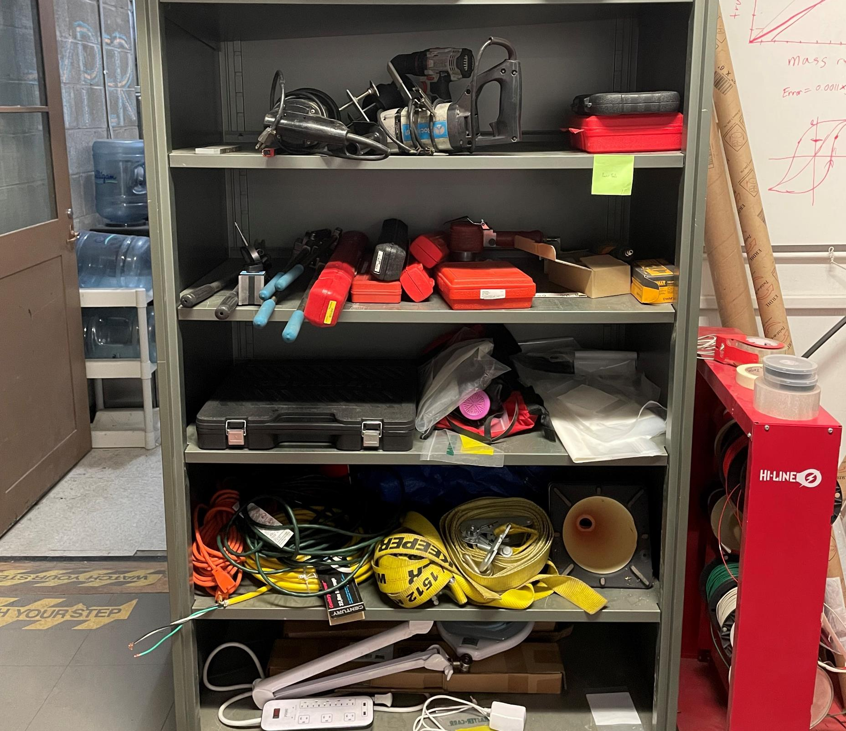
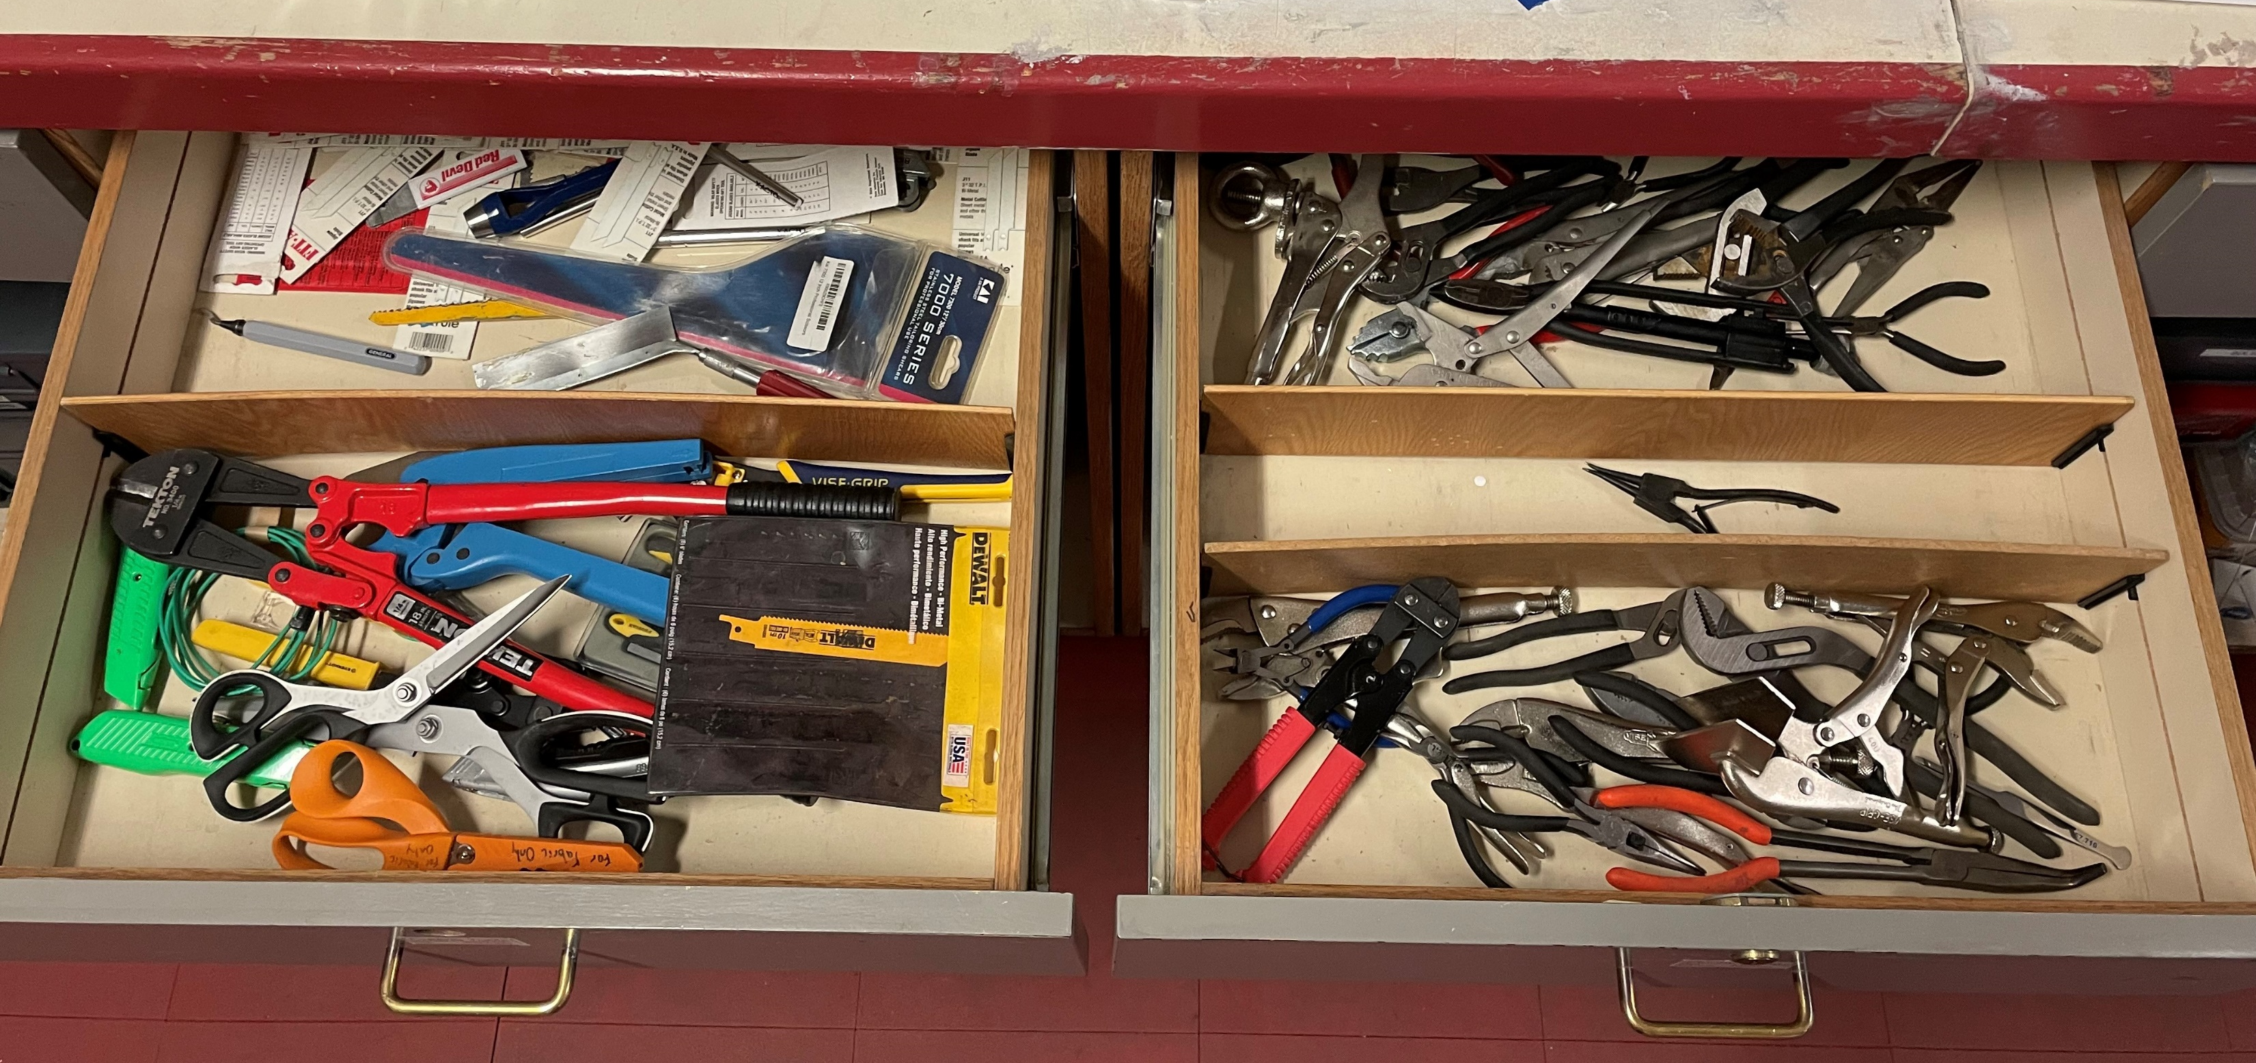
Disorganization
The poor arrangement of tools/inventory and machines create waste, as well as poor layouts of workspaces.

Slide 13


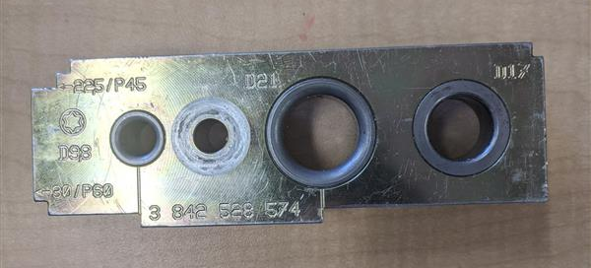
Defects
Inspection and repair of material in inventory
We should reduce the likelihood of defects so that you don’t need to inspect and repair it later.
Get it right the first time >> No need to go back and rework anything, just continue along your path
Notes:
Part of the process but should aim to reduce it by error proofing and jigs!

Slide 14
Discussion:
Complexity: Needlessly complex systems necessitate more energy to use, manage, and create
Scraps: The conversion of materials intro products that create scrap, trim, excess and bad raw materials
Motion: The use of time and energy in unnecessary motion of people and materials
Idle inventory: Any excess material/tools that is not frequently used
Time: Delays, unplanned downtime of machines or processes or people, setup time, searching
Disorganization: The poor arrangement of tools/inventory and machines create waste, as well as poor layouts of workspaces
Defects: Inspection and repair/reworking material in inventory (causes: weak process control, inadequate training/work instructions)

Slide 15
Activity
We know how to identify waste, but what about eliminating it?
Break back into your warmup teams
Go through the given waste elimination template to narrow down a problem and propose a solution for it
Implementation will be another day…

Slide 16
The Waste Elimination Template!
For routine practice
Haven’t figured out how to sustain the practice but we’re working on it!

Slide 17
Awards
Remember: Nominate someone who has done something above and beyond their actual job

