Slide 1
Problem Solving

Slide 2
Itinerary
Warm-up 5min
Updates and Awards 10min
Presentation 15-20min
Activity 20min
Reflection 10min
Problem Solving

Slide 3
Warm-up
Diagram/write out your current problem-solving method.
Example Problem: You’re only allowed to buy food one day every week and everything you buy expires in one week. How do you feed yourself for a week and minimize food waste?
Problem Solving

Slide 4
Updates and Awards
Voting: Close your eyes!
Problem Solving

Slide 5
Goals for Today
Reinforce the core principle of Lean as Kaizen thinking
Introduce Improvement Kata as an add-on to the Design, Build, and Test problem-solving technique
Implement the improvement kata as a daily warm-up and cooldown
Problem Solving

Slide 6
First, clarification
Lean: not about the steps, tools, or techniques alone—rather, it’s about the continuous improvement method that leads to those steps, tools, and techniques.
Lean Tools
Kaizen Mindset (Improvement Kata)
Problem Solving
Notes:
Use paint brush example

Slide 7
Now back to the fundamentals of lean: continuous improvement via Problem Solving.
Problem Solving
Notes:
So we are returning to the fundamentals of lean which is problem solving. It is the base off which all the lean tools were built.

Slide 8
What we already know:
Traditional Engineering Problem Solving
Ex) Solving a physics problem. The problem is given to you, and you solve it.
1. Write the problem
2. List all assumptions, unknowns, knowns
3. Apply theory
4. Results
Positives:
Helpful when you are given the problem and tools to solve the problem
Drawbacks:
Not helpful when you don’t know the problem or have the tools you need to solve said problem
Problem Solving

Slide 9
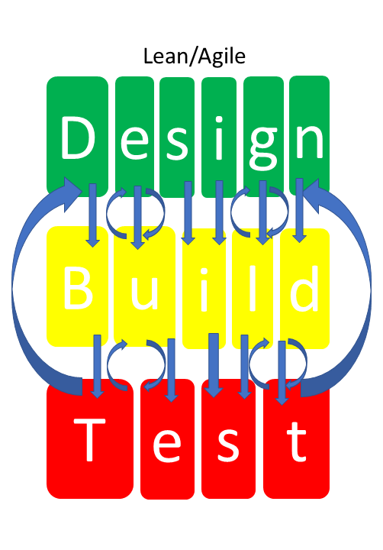
What we already know:
We are adding in improvement kata as a framework for Design, Build, Test.
Design Problem Solving
Ex) Project at a research lab, where the problem isn’t handed over to you.
1. Design
2. Build
3. Test
Improvement Kata
Positives:
Learning through doing
Focus on only the obstacles you need to deal with
Continuous compounded improvement
Problem Solving

Slide 10
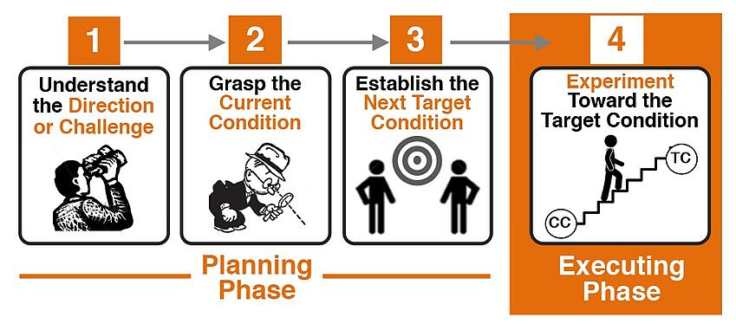
Improvement Kata
Kata = a practice routine
Improvement Kata = a practice routine that helps us do the “Design, Build, Test” problem-solving method better
Problem Solving
Notes:
Talk on dbt

Slide 11
Step 1: Establish Direction
Purpose: Set a long term goal to strive toward
What is the big goal?
Where you want to be long term?
What is the end vision?
Can be vague since there are many unknowns
Example: I want to get 8 hours of sleep every night
Problem Solving
Notes:
Make example vague

Slide 12
Step 2: Grasp the Current Condition
Purpose: Identify and understand the problem
What is your current condition?
What process has led to the current condition?
Current process
Current Condition
I get stuck on homework problems and proceed for hours without seeking help
I am working 17-hour school days
Problem Solving
Notes:
Add in purpose

Slide 13
Step 3: Establish Next Target Condition
Target Condition: an intermediate goal before your final vision
The How
Describe two things:
The specific desired outcome
Proposed steps to get there
Example:
I want to spend less time doing homework
I will go to professors’ office hours, meet with TAs, and go to tutoring when presented with hard homework problems
A target condition helps you beat entropy. Without something to strive for, any process will naturally tend to degrade. - Constantino
Problem Solving

Slide 14
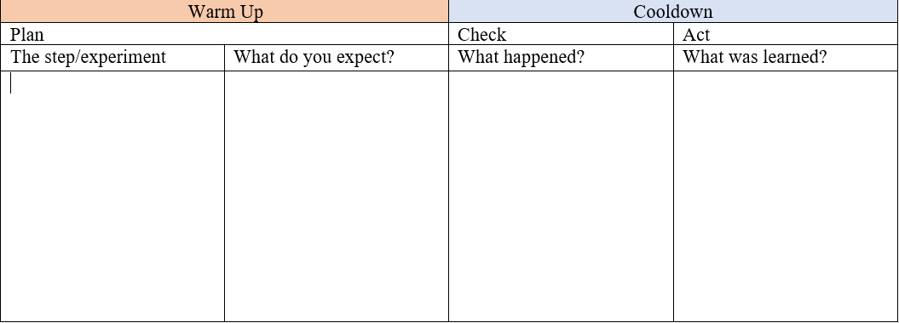
Step 4: Experiment Toward Target Condition
Trying out the proposed steps from Step 3 using PDCA format:
Going to office hours, meeting with TA, going to tutoring
Metric: hours spent on homework
I expect to do homework faster due to better learning
Office hours didn’t help, but meeting with my TA did which resulted in finishing the assignment in 2 hours
Not to waste time trying to figure it out without asking, and that one professor isn’t helpful during office hours.
Problem Solving
Notes:
Choose one

Slide 15
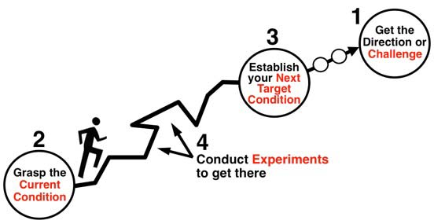
After Reaching Step 4,
Reevaluate where you’re at and determine a new target condition.
Example:
I am spending less time doing homework now… but I am still not getting 8 hours of sleep at night (my final vision).
So, go through the Improvement Kata again and again until I reach my final goal.
Establish another target condition: Less wasteful studying
Experiment toward your new target condition: Try flash cards, study with friends, study to music, etc.
Problem Solving

Slide 16
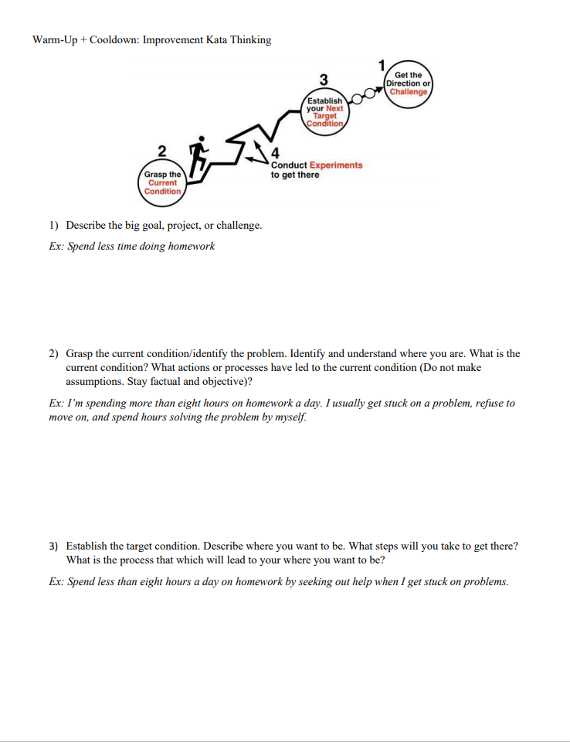
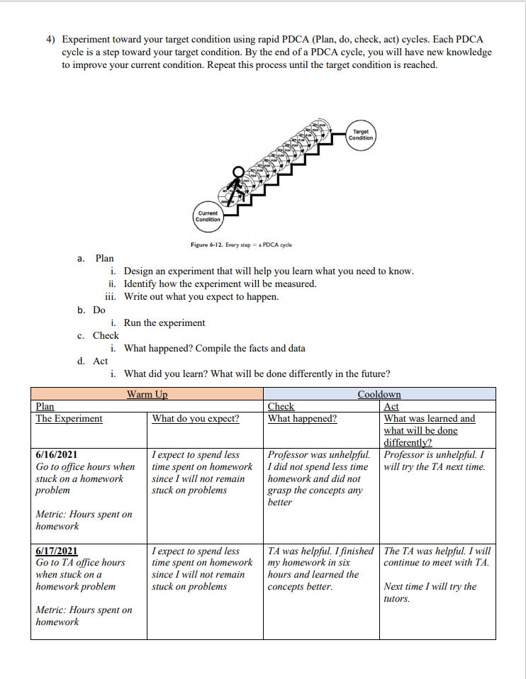
The Template for Daily Practice
Why use the template?
Importance of warm-ups and cooldowns
Setting an intention for the day to stay focused
'What can we do' vs 'what do we need to do'
Daily practice of the fundamental lean method: continuous improvement thinking
The worksheet is our current experiment
Try it out and give us feedback so we can continuously improve!

Slide 17
In the end…
Some key points to remember:
Start every workday with a target condition in mind so that your tasks are always value-adding
This approach to problem solving helps us understand the underlying philosophy of lean—continuous improvement
Target Conditions
PDCA cycles
Problem Solving

Slide 18
Activity
Back to paper airplanes…
Plan:
Break up into teams of 2
Each team gets paper and can use any other materials they find in TFRB
Vision is to hit the target from behind the line
Purpose:
To go through kata cycles to reach your target conditions—this isn’t a throwing contest
Rules:
No baseball pitching
Can’t cross the line even after releasing plane
Use any materials in the lab and the given paper
Points:
Heaviest cargo: +10 points
Highest success rate: +10 points
Hitting the white board: +5 points
Problem Solving

Slide 19
Reflection/Discussion
What is your current condition and what will be your next target condition?
(Where you are, where you're going)
How can the improvement kata help us at lab or help us as individuals?
Problem Solving

