Slide 1


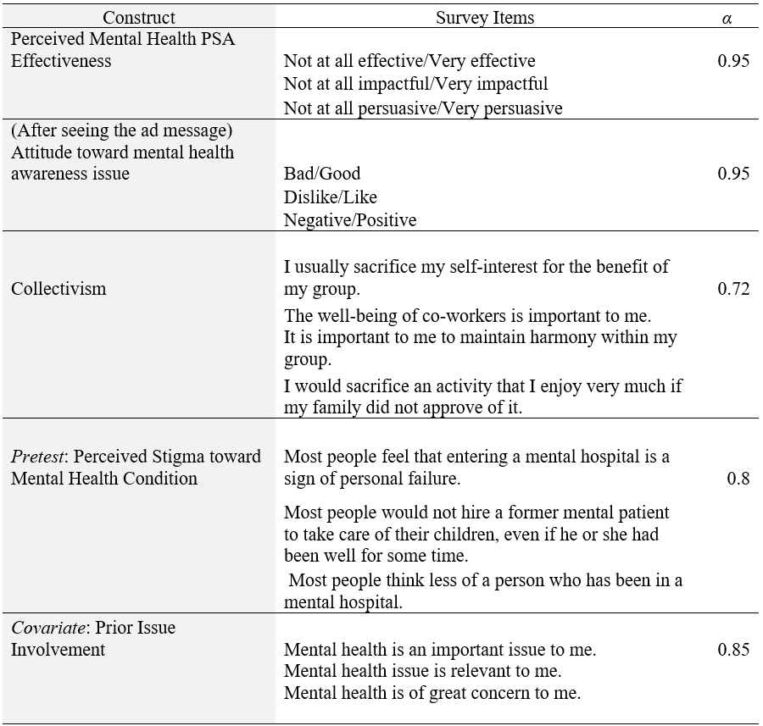
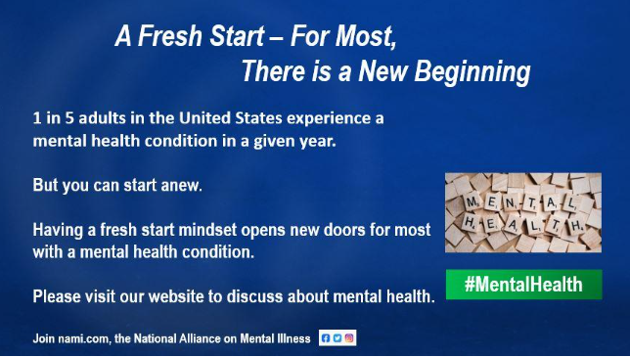
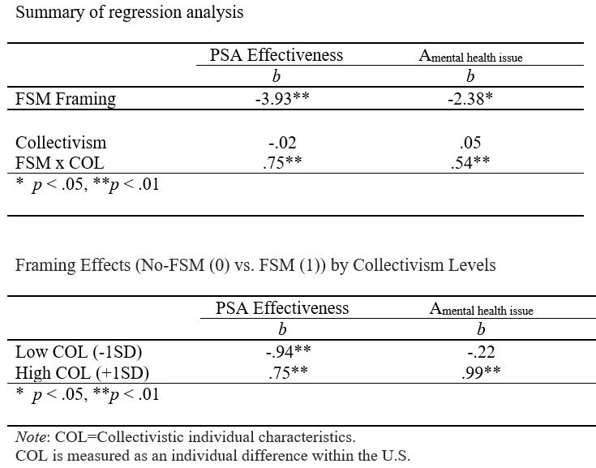
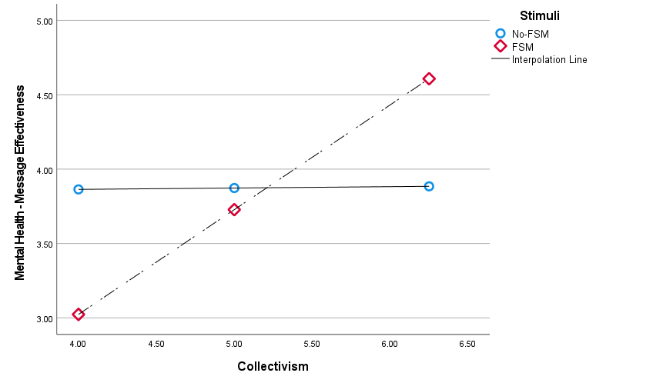
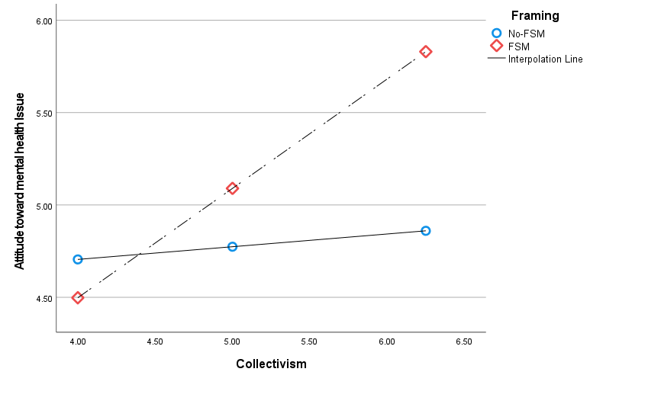
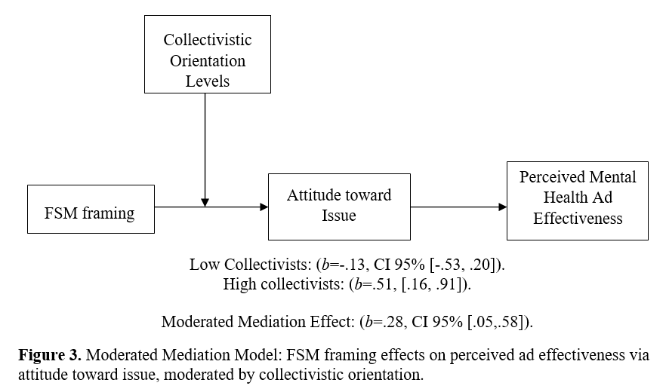

The Role of Fresh Start Mindset (FSM) and Collectivistic Orientation
in Mental Health PSAs
Yoon-Joo Lee¹, Hyejin Yoon², and Hae Yeon Seo¹
^{1.}Washington State University, Edward R. Murrow College of Communication
^{2.}University of Georgia, Grady College of Journalism and Mass Communication
OVERVIEW
METHOD
The high incidence of the mental health conditions underscores the paramount importance of formulating and implementing mental health awareness campaigns. Despite the urgency of this endeavor, public health campaigns striving to raise mental health awareness are frequently stymied by formidable challenges.
Collectivism cultures, interdependent relationships with others, have been documented to be associated with a higher stigma toward mental illness. A fresh start mindset (FSM) can be used as a message framing to activate a positive mindset toward stigmatized issues. This framing can act as a nudge and a reminder to “refresh” and “reinvent,” especially when one feels trapped in a self-identity and fear to be deviant from social approvals that does not allow them to move forward.
FSM framing could mitigate negative thoughts toward mental health PSAs among collectivistic individuals. This study suggests that those with higher collectivism have more positive responses (attitude toward the issue and ad effectiveness) than those with lower collectivism when exposed to FSM framing cues.
Among the high collectivists, when they viewed the FSM framing (vs. non-FSM framing), they will have a more positive attitude toward the mental health issue (H1a) and perceive the ad message more effective (H1b) than the low collectivists.
The types of FSM framing will influence the ad effectiveness mediated via the attitude toward the mental health issue advocated in the ad (H2).
Study Design and Procedure
Variables and Measures
Participants in the U.S. (N=165) were recruited via Sona A 2 (Message Strategy: Fresh New Start (FSM) vs. No-FSM) x Collectivism (continuous variable) between-subjects factorial design. When participants agreed to participate in the study, they were randomly assigned to one of the two conditions.
Stimuli
FSM Stimuli Example:
RESULTS
FINDINGS & DISCUSSION
Pretest: higher collectivistic characteristics led to a higher level of stigma perception toward mental illness (e.g., “Most people think less of a person who has been in a mental hospital,” “Once they know a person was in a mental hospital, most people will take his or her opinions less seriously”) (b=.27, t=2.77, p <.01).
Findings
H1: Among the high collectivists, when they viewed the FSM framing (vs. non-FSM framing), they had a more positive attitude toward the mental health issue (H1a) and perceive the ad message more effective (H1b) than the low collectivists.
H2: The types of FSM framing influenced the ad effectiveness mediated via the attitude toward the mental health issue advocated in the ad.
Discussion
Highly collectivistic individuals often experience dissonance between socially imposed stigmatizing norms and mental health issues.
A fresh start mindset framing (FSM) can help high collectivists process mental health issues and advertisement messages more positively and effectively.
The FSM may differ from traditional positive or gain frames as it emphasizes the shift from entrenched societal beliefs, especially within the American context. and may serve as an effective tool to assist high collectivists transition from viewing mental health issues as stigmatizing defects to opportunities for new beginnings, reframing mental health issues not as deviance from social norms, but as a platform for a fresh start.
The FSM method aligns with the concept of "identity-safe" cues, which can lessen perceived threats to social identity (e.g., being deviant from social norms) and foster a more inclusive environment for stigmatized groups.

