Slide 1


Hospital Expansion Capital Campaign
Goal: Create an integrated communications strategy and materials for PRH capital campaign
Partner: Pullman Regional Hospital Foundation
Client: Stephanie Pierce, Director of Development, Annual Giving

Slide 2
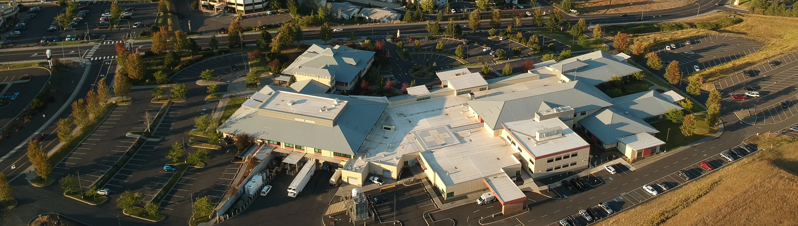

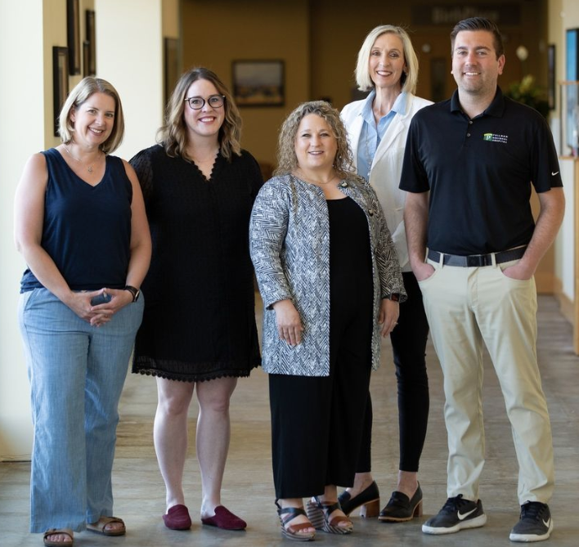
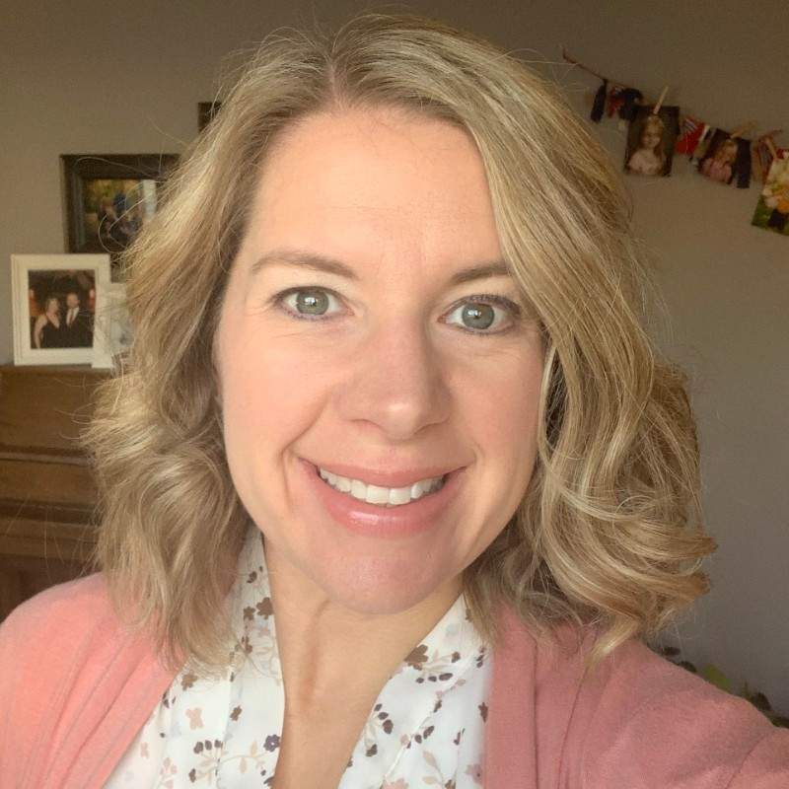
Organization: Pullman Regional Hospital Foundation Expansion Project (as part of capital campaign)
Our Lead: Stephanie Pierce, Director of Development, Annual Giving [email]
What they do: To meet increasing community demand, Pullman Regional Hospital is launching a multi-year, $45–50 million phased expansion and renovation project funded by a voter-approved bond, with groundbreaking in November 2025
What they need from you: Broadly speaking, they need help with all facets of outreach, building awareness, and promotion. They are working from a VERY limited budget so your work will be instrumental in meeting their marcomm objectives

Slide 3

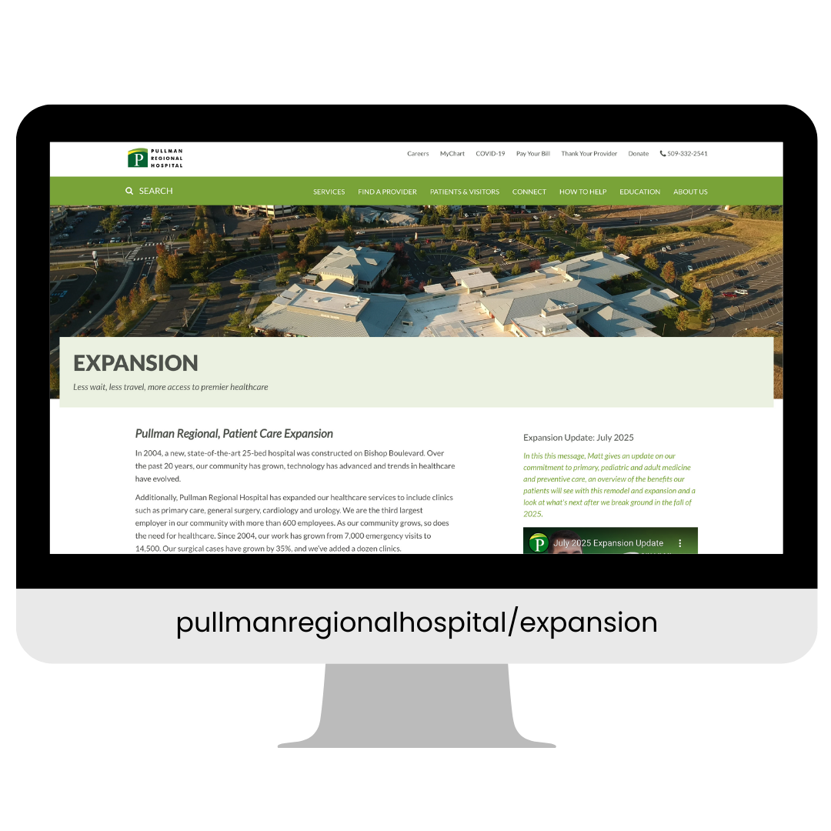
About the Expansion
Meeting Increased Demand: Driven by a 100% increase in emergency visits and 35% growth in surgical cases since 2004, the hospital is expanding to improve patient access and experience.
Project Scope & Cost: A $45-50 million, multi-year phased project including a comprehensive hospital remodel, facility expansion, and the construction of a new medical office building.
Strategic Funding: Investment is supported by a $27.5 million voter-approved bond (passed in 2022), hospital operations, and community philanthropy.
Collaborative Design: Planning involves over 100 stakeholders including physicians, staff, and community members - to optimize workflows and flexible care spaces.
Key Timeline: Following several years of design and permitting, the project had its groundbreaking on November 3, 2025.
> Visit site

Slide 4
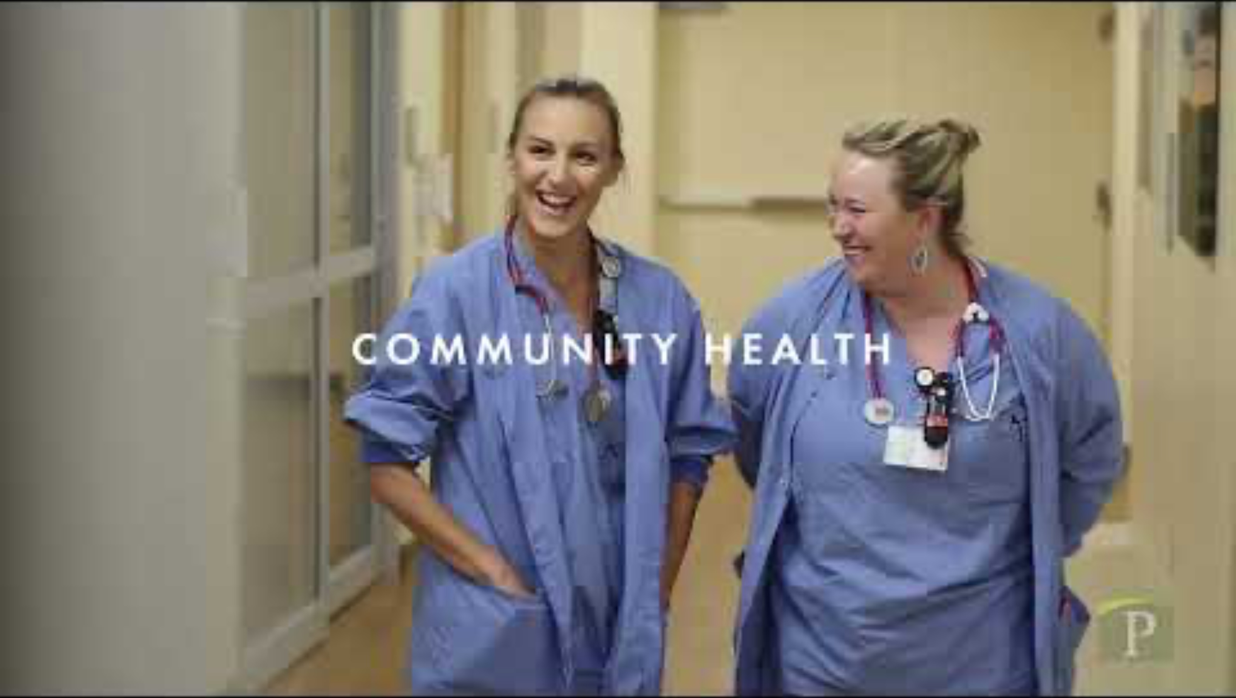

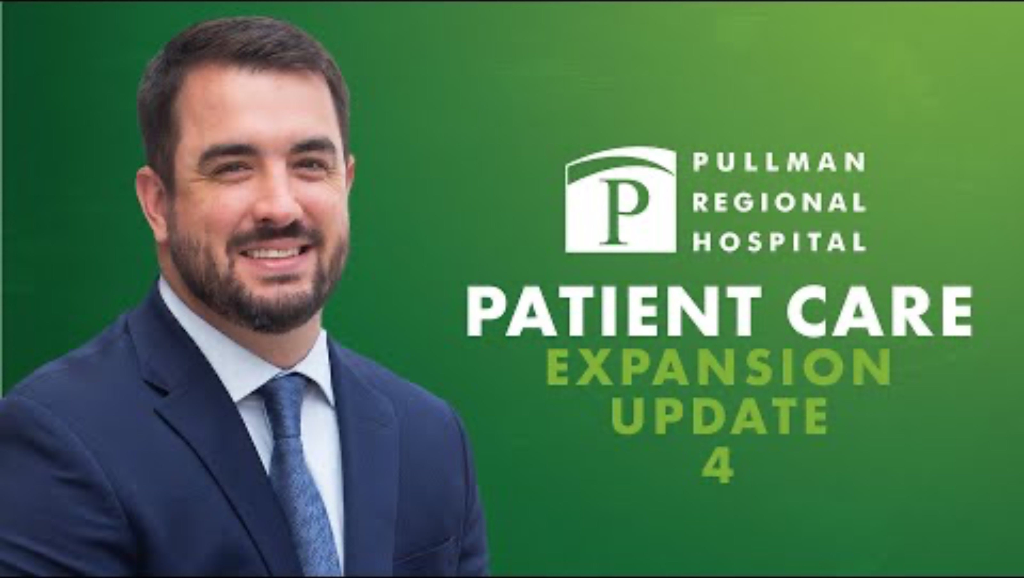
Videos
> Video link [01:25]
> Video link [00:45]
> Video link [03:22]

Slide 5




CCE Task Overview
Preliminary research: Outlining PRH Foundation 5Ws, the Expansion project, needs assessment, audience personas, SWOT analysis, creation of regional media list, etc.
Build an integrated communications strategy that focuses primarily on earned, owned, and shared outreach (note that their budget is $5k)
After meeting with Stephanie, we will brainstorm and identify the various tactical tasks you will complete throughout the rest of the semester. Some ideas:
Public relations materials (e.g., press release, fact sheet (one pager), feature story, op-ed from PRH executive director, PSA (audio or video), email marketing
Social media posts including reels, static posts, carousels, polls, etc. (IG, FB, LinkedIn, X)
Print publications (e.g., flyers, postcards, posters, banners, signage around hospital)
Experiential outreach and initiatives (e.g., photo opps, contests, artistic displays, time capsule, wayfinding art, behind-the-scenes tours)
Digital assets (e.g., infographics, graphs, before-and-after images, micro-videos, QR code where people can get updates, digital dashboard for the website that tracks construction milestones, podcast ideas, web content)
Progress reports and presentations with Stephanie
1
2
3
4

Slide 6
PUBLICITY
PESO Model
EARNED MEDIA
Media relations
Community relations/Events
Influencer relations
Crisis communications
BRAND
MEDIA INTEGRATION
Advertorials
Contests
Lead generation
Influencer campaigns
SHARED MEDIA
INFLUENCER ENGAGEMENT
PAID MEDIA
PAID MEDIA
PARTNERSHIPS
Social media advertising
Digital advertising
Traditional advertising
Paid partnerships
Charity tie-ins
Community service
Co-branding
OWNED MEDIA
SOCIAL MEDIA
INCENTIVE
Facebook
Twitter
LinkedIn
TikTok
YouTube
Pinterest
Instagram
Snapchat
Yelp
Sponsored content
Sponsored events
Native advertising
Contests
CONTENT
Internal communications
Website
Collateral
Events and seminars
Photo and video
Thought leadership
Branded graphics
Adapted graphic from Wright on Comm
PAID:
Online advertising, search engine marketing
Underwriting and sponsorship
Radio PSAs
Professional videos or video ads
Social media advertising
Swag, merchandise
Sponsored content
EARNED:
Event listings
Influencers – blog coverage
Articles and stories shared on web, print, radio and TV
Interviews with stakeholders
Event coverage
Social media engagement (likes, shares, comments)
Reviews by stakeholders, donors, supporters
Testimonials
SHARED:
Social media channels
Newsletter
Curated content - blogs, social, article contribution
Op-Eds
Letters to the editor
Community engagement
OWNED:
Websites, campaign landing pages
Social media engagement strategy
Articles
Letters from the editor
Printed materials
Direct marketing (postcards, e-newsletter)
Public speaking
Online newsroom, press

Slide 7
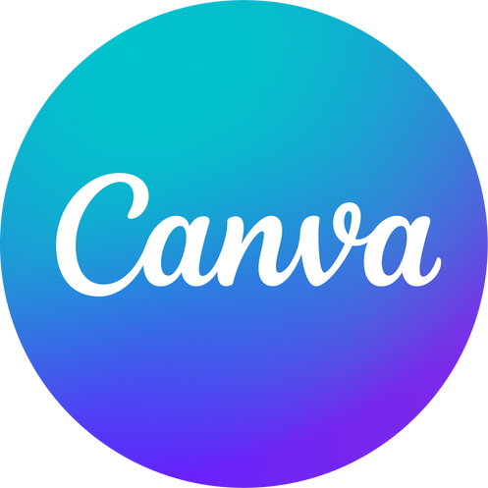


Digital Content Creation Tools
 | Canva Free account available. Check out ”Canva for Students” for details | Templates for social media, print pubs, landing pages, swag, signage, etc. Access to stock photos, video, audio, graphics. Web-based; app available
 | Adobe Creative Cloud Express Students have free access using their wsu.edu login credentials. | Templates for social media, print pubs, landing pages, swag, signage, etc. Access to stock photos, video, audio, graphics. Web-based; app available
 | Adobe Creative Cloud Including Photoshop, Illustrator, InDesign, Rush, Premiere, After Effects. Students have free access using their wsu.edu login credentials. | Adobe Creative Cloud software is considered the premier for graphic design, video editing, web development, photography, and interactive media
7

