Slide 1


The Legalization of Marijuana and Resultant Marijuana-Related Arrest Rates Disaggregated by Race, Gender, and Age
Mikala Meize, MA
Department of Criminal Justice and Criminology
Research Team
Dale Willits, David Makin, Duane Stanton, Nicholas P. Lovrich, Craig Hemmens, Mary K. Stohr, John Snyder, Rachael Brooks, and multiple undergraduate students

Slide 2
What are I-502 and A-64?
Initiative 502 (Washington) & Amendment 64 (Colorado)
Ballot measures that legalized the use and sale of recreational marijuana
Passed in November 2012, implementation began in December 2012
Still illegal to:
Sell marijuana without retail license, possess marijuana under the age of 21, use marijuana in a public space, drive under the influence of marijuana, and possess marijuana over legal limits

Slide 3
Literature Review
System-wide racial disparities (Beckett et al., 2005; Firth, 2018)
Reallocation of police resources (Trilling, 2016)
Low priority offenses already (Ross &Walker, 2016)
Clearance rates for more serious offenses (Makin et al., 2018)
Black market changes (Richter & Levy, 2014)

Slide 4
Aim
To determine the effects of the legalization of recreational marijuana on marijuana-related arrests across different demographic groups using an interrupted time-series analysis
Hypotheses
Overall arrest rates for possession should decrease in 2012, and arrest rates for sales should decrease over time
Arrest rates in general should decline post-legalization for all individuals except juveniles
Arrest rates across races should decrease similarly in 2012 and remain stable over time

Slide 5
Data
Uniform Crime Reporting (UCR) Program Data: 2009-2016
Only agencies that reported for all 12 months of each of the 8 years
124 agencies from Washington
60 agencies from Colorado
Census data for demographic information
Aggregated to state level

Slide 6
Methods
Interrupted time-series analysis
Population level changes with clear introduction of intervention
Routine measurements
Pre-intervention, immediately post-intervention, over time post-intervention compared to pre-intervention trends
Controlled for monthly autocorrelations
Monthly rates per 100,000 people

Slide 7
Arrest Totals
 | Washington |  | Colorado
Year | Sales | Possession | Sales | Possession
2009 | 931 | 5388 | 440 | 6453
2010 | 1043 | 5065 | 435 | 6139
2011 | 771 | 5088 | 415 | 5800
2012 | 474 | 4292 | 379 | 5356
2013 | 242 | 1546 | 254 | 3187
2014 | 162 | 1347 | 323 | 3780
2015 | 160 | 1085 | 271 | 3781
2016 | 141 | 1168 | 364 | 3141

Slide 8
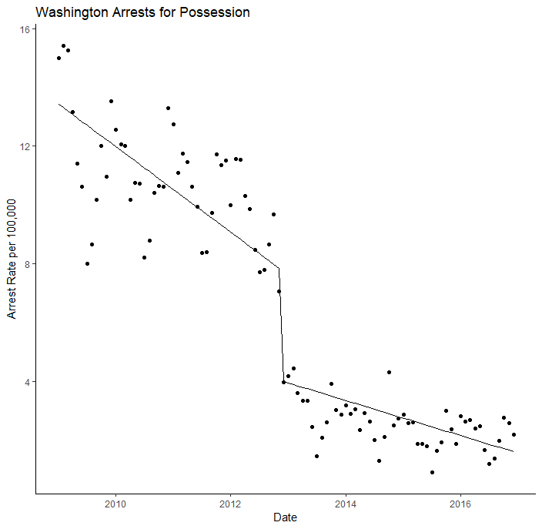
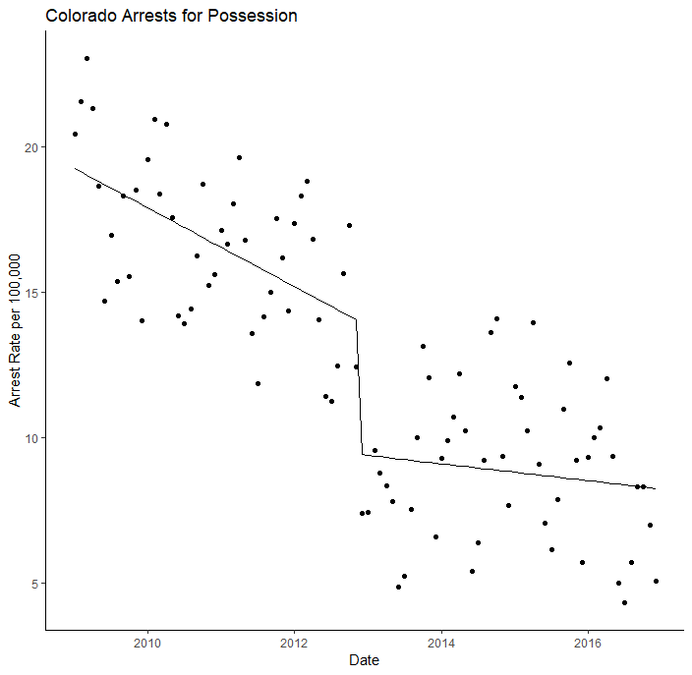
Overall Possession Arrest Rate
Pre-legalization: Significant decrease
Post-legalization : Significantly negative
Over time: Significantly positive
Pre-legalization: Significant decrease
Post-legalization : Significantly negative
Over time: Significantly positive

Slide 9
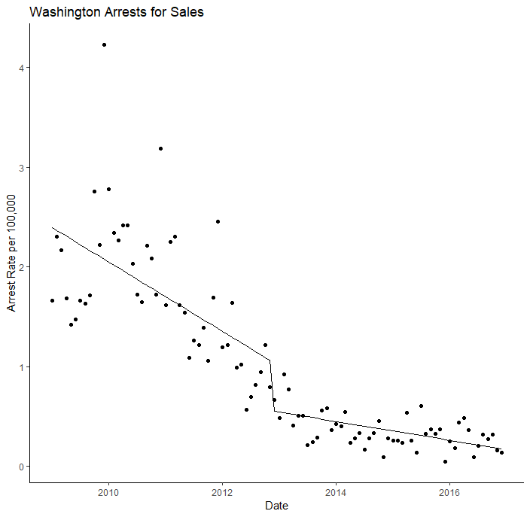
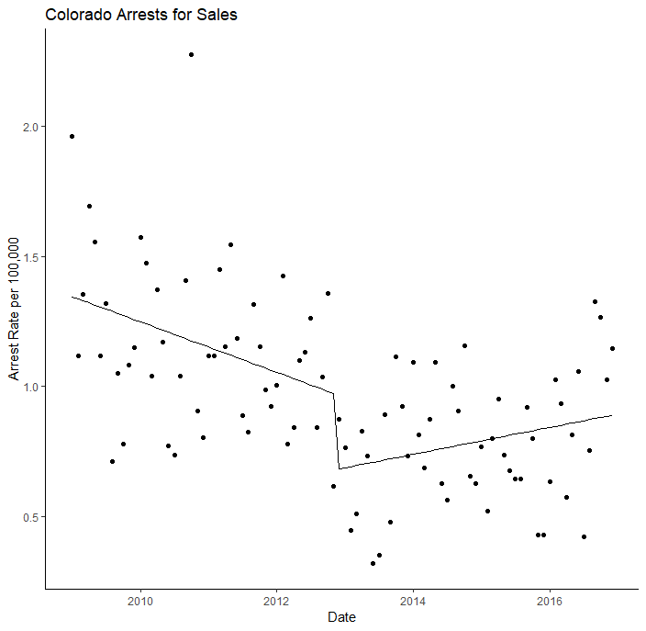
Overall Sales Arrest Rate
Pre-legalization: Significant decrease
Post-legalization : Significantly negative
Over time: Significantly positive
Pre-legalization: Significant decrease
Post-legalization : Significantly negative
Over time: Significantly positive

Slide 10
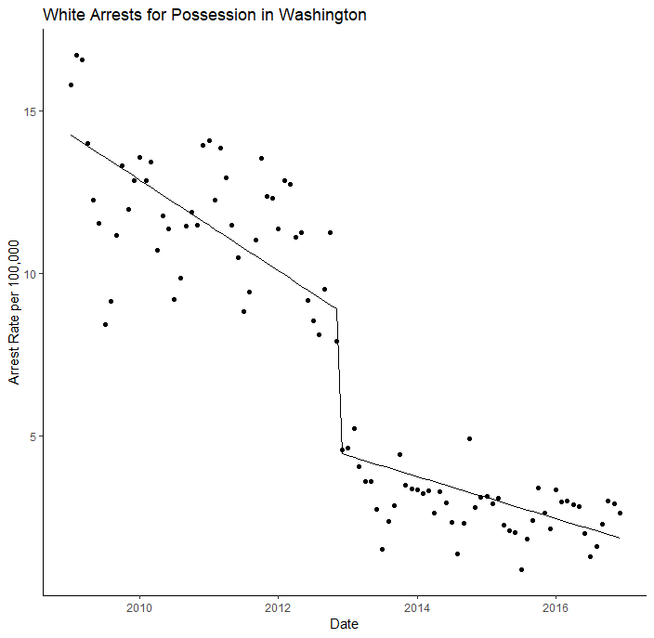
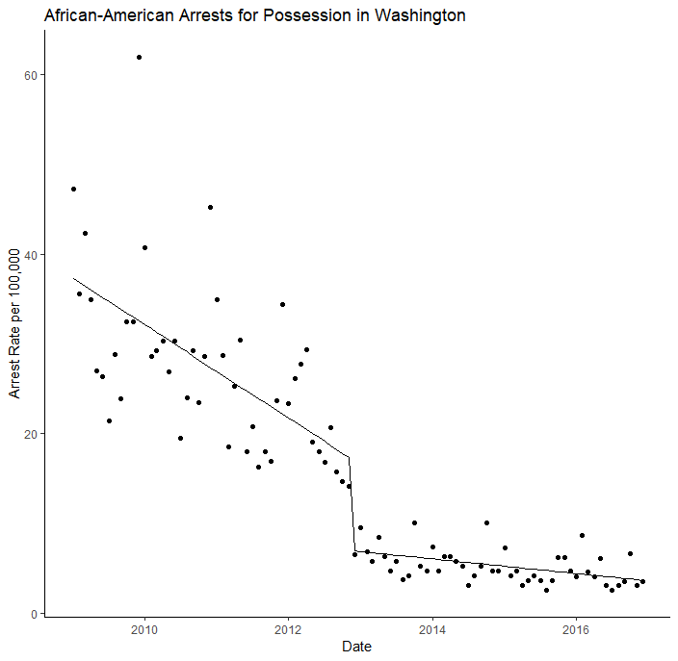
WA Possession Arrests by Race
Pre-legalization: Significant decrease
Post-legalization : Significantly negative
Over time: No significance
Pre-legalization: Significant decrease
Post-legalization : Significantly negative
Over time: Significantly positive

Slide 11
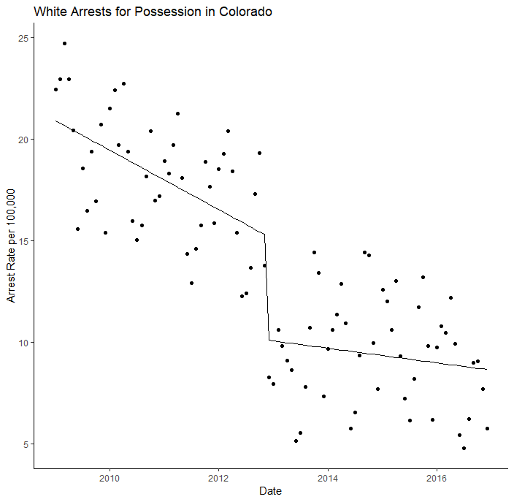
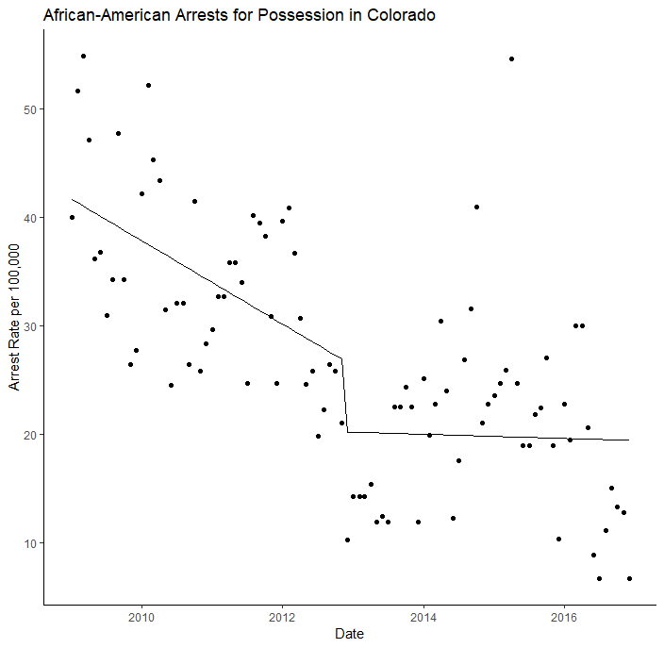
CO Possession Arrests by Race
Pre-legalization: Significant decrease
Post-legalization : Significantly negative
Over time: Significantly positive
Pre-legalization decrease, no statistically significant changes post-legalization or over time

Slide 12
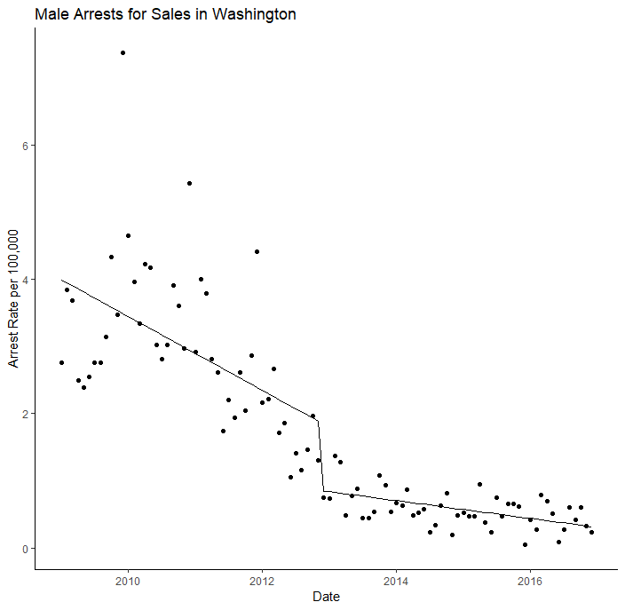
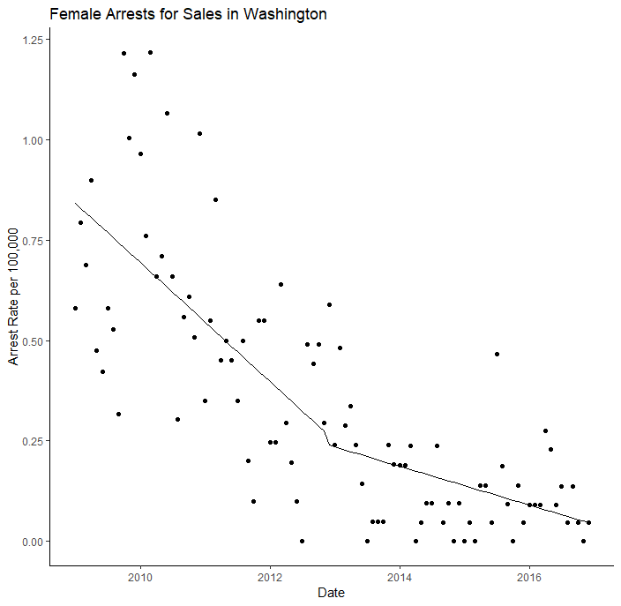
WA Sales Arrests by Gender
Pre-legalization: Significant decrease
Post-legalization : Significantly negative
Over time: Significantly positive
Pre-legalization: Significant decrease
Post-legalization : No significance
Over time: Significantly positive

Slide 13
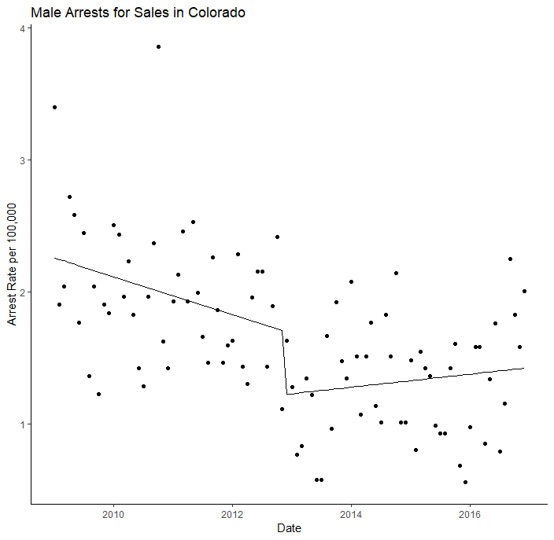
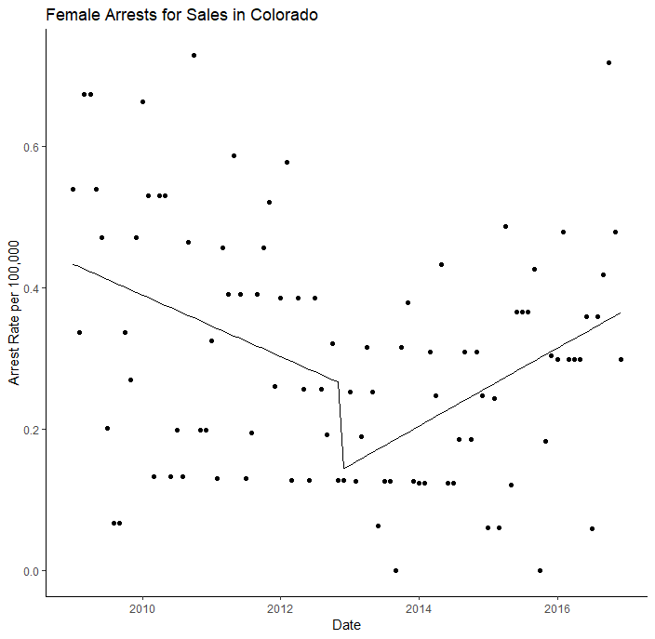
CO Sales Arrests by Gender
Pre-legalization: Significant decrease
Post-legalization : Significantly negative
Over time: Significantly positive
Pre-legalization: No significance
Post-legalization : No significance
Over time: Significantly positive

Slide 14
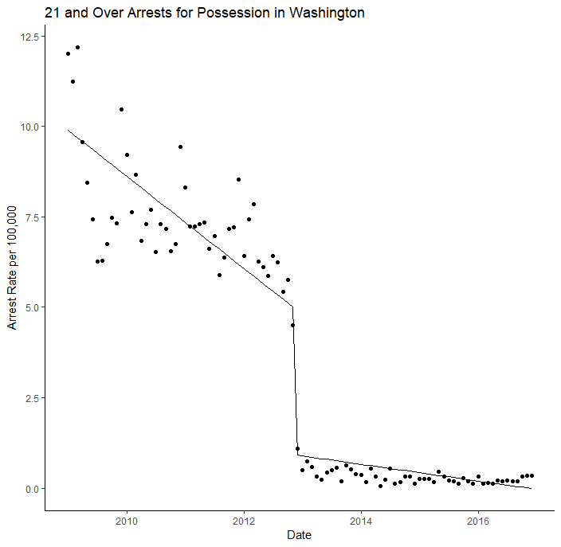
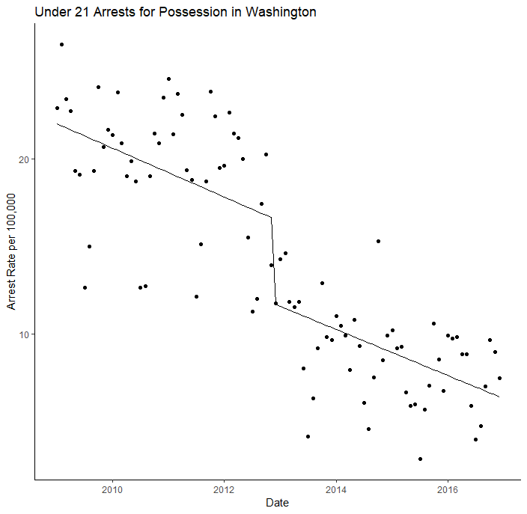
WA Possession Arrests by Age
Pre-legalization: Significant decrease
Post-legalization : Significantly negative
Over time: Significantly positive
Pre-legalization: Significant decrease
Post-legalization : Significantly negative
Over time: No significance

Slide 15
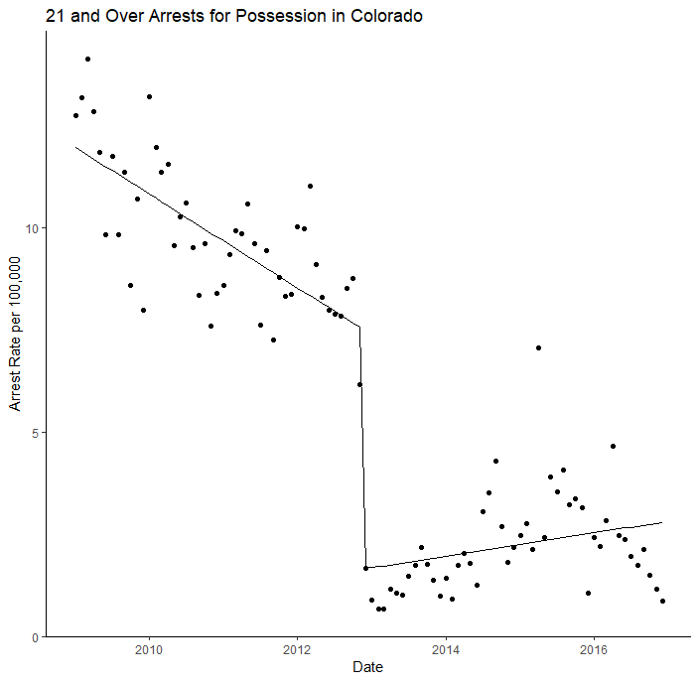
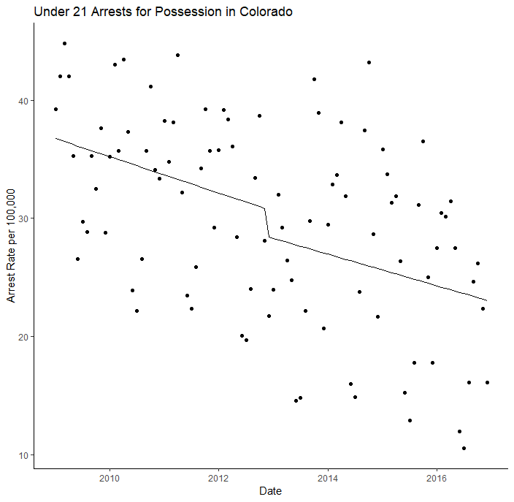
CO Possession Arrests by Age
Pre-legalization: Significant decrease
Post-legalization : Significantly negative
Over time: Significantly positive
Pre-legalization decrease, no statistically significant changes post-legalization or over time

Slide 16
Discussion
Changes in arrest rates are not uniform across states, nor demographic groups
Prior to legalization decreases in arrest rates
Arrest rates for sales inconsistent with hypothesis
Arrest rates for juveniles inconsistent with hypothesis
Further evidence of shift in police priority/resources

Slide 17
Limitations and Further Research
State level versus agency level
Limited number of agencies
Time-series imputation
Time of first retail locations not included
Short-term trends

Slide 18
Contact Information
Mikala Meize, M.A.
mikala.ewert@wsu.edu
Dale Willits, Ph.D.
dale.willits@wsu.edu

