Slide 1
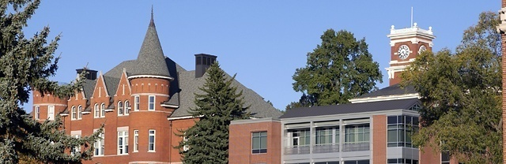

Marijuana Legalization and Police Resource Deployments
Rural and Urban Case Studies
David A. Makin, PhD
Department of Criminal Justice and Criminology
Research Team
Mary K. Stohr, Dale Willits, Duane Stanton, Nicholas P. Lovrich, Craig Hemmens, John Snyder, Mikala Meize, Rachael Brooks, and multiple undergraduate students

Slide 2
Purpose
Perceptions of Officers in Washington State Suggests Legalization of Marijuana Has Been Associated with Increases in Workload and Not Decreases as Indicated by Proponents.
Workload is a dominant theme in preliminary analysis of focus groups (N = 11) and interviews (N >100)

Slide 3
Marijuana Legalization
Legalization of Marijuana was Associated with a Significant Decrease in Arrests for Marijuana Possession.

Slide 4
Statement of the Problem
Traditional Research on Resource Distribution Focuses on Crime as the Primary Unit of Measure.
Crime as a Unit Of Measure Remains Contentious.
As Warner and Price (1993), among many others offer, are we measuring crime or crime control?

Slide 5
Modern Policing
Law Enforcement
Service
Order Maintenance

Slide 6
The Third “Crime” Measure
Calls-for-Service
Represent requests for police services, which include criminal code violations, non-code violations (welfare checks), and agency assists.
Captures two important elements: criminal behavior and willingness to report.
*May allow for further disaggregation for Dispatch-Initiated to Officer-Initiated calls for service.
Patrol Initiated is considered a potential indicator of pro-active policing.

Slide 7
The Present Study
Research Questions
To what extent did legalization of marijuana influence calls for service in Washington State?
Are there different impacts on calls for service for legalization, occurring in December of 2012, and retail distribution, occurring in July of 2014?

Slide 8
Methods
Case Study #1
Analysis of Calls for Service in Pullman, WA (Treatment) and Moscow, ID (Control)
Monthly Calls for Service from 2005-2016
Case Study #2
Analysis of Calls for Service in Seattle, WA
Disaggregated to Dispatch-Initiated and Patrol-Initiated
Monthly Calls for Service from 2010-2018

Slide 9
Design
Unit of Analysis
Total Calls for Service
Rate per 10,000
Disaggregated Calls for Service
Interrupted Time-Series Modeling
Legalization = December of 2012
Retail Distribution = July of 2014
Initial Analysis using ITSA (Linden, 2015)
Monthly autocorrelation addressed using alternative modeling.

Slide 10
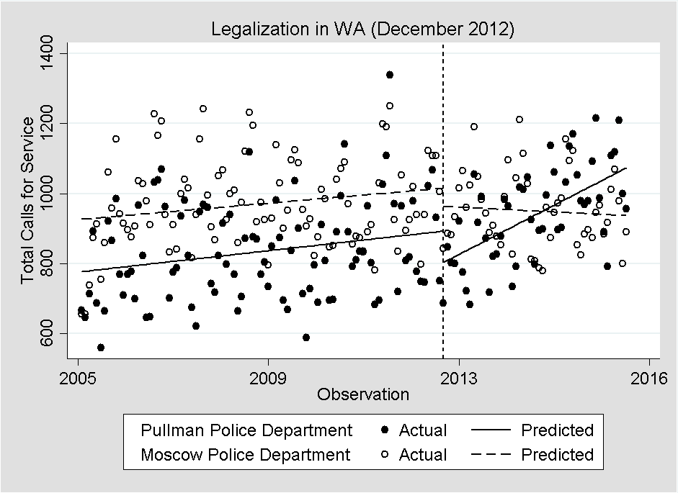
Case Study #1 Results
Increase of ~6 Calls Per Month

Slide 11
Disaggregated Calls for Service
Negligible Increase
Alcohol Offenses – Increase
Domestic Disputes – Increase
Drugs - Increase
False Identification - Increase
Intoxication - Increase
Welfare Checks - Increase
Not Significant
Accidents
Assault
Burglary
Disorderly Conduct
DUI
Malicious Mischief
Noise Complaints
Suicide Attempts
Theft

Slide 12
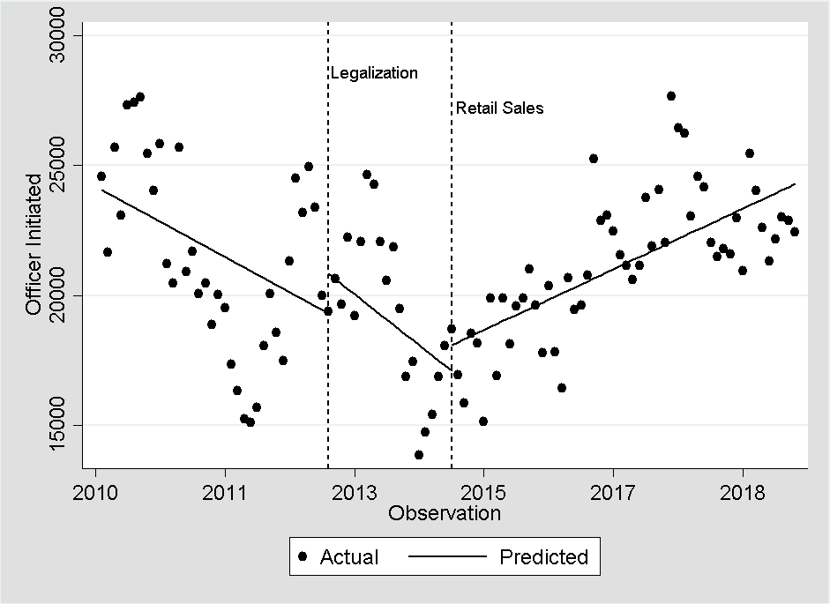
Case Study #2 Results
~357 Additional Interactions Recorded per Month

Slide 13
Summary of Results
Case Study #1
Legalization of marijuana increased calls for service in Pullman.
Negligible, though significant results for several lower level calls.
Case Study #2
Recreational sales, not legalization, increased Officer-Initiated Contacts.
Dispatch-Initiated calls were increasing on average by 87 calls pre-legalization, increased significantly after legalization on average by 271 calls, and following recreational sales have decreased by 214 calls per month.

Slide 14
Future Research
Case Study #3
Spatial Analysis of police beats and presence of dispensaries.
Disaggregated calls for service to understand what is influencing shifts in calls dispatched, post retail sales.

Slide 15
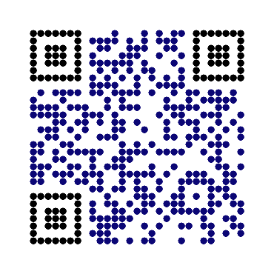
Contact Information
David A. Makin, PhD (dmakin@wsu.edu)
Lab Director, Complex Social Interactions Lab
Assistant Professor, Department of Criminal Justice and Criminology
Research Faculty, Washington State Institute for Criminal Justice
Washington State University
crmj.wsu.edu | wsicj.wsu.edu | Linkedin |Research Gate | Twitter (@DavidMakinPhD)

Slide 16
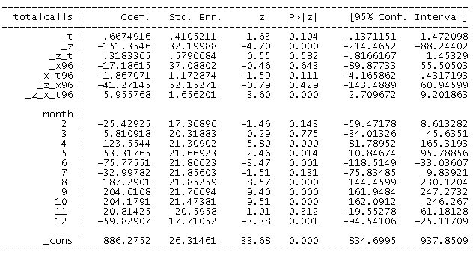
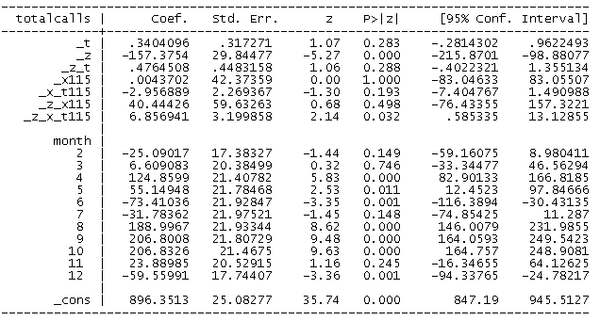
Results
Legalization
Recreational Sales

Slide 17
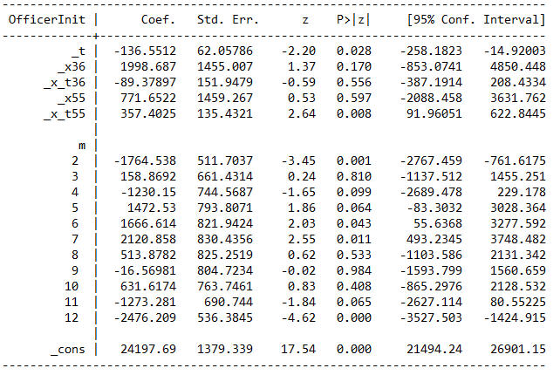
Results
Legalization & Recreational Sales

