Slide 1
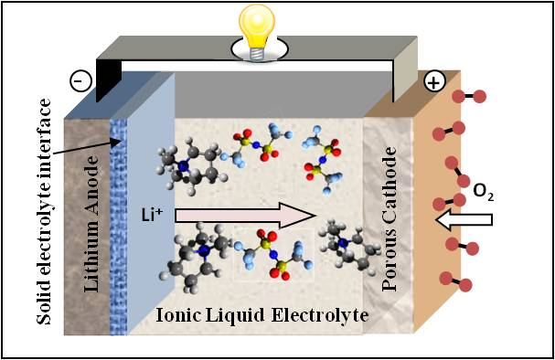
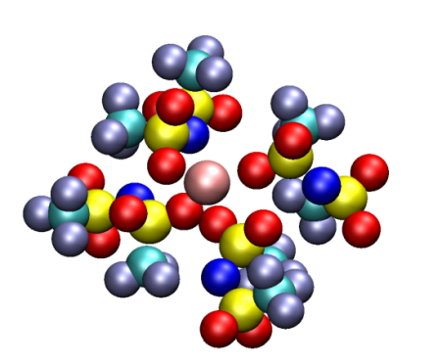

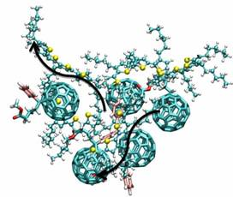
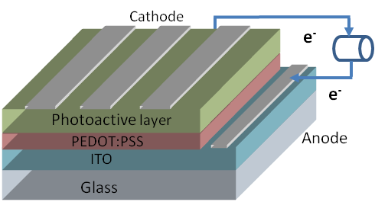
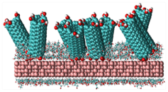
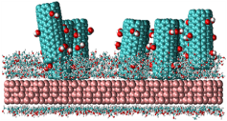
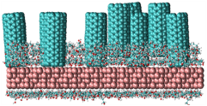
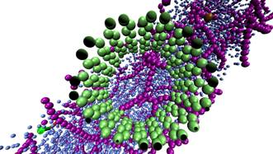
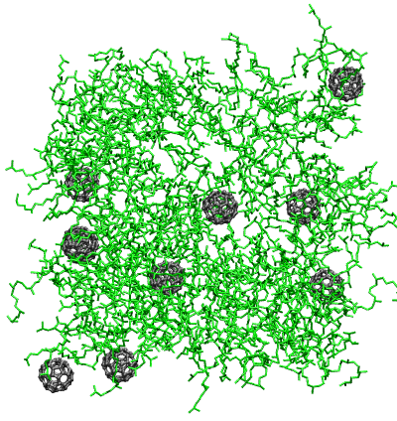
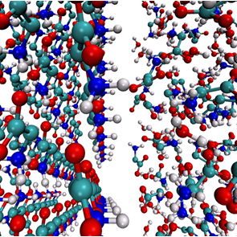
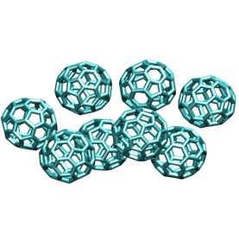
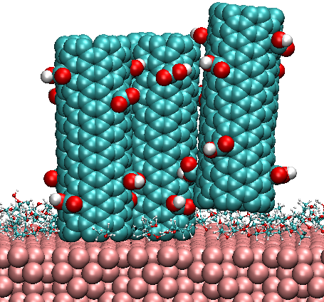
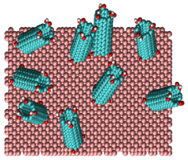
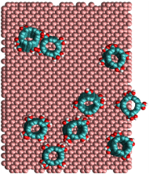
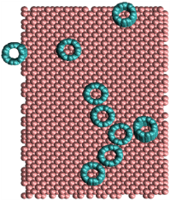

Computational Nanoscience Laboratory (PI: Soumik Banerjee)
Modeling materials relevant to energy conversion and storage devices
Identifying Novel Electrolytes for Lithium Batteries
Energy Challenge
Energy Conversion and Storage Devices
Nanomaterials
Modeling the Photoactive Layer of Organic Photovoltaic Solar Cells
Controlled Deposition of Aligned Carbon Nanotubes on Substrates for Super-capacitors
(a)
E
(c)
E
(e)
E
For more information, please write to me or visit:
http://www.mme.wsu.edu/~sbanerjee/
Contact information:
soumik.banerjee@wsu.edu
Office: 215 Sloan Hall
(b)
(d)
(f)

