Slide 1


Nonpermanent Employment

Slide 2
Training Agenda
WSU
Nonpermanent Overview
Appointments
Job Profiles
Compensation
Time
Leave

Slide 3
Nonpermanent Positions
WSU
Can be nonpermanent for the following reasons:
WAC 357-19-360
(1) A permanent employee is absent from the position;
(2) The employer is recruiting to fill a vacant position with a permanent appointment;
(3) The employer needs to address a short-term immediate workload peak or other short-term needs;
If need becomes ongoing in nature, must take action to fill on permanent basis
(4) The employer is not filling a position with a permanent appointment due to the impending or actual layoff of a permanent employee(s);
(5) The nature of the work is sporadic and does not fit a particular pattern.

Slide 4
Nonpermanent Appointments
WSU
Appointments can be maximum of 12 months and renewed for another 12 months
  Can be lesser increments
Maximum of 24 consecutive months for any Nonpermanent appointment
Employees can hold multiple Nonpermanent positions
Prior Nonpermanent employees can be rehired into new Nonpermanent appointments
  No rehire or lifetime maximum hours limitation
If a department has an ongoing need past 24 months, employees approaching this limit in a Nonpermanent position will need to be reviewed for available options.
NP employees under 50% FTE
Cannot be renewed
May be eligible for continuation of employment in a different Nonpermanent position
NP employees over 50% FTE
Cannot be renewed
A permanent Civil Service will need to be created with a recruitment to fill that position
Notes:
https://app.leg.wa.gov/WAC/default.aspx?cite=357-19-376
Individuals may receive consecutive nonpermanent appointments as long as any subsequent appointment is to a different position.

Slide 5
Nonpermanent Appointments
WSU
Appointments can be maximum of 12 months and renewed for another 12 months
  Can be lesser increments
Maximum of 24 consecutive months for any Nonpermanent appointment
Employees can hold multiple Nonpermanent positions
Prior Nonpermanent employees can be rehired into new Nonpermanent appointments
  No rehire or lifetime maximum hours limitation
If a department has an ongoing need past 24 months, employees approaching this limit in a Nonpermanent position will need to be reviewed for available options.
NP employees under 50% FTE
Cannot be renewed
May be eligible for continuation of employment in a different Nonpermanent position
NP employees over 50% FTE
Cannot be renewed
A permanent Civil Service will need to be created with a recruitment to fill that position
Notes:
https://app.leg.wa.gov/WAC/default.aspx?cite=357-19-376
Individuals may receive consecutive nonpermanent appointments as long as any subsequent appointment is to a different position.

Slide 6



Selecting Nonpermanent
Position Codes
WSU
Classifications are based on typical or day to day job duties
  Duties should be specific to work performed at WSU
Position may fit more than one code
  i.e. Agricultural Research Technologist vs Research Technologist
Position descriptions and compensation designated by the State of Washington.
  OFM Classified Job Listings
Notes:
PD should be specific to the WSU position and job duties
It is about finding the best fit not just one fit
Compensation ranges set by the State, dept selects Step. Hires come in at Step A and departments have flexibility to go up to Step F.

Slide 7
Understanding Nonpermanent Position Codes
WSU
Job codes and titles read like the following:
100I - YN - NPNS - Office Assistant 2 - Hourly
Job code
OT / BU
eligibility
Employee type
Job title
For NPNS only, indicates these job profiles are paid hourly
100I - YN - NPS - Office Assistant 2
Job code
OT / BU
eligibility
Employee type
Job title

Slide 8
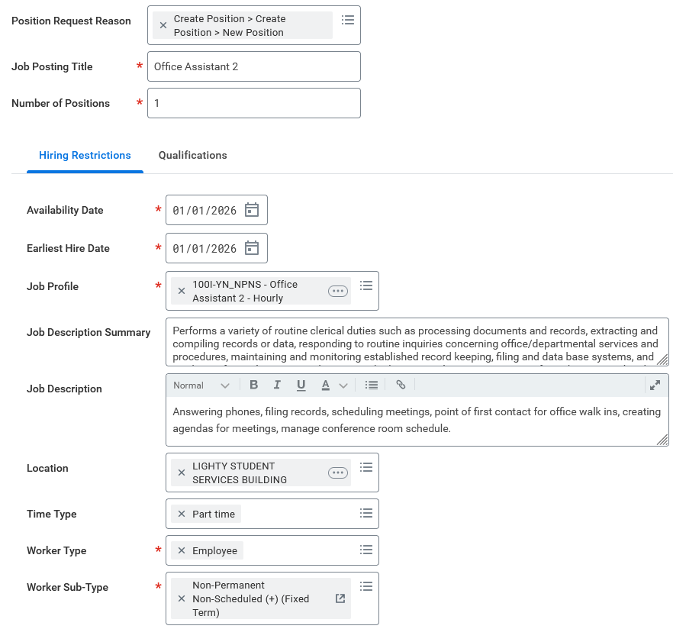
Creating a Position
WSU
The dates will need to be on or before the hire date or the position will not show up at the Hire step.
This field will need to match worker sub type.
Job description field should include typical or day to day duties employee will be performing that are specific to their work at WSU.
This field must align with the position code selected above.
Notes:
Job posting title can be anything but shouldn’t be the name of another employment type. Example should not be “office worker” as that is a Student Hourly title.
Job description summary is auto filled from WD
You can use OFM as a resource and template but it should not be a 1:1 copy

Slide 9
Compensation
WSU
Civil Service & Nonpermanent Scheduled
Periodic Increment Date (PID)
“Classified Pay R030”
Used for both CS and Nonpermanent Scheduled positions
Civil Service Monthly Rate
Nonpermanent employees will receive two Step increases on their PID
PID will always be 12 months from date of hire, on the closest first day of the month from the date of hire
  Hire date of 1/15 would have PID of 1/1
PID is set independently for each position
PID for a rehire after a break in service is “reset”
WAC 357-28-056
Nonpermanent Nonscheduled
“Classified Pay Hourly R030”
This will be used for Nonpermanent Nonscheduled
Civil Service Hourly Rate
Notes:
PID is always first of the month; whichever is closer WAC 357-28-056 requires PID reset after break in service and rehire
Renewals that begin on PID date will require two step increase to be manually entered in that renewal.
Compensation is set by the State

Slide 10
Compensation - Time Entry
WSU
Nonpermanent Scheduled
Employee enters leave, LWOP, and OT hours
Paid a set monthly amount based on FTE that only changes with use of LWOP or OT hours.
Holidays are automatically entered into Time Entry based on FTE.
Personal Holiday use is based on FTE; 50% FTE position would have 4 hours to use.
Nonpermanent Nonscheduled
“Clock in, clock out” time entry
Paid hourly rate
Holidays are accrued as credit based on hours worked each month and are not entered into Time Entry.
Personal Holiday entered as one hour “tracker”. This triggers WorkDay to enter final amount of personal holiday hours into employee’s Time Entry at the end of the month.
Notes:
NPS employees must use leave, LWOP, or enter hours to meet FTE. They will be paid the same amount and NPS is best used for temps with regular schedules.

Slide 11
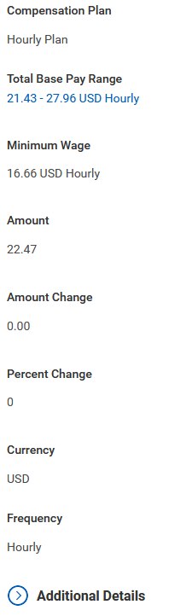
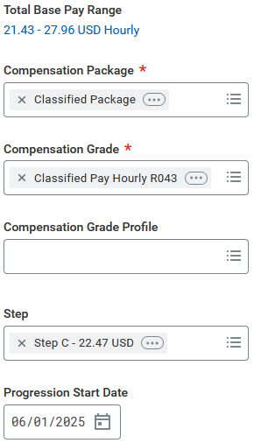
Compensation Change
WSU
The range is based on the selected position and assigned by the State.
This amount should match amount of selected Step.
Nonpermanent hires can be Step A – F of the assigned Range.
PSD will always be one year out from date of hire or rehire, on the closest first day of the month.
The fields to provide end dates are under the “additional details” drop down menu.

Slide 12
Leave – Accruals
WSU
Nonpermanent Scheduled
Annual Leave
  Accrued at Civil Service rate based on FTE
Sick Leave
  Accrual rate based on FTE
Holiday
  Received at FTE rate; must start position before holiday occurs
Personal Holiday
  Civil Service rules, based on FTE
Nonpermanent Nonscheduled
Annual Leave
  Accrued using FTE calculated at the end of the month based on hours worked/possible work hours
Sick Leave
  Accrued using FTE calculated at the end of the month based on hours worked/possible work hours
Holiday
  Received as a holiday credit at end of month at FTE rate; must start position before holiday occurs
Personal Holiday
  Civil Service rules, based on FTE in month that Personal Holiday is used

Slide 13
Leave - Payouts
WSU
Nonpermanent Scheduled
Annual Leave
  Paid out if employed in position for at least 6 consecutive months
Sick Leave
  Sick leave balance is reinstated if rehired within 5 years
Holiday
  Paid at the time of the holiday so there is no holiday payout for NPS.
Personal Holiday
  PH is not paid out if unused at separation
Nonpermanent Nonscheduled
Annual Leave
  Paid out if employed in position for at least 6 consecutive months
Sick Leave
  Sick leave balance is reinstated if rehired within 5 years
Holiday
  Any remaining balance is paid out regardless of tenure in position. Holiday credits cannot be carried over into next calendar year and is paid out January 10.
Personal Holiday
  PH is not paid out if unused at separation
Notes:
Payouts and transfers for position changes covered on next slide.
NPNS holiday credit does not carry over into new year and would be paid out at the end of the year. December holiday credit would be accrued available to use in following January and is not paid out.

Slide 14
Leave - Position Changes
WSU
Leave Transfer
Annual leave will be transferred to new position if there is no break in service:
  NPS ←→ NPNS
Sick Leave will be reinstated or transfer:
  NP ←→ CS/AP/Fac
  Student Hourly → NP (but not the reverse)
  WA State Agency → NP
Break in service required
Employees resigning from or going to an AP, Faculty, or Civil Service position will require a break in service prior to moving in or out a Nonpermanent position
Annual leave and holiday credit (if applicable) will be paid out from the appointment and not carried over to the new appointment, sick leave will be reinstated to new position.
Actions should be processed in Workday as a change job with a “Separation from Fac/Staff” or “Separation from Nonpermanent” as the reason code

Slide 15
Commonly asked Questions
Important Dates to Remember
WSU
What position code should I use?
Does there need to be a break in service between Nonpermanent appointments?
Can the department increase compensation of current Nonpermanent employee?
4 months – Personal Holiday available
6 months – Will receive Annual Leave payout
12 months – Two step compensation increase
21 months – Review renewal status
24 months – Maximum appointment length
Notes:
Office assistant, different types of research position codes, IT series.
12 months at a time up to 24 consecutive months. A break in service will restart this timer and rehires are not limited, however, a break in service is no longer required and a Change Job action to a new position can continue an employee’s Nonpermanent employment.
Up to Step F at any time. Over Step F must wait for PSD.

Slide 16
Additional Resources
WSU
Contact the HR Service Team
  https://hrs.wsu.edu/contact/es-service-teams/
HRS Records (hrs.records@wsu.edu)
BPPM 60.26
HRS Benefits
  https://hrs.wsu.edu/employees/benefits/temporary-seasonal-employee-benefits/
  https://hrs.wsu.edu/employees/benefits/retirement-information/retiree-reemployment-guidelines-and-directives/
Workday Knowledge Base:
  Reference guides for hire, change job, compensation, and time and absence have been updated to include nonpermanent information
OFM Classified Job Listings
  https://ofm.wa.gov/state-human-resources/compensation-job-classes/ClassifiedJobListing

