Slide 1
Improving the Candidate Experience
WSU Human Resources

Slide 2

Why is a positive experience important?
It is an essential part of attracting and retaining top performers
The experience can influence the individuals perception of an organization and its work environment.
Critically important for employers of choice and any organization that wants to maintain a competitive edge in attracting, retaining, and engaging top performers.

Slide 3

Tips for creating a positive
candidate experience at WSU
Posting timely and clear information
Reviewing the applicants
Contacting candidate for interview
When the candidate arrives
The on-campus interview
After the selection process is complete

Slide 4
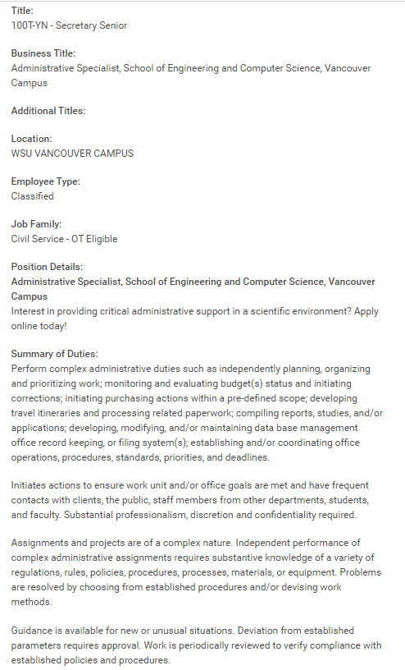
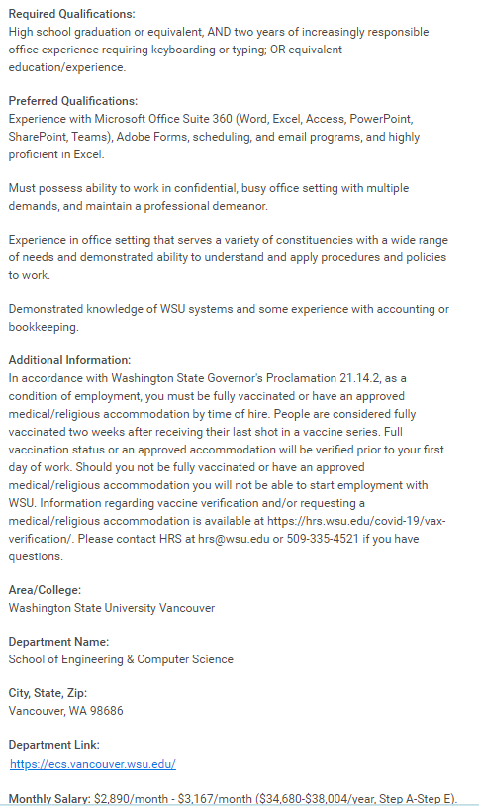
Posting Information
Give a clear description of the position to help ensure interested individuals apply

Slide 5

Reviewing Applicants
While reviewing applications be sure to notify candidates who are no longer being considered for the position (do not meet minimum qualifications).
OPDRS will NOT notify candidates until the position has been filled or cancelled.
Be sure to review applications in a timely manner to provide a quick response to the candidates

Slide 6
Call the candidates the search committee is interested in interviewing and set up a mutually convenient time for the candidate and the committee.
Provide the name and contact information of the individual the applicant can contact if they have questions.
Contacting Candidates for an Interview

Slide 7
Contacting Candidates for an Interview
The location, date and time of the interview
Directions to the building and room where the interview will be held
A list of names and titles of those who will be interviewing the candidate.
Parking information. If feasible, send a visitor’s parking pass in the mail prior to the interview.
Attach a copy of the description of the position
Ask them if they need any additional information regarding the interview.
After you have called the candidate and confirmed a date and time for their interview, send a follow up e-mail with the following information:

Slide 8
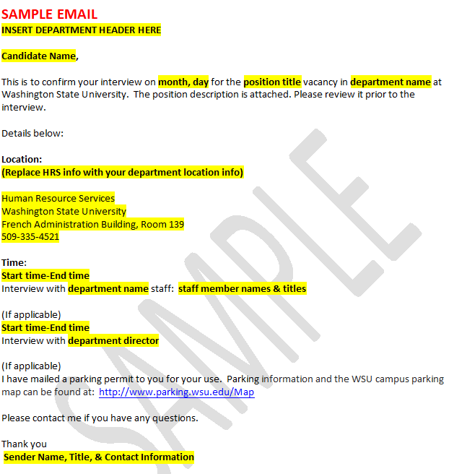
Interview Confirmation Email
You can get a copy of the confirmation email here on the recruitment toolkit!
Interview Conformation Email Example

Slide 9
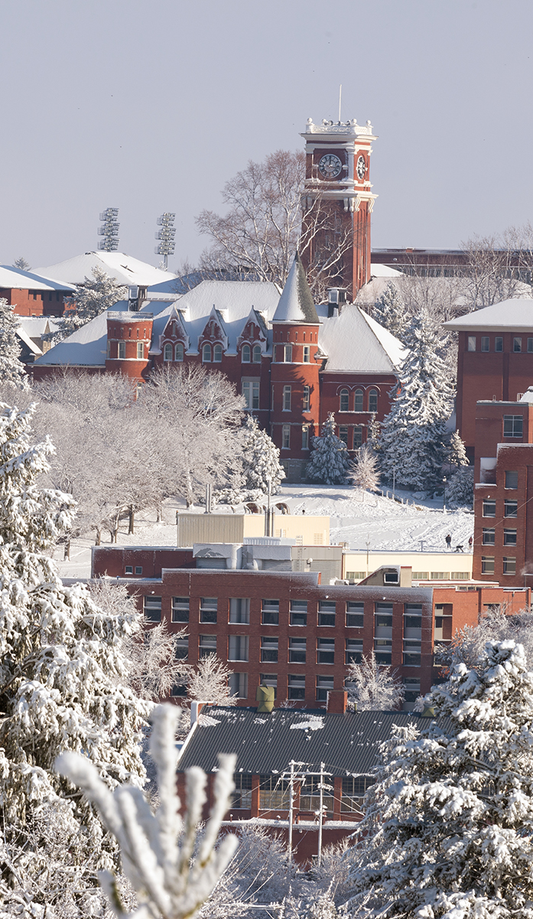
Candidate Experience on Campus
When the candidate arrives
  Be courteous and hospitable when greeting the candidate. If they have not already received an interview packet, provide them with a copy.
    (Samples located on the HRS Candidate Experience website)
  Before the interview begins, offer them coffee, and/or water and ask if they have any questions.
  Be mindful that this may be the candidate’s first impression of your department as well as WSU.

Slide 10

The Interview
The search committee members should introduce themselves
The search committee should have a standard set of questions based on the requirements of the job that each candidate will be asked.
It is also appropriate to ask questions directly related to the particular candidate’s application materials and to ask follow-up questions that may be different for each candidate based on their responses.
Sample Interview questions are on the HRS Website
The search committee members should be familiar with what questions are illegal to ask or consider when selecting the top candidate(s) (Refer to BPPM 60.08))
Be sure to allow time for the candidate to ask questions.
The interview is a great opportunity to showcase your office/department. If the candidate will be interviewing with individuals in other locations, consider who will escort them to those areas.
Provide the candidate with a rough timeline of when interviews should be complete and thank them for taking the time to interview for the position.

Slide 11

Candidate Selection
Once the search committee recommends a candidate for a position it is up to the appointing authority to make the final decision.
After the offer has been extended and the candidate accepts:
  Contact the candidates who were not selected for the position
  HRS recommends promptly notifying the candidates who were interviewed by telephone. A follow-up letter may be appropriate too.
  For the applicants who were not interviewed an email communication is acceptable (Samples available –Candidate Experience Site)
  Update OPDRS

Slide 12
Candidate Selection
Importance of Notifying Candidate in a Timely Manner
Regardless of whether or not the candidate is extended an offer by the university it is important to notify them in a timely manner.

Slide 13

Onboarding Process
Once the individual has accepted the offer, begin mapping out their orientation to their position, your department and WSU.
Things to consider:
  What is their effective start date?
  Who will help acclimate them and train them?
  Register the new employee for upcoming trainings
  Prepare a welcome letter letting them know information about the department and resources available to them
  Register the them for “New Employee Orientation”
Many great resources for new employees can be found on the Onboarding Resources site: hrs.wsu.edu/New_Employees

Slide 14
Employee Engagement
1
ENGAGED employees work with passion and feel a profound connection to their company.
2
NOT-ENGAGED employees are essentially “checked-out.” They’re sleepwalking through their
They drive innovation and move the organization forward
Workday, putting time – but not energy or passion- into their work.
3
ACTIVELY DISENGAGED employees aren’t just unhappy at work; they’re busy acting out their
Unhappiness. Every day, these workers undermine what their engaged coworkers accomplish.
You’ve hired a new individual, now how to you retain them?
It’s important to keep your new employee and all employees engaged in the workplace.
What do we mean by Employee Engagement?
Employee engagement is the extent to which employees feel passionate about their jobs, are committed to the organization, and put discretionary effort into their work.

Slide 15
Employee Engagement
Gallup research indicates employees are engaged when:
Know what is expected of them.
Have the right materials and equipment to do their work correctly.
Have the opportunity to do what they do best everyday.
In the past seven days, they have received recognition or praise
Supervisor, or someone at work, seems to care about them as a person.
Opinions seem to count.
The mission of the company makes them feel like their work is important.
Co-workers are committed to doing quality work.
Have a best friend at work-someone to unconditionally rely upon.
In the past six months, they have talked with someone about their progress.
Have opportunities to learn and grow.

Slide 16

In Conclusion
Creating a positive candidate experience is a crucial step in WSU’s recruitment process. “Roll out the Crimson Carpet” for all candidates.
Think about the small details in your interactions with candidates. Sometimes the smallest detail can mean the most.
Participate in the Faculty and Staff Recruitment Basic trainings to learn the recruitment processes at WSU
Contact HRS if you’re unsure about any steps in the process. hrs@wsu.edu (509) 335-4521

Slide 17

Thank you!

