Slide 1
WSU Staff
Recruitment Basics
April 2021
Overview of the Staff Recruitment Process
Developed by:
Human Resource Services

Slide 2


Key Objectives
Recruitment Laws & Policies
Individual Recruitment Phases
Recommended Best Practices

Slide 3

Search Phases
Prepare for the Search
Advertise & Outreach
Screen & Interview
Perform Reference & Background Checks
Hire & Onboard
Notes:
The Staff Recruitment Process itself falls into five distinct phases. Each phase of the process has it’s own module that highlights a number of best practices recommended at each step. If you are not intending to complete the entire training you can navigate directly to any of the individual phases as desired. To do so simply click on the desired phase on this slide OR use the menu to the left.

Slide 4
Recruitment Laws & Policies
Equal Opportunity in Employment
FEDERAL LAWS
Title VII of the Civil Rights Act
Age Discrimination in Employment Act
American with Disabilities Act Rehabilitation Act
Genetic Information Non-Discrimination Act
    Race
    Color
    Religion
    Sex
    National Origin
    Age
    Disability
    Genetic Information
Notes:
WSU strives to conduct recruitments which provide candidates equal opportunity to an open and fair selection process.
Equal opportunity is governed by a number of laws and applies to all employment conditions, decisions and terms such as recruitment, hiring, pay (compensation) determination, promotion, training and termination.
A number of statutes govern this area. At the federal level -
Title VII of the Civil Rights Act of 1964 and its amendments forbid discrimination on the basis of race, color, religion, sex and national origin.
The Age Discrimination in Employment Act passed in 1967 added age as a basis of unlawful discrimination.
The Americans with Disabilities Act (or ADA) passed in 1990 and the Rehabilitation Act prohibit disability discrimination.
The Genetic Information Non-Discrimination Act prohibits discrimination because of genetic information.
The Equal Employment Opportunity Commission (referred to as the EEOC) is charged with enforcing these statutes.

Slide 5
Recruitment Laws & Policies
Equal Opportunity in Employment
STATE LAWS
WA State Law Against Discrimination
Age
Sex
Marital Status
Sexual Orientation
Race
Creed
Color
National Origin
Veteran Status
Military Status
Disability Status
WSU POLICIES
Policy Prohibiting Discrimination & Sexual Harassment, EP #15
Gender
Gender Identity/Expression
Genetic Information
Notes:
At the state level the laws are broader -
The Washington State Law Against Discrimination makes it an unfair practice for an employer to discriminate against a candidate due to age, sex, marital status, sexual orientation, race, creed, color, national origin, honorably discharged veteran or military status, or the presence of any sensory, mental, or physical disability or the use of a trained dog guide or service animal by a person with a disability. (RCW 49.60.180, WAC 162-12)
If a WSU employee violates the rights of a candidate, the candidate may bring a civil action to enjoin further violations and to recover the actual damages and the cost of the legal action which may include reasonable attorney fees. (RCW 49.60.030(2))
The Washington State Human Rights Commission is charged with enforcing these statutes in Washington.
At the University level –
Executive Policy #15 prohibits discrimination for all the reasons above and includes additional categories of gender, gender/identity expression and genetic information.
These statutes and policies are the framework for WSU recruitment and selection processes and guide the best practices discussed here.

Slide 6
Recruitment Laws & Policies
Equal Opportunity in Employment
STATE LAWS
Equal Pay Act (RCW 49.58.100) | Employers may not seek the wage/salary history of an applicant, either from the applicant or their current or former employer, except as allowed in #3 below Employers may not require applicants’ prior wage/salary to meet certain criteria, e/g/ meet a certain level or threshold To facilitate the employment process, employers may confirm an applicant’s wage or salary history only If the applicant has voluntarily disclosed their wage or salary history, or After the employer has negotiated and made a job offer, including the amount of compensation, to the applicant Post offer, employers must provide the minimum wage or salary for the position for which the applicant is apply (upon applicants request)
Notes:
RCW 49.58.100 added the following sections to the state’s Equal Pay Act.
Employers may not seek the wage/salary history of an applicant, either from the applicant or their current or former employer, except as allowed in #3 below
Employers may not require applicants’ prior wage/salary to meet certain criteria, e/g/ meet a certain level or threshold
To facilitate the employment process, employers may confirm an applicant’s wage or salary history only
If the applicant has voluntarily disclosed their wage or salary history, or
After the employer has negotiated and made a job offer, including the amount of compensation, to the applicant
For Employers with fifteen or more employees:
Post offer, employers must provide the minimum wage or salary for the position for which the applicant is apply (upon applicants request)
Upon request of an employee offered an internal transfer to a new position/promotion/demotion/transfer. The employer must provide the wage scale or salary range for the employee’s new position
If no wage scale or salary range exists, the employer must provide the minimum wage or salary expectation set by the employer prior to posting the position, making a positon transfer, or making the promotion

Slide 7

Pitfalls to Avoid

Slide 8
Disparate Treatment Discrimination
Disparate Treatment - is direct intentional discrimination. It can take the form of treating an individual or several individuals differently from others based upon their membership in a protected class, such as race, gender, age, religion, color, national origin, or disability. Generally, this type of discrimination is easy to spot.
Example: A job ad for an office assistant seeking “males” or “recent college graduates.” Such an ad discourages females or person’s over 40 from applying to the job.
Notes:
Disparate Treatment is direct intentional discrimination. It can take the form of treating an individual or several individuals differently from others based upon their membership in a protected class, such as race, gender, age, religion, color, national origin, or disability. Generally, this type of discrimination is easy to spot.
Example: A job ad for an office assistant seeking “males” or “recent college graduates.” Such an ad discourages females or person’s over 40 from applying to the job.

Slide 9
Disparate Impact Discrimination
Disparate Impact - Disparate impact refers to the policies, practices, rules or other systems that appear to be neutral, but result in a disproportionate impact on protected groups.
Example: say that job applicants for a certain job are tested on their reaction times, and only people with a high score are hired. This test will discriminate against older workers, who are less likely to have fast reaction times. Whether this test is illegal will depend on whether fast reaction times are necessary for the job
Notes:
Adverse/Disparate Impact, on the other hand, refers to employment policies or employment practices which have a biased impact on protected groups. The policy or practice may seem reasonable on its face but it screens out one or more protected groups at rates that exceed acceptable limits under the EEOC’s Uniform Guidelines on Employee Selection Procedures. Generally, this type of unintentional discrimination is harder to spot.
Example: say that job applicants for a certain job are tested on their reaction times, and only people with a high score are hired. This test will discriminate against older workers, who are less likely to have fast reaction times. Whether this test is illegal will depend on whether fast reaction times are necessary for the job

Slide 10
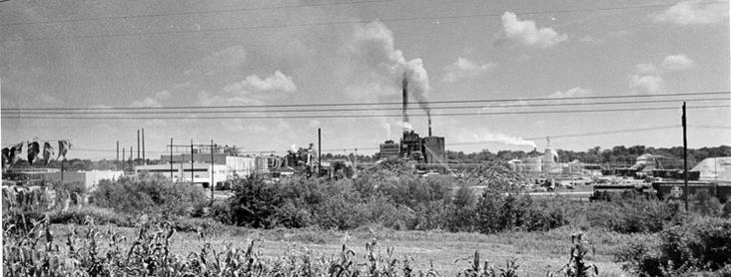
Griggs v. Duke Power Co.
401 U.S. 424 (1971)
Griggs was an African American male;
He was denied a ditch digger job because he failed to meet selection criteria (possession of high school diploma or passing grade on a written test);
Supreme Court found that the facially neutral employment criteria violated Title VII because:
    It had a disproportionate impact on Griggs’ protected group and
    It was not job-related or consistent with business necessity.
Notes:
Adverse/Disparate Impact Example

Slide 11

Reasonable Accommodation
Reasonable accommodations are effective adjustments made to a job, work environment or application process that enable qualified employees with disabilities to perform the essential functions of the job, and applicants to participate in the application process.
Notes:
*Reasonable accommodations are effective adjustments made to a job, work environment or application process that enable qualified employees with disabilities to perform the essential functions of the job, and applicants to participate in the application process.
*Under the American’s with Disabilities Act, an employer must provide reasonable accommodation to an employee or job applicant with a disability, unless doing so would cause an undue hardship (significant difficulty or expense for the employer.)

Slide 12
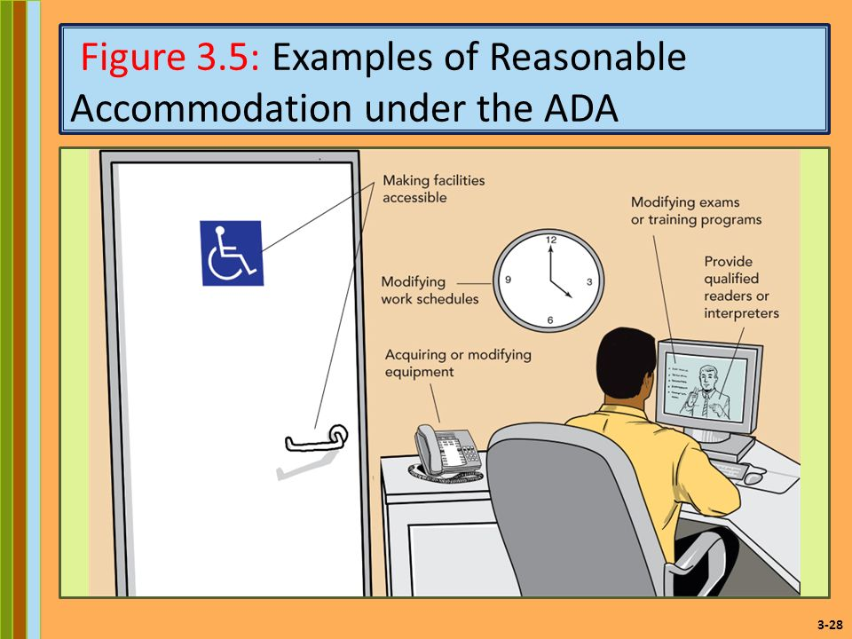
Reasonable Accommodation
Notes:
*Such accommodations may include modifying work schedules and policies, providing devices or modifying equipment and making workplaces accessible.
*They may also include accessibility to Electronic and Information Technology (EIT) and may require the purchase of assistive devices to meet the needs of the individual.

Slide 13
Reasonable Accommodation in the Selection Process
Tell ALL applicants what the selection process involves
Ask ALL applicants whether or not they will need a reasonable accommodation for this process
Ask ALL applicants whether or not they are able to perform the essential functions of the job either with or without reasonable accommodation
*Contact your area’s/college’s HR Consultant if you have questions or concerns
regarding the legal framework of recruitment and how it pertains to your particular search.
Notes:
DO NOT ask questions in an interview about whether a single applicant will need reasonable accommodation for a particular function of the job.
Example: A University office conducts job interviews in a second floor office. There is no elevator. The search support calls a candidate to arrange for an interview for an Office Assistant position. She requests a reasonable accommodation because she uses a wheelchair. Installing an elevator would be a undue hardship, but the employer could conduct the interview in a first floor office. The employer must move the location of the interview as a reasonable accommodation.
Contact your area’s/college’s HR Consultant if you have questions or concerns regarding the legal framework of recruitment and how it pertains to your particular search.

Slide 14
Search Phases
Prepare for the Search
Advertise & Outreach
Screen & Interview
Perform Reference & Background Checks
Hire & Onboard
Notes:
Be sure to keep the legal framework in mind when going through the recruitment process.
The bulk of this course reviews each phase of the process and highlights a number of best practices.
The first phase – Preparation – is the foundation of every successful search.

Slide 15

Prepare for the Search
Benefits of hiring the best candidate for the position include:
Decrease Costs
Less Performance Issues
Lower chance of Lawsuits and Litigation
Overall increase in Morale
Advance Research, Innovation & Creativity; Student Experience, and Diversity, Equity and Inclusion
Notes:
The goal of the recruitment process is to hire the best candidate for the job.
The recruitment process should be consistent with WSU’s Strategic Plan to have diverse faculty and staff.
Benefits of hiring the best include:
Decrease Costs – Turnover, etc.
Decrease Performance Issues
Decrease Lawsuits and Litigation
Increase Morale
Advance Research, Innovation & Creativity; Student Experience, and Diversity, Equity and Inclusion

Slide 16
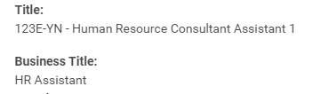

Prepare
Position Details and Duties
Official Title/University Title
Business Title (if applicable) How will this be advertised?
Primary responsibilities and duties
  Why does this position exist? Primary Functions?
Position configuration
  Full Time/Part Time
  12 month appointment/9 month appointment
Notes:
Prior to the recruitment, the Primary Recruiter should review the details of the position description. As business needs change and job duties evolve, it is important that the position description reflects the actual job duties needed. Is the position still appropriately titled? Have the job responsibilities increased or decreased? Do the qualifications reflect what is actually needed in the job?
Position details include:
Official Title and Business Title (if applicable)
Primary responsibilities and duties to answer such questions as. “Why does the position exist? What is its primary function?”
Position configuration details, such as full time vs. part time, 12 month vs. 9 month, and so on

Slide 17
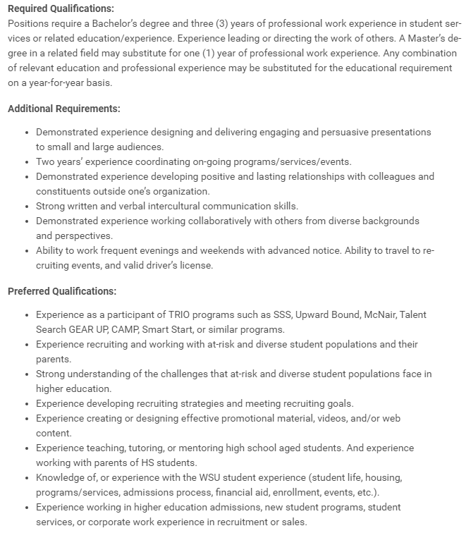
Prepare
Notes:
Position details and duties also include;
Minimum Qualifications (MQ’s) for the position, which are criteria required for the position such as educational level, field(s) of study, years of experience and/or additional mandatory licenses or credentials. MQ’s include those that the department has determined for the specific position as well as those set by the State of Washington’s Human Resources Office for classified employees and WSU Human Resource Services for Administrative Professional employees.
Minimum qualifications are based upon demonstrated necessity and are a valid predictor of the incumbent’s success. It is important to avoid arbitrary “years of experience” or qualifications which merely reflect the previous incumbent’s experience. Also avoid unnecessary qualifications which will limit the candidate pool because of unrealistic expectations.
In other words, allow for flexibility to consider a broad array of candidates.
Preferred Qualifications may also be added. These are desired criteria which may enhance the effectiveness of the incumbent performing the job, but are not an absolute requirement.
When adding preferred qualifications, ensure they are related to the responsibilities and duties of the job. As with the MQ’s, avoid unnecessary qualifications here as well.
Finally, diversity related needs of the position should also be included in the qualifications. Examples include those related to working with, supervising, recruiting, and/or counseling diverse individuals or groups.

Slide 18
Roles & Responsibilities
Diverse Group of Individuals
Neutral Evaluators
Cross section of areas
Committee Composition
Notes:
After HRS and the Primary Recruiter have finalized the official position description, the Search Committee is appointed.
The ultimate goal of this Search Committee will be to recommend the best possible candidate for the job.
Generally, the Search Committee includes a cross-section of individuals from the department or college and it may also include individuals from outside the area. The composition of the Search Committee should be diverse to allow for a range of ages, gender, ethnicities and professional backgrounds if possible.
Towards this end the Search Committee should have a basic understanding of the position including the job details and its configuration.

Slide 19


Roles & Responsibilities
Fair &
Equitable
Conflicts
of Interest
Search Support
Search Committee Members
Search Chair
Appointing Authority
Office of the Provost
Search Support
Various Roles in Workday
Various Workday access
Personal Agendas
Or Biases
Confidentiality
Notes:
The Primary Recruiter, Primary Recruiting Coordinator, HR Partner for the unit, and Search Committee Members function as advisors to the Appointing Authority by developing recruitment and outreach strategies and recommending one or more finalists for the vacant position. They may assist in providing feedback on the position description and recommend recruitment and outreach strategies for finding qualified candidates, review and carefully evaluate application materials and conduct screening and on-campus/ Zoom interviews to find the best possible finalists.
Additionally, the Search Committee is responsible for conducting a fair and equitable recruitment and for protecting the confidentiality of the search on a need-to-know basis. It needs to put aside personal agendas or biases so that each candidate receives a fair and equitable evaluation. Any potential conflicts of interest should be disclosed to the Primary Recruiter or HR Partner.
Primary Recruiter will administer the movement of candidates
Recruiting Coordinator will typically be the scheduler for interviews, assessments, and reference checks.
HR Partner is responsible for coordinating the Employment Agreement processes. Because they are closest to the data input on the EA in Workday.
Please note
Some individuals may hold more than one role.
Not all members of the search committee may have access the Recruitment Dashboard and may need to find the job requisition by searching the job requisition number

Slide 20

Roles & Responsibilities
Notes:
It is important to avoid potential conflicts of interest when selecting members of the search committee and also when confronted with situations with individual applicants. After the committee has been established, set forth a consistent protocol for handling difficult situations of a real or perceived conflict of interest.
These include when a student collaborator, former student, friend or close colleague, or someone related to a committee member applies for the position. Ideally these situations can be anticipated ahead of time and the affected individual can choose not to sit on the particular search committee.
In other cases, it is appropriate for the committee member to disclose the relevant information and recuse himself or herself from committee deliberations about the individual. Any potential conflicts of interest should be disclosed to the Primary Recruiter or HR Partner. Please consult your Area HR Consultant if you need assistance dealing with conflicts of interest on the search committee

Slide 21

Confidentiality
Notes:
Confidentiality preserves the integrity of the selection process and protects the privacy of the candidates. All members of a search committee, including students and individuals outside the department or school, have access to confidential search information on a “need to know” basis.
All members of the search committee with access to search records are ethically bound to the utmost level of confidentiality. Specifics of the committee deliberations should not be discussed with anyone outside the search committee, with the exception of the appointing authority, department chair, dean of the school, or Human Resource Services. The requirement for confidentiality extends to all aspects of the search, including written and verbal communications, and through all phases of the search process. Discourage discussions about candidates that do not focus on the established criteria for the position. Demographic characteristics, family status, spousal/partner issues, or other non-job related information or rumors should not enter into deliberations about the candidates.

Slide 22

Requisitions designed to “sell” the position
Posted via Workday on wsu.edu/jobs for external candidates and in Workday Find Jobs for Internal candidates
  Describe duties
  Describe department, college, University
  Diversity commitment/needs
Notes:
The Job Posting or Requisition “sells” the open position and promotes the department, college and WSU to potential job candidates.
This Requisition is used on the WSU.edu/jobs website and in Workday Find Jobs for Internal applicants. Modified versions may be used in additional advertisements as part of the outreach and recruitment plan.
Typically, the HR Partner will craft the job posting (Create Requisition). When doing so they should consider the following best practice tips:
Clearly describe the duties of the position, as well as its purpose and function within the organization
What is enticing or exciting about the position, the department, the area or college, and the University? Is this communicated through the posting?
Who in the job market will see themselves in this position as described?
Indicate the University’s commitment to diversity by asking these questions:
Will the tone and content of the Job Posting appeal to the widest array of qualified individuals, including any underrepresented groups that the area/college is seeking to recruit?
Once the job posting is crafted it will be reviewed by the Search Committee to create the Evaluation Tools.

Slide 23

Prepare
Objective and measurable
Consistent with position details
Interpretation consensus
Specific qualifications
Qualification weight
Screening matrix
Notes:
Prior to beginning the recruitment, establish the mechanism(s) for evaluating candidates. Evaluation methods/tools should be as objective and measurable as possible. They should be consistent with the position details and any advertisements.
Review and discuss each minimum and preferred qualification paying careful attention to the following:
Ensure consensus in the interpretation of each qualification by all involved in the evaluation process.
Discuss how candidates might meet the specific qualifications, such as direct experience, transferable skills and other scenarios.
Determine how each qualification will be weighed in comparison to other qualifications.
Create a screening matrix or candidate comparison sheet to document demonstrated qualifications.
For assistance with developing appropriate evaluation tools, contact Human Resource Services.

Slide 24
Search Phases
Prepare for the Search
Advertise & Outreach
Screen & Interview
Perform Reference & Background Checks
Hire & Onboard
Notes:
With the appropriate preparations made and documents approved, the process now moves into the second phase – Advertise & Outreach. Here, the Primary Recruiter/HR Partner and and Search Committee Members work to develop an outreach strategy and begin to actively recruit for the vacant position.

Slide 25

Advertise & Outreach
  Good faith efforts
  Cast wide recruitment net
  Reach passive candidates
  Review underutilized data
  Underutilized data is for outreach efforts only
Outreach Strategy
Notes:
The goal of the outreach strategy is to attract a pool of qualified, talented and skilled candidates which is also broadly diverse in order to achieve compliance with Equal Employment Opportunity and Affirmative Action goals.
Generating a diverse and qualified applicant pool requires strategizing to reach those looking for new opportunities, as well as capturing the attention of outstanding individuals who are not actively looking for a new job.
The Primary Recruiter and Search Committee Members utilize good faith efforts to develop an array of outreach strategies and advertisements that cast a wide recruitment net.
Reviewing Equal Employment Opportunity/Affirmative Action goals (EEO/AA goals) and underutilized data can be helpful to increase outreach efforts for protected groups which may be under-represented in a particular job category. This information is visible to the Hiring Manager when creating the job posting in the Workday System.
Please note, underutilized data is for outreach efforts only.

Slide 26

WSU’s Equal Employment Opportunity and Affirmative Action Policy
Evaluation and hiring decisions are to be made without regard to race, sex, sexual orientation, gender identity/expression, religion, age, color, creed, national or ethnic origin, physical, mental or sensory disability, marital status, genetic information and/or status as a veteran.
Search Committee may NOT give a candidate an advantage over other candidates simply because he/she may be in an underutilized group.
Use this link to access WSU’s
Equal Employment Opportunity and Affirmative Action Policy.
Notes:
Evaluation and hiring decisions are to be made without regard to race, sex, sexual orientation, gender identity/expression, religion, age, color, creed, national or ethnic origin, physical, mental or sensory disability, marital status, genetic information and/or status as a veteran.
In other words, the Search Committee may NOT give a candidate an advantage over other candidates simply because he may be in an underutilized group. Use this link to access WSU’s Equal Employment Opportunity and Affirmative Action Policy.

Slide 27

Advertise & Outreach
Proactive Outreach Ideas
Department/College Suggestions
Nominations
Alumni
Directories/Databases
Professional Contacts
Student Groups
Notes:
When creating the overall recruitment plan, consider a broad array of efforts such as print ads, online ads, social media and listservs, as well as personal networking. The best recruitments are those which are active! The Search Committee should seek out potential candidates in addition to placing traditional advertisements.
Proactive outreach ideas include:
Potential candidates identified by current department or college members
People acquainted with the field that may be called upon to nominate individuals to invite to apply
Potential candidates who are WSU alumni
Directories or database listings
Professional contacts from social media, professional conferences, or associations and organizations

Slide 28


Advertise & Outreach
Advertising Ideas
National Publications or Websites (Chronicle of Higher Education,
Seattle Times, NY Times)
Professional Associations
Mailings/Listservs
Orgs or Websites for underrepresented groups (i.e. HERC Diversity Resources)
Department Website
  See Staff Recruitment
Notes:
Advertising can also be in many forms, including:
Nationally recognized publications or websites in higher education
Professional associations, organizations, journals and other publications for the particular discipline or profession. This includes professional and specialty directories and databases, as well as professional conferences and meetings
Mailings or listservs to other universities’ departments and career placement services
Relevant professional or community organizations, advocacy groups, and so forth that respond to the needs of ethnic and racial minorities, women, and individuals from other underrepresented groups
Still another option is to advertise the position on the WSU department’s, area’s or college’s own web site as well
HRS maintains general and specialized outreach and advertising resources to help initiate recruitment efforts. Visit the Staff Recruitment webpage for specific information.

Slide 29

Outreach Tools
Notes:
http://hrs.wsu.edu/managers/recruitment-toolkit/outreach-tools/

Slide 30

Advertise & Outreach
Length of Recruitment Period
Recruitment Periods
AP -National
AP-NW Regional/Statewide
AP - Local
CS
30 calendar days
21 calendar days
14 calendar days
Minimum of 5 business
days
Notes:
Yet another important consideration when preparing the advertising plan is the length of the recruitment period. The recruitment period is defined as the time period between the commencement of advertising and the application deadline or application review begin date. A list of recruitment periods follows:
For AP National Searches, 30 calendar days is recommended.
For AP Northwest Regional Searches as well as AP Statewide Searches, a minimum of 21 calendar days is recommended.
For AP Local and Internal Searches, a minimum of 14 calendar days is recommended.
Classified Staff positions require at minimum 5 business days.

Slide 31
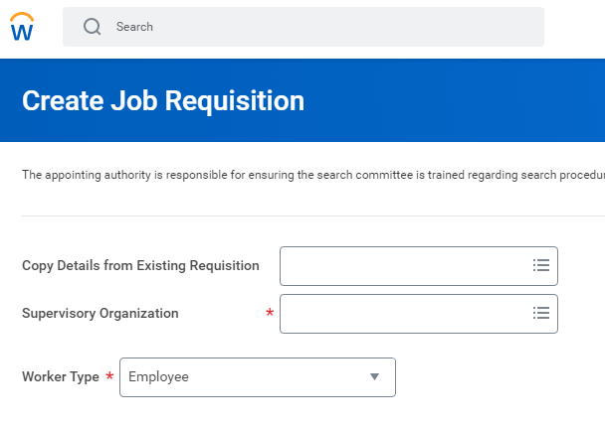
Advertise & Outreach
Workday System
  Primary Recruiter/ Manager/ HR Partner submits the Job Requisition in Workday
    Include recruitment documents in attachments section
  HR Partner Approves (if not initiate)
  HRS approves and posts Evergreen Requisition to external & internal site
  Direct link created
  Search committee access varies
Notes:
Once the job posting verbiage, outreach strategy and advertisements are finalized, the HR Partner or Primary Recruiter may create a Job Requisition in Workday:
Please be sure to identify a Primary Recruiter and Primary Recruiting Coordinator when submitting the JR. Search Committee Members may be identified further in the process.
Human Resource Services conducts a final review of the position before creating an Evergreen Requisition in Workday to post to the WSU.edu/jobs website.
Recruitment documents such as the evaluation tools, outreach strategy and advertising copy can be attached in the system as part of the posting for record retention purposes. These documents are not viewable by candidates.
Once the position is posted, a direct link to view the vacancy is generated by the Workday system. This link can be used in emails and web sites so candidates can easily locate the position.
The search committee members may not have access to the Workday Recruiting Dashboard and will need to use the search feature within Workday to view the job requisition. Those search committee members who do not have access to the Workday system will need to have the search materials given to them outside of the system.
Contact HRS for assistance if search committee members need to be changed in Workday

Slide 32
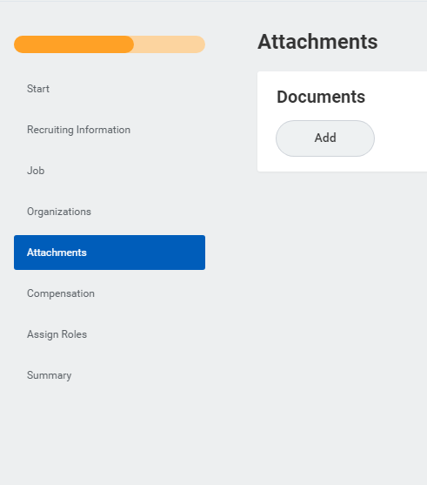
Advertise & Outreach
Utilize the tools within Workday including identifying search committee members and add attachments of where advertisements are being placed.
  Workday Help Text
  Add Attachments
Notes:
Be sure to “fully” utilize the tools within Workday including identifying search committee members and adding attachments of where advertisements are being placed/ ad language used.
By completing this information the department will be able to pull and analyze search data to help determine if recruitment methods were successful or how to modify future recruitments.

Slide 33
Search Phases
Prepare for the Search
Advertise & Outreach
Screen & Interview
Perform Reference & Background Checks
Hire & Onboard
Notes:
The search is well on the way now. With the initial preparation tasks completed and the posting closed, the Search Committee now moves forward with the Screen & Interview phase.

Slide 34
Screen & Interview
Candidate Evaluation
  Search Committee reviews candidate materials on an individual basis
Large pools; apportion the applications for initial evaluation
Minimize risk of potential bias
Notes:
Each member of the Search Committee reviews the candidates’ application materials on an individual basis, using the pre-established evaluation tools.
If the pool is exceptionally large, the Search Committee may elect to apportion the applications for the initial evaluation.
In these cases, it is recommended that each candidate be screened by at least two Search Committee Members to minimize the risk of potential bias.

Slide 35
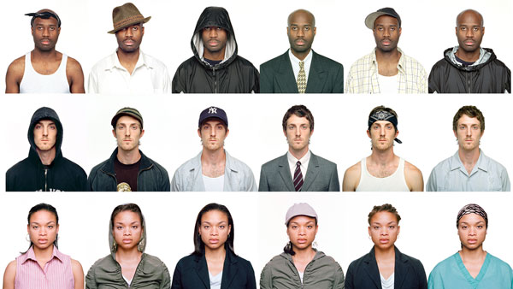
Screen & Interview
Implicit Association Test | IATs (Implicit Association Tests) are tools to demonstrate and examine conscious and unconscious divergences related to attitudes and beliefs about race, gender, religion, sexual orientation, disability, and other social categories. (Linked on the Staff Recruitment Toolkit)
Notes:
Regardless of the social groups we belong to, we all perceive people differently based on their demographic characteristics (race/ethnicity, gender, sexual orientation, gender identity, disability, religion, politics, etc.). However, and importantly, most people try to overcome their stereotypic preconceptions. Understanding the nature of such biases and implicit assumptions may reduce the impact of irrelevant factors in the candidate selection process.
Implicit biases are the attitudes or stereotypes that affect our understanding, actions and decisions in an unconscious manner. These attitudes exist deep within the subconscious and are different from known biases that people try to conceal for the purpose of political correctness. Implicit biases are hard to know by just thinking about them.

Slide 36
Screen & Interview
When screening candidates, Search Committee Members must:
Review all application materials
Consider entire career history provided
Use pre-established evaluation tools
Ensure qualifications clearly demonstrated
Refrain from assumptions
Do not consider or score answers regarding work eligibility or visa sponsorship status
Workday Disposition reasons
Candidate Evaluation
Notes:
When screening candidates, Search Committee Members must:
Review all of the application materials;
Consider entire career history provided;
Use the pre-established evaluation tools to ensure the evaluation criteria is applied consistently to each candidate. Adherence to this point may assist in defending against allegations of unequal treatment or bias;
Ensure application materials clearly demonstrate requisite education, experience and skills outlined in the job posting;
Thus, refrain from making assumptions about the candidate and/or the application materials. Evaluate only the actual information provided.
Do not consider or score answers regarding work eligibility or visa sponsorship status.
Next the Primary Recruiter must request the interview in Workday for each candidate with which they wish to move forward. This is a key step, before scheduling interviews they must get approval from HRS.

Slide 37
Interview Question
Activity

Slide 38
In your group, develop an interview question to determine the applicant’s skill/experience related to one of the following competencies:
1) Conflict Resolution
2) Communication
3) Critical Thinking
4) Customer Service
5) Problem Solving

Slide 39
Screen & Interview
Developing Interview Questions
  Developing Interview Questions
  Standard set of questions
  Focus on job duties
  You can eliminate areas you already have adequate information on from the application and focus on those you need to learn the most about.
  Behavioral vs. open ended questions
  Application questions
Refer to Sample Interview Questions
Notes:
The development of interview questions is a key step in the recruitment process.
Be sure to develop a standard set of questions to be asked of all applicants, based on the requirements for the job.
A good way to start is to write one question for each qualification, to make sure you cover the territory.
You can eliminate areas you already have adequate information on from the application and focus on those you need to learn the most about.
Focus on creating questions that elicit the applicant’s competencies relative to the duties of the job. Behavioral questions are a great way to explore an interviewee's past behaviors to help identify future performance. Open ended questions encourage a full meaningful answer using the subject’s own knowledge and/or feelings.
You may also note any particular questions you have about any applicant’s application, e.g. “We couldn’t tell from your application whether you actually resolved customers’ complaints, or just received and recorded them for someone else to resolve.”
A set of sample interview questions based on different core competencies can be found on the Staff Recruitment toolkit.

Slide 40
Screen & Interview
  Prohibited Pre-employment questions
    Be vigilant in all interactions with candidates
    Focus on job-related questions
    Refrain from questions related to:
      Race, Religion, Gender, Age, Citizenship, National Origin, Sexual Orientation, Martial Status, Disability Status, Veteran Status
Interview Questions
Refer to the Pre-employment Inquiry Guidelines | BPPM 60.08
Notes:
As you prepare for the interview(s), keep the following in mind:
The Search Committee and anyone else speaking with the applicant must refrain from prohibited inquiries throughout all interactions, be they on the phone, during meals, on tours, within department gatherings, small group meetings, formal interviews, etc. All inquiries should be related to the job duties of the position or consistent with business necessity.
Specifically, refrain from seeking information that could potentially be used to discriminate against the applicant based upon race, color, religion, gender, age, national origin, sexual orientation, marital status, disability status and/or veteran status
For example:
Do not ask if the applicant has children or is married.
Do not ask where the applicant was born or whether she is a US citizen.
Do not ask if the applicant has religious preferences or affiliations.
Do not ask about memberships in organizations or affinity groups which may give an indication of race, color, creed, sex, marital status, national origin, or ancestry of its members.
The Pre-Employment Inquiry Guidelines in the Business Policies and Procedures Manual has many more examples of appropriate and inappropriate questions for each category listed.
Finally, if you have any uneasiness or doubt about a particular question or inquiry, do not hesitate to contact your area or college HR Consultant for advice.

Slide 41
Screen & Interview
Screening Interviews
Short telephone call or videoconference
Clarify application materials
Job-related questions
re: experience/qualifications
Gauge level of interest
Same opportunities provided to all
Take notes; narrow down the pool
Provide updates to Hiring Manager
Notes:
The screening interview is an initial interview often conducted by telephone or videoconference with each of the top tier (long-list) candidates. Some area's/college's may choose to skip this step and go directly to the on-campus interviews.
• Generally, screening interviews are short conversations (20-30 minutes) with the purpose of:
o Describing the position and department
o Obtaining clarification of the application materials
o Asking questions about the applicant's experience
o Ascertaining an individual's continued interest in the position
• The screening interviews may be conducted by the Primary Recruiter, HR Partner, designated Search Committee Members, or by the entire Search Committee.
• It is critical that the interview process be similar in structure and format for each interviewee. For example, if the pool includes a local candidate who could be interviewed in person but other candidates are outside of the local area, then all screening interviews should be conducted by telephone or videoconference.
• When preparing for the interview, determine the questions that will be asked. The general questions should be the same for each interviewee, although clarification questions on experience or follow-up questions to address an inconsistency in the candidate's answers will likely vary.
• Remember to set aside a few minutes to allow for each candidate to ask questions of the Search Committee. This is their chance to learn more about the position, department and University.
• The interviewers should take notes of the candidates' answers and any questions they might have asked.
• After concluding all the screening interviews, the Search Committee (in-whole or in-part) should meet to discuss each candidate's strengths and weaknesses as demonstrated in the screening interview.
• Select the top candidates to invite for on-campus interviews and document the reasons as to why the other candidates were not selected to move forward.
• Lastly, provide the Primary Recruiter with the short-list of candidates selected to interview, the “disposition” reasons for the other candidates, and any interview notes taken during the process for records retention purposes.

Slide 42
Screen & Interview
On-Campus Interview
Short-list of top candidates
Candidate also evaluating WSU
Various components included
Similar structure and opportunities for all
All interactions are potentially considered an “interview”
Notes:
The evaluation, vetting and screening activities ultimately yield the top 2-4 candidates (short-list) for the position. The Search Committee typically invites these individuals for a campus visit.
A vital step in the recruitment process, the on-campus visit allows both the Search Committee and the candidate to further evaluate whether the position, department and University is a good fit. In this way, the on-campus interview is actually as much an interview by the candidate of the University as it is an interview of the candidate by the Search Committee. The candidate’s early impressions of the University can and do play a major role in their decision-making process.
To make the best impression on the candidate requires a well-planned campus visit. Components of this visit will include a formal interview with the Search Committee. Administrative Professional recruitments may also include lunch or dinner with the candidate, a campus tour, a presentation by the candidate, meeting with key stakeholders, meetings with special interest groups and a wrap-up with the Department Director or Executive Head. The campus visits for all the invited candidates should be similar in structure and allow the same opportunities. That said, however, the actual agenda can sometimes vary based upon the individual candidate’s needs and interests. When planning the visits:
Ask in advance if the candidate has any special requests or requires a reasonable accommodation for the interview process.
Allow time for the candidate to debrief, ask questions and share any potential concerns with the Primary Recruiter or a designated member of the Search Committee.
The Search Committee also needs to consider who will be interacting with candidates during the on-campus interviews. Take steps to brief these individuals to ensure they understand that all interactions with the candidate are considered “an interview” and they must not inadvertently ask legally prohibited pre-employment questions.

Slide 43
Screen & Interview
      During the entire interview process remember to think about the “candidate experience”
      Prior to the candidate coming on-campus:
      Will someone meet the candidate at the airport? Are they driving?
      Does the candidate know where your office is located?
      Did you provide a campus map?
      Did you provide a parking permit for the candidate?
      Have you prepared an Interview/Welcome Packet?
Candidate Experience
Candidate Experience |Sample Interview Packets
Notes:
During the entire interview process remember to think about the “candidate experience”
Prior to the candidate coming on-campus:
Will someone meet the candidate at the airport? Are they driving?
Does the candidate know where your office is located?
Did you provide a campus map?
Did you provide a parking permit for the candidate?
Have you prepared an Interview/Welcome Packet?
Templates are available on the candidate experience website.

Slide 44
Screen & Interview
      Before the interview:
      Provide names and titles of interviewers
      Provide an agenda
      Copy of the Position Description
Candidate Experience
Notes:
Before the Interview:
Be sure the candidate is given a briefing regarding how the interview will be conducted
Let them know the names and titles of the people they will be meeting with
Provide them with an agenda for the day

Slide 45
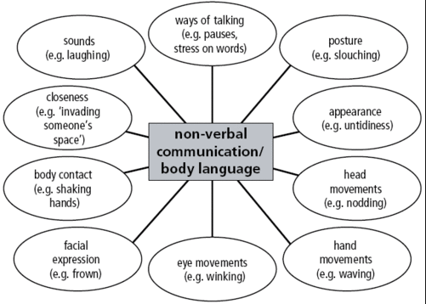

Slide 46
Screen & Interview
      During the interview:
      Does the candidate have everything they need?
      Did you ask if they’d like something to drink?
      Have they been to WSU before?
      Did you offer a campus tour?
      After the Interview:
      Thank the candidate for their time
      Make sure to inform them when they will hear back
Candidate Experience
Notes:
During the interview:
Does the candidate have everything they need?
Did you ask if they’d like something to drink?
Have they been to WSU before?
Did you offer a campus tour?
Do they know where the restrooms are located?
Again make sure they feel welcome, introduce everyone on the search committee and allow the applicant time to describe themselves before jumping into questions.
After the Interview:
Thank the candidate for their time
Provide them with expected timeline of next steps in the process.
i.e. It is expected that finalists will be selected in the next week or two following the interview. Reference checks will be conducted on those finalists moving to the next round as well as a full background check.

Slide 47
Search Phases
Prepare for the Search
Advertise & Outreach
Screen & Interview
Perform Reference & Background Checks
Hire & Onboard
Notes:
Phase 4 –Perform Reference & Background Checks–in this phase the search committee looks into the finalists’ backgrounds through reference checks and, if applicable, background checks.

Slide 48
Perform Reference & Background Checks
      Purpose – deeper dive; clarify questions or areas of concern which arose during the screen & interview phase
      Notify candidate references will be contacted
      Three contacts by two people
      Same method for all candidates
Reference Checks
Sample Reference Check Documents: Staff Recruitment Webpage
Notes:
Reference checks are typically conducted after interviews. The purpose of the reference check is to dig deeper into the candidates’ background and clarify questions or areas of concern which arose during the Screen & Interview
Phase.
Notify candidate references will be contacted
Incidentally, members of the Search Committee are prohibited from providing references for candidates in the application pool. If there is any concern regarding an actual or perceived conflict of interest, the Search Committee Member should remove himself from discussions regarding the candidate. In some instances, the Search Committee Member may need to remove himself from the committee completely. Contact the area’s or college’s HR Consultant if you have concerns.
If the position has been designated to require a criminal history background check, it will be conducted through Human Resource Services’ third-party vendor. Reference checks themselves do not take the place of criminal history background checks.
Best practice calls for two people – usually the Primary Recruiter and a Search Committee Member – to conduct reference checks with two to three contacts for each finalist. These are usually done by telephone so both Search Committee persons can hear the responses from the reference, take notes and follow-up on any points that may require clarification. Alternately, questions can also be submitted by email if a telephone reference check is not possible. Whenever possible, reference checks should be conducted using the same method for each finalist.
Sample reference check documents can be found at the Staff Recruitment webpage.

Slide 49

Perform Reference & Background Checks
Internet Searches
Internet searches should be done appropriately and for professional purposes and not to obtain personal information about the candidate.
      Internet Searches
        Google
        Social Media
        “Reference” and/or “background checks” should not be replaced with internet searches.
If departments find something of concern during an internet search they should notify HRS.
Notes:
Internet searches should be done appropriately and for professional purposes and not to obtain personal information about the candidate.
The information obtained via google and other social media sites should not be used as the sole reason to hire OR not hire/interview someone. Departments need to be aware challenges can be made if information obtained via internet searches is inaccurate. Applicants may also challenge that they learned of a protected status via google and that is why they weren’t interviewed/hired. Departments need to recognize that an applicant could make a public records request and would receive information on the google search etc.
“Reference” and/or “background checks” should NOT be replaced with internet searches.
If departments find something of concern during an internet search they should notify HRS.

Slide 50

Perform Reference & Background Checks
Background Checks
Designated at the
beginning of search
Offer may be contingent upon
a successful completion
Background check components
Conducted on top 1-2 finalist(s)
Background Checks, BPPM 60.16
Notes:
It is best if determination on requiring a background check is made prior to posting the position.
The HR representative assigned to the area or college is available to discuss any background check issues and the general process involved.
Please note that background checks are required for positions with duties involving supervision, care, or treatment of children, vulnerable adults, or individuals with mental illness or developmental disabilities.
Even in cases where there is only one finalist, the offer may be made contingent upon successful completion of the background check. Contact HRS for assistance.
Components of the background check typically include investigations of criminal and/or conviction records, but may also include verification of degrees, driving records and work experience. Generally, background checks are conducted only on the top one or two finalists for the position.
Once identified, the Primary Recruiter communicates to the candidates that they are finalists for the position and a background check will be initiated. The Primary Recruiter in turn moves the candidate to the background check stage in the job requisition and selects the background check package for the candidate
Background check package is then reviewed by HRS prior to running and HRS will check the results from the external agency (agencies)
See BPPM 60.16 for more information on background checks.

Slide 51

Perform Reference & Background Checks
Personnel File
Top Finalists
Current or former employees
Primary Recruiter, AA, or
Supervisor may review
Visit HRS to review file
Notes:
Regarding top finalists who are current or former WSU employees, the personnel file serves as another key deep dive resource. The Primary Recruiter, Appointing Authority, or the supervisor (such as the Department Chair) may review the official HRS Personnel File for a finalist in order to make employment decisions. Visit HRS to review the file.

Slide 52

Perform Reference & Background Checks
      Hire recommendation to Appointing Authority
        Summary of strengths/weaknesses
        Hiring recommendation to HRS via Workday
      Verbal offer made by Department Head
        Negotiations of additional salary/terms may require approval
      Employment Agreement (Offer Letter) drafted, approved and sent in the Workday System
      Official signature acceptance distributed to CC’s
Hire Recommendation
Notes:
After the “deep dive” has been completed (i.e. references, background check and personnel file review, if applicable), the Search Committee’s next task is to recommend the finalist for hire to the Appointing Authority or his designee.
Review the documentation gathered for each finalist during the entire search, including the initial evaluation, pre-screen (if applicable) and on-campus interview, feedback received from key stakeholders (if applicable) and information from the “deep dive.”
Verify the candidates have demonstrated they meet the minimum and most or all of the preferred qualifications.
Discuss other strengths the candidates may have demonstrated or areas of expertise they could bring to the position.
Discuss weaknesses or areas where the candidates need development.
Discuss any areas of concern.
After vetting the candidates, a recommendation briefly reviewing the finalists who participated in on-campus or Zoom interviews is developed for discussion with the Appointing Authority or his designee.
Note that written communications are subject to the Public Records Law in Washington State.
The Appointing Authority or designee will review the recommendation to hire and make a final determination as to which candidate will be offered the position.
Prior to an offer of employment, WSU must comply with RCW 28B.112.080 in regards to Sexual Misconduct. The sexual misconduct form is part of the application process in Workday. To comply with this law, hiring departments may not make an offer of employment until approved by HRS Employment Services.
Once approved by HRS, the verbal offer may be made to the candidate either by the Appointing Authority, the Department Head or another designated individual. The HR Partner initiates the employment agreement in Workday
For AP positions additional negotiations may occur, such as salary and/or relocation terms. These items are to be vetted with the Appointing Authority and HRS. Final terms of the offer are detailed in the official offer letter which is approved by the Appointing Authority.
It is critical to ensure the accuracy of all information in the offer letter, including job title, salary, additional terms and effective dates. Offer letters are completed in the Workday System.
The area or college administrator completes the required paperwork, including distributing the offer letter copies, etc.

Slide 53
Search Phases
Prepare for the Search
Advertise & Outreach
Screen & Interview
Perform Reference & Background Checks
Hire & Onboard
Notes:
Hire & Onboard, the final phase of the search, begins when the finalist has accepted the offer of employment for the position. The bulk of the Search Committee’s work is now complete. A few items need to be wrapped up in this phase and, most importantly, the emphasis shifts to onboarding the new hire.

Slide 54
Hire & Onboard
      Notify Candidates
      Courtesy notification to on-campus interviewees
      Email/letter to other candidates
Notify Candidates
      Move final candidate to Ready for Hire ; update all candidates’ status with individual disposition reasons and complete the hire (external) or change/add job (internal) process.
HRS Templates: Staff Recruitment Webpage
Notes:
After the finalist has accepted the position, the Search Committee needs to inform the other candidates that the position is filled.
Generally, the Primary Recruiter or HR Partner will personally notify the top candidates who were included in the on-campus interviews by telephone or email
HRS recommends notifying the remaining candidates as well, typically by letter or email.
HRS has created notification letter templates for consideration. These can be viewed at the Staff Recruitment website.
Update all candidates’ status with “disposition reasons” and complete the Employee Agreement (Offer) processes for final candidate.
After employment agreement details and offer letter has been finalized, the HR Partner will move the candidate forward into Workday staffing processes - Hire for external candidates, Change Job or Add Job for internal candidates.

Slide 55
Hire & Onboard
Records Retention
      Ensure recruitment records are kept in accordance with WSU’s Records Retention Policy
      Workday
      Application materials
      Disposition reasons
      Search Committee Members
      Search Committee
      Copies of all advertising
      Candidate evaluation tools
      Screening and interview notes
      Hiring Recommendation
      Copy of final offer letter
University Records – Retention & Disposition, BPPM 90.01
Notes:
Lastly, the Primary Recruiter, HR Partner, and Search Support must ensure recruitment records are kept in accordance with WSU’s Records Retention Policy.
Certain recruitment records are maintained inside the Workday system by HRS and others are maintained by the hiring department.
For example, Workday maintains copies of application materials, disposition reasons and the names of the Search Committee Members.
Other items that need to be maintained by the search committee include copies of all internal and external advertising, candidate evaluation tools, screening and interview notes. These items can be uploaded into Workday as well.
See the University Records – Retention and Disposition in the Business Policies and Procedures Manual 90.01 for more details.

Slide 56
Hire & Onboard
      Onboarding plan suggestions
      Orientation Checklist
      Welcome communication
      Review duties/responsibilities, goals & plans
      Department & Area/College orientation
Onboarding Process
New Employee Orientation (HRS)
Notes:
Congratulations! The new staff member is ready to begin at the University. Now the hiring department engages in actively supporting the integration and success of the new team member.
The following are recommended components of an onboarding plan.
Use the Orientation Checklist available at the HRS website as a guide.
Plan a “welcome communication” introducing the new staff member to the area or college. Highlight his/her strengths, abilities and areas of expertise.
Schedule time for the supervisor and the new staff member to review the position duties and responsibilities. HRS recommends establishing bi-weekly or 30, 60 and 90 day follow-ups as the new staff member gets settled into the position.
Ensure the new staff member receives a department and area or college-specific orientation
Arrange for the new staff member to attend New Employee Orientation sessions coordinated through Human Resource Services.
The goal of these efforts is to provide the new staff member with a warm welcome and the resources and support to establish a successful employment relationship with the University for years to come.

Slide 57
Resources
Human Resource Services
(509) 335-4521 | hrs.wsu.edu | hrs@wsu.edu
International Programs – Global Services
(509) 335-4508 | ip.wsu.edu/global-services | ip.globalservices@wsu.edu
Office of Compliance & Civil Rights
(509) 335-8288 | ccr.wsu.edu | ccr@wsu.edu
Notes:
The offices primarily responsible for the Staff Recruitment Process are listed here, along with contact information. Do not hesitate to contact these offices for more information as you conduct your search. Your area or college HR Consultant is also available for your questions at any time.

