Slide 1
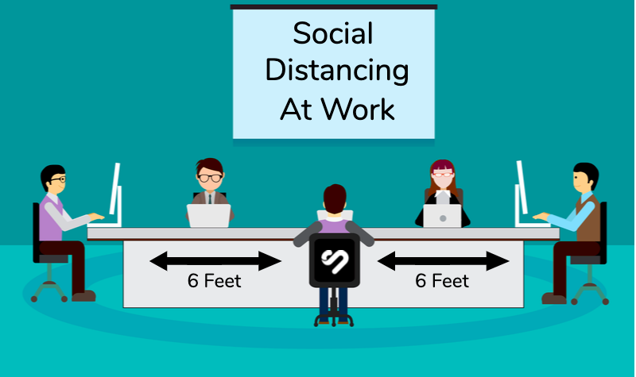

RETURN TO WORK:
STRATEGIES TO IMPLEMENT WITHIN the workplace

Slide 2
Easy + Inexpensive (or no cost) Considerations
STAY HOME
SANITIZE + DISINFECT
RESPECT BOUNDARIES
THINK MINIMALIST
SIGNAGE + TRAFFIC FLOW
  Formal remote and flexible work policy/schedules. Implement flexible work hours.
  Stagger Schedules if remoting is not an option.
  Feeling sick? STAY HOME.
  If in workplace, wear a mask anytime you are circulating.
  Comply with HRS employee attestation requirements.
  Wash Your Hands Often.
  Don’t Touch Your Face.
  Use sanitizing and disinfecting cleaning products to wipe down shared spaces and/or items before and after use.
  Strategically place hand sanitizer and disinfecting stations at entry points.
  6’ (six feet) Social Distance.
  Be mindful of utilizing only your personal space.
  Call or utilize Zoom for collaboration with coworkers instead of walking to their personal space.
  Avoid shaking hands.
  Declutter!
  Clean personal desks and work surfaces from un-necessary items. The more you have, the more germs can attach. Think minimalist – what did you actually need to function while remoting from home? Implement that mentality in office spaces. By doing so, you can easily sanitize and disinfect surfaces before and after use much more easily.
  Remove shared candy dishes.
  WSU approved floor signage indicating 6’ distances.
  WSU approved Directional Arrows indicating flow of traffic preferred.
  While signage is being designed and produced, blue painters tape is an effective, inexpensive and doesn’t leave residue on floor surfaces as a way to indicate these distances and traffic flow.
  When in doubt:
    Walk Clockwise everywhere and anywhere.
    Stay on the right hand side of the hallway/walkway.
  Avoid walking through open office spaces. Stay only on perimeter.
For most current up to date guidelines, please visit the following websites:
Center for Disease Control (CDC) https://www.cdc.gov/
WSU Environmental Health & Safety (EH&S) https://ehs.wsu.edu/

Slide 3
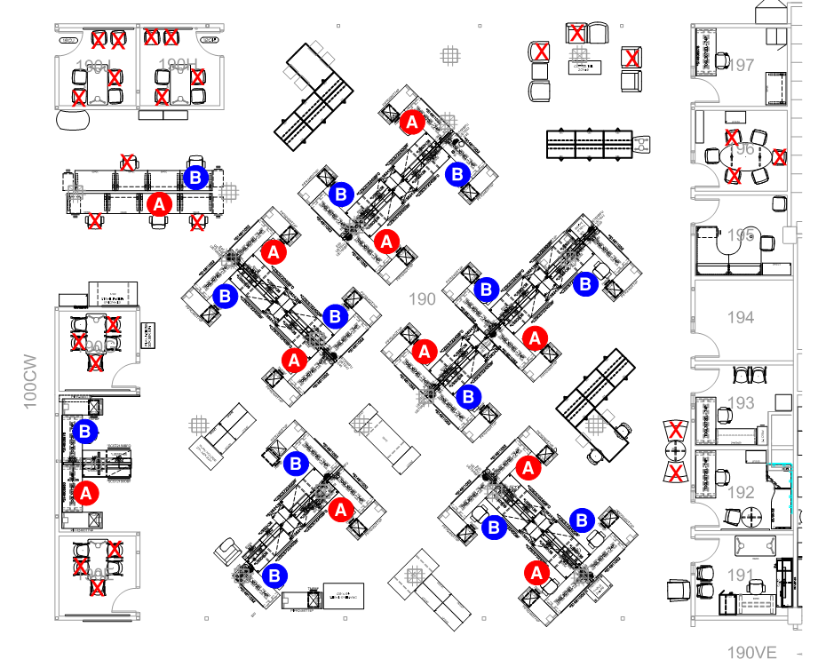
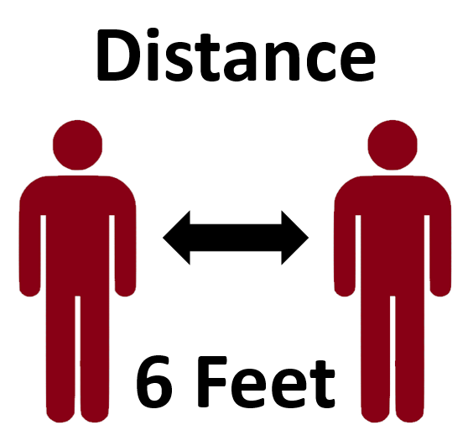
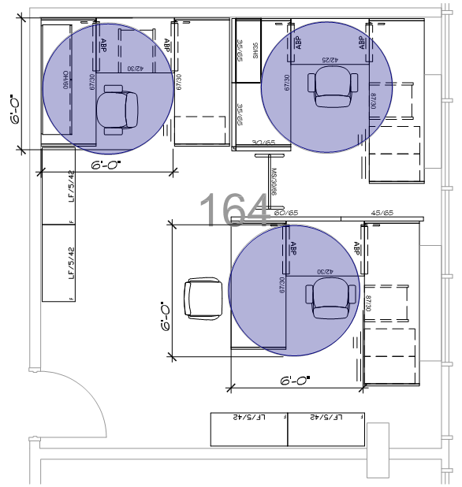
What can I do with my workstations?
Stagger Schedule Approach
Formal remote and flexible work policy/schedules. Implement flexible work hours to include evenings and weekends if necessary.
Stagger / “Checker Board” Schedules. “A” group office days vs. “B” group office days to promote distancing, and reduce the number of people in the space at one time.
Remove guest seats to discourage “Pop-In’s” at the workstation.
Reduce number of seats available in side meeting rooms.
  If storage doesn’t allow them to be removed from the space entirely, stack in the corner of the room and tape off with a sign.
Side Meeting Room Strategies:
  Convert to temporary Private Offices for those in the High Risk Category that may sit in an Open Office environment.
  Convert to “Zoom Rooms” you can reserve and utilize for Zoom specific meetings.
Use sanitizing and disinfecting cleaning products to wipe down shared spaces and/or items before and after use. This is everyone’s responsibility, not just Custodial staff.
X
  Wash hands often. Don’t Touch Your Face.

Slide 4



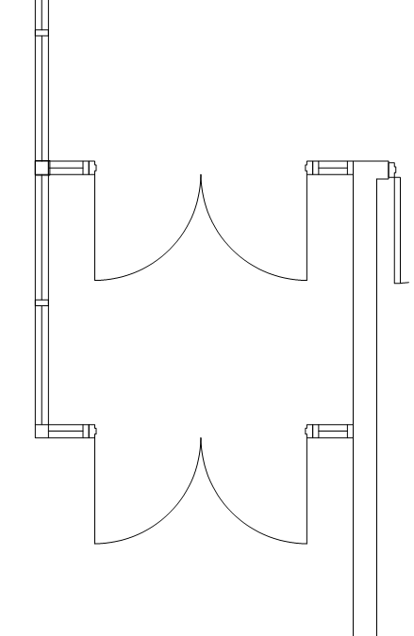

How do I move throughout the space?
Directional Flow
Directional “Flow” of Traffic. Walk Clockwise always and anywhere.
Stay on the right hand side of walkways just like you would driving a car. Stay in your lane.
Don’t walk directly through an open space. Keep to the perimeter whenever possible.
Call coworkers to eliminate excess traffic throughout.
Strategically place hand sanitizer and disinfectant stations with focus on entry/exit points.
Be Mindful of only using your personal space.
Lounge furniture such as sofas should be marked
for single usage unless they can allow physical
distancing.
Note: Signage and demarcation for major building/
public areas has been developed and funding/installation
options are being considered. Departments must install
signage and demarcation in their areas. Preferred
materials and designs will be available for purchase.
More information to come regarding final design
and cost.
EXIT on Right Hand side.
ENTER on Right Hand side.
  When in doubt: Walk Clockwise! Anywhere and Everywhere!

Slide 5
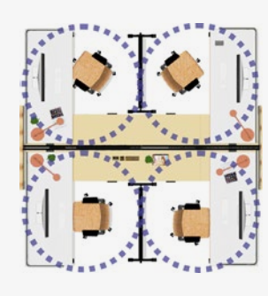
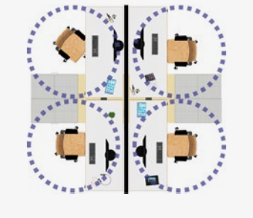
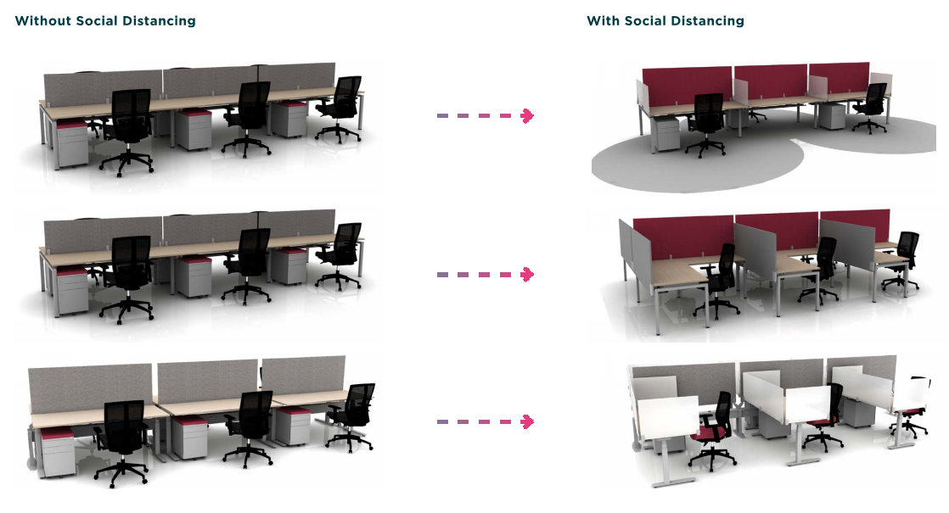
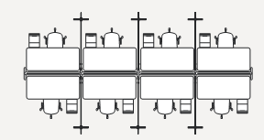
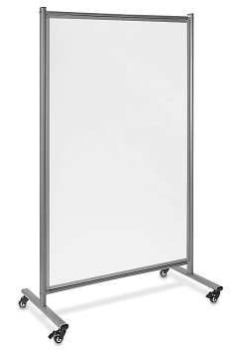
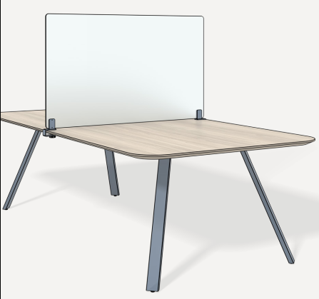
What can I do with what I have?
Change Geometry, Add Division, Reduce Density
Add Division: Relocate existing mobile screens, white boards or storage pieces to provide barriers. Use minimum 6’H panels to separate standing occupants when spaces do not support distancing, or minimum of 3’H between sitting occupants.
Change Geometry: Reconfigure workstations to reduce sitting face-to-face without a barrier. Rotate 90 degrees to face in a different direction.
Reduce Density: Remove guest seats to discourage “Pop-In’s” at the workstation. Use visual ques (tape, signs) to identify and suggest appropriate distance between people. In some cases, shared offices will have no choice but to use the staggered schedule approach if the space is any less than 10’x10’ or configured to preclude 6’ distancing.
Clean frequently and visibly. Provide cleaning products to wipe down shared spaces and/or items before and after use. This is everyone’s responsibility, not just Custodial staff.
BEFORE
AFTER
A
B
A
B
B
A
B
A

Slide 6
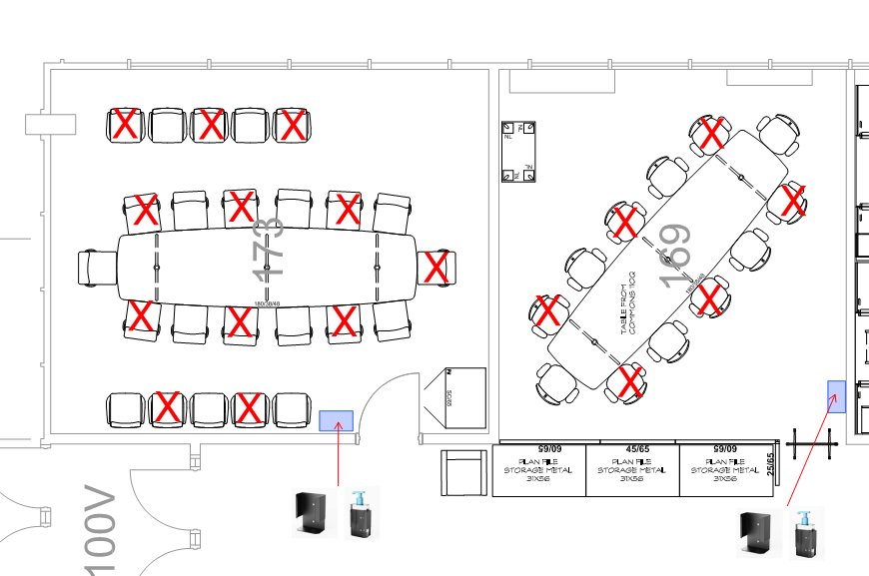
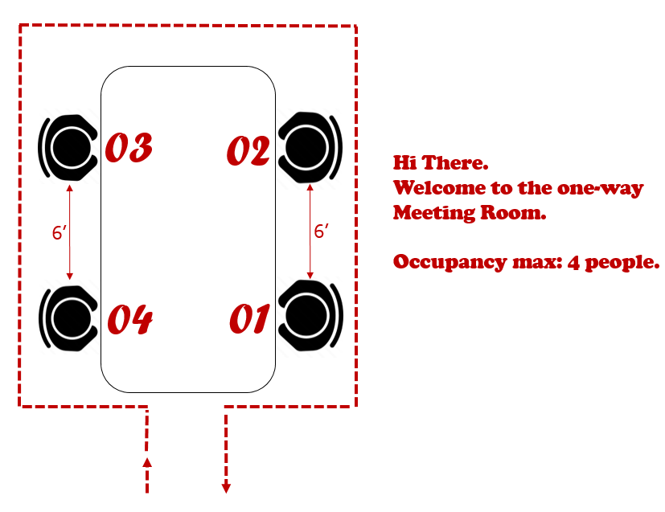
What about Meeting Spaces?
If possible, Conference Rooms should remain closed and limit group meetings. If meeting room size is less than 10’x10’ this may be your only option.
Schedule Virtual Collaboration Meetings.
Meet in the Open: Meet in large open spaces.
Have a standing meeting. There is a natural instinct to provide personal respect distance from yourself and another person when we stand.
Smaller meeting rooms can be used as temporary Private Offices and/or zoom spaces.
Establish protocols for the number of people who can occupy an enclosed space. Post that information at the door of the space so it is commonly understood.
Leave doors open or incorporate door-opening sensors.
Clean frequently and visibly. Provide cleaning products to wipe down shared spaces and/or items before and after use. This is everyone’s responsibility, not just Custodial staff.
  Use internal communication channels available: intranet, email, instant messaging.

Slide 7
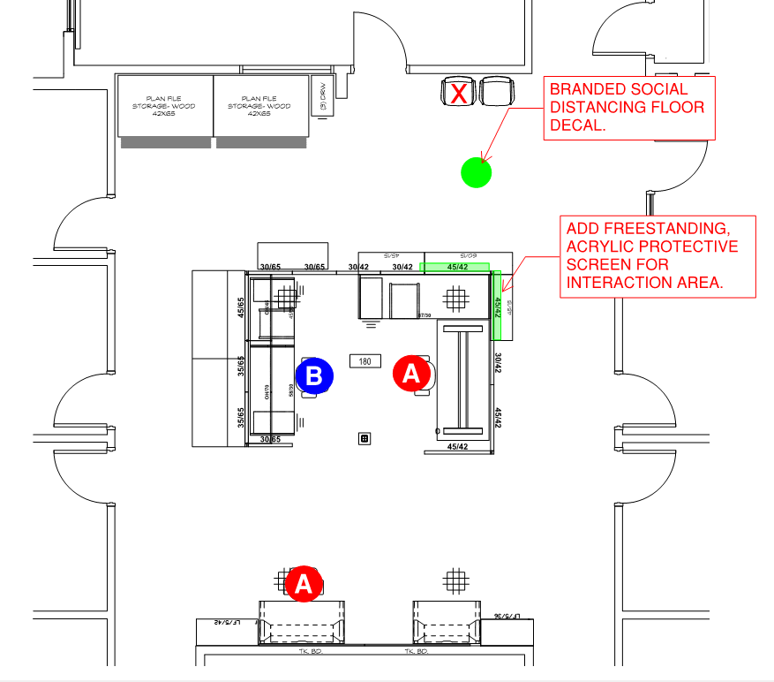
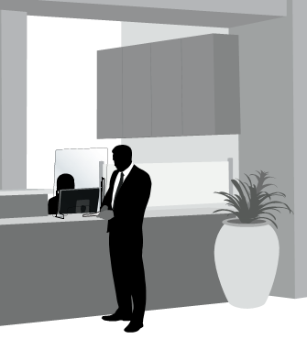
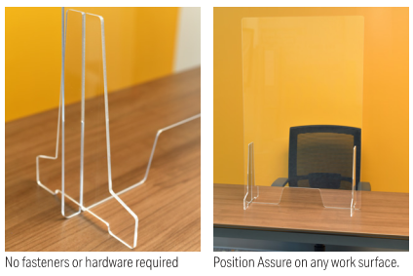
What about Reception Spaces?
Establish a directional “Flow” of Traffic using demarcation when necessary, best suited for the space given entrances and exits. As a general rule, Walk Clockwise always and anywhere.
Stay on the right hand side of walkways just like you would driving a car. Stay in your lane.
Stagger / “Checker Board” Schedules. “A” group office days vs. “B” group office days to promote distancing and reduce the number of people in the space at one time.
Use WSU approved floor decals (or blue painters tape) to indicate 6’ distances and waiting zones.
Install clear acrylic barriers where personnel interact with students, staff or the public.
Clean frequently and visibly. Provide cleaning products to wipe down shared spaces and/or items before and after use. This is everyone’s responsibility, not just Custodial staff.
Product costs TBD by vendor on case by case basis and dependent on material availability.

Slide 8
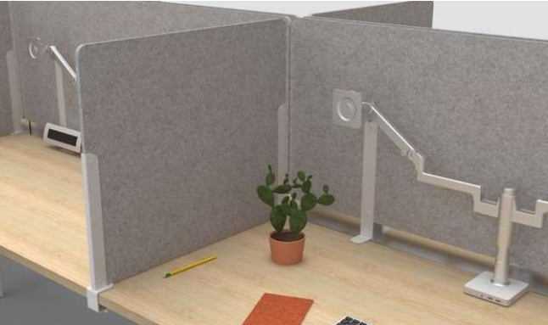
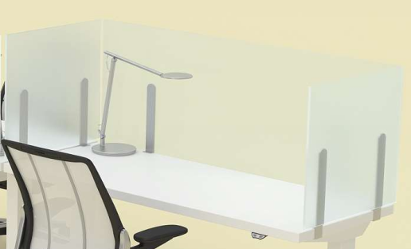
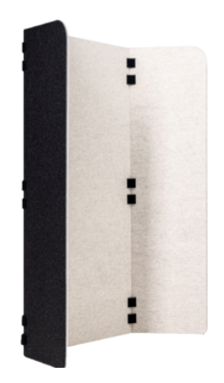
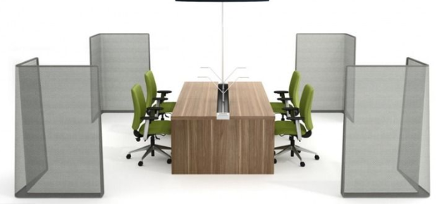
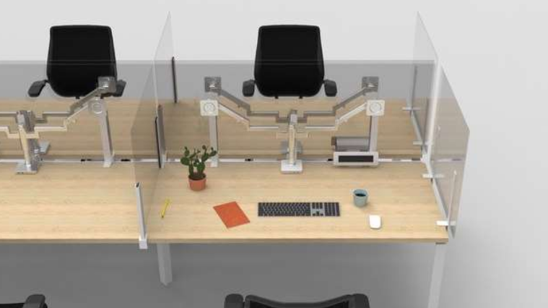
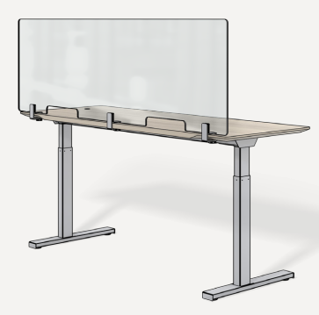
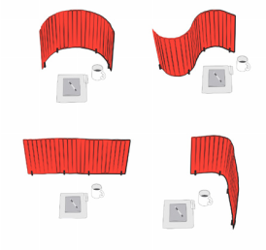
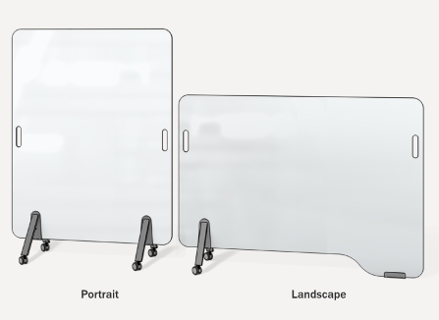
Universal Product Examples that can be purchased and added to spaces:
Product costs TBD by vendor on case by case basis and dependent on material availability.
For Design & Alterations, please contact: Facilities Services https://myfacilities.wsu.edu/

Slide 9
We are in this together.
If you need additional guidance, please contact:
WSU Environmental Health & Safety [EH&S] https://ehs.wsu.edu/
Jason Sampson sampsonj@wsu.edu or 509.335.9564
For Design & Alteration Services, please contact:
Facilities Services https://myfacilities.wsu.edu/

