Slide 1
Animal Care Ergonomics
Occupational Health & Safety
Department of Environmental Health & Safety
Washington State University

Slide 2
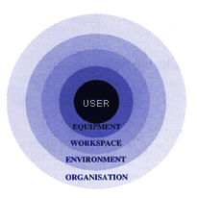
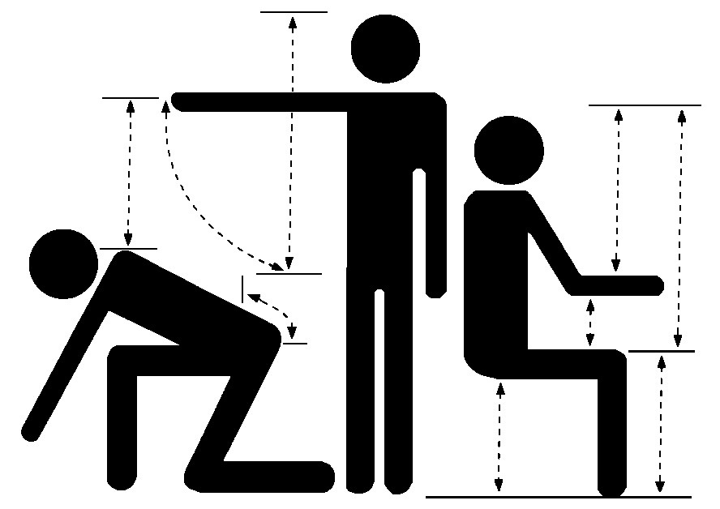
What is Ergonomics?
Ergonomics is the science and practice
of designing tasks and workplace considering
our capabilities and limitations.
OR
Fitting the work to the person
User
Equipment/Work Space
Tasks

Slide 3
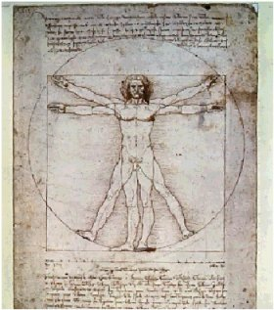
Benefits of Ergonomics
Prevention of WMSDs
Reduced fatigue and discomfort
Increased productivity
Improved quality of work
Enhanced quality of life

Slide 4
What are Work-Related Musculoskeletal Disorders?
WMSDs are soft-tissue injuries to muscles,
tendons, ligaments, cartilage, blood vessels and
nerves that usually develop gradually.
Can be serious, if not taken care of early.
Also know as:
Cumulative Trauma Disorders (CTDs)
Repetitive Strain Injuries (RSIs)
Overuse Injuries

Slide 5
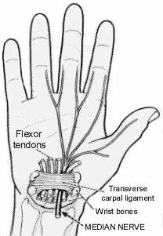
Common WMSDs
WMSDs can occur when demands on tissues
exceed their capacities.
Typically they occur in the moving parts of the
body like the neck, back, shoulder, elbow, wrist
and knee.
Low Back Injury
Carpal Tunnel Syndrome
Tendonitis
Tenosynovitis
Epicondylitis
De Quervain’s Syndrome

Slide 6
WMSDs Symptoms
Discomfort
Fatigue
Pain
Swelling
Loss of ROM
Stiff/tight muscles
Numbness
Tingling
Burning Sensations
Shooting/Stabbing Pains
Weakness in the hands; dropping things

Slide 7
When are symptoms a concern?
Experiencing one or more symptoms does not
necessarily mean a person has a WMSD.
However, an Incident Report should be completed
and a task evaluated when:
Symptoms are associated with specific movements/postures and/or tasks
Symptoms are chronic
Symptoms appear to worsen throughout the work day & week, with some relief in the evenings and on weekends

Slide 8
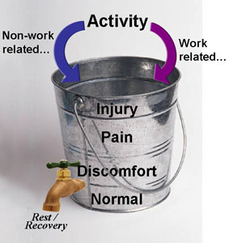
Why is it important to act early?
Early modifications to work conditions and practices are more successful
Early treatment is more successful
Ignoring early symptoms can lead to injuries requiring more intensive treatment
Untreated symptoms and injuries might result in permanent disability

Slide 9
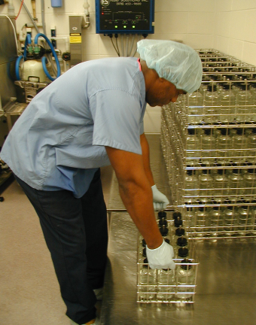
What Causes WMSDs?
WMSDs causes are multifactorial.
Physical risk factors:
Awkward and Static Postures
High Hand Forces
Highly Repetitive Motions
Mechanical/Contact Stress
Cold
Vibration
Combinations of factors

Slide 10
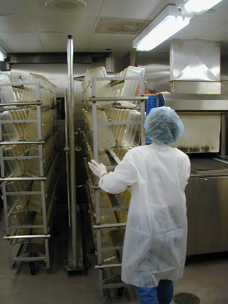
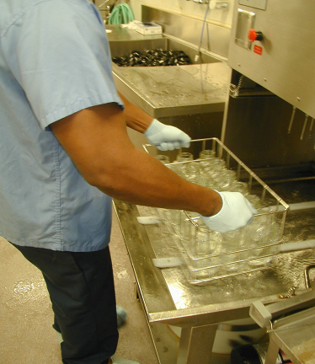
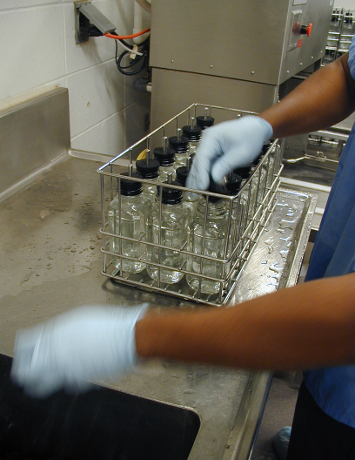
Animal Care Tasks –WMSDs Risk
Cage Handling
Small Animal Handling
Large Animal Handling
Cart Handling
Feed and Bedding Bag Handling
Water Bottle Handling
Medical & Research Procedures

Slide 11
High-Risk Large Animal Tasks: WMSDs by Body Area
Task | Hands/Wrists | Elbows | Shoulders | Neck | Back | Legs
Lifting animals for cage cleaning |  | • | • | • | • | •
Lifting cage floors and grating | • | • | • |  | •
Pushing, pulling, rotating full cage carts | • | • | • |  | •
Cleaning cages with spray nozzle/scrub brush | • | • | • | • | • | •
Lifting feed bags | • | • | • |  | • | •
Dispensing food pellets into wire cages |  |  | • |  | •

Slide 12
High-Risk Small Animal Tasks: WMSDs by Body Area
Task | Hands/Wrists | Elbows | Shoulders | Neck | Back | Legs
Transferring rodents with forceps | • | • | • | • | •
Handling containers, wire cages, cage lids | • | • | • |  | •
Preparing, transferring, replenishing water bottles | • | • | • |  | • | •
Rodent dosing | • |  | •
Lifting feed bags | • | • | • |  | • | •
Pushing, pulling, rotating full carts |  |  | • |  | •

Slide 13
WMSD Prevention & Treatment
Preventing and responding to WMSDs
involves:
Designing or modifying the work environment (engineering controls)
Modifying tasks (administrative controls)
Task variability (administrative controls)
User health/fitness
Professional Health Care

Slide 14
WMSD Prevention Engineering Controls and Facility Design
Engineering controls are the preferred control
method
Ergonomic design specifications should be considered from the inception of all projects to ensure proper facility design and equipment purchases.
Specifications can include: rules, checklists or guidelines addressing factors such as reach distances, working heights, forces, and grip dimensions.

Slide 15
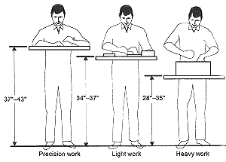
WMSD Prevention Engineering Controls and Facility Design
Good design minimizes exposures to:
Awkward and static postures
High hand forces
Repetitive motions
Mechanical/contact stress
Prolonged standing
Good Design = Desired Actions

Slide 16
WMSD Prevention Engineering Controls and Facility Design
Common Engineering Controls
Large (min. 20 cm) roller bearing casters on movable cages
Automatic cage waste disposal, dumping & washing systems
Vacuum disposal & delivery for cage bedding
Feed bags, cages and other items requiring repeated lifting stored 40-50 cm above the floor (or store feed bags on lift and swivel tables)
Adjustable footrests for seated work or foot rails with anti-fatigue matting for standing work areas
Centrally located feed bags (20kg maximum) and all supplies

Slide 17
WMSD Prevention Engineering Controls and Facility Design
Engineering Controls - Large Animal Tasks
Ceiling mounted water systems to reduce lifting forces while spray washing cages
Phase out stainless steel cage floors for lightweight aluminum floors/grating with handholds
Curved shaft mops and cage scraping tools with upper handle grip
Provide as much space as possible in animal housing areas

Slide 18
WMSD Prevention Engineering Controls and Facility Design
Engineering Controls - Large Animal Tasks
Multiple floor drains in animal rooms with easy access for cleaning
Smooth transition between rooms, minimize ramps
Remove bumps leading to animal rooms and floor drains
Advancing back wall (“squeeze”) on cages to minimize animal handling

Slide 19
WMSD Prevention Engineering Controls and Facility Design
Engineering Controls - Small Animal Tasks
Height adjustable (70-115 cm) bio-containment hoods with kneewell clearance
Ergonomic forceps with larger grips to minimize finger fatigue
1.2 m maximum shelf height of rodent cages
Replace glass water bottles with plastic or install automatic watering systems

Slide 20
WMSD Prevention Engineering Controls and Facility Design
Engineering Controls - Small Animal Tasks
Minimum of 2 m between racks in rodent rooms to improve cart and equipment maneuverability
Provide rodent surgeons with adjustable angled rodent tray or support stand for tail bleeding
Adjustable extended eyepieces for microscopy work

Slide 21
WMSD Prevention Administrative Controls
Administrative controls: policies, procedures and
practices minimizing exposure of workers to risk.
Less effective than engineering controls as they do
not eliminate the hazard; however, they:
Lessen frequency of exposure
Lessen duration of exposure
Advantages: cost and feasibility

Slide 22
WMSD Prevention Administrative Controls
General administrative controls include:
Broaden or vary job content
Distribute equal workloads among workers
Rotate workers through several jobs
Schedule more breaks for rest and recovery
Adjust work pace to give workers more control of work
Training:
Work practices and procedures
Recognize risk factors
Recognize and report WMSD signs and symptoms
Participate in identifying and implementing controls

Slide 23
WMSD Prevention Administrative Controls
Task Development and Variability
Developing or modifying tasks
depends on 3 interacting factors
Task variability offers several
advantages:
Opportunity to change postures
Users will be more alert and productive
Different tasks use different muscle groups
Provides recovery time and pauses for stretches
Tasks with highly repetitive motions and high hand forces can be spread out during the day
Tasks
Workstation
You (user)

Slide 24
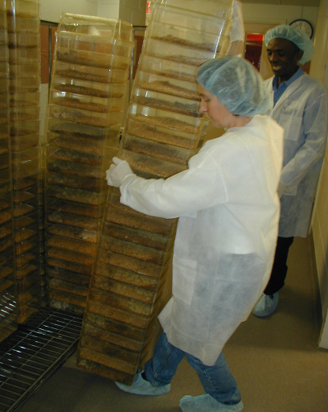
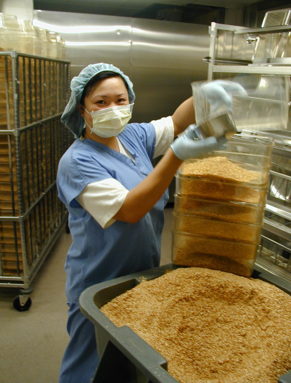
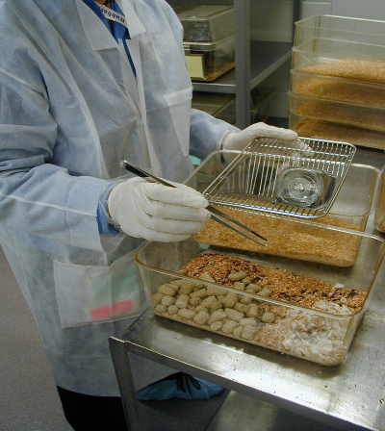
WMSD Physical Risk Factors
do you see?
risk factors
What physical

Slide 25
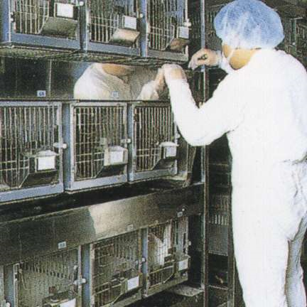
WMSD Prevention Standing Tasks
Associated Risk Factors:
Static Postures
Awkward Postures – neck, head
and arms
Associated Health Concerns:
Sore feet
Swelling of the legs
Fatigue
Low back pain
Neck pain

Slide 26
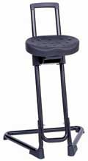
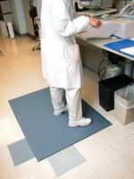
WMSD Prevention Standing Tasks
Preventative Measures:
Proper shoes
Change in posture
Walking
Footrests
Sit-stand stools
Anti-fatigue mats

Slide 27
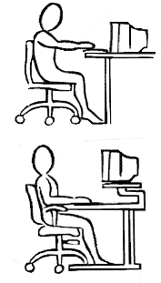
WMSD Prevention Computer Tasks
Computer workstation ergonomic considerations:
User
Workstation configuration
Chair
Desk & Keyboard/Mouse Tray
Input Devices
Monitor – CRT vs. LCD
Tasks
Lighting

Slide 28
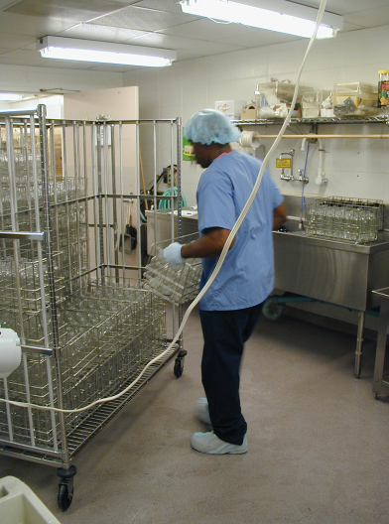
WMSD Prevention Back Injury Prevention
Risk Factors:
Health & injury history
Lifting, carrying, pulling & pushing
Awkward & static postures
Object weight
Preventative Measures:
Engineering controls
Maintenance programs
Minimize weight/force
Proper techniques

Slide 29

Questions & Consultation
If you have additional questions or would like to
schedule an ergonomic evaluation contact:
Sarah Greer
slgreer@wsu.edu
335-0948

