Slide 1
Back Injury Prevention
Washington State University
Department of Environmental Health & Safety

Slide 2
Back Injury Prevention
Training Outline
Basic Structures & Functions of the Back
Common Back Injuries
Maintaining a Healthy Back
Back Injury Risk Factors
Manual Material Handling
Proper Lifting Techniques
Other Back Stressors

Slide 3
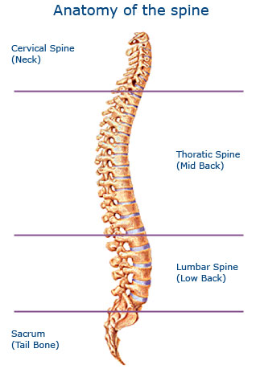
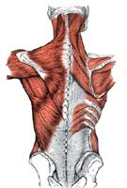
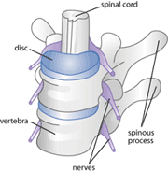
Structures of the Spine

Slide 4
Functions of the Spine
Summary of the Spine’s Functions
Protection | Spinal Cord and Nerve Roots Many Internal Organs
Base for Attachment | Ligaments Tendons Muscles
Structural Support | Head, Shoulders, Chest Balance and Weight Distribution
Flexibility & Mobility | Flexion (forward bending) Extension (backward bending) Side Bending (left and right) Rotation (left and right) Combination of the above

Slide 5
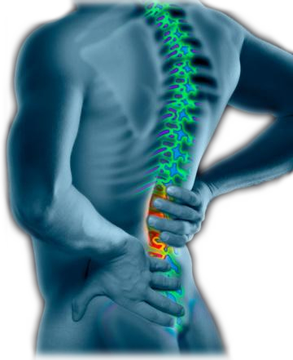
Back Injuries
Estimated that 85 – 95% will suffer from Low Back Pain
Acute events vs. cumulative trauma

Slide 6
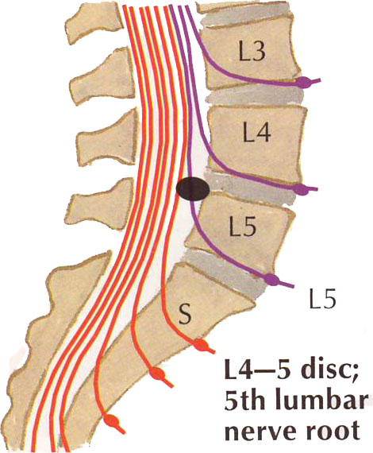
Back Injuries
L5/S1 incurs the greatest stress:
Compression
Shear
Torsion

Slide 7
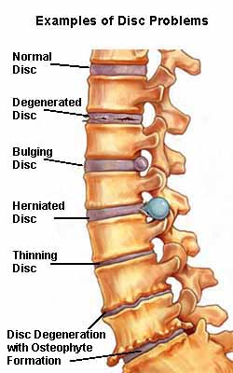
Back Injuries
Muscle and Tendon Sprains
Ligament Strains
Vertebrae Factures
Disc Problems

Slide 8


Back Injury Risk Factors
General Health
Genetics
Injury History
Recreational Activities
Home Activities
Work Tasks
Lifting, lowering, carrying, pushing & pulling
Awkward and static postures

Slide 9
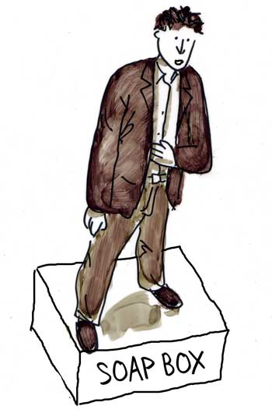
Maintaining a Healthy Back
We use are backs 24/7: how we live affects our back’s health
Reduce Stress
Balance Diet
Quit Smoking
Exercise
Strength
Flexibility
Endurance

Slide 10
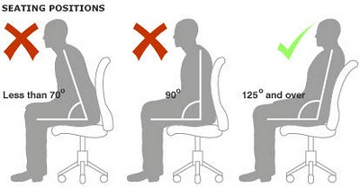
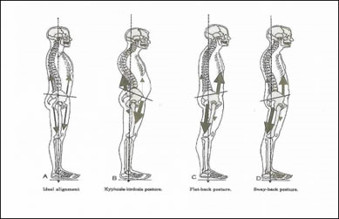
Maintaining a Healthy Back
Neutral Postures
Sitting
Standing

Slide 11

Manual Material Handling (MMH)
What is Manual Material Handling:
It is the …
lifting
lowering
pushing
pulling
and carrying…..
of objects, tools, equipment and supplies.

Slide 12
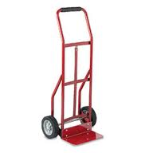
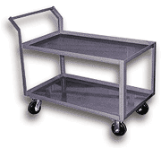
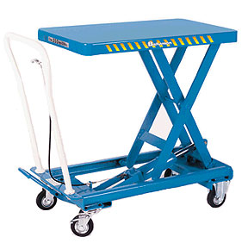
Manual Material Handling
Methods to control back stressors when manually handling materials:
Minimize the amount of weight handled
Use a material handling device
Breakdown/repackage into smaller packages
Order smaller size packages

Slide 13
Manual Material Handling
So how much can you safely lift?
It depends on a number of factors:
Who is doing the lifting
How frequent are the lifts (lifts/minute)
How long is the lifting task (lifts/total time)
Is twisting and bending part of the lift
Object weight, size, contents, and shape (hand holds)
Frequency, duration and intensity are the key factors

Slide 14

Manual Material Handling
So how much can you safely lift?
It depends on who you ask:
CDC/NIOSH – 51lbs.
ACGIH – 70 lbs.
Washington State Department of Safety & Health repealed ergonomics standard – 90 lbs.

Slide 15
Proper Lifting
Five factors to consider:
Object weight (heft test)
Object size, contents, shape – hand holds
Frequency of the lifts
Vertical distance of the lifts
Horizontal distance between the object and person

Slide 16
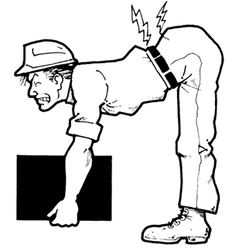
Proper Lifting
The two most critical factors to consider:
Object weight – duh!
Object size, contents and shape – hand holds
Frequency of the lifts
Vertical distance of the lifts
Horizontal distance between the object and person

Slide 17
Impact of Horizontal Distance
L5/S1 Disk
12 in.
L5/S1 Disk
36 in.
16 in.
0 in.
30 lbs.
30 lbs.
85 lbs.
85 lbs.
(30 lbs. x 36 in.) + (85 lbs. x 12 in.) = 2,100 in-lbs.
(30 lbs. x 16 in.) + (85 lbs. x 0 in.) = 480 in-lbs.

Slide 18
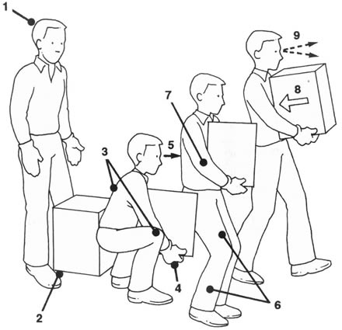
Proper Lifting Technique
Plan the lift
Spread feet shoulder width apart
Maintain the curves of the spine
Bend at the knees
Head up and chin up
Lift slowly and evenly
Avoid twisting
Keep load close to the body!
Maintain clear field of view

Slide 19
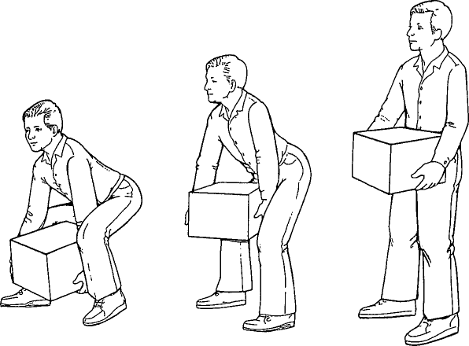
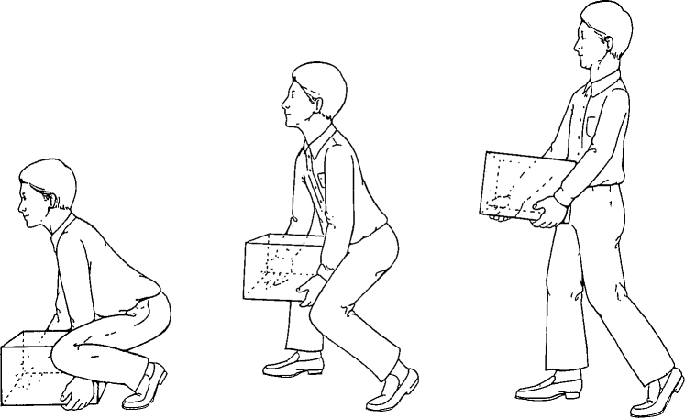
Different Lifting Techniques
The Diagonal Lift
The Power Lift

Slide 20
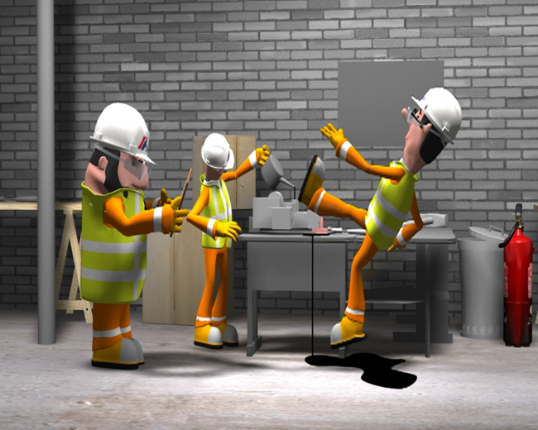
Other Back Stressors
Prolonged Standing
Prolonged Sitting
Vibration
Using Tools
Slips, Trips and Falls
Pushing and Pulling
Prolonged and Frequent Bending, Reaching and Turning

Slide 21

Thank You

