Slide 1

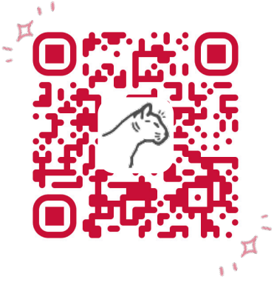
Bursar’s Office
We are here to help!

Slide 2

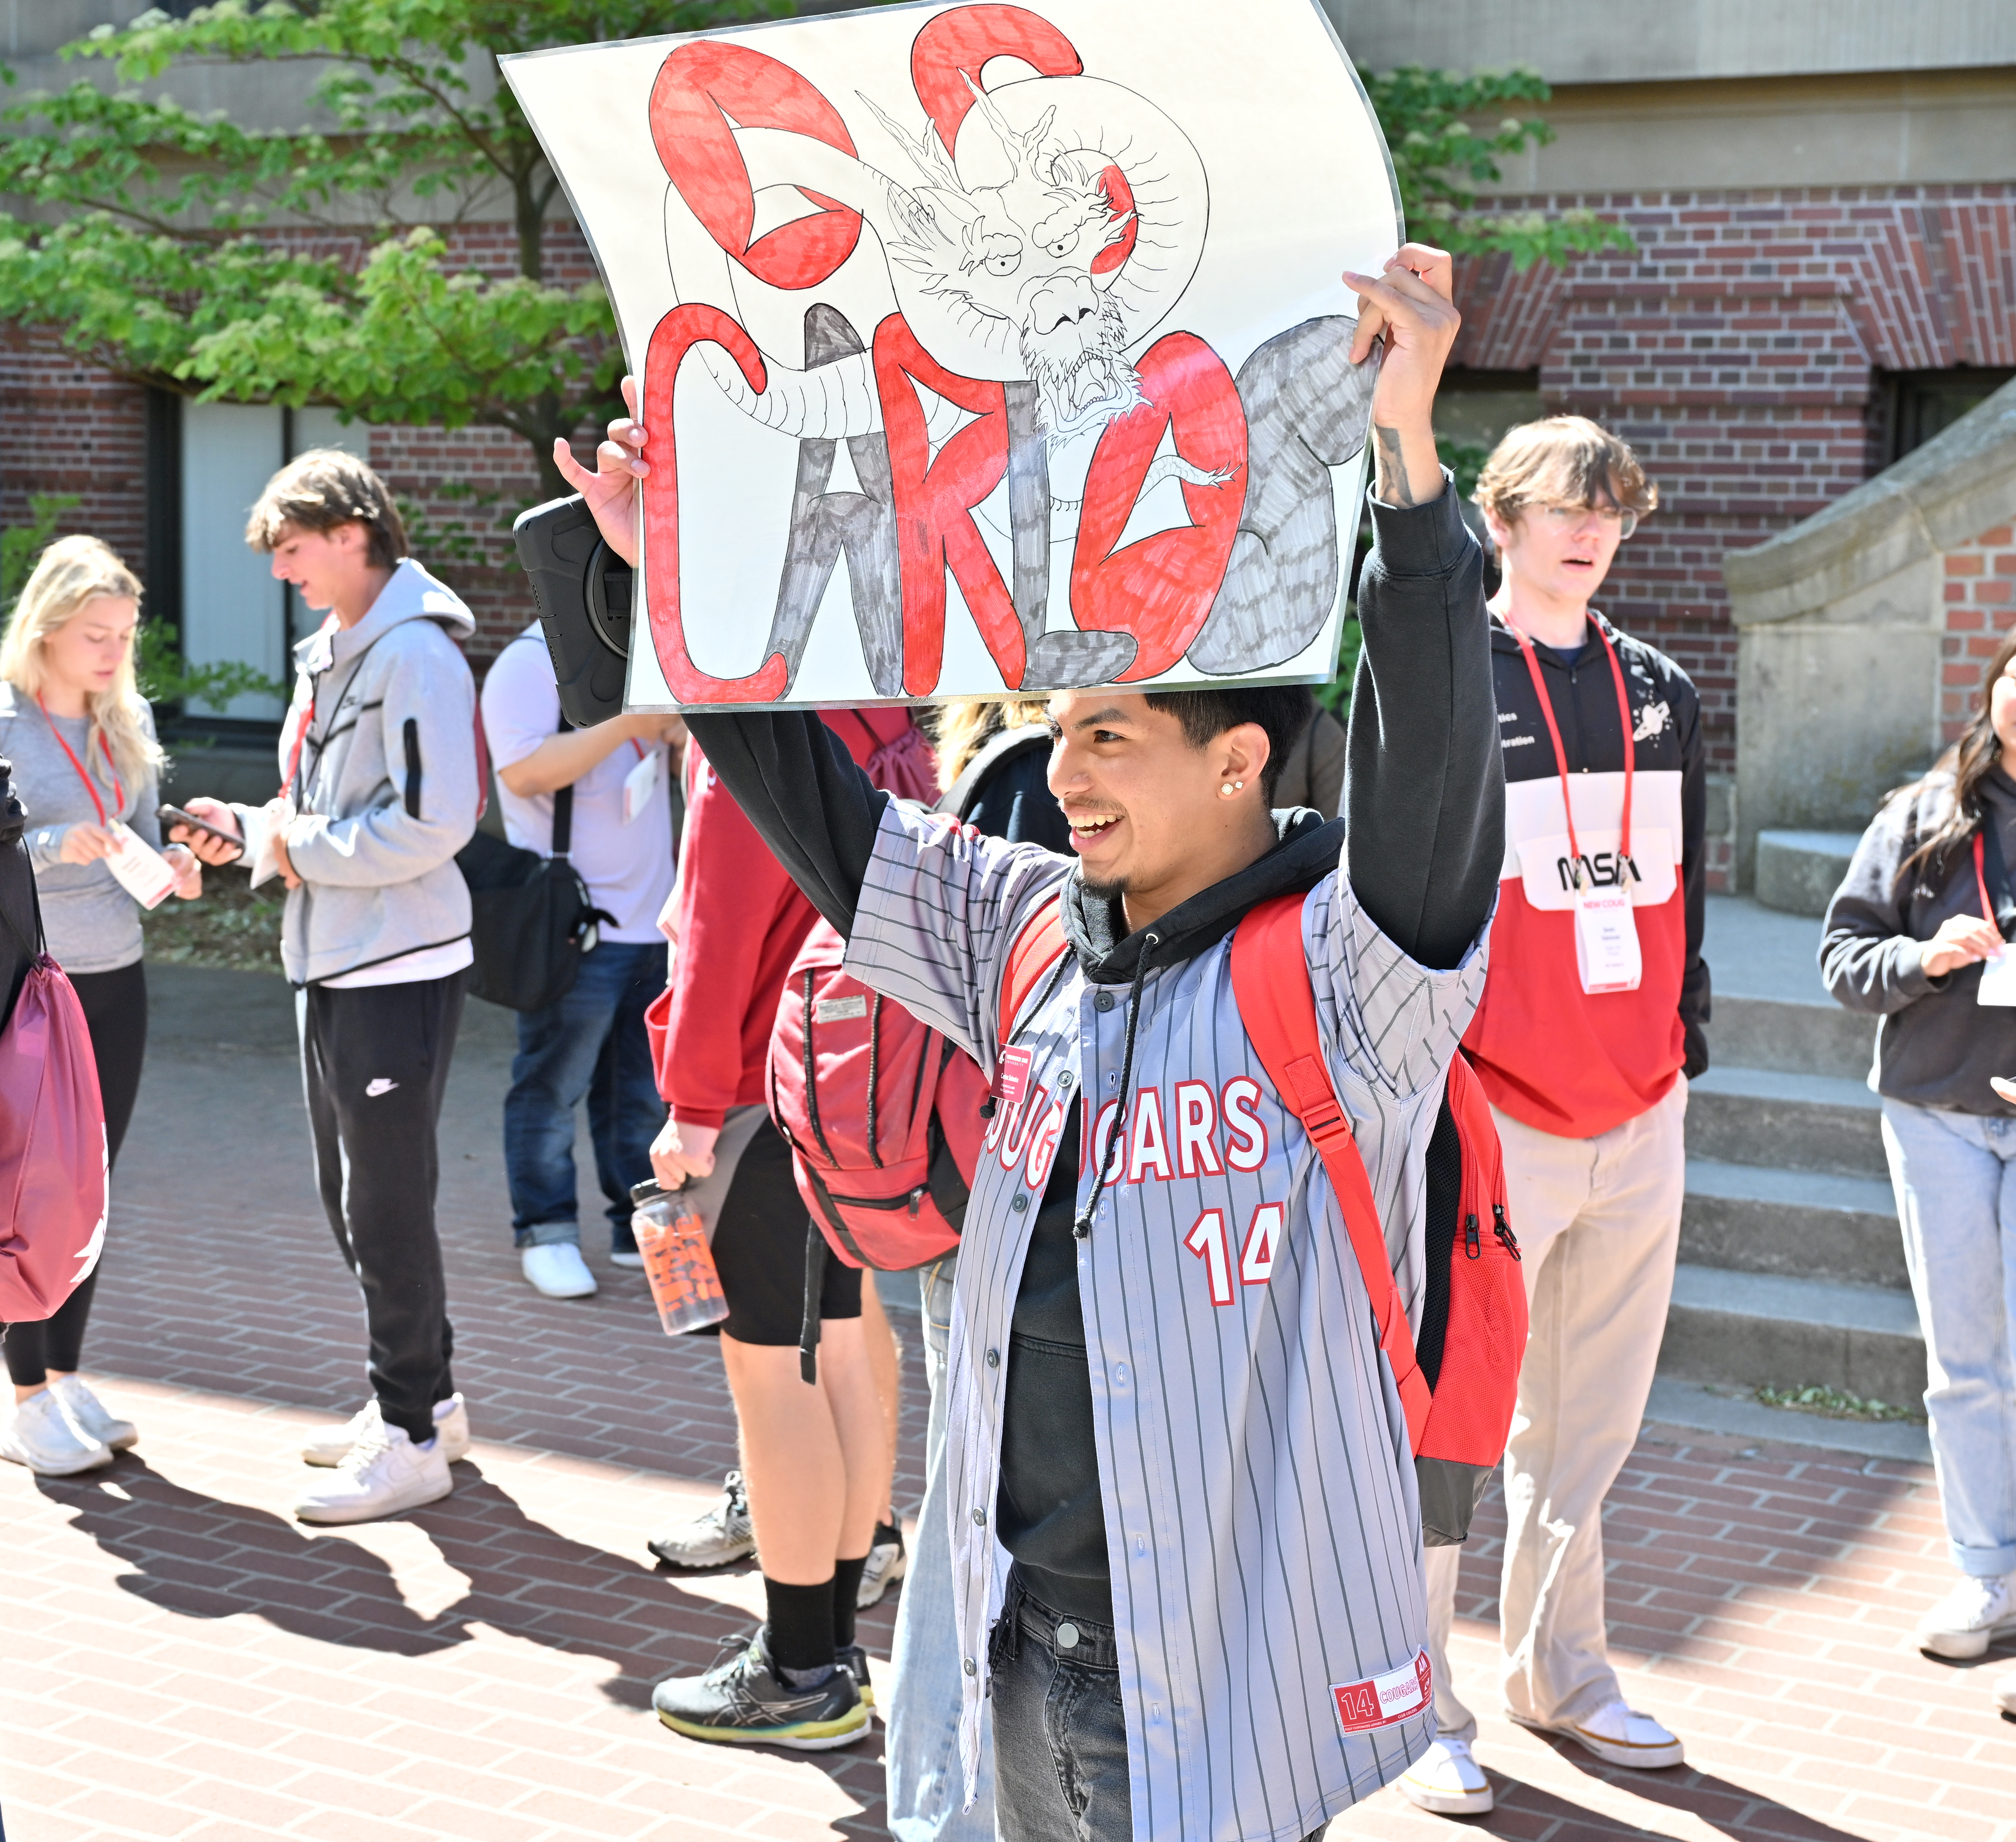
What We Do
Tuition and Mandatory Student Fees
Making A Payment
Payment plans (current term only)
External Donor Scholarships
Third-Party Guarantees (529, GET, Tuition Assistance, etc.)
Financial Aid and Account Credit Refunds
Late Fees
Past Due Account Balances
Financial Registration Holds
Tax Form 1098-T

Slide 3


The Big Questions
When will I see the charges?
Charges begin posting one month before semester starts or when your student signs up for courses
When are they due?
Charges are due on the first day of classes
When will late fees begin posting?
Late fees post the 3rd, 5th, and 8th week of classes

Slide 4
Payment Plans
Combines tuition & housing charges only
Payment Plans offer the option to make payments of equal installments throughout the semester
Automatic email notifications for upcoming payments
Automatic payment adjustments based on additional aid awards / payments
Available to most Students
Sign up via the Student’s payment portal area
**Visit our website for step-by-step instructions and payment plan dates.

Slide 5
Payment Plans Continued
No Payment plans for Summer or Winter Sessions
Low setup fee = $50 per plan / semester
25% down payment until 1st late fee posts, then it will be larger. Sign up early!
Payment plan is open until the 3rd late fee posts.
Visit the Academic Calendar for Late Fee Dates
Payment plan is set up to pay full balance before enrollment opens for the upcoming semester.
Payment plans are only available if past due balances are paid in full!
**Visit our website for step-by-step instructions and payment plan dates.

Slide 6





Making Payments
Mail It!
Online!
In-Person!
WSU – Bursar’s Office PO Box 641039 Pullman, WA 99164-1039 Include your WSU ID!
E-Check
VISA/MC/Discover/AmEx
(with 2.95% convenience fee)
Cash or Check only
French Administration Building, Floor 3 Room 342

Slide 7



How to Receive Student Account Refunds - Not including Debit/Credit Card Refunds
Paper check
May take several days to receive
WSU mails all student account checks to the student’s primary mailing address. That address is controlled online by each student via myWSU, and WSU considers it to always be correct.
Checks that are mailed to the address maintained by the student will not be cancelled and re-issued for a minimum of 10 Business days.
Direct Deposit
The fastest and most secure way to receive your refund is by direct deposit.
Complete direct deposit to avoid any address issues in the future.
*Visit our website for step-by-step instructions!

Slide 8

Third-Party Access
Student must set this up for the Parent or Supporter!
FERPA – Family Educational Rights and Privacy Act
Answer any questions about your student’s account information over the phone or email.
Access to the 1098-T Form

Slide 9


GET, 529, Other Third-party Education Funds
Charges Post to Student Account
Request Payment from Education Fund
Education Fund approves Monies
Monies are forwarded to WSU
Bursar’s Office posts the payments
Can take 2 or more weeks!
Notes:
GET is Term Specific will not pay for semesters not requested. Ex. Fall 2024 will pay Fall 2024 not Spring 25
WSU does not request or invoice payments. We cannot request payment on your behalf.
Select how monies should be delivered.
If E-check is unavailable, send to our PO Box
Please make sure to include your students WSU ID number
College of Illinois, Florida Pre-pay, Texas, Nevada – Email document with credit rate for each term stu is enrolled in bursar.guarantees@wsu.edu

Slide 10

External Scholarships/Awards
If you are receiving a scholarship from a non-WSU or non-State of Washington donor. Fill out the Scholarship Designation Form!
Supply it to the donor as soon as you are aware of the award. The Scholarship Designation Form is designed for submission of a scholarship for a specific student and will help us designate how the scholarship is to be applied to your student account.
Have check mailed to us with scholarship designation form
Include your WSU ID!

Slide 11

Helpful Contacts
Crimson Service Desk: crimsonservicedesk@wsu.edu Website: its.wsu.edu/crimson-service-desk/ Phone: (509) 335-4357
Student Financial Services (Financial Aid): financialaid@wsu.edu Website: financialaid.wsu.edu/home/ Phone: (509) 335-9711, opt. 1
Housing & Dining Services: housing.wsu.edu/home/
Finances: hd.finance@wsu.edu, (509) 335-8625
Residence Life: res.life.front.desk@wsu.edu, (509) 335-1227
Cougar Health Services: Website: cougarhealth.wsu.edu cougarhealth@wsu.edu
(509) 335-3575
Athletics Ticket Office:
1-800-GO-COUGS
athletictickets@wsu.edu
On-Campus Parking:
Website: transportation.wsu.edu
transportation@wsu.edu
(509) 335-PARK
Veteran’s Affairs (VA): Website: va.wsu.edu/pullman (509) 335-1857

Slide 12
Get in Touch!
Website: www.bursar.wsu.edu
Phone: 509-335-9711, option 2
Mailing Address:
WSU Bursar’s Office PO Box 641039 Pullman, WA 99164-1039
*Include the student’s full name and SID# in the letter or on the check*
Location:
French Administration Building, Room 342 *West side of the building near the entrance from the sky bridge*
Emails:
bursar.office@wsu.edu bursar.guarantees@wsu.edu
bursar.scholarships@wsu.edu
*Don’t forget your Designation Form*

Slide 13

Check Email and Student Account Frequently
And Remember!
Check Email and Student Account frequently

Slide 14
Organize Classes on the same day (Add/Drop)
And Remember!
Check Email and Student Account frequently
Organize Classes on the same day (Add/Drop)

Slide 15
Update Address
And Remember!
Check Email and Student Account frequently
Organize Classes on the same day (Add/Drop)
Update address

Slide 16
Get Third Party Access created
And Remember!
Check Email and Student Account frequently
Organize Classes on the same day (Add/Drop)
Update address
Get Third Party Access created

Slide 17
Set up Direct Deposit
And Remember!
Check Email and Student Account frequently
Organize Classes on the same day (Add/Drop)
Update address
Get Third Party Access created
Set up Direct Deposit

Slide 18

Questions?

